Slide 1
Cybersecurity and Economics
Goldi and the Three Passwords
Lesson Slides
By:
Deborah Kozdras, Ph.D.

Slide 2
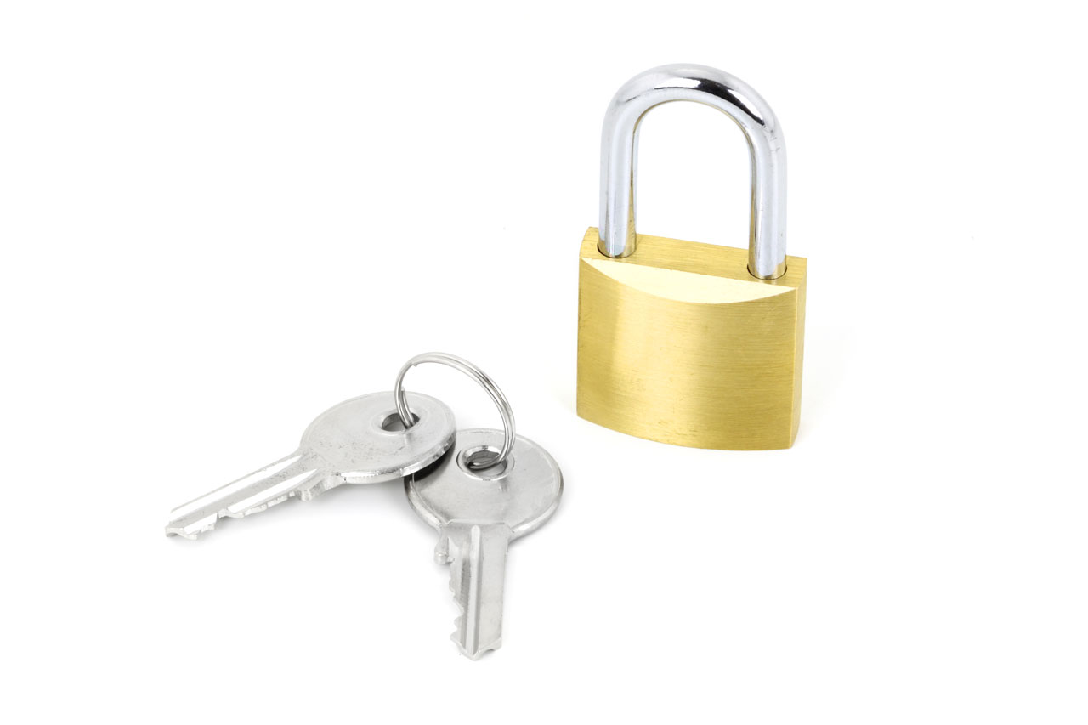
Visual 1: Image of a Lock

Slide 3
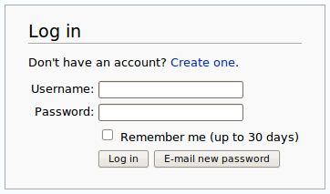
Visual 2: Email Log In

Slide 4
Handout 1:
Password Graphic Organizer
What is a too-easy password? | What is a just-right password? | What is a too-hard password?

Slide 5
Handout 2:
Baby Bear’s Suggestions for Just-Right Passwords
Password Do’s
Password Don’ts
At least eight characters
Use upper- and lower-case letters
Use numbers and symbols (&%$#)
Change passwords regularly
Should only be shared with a parent or guardian in case you forget it.
Don’t use your email address
Don’t use private information
Should not be the same on all sites
Don’t share with friends

Slide 6
Making Stronger Passwords
Adding new values can make your password much stronger. See how long the time to guess Goldi’s password can be just by adding more characters, or numbers:
Goldi – 26 Seconds
GoldiPlays – 300 Years
GoldiPlays! – 6,000 years
GoldiPlays!Hockey5 – Over a Million Years

Slide 7
Handout 3:
Instructions for a Public Service Announcement
You are a consulting company providing information to others about the importance of creating good passwords.
  Who are you? (Use a name that reflects what you are doing) _______________________________________________
  We are here to tell you about: _______________________________________________
  Why should you create strong passwords? (Discuss: costs, benefits, and risks in your statement) ____________________________________________________________________________________________________________
  Here are some tips for creating good passwords: (each student provides one tip)
    ____________________________________
    ____________________________________
  So remember: (end with a short slogan or saying) _________________________________________________.

Slide 8
Visual 3
Mnemonic Passwords
A Mnemonic password is created when you create a sentence and use the first letter of every word and include number words as characters.
For example:
My Friend Jane Eats 2 Apples Every Day To Stay Very Healthy! = MFJE2AEDTSVH!

