Slide 1
Federal Reserve Economic Data (FRED) and Federal Budgets
Part A
Lesson Dashboard:
https://research.stlouisfed.org/dashboard/14943

Slide 2
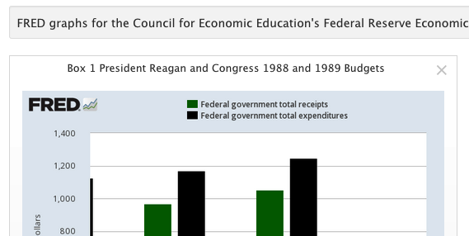
Notice each box is labeled on the upper left corner
(i.e.: Box 1, Box 2, Box 3, etc.)

Slide 3
2. Click on “View on FRED” located in the lower right-hand
corner.

Slide 4
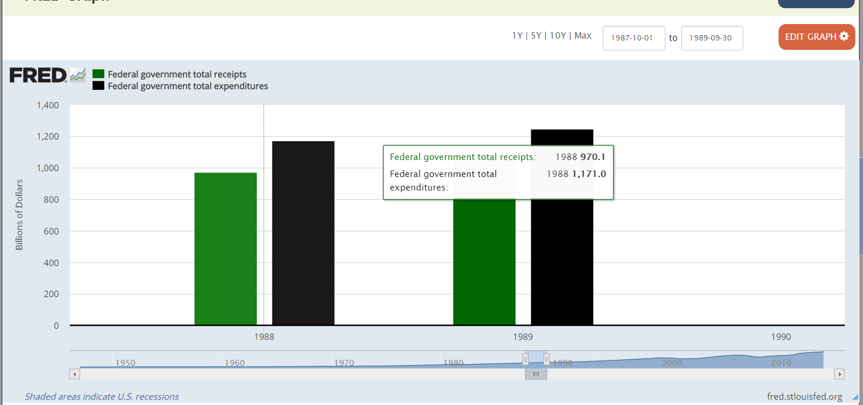
3. Hover mouse over desired information to see details.
Adjust date range with sliders

Slide 5
Federal Reserve Economic Data (FRED) and Federal Budgets
Part B

Slide 6
Notice each box is labeled on the upper left-hand corner
(i.e. Box 1, Box 2, Box 3, etc.)

Slide 7
2. Click on “View on FRED” on the lower right-hand corner.

Slide 8
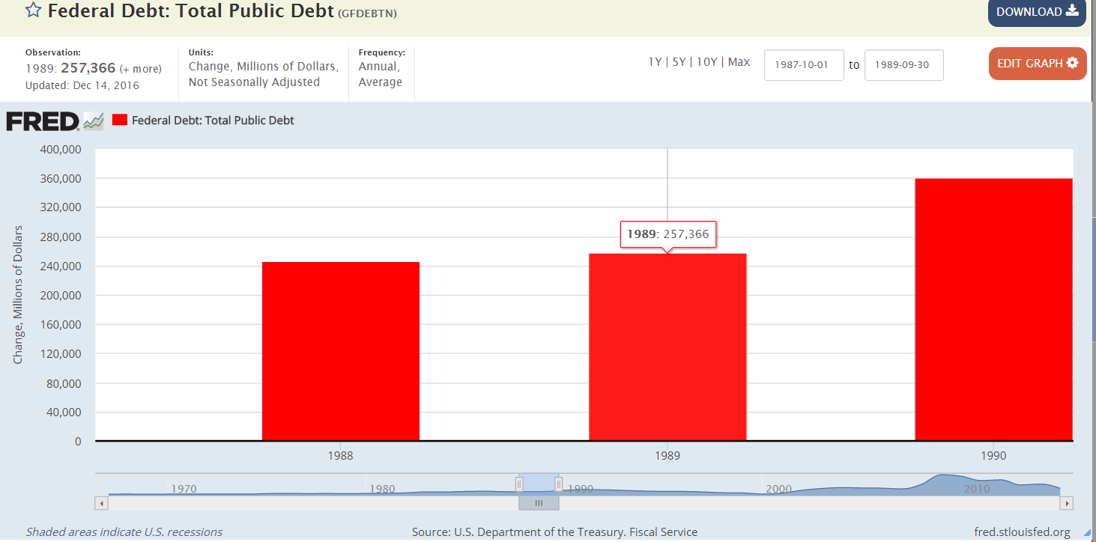
3. Hover mouse over desired information to see details.
Adjust date range with sliders

