Slide 1
Slide 1. Jumping Jack Cash
When I say go, do as many jumping jacks as you can until I say stop
Keep count of the number of jumping jacks you do
© Council for Economic Education

Slide 2
Slide 2. Productivity
Amount of output produced per unit of input used per unit of time
Example: number of jumping jacks completed by a student per second
© Council for Economic Education

Slide 3
Slide 3. Temporary Assistance for Needy Families (TANF)
Created by Congress in 1996
Replaced previous federal welfare programs first created in 1935 during the Great Depression
Goal: help needy families achieve self-sufficiency
Federal government provides some funds to states to administer their own welfare programs
Financial assistance limited to five years and requires work activity
© Council for Economic Education

Slide 4
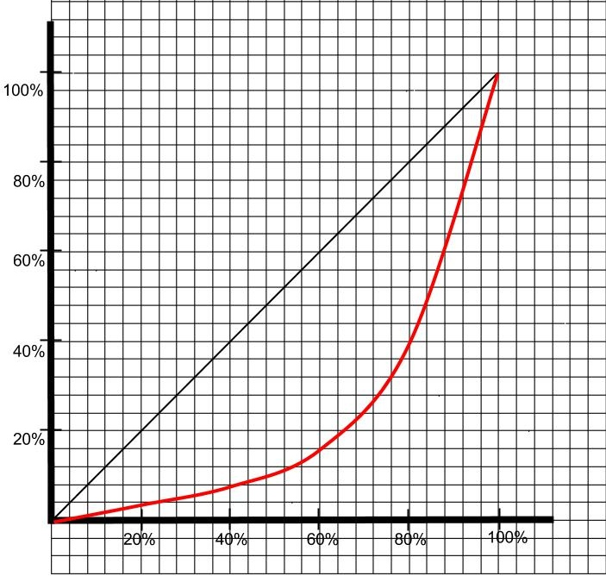
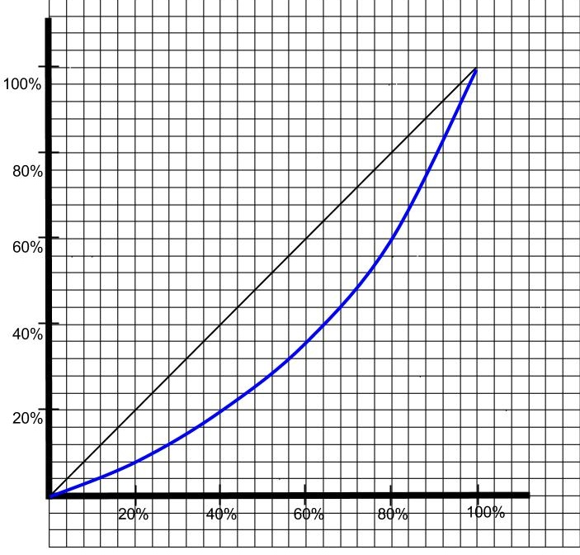
Slide 4. Lorenz Curves
Percentage of Income
Percentage of Income
Percentage of Households
Percentage of Households
© Council for Economic Education

Slide 5
Slide 5. Mean
$1,000 | $95
$800 | $88
$600 | $75
$500 | $50
$375 | $43
$250 | $33
$225 | $28
$200 | $18
$175 | $15
$190 | $5
$140 | $10
$120 | $0
$105
Find the mean of the income data from Activity 1
($1000 + $800 + … + $10 + $0) / 25 = $205.60
© Council for Economic Education

Slide 6
Slide 6. Median
$1,000 | $95
$800 | $88
$600 | $75
$500 | $50
$375 | $43
$250 | $33
$225 | $28
$200 | $18
$175 | $15
$190 | $5
$140 | $10
$120 | $0
$105
Find the median of the income data from Activity 1
Sort the income data
Determine the center value
Median = $105
© Council for Economic Education

Slide 7
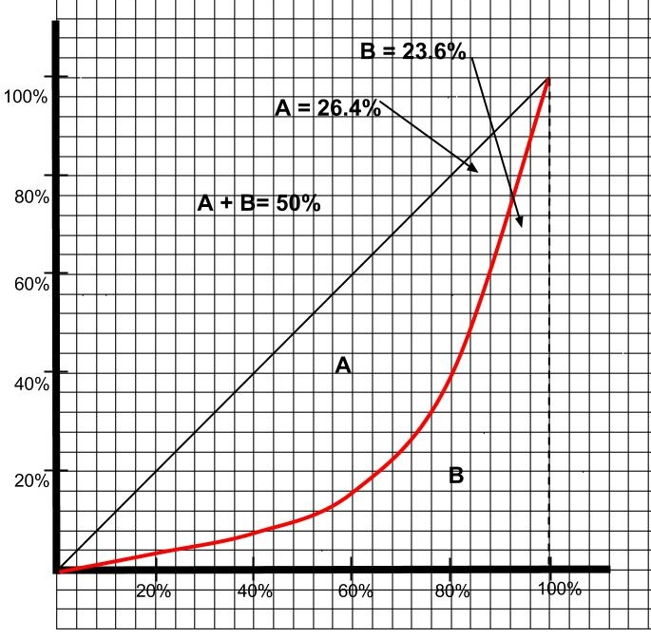
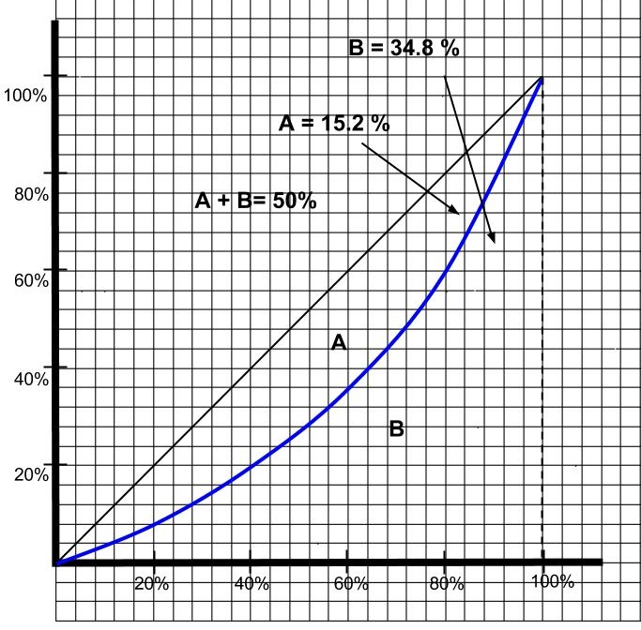
Slide 7. Gini Coefficient
Gini is 0.264/0.50 = 0.528
Gini Coefficient= A/(A + B)
Gini is 0.152/0.50 = 0.304
B=0.236
B=0.348
A=0.264
A=0.152
A+B=0.5
A+B=0.5
X (%) | 20 | 40 | 60 | 80 | 100
Y (%) | 4 | 8 | 16 | 40 | 100
X (%) | 20 | 40 | 60 | 80 | 100
Y (%) | 8 | 20 | 36 | 60 | 100
© Council for Economic Education

Slide 8
Slide 8. Gini Coefficient for U.S. Families, 1947-2014
Source: http://www.census.gov/hhes/www/income/data/historical/inequality/, Table F-4
© Council for Economic Education

