Slide 1
The Fiscal Ship
Playing the Game

Slide 2
You need to captain the U.S.S. Federal Budget to avoid the stormy seas of debt.
Your mission is to pick from a menu of tax and spending options to reduce the debt from projected levels over the next 25 years and keep the debt level no higher than it is today.
But budget decisions aren’t only about fiscal sustainability. They also shape the kind of country we live in. To win the game, you need to find a combination of policies that match your values and priorities AND set the budget on a sustainable course.

Slide 4
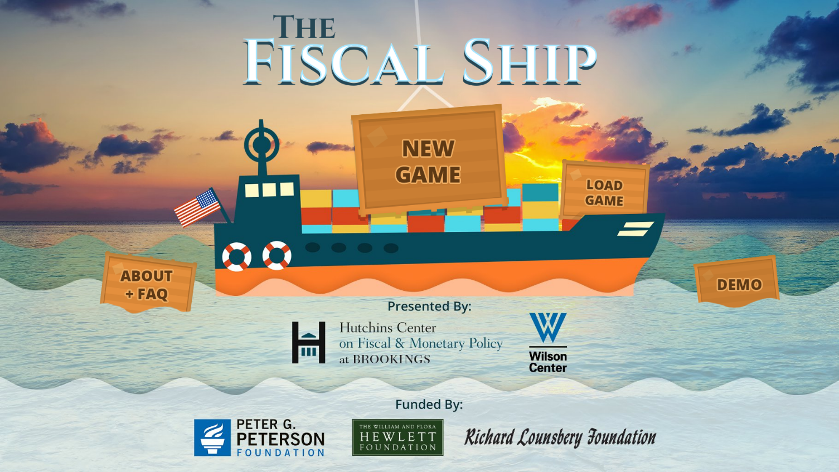
Watch how to play the game (clip length 1:38)
https://www.youtube.com/watch?v=QSWUcaT4GGA
Notes:
https://www.youtube.com/watch?v=QSWUcaT4GGA

Slide 5
Post-Game Class Discussion
How difficult was it to pursue your goals while also hitting the debt target?
Which of your goals were most difficult to achieve?
Which of your policy choices had the largest impact on your fiscal target? Which barely moved the line?
Were you surprised by the magnitude of any policy choices?
What do you think the political obstacles would be to hitting the debt target?
What do you think would be the impact on the American middle class of the choices you made?
Did the game make you reevaluate your initial governing goals?

