Slide 1
Investing Games for Personal Finance
Alex Lamon, CEE Master Teacher Presents…
October 2023
001

Slide 2
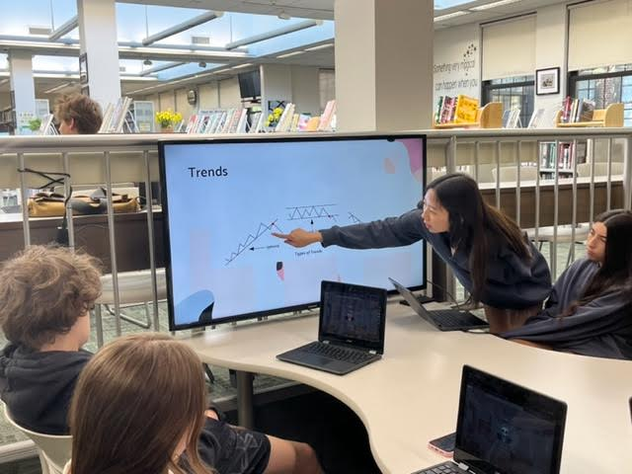
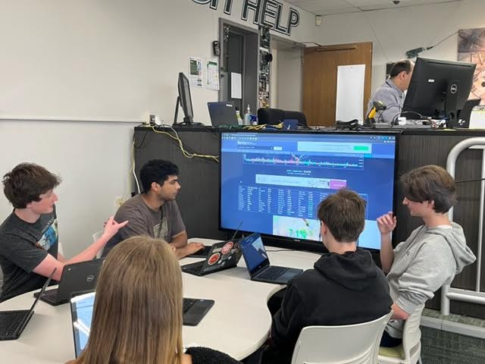
My Teaching Context
Who do you teach, what do you teach, and where do you teach them?

Slide 3
01
Toolbox Session
& don’t fear the games!
Notes:
Take what you need, modify, leave the rest. And note on being willing to try out games in your teaching

Slide 4
USING GAMES
001
002
003
004
005
Set the stage
Demo, model or click and test
Encouragement, announcements and focus
Post-game reflection
Connect to future/past learning

Slide 5
ARE YOU READY?
Let’s get to the games!

Slide 6
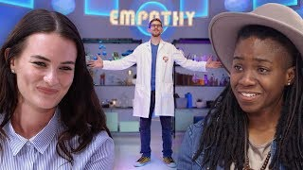
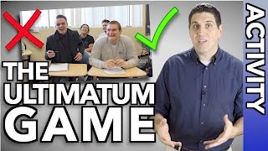
THE ULTIMATUM GAME
Are people rational?
Divide 20 dollars, points, etc.
One student determines how to divide the amount
The responder accepts or denies
Accept = get the money
Reject = No one gets anything and the game ends
Framing: Money Mindset
Notes:
If I gave you $5 right now, would you accept it?
Why not accept it with a 15 / 5 split?

Slide 7
Trading Games
Bloomberg
Wharton
S&P 500
Global investment challenge - NOT portfolio growth!
Time individual stocks & accumulate gains
10 years of timing the market
001
002
003

Slide 8
Backtest Portfolios
001

Slide 9
Build Your Stax
Notes:
Time to introduce any other games the participants have played

Slide 10
Crypto Craze
YOU
WIN
GAME OVER
$
$$
$$$
Experience the FOMO and nonsense of Crypto
Play in a group and let students feel emotions related to Crypto investment - and bring them back to think about logical investing.

Slide 11
Powerball Simulator
002
WINNERS
LOSERS
It could be you!
Just try again! Or try sports betting.
Notes:
You are starting with $100. How much do you anticipate having after playing this lottery game dozens of times?
You started with $100. What was the highest balance that you had at ANY point during the game? Did you win any of the drawings?
What were your emotions during the game?
Why do you think the lottery is structured to pay out small prizes to large numbers of players?
Why do you think people play the lottery? Has this game changed your view of lotteries?

Slide 12
Thanks!
Stay in touch!
lamonteach@gmail.com
@AlexMLamon
linkedin.com/in/alexlamon
Please keep this slide for attribution
002

