Slide 1
Presented by: Mike Kaiman Email: mike.kaiman@stls.frb.org Date: October 30, 2023
That’s the Ticket!
Using Entry & Exit Tickets in the AP Econ Classroom

Slide 2
EconEdLink Membership
You can now access CEE’s professional development webinars directly on EconEdLink.org! To receive these new professional development benefits, become an EconEdLink member. As a member, you will now be able to:
Automatically receive a professional development certificate via e-mail within 24 hours after viewing any webinar for a minimum of 45 minutes
Register for upcoming webinars with a simple one-click process
Easily download presentations, lesson plan materials and activities for each webinar
Search and view all webinars at your convenience
Save webinars to your EconEdLink dashboard for easy access to the event
Access our new Professional Development page here

Slide 3
Before we begin, please briefly respond if you teach AP Macro, AP Micro (or both!) and how long you have been an instructor for this course
ⓘ Start presenting to display the poll results on this slide.

Slide 4
That’s the Ticket!
Using Entry & Exit Tickets in the AP Econ Classroom

Slide 5
What's your #1 overall challenge in an AP Econ classroom?
ⓘ Start presenting to display the poll results on this slide.
Notes:
Anticipatory Email:

Slide 6
About Me
Senior Economic Education Specialist, Federal Reserve Bank of St. Louis
Teacher Timberland HS in Wentzville, MO 2002-23
AP US History / AP Macro & Micro
Email: mike.kaiman@stls.frb.org

Slide 7
Disclaimer
The opinions expressed here do not necessarily reflect those of the Federal Reserve System or the FRB of St. Louis
Any comments, questions, feedback from participants must be appropriate & professional

Slide 8
Agenda
Purpose of Entry/Exit Tickets
How to incorporate into classroom routines
For both new & veteran teachers
Demo!
Data tracking sheet
Q&A

Slide 9
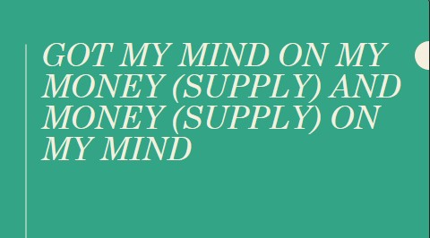
Disrespecting The Dismal Science: Challenges For The Econ Teacher
Common Complaints
It’s Hard
No One Understands It
Smart Kids HATE Admitting Weakness
Easy Solutions
Humor!
Honesty Is The Best Policy…Build Rapport
Drill, Baby, Drill…
Notes:
Dismal Science: Scottish writer/philosopher Thomas Caryle coined the term in 1849 as opposed to what was the called “the gay science” which was known as writing verse. (He did it in his essay Occasional Discourse on the Negro Question…so take it for what its worth.)

Slide 10
The Entry Ticket Has Entered the Chat
Bell Ringers / Entrance Slips or Tickets / Do Now’s
Serves Dual Purpose*
Classroom Management Tool
Introduction / Review of Material
Sparks Discussion / Focuses Lesson / Takes Attendance
Maximum 5 Minutes!!!
*Administrators LOVE seeing this in classroom observation

Slide 11
(Exit) Ticket to Ride
Serves Dual Purpose
Informal Assessment
LOW STRESS ON STUDENTS (Attendance Grade / Less Than 5 Points)
Questions Aligned to AP Exam MCQ/FRQ
Checks for Understanding / Honest Feedback
Can Clarify Issues Before Moving On
Maximum 5 Minutes!!!

Slide 12
Profit Maximization: The Ticket To Student Success
First Year Teachers
Experienced Teachers
Good News!
Aligned To AP Curriculum
Assists With Pacing
Additional FRB STL Print Resources Included For Content
The Scarcity Problem
Teaching New Dogs Your Old Tricks
Anecdotal Evidence

Slide 13
Follow Along???
MACRO
https://www.stlouisfed.org/education/ap-macroeconomics-entrance-and-exit-tickets
MICRO
https://www.stlouisfed.org/education/ap-microeconomics-entrance-and-exit-tickets

Slide 14
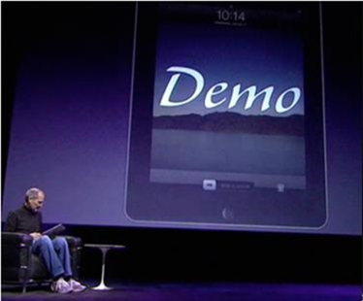
Demo—Pick ONE Topic
MACRO
MICRO
Procedure
4.6—Monetary Policy
https://tinyurl.com/FREDmacro
6.2—Externalities
2 Minutes to do Entrance Ticket
Discussion
5 Minutes for Exit Ticket (NO PEEKING!)

Slide 15
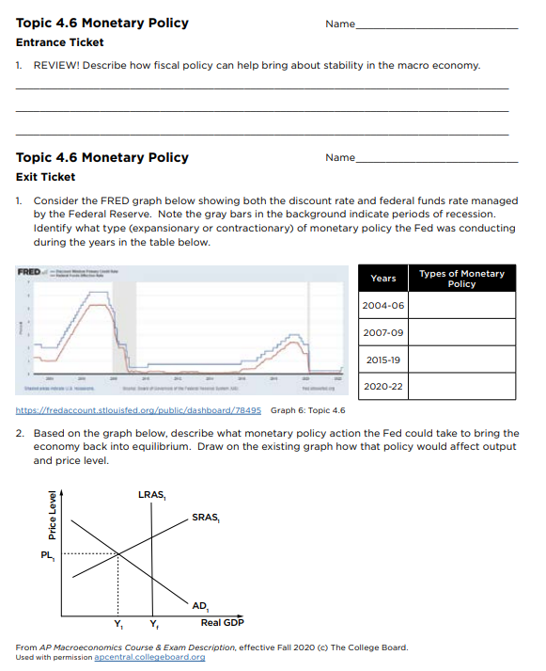
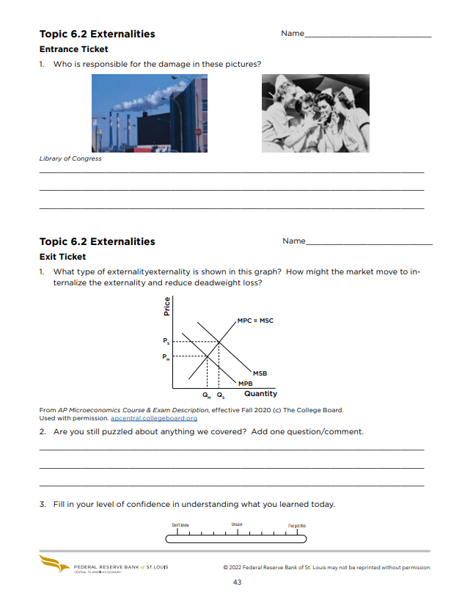
Macro
Micro

Slide 16
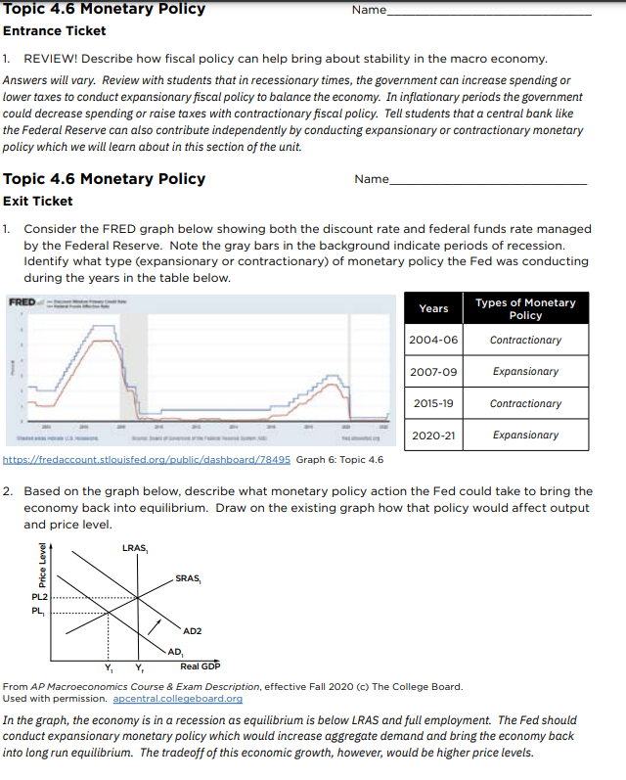
Demo: Macro 4.6
Monetary Policy
Emphasize:
Low stress
Graph drawing
Complete answers

Slide 17
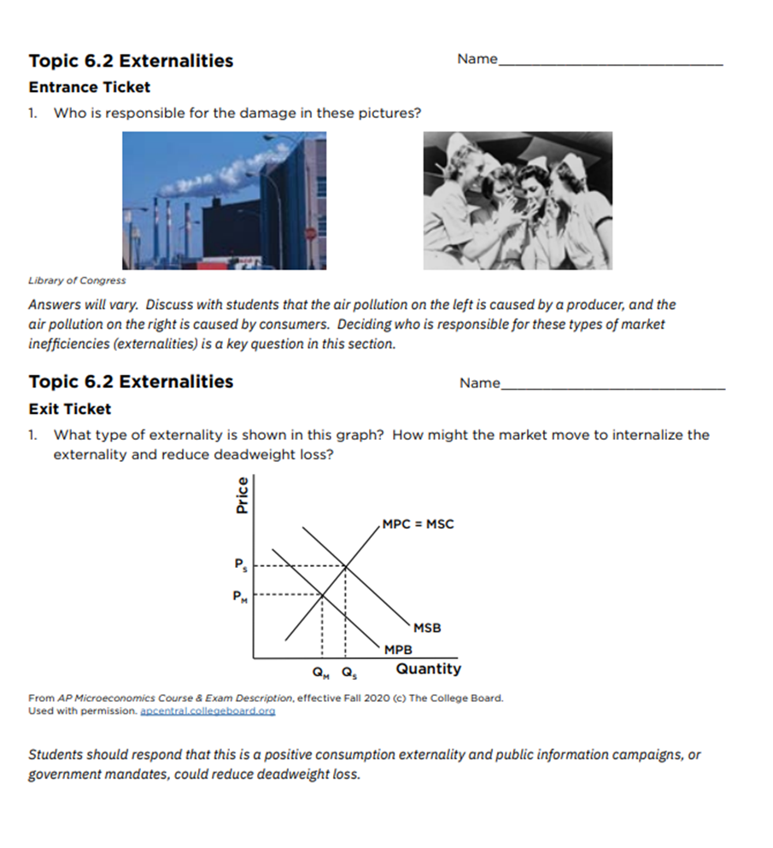
Demo: Micro 6.2
Externalities
Emphasize:
Low stress
Graph drawing
Complete answers

Slide 18
Taking The Room Temp
Create an honest space for learning
Failure IS an option…now (not later)
Minimizing embarrassment leads to truthfulness
One question / comment
Answer NEXT period
Gauging confidence ASAP

Slide 19
Record confidence in spreadsheet ASAP
Review data before:
Unit Exams
Finals
AP Exams
Customize Assessments
Balance class strengths & challenges

Slide 20
Using Data in the Short Run
Unit 2 FRQ
Assesses 2.6 (CS/PS)
Class weakness
Assesses 2.9 (Intl Trade)
Class strength

Slide 21
Using Data in the Long Run
Compare exit tickets to unit exams
3 pts.: “I’ve Got This”
2 pts.: “Unsure”
1 pt.: “Don’t know”
Design review tools for finals / AP exam

Slide 22
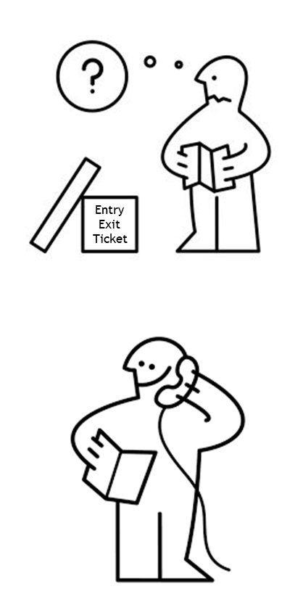
THANK YOU
Mike Kaiman
Mike.kaiman@stls.frb.org

Slide 23
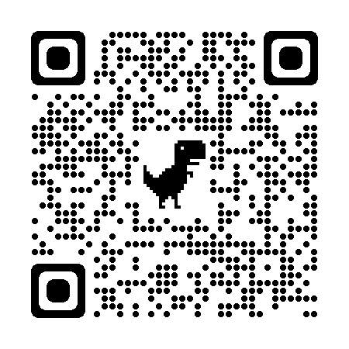
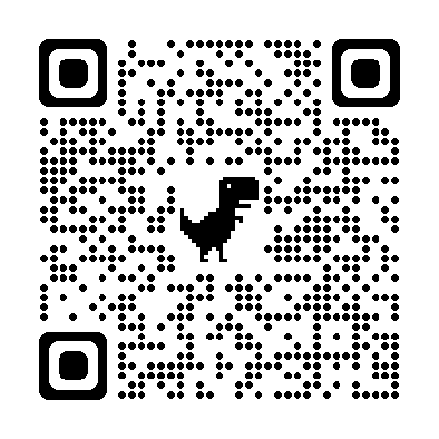
Entry and Exit Tickets
MICRO
MACRO

Slide 24
Professional Development Opportunities
To earn professional development credit for CEE webinars found on EconEdLink, you must:
Watch a minimum of 45-minutes and you will automatically receive a professional development certificate via e-mail within 24 hours.
Attendees can learn how much credit they will earn per workshop.
Accessing resources:
You can now easily download presentations, lesson plan materials, and activities for each webinar from EconEdLink.org/professional-development/
Local resources:
Insert your local professional development opportunities (if applicable)

Slide 25
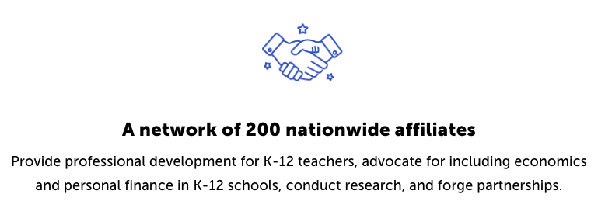
Suggested Presentation Deck
CEE Affiliates
https://www.councilforeconed.org/resources/local-affiliates/
Include your local affiliate page

Slide 26
Thank You to Our Sponsors!

Slide 27
Mike Kaiman mike.kaiman@stls.frb.org
Thank You

