Slide 1
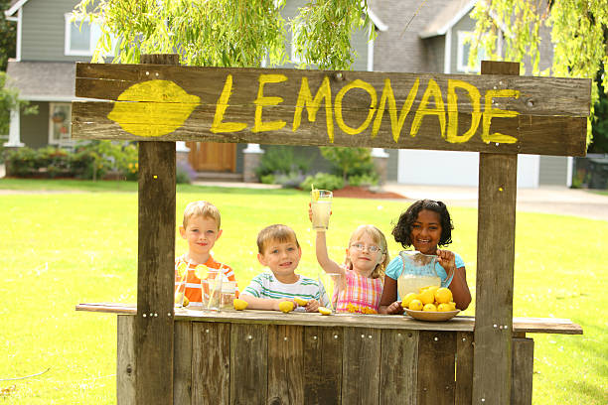
Presented by: Lauren Shifflett Email: shiffllh@jmu.edu Date: January 20th, 2023
2023 Summer Institute: K-5 Session 1

Slide 2
EconEdLink Membership
You can now access CEE’s professional development webinars directly on EconEdLink.org! To receive these new professional development benefits, become an EconEdLink member. As a member, you will now be able to:
Automatically receive a professional development certificate via e-mail within 24 hours after viewing any webinar for a minimum of 45 minutes
Register for upcoming webinars with a simple one-click process
Easily download presentations, lesson plan materials and activities for each webinar
Search and view all webinars at your convenience
Save webinars to your EconEdLink dashboard for easy access to the event
Access our new Professional Development page here

Slide 3
Professional Development Opportunities
To earn professional development credit for CEE webinars found on EconEdLink, you must:
Watch a minimum of 45-minutes and you will automatically receive a professional development certificate via e-mail within 24 hours.
Attendees can learn how much credit they will earn per workshop.
Accessing resources:
You can now easily download presentations, lesson plan materials, and activities for each webinar from EconEdLink.org/professional-development/
Local resources:
Insert your local professional development opportunities (if applicable)

Slide 4
Lauren Shifflett
Associate Director,
JMU Center for Economic Education
shiffllh@jmu.edu
Lauren Shifflett is the Associate Director at the James Madison University Center for Economic Education. Prior to joining the Center, she spent twelve years in early elementary education where she enjoyed prospering young minds as a classroom teacher. Lauren became nationally known as an elementary economic educator when she received the John Morton Award of the national Council for Economic Education in 2021. Her love for economics guides her lessons to prepare students for life.

Slide 5
Agenda
Why use children's literature to teach economics? (5 min)
Book 1: Cooler Than Lemonade (Decision Making and Entrepreneurship) (10 minutes)
Book 2: When Grandma Gives You Lemons (Decision Making, Productive Resources) (10 minutes)
Book 3: It Begins with Lemonade (Scarcity, Money, Decision Making) (10 minutes)
Book 4: The Lemonade War (Scarcity, Money, Decision Making Entrepreneurship) (10 minutes)

Slide 6
Agenda
Book 5: Curious George Lemonade Stand (Decision Making and Entrepreneurship) (10 minutes)
Podcast: The Creative Classroom (10 minutes)

Slide 7
Objectives
Learn about opportunity cost and the trade-offs involved in choosing one option over another due to limited resources.
Understand the concept of scarcity and its impact on resource availability and the need to make choices.​
Explore the relationship between supply and demand, how it affects prices, and the quantity of lemonade available.​
Identify the productive resources needed to make lemonade, such as lemons, sugar, and labor, and understand their importance in the production process.

Slide 8
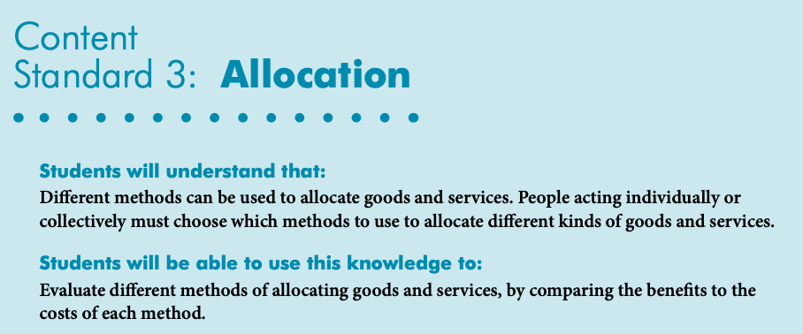
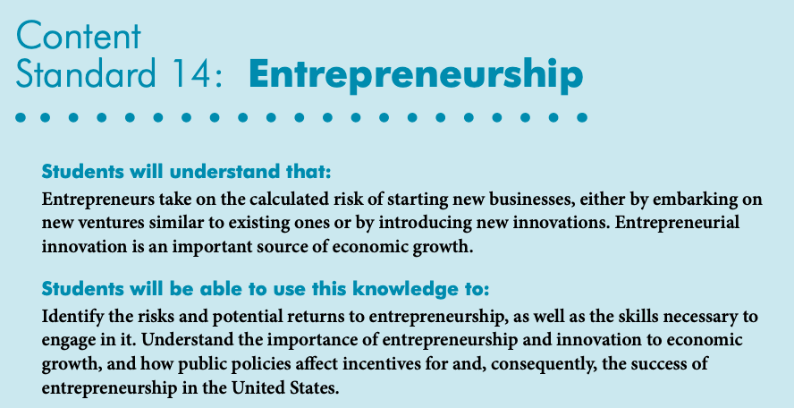
National Standards
https://www.councilforeconed.org/wp-content/uploads/2012/03/voluntary-national-content-standards-2010.pdf

Slide 9
Why Children's Literature?
The purpose of a children's story is to persuade, inform, entertain, or describe.
Children’s literature teaches us to find complexity in the things that seem simple.
"Teaching economics through children’s literature is an effective way to integrate key economic concepts into the classroom. Concepts such as earning, saving, risk, scarcity and entrepreneurship are easily understood by students once they can relate to character in a realistic situation.” - EducationWeek
https://www.edweek.org/teaching-learning/opinion-three-ways-to-teach-economics-through-childrens-literature/2017/03#:~:text=Teaching%20economics%20through%20children's%20literature,character%20in%20a%20realistic%20situation.

Slide 10
Children's Literature

Slide 11
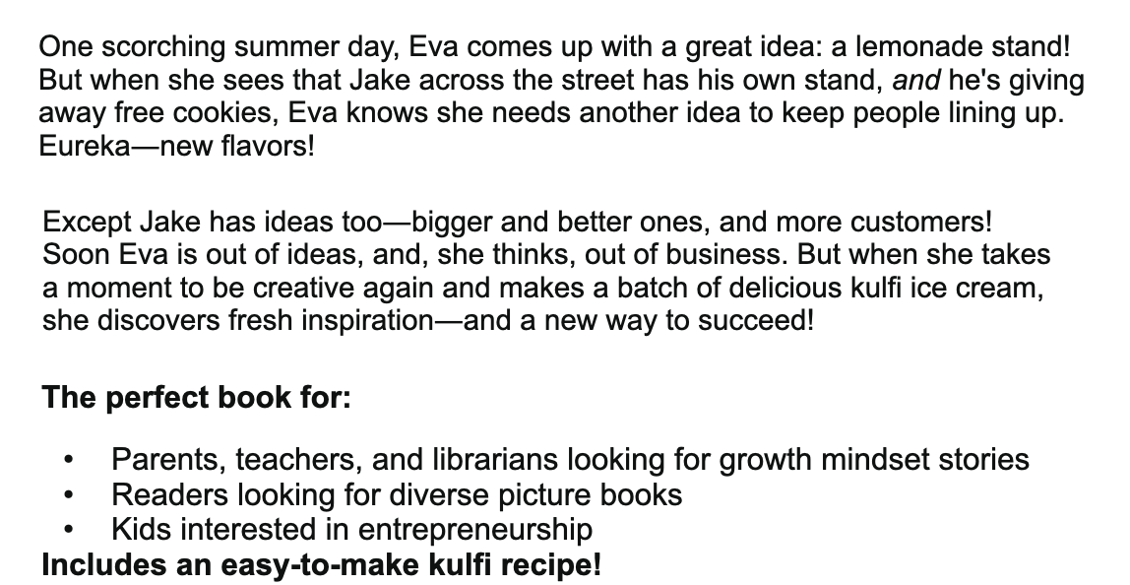
Cooler Than Lemonade
Cooler Than Lemonade: Online Read Aloud

Slide 12
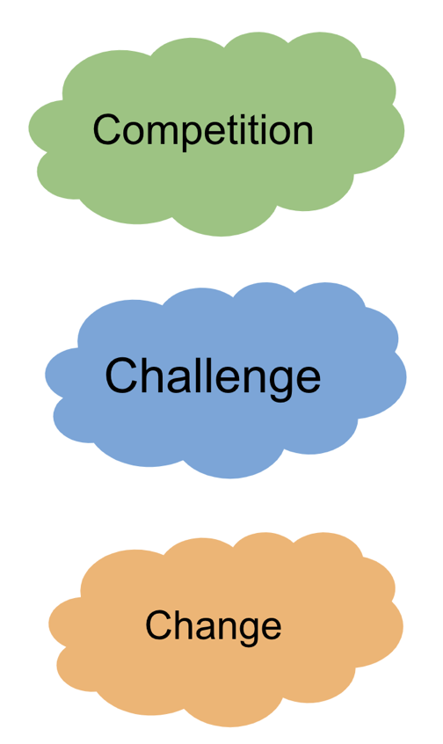
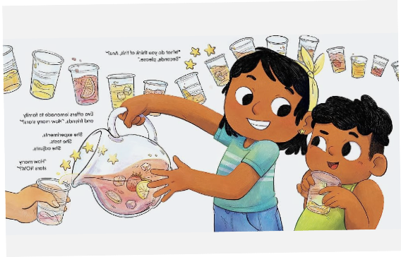
Cooler Than Lemonade
How will Eva solve all these problems?

Slide 13
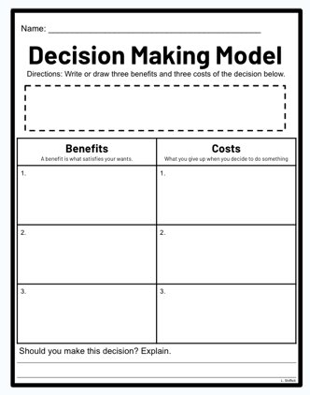
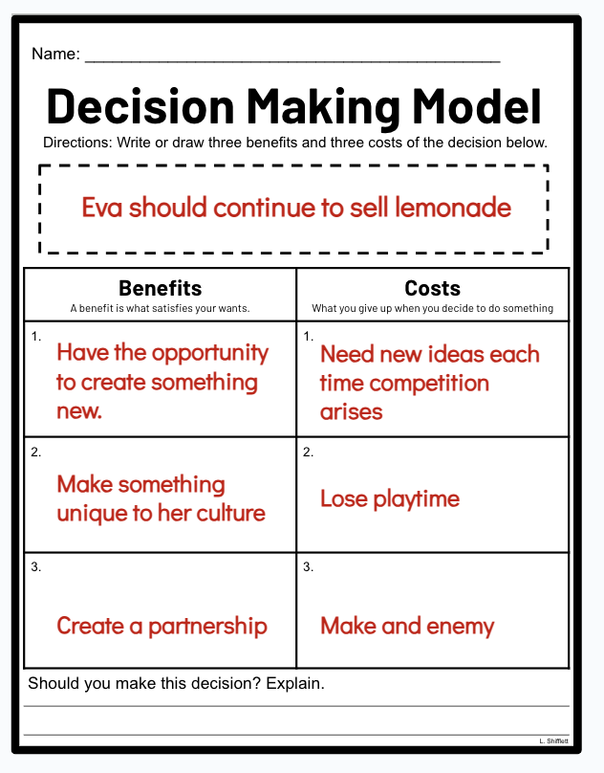
Cooler Than Lemonade

Slide 14
Decision Making
In this economics interactive, students will learn about decision making while shopping for a fish.
https://www.econedlink.org/resources/the-perfect-pet-decision-making/

Slide 15
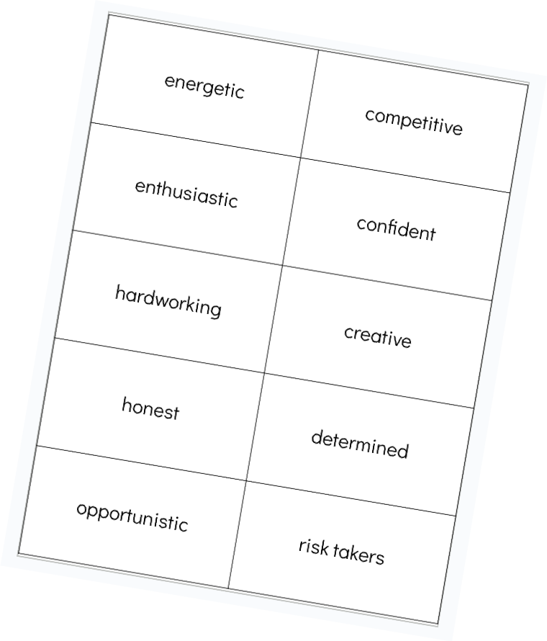
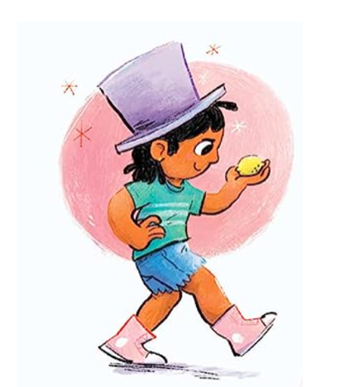
Entrepreneurship

Slide 16
Entrepreneurship: Ranking

Slide 17
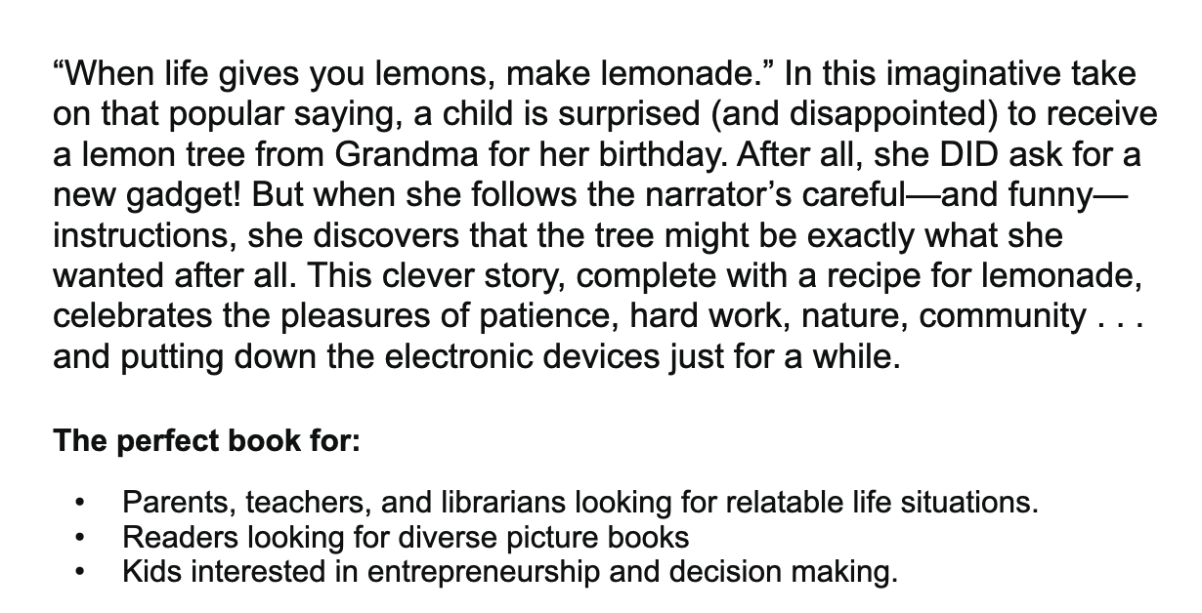
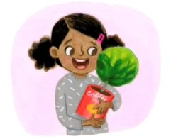
When Grandma Gives You a Lemon Tree
When Grandma Gives You a Lemon Tree: Online Read Aloud

Slide 18
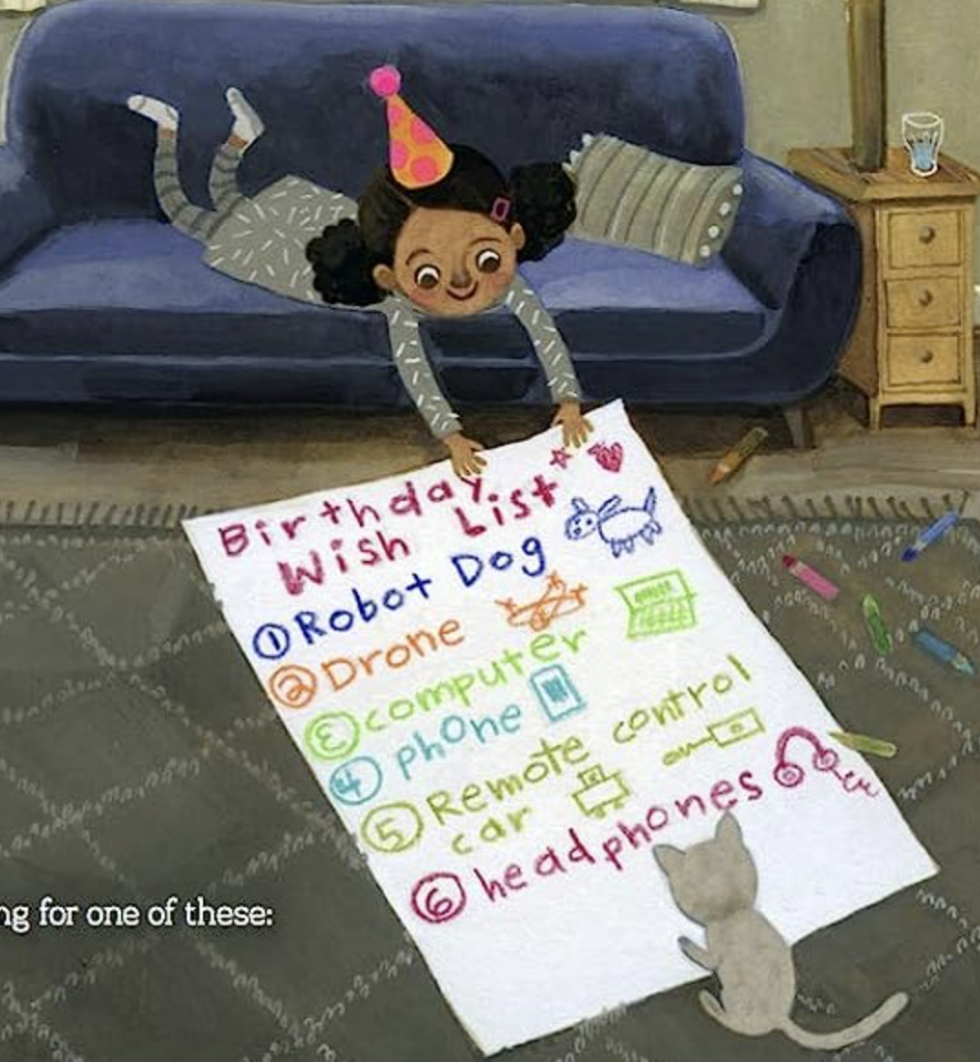
When Grandma Gives You a Lemon Tree

Slide 19
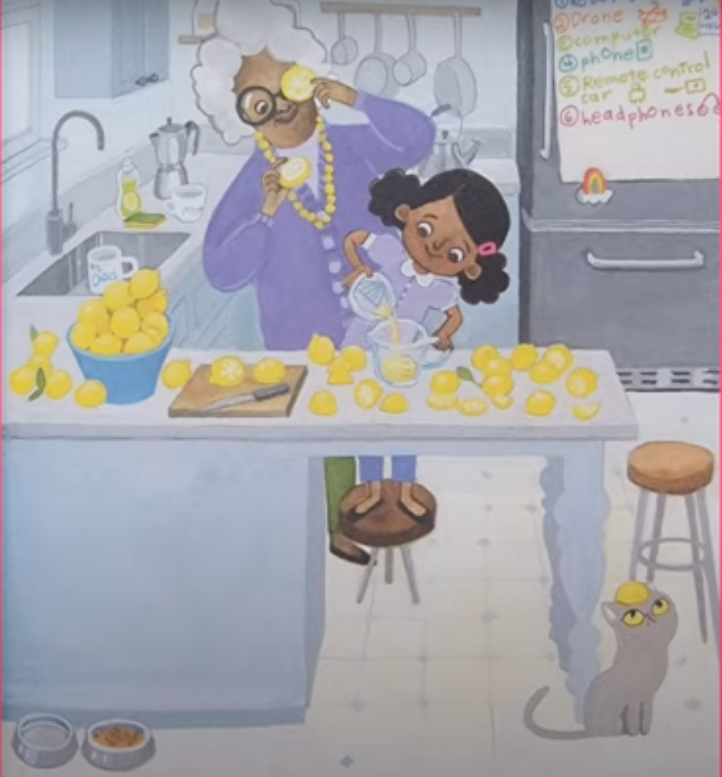
When Grandma Gives You a Lemon Tree
What type of productive resources do you see?

Slide 20
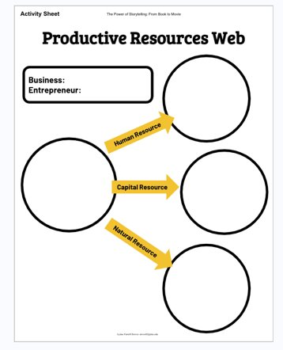
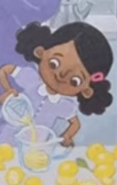
What Resources Went Into Making Lemonade?
Lemonade
Sue

Slide 21
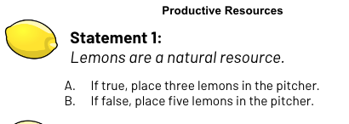
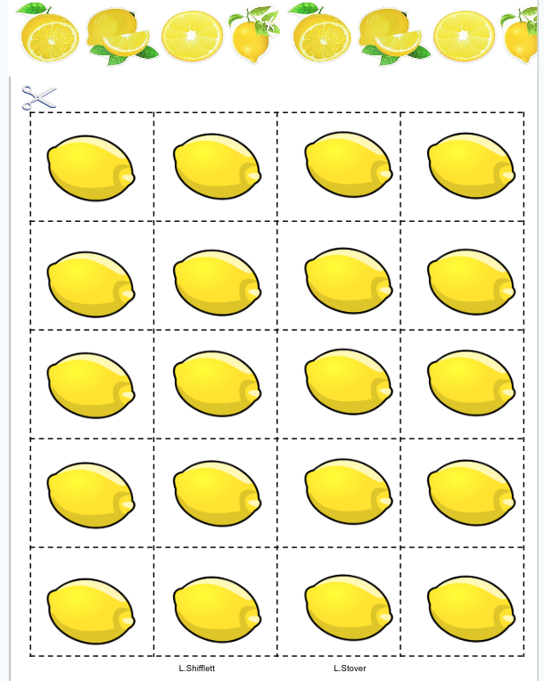
Productive Resources

Slide 22
Resources Matching Game
https://www.econedlink.org/resources/producers-use-resources-matching-practice/

Slide 23
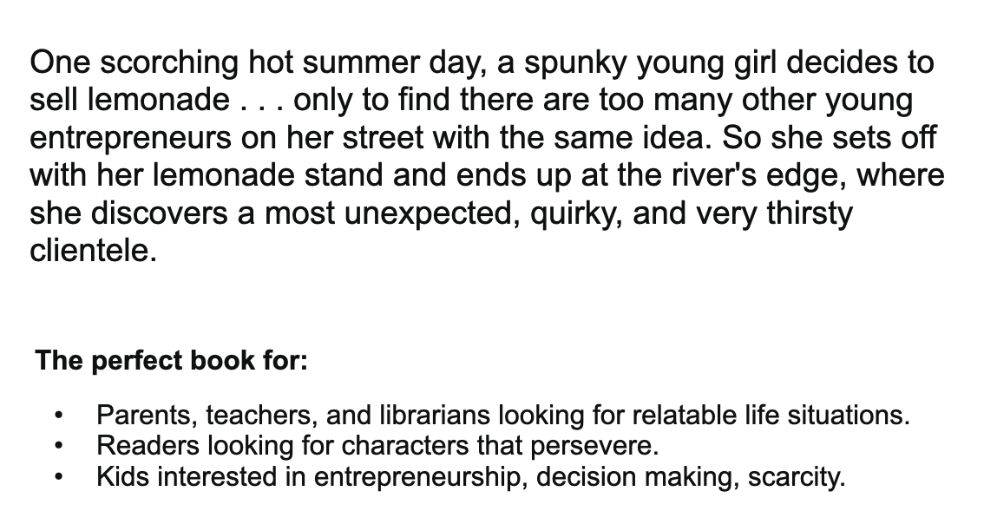
It Began With Lemonade
It Began With Lemonade: Online Read Aloud

Slide 24
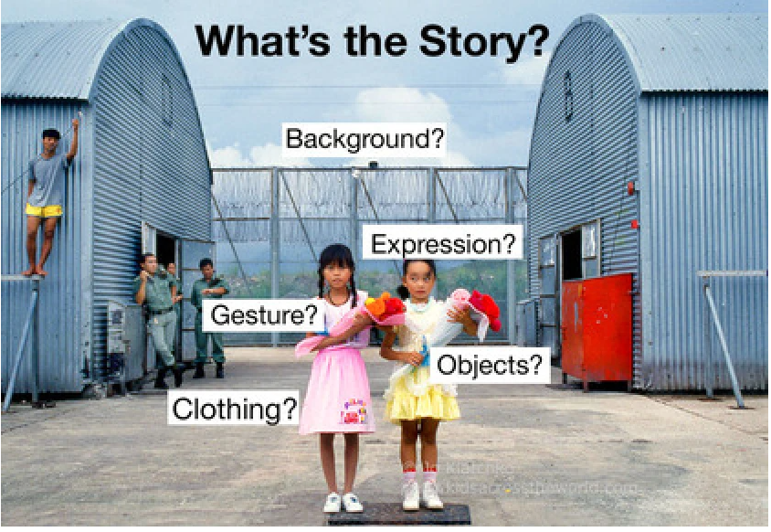
Using photographs to teach a concept:
Knowing how to decipher an image—visual literacy—is a vitally important skill. It encourages young people to slow down and pay attention; to step back from the hyper skimming of the internet age, to look closely, to observe, to engage—skills that will set students down a path of deeper learning for a lifetime. Visual literacy is about understanding what we see—with our eyes, our minds, and our hearts.- EducationWeek
https://www.edweek.org/teaching-learning/opinion-photo-detectives-connecting-the-cross-cultural-with-the-cross-curricular/2016/01

Slide 25
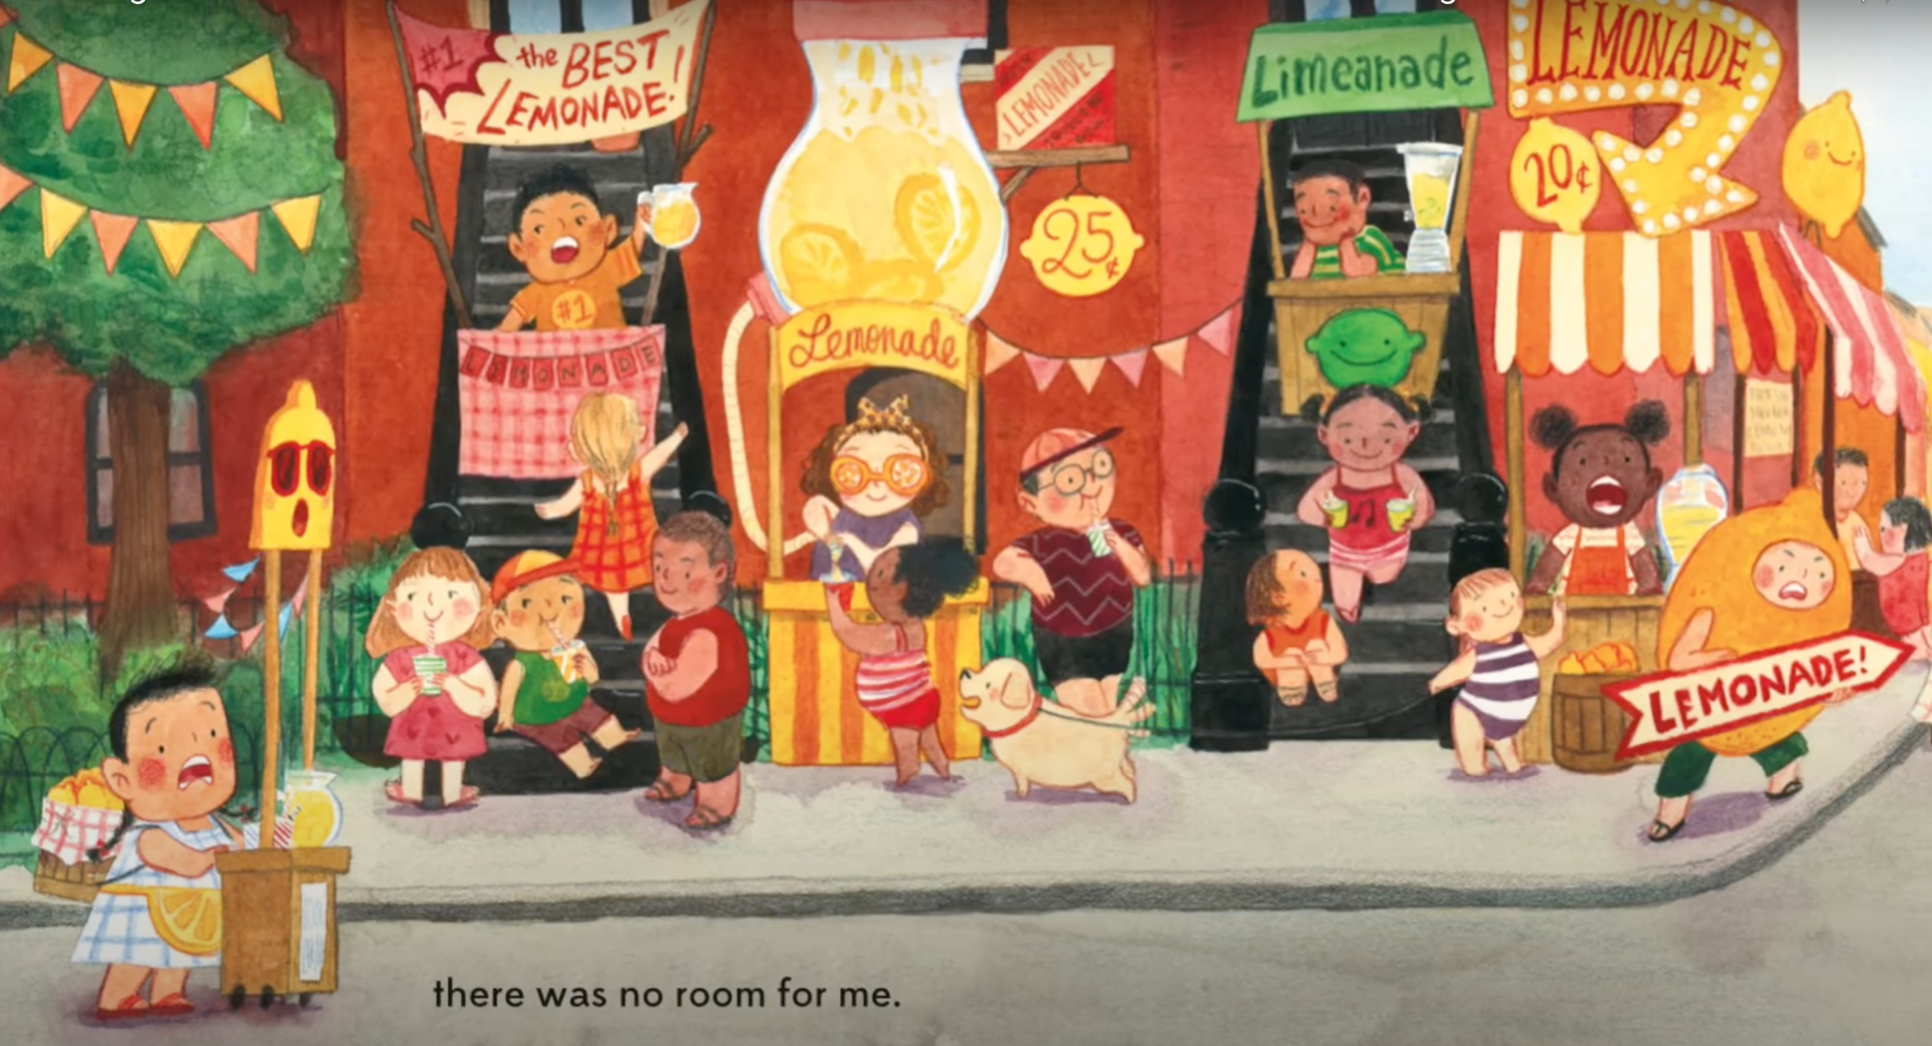
There is not enough room for a lemonade stand- scarcity of space
What's the Story?

Slide 26
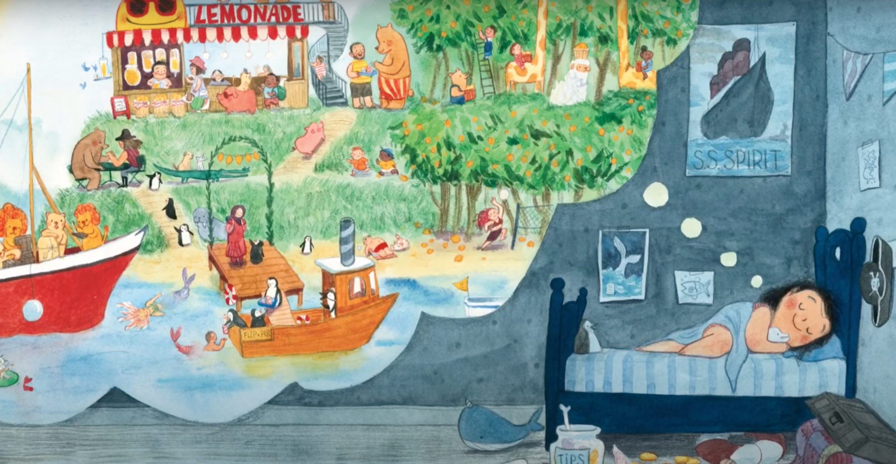
Dreaming of what could be.
How can everyone benefit from the process?
What's the Story?

Slide 27
What is Scarcity?
This video teaches the concept of scarcity. The total resources of society, including natural resources, human resources, capital goods and entrepreneurship, are limited, causing scarcity to exist.
https://www.econedlink.org/resources/scarcity-video-and-quiz/
https://www.econedlink.org/resources/toys-for-me/

Slide 28
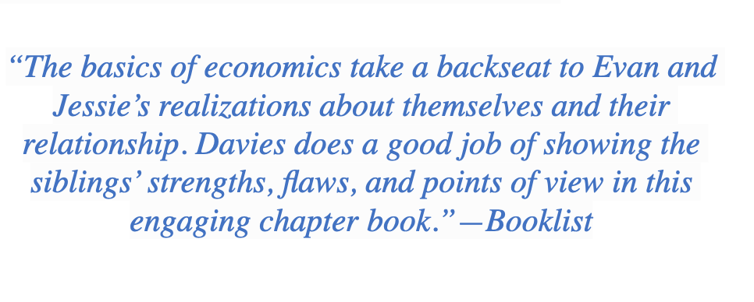
The Lemonade War
Evan Treski is people-smart. He’s good at talking with people, even grownups. His younger sister Jessie, on the other hand, is math-smart—but not especially good at understanding people. She knows that feelings are her weakest subject. With just five days left of summer vacation, Evan and Jessie launch an all-out war to see who can sell the most lemonade before school starts. As the battleground heats up, there really is no telling who will win—and even more important, if their fight will ever end.

Slide 29
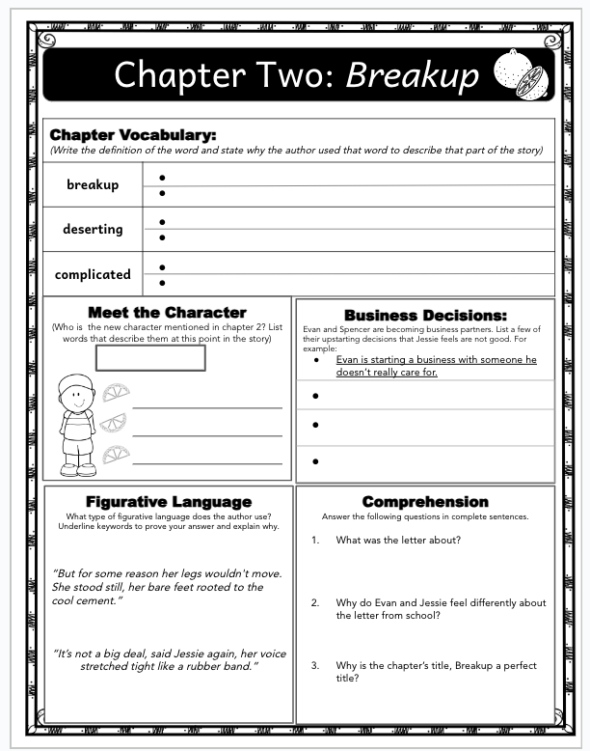
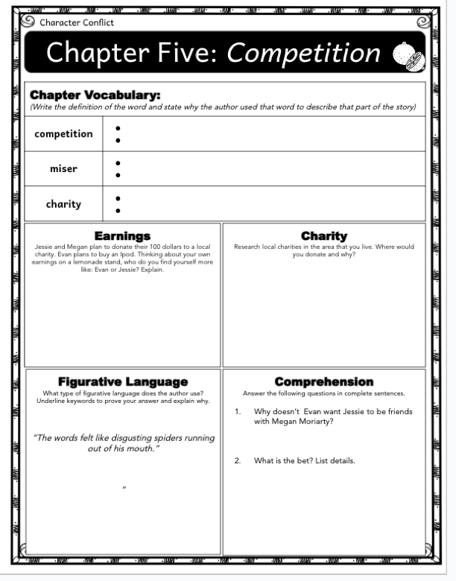
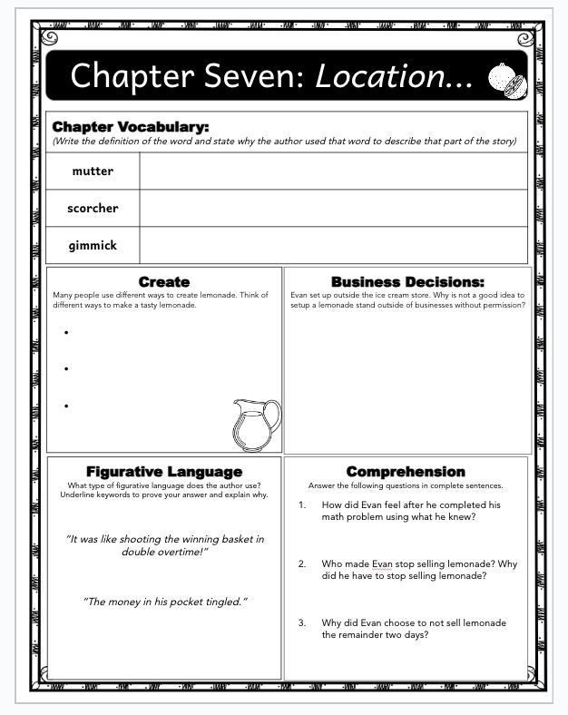
The Lemonade War: Novel Study

Slide 30
Curious George

Slide 31
Curious George
https://youtu.be/lfHfDD2p55w

Slide 32
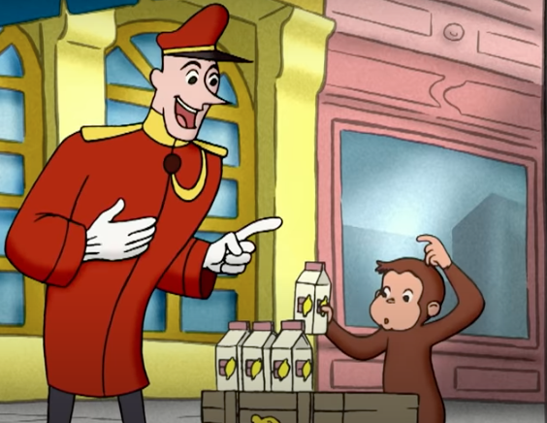
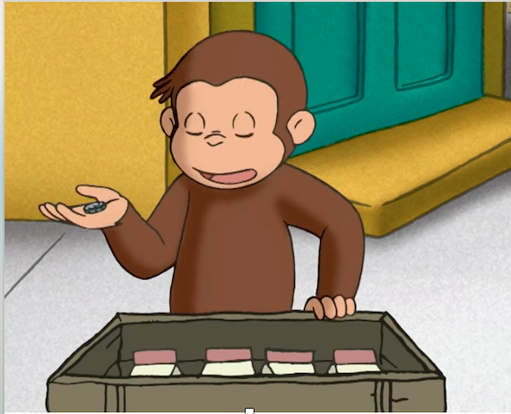
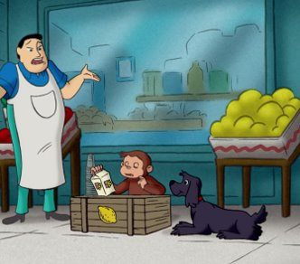
Using Pictures to incorporate ideas
What can we learn from the mistakes that George made?

Slide 33
Lemon Squeeze: The Lemonade Stand
Everyone has at one time or another opened a lemonade or Kool-Aid Stand. What a great place to begin an economics lesson. Students can taste test three brands of lemonade and compare prices with taste – is the most expensive the best? Using a reader’s theater students will construct a supply and demand schedule and can create a bar or line graph to demonstrate market interaction between buyers and sellers.
Lemon Squeeze – The Lemonade Stand
https://www.econedlink.org/resources/lemon-squeeze-the-lemonade-stand/

Slide 34
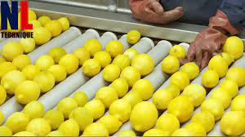
How is it Made?
https://www.econedlink.org/resources/curious-george-economics/
https://www.google.com/search?q=how+is+lemonade+made+in+factories&oq=how+is+lemaonade+made%3F&aqs=chrome.2.69i57j0i13i512j0i13i395i512j0i13i30i395l2j0i22i30i395l5.6676j1j4&sourceid=chrome&ie=UTF-8#fpstate=ive&vld=cid:d2401b95,vid:1soAZM5gUPc

Slide 35
Entrepreneurship
Podcast: https://spencerauthor.com/daymond-john/
Little Daymond Learns to Earn is an original picture book created by Daymond John and published by Penguin Random House. The story follows Little Daymond and his friends as they identify the best way to afford their purchases of choice at a craft fair – starting a t-shirt business! Little Daymond learns the value of creating a product, marketing it to your audience, and earning money through hard work.

Slide 36
Suggested Presentation Deck
Assessment Questions
In what ways can children's literature serve as a gateway to introduce economic concepts to young readers?
What strategies can educators employ to encourage critical thinking skills in children while using children's literature as a teaching tool?
How can children's literature be effectively utilized to teach complex concepts, such as empathy or diversity, to young learners?

Slide 37
Questions?
Are there any questions on the material presented today?

Slide 38
Suggested Presentation Deck
Supporting Materials
https://vcee.org/elementary-school/virginia-reads-one-book/resources-for-the-lemonade-war/

Slide 39
Invest In Girls

Slide 40
Advocacy

Slide 41
Suggested Presentation Deck
CEE Affiliates
https://www.councilforeconed.org/resources/local-affiliates/
Include your local affiliate page

Slide 42
Thank You to Our Sponsors!

Slide 43
Lauren Shifflett shiffllh@jmu.edu
Thank You

