Slide 1
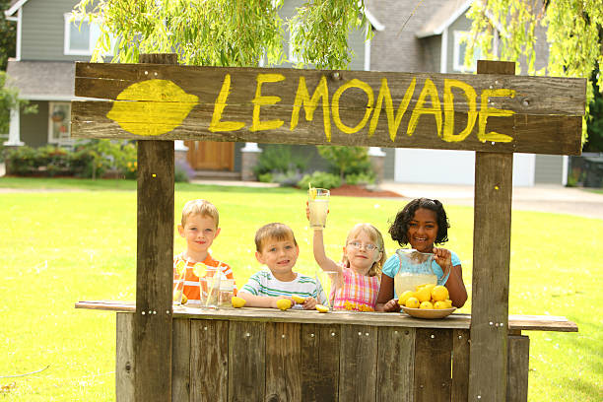
Presented by: Lauren Shifflett Email: shiffllh@jmu.edu Date: January 20th, 2023
2023 Summer Institute: K-5 Session 2

Slide 2
EconEdLink Membership
You can now access CEE’s professional development webinars directly on EconEdLink.org! To receive these new professional development benefits, become an EconEdLink member. As a member, you will now be able to:
Automatically receive a professional development certificate via e-mail within 24 hours after viewing any webinar for a minimum of 45 minutes
Register for upcoming webinars with a simple one-click process
Easily download presentations, lesson plan materials and activities for each webinar
Search and view all webinars at your convenience
Save webinars to your EconEdLink dashboard for easy access to the event
Access our new Professional Development page here

Slide 3
Professional Development Opportunities
To earn professional development credit for CEE webinars found on EconEdLink, you must:
Watch a minimum of 45-minutes and you will automatically receive a professional development certificate via e-mail within 24 hours.
Attendees can learn how much credit they will earn per workshop.
Accessing resources:
You can now easily download presentations, lesson plan materials, and activities for each webinar from EconEdLink.org/professional-development/
Local resources:
Insert your local professional development opportunities (if applicable)

Slide 4
Lauren Shifflett
Associate Director,
JMU Center for Economic Education
shiffllh@jmu.edu
Lauren Shifflett is the Associate Director at the James Madison University Center for Economic Education. Prior to joining the Center, she spent twelve years in early elementary education where she enjoyed prospering young minds as a classroom teacher. Lauren became nationally known as an elementary economic educator when she received the John Morton Award of the national Council for Economic Education in 2021. Her love for economics guides her lessons to prepare students for life.

Slide 5
Agenda
Cooler Than Lemonade:
1. Entrepreneur Ranking Activity
2. What Characteristics are shown activity.
When Grandma Gives You Lemons:
Productive Resources Web
2. Productive Resources-Making Lemonade
It Begins with Lemonade:
1. Pictures tell a story activity

Slide 6
Agenda
Lemonade War:
1. Create a Business Plan

Slide 7
Objectives
Learn about opportunity cost and the trade-offs involved in choosing one option over another due to limited resources.
Understand the concept of scarcity and its impact on resource availability and the need to make choices.​
Explore the relationship between supply and demand, how it affects prices, and the quantity of lemonade available.​
Identify the productive resources needed to make lemonade, such as lemons, sugar, and labor, and understand their importance in the production process.

Slide 8
Why Children's Literature?
The purpose of a children's story is to persuade, inform, entertain, or describe.
Children’s literature teaches us to find complexity in the things that seem simple.
"Teaching economics through children’s literature is an effective way to integrate key economic concepts into the classroom. Concepts such as earning, saving, risk, scarcity and entrepreneurship are easily understood by students once they can relate to character in a realistic situation.” - EducationWeek
https://www.edweek.org/teaching-learning/opinion-three-ways-to-teach-economics-through-childrens-literature/2017/03#:~:text=Teaching%20economics%20through%20children's%20literature,character%20in%20a%20realistic%20situation.

Slide 9
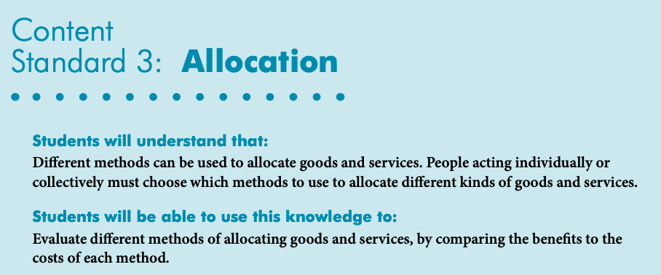
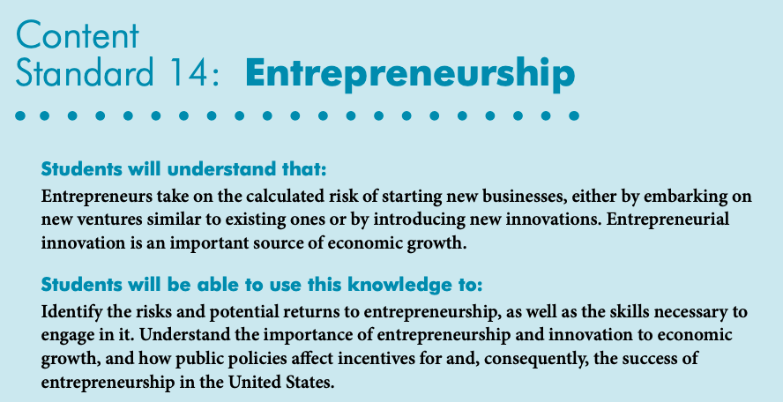
National Standards
https://www.councilforeconed.org/wp-content/uploads/2012/03/voluntary-national-content-standards-2010.pdf

Slide 10
Children's Literature

Slide 11
Using Jamboard
https://jamboard.google.com/d/159llySQJn8z_sdT3MRLlBv54pU0KIIobqBeF0Ag3mHg/copy?usp=sharing

Slide 12
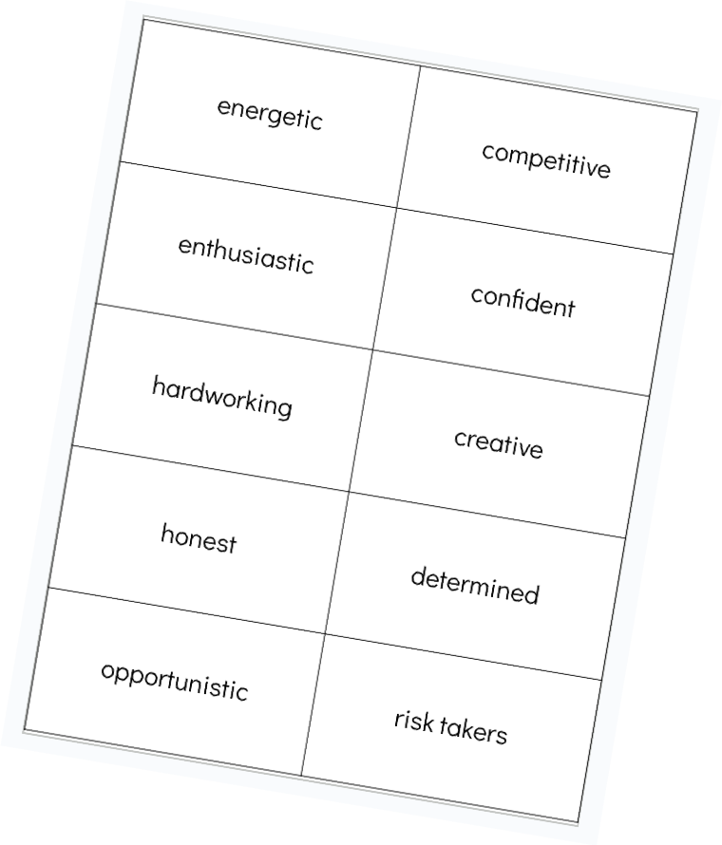
Entrepreneurship: Ranking

Slide 13
Entrepreneurship: Breakout Room
As a group, rank the 10 characteristics of an entrepreneur from most valuable to least valuable.
Determine a speaker who will share the rankings with the whole group when we all come back together.
Just have fun! There is no right or wrong answer. :)

Slide 14
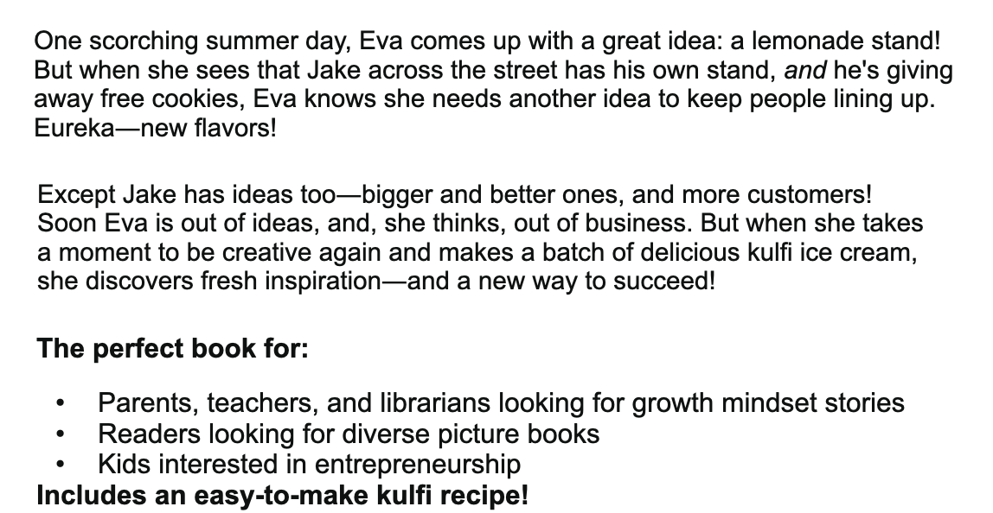
Cooler Than Lemonade
Cooler Than Lemonade: Online Read Aloud

Slide 15
Entrepreneurship

Slide 16
Entrepreneurship: Breakout Room
As a group, discuss the characteristics that Eva showed throughout the story.
Determine a speaker who will share the characteristics with the whole group when we all come back together.
Just have fun! There is no right or wrong answer. :)

Slide 17
Entrepreneurship: Breakout Room

Slide 18
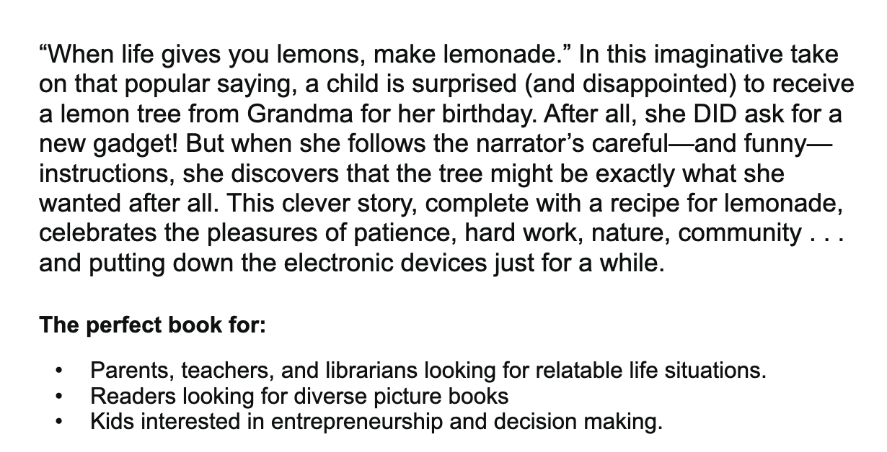
When Grandma Gives You a Lemon Tree
When Grandma Gives You a Lemon Tree: Online Read Aloud

Slide 19
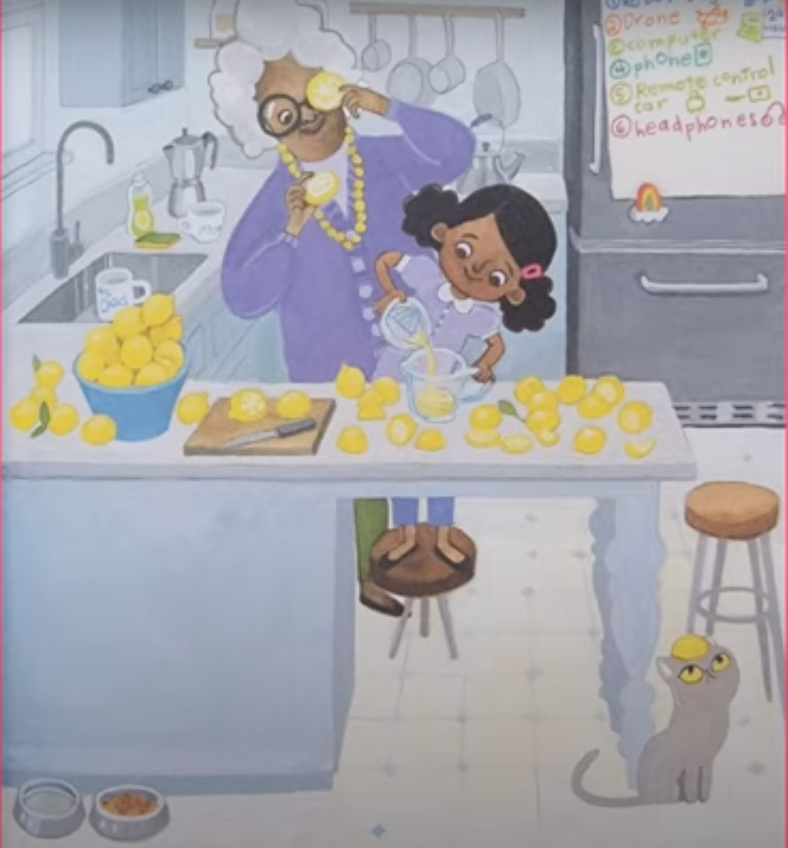
When Grandma Gives You a Lemon Tree
What type of productive resources do you see?

Slide 20
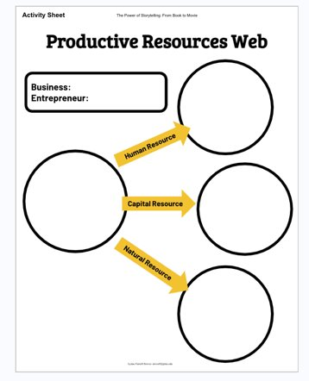
What Resources Went Into Making Lemonade?
Lemonade
Sue

Slide 21
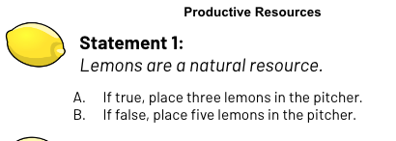
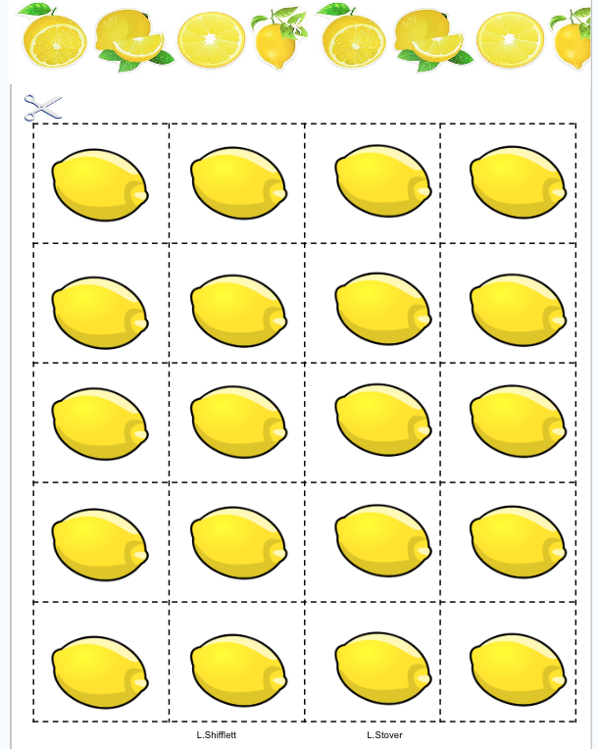
Productive Resources

Slide 22
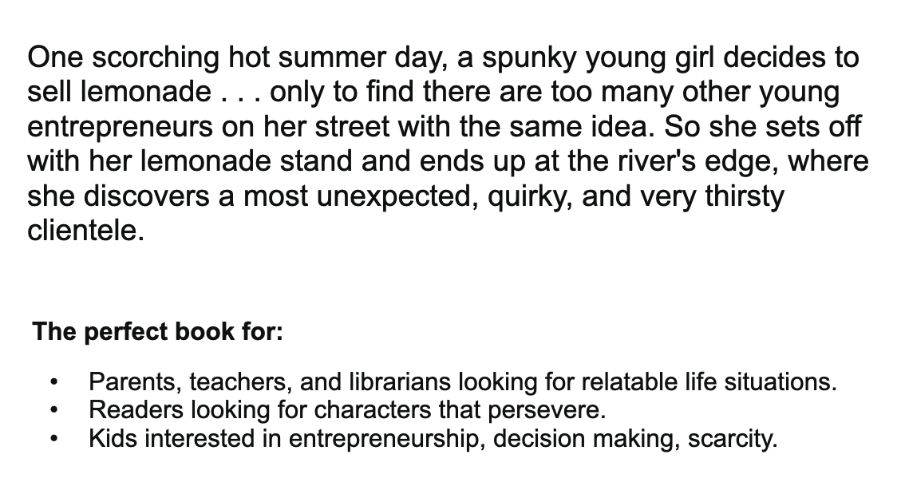
It Began With Lemonade
It Began With Lemonade: Online Read Aloud

Slide 23
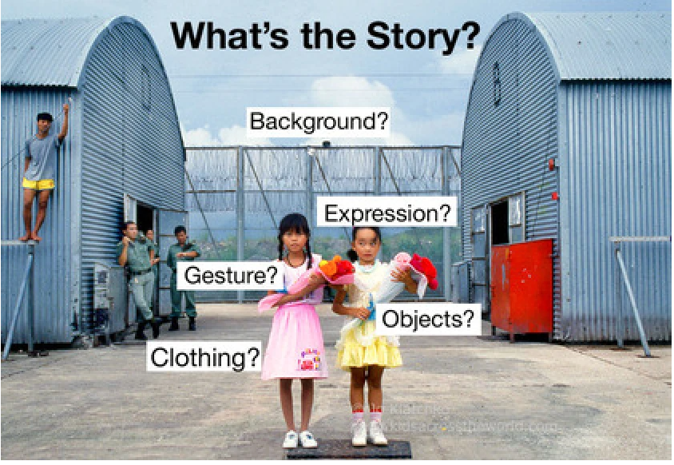
Using photographs to teach a concept:
Knowing how to decipher an image—visual literacy—is a vitally important skill. It encourages young people to slow down and pay attention; to step back from the hyper skimming of the internet age, to look closely, to observe, to engage—skills that will set students down a path of deeper learning for a lifetime. Visual literacy is about understanding what we see—with our eyes, our minds, and our hearts.- EducationWeek
https://www.edweek.org/teaching-learning/opinion-photo-detectives-connecting-the-cross-cultural-with-the-cross-curricular/2016/01

Slide 24
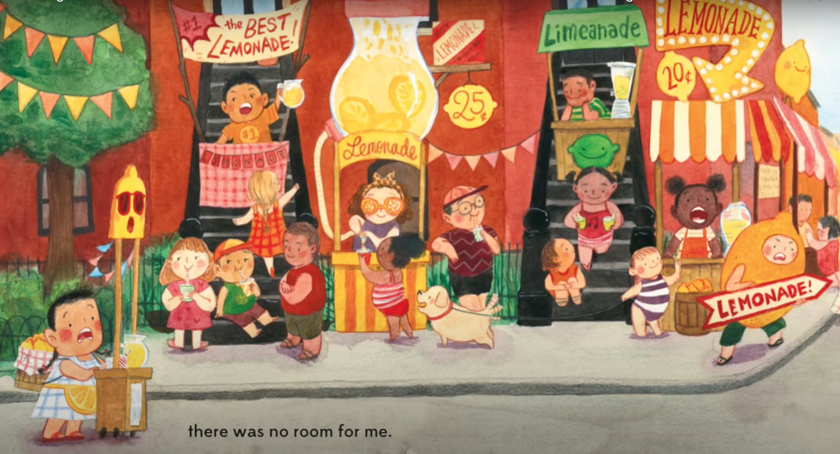
What's the Story?

Slide 25
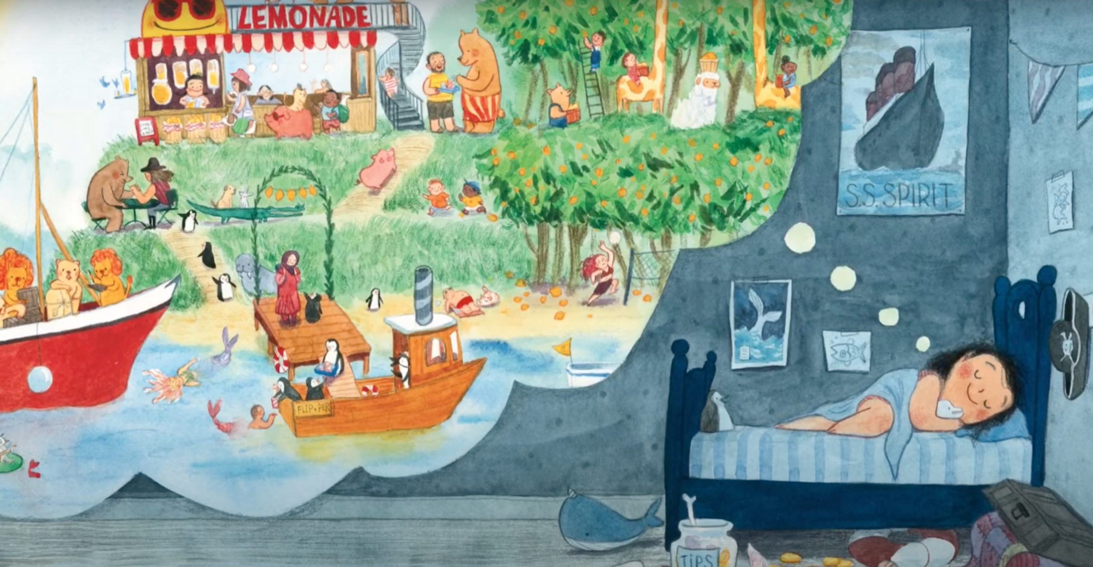
What's the Story?

Slide 26
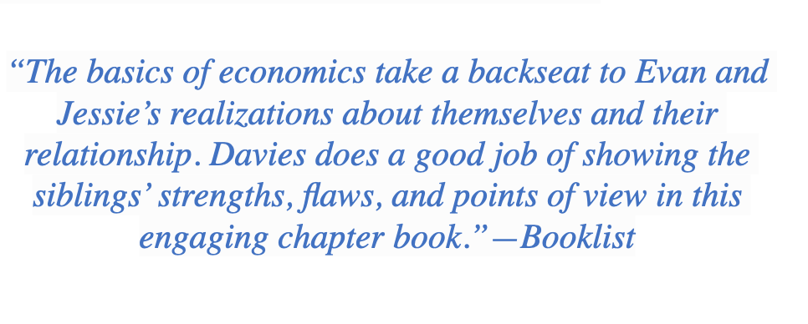
The Lemonade War
Evan Treski is people-smart. He’s good at talking with people, even grownups. His younger sister Jessie, on the other hand, is math-smart—but not especially good at understanding people. She knows that feelings are her weakest subject. With just five days left of summer vacation, Evan and Jessie launch an all-out war to see who can sell the most lemonade before school starts. As the battleground heats up, there really is no telling who will win—and even more important, if their fight will ever end.

Slide 27
Creating a Lemonade Business

Slide 28
Creating Business Breakout
As a group, follow the business plan cards to create/design your new business idea.
Create an elevator pitch that will be presented back to the group.
Determine a speaker who will share their elevator pitch with the whole group when we all come back together.
Just have fun! Be Creative! There is no right or wrong answer. :)

Slide 29
Creating Business Breakout
Elevator Pitches: is a short description of an idea, product, or company that explains the concept in a way such that any listener can understand it in a short period of time.
Each group will have 1 minute to pitch their new innovative idea.
Explain to students that their elevator pitches will come from their advertisement sheet.
Students should mention:
Component 1: Your product name and category.
Component 2: The problem you are attempting to solve.
Component 3: Your proposed solution.
Component 4: The key benefit of your solution

Slide 30
Questions?
Are there any questions on the material presented today?

Slide 31
Invest In Girls

Slide 32
Advocacy

Slide 33
Suggested Presentation Deck
CEE Affiliates
https://www.councilforeconed.org/resources/local-affiliates/
Include your local affiliate page

Slide 34
Thank You to Our Sponsors!

Slide 35
Lauren Shifflett shiffllh@jmu.edu
Thank You

