Slide 1
Should We Allow a Market for Transplant Organs?

Slide 2
What is economics? What is ethics?
Economics is the study of how people choose
Ethics is the analysis of right and wrong.
Ethical frameworks help explain human behavior and evaluate policies, even if the frameworks seem to conflict with one another.

Slide 3
Who wants this?!
Is the item scarce?
How do we decide who gets it?

Slide 4
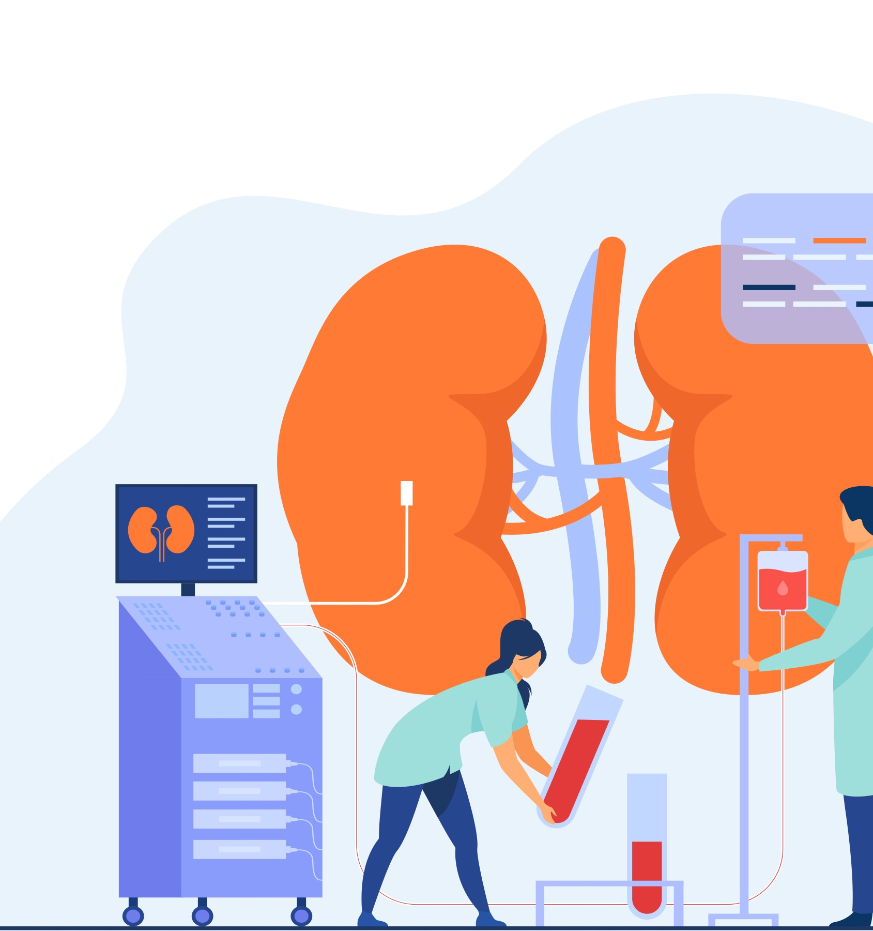
Today
In this economics lesson, students will analyze and debate the ethical considerations for dealing with a shortage of transplant organs.

Slide 5
Transplant organs in the US
There is a large and growing shortage of transplant organs in the United States.
Because of this shortage, many people die while waiting for a transplant, and others must use expensive medical procedures and equipment to stay alive.
Shortage occurs when
the quantity demanded is greater than the quantity supplied at the market price, meaning…
there are more people that want or need an organ than organs available.

Slide 6
Activity 9.1 Kidney Candidates
Your task: You are the leader of a Transplant Team, as the leader you must decide who gets a kidney.
Using any of the criteria listed below OR criteria you came up with on your own, select one (1) patient for a kidney transplant.
Assume that all suffer equally, and the matter is urgent. They are all a match to the available kidney.
Those who do not receive a kidney will die within a year.

Slide 7
Activity 9.1 Kidney Candidates
List of possible criteria for consideration:
Their need
Merit
Contribution to society (past or present)
Their ability to pay
Their age
Some other criteria

Slide 8
Discussion
Was it hard to decide who got a kidney?
What strategies were used?
Did you use an alternative criteria? Why? Which one?

Slide 9
Who gets the Kidney?

Slide 10
What is a market?
A market is a place where buyers and sellers go to negotiate the price for goods or services.
In our current market for a kidney there were six (6) people who wanted a kidney (demand or buyer) and only one (1) kidney available (supply or seller).
How would an economist describe this market?

Slide 11
What is the difference?
Vs.
Why did these two examples of deciding how to allocate a scarce resource differ so much?
Notes:
Teacher note: Replace visual on left with a visual of what you used in the beginning of class to demonstrate shortage – candy bar, homework pass, extra credit, etc.

Slide 12
Organ Transplant Market: Qd Exceeds Qs
Federal law prohibits buying and selling organs for transplant.
In 2022:
Doctors transplanted more than 42,800 organs in the United States–setting an annual record.
More than 34,000 from deceased donors and about 6500 from living donors
As of April 2023, there are currently over 103,000 patients on the waiting list (all organs).
Nearly 89,000 for a kidney, over 10,000 for a liver, and almost 3,400 waiting for a heart
What is the quantity supplied for kidneys?
What is the quantity demanded for kidneys?
42,800
89,000
Notes:
Data for the graph came from the U.S. Organ Procurement and Transplantation Network, administered by the United Network for Organ Sharing. More recent data are available at https://optn.transplant.hrsa.gov/data/. For simplicity numbers were rounded based on 2022 data.

Slide 13
Organ Transplant Market: Qd Exceeds Qs
Around 8000 patients die every year while waiting for a transplant. That is about 22 people per day and almost one an hour.
In 2022:
The waiting list for transplants increases at twice the rate of donations.
Survival rates for transplant recipients continued to increase.
Notes:
Data for the graph came from the U.S. Organ Procurement and Transplantation Network, administered by the United Network for Organ Sharing. More recent data are available at https://optn.transplant.hrsa.gov/data/. For simplicity numbers were rounded based on 2022 data.

Slide 14
Graph of Kidney Market and Price Ceiling
Market for Kidneys
S
Price
$30,000
D
Pc
$0
40,000
100,000
Quantity per year

Slide 15
What if we could buy and sell organs? Would that help?
Work on Activity 9.2 A Market for Kidneys in groups of 2-3.
The last part of the assignment asks you to make a decision.
Cost-benefit analysis is a tool to make decisions based on the expected costs of the decision and the benefits that people would receive from that decision.
Use Ethics and Economics to help you make the decision!

Slide 16
Ethical concerns
The following ethical frameworks are key to the decision-making process.
Outcomes-based ethics
Virtue-based ethics
Duty-based ethics
Let’s look at each one individually.

Slide 17
Ethical concerns
Outcomes-based ethics: a moral philosophy that discerns right or wrong action based on the consequences produced by the action.
We should do the thing that results in the best outcome. Results are the only thing that matters.
More kidneys available for transplant is the best outcome.
Consequences in terms of fairness or unequal access are vague or not considered.

Slide 18
Ethical concerns
Virtue-based ethics: a moral philosophy that discerns right or wrong based on whether one’s actions contribute to the formation of good character.
What are the intentions of the person making the decision? Is the decider a good person with good morals?
Would a good person buy or sell a kidney? Why?

Slide 19
Ethical concerns
Duty-based ethics: a moral philosophy that discerns right or wrong based on the analysis of one’s obligations.
There is a set of ethical principles, rules, or laws to guide our actions.
Rules – formal and informal - help us do the right thing.
Is it right to treat your kidney as something to sell – a commodity?

Slide 20
Donation only vs. Open Market policies
What concerns do you have about a donation-only policy for kidneys?
What concerns do you have about an open market, or a situation where people are buying and selling kidneys?

Slide 21
Thinking about the policies
What outcome do you hope to achieve with a kidney policy like donation only or open market?
Who makes the choice for how to decide who gets the kidneys?
The Health Resources and Services Administration (HRSA) with the Centers for Medicare and Medicaid Services (CMS), or Centers for Disease Control and Prevention (CDC).
While the outcome discussed (Q #3) and economic agent (HRSA in Q#4) are similar the action might not be the same.
Work individually to explore how ethics affect two kidney allocation policies –donation only or an open market.

Slide 22
Closure
Economics is the study of choices. How can ethical frameworks help make these choices?
Scarcity necessitates that we allocate resources. How does the type of resource we are distributing affect the ethical decisions we make?
What are the three main ethical frameworks and the main question that framework posed/answer?
Your homework is going to be evaluating other options beyond the donation or open market policy. You will expand the economic and ethical frameworks to alternative methods to allocate a kidney.

