Slide 1



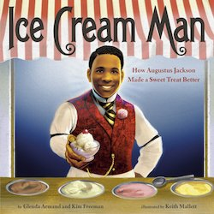



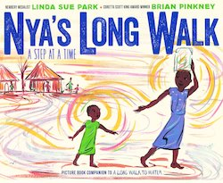

Lauren H Shifflett shiffllh@jmu.edu
Lynne F Stover stoverlf@jmu.edu
May 11 , 2023
Using Children’s Literature to Teach Economics Series
Session II
What’s New: Biographies, Chapter Book Series
& Tales from Around the World

Slide 2
EconEdLink Membership
You can now access CEE’s professional development webinars directly on EconEdLink.org! To receive these new professional development benefits, become an EconEdLink member. As a member, you will now be able to:
Automatically receive a professional development certificate via e-mail within 24 hours after viewing any webinar for a minimum of 45 minutes
Register for upcoming webinars with a simple one-click process
Easily download presentations, lesson plan materials and activities for each webinar
Search and view all webinars at your convenience
Save webinars to your EconEdLink dashboard for easy access to the event
Access our new Professional Development page here

Slide 3
Professional Development Opportunities
To earn professional development credit for CEE webinars found on EconEdLink, you must:
Watch a minimum of 45-minutes and you will automatically receive a professional development certificate via e-mail within 24 hours.
Attendees can learn how much credit they will earn per workshop.
Accessing resources:
You can now easily download presentations, lesson plan materials, and activities for each webinar from EconEdLink.org/professional-development/
Local resources:
Insert your local professional development opportunities (if applicable)

Slide 4
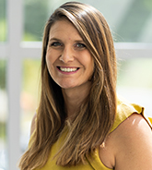
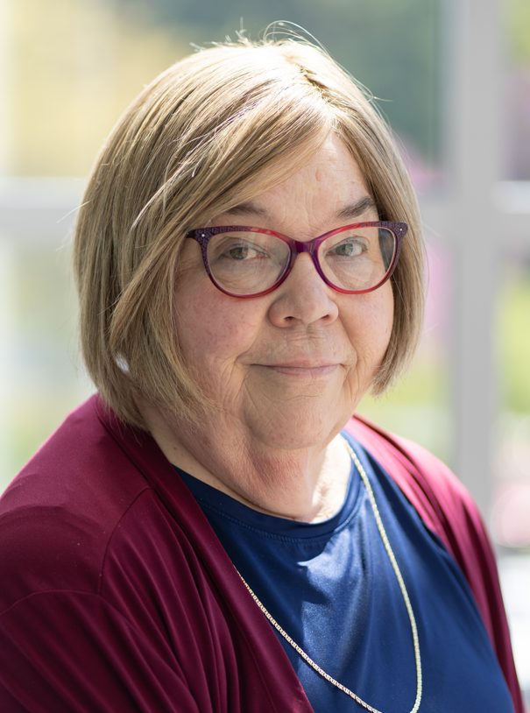
Presenters
Lauren Hensley Shifflett is the new Associate Director at the James Madison University Center for Economic Education. Prior to joining the Center, she spent twelve years in early elementary education where she enjoyed prospering young minds as a classroom teacher. Lauren became nationally known as an elementary economic educator when she received the John Morton Award of the national Council for Economic Education in 2021. Her love for economics guides her lessons to prepare students for life.
shiffllh@jmu.edu
Lynne Farrell Stover is currently a Teacher Consultant at the James Madison University Center for Economic Education. Prior to this, she spent thirty-three years in public education where she enjoyed various teaching assignments including classroom teacher, gifted education specialist, and librarian. She is the author of over fifty educational articles and eight teacher resource books. She is the recipient of the 2022 NAEE Platinum Curriculum Award for her lessons developed for Virginia’s Reading Makes Cents Program.
stoverlf@jmu.edu

Slide 5
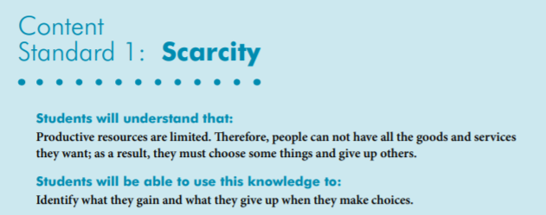

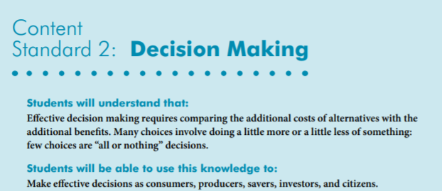
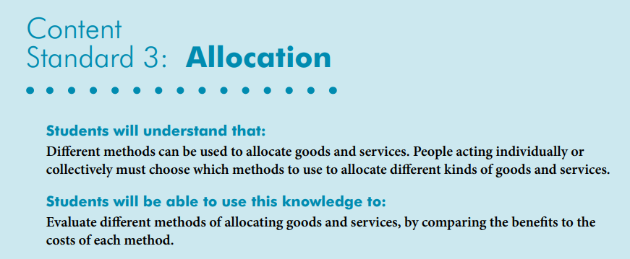
National Content Standards
https://www.councilforeconed.org/wp-content/uploads/2012/03/voluntary-national-content-standards-2010.pdf

Slide 6

Agenda
Introduction [5 mins.]
Review information concerning value of using children’s literature to teach in the content area. [5 mins.]
Examine related children’s books and review lessons and activities based on the featured titles. [45 mins.]
Conclude with discussion questions, book list review, and webinar survey [5 mins.]

Slide 7
Objectives
In this webinar teachers will:
Explore the concept of the value of using children’s literature to teach in the content areas.
Relate the concepts of scarcity, goods, services, opportunity cost, and decision-making as they pertain to the featured titles.
Consider the cross curricular possibilities of the topic as related to the social sciences, math, and language arts.
Review an annotated bibliography listing new children’s chapter books, international tales, and biographies that contain economic and personal finance content.

Slide 8
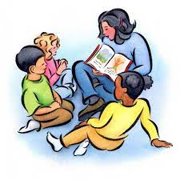
Using Children’s Literature to Teach Economics
Economics has become a component of the social studies curriculum. Research has show that children enter school with an experienced-based knowledge of economics. Educators, faced with a crowded instructional schedule, are combining reading strategies with economic education. They find that integrating a class read aloud that features economic concepts is a time saving teaching strategy.

Slide 9

PART I
Biographies

Slide 10
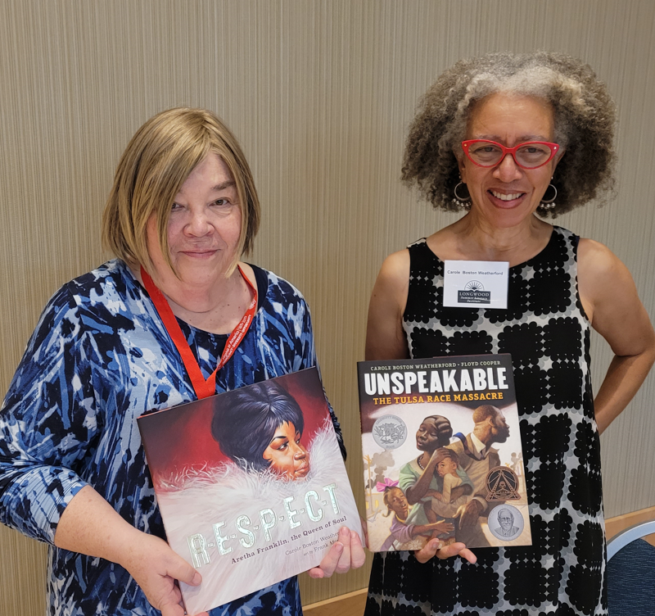

R-E-S-P-E-C-T: Aretha Franklin, the Queen of Soul
by Carole Boston Weatherford
Publisher: Simon & Schuster
Copyright Date: 2020
Reading Level: 2.0
Interest Level: K-3
https://www.youtube.com/watch?v=uF9wqecpwKA
4 minutes

Slide 11
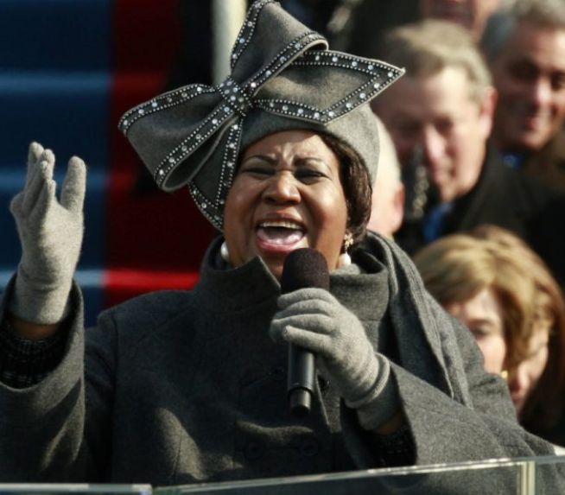
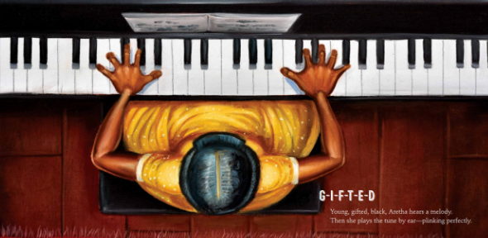
Aretha Franklin
Aretha Franklin’s musical talent was clear from her earliest days when singing in her father’s Detroit church.
Later, her hit songs earned her the title “the Queen of Soul,” multiple Grammy Awards, and a place in the Rock & Roll Hall of Fame. But Aretha didn’t just raise her voice in song; she also spoke out against injustice and fought for civil rights.
March 25, 1942- August 16,2018

Slide 12
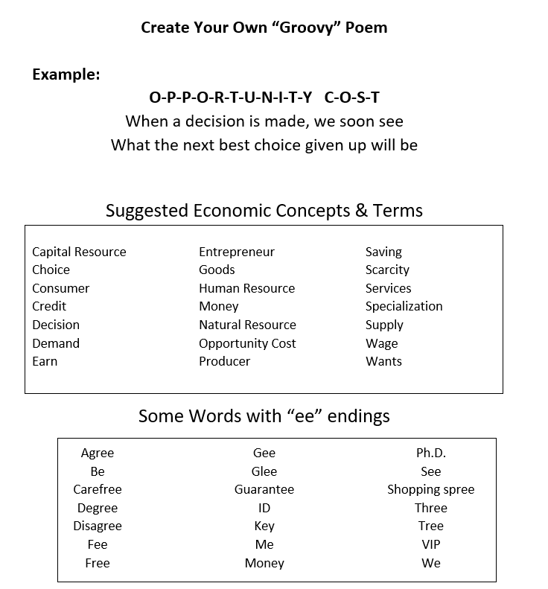
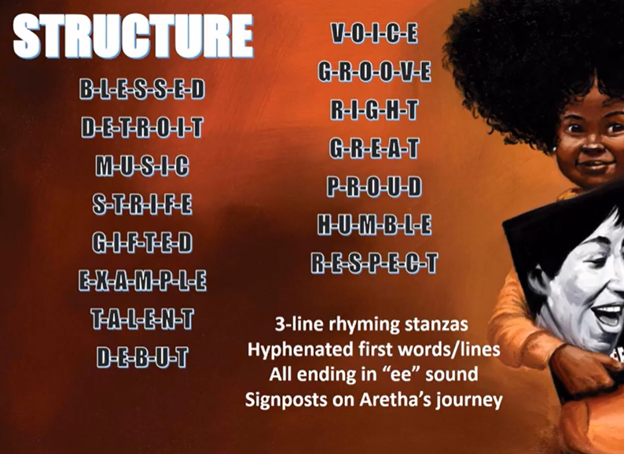

Slide 13
The Secret Garden of
~George Washington Carver~
Story Synopsis: Focusing on the early life of George Washington Carver, rather than his accomplishments as an adult, this biography features the struggles and prejudices he faced on his journey to become a prominent scientist and respected educator.
Publisher: HarperCollins
Copyright Date: 2020
Reading Level: 4.5
Interest Level: K-3
https://www.youtube.com/watch?v=28vSGkGNtkA
12 minutes

Slide 14
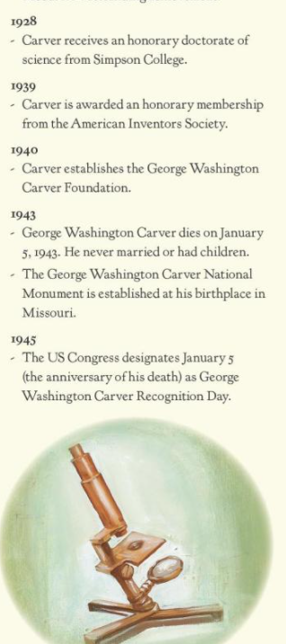
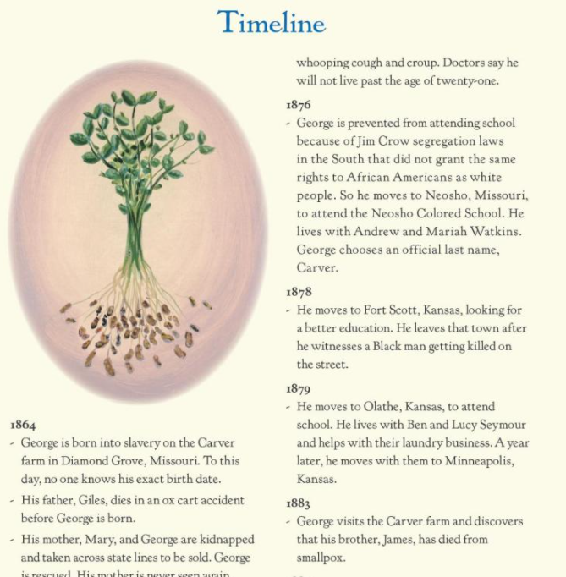

Back Material
Includes:
Timeline
Bibliography
Further Reading

Slide 15
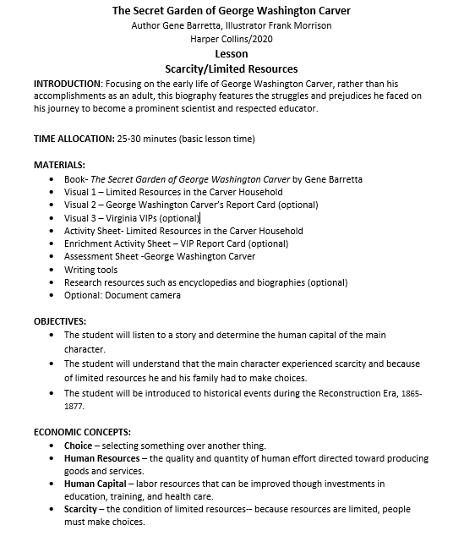
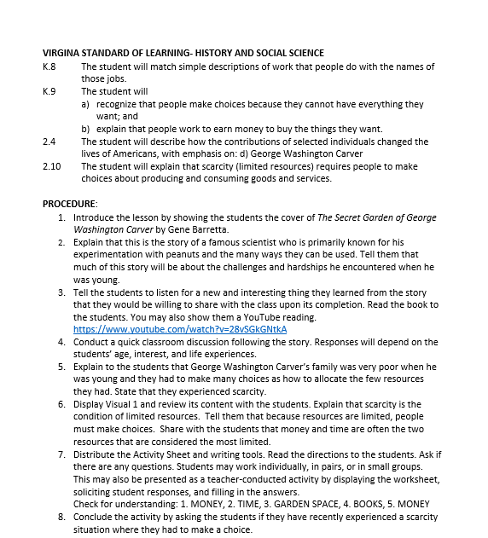
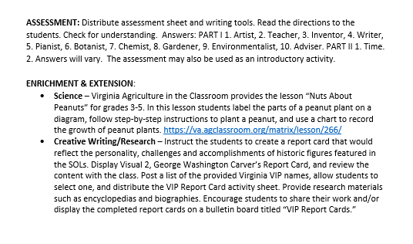
Lesson Plan

Slide 16
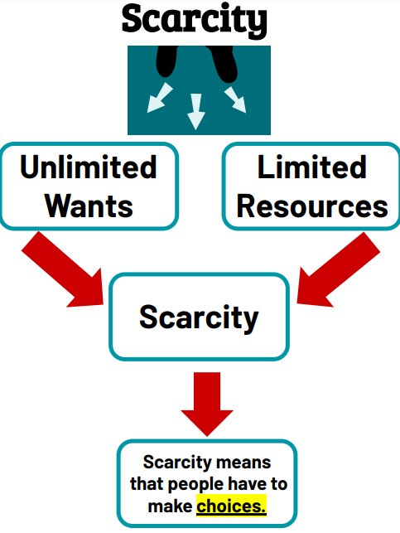
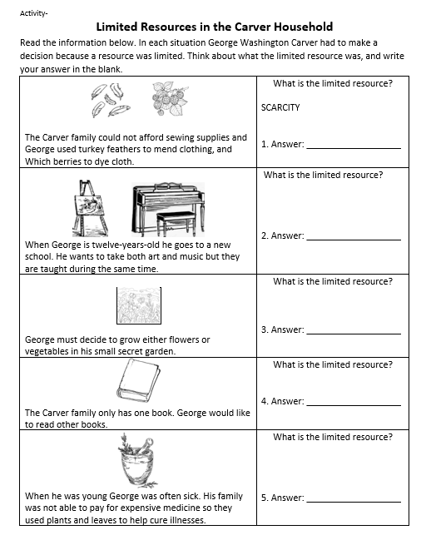
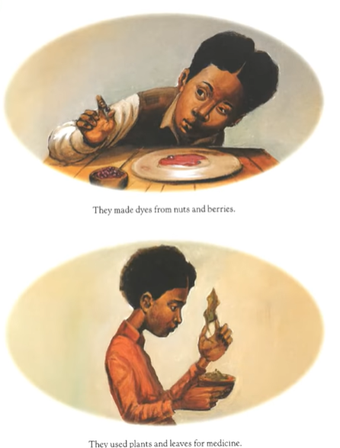
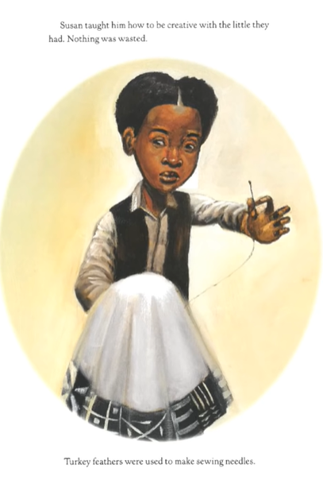


Slide 17
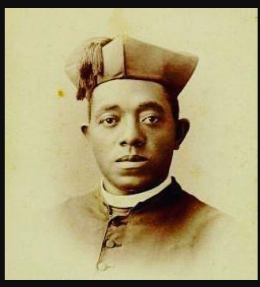
A picture book biography that covers the story of Augustus Jackson (1808-1852), the Black cook who innovated the modern recipe and production of ice cream in the 19th century. Jackson grew up in Pennsylvania and moved to Washington, DC, as a youth to work at the White House.
Publisher: Random House
Copyright Date: 2023
Reading Level: 1.3
Interest Level: K-3

Slide 18
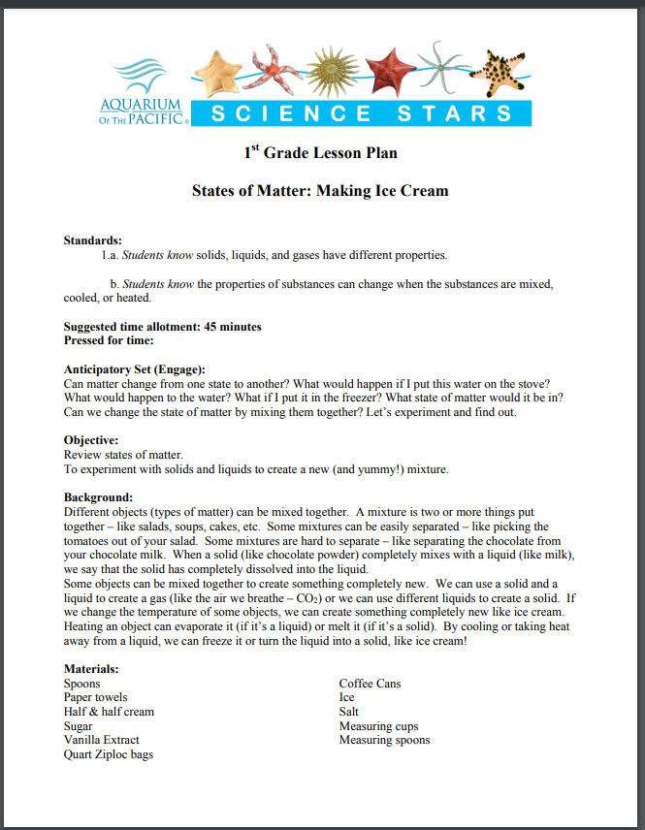
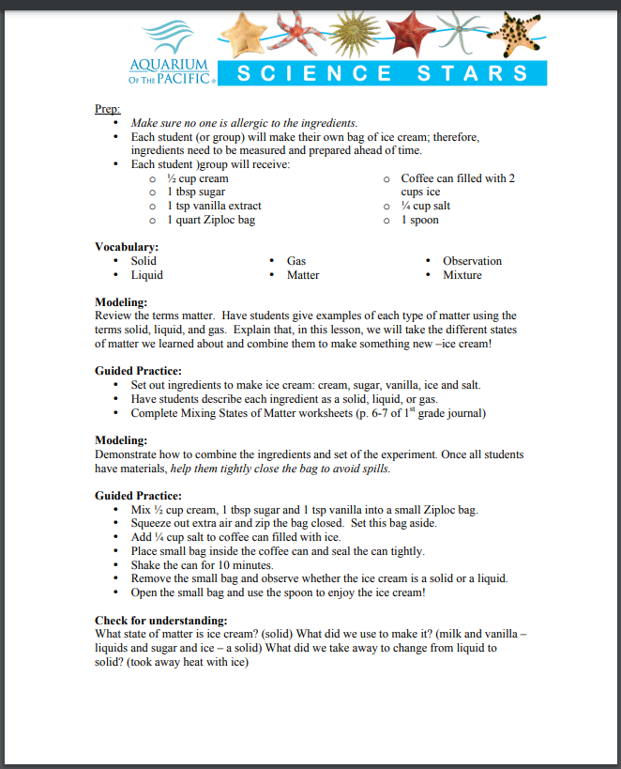
https://www.aquariumofpacific.org/downloads/ed_01SSIceCream.pdf

Slide 19

PART II
Book Series

Slide 20


Wednesday Wilson Gets Down to Business
Story Synopsis: The most important thing to know about Wednesday Wilson is that she's an entrepreneur. She and her best friend, Charlie (Wednesday's future Vice President of Operations), with some help from her little brother, Mister, have made a list of potential businesses. But before they get to move forward on one, there's an unfortunate incident in class with the Emmas (whose last initials happen to spell M.E.A.N.) involving a piece of kale. Maybe this is just the opportunity Wednesday and her friends needed to come up with a brilliant business idea that will save the day and make them millionaires.

Slide 21
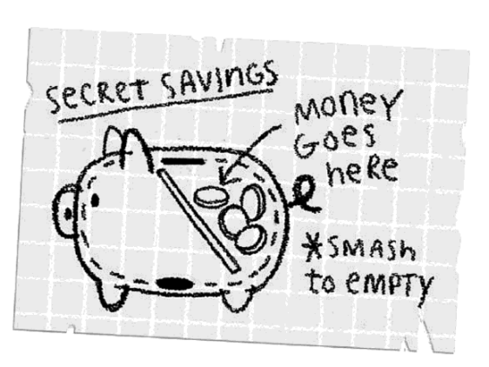
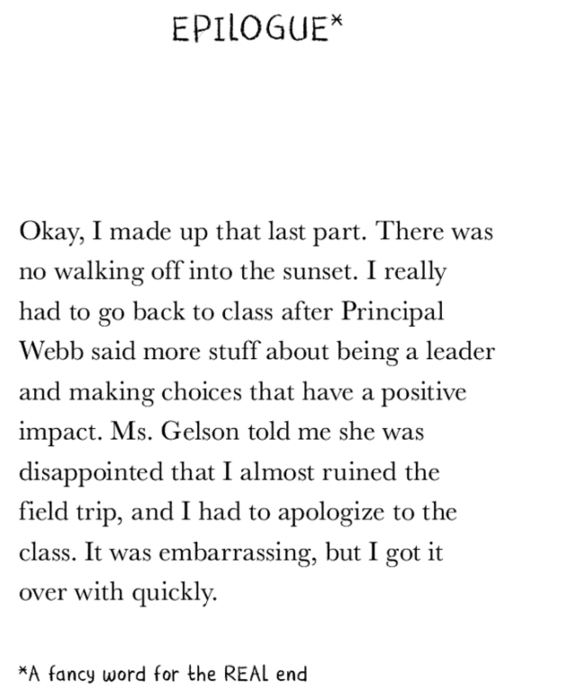
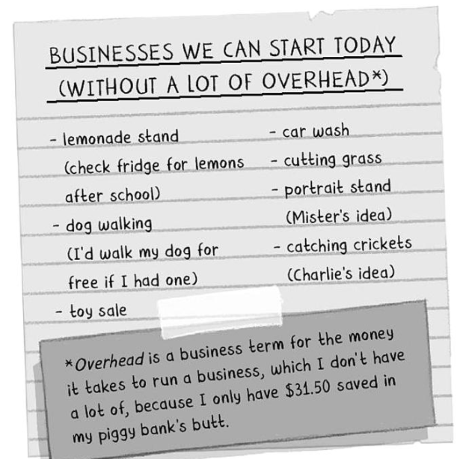

Book Features

Slide 22
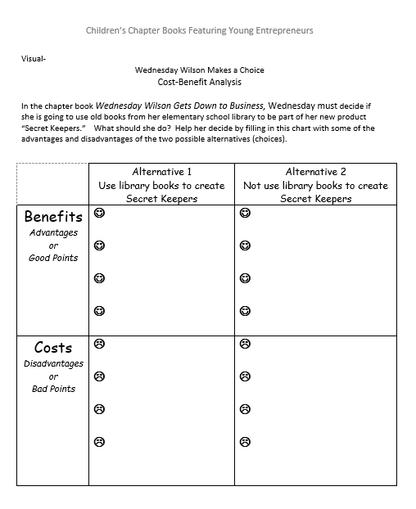
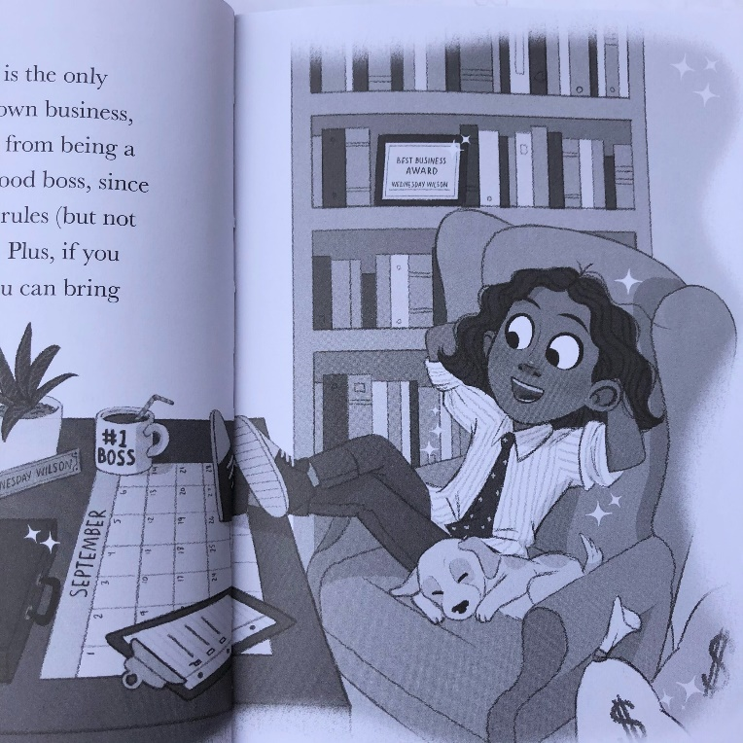

Slide 23
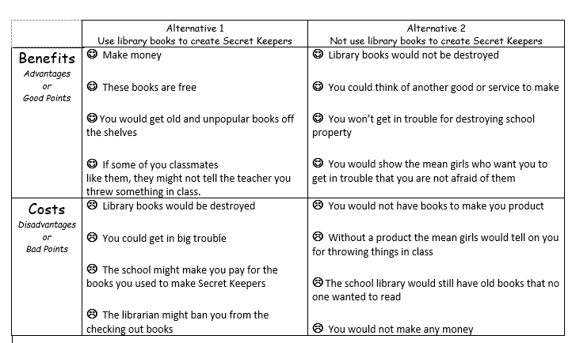
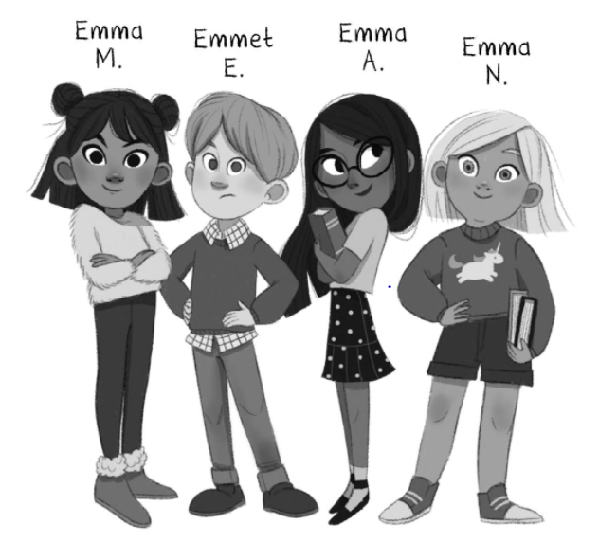
Possible Responses

Slide 24
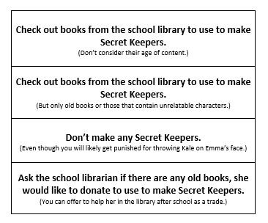

Vote With Your Feet!

Slide 25


J.D. and the Great Barber Battle
Story Synopsis: J.D. has a big problem--it's the night before the start of third grade and his mom has just given him his first and worst home haircut. However, he's a genius with the clippers and styles his own hair. His work makes him the talk of the town and brings him enough hair business to open a barbershop from his bedroom. But when Henry Jr., the owner of the only official local barbershop, realizes he's losing clients to J.D., he tries to shut him down for good.
Publisher: Penguin
Copyright Date: 2021
Reading Level: 3.0
Interest Level: 1-4

Slide 26

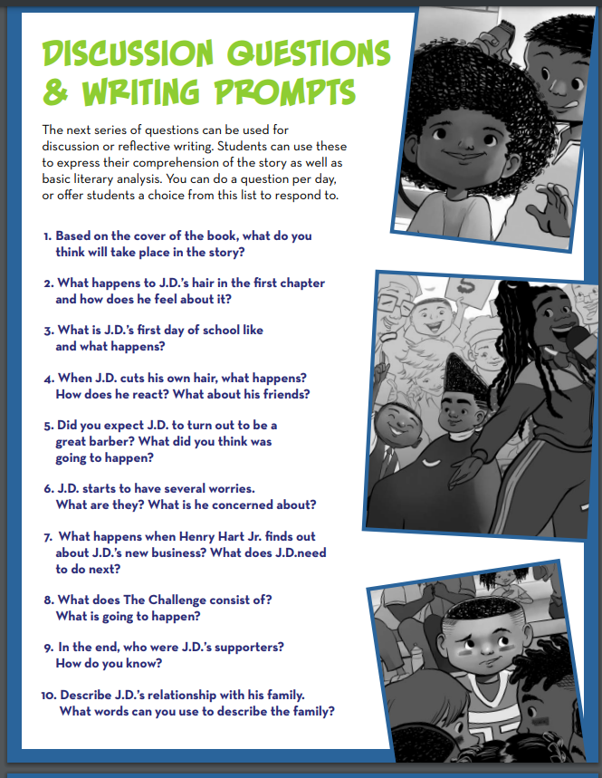
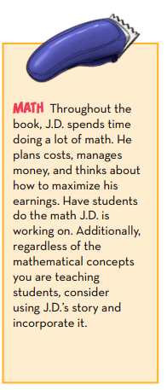
https://storage.googleapis.com/classroom-portal-production/uploads/2021/11/95f7c924-28238_jdbarberbattle_discussionguide_21.pdf
Eleven page Teacher’s Guide from the Publisher

Slide 27
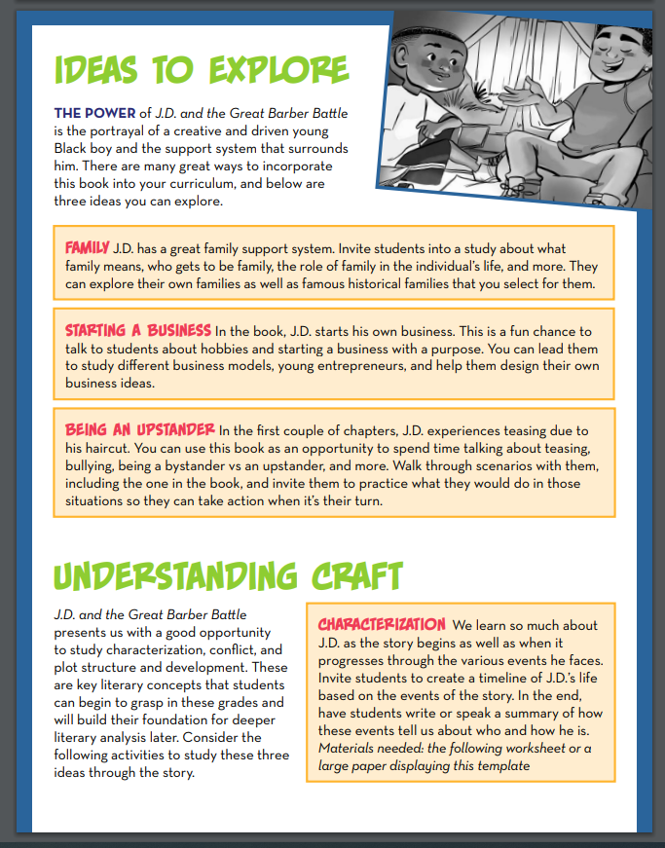
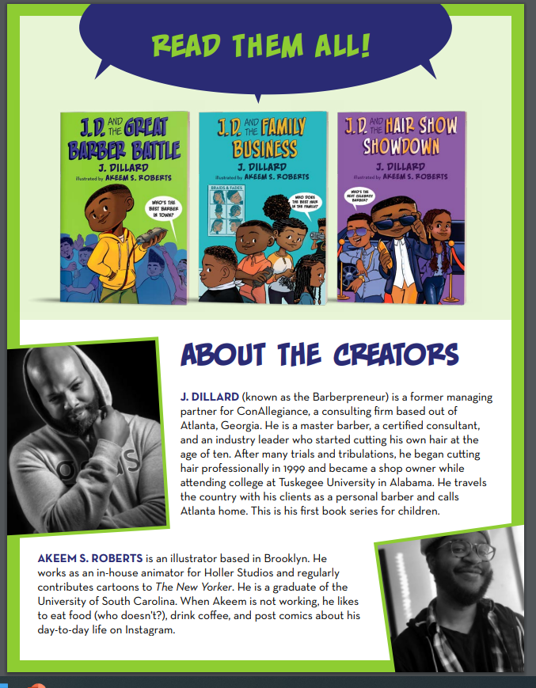

Slide 28
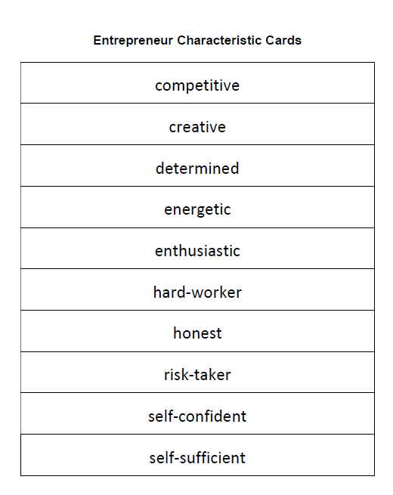
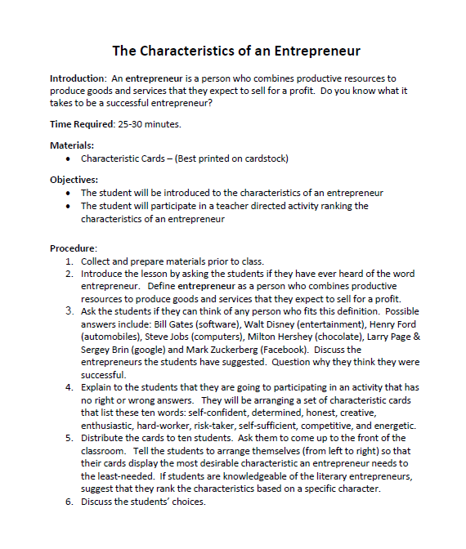

Slide 29

The Bridge Battle
Evan and Jessie Treski have waged a lemonade war, sought justice in a class trial, unmasked a bell thief, and created a professional magic show. Yet for all their skills and talents, both find themselves being singled out this summer for reasons beyond their control. Natural-born leader Evan, who is always good at making new friends, discovers he is at the mercy of a bully on the summer school playground, and is pressured to act in a way he never has before. Science-loving Jessie just wants to construct the best bridge she can for the competition next month, yet she is stuck in the wrong summer camp, surrounded by kids who believe fairies are more real than physics and a group of girls who tortured her back in second grade.
Publisher: Harper Collins Copyright Date: 2022
Reading Level: 4.0
Interest Level: 3-6

Slide 30
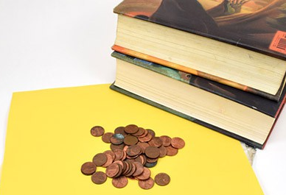
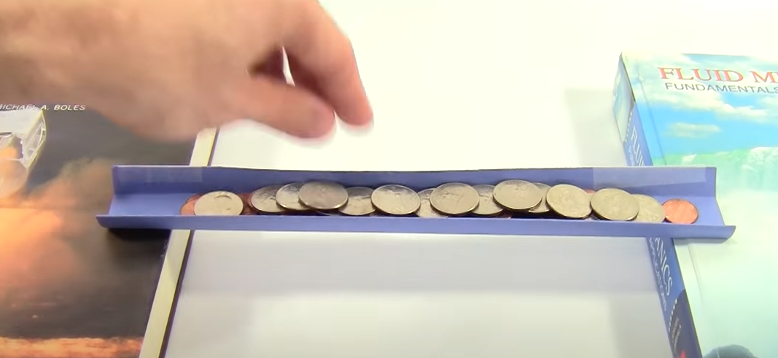
https://www.sciencebuddies.org/teacher-resources/lesson-plans/paper-bridge-design
https://www.youtube.com/watch?v=CqYGVW2Eu6Y

Slide 31

Front Desk
by Kelly Yang
Story Synopsis: It is the early 1990s in Anaheim, California and ten-year-old Mia Tang and her parents are desperate for work and money.
Mia’s parents take a job managing a rundown motel. Exploited by the motel’s owner, the family struggles physically and financially. As her mother -- who was an engineer in China -- does the cleaning, Mia works the front desk and tries to cope with demanding customers and other recent immigrants. Immigrants who are being taken advantage of by Payday lending schemes.
Publisher: Scholastic
Copyright Date: 2019
Reading Level: 4.5
Interest Level: 4-7

Slide 32
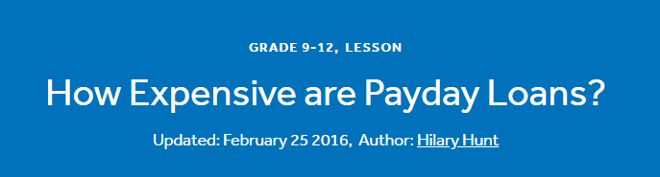
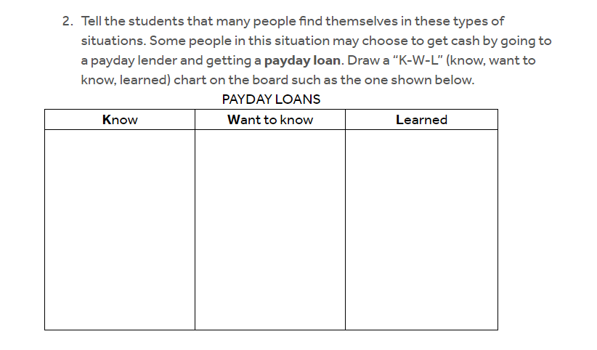
https://www.econedlink.org/resources/how-expensive-are-payday-loans/?view=teacher

Slide 33

PART III
Tales from Around the World

Slide 34
Nya’s Long Walk: A Step at a Time
Story Synopsis: Nya’s little sister becomes sick when they are returning home from their daily journey to the water hole. Nya must find the strength to her and the water back to their village, one step at a time.
Publisher: Houghton Mifflin
Copyright Date: 2019
Reading Level: 2.9
Interest Level: P-2
https://youtu.be/yZvgsh0TLhA
6 minutes

Slide 35




Nya’s Long Walk to Water
Fresh Water Availability Demonstration
With an eyedropper, drop one drop of water from the half-cup onto a small plate. This one drop represents the freshwater that is available for our use. This water is found in rivers and lakes. The rest of the water in the half-cup is deep groundwater, water bound up as soil moisture, biomass water, or water in the atmosphere.

Slide 36

Story Synopsis: Minni lives in the poorest part of Mumbai, where access to water is limited to a few hours a day and the communal taps have long lines. In the high-rise building where she just started to work, she discovers that water streams out of every faucet and there’s even a rooftop swimming pool. She resolves to fight for water equity.
Publisher: Penguin
Copyright Date: 2022
Reading Level: 4.4
Interest Level: 5-9

Slide 37

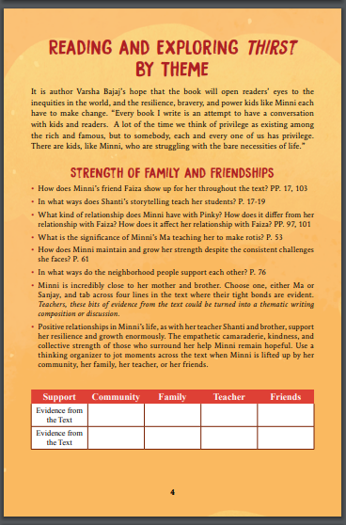
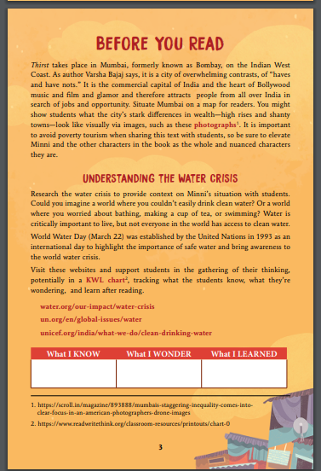
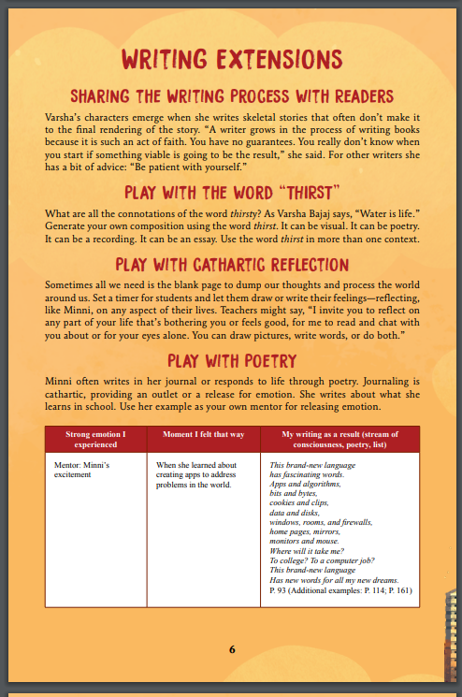
https://www.varshabajaj.com/wp-content/uploads/2022/07/Thirst_Teachers_Guide.pdf

Slide 38

ROOM FOR EVERYONE
Musa and his sister travel to a Zanzibar beach in a shared minibus which, despite Musa's protests, gets loaded with everything from a man and his bicycle to ten swimmers.
Publisher: Simon & Schuster , Inc
Copyright Date: 2021
Reading Level: 4.1
Interest Level: P-2
https://www.youtube.com/watch?v=oFriQcIUheA
Seven Minutes

Slide 39
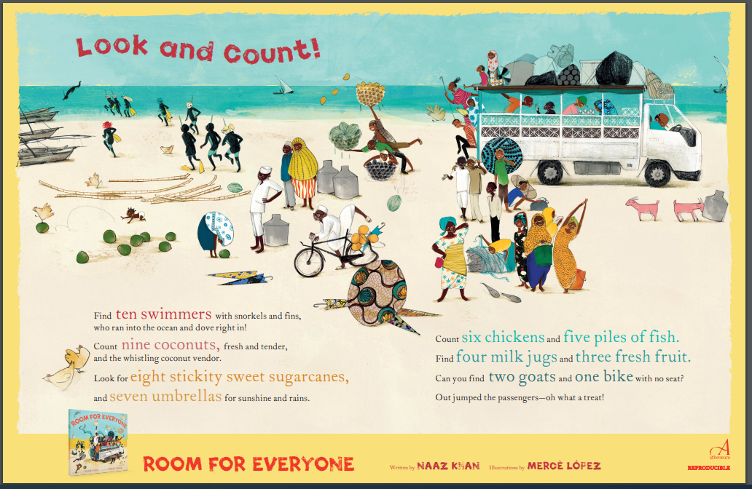

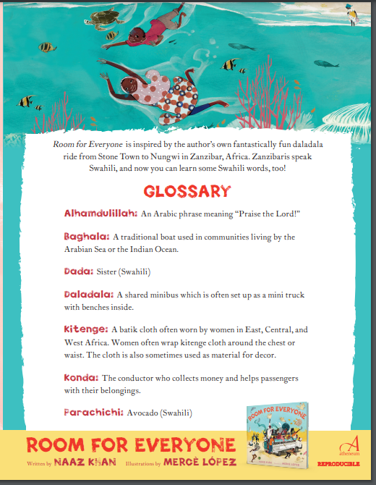
https://d28hgpri8am2if.cloudfront.net/tagged_assets/8573598/9781534431393_as_room%20for%20everyone%20activities.pd
f

Slide 40
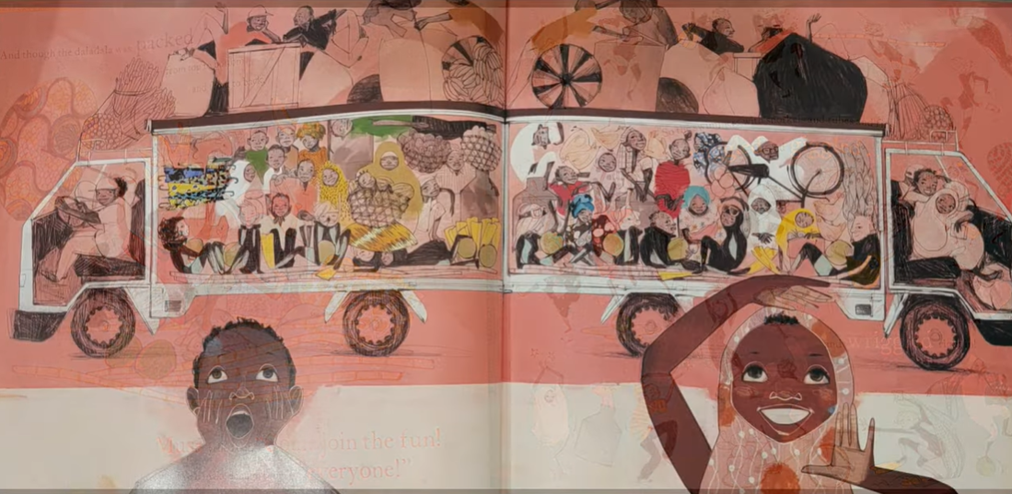
https://www.in.gov/library/files/Program_Guide_2023.pdf

Slide 41
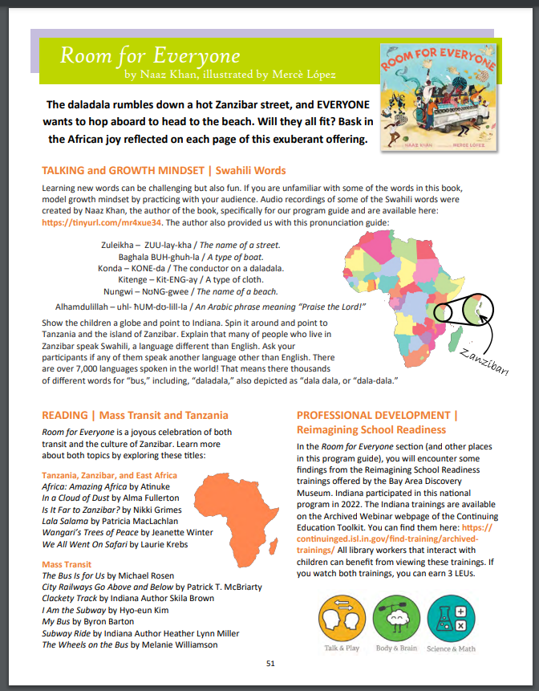



Slide 42



Productive Resources

Slide 43

Assessment Questions
Do you think there is merit in using picture books to teach economics and personal finance in the elementary classroom?
What other subjects could the featured titles be used to teach?
Which one of these titles do you think would work best in either a “one book-one school” program or as a multi-curricular component for a grade level teaching unit?

Slide 44


Slide 45

Invest In Girls

Slide 46

NEC

Slide 47

NPFC

Slide 48

Advocacy

Slide 49

Suggested Presentation Deck
CEE Affiliates
https://www.councilforeconed.org/resources/local-affiliates/
Include your local affiliate page

Slide 50










Thank You to Our Sponsors!

Slide 51
Contact information
Thank You
Lauren H Shifflett shiffllh@jmu.edu
Lynne F Stover stoverlf@jmu.edu

