Slide 1

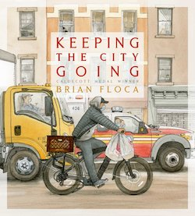
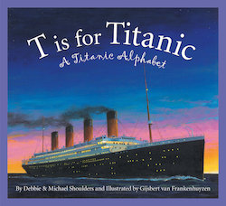
May 25, 2023
Lauren Shifflett shiffllh@jmu.edu
Lynne Stover stoverlf@jmu.edu
Using Children’s Literature to Teach Economics
Session IV
The Power of Storytelling:
The Titanic, The Great Depression,
and Pandemics

Slide 2
EconEdLink Membership
You can now access CEE’s professional development webinars directly on EconEdLink.org! To receive these new professional development benefits, become an EconEdLink member. As a member, you will now be able to:
Automatically receive a professional development certificate via e-mail within 24 hours after viewing any webinar for a minimum of 45 minutes
Register for upcoming webinars with a simple one-click process
Easily download presentations, lesson plan materials and activities for each webinar
Search and view all webinars at your convenience
Save webinars to your EconEdLink dashboard for easy access to the event
Access our new Professional Development page here

Slide 3
Professional Development Opportunities
To earn professional development credit for CEE webinars found on EconEdLink, you must:
Watch a minimum of 45-minutes and you will automatically receive a professional development certificate via e-mail within 24 hours.
Attendees can learn how much credit they will earn per workshop.
Accessing resources:
You can now easily download presentations, lesson plan materials, and activities for each webinar from EconEdLink.org/professional-development/
Local resources:
Insert your local professional development opportunities (if applicable)

Slide 4
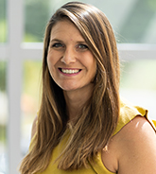
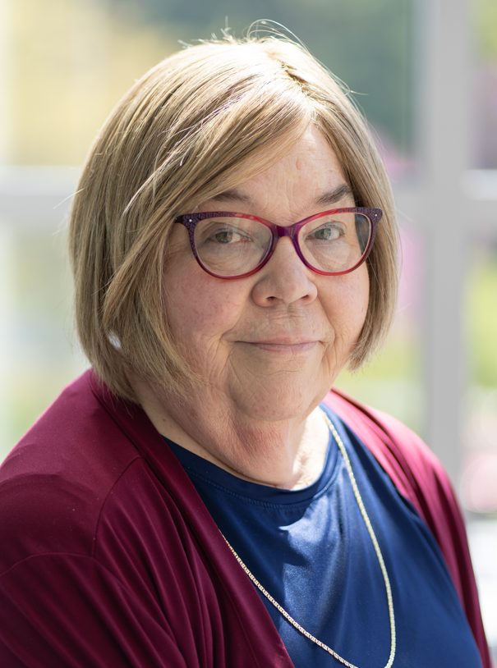
Presenters
Lauren Hensley Shifflett is the new Associate Director at the James Madison University Center for Economic Education. Prior to joining the Center, she spent twelve years in early elementary education where she enjoyed prospering young minds as a classroom teacher. Lauren became nationally known as an elementary economic educator when she received the John Morton Award of the national Council for Economic Education in 2021. Her love for economics guides her lessons to prepare students for life.
shiffllh@jmu.edu
Lynne Farrell Stover is currently a Teacher Consultant at the James Madison University Center for Economic Education. Prior to this, she spent thirty-three years in public education where she enjoyed various teaching assignments including classroom teacher, gifted education specialist, and librarian. She is the author of over fifty educational articles and eight teacher resource books. She is the recipient of the 2022 NAEE Platinum Curriculum Award for her lessons developed for Virginia’s Reading Makes Cents Program.
stoverlf@jmu.edu

Slide 5
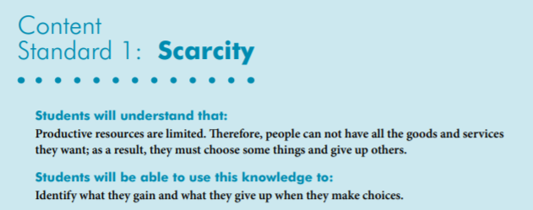

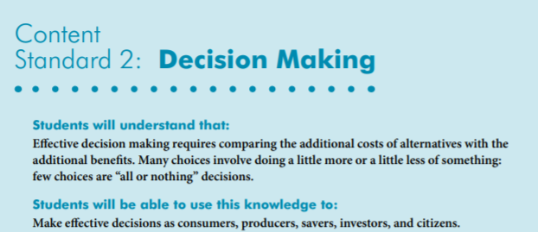
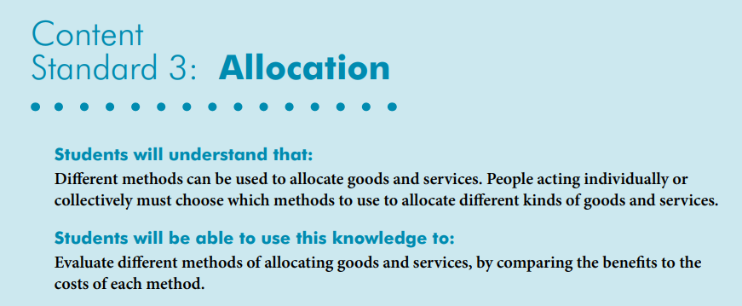
National Content Standards
https://www.councilforeconed.org/wp-content/uploads/2012/03/voluntary-national-content-standards-2010.pdf

Slide 6

Agenda
Introduction [5 mins.]
Review information concerning the power of storytelling. [5 mins.]
Examine related children’s books and review lessons and activities based on the featured titles. [45 mins.]
Conclude with discussion questions, book list review, and webinar survey [5 mins.]

Slide 7
Objectives
In this webinar teachers will:
Explore the concept of the value of using children’s literature to teach in the content areas with an emphasis on social studies.
Relate the concepts of scarcity, choices, opportunity cost, incentives, and decision-making as they pertain to the featured titles.
Consider the cross curricular possibilities of the topic as related to the social sciences and creative problem solving.
Recognize the value of the social commentary featured in the session’s topic.
Review an annotated bibliography listing topical titles.

Slide 8
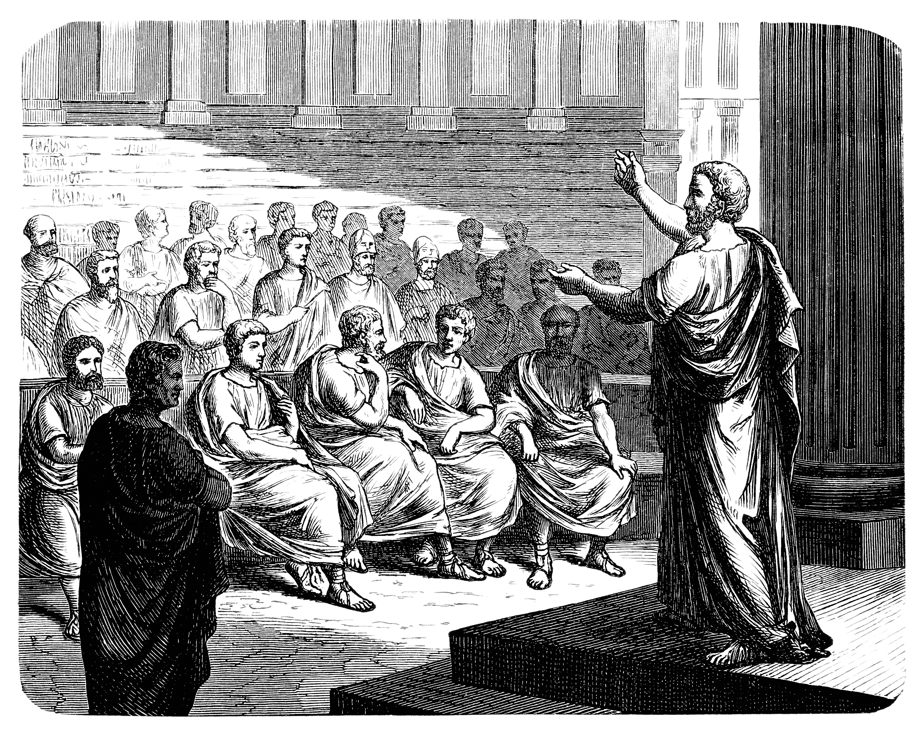
Storytelling is the oldest form of education.
Stories are told in all cultures as a way of passing down traditions, sharing ideas, and learning about history.
Stories can take us on terrific journeys as we learn about other people, different worlds, and incredible situations.

Slide 9

PART I
The Great Depression
In the United States, the Great Depression took place from 1929 to 1941 when the economy was not working.
Banks failed, people were out of work and lost their homes and farms. The Great Depression was worldwide, although it hit the USA the hardest and the longest.

Slide 10
HOME IN THE WOODS
Six-year-old Marvel along with her mother and seven siblings, are homeless after the death of her father during the Great Depression. They move to a deserted tarpaper shack in the woods and, over the course of a year, turn it into a home. Based on the author's grandmother's childhood; includes historical notes.
Publisher: Nancy Paulsen Books
Copyright Date: 2019
Reading Level: 3.5
Interest Level: K-3
https://www.youtube.com/watch?v=cLblAHx1tLQ

Slide 11
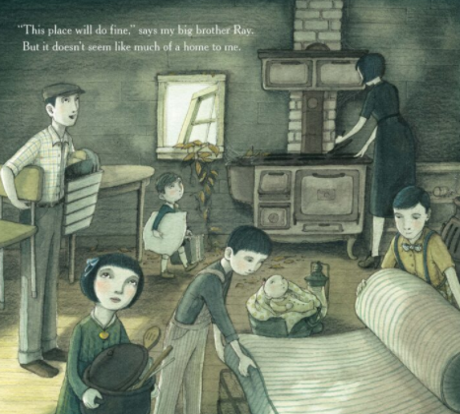
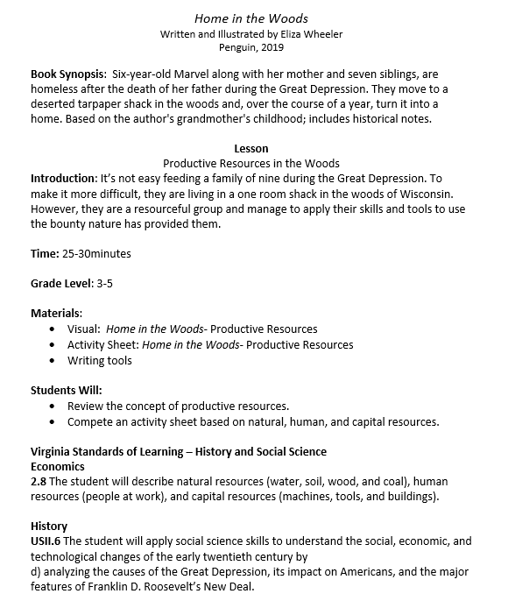
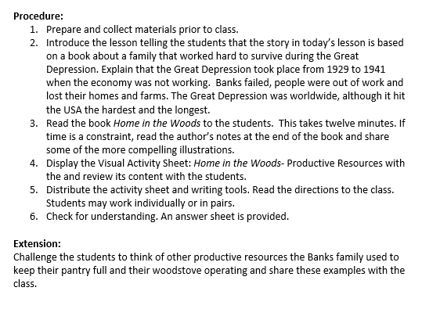
HOME IN THE WOODS

Slide 12
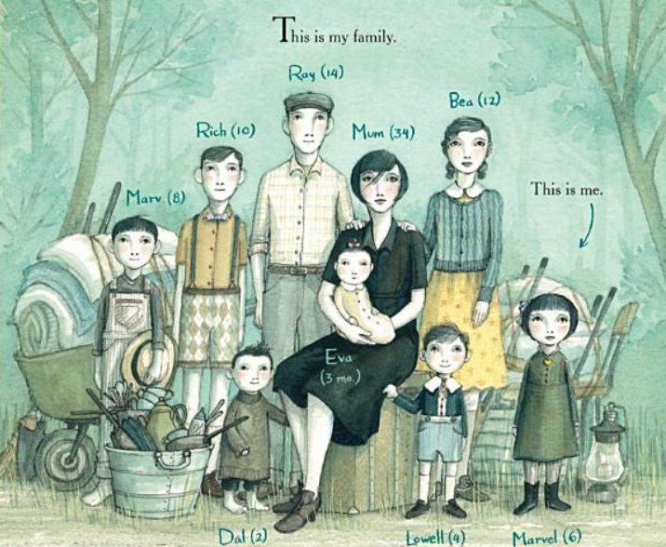
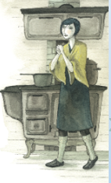
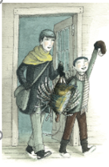
Human Resources – the quality and quantity of human effort directed toward producing goods and services.

Slide 13
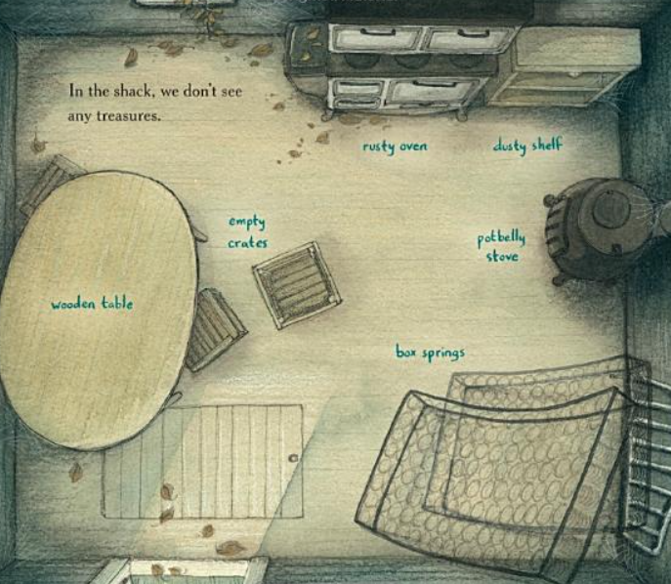
Capital Resources – things used in the production of other goods. Examples include buildings, equipment, vehicles, and tools.

Slide 14
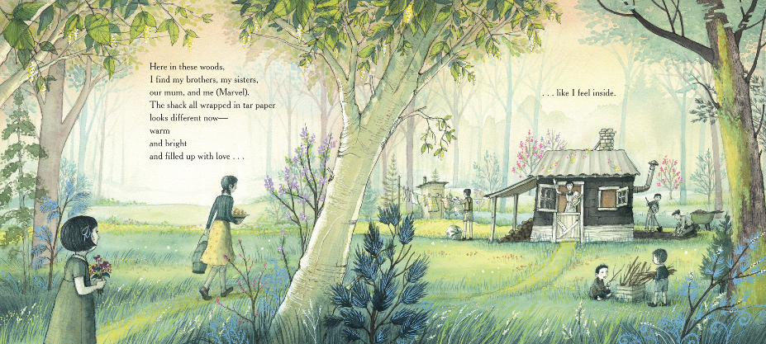
Natural Resources – the gifts of nature that are used to produce goods and services including land, timber, fish, oil, and mineral deposits.

Slide 15
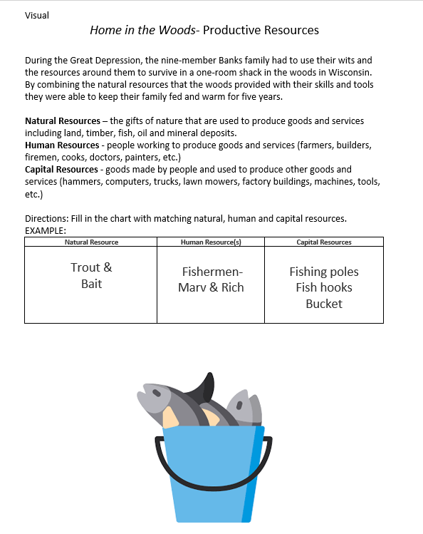
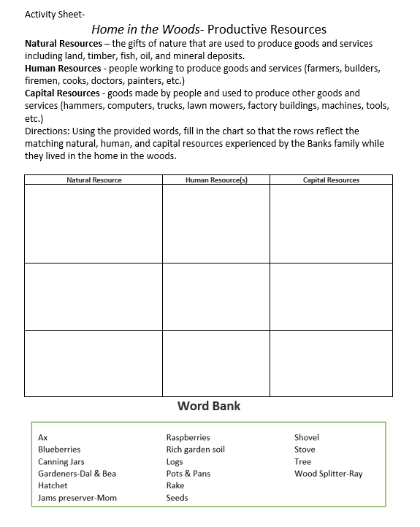

HOME IN THE WOODS

Slide 16

Esperanza Rising
When her father dies, thirteen-year-old Esperanza and her mother are forced to leave their life of wealth and privilege in Mexico to go work in the labor camps of Southern California. There they must adapt to the harsh circumstances facing Mexican farm workers on during the Great Depression.
Publisher: Scholastic
Copyright Date: 2000
Reading Level: 5.3
Interest Level: 5-9

Slide 17
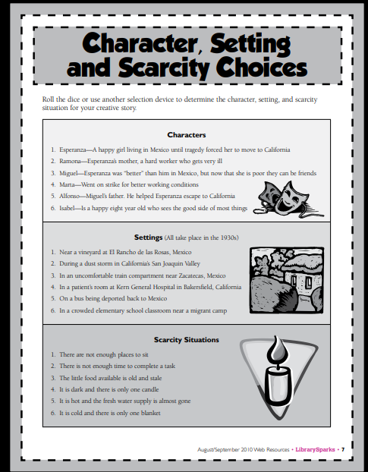
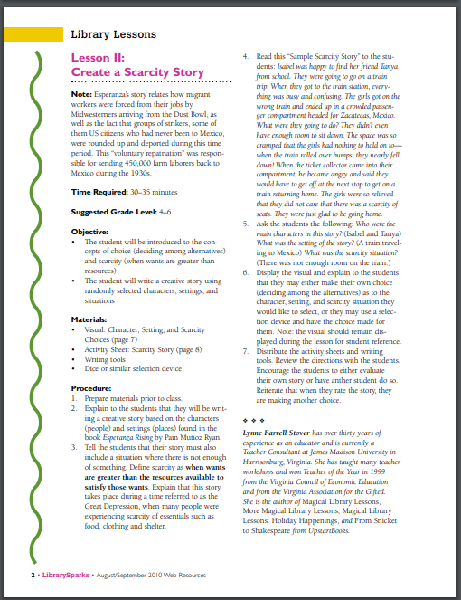
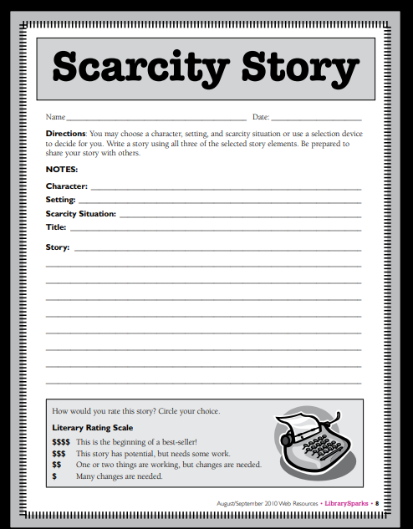
http://librarysparks.com/wp-content/uploads/2016/06/lsp_augsept10_ll_naomiespera.pdf

Slide 18
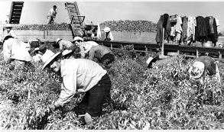
Note: Esperanza's struggles are easily relatable to today’s current events.
The story relates how migrant workers are forced from their jobs by
Midwesterners arriving from the Dust Bowl.
Also groups of strikers, some of them US citizens who had
never been to Mexico, are rounded up and deported.
This “voluntary repatriation” was responsible for
sending 450,000 farm laborers back to Mexico during the 1930s.

Slide 19

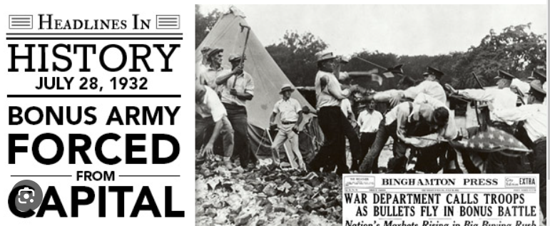
Hot Off the Presses!
When Bea’s father abandons her and her little sister in a Virginia barn during the Great Depression, she uses her skills and cunning to find a new home.
What New Things We Learned from the Story
In May 1932, jobless WWI veterans organized a group called the “Bonus Expeditionary Forces” to march on Washington, DC. Their goal was to get the bonus payment now, when they really needed the money. It did not go well.
Publisher: HarperCollins Copyright Date: 2023
Reading Level: 6.0
Interest Level: 5-9

Slide 20
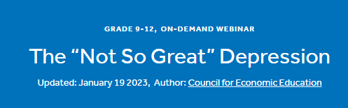
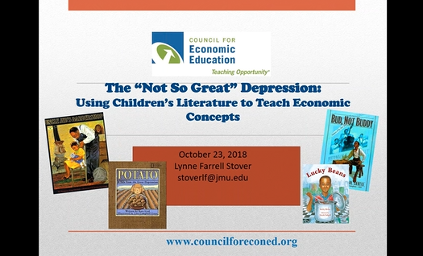

For more content on this topic visit….
https://www.econedlink.org/webinar/the-not-so-great-depression/

Slide 21

PART II
Pandemics
Cholera, bubonic plague, smallpox, and influenza are some of the most brutal killers in human history. When outbreaks of these diseases cross international borders they are properly defined as a pandemic. This is especially true with smallpox, which throughout history, has killed between 300-500 million people in its 12,000 year existence.

Slide 22
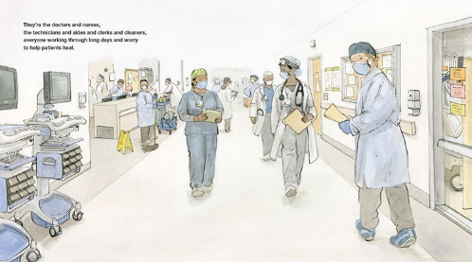
Keeping the City Going
Story Synopsis:. New York City is experiencing a pandemic and once busy streets are mostly empty. Thankfully there are still those doing their necessary jobs. These are the essential workers keeping us safe and healthy. They make sure our mail is delivered and the grocery stores’ shelves are stocked.
Publisher: Atheneum
Copyright Date: 2021
Reading Level: 2.0
Interest Level: PK-2
https://www.youtube.com/watch?v=qkv52VAFbBk
Starred Review ALA Booklist
Starred Review for Kirkus Reviews
Starred Review for Publishers Weekly

Slide 23
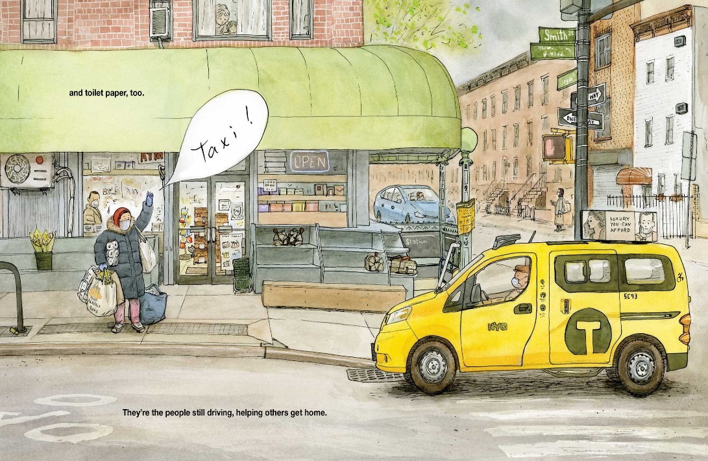

Keeping the City Going
Featuring the concepts of…
Allocation of limited resources
Capital resources
Human capital
Interdependence
Scarcity
Specialization

Slide 24
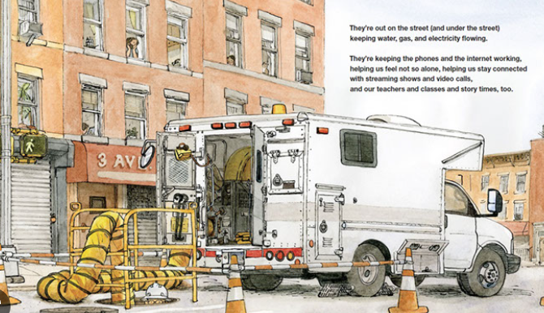
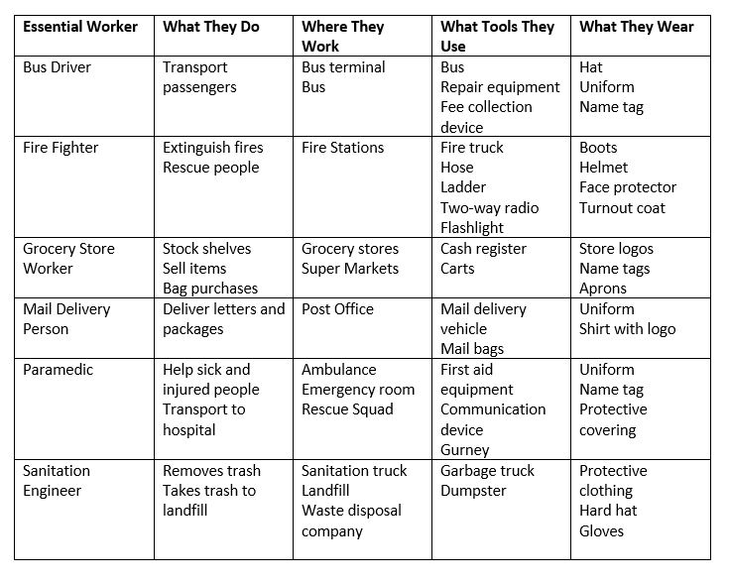
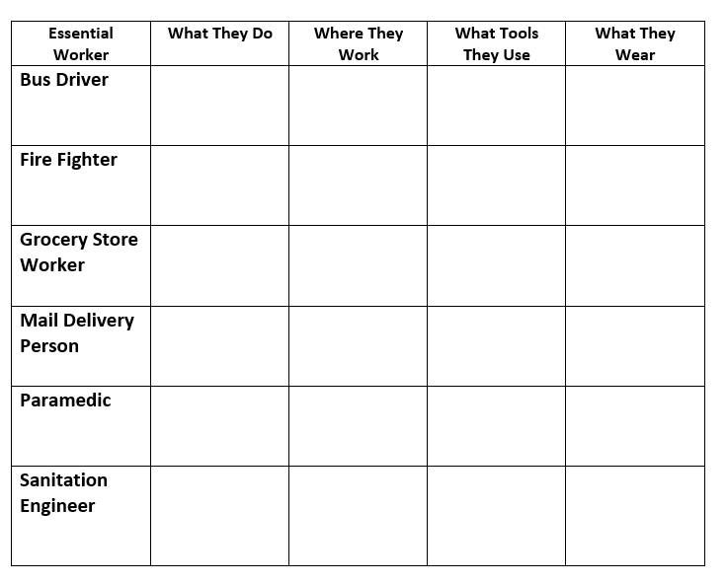

Slide 25
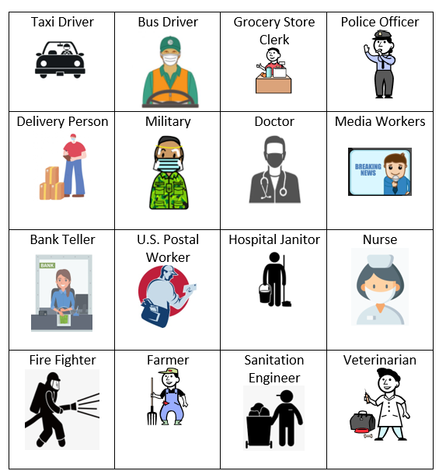
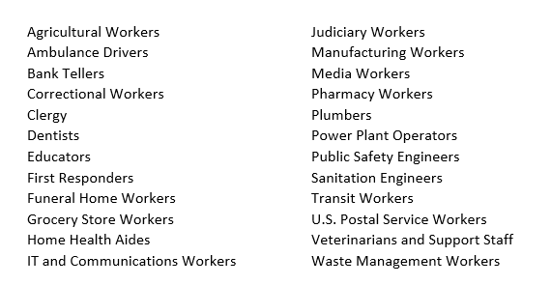
Essential Worker Activity Cards & Job List

Slide 26
Possible Essential Workers Cards Activities
Categories: Provide small groups of students with a set of the Essential Workers Cards and instruct them to create categories into which to sort the workers. Some suggestions might be outside jobs/inside jobs, safety related jobs/comfort related jobs or dangerous jobs/peaceful jobs. Encourage them to share their sorting ideas with the class.
Compare/Contrast: Turn multiple sets of Essential Workers Cards face down on a table. Instruct students to select two of these cards. They are to return to their seats and list five ways the workers on the cards are the same and five ways they are different. Encourage students to share their results with the class.
Poetry: Allow the students to select one of the Worker Cards or select a worker from the Job List. Instruct them to write an acrostic poem using the word on their card. (In an acrostic poem the first letter of a selected word is the beginning of each line of the poem.) They may wish to illustrate their poem.
Ranking: Students use their knowledge of the essential workers depicted on the cards to rank them in a specific order. Allow students to compare their selections and discuss their decisions for card ranking. Possible categories include:
  Most Dangerous to Least Dangerous
  Most Appreciated to Least Appreciated
  Most Contact with People to Least Contact with People
  Most Helpful to the Environment to Least Helpful to the Environment

Slide 27

Hot Off the Presses!
Knox works to keep his family together as they move from Hong Kong back to northern California during the initial outbreak of the coronavirus.
Publisher: Simon & Schuster Copyright Date: 2022
Reading Level: 4.1
Interest Level: 4-7
What New Things We Learned from the Story
ICEE: interrupt, correct, educate, echo.

Slide 28
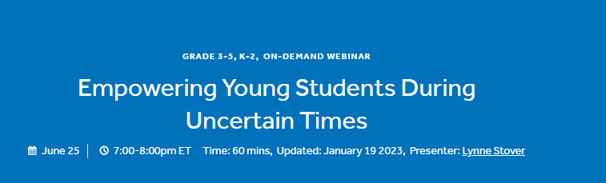
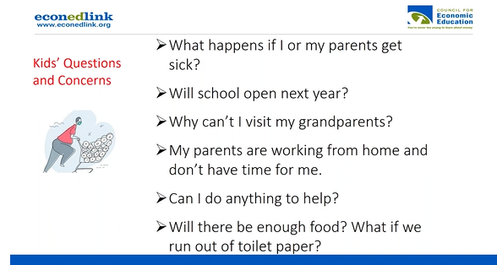
For more content on this topic visit….
https://www.econedlink.org/webinar/empowering-young-students-during-uncertain-times/

Slide 29


PART III
The Titanic
On April 10, 1912, the R.M.S. Titanic left its port in Southampton, England, and began the transatlantic journey to New York City in the United States.. On April 15, Titanic sank in just over two and a half hours after colliding with an iceberg. Of the 2,240 passengers and crew on board, more than 1,500 lost their lives in the disaster.

Slide 30
T is for Titanic: A Titanic Alphabet
T is for Titanic, sifts through the stories, documents, and artifacts surrounding the famous ship, giving a you-are-there view to one of the greatest disaster stories.
Publisher: Sleeping Bear
Copyright Date: 2011
Reading Level: 7.4
Interest Level: 2-5

Slide 31
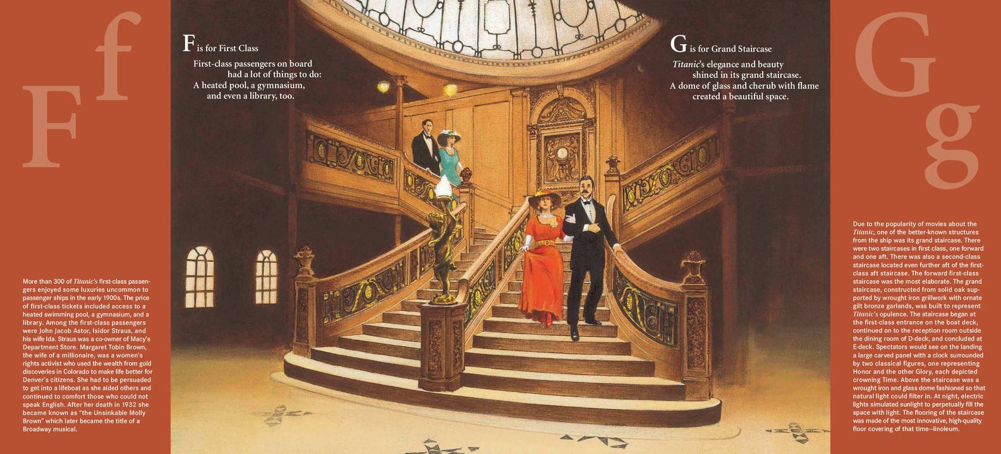
T is for Titanic: A Titanic Alphabet

Slide 32
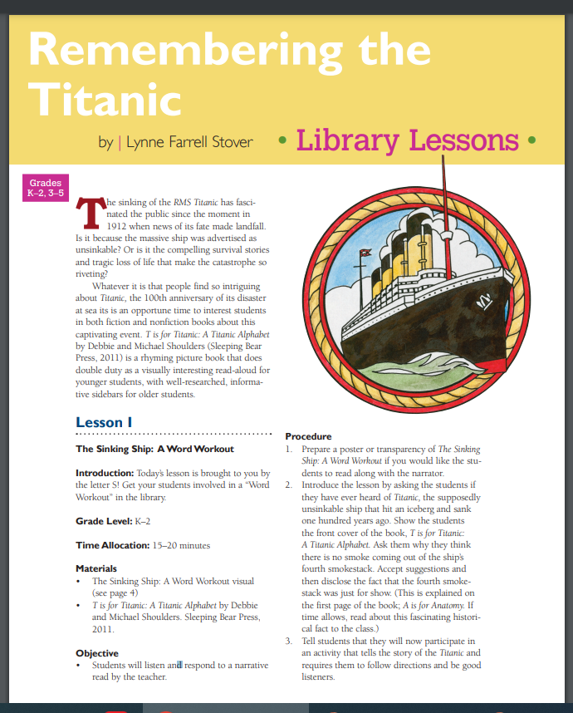
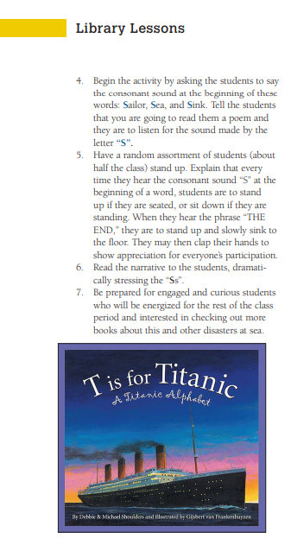
https://www.librarysparks.com/wp-content/uploads/2016/06/lsp_mar12_ll_titanic.pdf

Slide 33
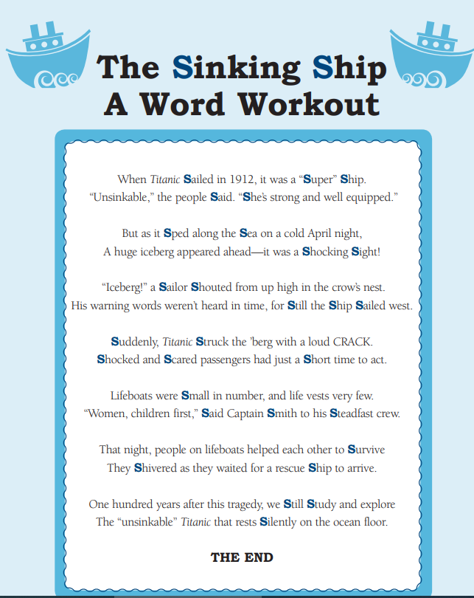

Slide 34
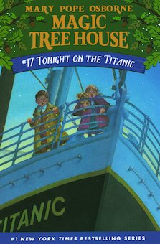
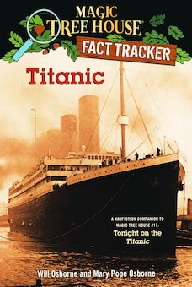
Magic Tree House: Tonight on the Titanic
The magic tree house transports Jack and Annie to the deck of the Titanic to find a mysterious gift that will free a small dog from a magic spell.
Publisher: Random House Copyright Date: 1999
Reading Level: 3.1
Interest Level: 2-5

Slide 35

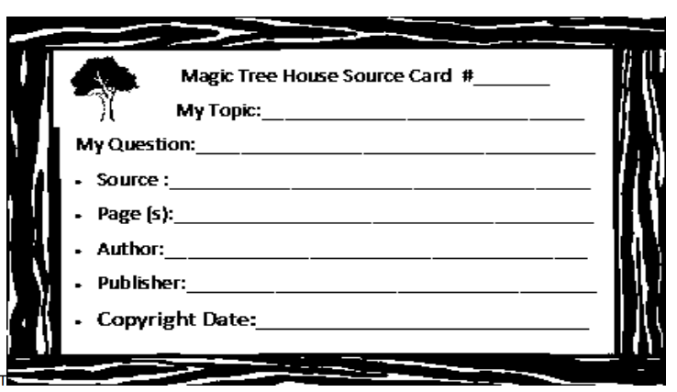
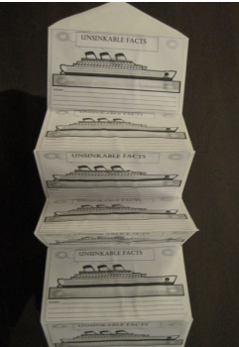
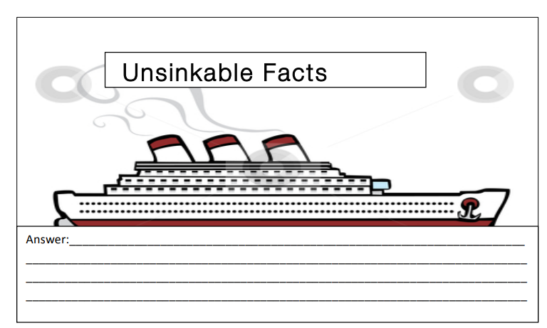
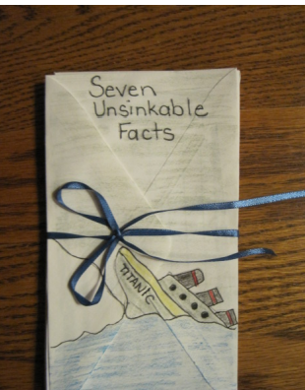
https://www.mthclassroomadventures.org/search-resources/lesson-plans?akID%5B136%5D%5Bvalue%5D=Tonight%20on%20the%20Titanic

Slide 36
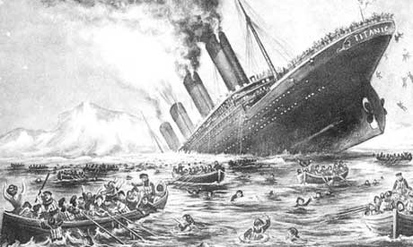
Why Did the Titanic Sink?
What Do You Think?
The Titanic was thought to be unsinkable.
How could this disaster have happened?
Was one person responsible?

Slide 37
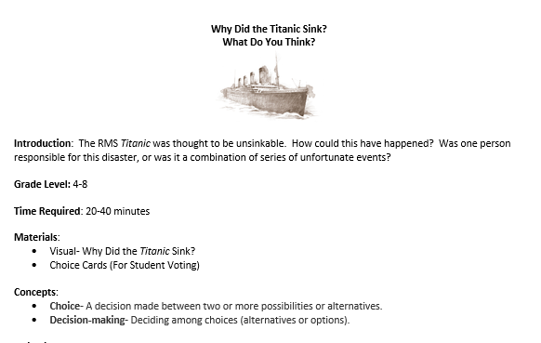

Slide 38
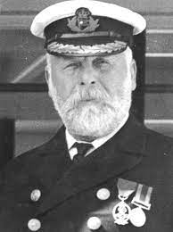
It was Captain Smith’s fault
This was Captain E.J. Smith's retirement trip. All he had to do was get to New York in record time. Captain E.J. Smith said years before the Titanic's voyage, "I cannot imagine any condition which would cause a ship to founder. Modern shipbuilding has gone beyond that.”
Captain Smith ignored seven iceberg warnings from his crew and other ships. If he had called for the ship to slow down then maybe the Titanic disaster would not have happened.

Slide 39
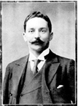
It was Bruce Ismay’s Fault
Bruce Ismay was the managing director of the White Star Line and
he was aboard the Titanic. Competition for Atlantic passengers was fierce
and the White Star Line wanted to show that they could make a six-day crossing.
To meet this schedule the Titanic could not afford to slow down.
It is believed that Ismay put pressure on Captain Smith to maintain the speed of the ship.

Slide 40
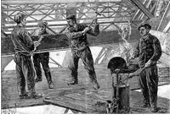
It was the Shipbuilder’s fault
About three million rivets were used to hold the sections of the Titanic together.
Some rivets have been recovered from the wreck and analysed.
The findings show that they were made of sub-standard iron.
When the ship hit the iceberg, the force of the impact caused the heads of
the rivets to break and the sections of the Titanic to come apart.
If good quality iron rivets had been used the sections may have stayed together
and the ship may not have sunk.

Slide 41

It was Thomas Andrew’s fault
Thomas Andrews was the naval architect in charge of the plans for the Titanic. The belief that the ship was unsinkable was, in part, due to the fact that the Titanic had sixteen watertight compartments. However, the compartments did not reach as high as they should have done.
The White Star Line did not want them to go all the way up because this would have reduced living space in first class. If Mr Andrews had insisted on making them the correct height then maybe the Titanic would not have sunk.

Slide 42
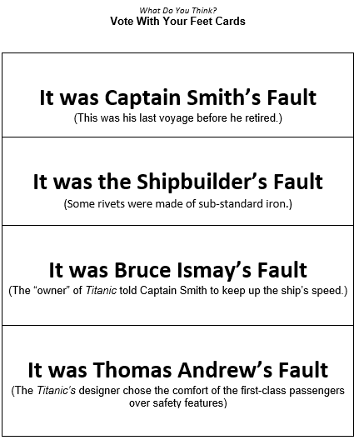

VOTE WITH YOUR FEET

Slide 43



For more content on this topic visit….

Slide 44

Hot Off the Presses!
Twelve-year-old Hazel Rothbury stows away aboard the Titanic and, with the help of a porter named Charlie and a first-class passenger named Sylvia, she sets out to explore the great ship, uncovering a haunting mystery--until the ship hits an iceberg and she must fight to save herself and her friends.
Publisher: Scholastic Copyright Date: 2023
Reading Level: 5.1
Interest Level: 4-7
What New Things We Learned from the Story
There was a fire aboard Titanic in coal bunker #5 during much of her voyage. Such fires, which often started spontaneously, were not unusual in coal-fired ships. They weren’t blazing fires but masses of smoldering coal and they were dealt with by shoveling the smoldering material into the furnaces.

Slide 45

Assessment Questions
Of the three topics, The Great Depression, the COVID Pandemic, and the sinking of the RMS Titanic, which one do you think was the most “unfair” as to a person’s financial status?
Why do some historians believe the sinking of the RMS Titanic continues to fascinate people?
How did scarcity play a part in each of the three topics?

Slide 46


Slide 47

Invest In Girls

Slide 48

NEC

Slide 49

NPFC

Slide 50

Advocacy

Slide 51

Suggested Presentation Deck
CEE Affiliates
https://www.councilforeconed.org/resources/local-affiliates/
Include your local affiliate page

Slide 52











Thank You to Our Sponsors!
52

Slide 53
Contact information
Lynne F Stover stoverlf@jmu.edu
Lauren H Shifflett shiffllh@jmu.edu
Thank You

