Slide 1
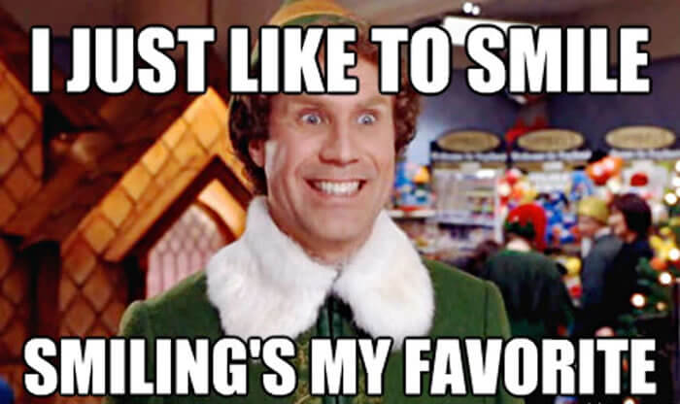
Who am i

Slide 2
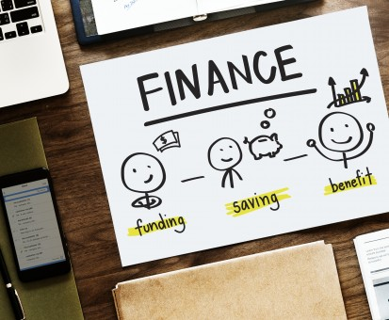
AGENDA
Some depressing facts- clarion call
WHAT IS BEHAVIORAL ECONOMICS
WHAT ARE BIASES (errors that we make)- THAT STAND IN OUR WAY
PERILS OF MAKING BAD DECISIONS
Please MAKE SURE TO TALK ABOUT SOLUTIONS

Slide 3

Stuff they don’t tell
you about MONEY
50%
of parents say they
don’t feel comfortable talking to their children about finances.
Source: T. Rowe Price
TAKE PERSONAL FINANCE.
Notes:
To customize, please click File > Make a Copy. That copy is then yours to modify freely. From ngpf.org/refer

Slide 4
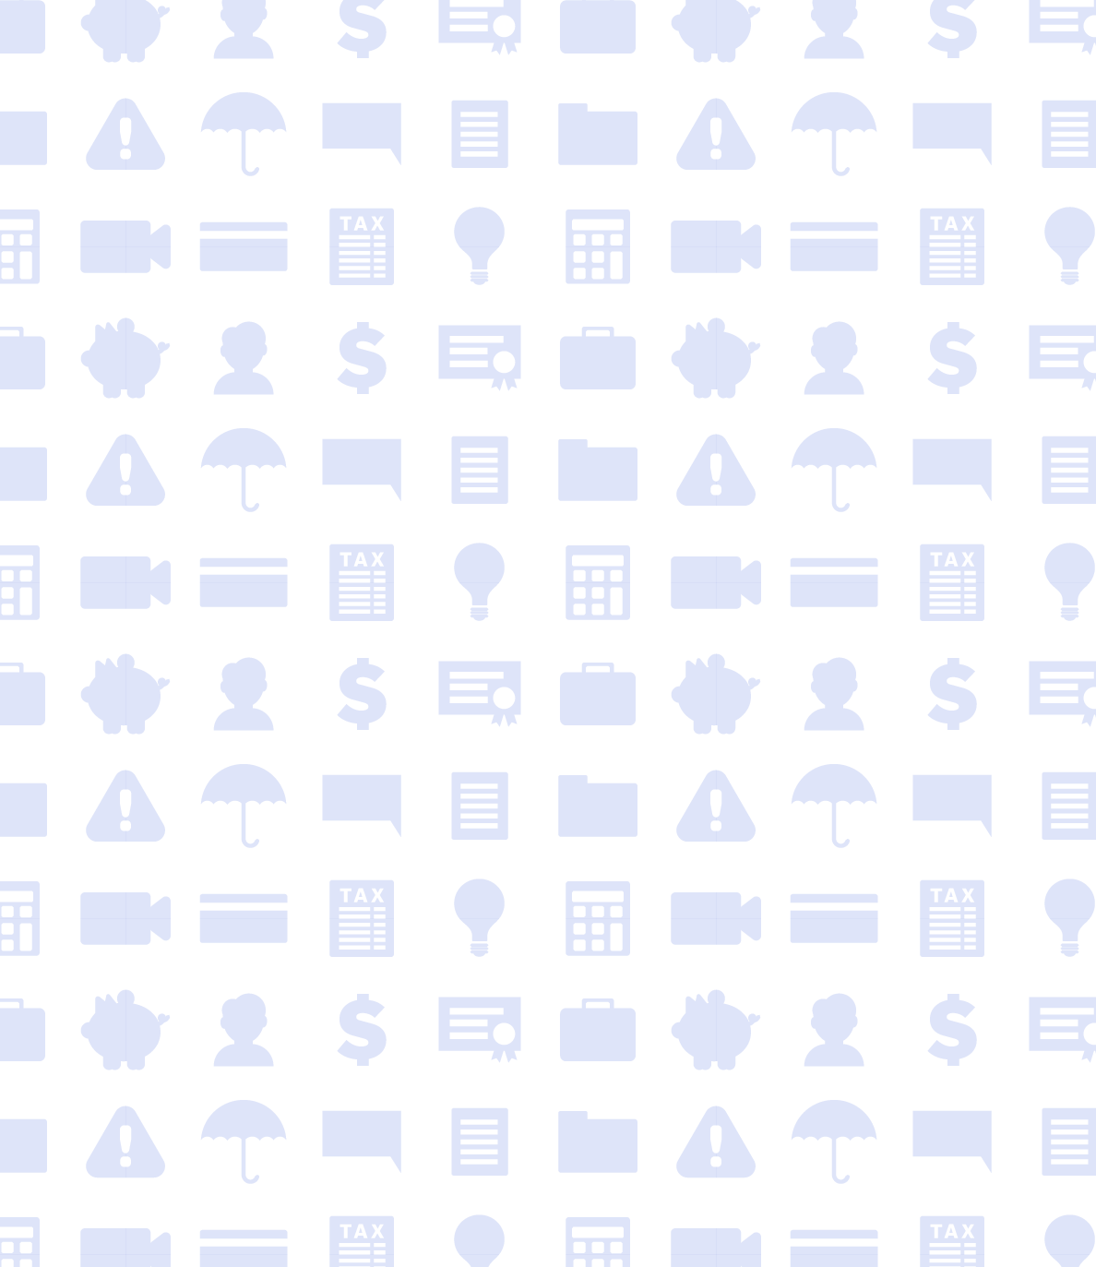
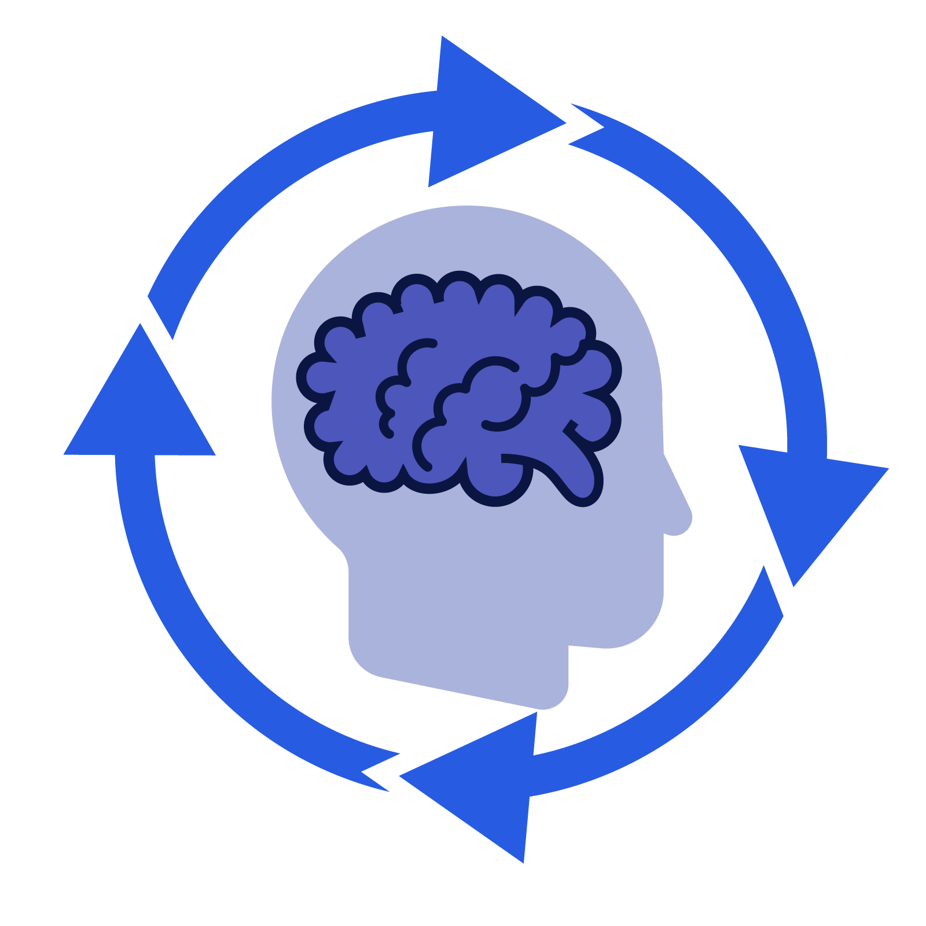
Stuff they don’t tell
you about MONEY
74%
of people experience regret, conflicts with loved ones, or lack of funds after making impulse purchases.
Source: Finder.com
TAKE PERSONAL FINANCE.
Notes:
To customize, please click File > Make a Copy. That copy is then yours to modify freely. From ngpf.org/refer

Slide 5

Stuff they don’t tell
you about MONEY
76%
of 18 & 19 year-olds say they wish their high school offered a class
on how to manage
their money.
Source: Experian
TAKE PERSONAL FINANCE.
Notes:
To customize, please click File > Make a Copy. That copy is then yours to modify freely. From ngpf.org/refer

Slide 6
Stuff they don’t tell
you about MONEY
Nationwide, only
1 in 5
High School Students is guaranteed to take a personal finance course before graduation.
Source: Next Gen Personal Finance
TAKE PERSONAL FINANCE.
Notes:
To customize, please click File > Make a Copy. That copy is then yours to modify freely. From ngpf.org/refer

Slide 7
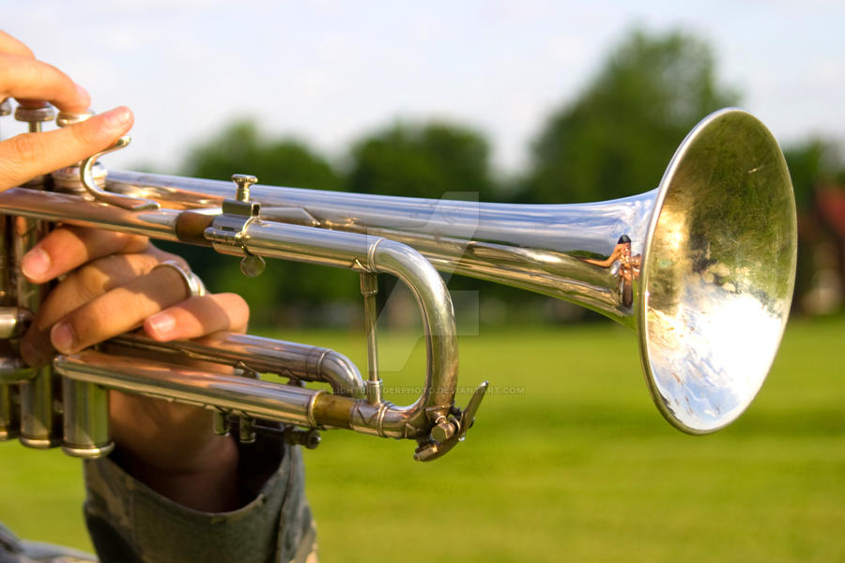
Why is it so difficult for people to do the right thing when it comes to money?
Overriding our natural impulses is needed to meet the financial demands of modern society, which require us to delay gratification, save money and build wealth

Slide 8
BEHAVIORAL ECONOMICS
THE STUDY OF HOW HUMAN PSYCHOLOGY ENTERS INTO ECONOMIC BEHAVIOR AS A WAY TO EXPLAIN WHY INDIVIDUALS SOMETIMES ACT IN PREDICTABLE WAYS COUNTER TO ECONOMIC MODELS.
CHAPTER 6
SLIDE 8

Slide 9
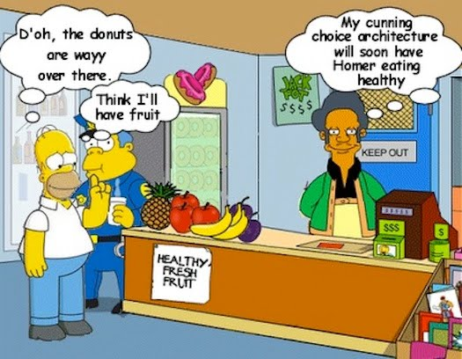
Behavioral Economics

Slide 10
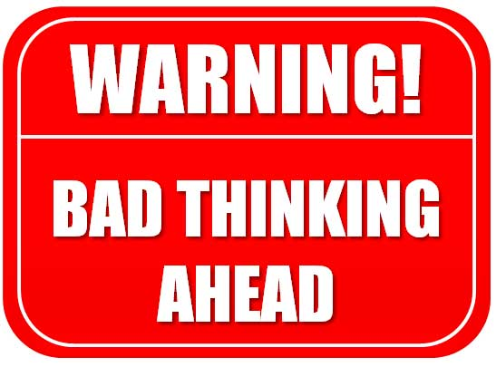
Why Do We Need to Understand Behavioral Economics?
People make mistakes when faced with certain types of decisions.
By understanding when they are likely to make mistakes, people can avoid errors.
Notes:
Final general principle of behavioral economics. Tell the students that these are four principles that two behavioral economists, David Laibson and John A. List, described in a short article about what they teach in behavioral economics courses.

Slide 11
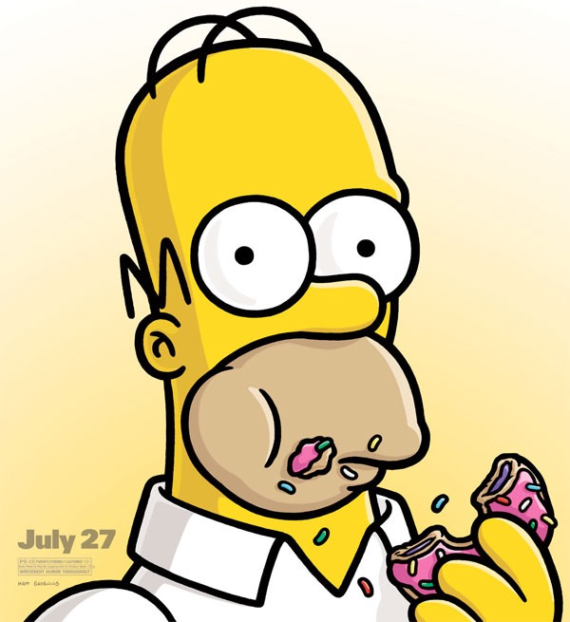
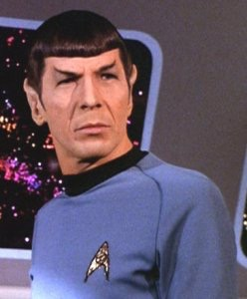
WHICH ONE DO YOU CLOSELY IDENTIFY WITH
System 1 | System 2
Emotional | Analytic
Fast | Slow
Reflexive | Reflective
Effortless | Effortful
Impulsive | Deliberative
Short-sighted | Patient

Slide 12
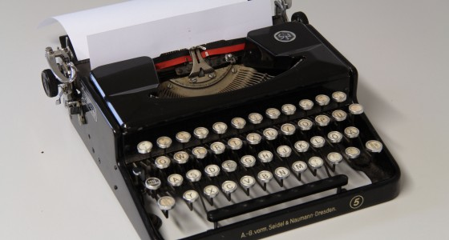
LET’S do some DEVICE USING

Slide 13

Isn’t saving money a healthy habit
What do we save for
Financial emergency
Retirement
Something new in the future
Notes:
I am going to hide this one, because I want the participants to come up with their own answwers

Slide 14
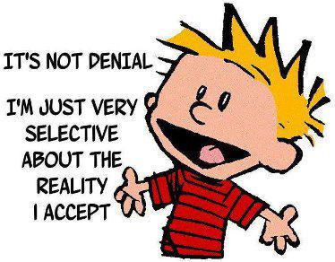
THE 52ND StAtE

Slide 15
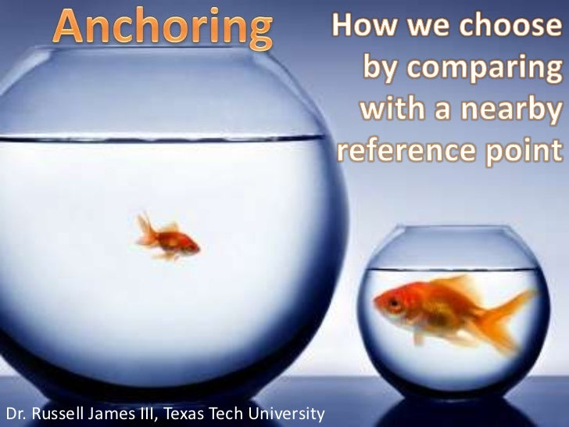
BIAS
ANCHORING

Slide 16
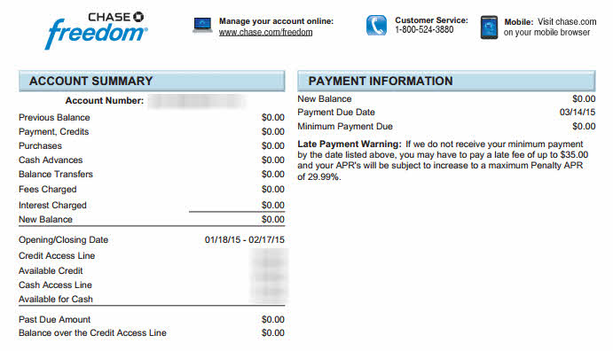
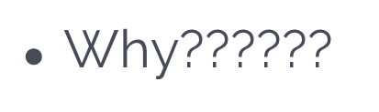
one third of credit card customers pay only the minimum

Slide 17
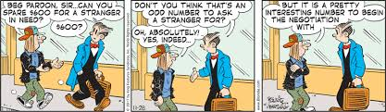
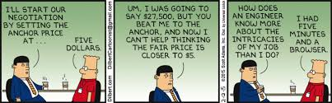
anchoring may be good for businesses

Slide 18
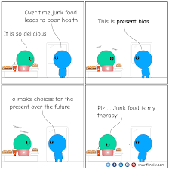
Present Bias
The future simply doesn’t tempt us as much as the present does”- Dan Ariely

Slide 19
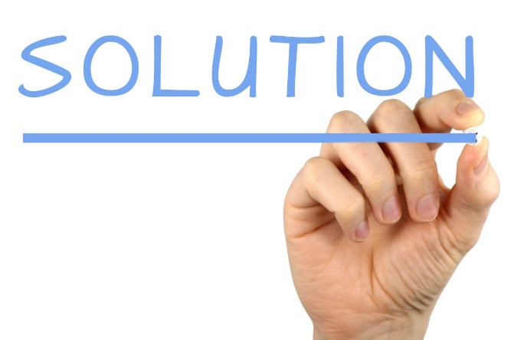
You only live Once?
Present biased consumers are more likely to spend in the present and less likely to save for the future.
Commitment Device- weight loss contract?
What about an IRA-you have to be 18 to open up an IRA?

Slide 20
LET’S do some DEVICE USING
Notes:
THIS IS WHERE I PUT A TRUE OR FALSE QUIZ

Slide 21
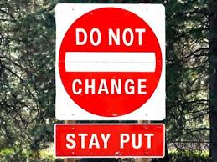
Status Quo Bias when you Don’t make a decision-you are in fact making a decision
Savers not being used to the idea that a bank would actually pay them interest.

Slide 22
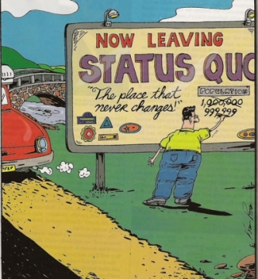
LET’S do some DEVICE USING

Slide 23
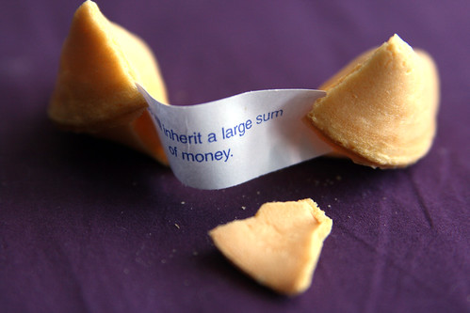
Optimism Bias
we overestimate the likelihood of positive events, and underestimate the likelihood of negative events.

Slide 24
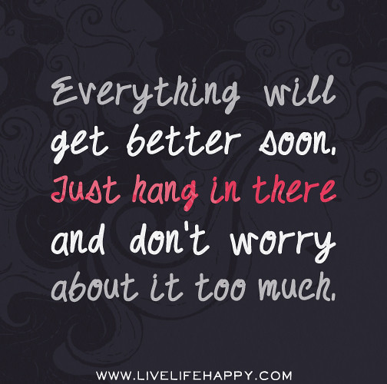
we assume we’ll be in a better position to have funds later.
Bad times could make these bias worse
Notes:
The solution is to focus on something that you have not – hang on to that, and start making baby steps if necessaey for the future

Slide 25
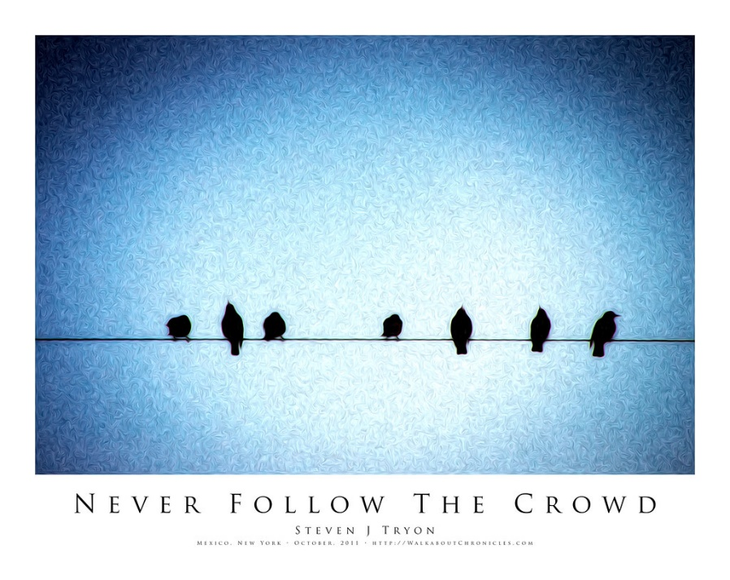
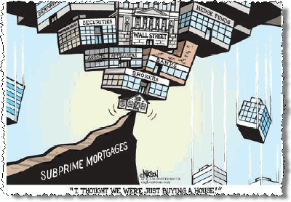
Bandwagon Effect

Slide 26

Stuff they don’t tell
you about MONEY
In 2020, the average American household carried
$6,200
in credit card debt.
Source: LendingTree
TAKE PERSONAL FINANCE.
Notes:
To customize, please click File > Make a Copy. That copy is then yours to modify freely. From ngpf.org/refer

Slide 27

Stuff they don’t tell
you about MONEY
23%
of Americans, surveyed in 2020, said too much credit card debt was their #1 financial mistake of the last decade.
Source: Lending Tree
TAKE PERSONAL FINANCE.
Notes:
To customize, please click File > Make a Copy. That copy is then yours to modify freely. From ngpf.org/refer

Slide 28
Bandwagon Effect
students feel peer pressure to keep up with the spending habits of their friends
post a selfie when YOU’re shocked by A credit card bill or you have a poor credit score.
financial appearance can be very different than the whole picture.

Slide 29

Stuff they don’t tell
you about MONEY
96.5%
of content creators on YouTube do not make enough money to rise above the U.S. poverty line.
Source: FORTUNE
TAKE PERSONAL FINANCE.
Notes:
To customize, please click File > Make a Copy. That copy is then yours to modify freely. From ngpf.org/refer

Slide 30
LET’S do some DEVICE USING
Notes:
This is where we can come up with solutions to overcome this bandwagon bias

Slide 31

Take it easy on yourself
We can’t do everything
We can’t fix everything
But we can do little things.

Slide 32
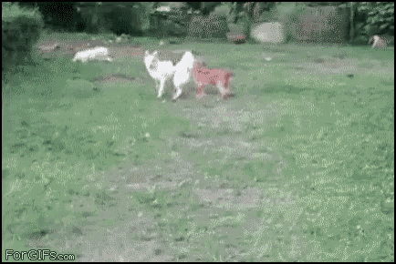
And be realistic about your own strengths

Slide 33
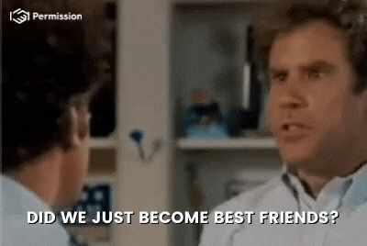
Anything you want to ASK

