Slide 1

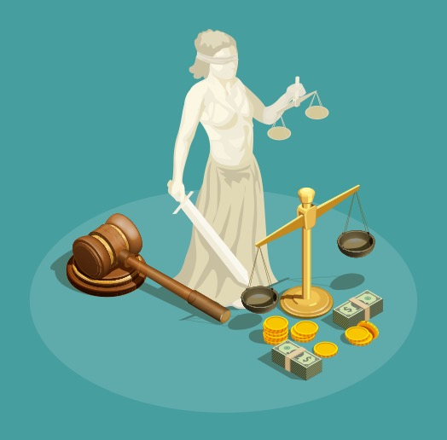
Does Self-Interest
Prevent Economic
Justice?

Slide 2
Equity and Justice
In recent years, economics has focused on economic efficiency, yet economic justice is also an important value to individuals and societies.

Slide 3
Scarcity
Because of scarcity, the economic condition of not having enough resources to satisfy everyone’s wants, not all wants can be satisfied and people differ greatly in their abilities and opportunities to satisfy their wants.
Do you think that scarcity creates economic inequality?

Slide 4
Equity and Justice
One definition of justice is the notion that everyone deserves equal economic, political, and social opportunities regardless of race, gender, or religion, for example.
To determine if something is just, people often ask two different-and possibly contradictory-questions:

Slide 5
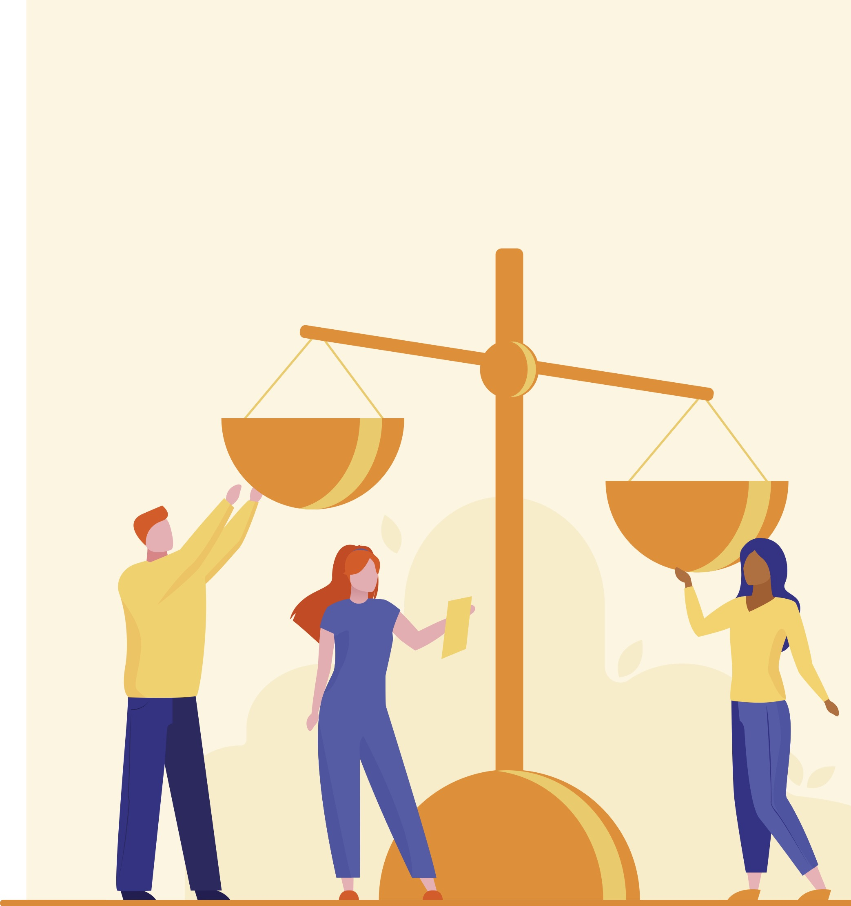
Equity and Justice
Is the outcome equitable?
  People who emphasize outcomes tend to see the existing degree of economic inequity as morally wrong.
Is the process equitable?
  People who emphasize process are more likely to approve the results of a system, even if those results are highly unequal, provided individuals have equal opportunity to succeed. If they believe the system is designed to be equal for all, they believe the outcomes should be just.

Slide 6
Outcome-based and Process-based Examples
Process based:
  If someone is focused on process, would it be just that some students in this class got As while others got Bs, Cs, Ds, or Fs?
  What if they focused on outcomes?
Outcome based:
  If someone is focused on outcomes, would it be just for everyone to get a high school diploma regardless of what they did during their time in school?
  What if they focused on process?

Slide 7

Equity and Justice
People’s experience and self-interest sometimes play a role in how they may answer these questions.
According to philosopher John Rawls, all people are biased by their situations. In order to avoid our biases we should imagine sitting behind a “veil of ignorance” that keeps us from knowing how we believe and identifying with our personal circumstances.
By being “ignorant” or blind to our own circumstances, we can more objectively consider how society should operate.
“Veil of Ignorance.” Ethics Unwrapped, 21 Feb. 2022, https://ethicsunwrapped.utexas.edu/glossary/veil-of-ignorance.

Slide 8

Equity and Justice
Notes:
https://econ.video/2023/02/07/the-good-place-trolley-problem/
https://econ.video/2023/02/11/the-good-place-the-trolley-problem-part-2/
There are two versions, the second one is NOT part 2, but a different version of the first video. Part 2 is linked here.

Slide 9
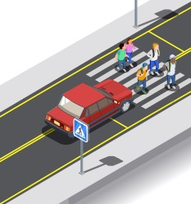
Veil of ignorance example
Decision-making under the veil of ignorance
  What if a car were speeding down the highway towards a group of five people who are completely oblivious of the car.
  You could save all five people if you pushed a 6th person in the way of the car. Would you do it?

Slide 10
Veil of ignorance example
Now, let’s remove the veil of ignorance.
  Would you push the 6th person in front of the car if someone you loved were one of the five people who might get hit?
  Would you push the 6th person in front of the car to save the other five people if someone you loved were the 6th person who would be pushed?

Slide 11

Veil of Ignorance Simulation
Directions: This role-playing simulation will help you understand an important principle of justice. We need
to divide into groups of 3-4.
Each group will receive an Economic Policy Ballot.
Members will read, discuss, and vote on each policy
as a group.
Voting in Round 1 will be done under the veil of ignorance.
Groups will not know if each policy will benefit
them or not.
We will share out how each group voted in 5-10 minutes.

Slide 12

Veil of Ignorance Simulation: Round 2
Directions: In Round 2 we will remove the veil
of ignorance and see how self-interest impacts decision-making.
Round 2:
Each group will receive a Role Card.
Each group needs to vote on each policy.
Groups will read, discuss, and vote on each policy based on how they think the person on their Role Card would vote.
We will share out how each group voted in
5-10 minutes.

Slide 13
Wrap-up
How many groups changed their votes from Round 1 to Round 2 on:
  Funding education
  Unemployment insurance
  Migrant workers
  Health insurance
If your group changed their vote, what influenced the group’s decision?
Did any group consider how your role would view the equity of the outcome or the process for each policy before the group voted?

Slide 14
Key takeaways:
The veil of ignorance provides an opportunity to identify how our own self-interest and circumstances can impact our decision-making.
By recognizing how our decision-making is influenced, we can attempt to make more just decisions both through government policies as well as in our own life.

