Slide 1
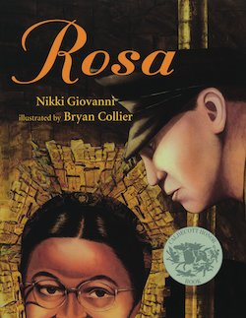



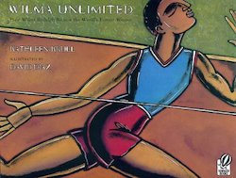
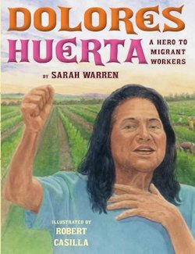

Lauren H Shifflett shiffllh@jmu.edu
Lynne F Stover stoverlf@jmu.edu
March 22, 2023
Women Making Choices:
Athletes, Artists, and Activists

Slide 2
EconEdLink Membership
You can now access CEE’s professional development webinars directly on EconEdLink.org! To receive these new professional development benefits, become an EconEdLink member. As a member, you will now be able to:
Automatically receive a professional development certificate via e-mail within 24 hours after viewing any webinar for a minimum of 45 minutes
Register for upcoming webinars with a simple one-click process
Easily download presentations, lesson plan materials and activities for each webinar
Search and view all webinars at your convenience
Save webinars to your EconEdLink dashboard for easy access to the event
Access our new Professional Development page here

Slide 3
Professional Development Opportunities
To earn professional development credit for CEE webinars found on EconEdLink, you must:
Watch a minimum of 45-minutes and you will automatically receive a professional development certificate via e-mail within 24 hours.
Attendees can learn how much credit they will earn per workshop.
Accessing resources:
You can now easily download presentations, lesson plan materials, and activities for each webinar from EconEdLink.org/professional-development/
Local resources:
Insert your local professional development opportunities (if applicable)

Slide 4
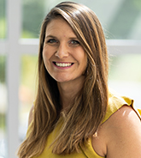
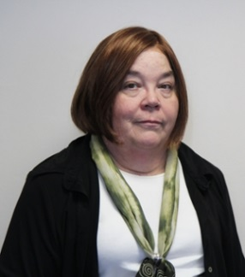
Presenters
Lauren Hensley Shifflett is the new Associate Director at the James Madison University Center for Economic Education. Prior to joining the Center, she spent twelve years in early elementary education where she enjoyed prospering young minds as a classroom teacher. Lauren became nationally known as an elementary economic educator when she received the John Morton Award of the national Council for Economic Education in 2021. Her love for economics guides her lessons to prepare students for life.
shiffllh@jmu.edu
Lynne Farrell Stover is currently a Teacher Consultant at the James Madison University Center for Economic Education. Prior to this, she spent thirty-three years in public education where she enjoyed various teaching assignments including classroom teacher, gifted education specialist, and librarian. She is the author of over fifty educational articles and eight teacher resource books. She is the recipient of the 2022 NAEE Platinum Curriculum Award for her lessons developed for Virginia’s Reading Makes Cents Program.
stoverlf@jmu.edu

Slide 5
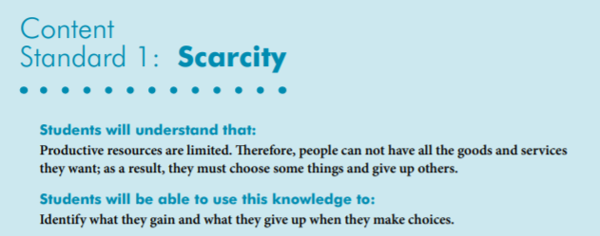

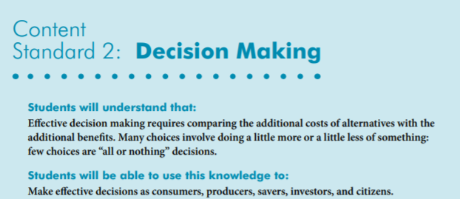
National Content Standards
https://www.councilforeconed.org/wp-content/uploads/2012/03/voluntary-national-content-standards-2010.pdf

Slide 6

Virginia HISTORY & SOCIAL SCIENCE Standards of Learning
K.9 The student will
a) recognize that people make choices because they cannot have everything they want; and
explain that people work to earn money to buy the things they want.
1.9 The student will recognize that people save money for the future to purchase goods and services.
2.8 The student will describe natural resources (water, soil, wood, and coal),
human resources (people at work), and capital resources (machines, tools, and buildings).
3.10 The student will identify examples of making an economic choice and will explain the idea of opportunity cost (what is given up when making a choice).

Slide 7
Agenda
In this webinar we will:
Welcome attendees and introduce the session. [5 mins.]
  Explore featured titles. [40 mins.]
  Discover online links to websites and resources. [5 mins.]
  Review content using “For Your Consideration” Questions. [5 mins.]
Conclude and complete evaluation. [5 mins.]

Slide 8
Objectives
In this webinar teachers will:
Celebrate Woman’s History Month by learning about the choices made by women athletes, artists, and activists. [Lucile Godbold, Wilma Rudolph, Serena Williams, Venus Willams, Aretha Franklin, Maya Lin, Rosa Parks, and Dolores Huerta.]
Consider the benefits of using children’s literature to teach in the content areas.
Review the economic concepts of decision-making, choices, human capital, and incentives.
Consider a cost/benefit grid as applied to an important decision.
Construct a PACED decision-making grid based on a specific event.

Slide 9

March is designated Women’s History Month by presidential proclamation.
The month is set aside to honor women’s contributions in American history.

Slide 10

Athletes

Slide 11
Long-Armed Ludy and the First Women’s Olympics
Book Synopsis: The story of Lucile Godbold who qualified for the first Women's Olympics but had no money to go. Her college classmates helped raise money to send her to Paris where she won the gold medal in 1922.
Publisher: Charlesbridge Publishing
Copyright Date: 2017
Reading Level: 4.1
Interest Level: 1-4
https://www.youtube.com/watch?v=nifzlPNsNz8
9 minutes

Slide 12
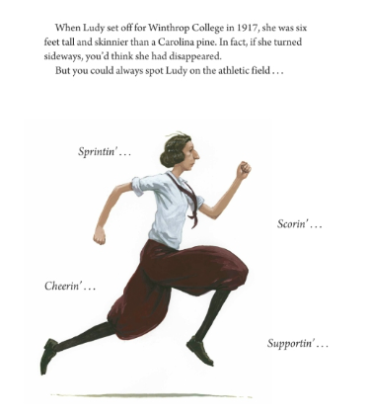
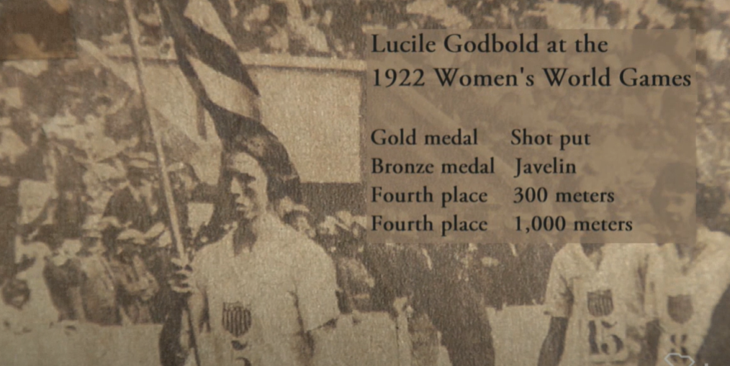
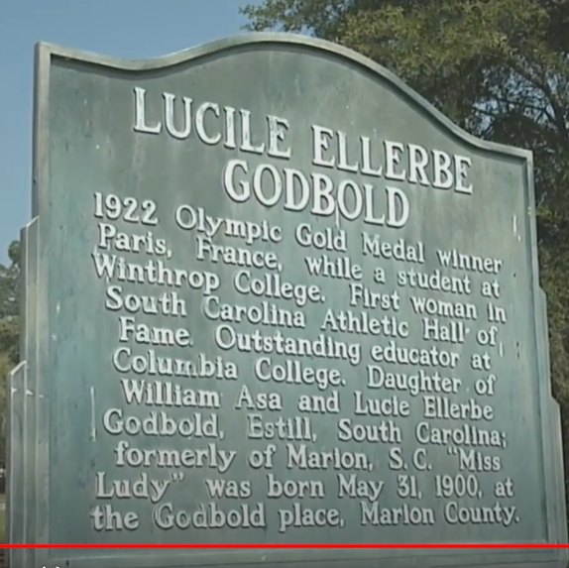
https://www.youtube.com/watch?v=RS5e99VHchI

Slide 13
Wilma Unlimited:
How Wilma Rudolph Became the World' S Fastest Woman
by Kathleen Krull
Story Synopsis Rudolph overcame polio and the inability to walk and became the first American woman to win three gold medals at a single Olympics.
Publisher: Harcourt
Copyright Date: 1996
Reading Level: 5.1
Interest Level: 2-5
June 23 1940 – November 12, 1994
https://www.youtube.com/watch?v=ruVKikbV0YM
11 minutes

Slide 14
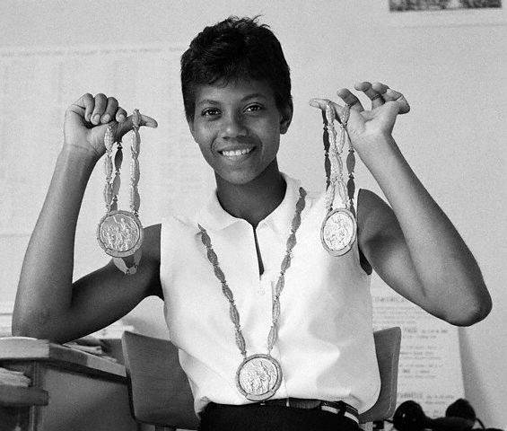
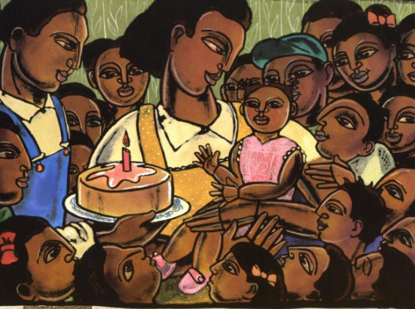
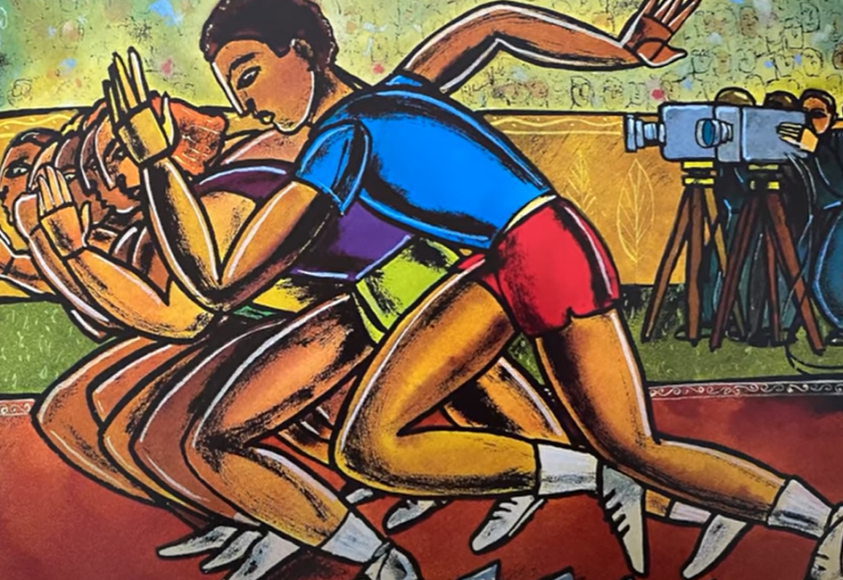
Wilma Rudolph
June 23, 1940-November 12, 1994
Rudolph graduated from Tennessee State with a bachelor's degree in education.
Wilma Rudolph(1940-1994) was the twentieth of 22 children. She was small and sickly. She contracted Polio at the age of five and it was thought she would never walk again. In school, Wilma was teased by her peers because she walked with a metal brace. As an African-American person in Tennessee, she had limited access to opportunities. Despite these challenges, in the 1960 Summer Olympics in Rome, Wilma Rudolph was the first American woman to win three gold medals in a single game.

Slide 15
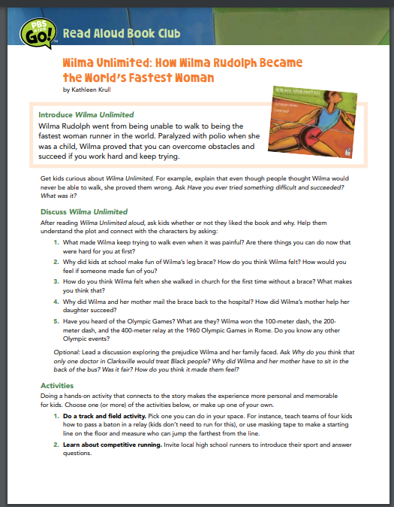
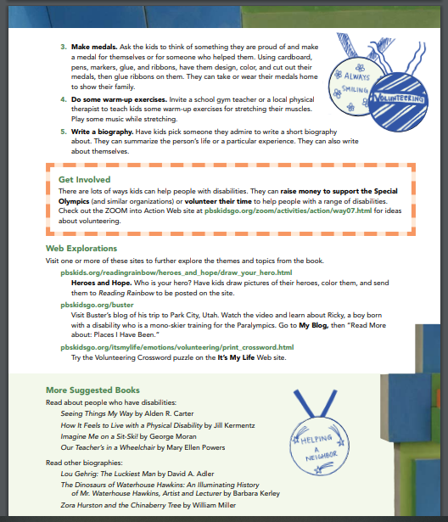
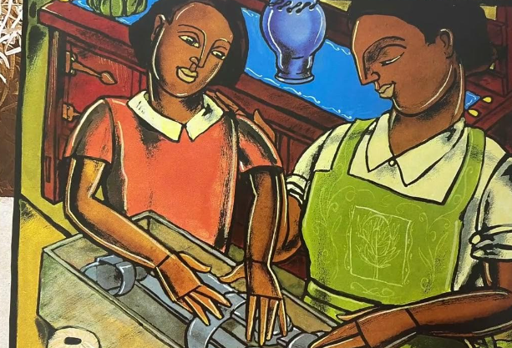
http://www-tc.pbs.org/parents/bookfinder/bookclub/PKGO_bc04_wilma.pdf

Slide 16
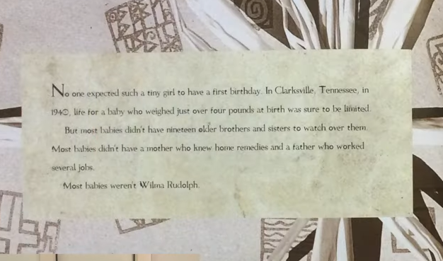
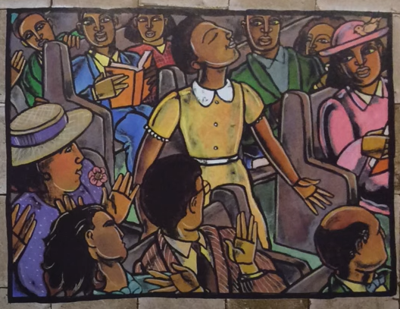
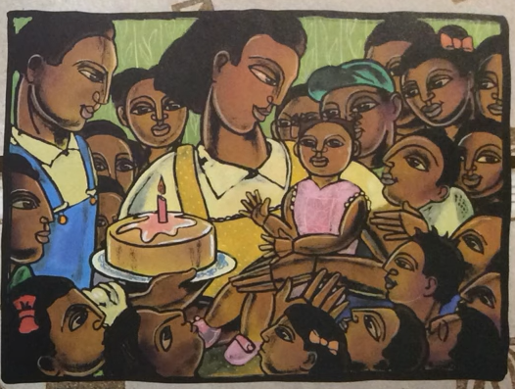

Slide 17
Venn Diagram
Godbold and Rudolph
Track Events
Field Events
Black
White
Teacher
Large Family
Polio
Gold Medal
1922 Women’s World Games
1960 Olympics

Slide 18
The story of the highly successful tennis players Venus and Serena Williams, laying out their humble beginnings, hard work, mutual support, and their resulting extraordinary achievements in tennis.
Publisher: Penguin
Copyright Date: 2018
Reading Level: 4.1
Interest Level: P-2
https://www.youtube.com/watch?v=s6k-Il_8v-s
11 minutes

Slide 19
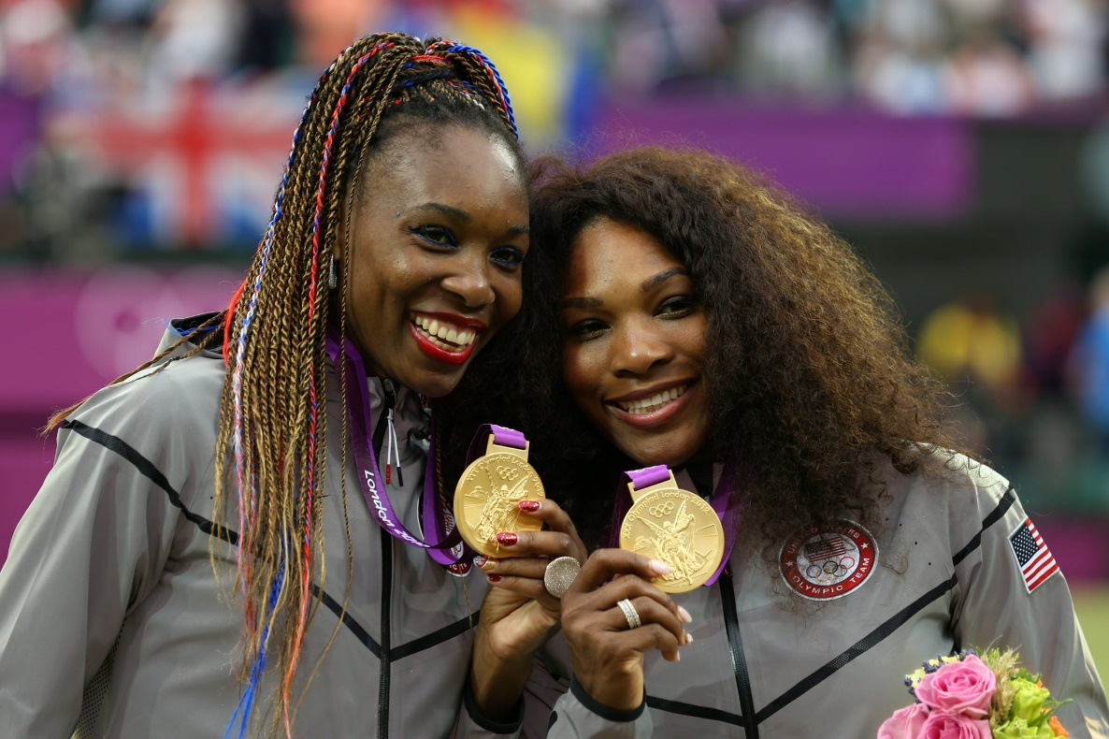

Venus- June 17, 1980
Serena- September 26, 1981
Three-time Olympic women's doubles champions, Venus and Serena Williams have each won four golds at the Games. The elder of the two was also the first to complete the singles and doubles 'double', at Sydney 2000, a feat her sibling repeated 12 years later.

Slide 20







Venus Williams net worth of $95 million. Williams is a former World No. 1 tennis player and is generally credited with ushering in a new era of power on the women's professional tennis tour.
Serena Williams Net Worth $260 : Serena Williams is one of the best tennis player of all time, she is an American professional tennis player. She has won 39 Grand Slam titles, had announced her retirement in August 2023.

Slide 21


Serena Williams, a tennis legend, a business powerhouse, a venture capitalist, an assistant soccer coach. She can add children’s book author to that list. The Adventures of Qai Qai, released on September 27, 2022 , and became an Amazon #1 bestseller.

Slide 22

ARTISTS

Slide 23
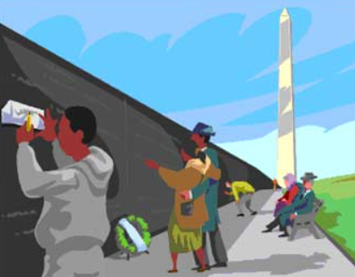

Maya Lin: Artist-Architect of Light and Lines
by Jeanne Walker Harvey
Publisher: Henry Holt & Co.
Copyright Date: 2017
Reading Level: 4.2
Interest Level: K-3
https://www.youtube.com/watch?v=ro7ylpGt5gQ
Reading Time: 5:05 minutes

Slide 24

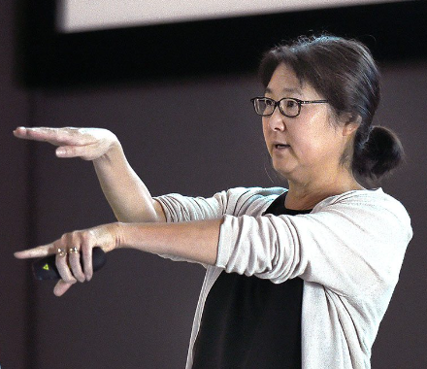
Maya Lin
Maya Lin’s design for the Vietnam Veteran’s Memorial only earned a B in her class at Yale, so Lin was shocked when competition officials came to her dormitory room in May 1981 and informed the 21-year-old that she had won the design and the $20,000 first prize.
October 5, 1959

Slide 25
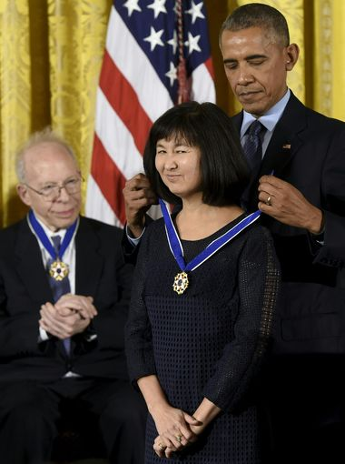
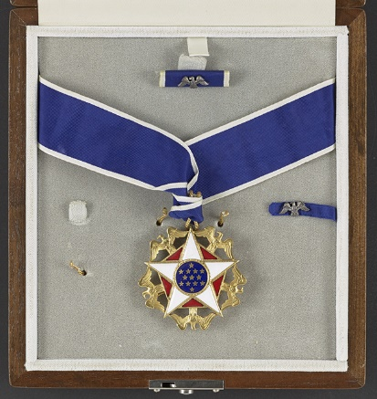
Maya Lin is awarded the Presidential Medal of Freedom by President Obama in 2016.

Slide 26
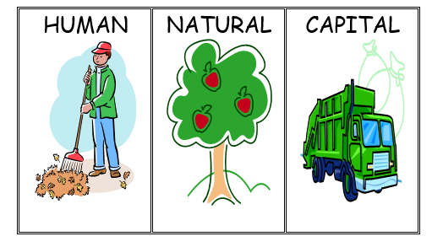
Productive Resources used in an Art Lesson

Slide 27
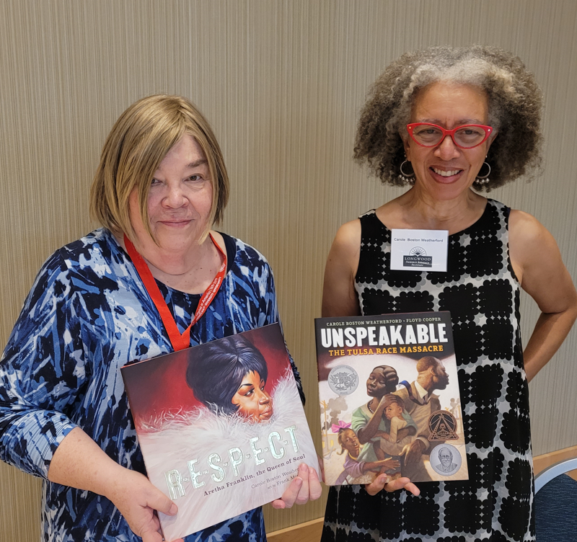

R-E-S-P-E-C-T: Aretha Franklin, the Queen of Soul
by Carole Boston Weatherford
Publisher: Simon & Schuster
Copyright Date: 2020
Reading Level: 2.0
Interest Level: K-3
https://www.youtube.com/watch?v=uF9wqecpwKA
4 minutes

Slide 28
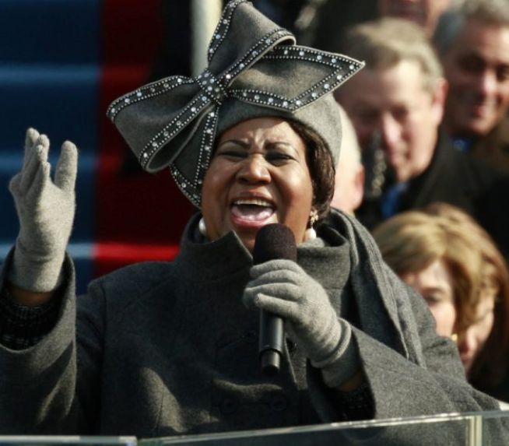
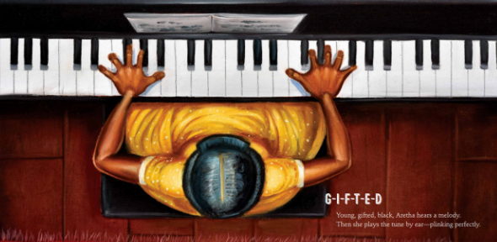
Aretha Franklin
Aretha Franklin’s musical talent was clear from her earliest days when singing in her father’s Detroit church.
Later, her hit songs earned her the title “the Queen of Soul,” multiple Grammy Awards, and a place in the Rock & Roll Hall of Fame. But Aretha didn’t just raise her voice in song; she also spoke out against injustice and fought for civil rights.
March 25, 1942- August 16,2018

Slide 29
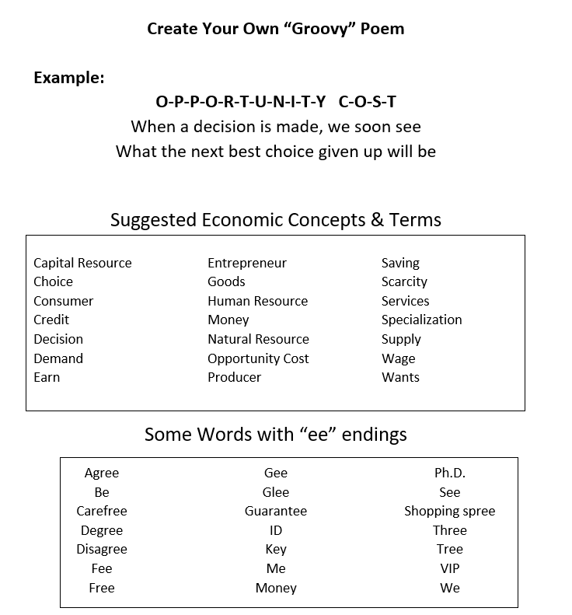
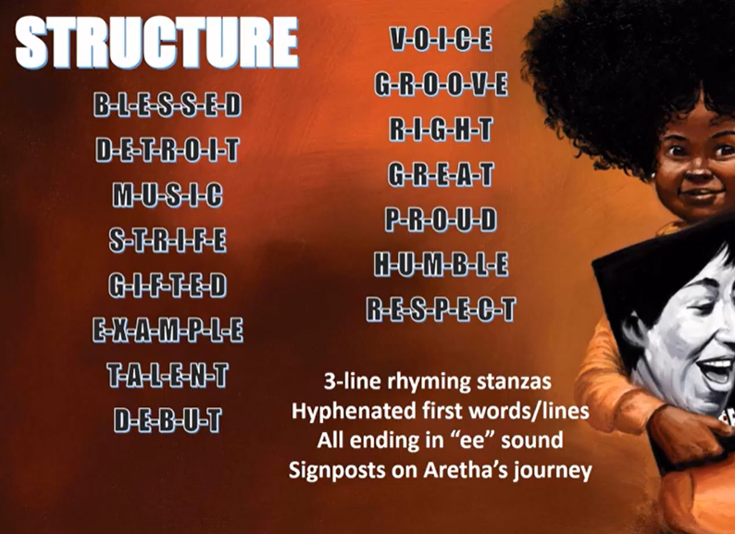

Slide 30
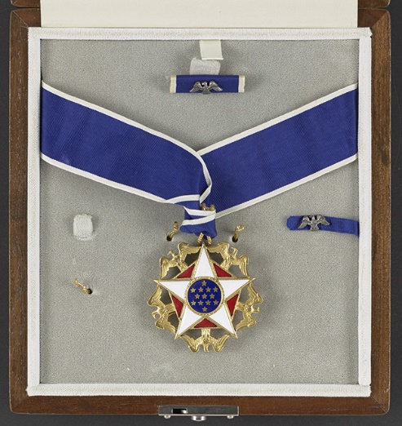
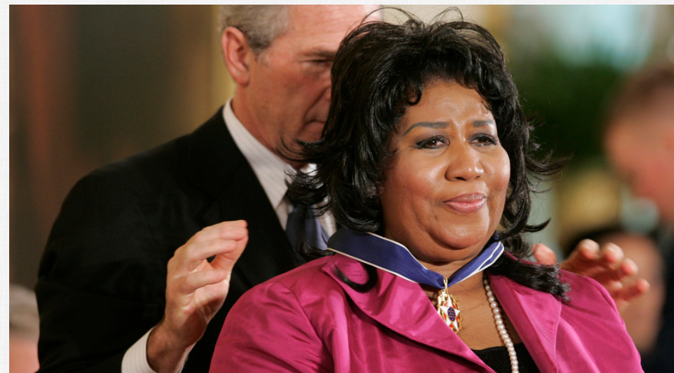
On Nov. 9, 2005, President George W. Bush awards singer Aretha Franklin the Presidential Medal of Freedom Award, the highest civilian award, in the East Room of the White House in Washington.

Slide 31

Activists

Slide 32
Rosa
In Montgomery, Alabama, on December 1, 1955 Rosa Parks refused to give up her seat on a city bus.
This picture book biography covers this historic event along with other details of Mrs. Park’s personal life. How her action spurred the Montgomery bus boycott and its part in the civil rights movement is portrayed in effective text and striking illustrations.
Publisher: Square Fish
Copyright Date: 2005
Reading Level: 4.9
Interest Level: 2-5
https://www.youtube.com/watch?v=q2dYS8aLNNA
14 minutes

Slide 33
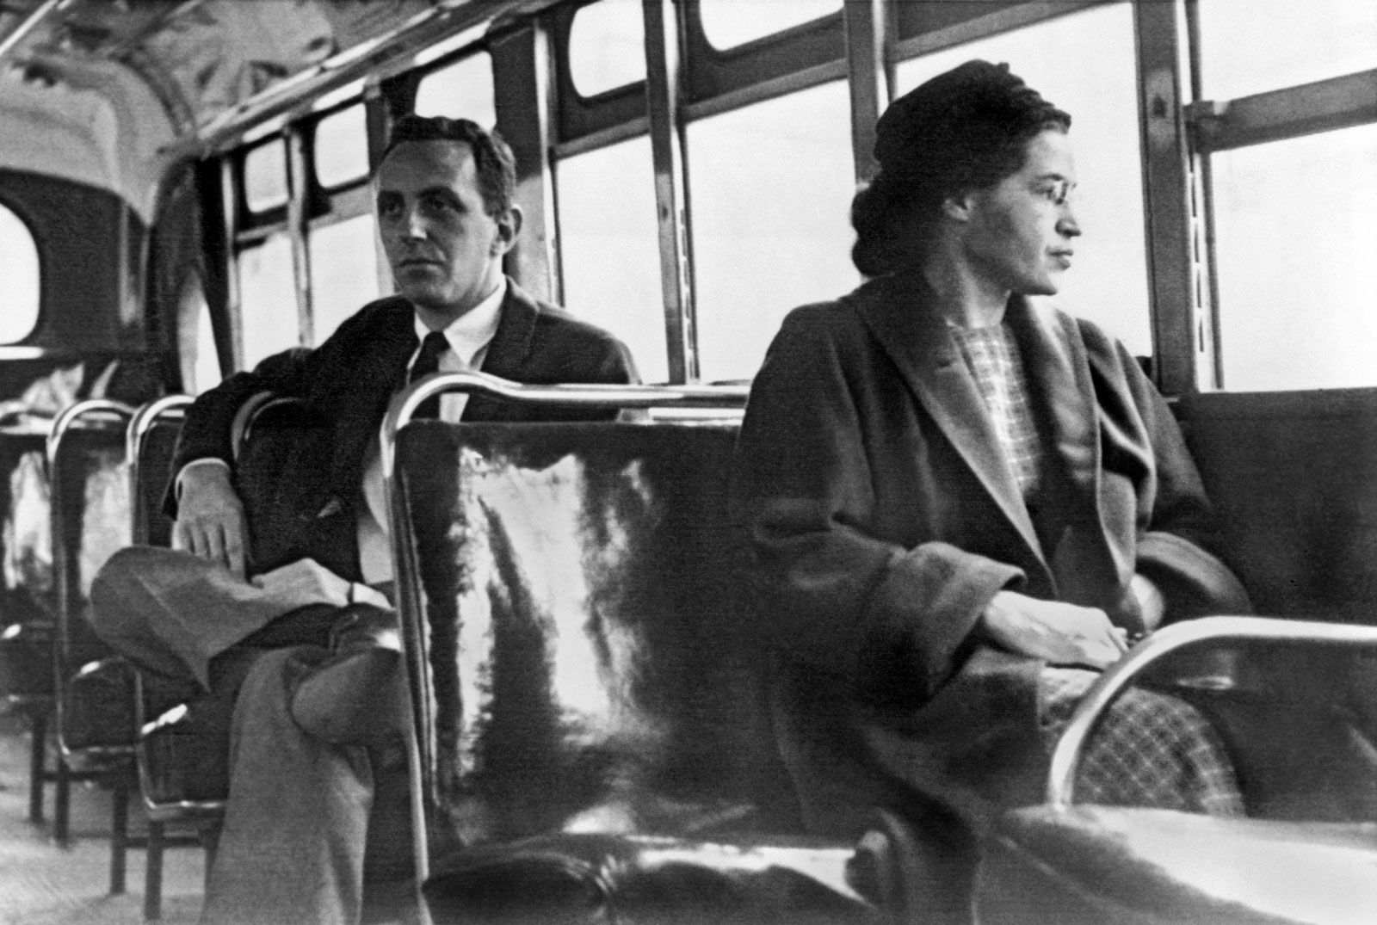
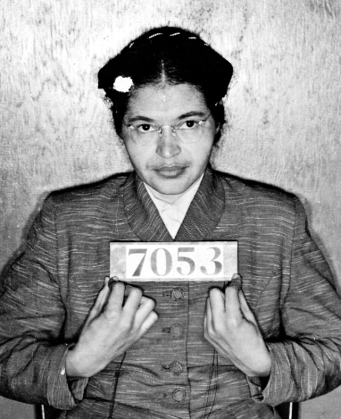
Rosa Parks, (born February 4, 1913 - October 24, 2005) was an American civil rights activist whose refusal to give up her seat on a public bus precipitated the 1955–56 Montgomery bus boycott Alabama. This became the spark that ignited the Civil Rights Movement.

Slide 34
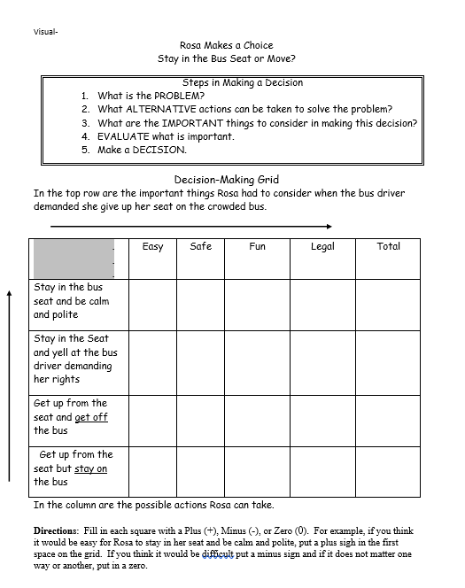
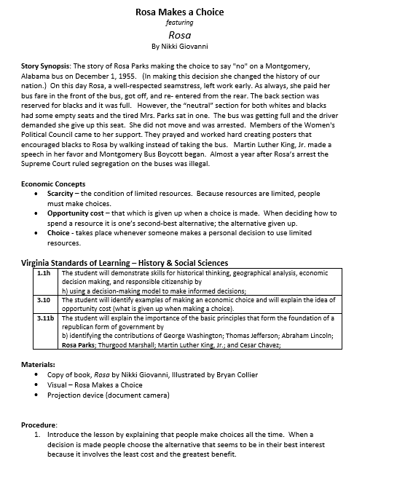
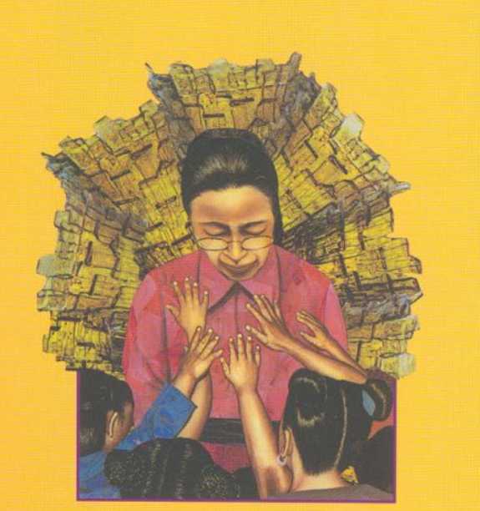
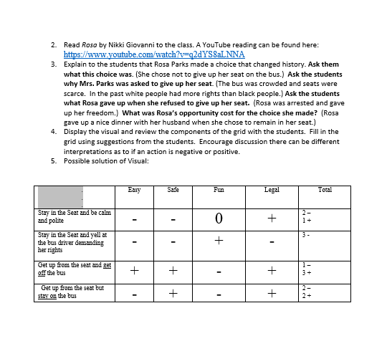

Slide 35
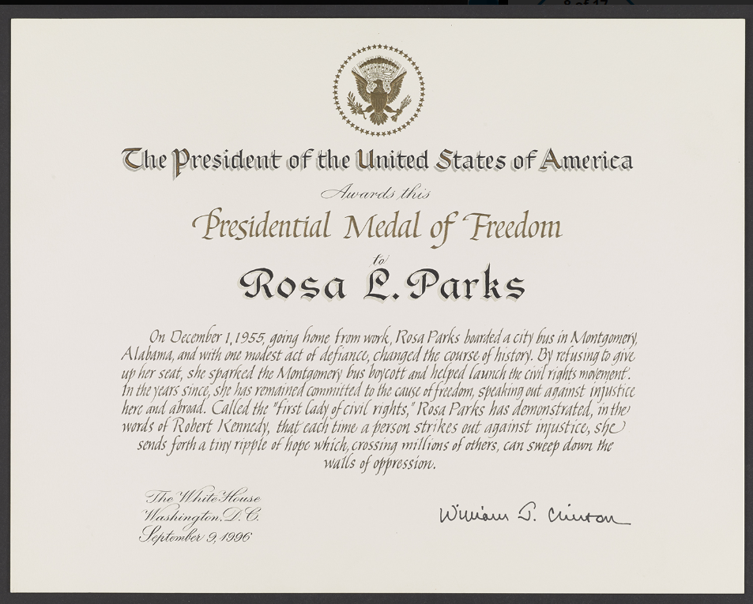
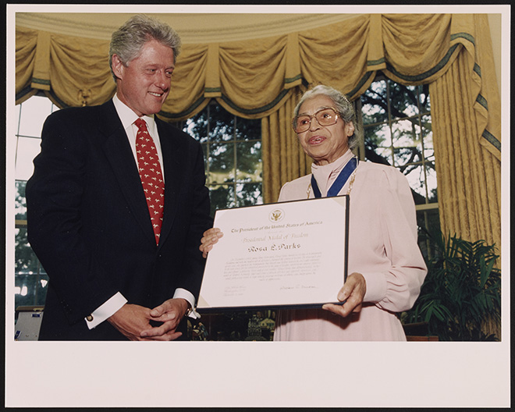
On September 15, 1996, President Clinton awarded Rosa Parks the Presidential Medal of Freedom, the highest civilian honor given by the U.S. executive branch.

Slide 36
Delores Huerta: A Hero to Migrant Workers
by Sarah Warren
Labor leader and civil rights activist Dolores Huerta co-founded the United Farm Workers (originally called the National Farm Workers Association) with César Chávez in 1962. She has been an activist for workers’ rights, women’s rights, and immigrant rights. In 2012, she received the Presidential Medal of Freedom from President Barack Obama.
Publisher: Marshall Cavendish
Copyright Date: 2012
Reading Level: 3.0
Interest Level: 2-5
https://www.youtube.com/watch?v=wPfiLygcusg
5 minutes
April 10, 1930

Slide 37
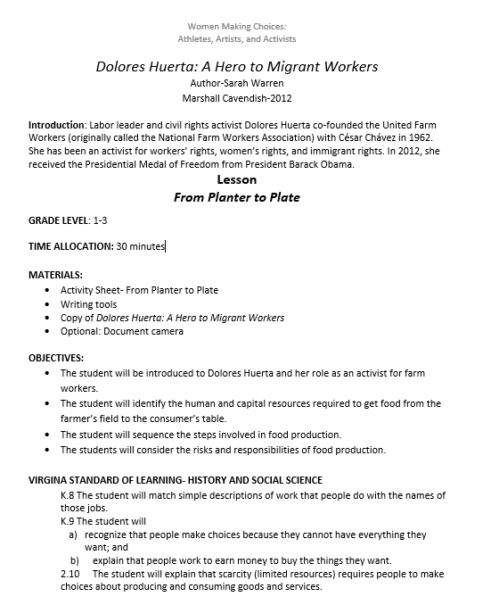
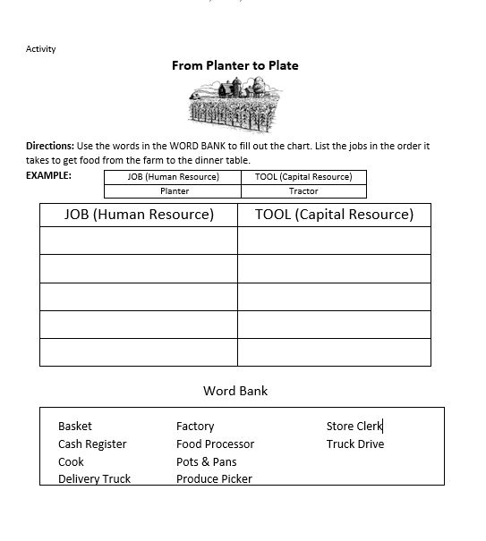
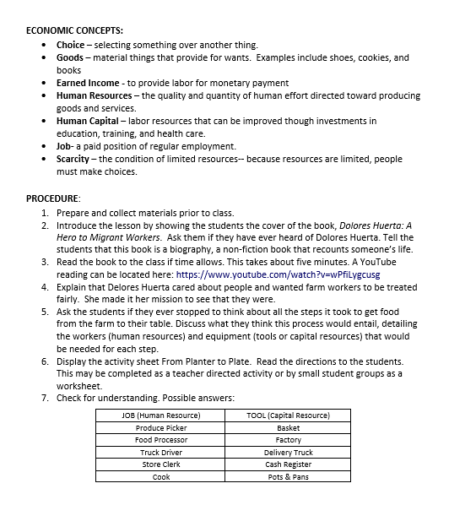

Slide 38
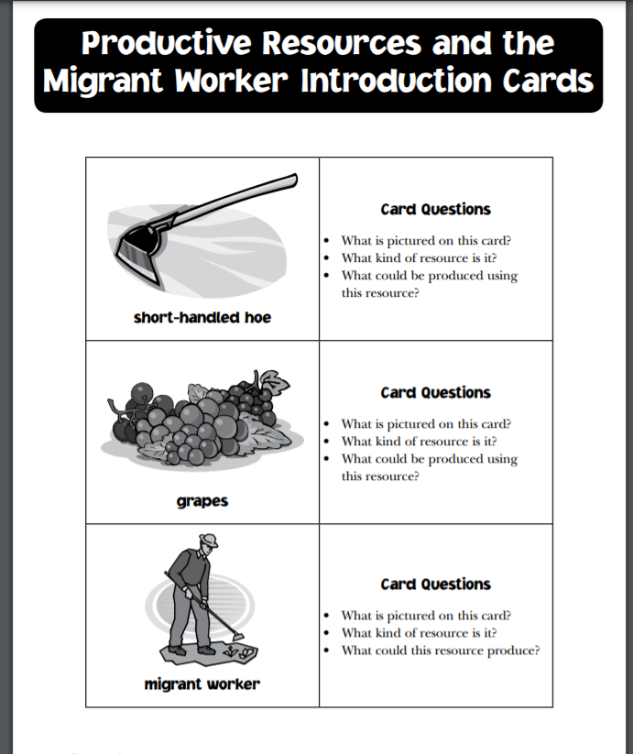
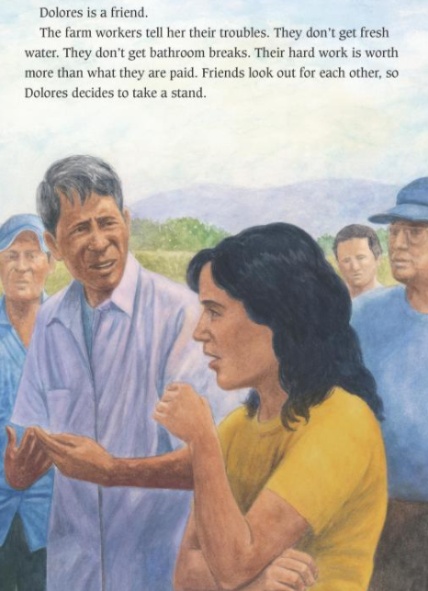
What Do You Think?
Migrant farm workers had to use the short-handled hoe for thinning and weeding crops. Because it required them to stoop during long hours in the fields, the hoe became a symbol of the brutal working conditions. Campaigns by the United Farm Workers and others helped outlaw use of the hoe in 1975.
What do you think was the reasoning behind the mandatory use of the short-handled hoe?

Slide 39
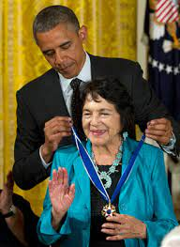
In 2012, President Barack Obama awarded Dolores Huerta Presidential Medal of Freedom.

Slide 40
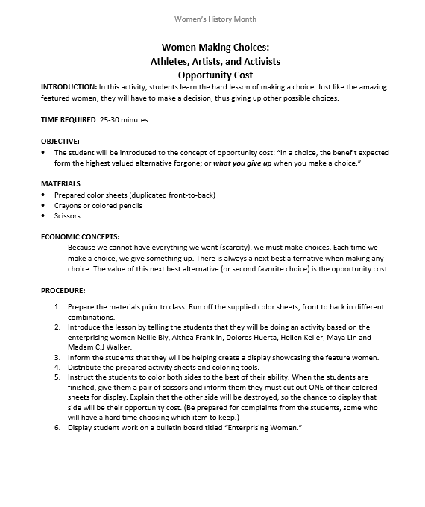

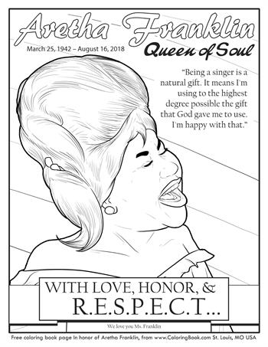
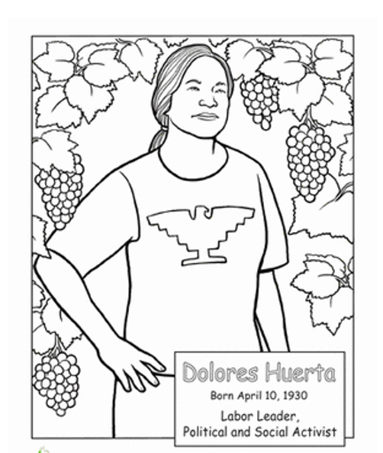

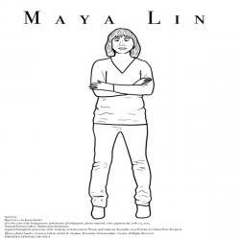





Slide 41

For Your Consideration
Overarching Themes
Honing Your Skills (investing in human capital)
Competing on the global stage
Making a Difference for others
Succeeding with the support of family and friends
Questions:
The featured women are all award winners. Is this significant or problematic when teaching young people about historic figures?
Would the “take-aways” from these stories be different for boys than girls?
Does the diverse background of these women contribute to their stories?

Slide 42

Invest In Girls

Slide 43

NEC

Slide 44

NPFC

Slide 45

Advocacy

Slide 46

Suggested Presentation Deck
CEE Affiliates
https://www.councilforeconed.org/resources/local-affiliates/
Include your local affiliate page

Slide 47










Thank You to Our Sponsors!

Slide 48
Contact information
Thank You

