Slide 1

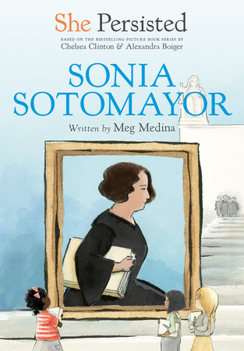



Lauren H Shifflett shiffllh@jmu.edu
Lynne F Stover stoverlf@jmu.edu
March 22, 2023
Women’s History Month:
Using the “She Persisted” Series to Teach Economics and Personal Finance

Slide 2
EconEdLink Membership
You can now access CEE’s professional development webinars directly on EconEdLink.org! To receive these new professional development benefits, become an EconEdLink member. As a member, you will now be able to:
Automatically receive a professional development certificate via e-mail within 24 hours after viewing any webinar for a minimum of 45 minutes
Register for upcoming webinars with a simple one-click process
Easily download presentations, lesson plan materials and activities for each webinar
Search and view all webinars at your convenience
Save webinars to your EconEdLink dashboard for easy access to the event
Access our new Professional Development page here

Slide 3
Professional Development Opportunities
To earn professional development credit for CEE webinars found on EconEdLink, you must:
Watch a minimum of 45-minutes and you will automatically receive a professional development certificate via e-mail within 24 hours.
Attendees can learn how much credit they will earn per workshop.
Accessing resources:
You can now easily download presentations, lesson plan materials, and activities for each webinar from EconEdLink.org/professional-development/
Local resources:
Insert your local professional development opportunities (if applicable)

Slide 4
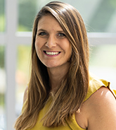
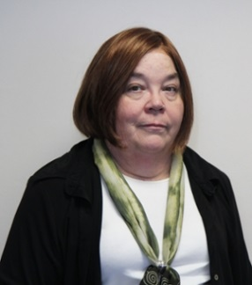
Presenters
Lauren Hensley Shifflett is the new Associate Director at the James Madison University Center for Economic Education. Prior to joining the Center, she spent twelve years in early elementary education where she enjoyed prospering young minds as a classroom teacher. Lauren became nationally known as an elementary economic educator when she received the John Morton Award of the national Council for Economic Education in 2021. Her love for economics guides her lessons to prepare students for life.
shiffllh@jmu.edu
Lynne Farrell Stover is currently a Teacher Consultant at the James Madison University Center for Economic Education. Prior to this, she spent thirty-three years in public education where she enjoyed various teaching assignments including classroom teacher, gifted education specialist, and librarian. She is the author of over fifty educational articles and eight teacher resource books. She is the recipient of the 2022 NAEE Platinum Curriculum Award for her lessons developed for Virginia’s Reading Makes Cents Program.
stoverlf@jmu.edu

Slide 5
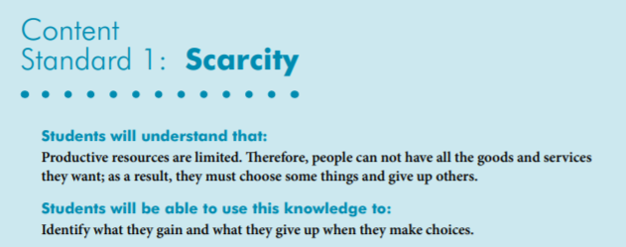
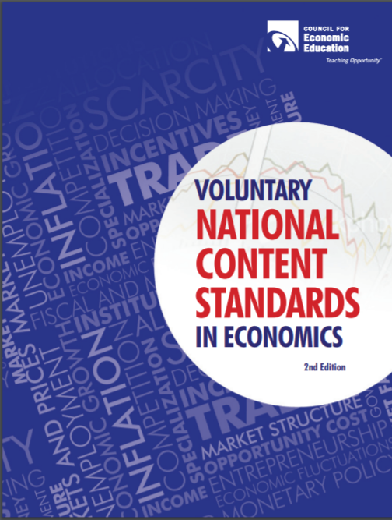
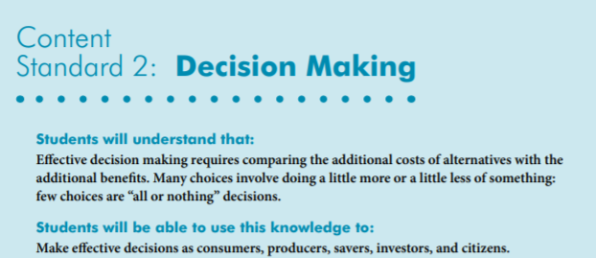
National Content Standards
https://www.councilforeconed.org/wp-content/uploads/2012/03/voluntary-national-content-standards-2010.pdf

Slide 6
Agenda
In this webinar we will:
Welcome attendees and introduce the session. [5 mins.]
Discuss the importance of teaching biographies. [5 mins.]
  Explore featured titles. [35 mins.]
  Discover online links to websites and resources. [5 mins.]
  Review content using Assessment Questions. [5 mins.]
Conclude and complete evaluation [5 mins.]

Slide 7
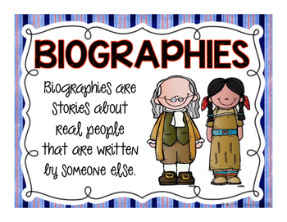
Objectives
In this webinar teachers will:
Celebrate Woman’s History Month by learning about the “She Persisted” series.
Consider the benefits of using children’s biographies to teach about women who made a difference.
Review the economic concepts of decision-making, choices, human capital, and incentives.
Consider a cost/benefit grid as applied to an important decision.
Discuss the influence biographies can have shaping student’s views on society.

Slide 8
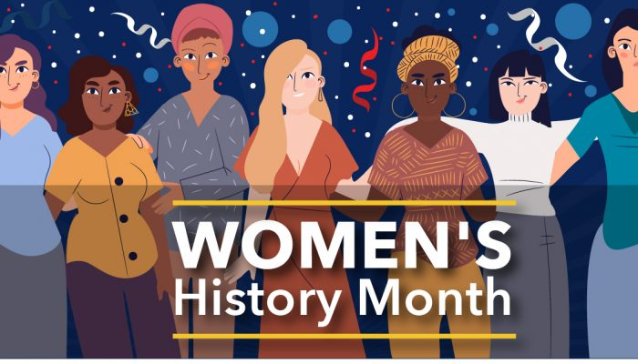
National Women's History Month was established by presidential proclamation in order to draw attention to and improve the focus on women in historical studies. It began in New York City on March 8th 1857, when female textile workers marched in protest of unfair working conditions and unequal rights for women. Beginning in 1910, March 8th became annually observed as International Women's Day.

Slide 9
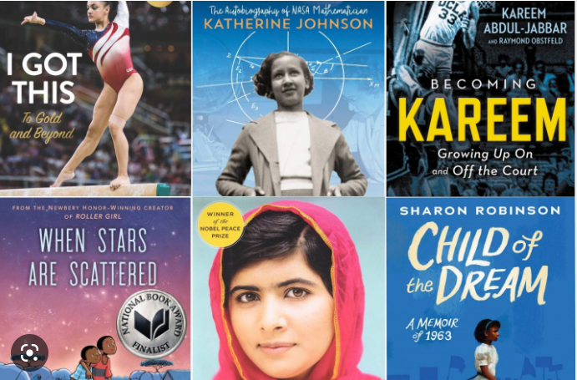
PART I
Introduction
The Benefits Of Students Reading Biographies
The student learns about the person's achievements, struggles, culture, life lessons, and personality.
The reader often makes connections to the featured person.
Biographies teach the student about the world through the eyes of another person.

Slide 10
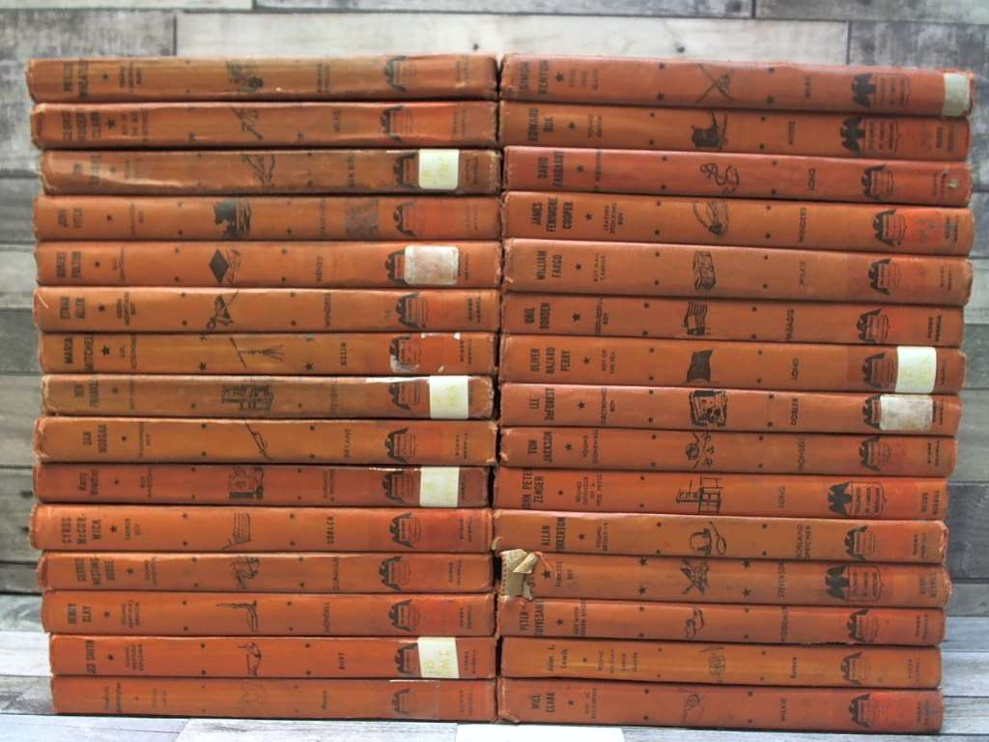
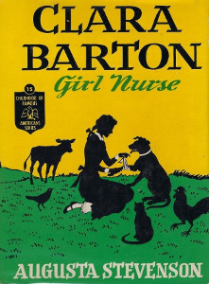




Childhood of Famous Americans
Childhood of Famous Americans series began in 1932 with Abraham Lincoln concentrating on his boyhood with a mix of fact and fictional episodes. It was aimed at children aged 8–12.

Slide 11
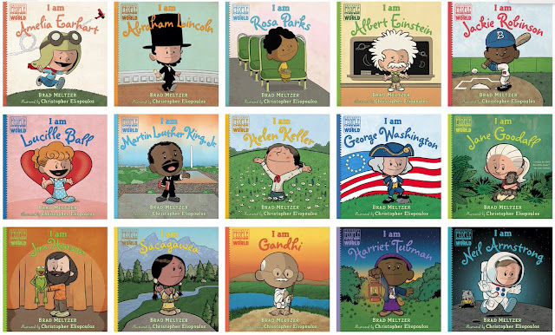
Ordinary People Change the World Series
28 Titles

Slide 12
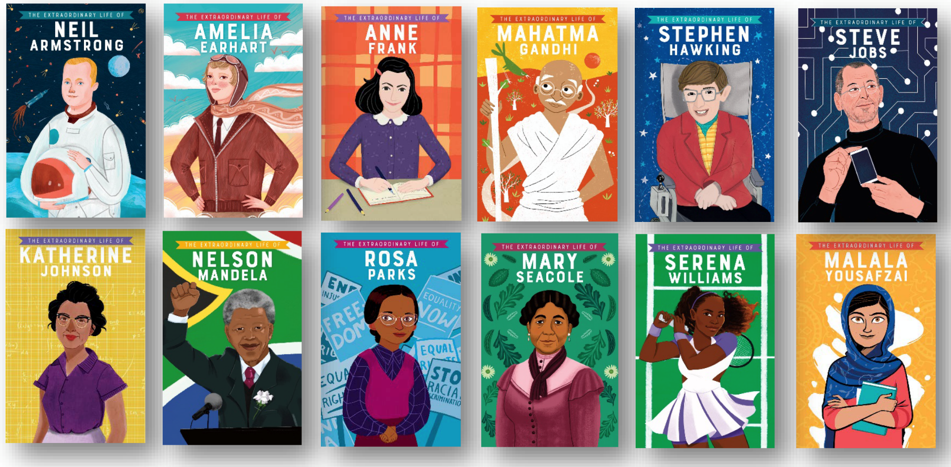
Series: Extraordinary Lives
16 Titles
From real-life narratives to timelines and facts, each fully illustrated book focuses on the life of an inspirational historical or modern figure. Explore the childhood, the achievements, and the qualities of each figure – the very things that helped them have such an incredible impact on the world.

Slide 13
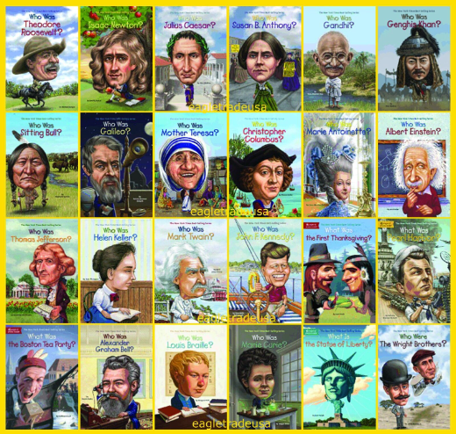
Who Was? Series
A series of illustrated biographies for young readers featuring significant historical figures, including artists, scientists, and world leaders.
216 Titles

Slide 14

The She Persisted Series
First Title in the Series
She Persisted: 13 American Women Who Changed the World
by Chelsea Clinton
Book Synopsis: She Persisted is for everyone who has ever wanted to speak up but has been told to quiet down, for everyone who has ever tried to reach for the stars but was told to sit down, and for everyone who has ever been made to feel unworthy or unimportant or small. This book features: Harriet Tubman, Helen Keller, Clara Lemlich, Nellie Bly, Virginia Apgar, Maria Tallchief, Claudette Colvin, Ruby Bridges, Margaret Chase Smith, Sally Ride, Florence Griffith Joyner, Oprah Winfrey, Sonia Sotomayor.
Publisher: Penguin
Copyright Date: 2017
Reading Level: 6.0
Interest Level: K-3
https://www.youtube.com/watch?v=DFJkBSbJe18
10 minutes

Slide 15

Newest Title in the Series
She Persisted: Bethany Hamilton
By Maryann Cocca-Leffler
Book Synopsis: Bethany Hamilton learned to surf when she was three years old, and she joined—and won—many surfing competitions as a child. When she was thirteen, while she was surfing one morning, a shark suddenly attacked her and bit off her left arm. Through hard work, courage, and faith, Bethany persisted and went on to reach her dream of becoming a professional surfer. Along the way, she used her experience to provide inspiration and comfort to surfers and non-surfers alike.
Publisher: Random House
Copyright Date: 2023
[Release Date 7/4/23]
Reading Level: 2.3
Interest Level: 1-4

Slide 16

PART II
Featured Titles

Slide 17
She Persisted: Marian Anderson
by Katheryn Russell-Brown
Book Synopsis: When renowned classical singer Marian Anderson wasn't allowed to sing at a theater in Washington, DC, because she was Black, First Lady Eleanor Roosevelt invited her to sing at the Lincoln Memorial, at a concert attended by thousands of people. Marian went on to sing around the world on behalf of the UN and the US State Department, and as a part of the Civil Rights Movement, she also performed at the March on Washington. She went on to win many awards, including the first ever Presidential Medal of Freedom and a Grammy Lifetime Achievement Award--and she inspired countless people along the way.
Publisher: Penguin
Copyright Date: 2022
Reading Level: 3.0
Interest Level: 3-6

Slide 18
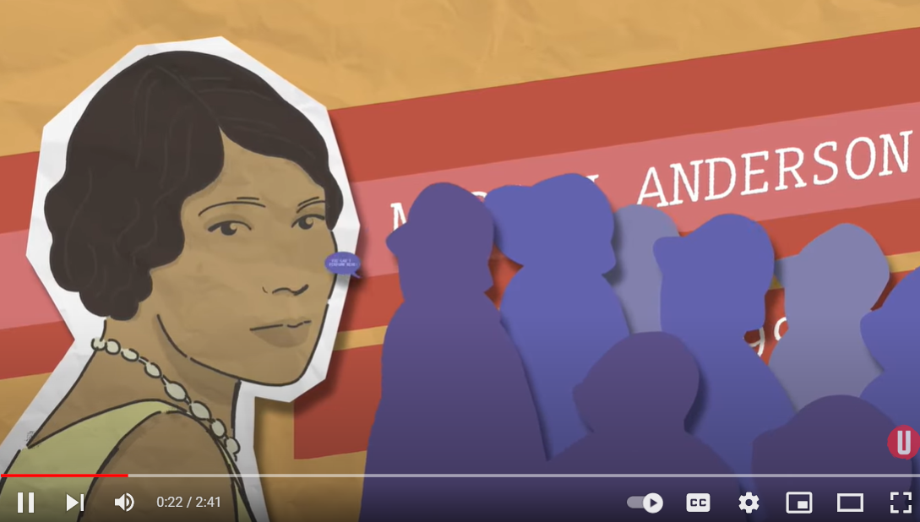
https://www.youtube.com/watch?v=zQgkUt1RZck

Slide 19
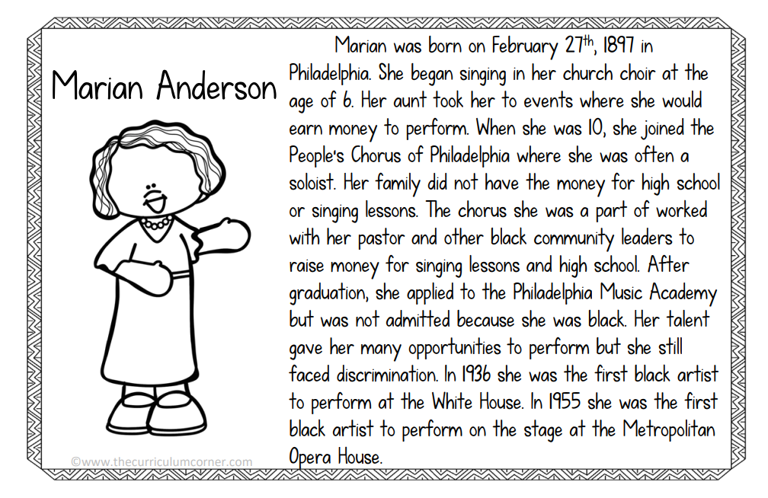

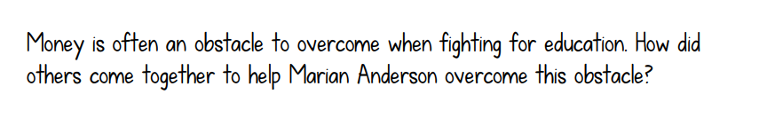
https://www.thecurriculumcorner.com/thecurriculumcorner123/wp-content/pdf/socialstudies/africanamericans/black%20history%20booklet.pdf

Slide 20
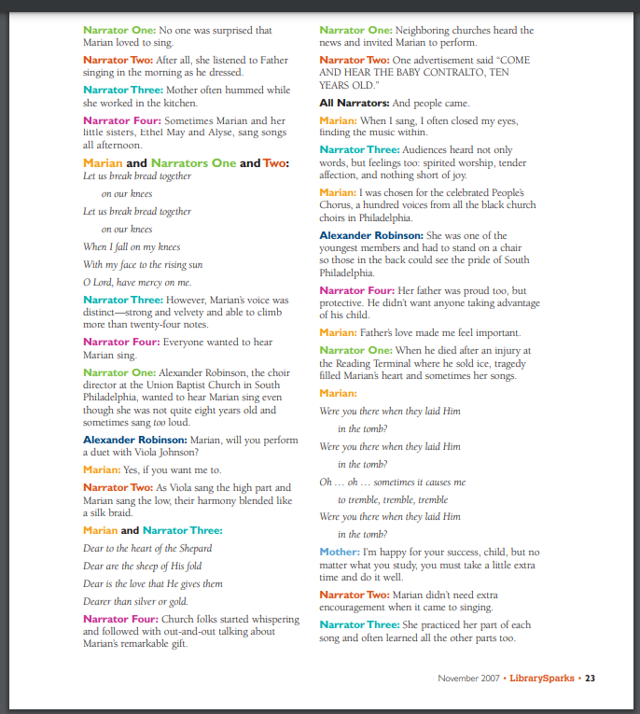
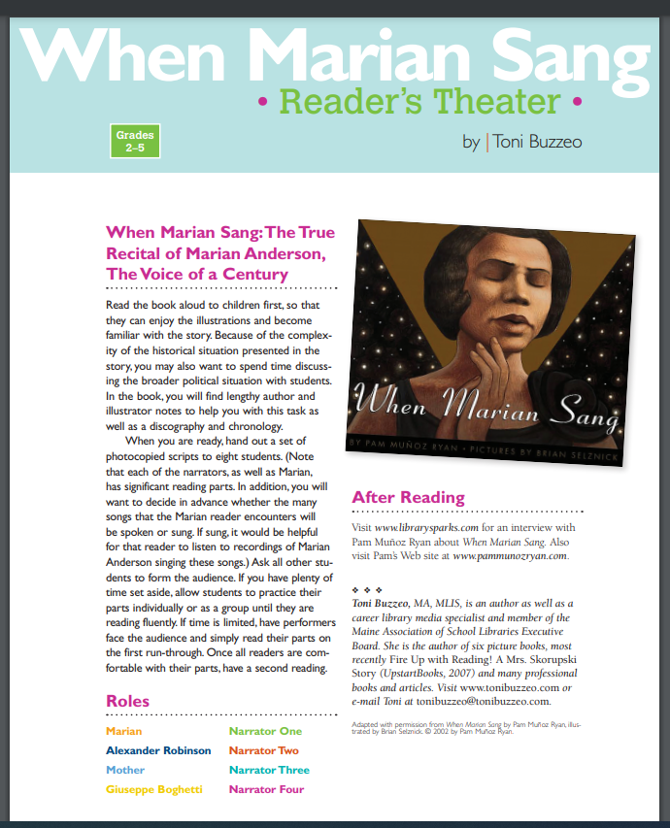
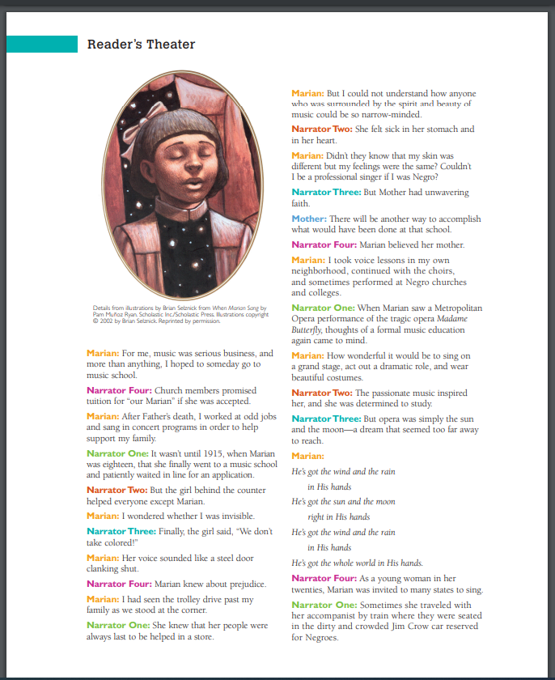
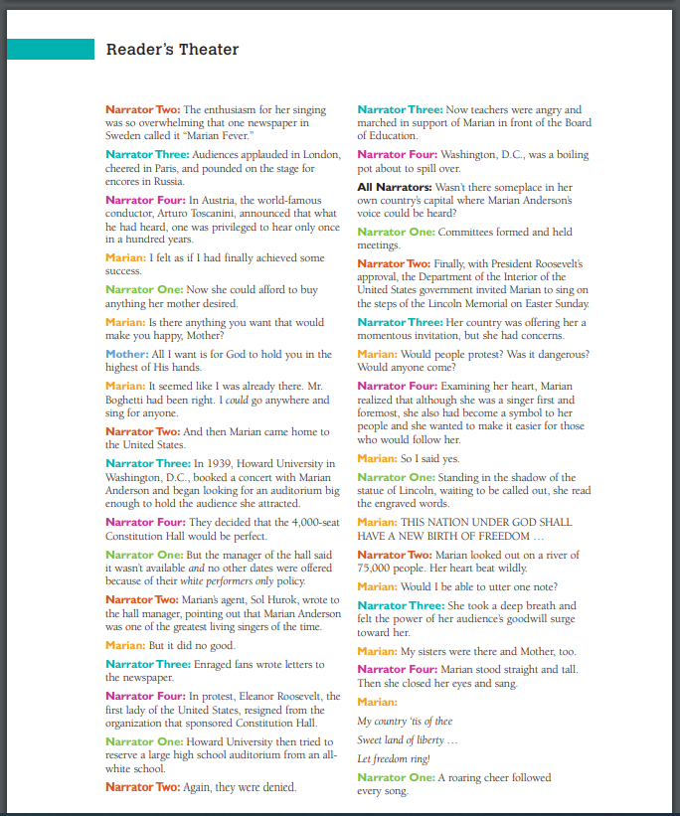
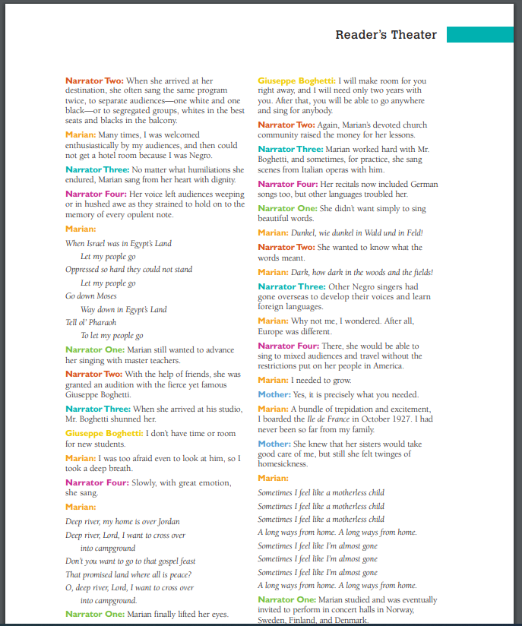
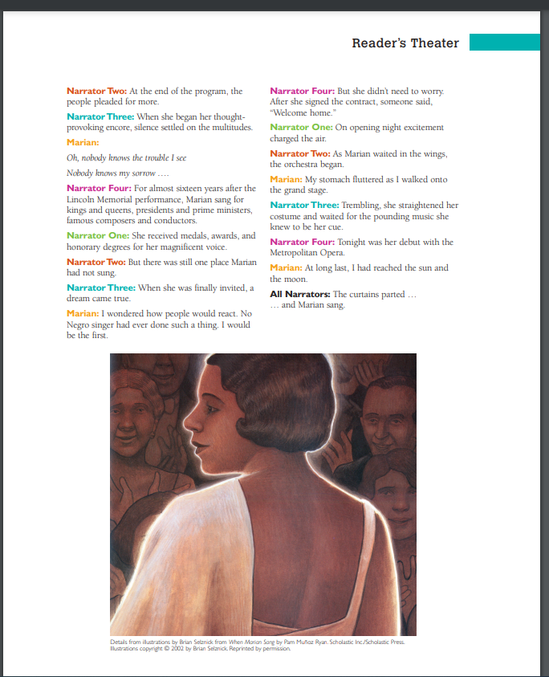
https://www.librarysparks.com/wp-content/uploads/2016/07/lsp_nov07_when_marian_sang_rt.pdf

Slide 21
She Persisted: Patsy Mink
by Tae Keller
Book Synopsis: This book introduces the first Asian American woman elected to Congress, who championed rights for women, children, immigrants and minorities, paving the way for many other women to succeed.
Publisher: Penguin Copyright Date: 2022
Reading Level: 3.0
Interest Level: 1-4

Slide 22
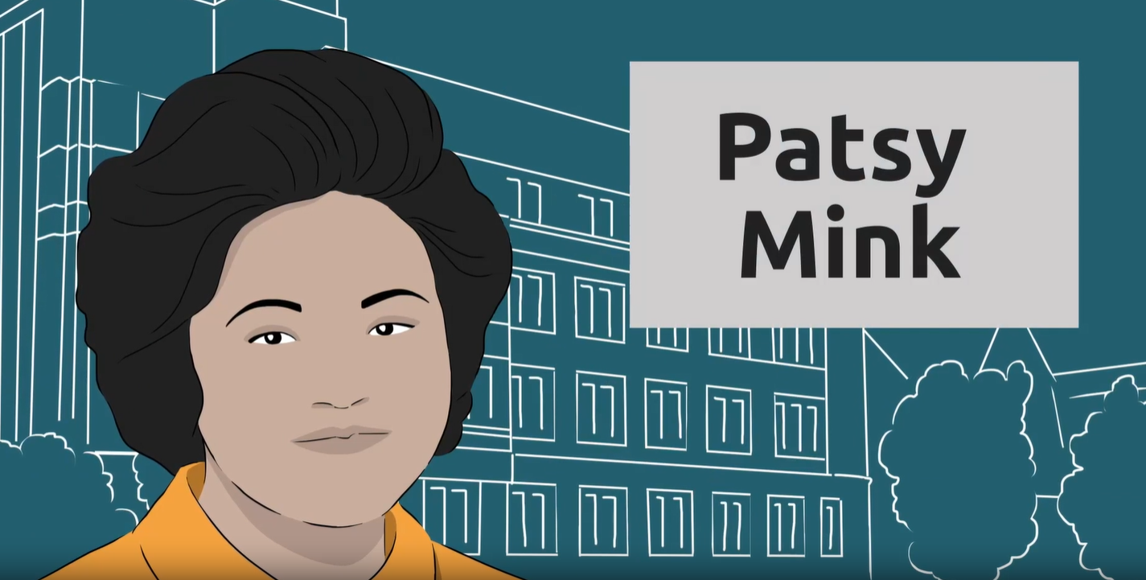
https://www.icivics.org/videos/patsy-mink-changing-rules?page=1&level=high

Slide 23
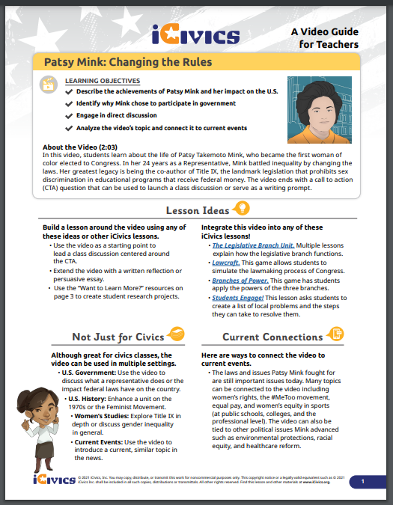
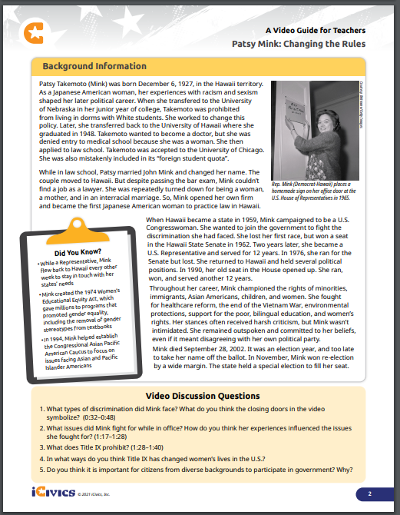

Slide 24
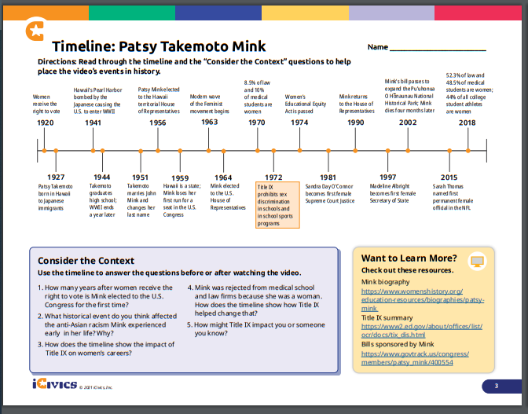

Slide 25
She Persisted: Wilma Mankiller
by Traci Sorell
Book Synopsis: This books shows how Wilma Mankiller dedicated her life to helping Native Nations and their citizens reclaim their rights, becoming the first woman Principal Chief of the Cherokee Nation, and lists ways readers can follow in her footsteps to make a difference.
Publisher: Penguin
Copyright Date: 2022
Reading Level: 3.0
Interest Level: 3-6

Slide 26
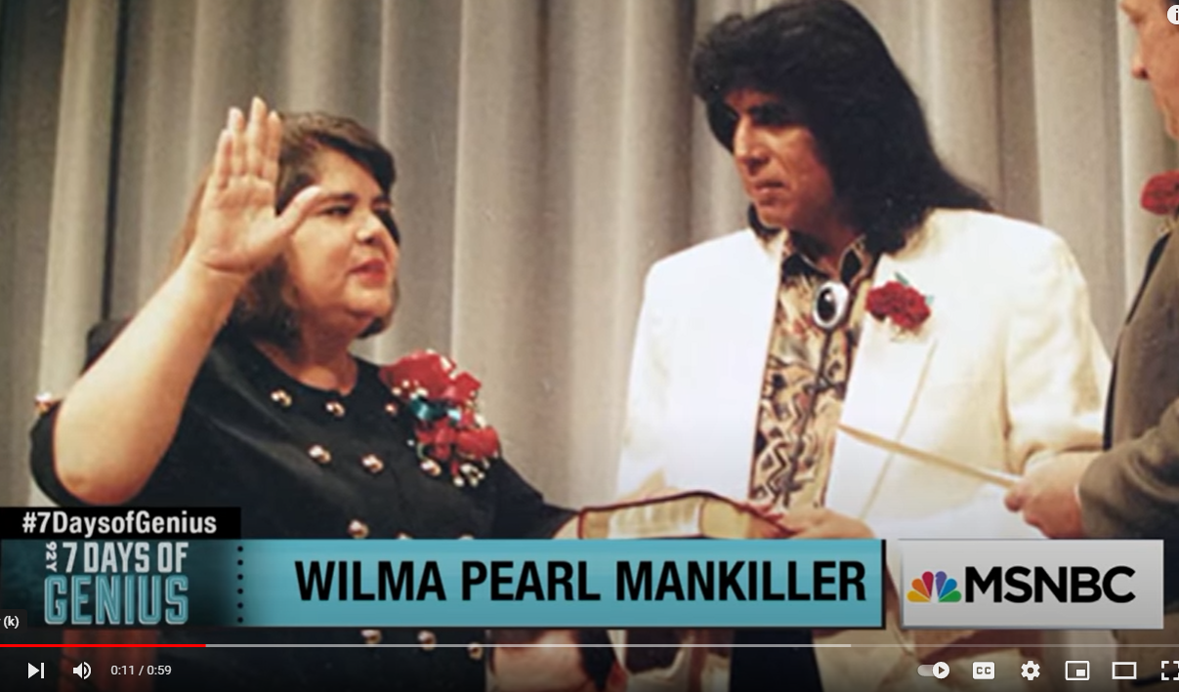
https://www.youtube.com/watch?v=Q9DqbJND2go

Slide 27
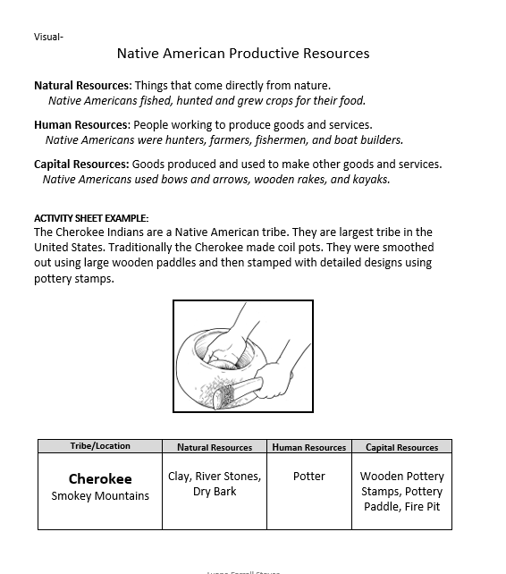
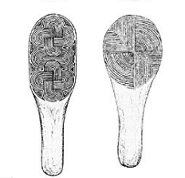
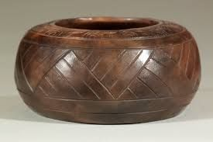
Native American Productive Resources

Slide 28
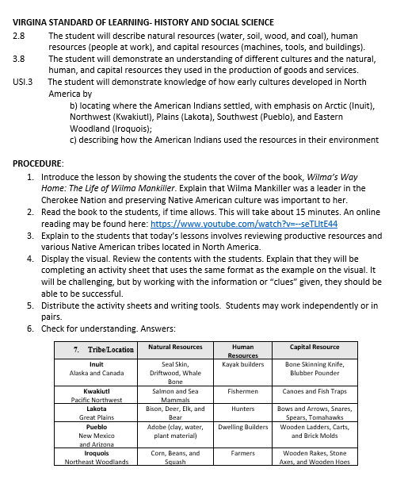
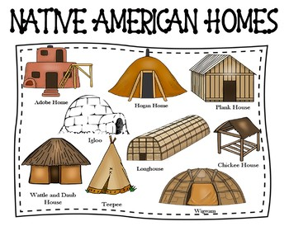
Native American Productive Resources

Slide 29
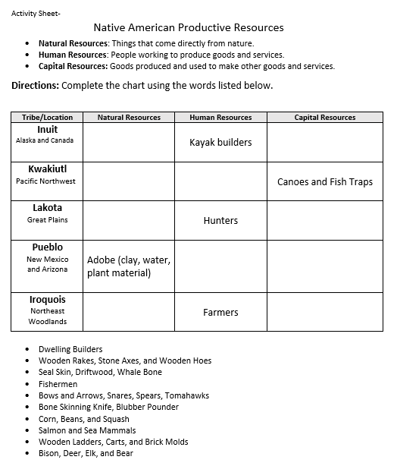


Slide 30
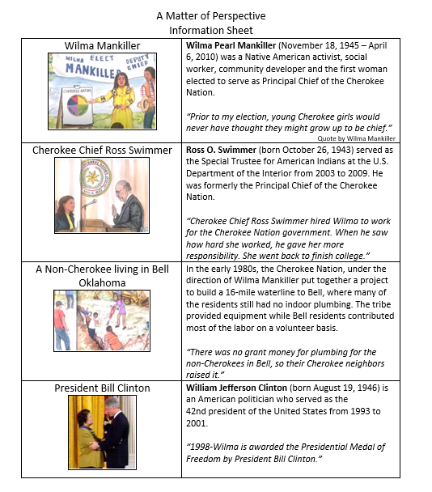
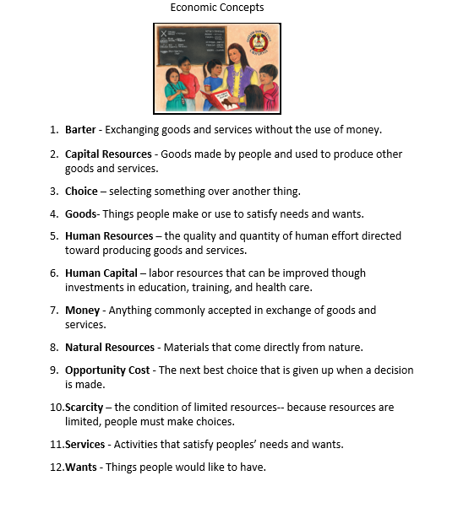
A Matter of Perspective

Slide 31
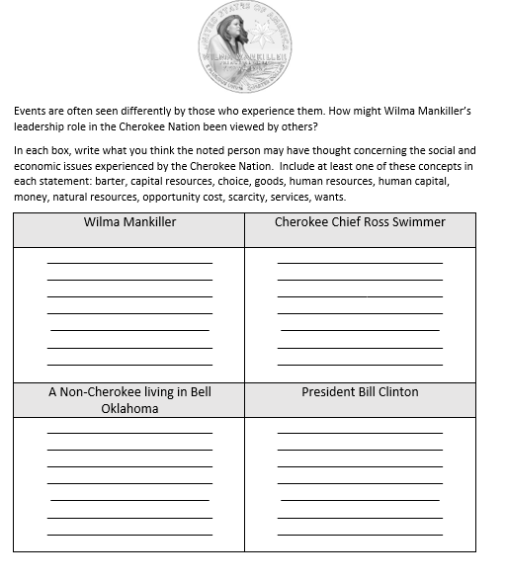

Slide 32
She Persisted: Sonia Sotomayor
by Meg Medina
Book Synopsis: Sonia Sotomayor is the first Latina Supreme Court Justice in the history of the United States, but her road there wasn't easy. She overcame many challenges along the way, including a diagnosis of diabetes at age seven. But she didn't let that stop her from achieving her dream and inspiring children all over the world to work hard and believe in themselves.
Publisher: Penguin
Copyright Date: 2021
Reading Level: 5.3
Interest Level: 3-6

Slide 33
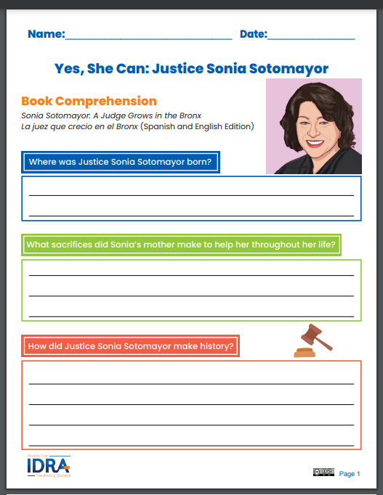
https://idraseen.org/hub-resources/say-her-name-justice-sonya-sotomayor/

Slide 34

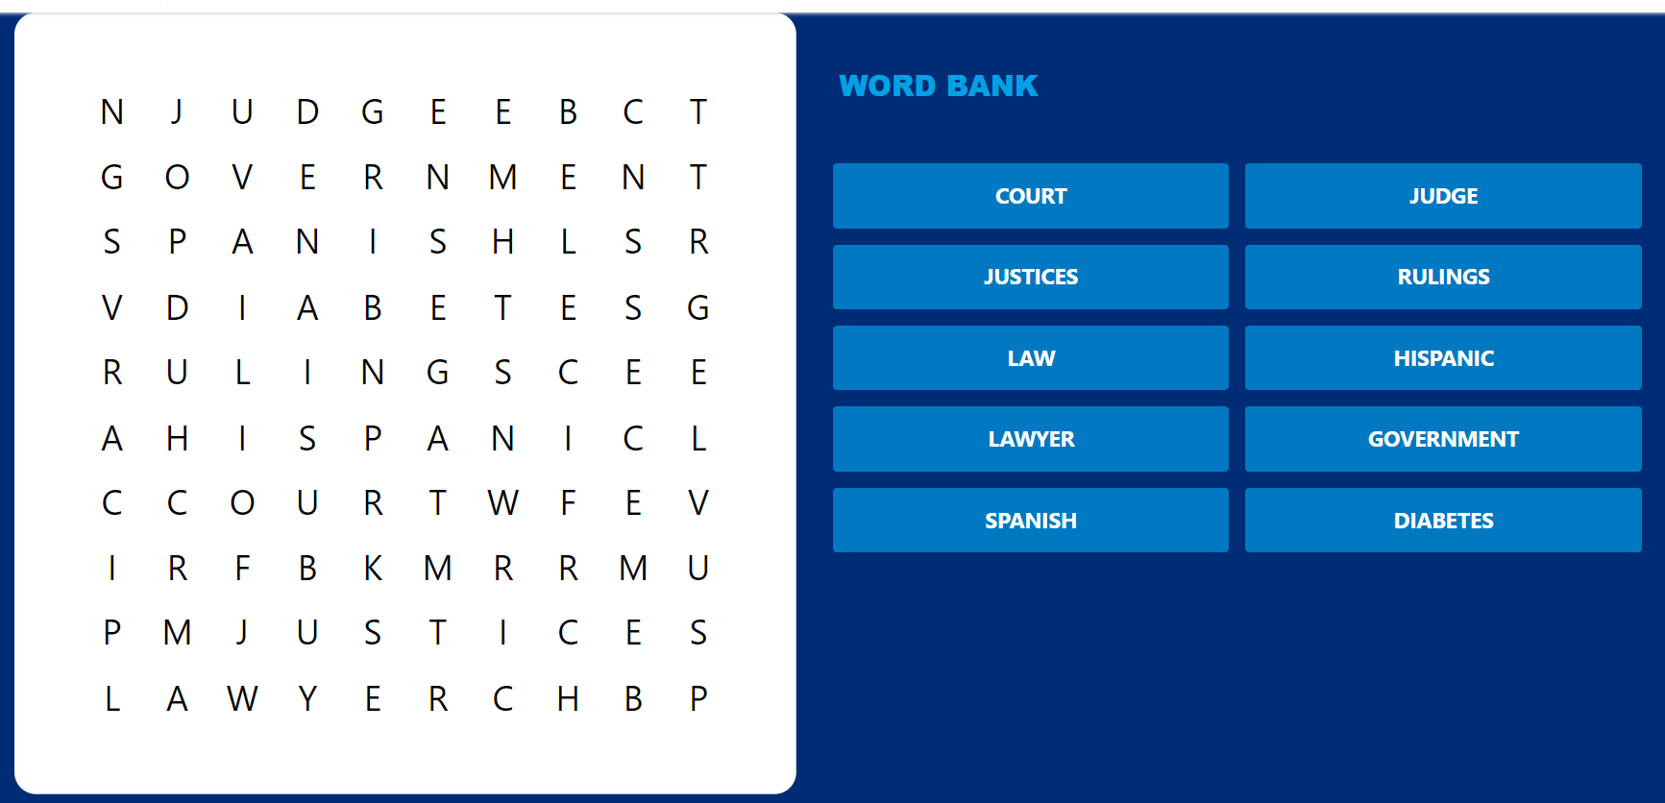
https://www.rif.org/literacy-central/book/sonia-sotomayor-national-geographic-kids

Slide 35

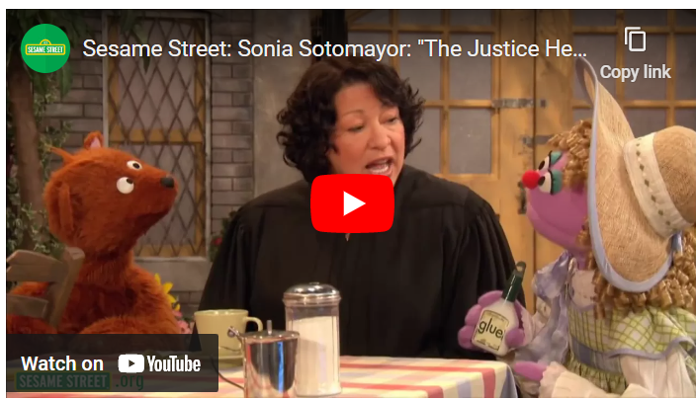
Just Ask!: Be Different, Be Brave, Be You
by Sonia Sotomayor
Book Synopsis: Presents a celebration of the world's diversity that explains why different people make the world more vibrant and wonderful, just the way a variety of plants and flowers enhance a garden.
https://www.learningtogive.org/resources/just-ask-be-different-be-brave-be-you-literature-guide

Slide 36

PART III
She Persisted Generic Lessons and Activities

Slide 37
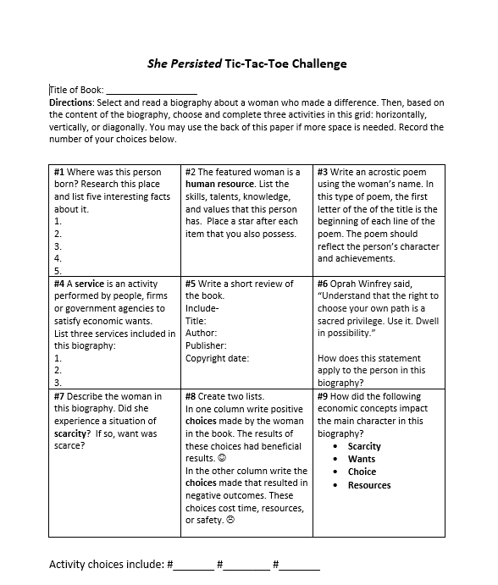
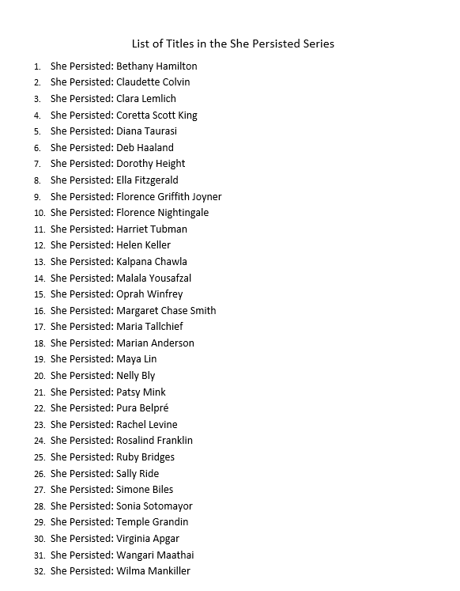


Slide 38
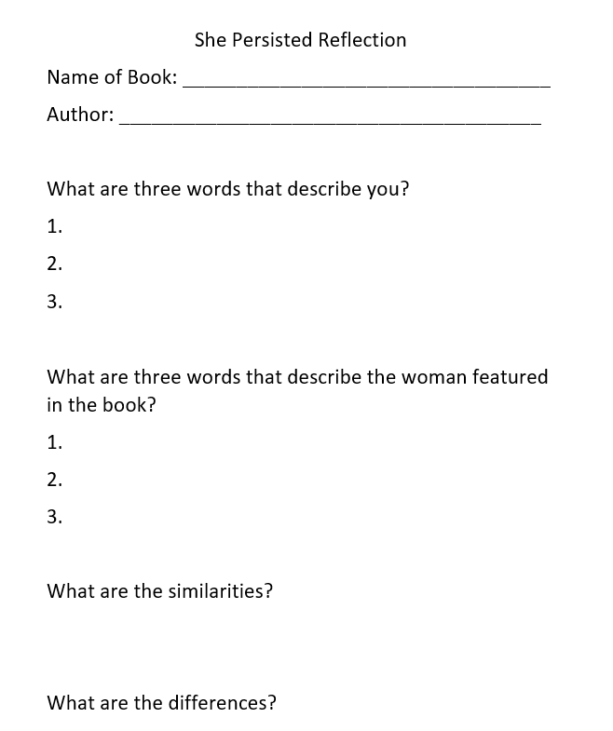
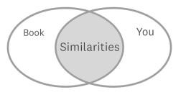

Slide 39
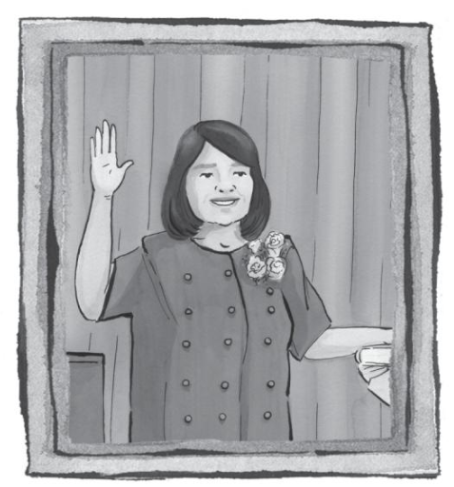
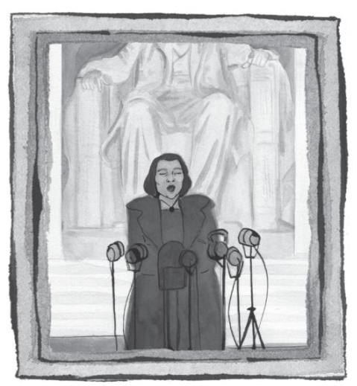
What Do You Think?
Each of these women invested in their success with hard work and education. Do you think their challenges made them over-achievers?
All four of the featured women experienced discrimination. How might the students react to this situation?
How do you think young students will react to learning about the lives of these four women?

Slide 40

Invest In Girls

Slide 41
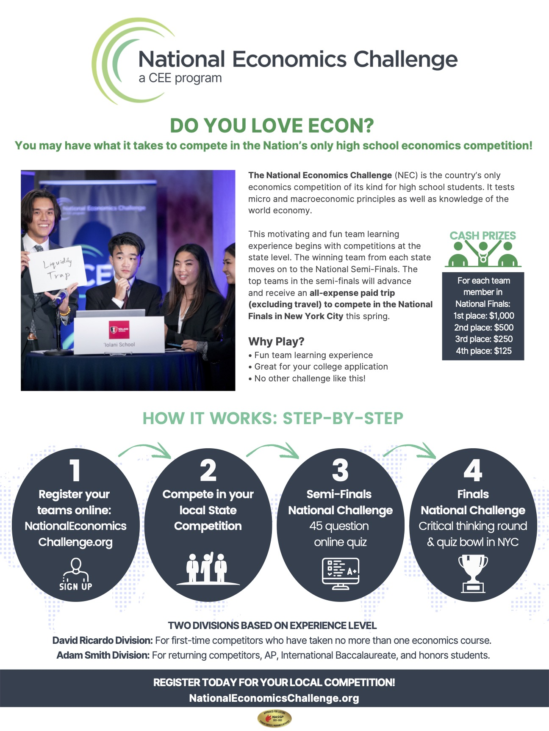
NEC

Slide 42
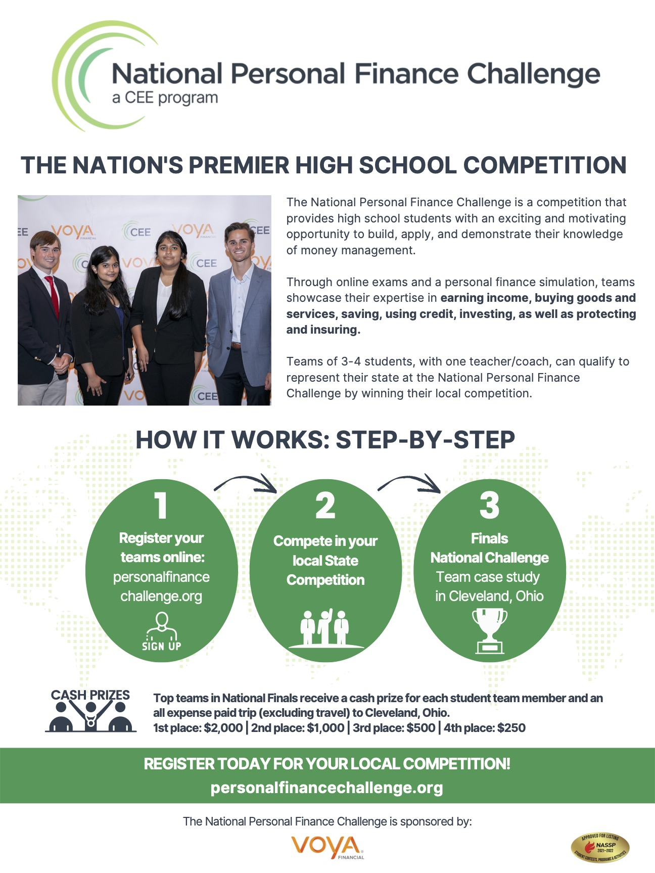
NPFC

Slide 43
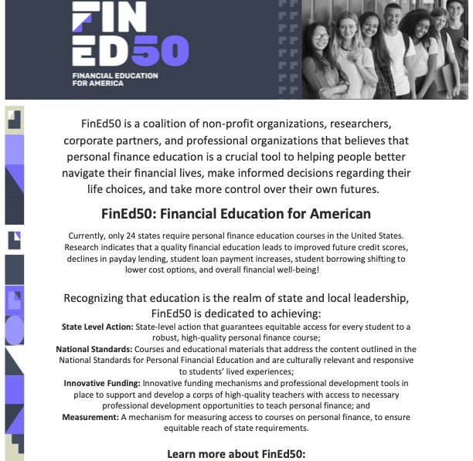
Advocacy

Slide 44

Suggested Presentation Deck
CEE Affiliates
https://www.councilforeconed.org/resources/local-affiliates/
Include your local affiliate page

Slide 45










Thank You to Our Sponsors!

Slide 46
Contact information
Lauren Shifflett shiffllh@jmu.edu
Lynne Stover stoverlf@jmu.edu
Thank You

