Slide 1
Economics Bootcamp: Microeconomics
Capitalism
Market Structures
Externalities
Trade
Presented by Amanda Stiglbauer
Blythewood High School
Blythewood, SC
February 21, 2023
Amanda.stiglbauer@moore.sc.edu

Slide 2
EconEdLink Membership
You can now access CEE’s professional development webinars directly on EconEdLink.org! To receive these new professional development benefits, become an EconEdLink member. As a member, you will now be able to:
Automatically receive a professional development certificate via e-mail within 24 hours after viewing any webinar for a minimum of 45 minutes
Register for upcoming webinars with a simple one-click process
Easily download presentations, lesson plan materials and activities for each webinar
Search and view all webinars at your convenience
Save webinars to your EconEdLink dashboard for easy access to the event
Access our new Professional Development page here

Slide 3
Agenda
Capitalism and its Institutions
  Activity - Break Out Rooms
Break
Market Structures
  Activity 1 - Google Monopoly?
  Activity 2 - Cartels and Competition
Break
Comparative Advantage
  Activity / Simulation
Wrap Up

Slide 4

What is an institution?
Notes:
🍐 This is a Pear Deck Text Slide
🍐 To edit the type of question, go back to the "Ask Students a Question" in the Pear Deck sidebar.

Slide 5

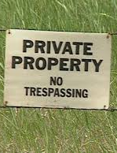
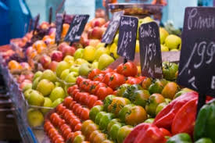
4 Key Institutions of Capitalism
Rule of Law
Markets
  prices, voluntary
Private Property
Entrepreneurship

Slide 6
Activity
Individually--Read your country’s description carefully.
In your group--Discuss the presence or absence of each of the institutions (on your chart). Then, list at least two pieces of evidence for each institution.
After completing your chart, decide where your country fits on the class continuum--more capitalist/less capitalist.
Write your country’s name on a post-it note and place it on the class continuum. Have a speaker who can defend your placement.
Notes:
https://www.fte.org/teachers/teacher-resources/lesson-plans/is-capitalism-good-for-the-poor-2/will-the-real-capitalism-please-stand-up/

Slide 7
Your Economic Analysis
Institution | Present/Absent | Evidence
Markets
Private Property
Rule of Law
Entrepreneurship
Clearly present - component is present in the economy with few exceptions
Generally present - component is present, but with many or significant exceptions
Generally absent - component is only present in the economy in limited forms
Clearly absent - component is almost entirely excluded from the economy
More Capitalist
Less Capitalist
U.S.
Notes:
https://www.fte.org/teachers/teacher-resources/lesson-plans/is-capitalism-good-for-the-poor-2/will-the-real-capitalism-please-stand-up/

Slide 8
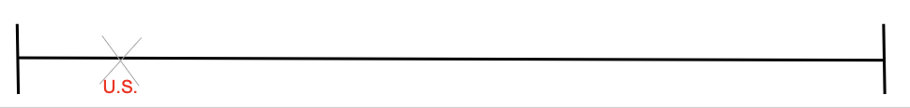
More Capitalist
Less Capitalist
Notes:
🍐 This is a Pear Deck Drawing Slide
🍐 To edit the type of question, go back to the "Ask Students a Question" in the Pear Deck sidebar.

Slide 9
Debrief
Where did you place your country on the spectrum? Why?
How has your view of capitalism changed as a result of this exercise?

Slide 10

Break!

Slide 11

Objectives
I can differentiate the characteristics of perfectly and imperfectly competitive market structures.

Slide 12
I can differentiate the characteristics of perfectly and imperfectly competitive market structures.
Objectives

Slide 13
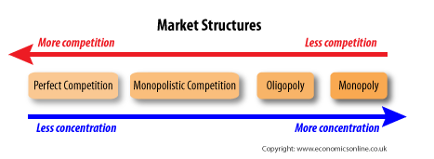

Slide 14
Characteristics of Perfect Competition
Many sellers— “price takers”
  Price taken from market
  Sell all they supply at market price
  Buyers/sellers too small to have impact
  No incentive to lower price
identical product
Free entry and exit
Zero economic profits (long run)**
  Same as earning a normal profit

Slide 15


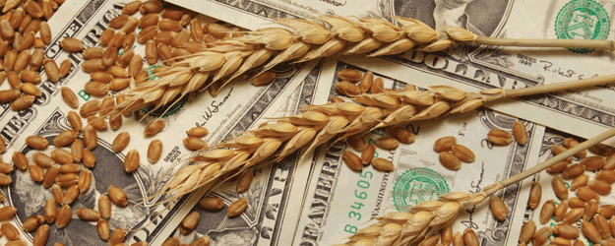
Examples

Slide 16

Monopoly

Slide 17

Pure Monopolies
Single Seller
No close substitutes
“Price Maker”
Blocked Entry
Examples:
  De Beers diamonds
  Professional sports teams
  Utilities
  Cable
  Taxis*
  lottery
  Patents on prescriptions
  Small, isolated communities
  Natural monopolies

Slide 18

RIP MR.DARP
October 30 - Today

Slide 19

Monopolist’s MR<D
Because monopolist must set a lower price to obtain greater sales, marginal revenue is less than price for every level of output except the first.
  Lower price applies to all units sold.
  Think about it this way: MR decreases for all units sold previously because you must charge same price for all.

Slide 20
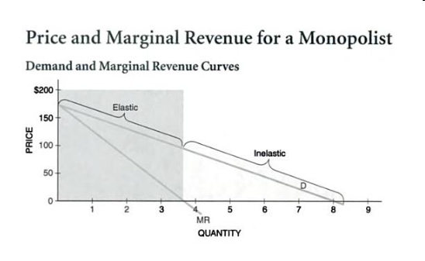

Slide 21
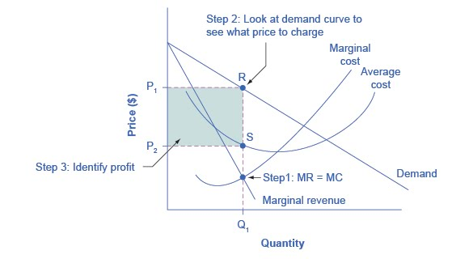
Graphing Monopoly

Slide 22
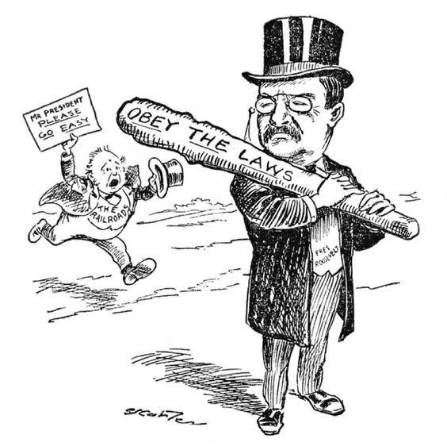
Ways to Deal With Monopolies
  Do Nothing
  Break Up Using Anti-Trust Regulation
  Publically own
  Price Regulation
    Price ceiling
    Socially optimal price/fair return price

Slide 23
Google: A Monopoly?
Instructions:
Read the article Justice Department Sues Google for Monopolizing Digital Advertising Technologies
Share key takeaways with your breakout group, beginning with the person wearing the brightest color shirt.
Person with LIGHTEST color shirt- share out for group on the PearDeck discussion.
Notes:
https://www.justice.gov/opa/pr/justice-department-sues-google-monopolizing-digital-advertising-technologies

Slide 24
Additional Resources for Monopoly
Market Structure Simulation – Mr. Clifford
Monopoly Overview – MR University
Price Discrimination – MR University
Monopoly and Imperfect Competition – Crash Course

Slide 25

Monopolistic
Competition

Slide 26

Drawing!
What’s your favorite monopolistically competitive firm? Draw its logo!
Notes:
🍐 This is a Pear Deck Drawing Slide
🍐 To edit the type of question, go back to the "Ask Students a Question" in the Pear Deck sidebar.
Drawing Conclusions
Being able to draw a conclusion after hearing new information is an important skill. Ask students to articulate the conclusions they are drawing from the new information. Show the responses anonymously on the projector screen to see if students came to different conclusions, then discuss.

Slide 27
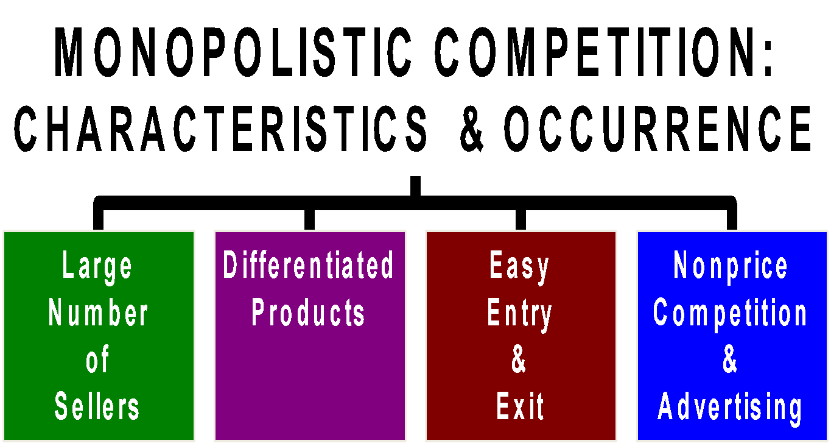

Slide 28


Activities to Introduce Oligopoly
Play Tic-Tac-Toe with a partner
Play Connect 4

Slide 29

Oligopoly

Slide 30
03
Cartels & Competition
Economics for Leaders
Activity 3
Lesson Available Online at www.fte.org
https://www.fte.org/teachers/teacher-resources/lesson-plans/efllessons/cartels-and-competition/

Slide 31
Meet Your Team
4 minutes
Come up with a Team Name
2. Choose a
Captain that will submit
your production decisions
3. Choose an
accountant keep
the balance sheet.
Notes:
Divide students into 6 companies.

Slide 32
The Producers…
6 companies…
Do 98% of the business in this industry.

Slide 33
The Incentive
Your goal: make as much profit as possible
Prizes for ALL companies that earn MORE than $200 profit!
Additional prize for company that earns the MOST profit!

Slide 34
Directions
The interaction of market demand and market supply will determine the market-clearing price, the price at which the units you produce will sell.
In each round, a forecast of market demand will be displayed. Remember that this is only a forecast, and actual demand may vary from the forecast somewhat.

Slide 35
Demand Forecast
Market Demand (QD) | Price
0-6 | $125
7-13 | $100
14-19 | $75
20-26 | $50
27-32 | $30
33-40 | $25
41-50 | $20
Notes:
Does this follow the law of demand? (Yes. At higher prices, QD is less and vice versa.)

Slide 36
Directions
You will have to make your own forecast, or prediction, of market supply. You will know how many units your own company will produce, but the TOTAL market supply will include not only your own production, but also that of the other companies in the class.

Slide 37
Example
Market Demand (QD) | Price
0-6 | $125
7-13 | $100
14-19 | $75
20-26 | $50
27-32 | $30
33-40 | $25
41-50 | $20
If you produce 1 unit and so do all the other companies, the total supply will be 6 units.
According to the demand forecast, what will the market price be?
Notes:
Answer: $125

Slide 38
Example (continued)
Your decision must also take into account your production cost.
Suppose your cost is $25 per unit and you sell that unit for $125:
$125 total revenue
- $25 total cost
$100 profit

Slide 39
Now you try...
Market Demand (QD) | Price
0-6 | $125
7-13 | $100
14-19 | $75
20-26 | $50
27-32 | $30
33-40 | $25
41-50 | $20
Suppose your company produces 3 units, total market supply is 19 units, and your production cost is $25 per unit.
Cost of production x #units produced = Total cost of production.
Units sold x price = Total Revenue
Total Revenue - Total cost = profit or loss
Notes:
🍐 This is a Pear Deck Text Slide
🍐 To edit the type of question, go back to the "Ask Students a Question" in the Pear Deck sidebar.
Display student answer results. Discuss correct answer.
Answer $150
TR: 3x75=225
TC: 3x25=75
Profit: 225-75 = $150
OR Calculate per unit profit and multiply by units produced: 75-25 = 50… 50x3 = 150

Slide 40
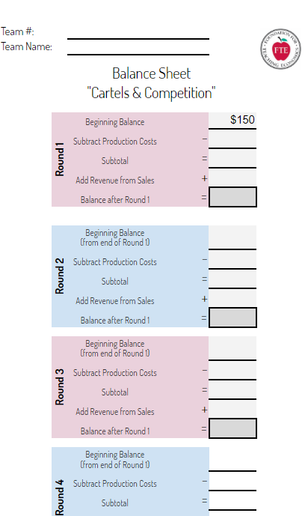
The Production Decision Worksheet

Slide 41
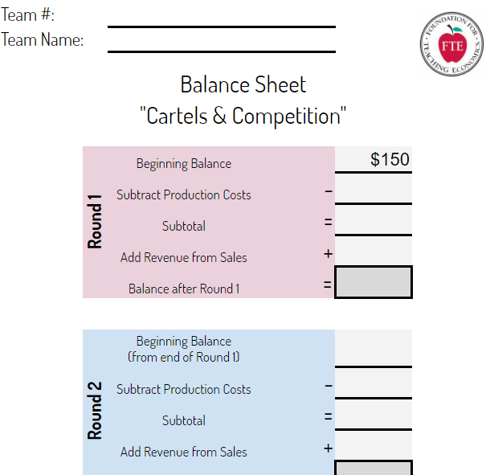
Production Decision Worksheet
Notice Balance is $150 to start.
Notes:
https://docs.google.com/spreadsheets/d/1Cpb0_i6o3Gd1dFZM21WpteZ8NZt5ga6DSXBLzYO5WT0/edit?usp=sharing

Slide 42
Production Costs
Market Demand (QD) | Price
0-6 | $125
7-13 | $100
14-19 | $75
20-26 | $50
27-32 | $30
33-40 | $25
41-50 | $20
You must pay your production costs up front (from your balance).
Production costs for all rounds will be $30.
What is the most any team could produce in round 1?
Notes:
🍐 This is a Pear Deck Text Slide
🍐 To edit the type of question, go back to the "Ask Students a Question" in the Pear Deck sidebar.
Correct answer: 5 ($30 x 5 = $150)

Slide 43
Round 1
Market Demand (QD) | Price
0-6 | $125
7-13 | $100
14-19 | $75
20-26 | $50
27-32 | $30
33-40 | $25
41-50 | $20
Make your production decisions.

Slide 44
Round 1 Results
Market Demand (QD) | Price
0-6 | $125
7-13 | $100
14-19 | $75
20-26 | $50
27-32 | $30
33-40 | $25
41-50 | $20
Market supply is…..
So price is….
Notes:
Announce production decisions (anonymously), total market supply and price.

Slide 45
Round 1 Results
When you return to breakout rooms.
Calculate your revenue from Round 1 sales. (price x # produced)
Calculate your new balance going into Round 2.
Questions?
Notes:
https://docs.google.com/spreadsheets/d/1Cpb0_i6o3Gd1dFZM21WpteZ8NZt5ga6DSXBLzYO5WT0/edit?usp=sharing
Ask if there are any questions then dismiss to breakout rooms for Round 2.

Slide 46
Round 2
Calculate your revenue from Round 1 sales. (price x # produced)
Calculate your new balance going into Round 2.
Make production decision for Round 2.

Slide 47
Round 1 Results
Market Demand (QD) | Price
0-6 | $125
7-13 | $100
14-19 | $75
20-26 | $50
27-32 | $30
33-40 | $25
41-50 | $20
Market supply is…..
So price is….
Notes:
Announce production decisions (anonymously), total market supply and price.

Slide 48
Round 2 Results
Market Demand (QD) | Price
0-6 | $125
7-13 | $100
14-19 | $75
20-26 | $50
27-32 | $30
33-40 | $25
41-50 | $20
Market supply is…..
So price is….
Update Balance Sheet
Notes:
Announce production decisions (anonymously), total market supply and price.
Explain how to calculate revenue and new balance.
Ask if there are any questions then dismiss to breakout rooms for Round 2.

Slide 49
Round 3
Market Demand (QD) | Price
0-6 | $125
7-13 | $100
14-19 | $75
20-26 | $50
27-32 | $30
33-40 | $25
41-50 | $20
Update Balance Sheet.
Discuss production decision for Round 3.
Notes:
Dismiss to break-out rooms

Slide 50
Round 3
Market Demand (QD) | Price
0-6 | $125
7-13 | $100
14-19 | $75
20-26 | $50
27-32 | $30
33-40 | $25
41-50 | $20
Exciting News!
Trade Convention for Industry Executives.
Each company can send 1 person (does not have to be team captain)

Slide 51
Round 3
Market Demand (QD) | Price
0-6 | $125
7-13 | $100
14-19 | $75
20-26 | $50
27-32 | $30
33-40 | $25
41-50 | $20
Executives Returning….
Make production decision for Round 3.

Slide 52
Round 3 Results
Market Demand (QD) | Price
0-6 | $125
7-13 | $100
14-19 | $75
20-26 | $50
27-32 | $30
33-40 | $25
41-50 | $20
Market supply is…..
So price is….
Questions?
Notes:
Announce production decisions (anonymously), total market supply and price.
Ask if there are questions. Anticipate some questions/comments directed to other teams.
If collusion did not happen, or they colluded and stuck to the agreement, continue with Round 4. Notice next 4 slides say “Next Round” so they can be re-used for a 4th or 5th round if necessary.
If they colluded and cheated on the agreement, end the game here. Quickly click past the next 4 “next round” slides. Have teams submit their balance sheets by sharing the link via Canvas message or private zoom chat.

Slide 53
Next Round
Market Demand (QD) | Price
0-6 | $125
7-13 | $100
14-19 | $75
20-26 | $50
27-32 | $30
33-40 | $25
41-50 | $20
Update Balance Sheet.
Discuss production decision.
Notes:
Dismiss to break-out rooms

Slide 54
Next Round
Market Demand (QD) | Price
0-6 | $125
7-13 | $100
14-19 | $75
20-26 | $50
27-32 | $30
33-40 | $25
41-50 | $20
Trade Convention!
Trade Convention for Industry Executives.
Each company can send 1 person (does not have to be team captain)
Production decisions will not be made until they return.

Slide 55
Next Round
Market Demand (QD) | Price
0-6 | $125
7-13 | $100
14-19 | $75
20-26 | $50
27-32 | $30
33-40 | $25
41-50 | $20
Executives Returning….
Make production decision.

Slide 56
Results
Market Demand (QD) | Price
0-6 | $125
7-13 | $100
14-19 | $75
20-26 | $50
27-32 | $30
33-40 | $25
41-50 | $20
Market supply is…..
So price is….
Questions?
Notes:
Announce production decisions (anonymously), total market supply and price.
Ask if there are questions. Anticipate some questions/comments directed to other teams.
If collusion did not happen, or they colluded and stuck to the agreement, continue with Round 5 (back-up and re-use last 4 “next round” slides”.
If they colluded and cheated on the agreement, end the game here. Have teams submit their balance sheets by sharing the link via Canvas message or private zoom chat.

Slide 57
Debrief
What happened?
Why did you want to talk to the other companies?
Did it work?
What motivated you to collude?
What motivated you to cheat on that collusive agreement?
Notes:
Suggested debrief questions from lesson:
Which team made the most money? What was your strategy?
• Which team made the least? What was your strategy and why did it fail?
• Why did you want to talk to the other teams/companies?
• Why did you agree to set production levels? What was the impact on the market of such an agreement? What was the impact on your profit?
• How did you decide how much to produce?
• Did agreeing to set production levels work? Why? Why not?
• How did the profit motive, the desire of teams to make profit, act as an incentive? What behaviors did this incentive encourage?
• Looking at all the rounds of the simulation, make a generalization about the relationship between price and level of production (supply)
• How does the creation of a cartel affect consumers - both in terms of product availability and in terms of price?
• Predict what happens - in the short run and in the long run - in markets that do NOT prohibit collusion among producers.
• Evaluate the argument that it doesn’t matter if producers try to collude; the system of incentives Will undermine their efforts. (You might want to read excerpts from Adam Smith at this point, or have ready a reading assignment for homework.)
• Predict the impact on the market of rules or laws that prohibit collusion between producers.
• Predict the impact on the market of rules or laws that enforce cooperation among producers – for example: licensing requirements for doctors, teachers, hairdressers, taxicabs; or regulatory agencies etc.

Slide 58
Debrief
Whose voice isn’t represented in this conversation?
  Consumers!
How would consumers they perceive this outcome?
People respond to incentives…
  Buyers, sellers, business executives… even high school students!
There’s an incentive to collude.

Slide 59
Debrief
What would be the impact of laws or rules that enforce cooperation among producers?
  EX: licensing requirements for doctors, teachers, hairdressers, taxicabs; or regulatory agencies etc.
What would be the impact of laws or rules that prohibit cooperation among producers?

Slide 60
Conclusion
Profit is the motivator. Competition is the regulator.
Incentives matter.
Desire for profit and competition undermine collusive agreements.

Slide 61
Break! :)

Slide 62

Learning Targets
I can explain the difference between absolute advantage and comparative advantage.
I can explain why nations trade.

Slide 63

Discussion
When you’re completing a group project, do you do all the work or do you divide tasks between your group members? How do you decide who completes each task?

Slide 64
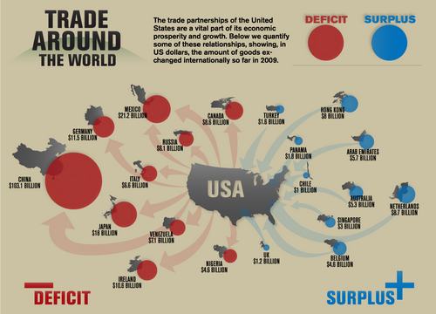

Slide 65

Important Definitions
Absolute Advantage: ability to produce more of a product using less of a resource….best at doing something
Comparative Advantage: an economy can produce a good for a lower OPPORTUNITY cost than another.

Slide 66

So What?
AA doesn’t necessarily mean an economy should produce the good.
  Country may have an absolute advantage in MANY goods, but shouldn’t produce everything.
  COMPARATIVE ADVANTAGE gives us a better indication of what economies should produce.

Slide 67
Comparative Advantage
One nation (individual/company) can produce a good at a lower opportunity cost than the other.
This comes into play when one individual (nation, company....) has the absolute advantage in both.
YOU CANNOT HAVE THE COMPARATIVE ADVANTAGE IN BOTH!

Slide 68

Task 1: I <3 Econ Texts
You have two minutes to TEXT I <3 Econ to a chosen recipient as many times as you can. At the end of the two minute time frame, count the number of completed texts and record it on your scorecard (type in the chat).

Slide 69
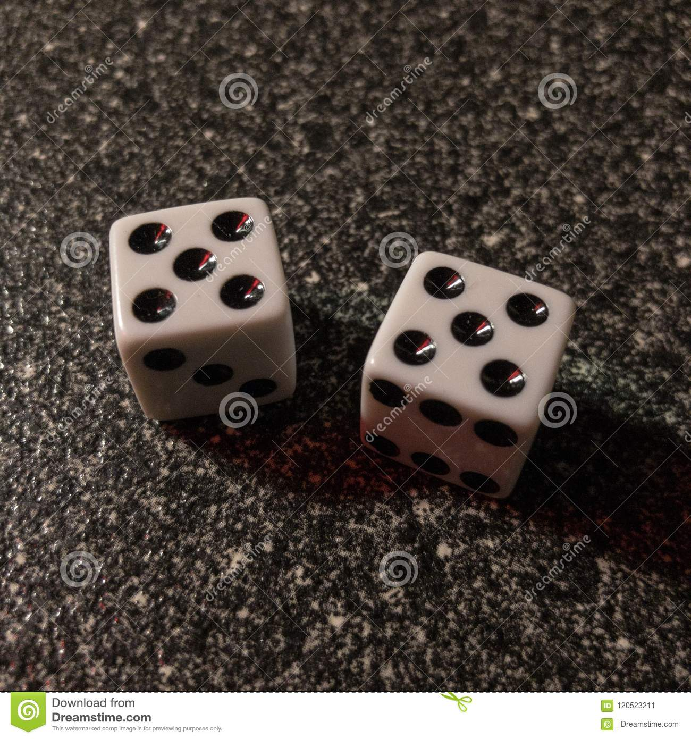
Task #2: Dice
You have two minutes to roll any combination of the number 10 on the two dice. Record the number of times you roll 10 by using tally marks and be ready to report your results when time elapses.

Slide 70
Data from Tasks 1 and 2
 | Smith | Keynes
Texts
Dice

Slide 71
Quick Fingers!
Type in the chat!
What are the top EXPORTS of the US?
What are the top IMPORTS of the US?

Slide 72
Thank you!
Presented by Amanda Stiglbauer
Blythewood High School
Blythewood, SC
February 21, 2023
Amanda.stiglbauer@moore.sc.edu

Slide 73
Professional Development Opportunities
To earn professional development credit for CEE webinars found on EconEdLink, you must:
Watch a minimum of 45-minutes and you will automatically receive a professional development certificate via e-mail within 24 hours.
Attendees can learn how much credit they will earn per workshop.
Accessing resources:
You can now easily download presentations, lesson plan materials, and activities for each webinar from EconEdLink.org/professional-development/
Local resources:
Insert your local professional development opportunities (if applicable)

Slide 74

Invest In Girls

Slide 75

NEC

Slide 76

NPFC

Slide 77

Advocacy

Slide 78

Suggested Presentation Deck
CEE Affiliates
https://www.councilforeconed.org/resources/local-affiliates/
Include your local affiliate page

Slide 79










Thank You to Our Sponsors!

