Slide 1
Presented by: Amber Thomas
Email: acthomas@nccee.org
Date: Monday, January 23, 2023
Professional Development
The Dollars and Sense of the Super Bowl

Slide 2
EconEdLink Membership
You can now access CEE’s professional development webinars directly on EconEdLink.org! To receive these new professional development benefits, become an EconEdLink member. As a member, you will now be able to:
Automatically receive a professional development certificate via e-mail within 24 hours after viewing any webinar for a minimum of 45 minutes
Register for upcoming webinars with a simple one-click process
Easily download presentations, lesson plan materials and activities for each webinar
Search and view all webinars at your convenience
Save webinars to your EconEdLink dashboard for easy access to the event
Access our new Professional Development page here

Slide 3
Professional Development Opportunities
To earn professional development credit for CEE webinars found on EconEdLink, you must:
Watch a minimum of 45-minutes and you will automatically receive a professional development certificate via e-mail within 24 hours.
Attendees can learn how much credit they will earn per workshop.
Accessing resources:
You can now easily download presentations, lesson plan materials, and activities for each webinar from EconEdLink.org/professional-development/
Local resources:
Insert your local professional development opportunities (if applicable)

Slide 4
Agenda
Background
Top Spenders, Winners and Losers
A Case Study
What If?
How can you use this in your classroom?

Slide 5
Objectives
In this webinar teachers will be able to…
  Analyze business incentives that are in place in the Sports industry.
  Determine the impact live events have on the economy.

Slide 6
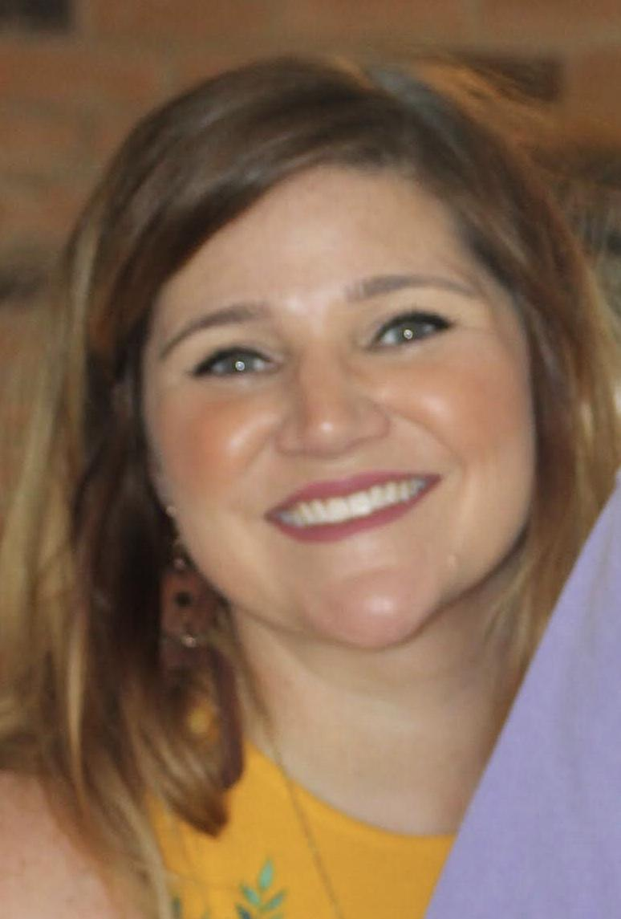
Amber Thomas
Program Consultant at NCCEE and Lecturer at Fayetteville State University
Amber Thomas is a full-time lecturer in the College of Business and Economics at Fayetteville State University and serves as an Educational Consultant for the North Carolina Council on Economic Education (NCCEE). Her passion is focused on effectively teaching economics, financial literacy and statistics to students and preparing teachers to do the same. She holds a Master's in Applied and Resource Economics and a MBA from East Carolina University. Prior to working at Fayetteville State, she taught full-time at Central Carolina Community College and as an adjunct at multiple institutions. Her industry experience includes time spent at BB&T working as a personal banker.

Slide 7
The Dollars and
Sense of the
Super Bowl

Slide 8
The Dollars and Sense of the Super Bowl
Questions to Consider
Who do you think are the top spenders on the Super Bowl?
Who do you think are the top winners of the Super Bowl?
Who do you think are the top losers of the Super Bowl?
Does it make sense for a city to try to host the Super Bowl?
Is there a reason that businesses should advertise during the Super Bowl and performers should accept an invitation or try to perform?

Slide 9
The Dollars and Sense of the Super Bowl
Background
  Super Bowl I
    1967
    AFL-NFL World Championship Game
    Olympic style stadium
    Teams don’t have the same size ball
    90,000 didn’t sell out in LA
  Stats and Facts
    One of the biggest single day sports competition in the world
    Super Bowl spending is 16.5 Billion dollar industry
      Average American consumer–$85.36
  Glendale, AZ–Hosting for the third time
  Most Successful Franchises–Pittsburgh Steelers and New England Patriots
Notes:
Sources
https://bleacherreport.com/articles/2601298-the-evolution-of-the-super-bowl-over-50-years
https://www.statista.com/topics/1264/super-bowl/#topicOverview

Slide 10
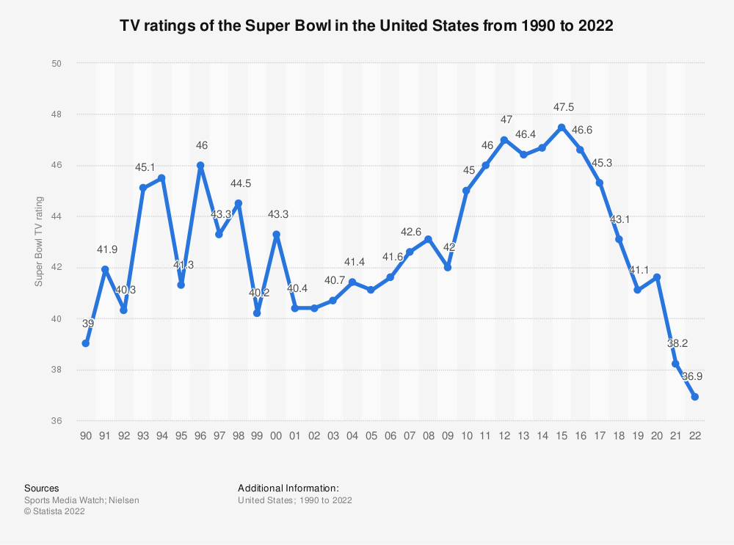
The Dollars and Sense of the Super Bowl: Ratings
Notes:
Sources
https://www.nationalmediaspots.com/us-tv-most-watched-primetime-telecasts-2021.php
https://www.statista.com/statistics/216526/super-bowl-us-tv-viewership/
https://russellstreetreport.com/2022/08/16/street-talk/most-watched-super-bowl/

Slide 11
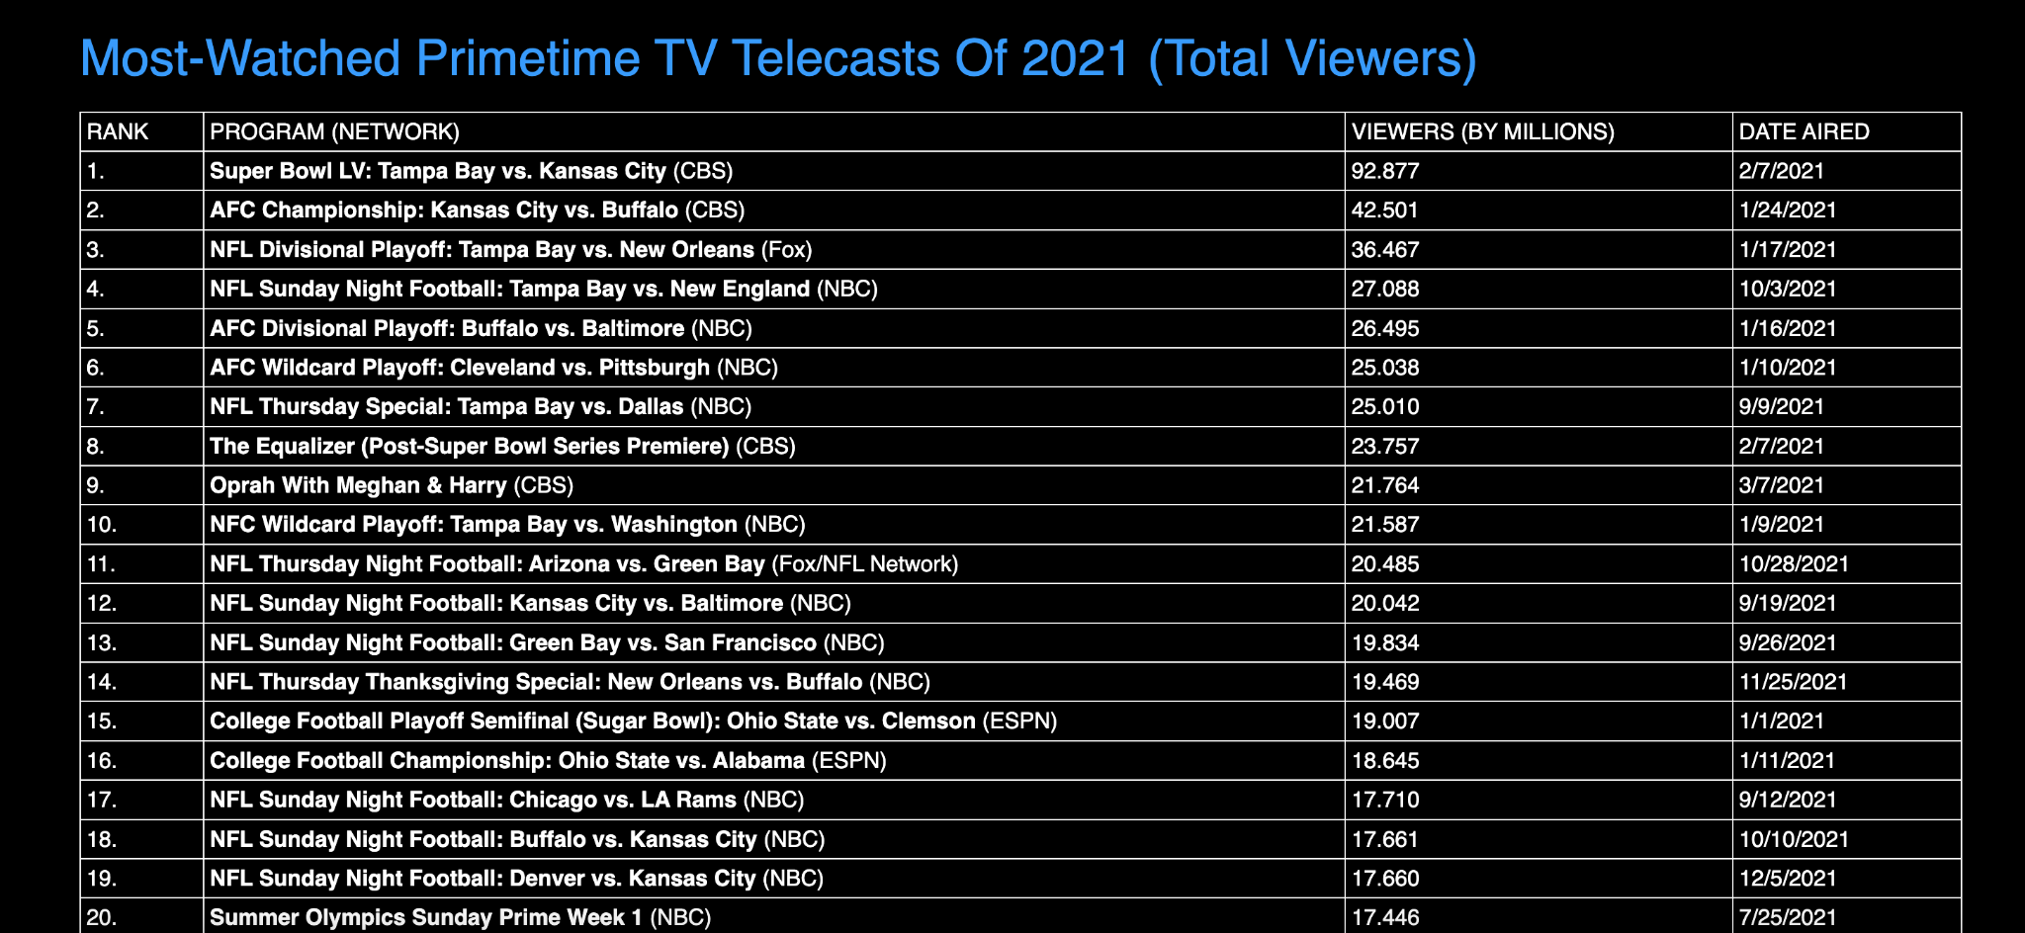
The Dollars and Sense of the Super Bowl: Viewers
Notes:
Sources
https://www.nationalmediaspots.com/us-tv-most-watched-primetime-telecasts-2021.php
https://www.statista.com/statistics/216526/super-bowl-us-tv-viewership/
https://russellstreetreport.com/2022/08/16/street-talk/most-watched-super-bowl/

Slide 12
The Dollars and Sense of the Super Bowl: Ads
Average Super Bowl Ad Cost Broken Down Per Year
Notes:
Sources
Ads
What was the first Super Bowl ad?
https://www.smithsonianmag.com/arts-culture/what-earliest-super-bowl-commercials-tell-us-about-super-bowl-180971391/
Ad Prices
https://www.superbowl-ads.com/cost-of-super-bowl-advertising-breakdown-by-year/

Slide 13

The Dollars and Sense of the Super Bowl: Ads
The First Super Bowl Ad
Notes:
Sources
Ads
What was the first Super Bowl ad?
https://www.smithsonianmag.com/arts-culture/what-earliest-super-bowl-commercials-tell-us-about-super-bowl-180971391/
Ad Prices
https://www.superbowl-ads.com/cost-of-super-bowl-advertising-breakdown-by-year/

Slide 14
The Dollars and Sense of the Super Bowl: Halftime Shows
What do you think was the best halftime show?
Notes:
Sources
Linked

Slide 15
The Dollars and Sense of the Super Bowl: Revenue
Revenue
Notes:
Sources
Revenue
https://marketscale.com/industries/sports-and-entertainment/super-bowl-lvii-business-figures/

Slide 16
The Dollars and Sense of the Super Bowl: Over Time
How Have Things Changed Over Time?
Notes:
Sources
Linked

Slide 17
The Dollars and Sense of the Super Bowl
Top Spenders, Winners and Losers
  Businesses
    Big Businesses vs. Local
    Connection between ad and sales
      Pepsi pulled out and they gained more money
    Top business participators
    What are the business/performer incentives?
Notes:
Sources
Big Businesses vs. Local
https://www.nielsen.com/insights/2010/9-in10-will-watch-super-bowl-at-home-most-will-spend-the-same-or-less-on-food-and-bev/
https://www.cbsnews.com/news/super-bowl-2021-sports-bars-crowds-covid-pandemic/
https://www.audacy.com/wbbm780/news/national/most-people-plan-to-watch-the-super-bowl-at-home-this-year
Connection between regular season ads and Super Bowl ads
Connection between ad and sales?
https://www.forbes.com/sites/forbesagencycouncil/2023/01/10/14-challenges-brands-must-meet-to-see-a-strong-roi-on-super-bowl-ads-in-2023/?sh=4c8a5dd762b0
Pepsi pulled out and they gained more money
https://www.espn.com/nfl/news/story?id=4751415
Top business participators
https://www.statista.com/statistics/1289600/all-time-super-bowl-advertisers/#:~:text=Budweiser%20was%20the%20company%20that,in%20third%20with%20202.44%20million.
https://wizardpins.com/blogs/education/which-companies-have-purchased-the-most-super-bowl-commercials-since-the-first-super-bowl
https://www.sportskeeda.com/nfl/super-bowl-commercials-top-5-companies-spent-money-super-bowl-ads

Slide 18
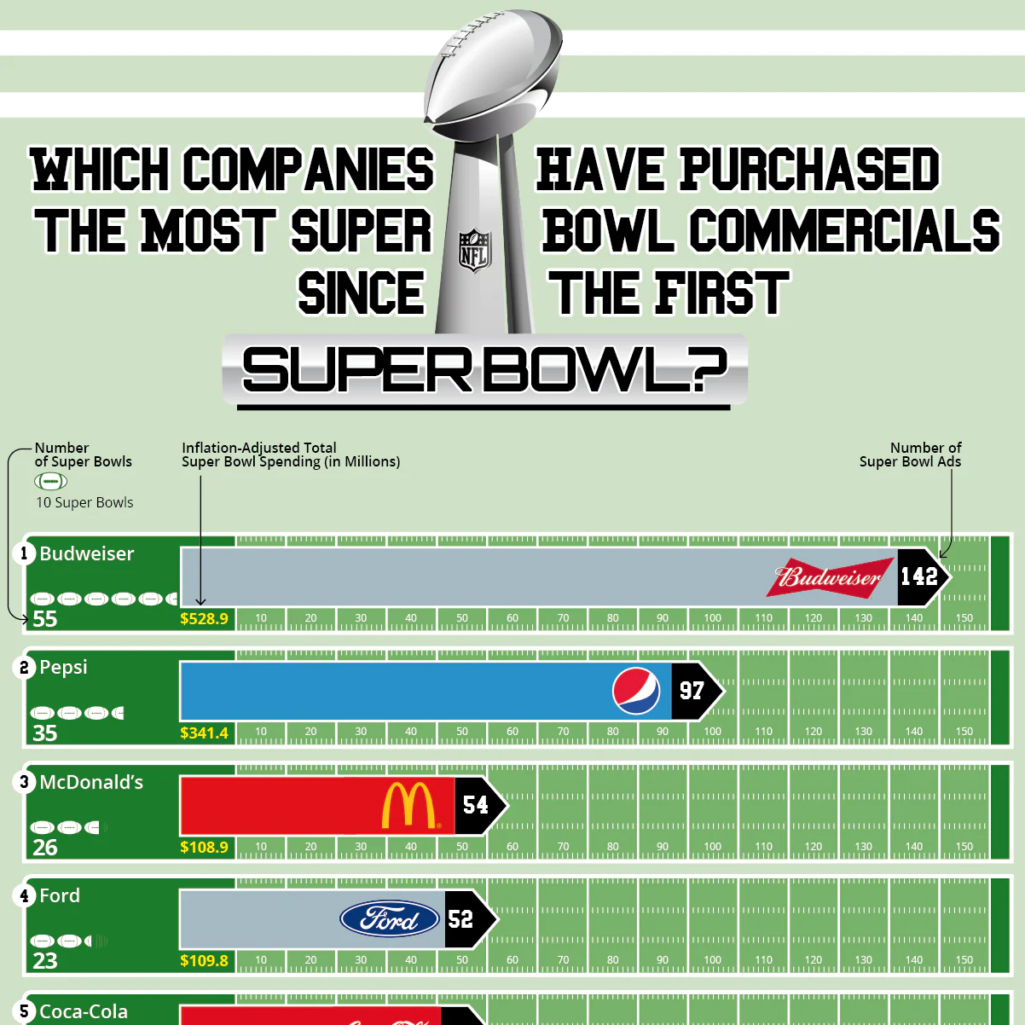
The Dollars and Sense of the Super Bowl
Top Spenders, Winners and Losers
    Top business participators
    What are the business/performer incentives?
Notes:
Sources
Big Businesses vs. Local
https://www.nielsen.com/insights/2010/9-in10-will-watch-super-bowl-at-home-most-will-spend-the-same-or-less-on-food-and-bev/
https://www.cbsnews.com/news/super-bowl-2021-sports-bars-crowds-covid-pandemic/
https://www.audacy.com/wbbm780/news/national/most-people-plan-to-watch-the-super-bowl-at-home-this-year
Connection between regular season ads and Super Bowl ads
Connection between ad and sales?
https://www.forbes.com/sites/forbesagencycouncil/2023/01/10/14-challenges-brands-must-meet-to-see-a-strong-roi-on-super-bowl-ads-in-2023/?sh=4c8a5dd762b0
Pepsi pulled out and they gained more money
https://www.espn.com/nfl/news/story?id=4751415
Top business participators
https://www.statista.com/statistics/1289600/all-time-super-bowl-advertisers/#:~:text=Budweiser%20was%20the%20company%20that,in%20third%20with%20202.44%20million.
https://wizardpins.com/blogs/education/which-companies-have-purchased-the-most-super-bowl-commercials-since-the-first-super-bowl
https://www.sportskeeda.com/nfl/super-bowl-commercials-top-5-companies-spent-money-super-bowl-ads

Slide 19
The Dollars and Sense of the Super Bowl
Halftime Artist
  Connection between performance and sales?
    People that refused to play
  What are the business/performer incentives?
Notes:
Sources
Connection between performance and sales?
People that refused to play
What are the business/performer incentives?
https://www.billboard.com/lists/super-bowl-halftime-shows-music-sales/
https://www.forbes.com/sites/conormurray/2023/02/03/the-biggest-super-bowl-halftime-show-music-sales-boosts-including-shakira-coldplay-beyonc-lady-gaga-and-more/?sh=2eb259302b75
https://www.esquire.com/entertainment/tv/a35405738/super-bowl-halftime-performers-money/
https://www.countryliving.com/life/entertainment/a38855699/do-super-bowl-halftime-performers-get-paid/

Slide 20
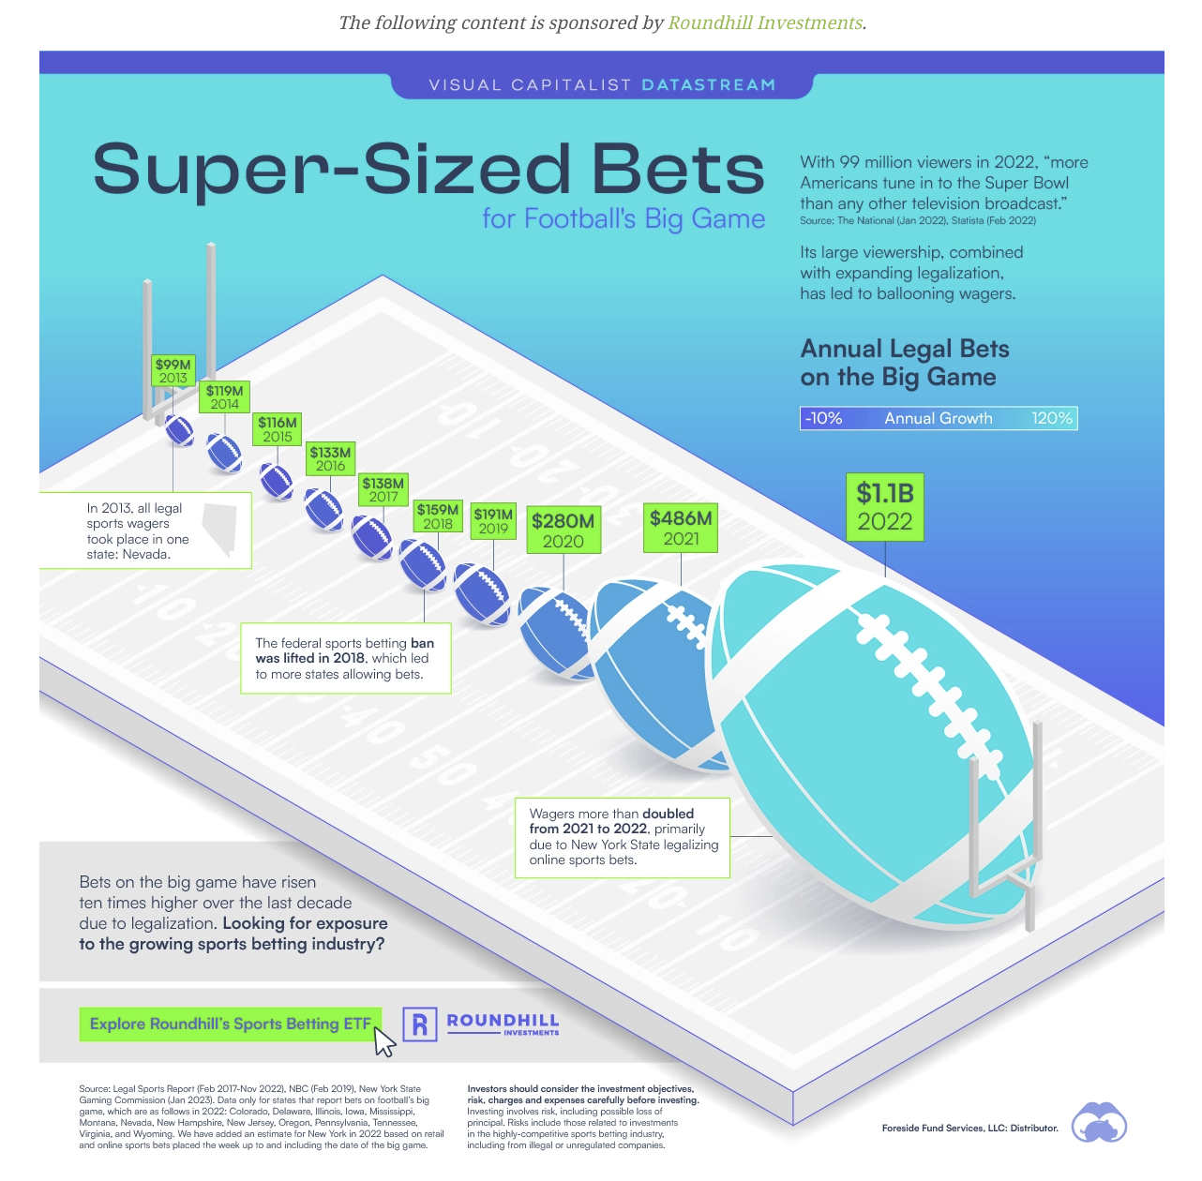
The Dollars and Sense of the Super Bowl
Players
  Platform
  Big Payouts!
Sports Betting Industry
City in Which It’s Held
Notes:
Sources
Players
https://www.npr.org/2022/02/12/1080228771/some-players-use-their-super-bowl-platform-to-make-a-super-impact-in-their-commu
https://www.sportingnews.com/us/nfl/news/how-much-nfl-players-make-winning-super-bowl-2022/rjxkgfnrrnqjaraaxxuqvro7
Sports Betting Industry
What are the business/performer incentives?
City in which it’s held?
https://www.gobankingrates.com/money/economy/is-hosting-the-super-bowl-worth-it/
https://news.asu.edu/20230120-arizona-impact-super-bowl-super-lucrative
https://www.nytimes.com/2018/01/29/sports/football/super-bowl-lii-minnesota.html

Slide 21
The Dollars and Sense of the Super Bowl
A Case Study from LA
Notes:
Sources

Slide 22
The Dollars and Sense of the Super Bowl
What if?
Notes:
Sources
What if?
What if it all goes away and goes to eSports, Flag Football, etc?
What if the Super Bowl was moved to Saturday?
"The reason we haven't done it in the past is simply just from an audience standpoint. The audiences on Sunday night are so much larger. Fans want to have the best opportunity to be able to see the game and we want to give that to them, so Sunday night is a better night."

Slide 23
The Dollars and Sense of the Super Bowl
How Can You Use This In Your Classroom?
  EconEdLink Lessons
  Super Bowl SMG Lesson
  MRU Lessons
  Visual Capitalist
  Financial Football
Notes:
Sources

Slide 24
The Dollars and Sense of the Super Bowl
So Now, Will You Be Able to Watch the Big Game Through the Same Lens?

Slide 25
The Dollars and Sense of the Super Bowl
Assessment Questions
Who do you think are the top spenders on the Super Bowl?
Who do you think are the top winners of the Super Bowl?
Who do you think are the top losers of the Super Bowl?
Does it make sense for a city to try to host the Super Bowl?
Is there a reason that businesses should advertise during the Super Bowl and performers should accept an invitation or try to perform?

Slide 26
The Dollars and Sense of the Super Bowl
References
All links are provided in the presenter notes of the slide deck.

Slide 27
The Dollars and Sense of the Super Bowl
Q & A

Slide 28

Invest In Girls

Slide 29
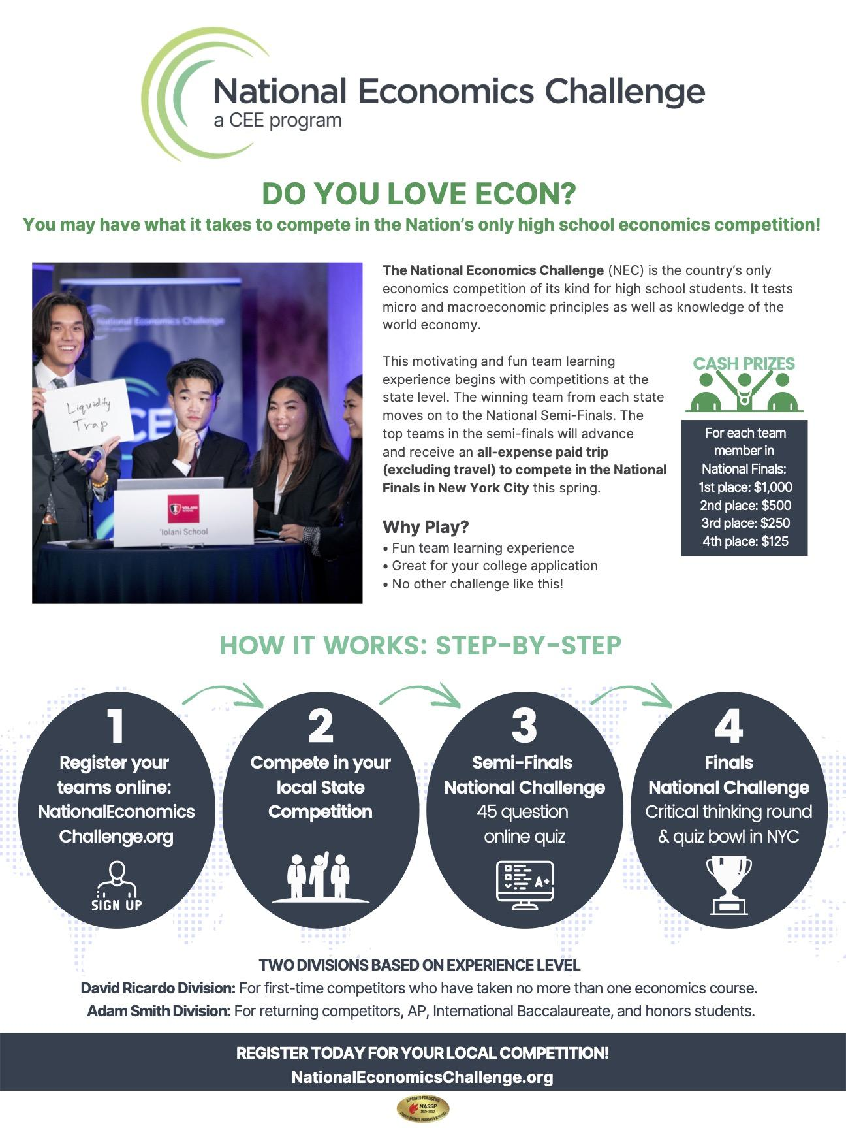
NEC

Slide 30
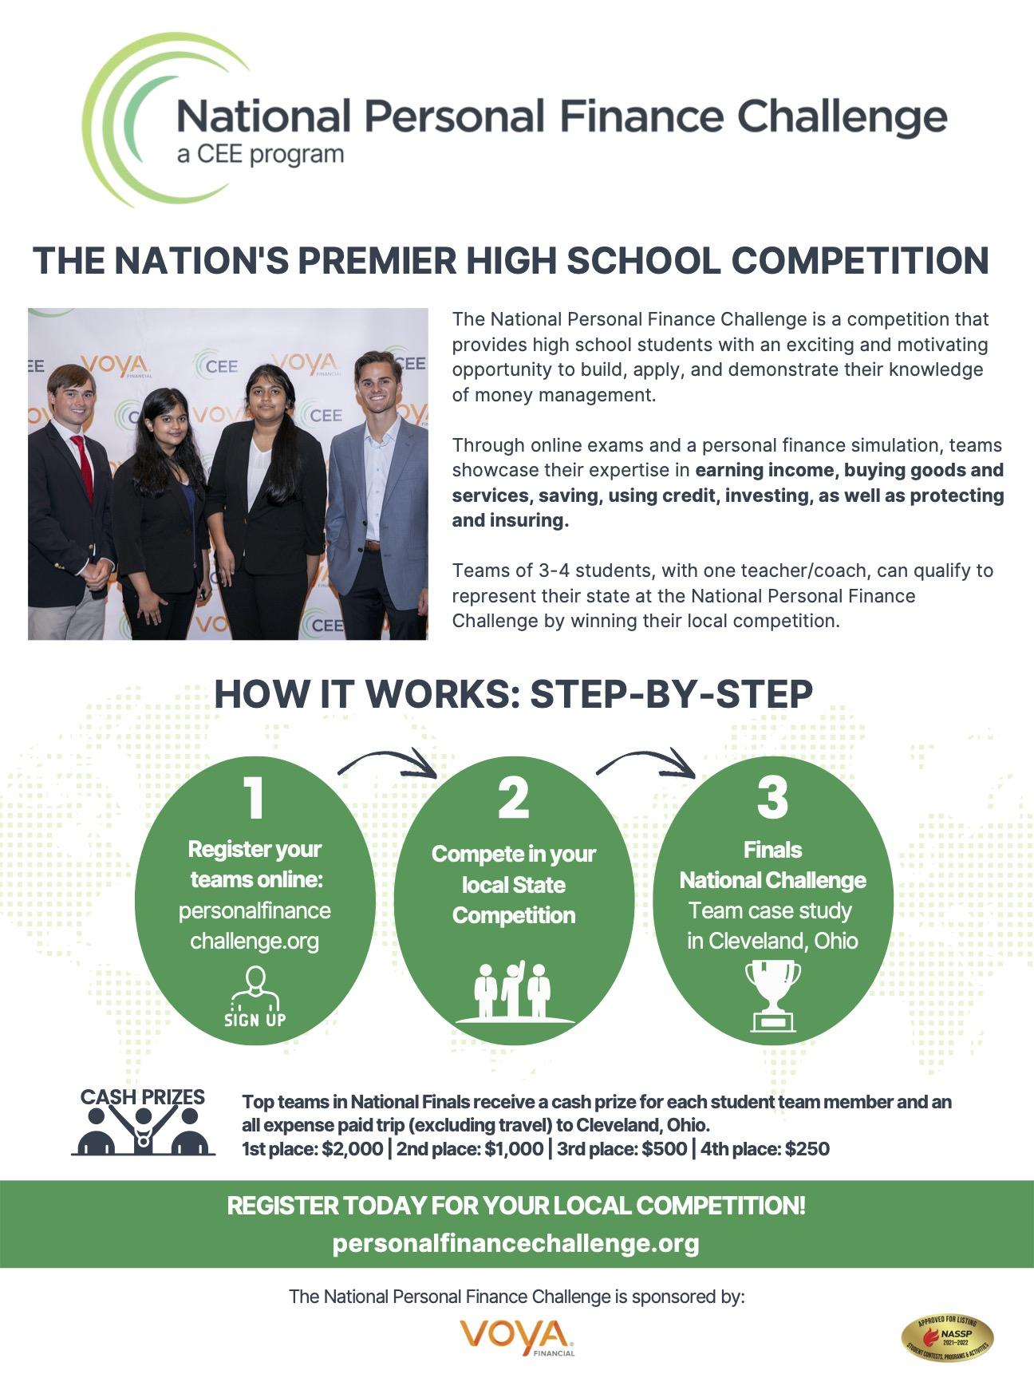
NPFC

Slide 31
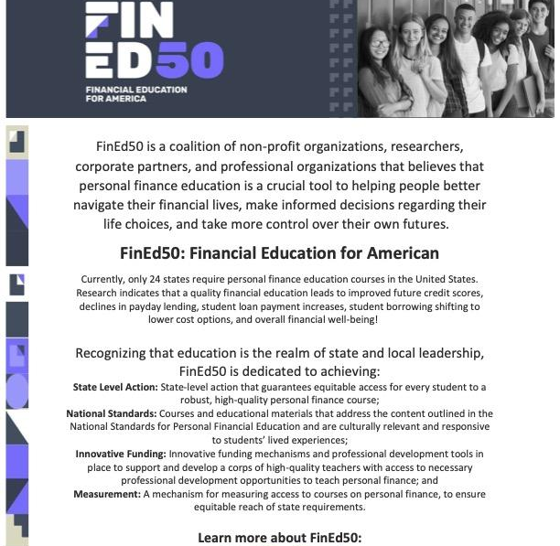
Advocacy

Slide 32

The Dollars and Sense of the Super Bowl
CEE Affiliates
https://www.councilforeconed.org/resources/local-affiliates/
Include your local affiliate page

Slide 33




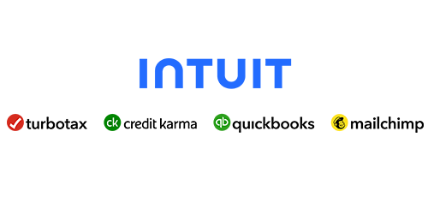





Thank You to Our Sponsors!

Slide 34
Amber Thomas
acthomas@nccee.org
Thank You

