Slide 1
Presented by: Clarissa Delgado
Email: Optionsinstitute@goddard.org
Date: 2/28/2023
Professional Development
Master Deck
Financial Aid II: Types of Aid, Gap & Packages

Slide 2
EconEdLink Membership
You can now access CEE’s professional development webinars directly on EconEdLink.org! To receive these new professional development benefits, become an EconEdLink member. As a member, you will now be able to:
Automatically receive a professional development certificate via e-mail within 24 hours after viewing any webinar for a minimum of 45 minutes
Register for upcoming webinars with a simple one-click process
Easily download presentations, lesson plan materials and activities for each webinar
Search and view all webinars at your convenience
Save webinars to your EconEdLink dashboard for easy access to the event
Access our new Professional Development page here

Slide 3
Professional Development Opportunities
To earn professional development credit for CEE webinars found on EconEdLink, you must:
Watch a minimum of 45-minutes and you will automatically receive a professional development certificate via e-mail within 24 hours.
Attendees can learn how much credit they will earn per workshop.
Accessing resources:
You can now easily download presentations, lesson plan materials, and activities for each webinar from EconEdLink.org/professional-development/

Slide 4

About Options
A program of Goddard Riverside​
Founded 1986 as direct service access center ​
Today​
Access Program​
  Success Program​
  Professional Development Program
Notes:
A program at Goddard Riverside​
​
Options has been around for 36 years. We support New Yorkers with getting into, paying for, and graduating from college or skill-specific certificate programs. We specialize in working with low-income and first-generation students, who often face the largest barriers to accessing and completing college.​
​
Started as, and continues to be, a one-on –one access counseling program – helping students to match good fit matches and apply for financial aid. The access program also offers services such as college trips, workshops for students; and student get-togethers​
​
In 2012 we added our Success program where counselors work with students in college to support them through graduation​
​
Lastly, through the Options Institute we offer workshops for Access professionals. The Institute started in 2005 and since than more than 9000 professionals have attended workshops​
​
We believe college access is a social justice issue that helps levels the playing field for underrepresented students and that college access is most importantly about choosing a good fit college that is affordable. ​

Slide 5

Housekeeping
Evaluation
One Mic
Cameras on is Highly Encouraged
Participation Highly Encouraged
Step Up, Step Back

Slide 6
Presenter
Clarissa Delgado
Trainer/College Access Counselor, Options Institute
Clarissa was born and raised in Queens, New York. She worked for the Department of Education for 8 years as an English teacher, college advisor, and mentor.
She is passionate about college and career access, as she is a firm believer that lack of access to information is one of the biggest barriers underrepresented communities face when it comes to post secondary planning.
In her free time, Clarissa enjoys singing, writing, and binge-watching Netflix series

Slide 7
Objectives
After this workshop, attendees will be able to…
Understand the various sources of financial aid to help students plan for the full cost of college
Have conversations with students and families about different financial award packages to help them make the most informed decisions
Notes:
After this workshop, attendees will be able to…
Understand the various sources of financial aid to help students plan for the full cost of college - it's important to be able to differentiate the various types of aid, and what requirements, if any, are attached when accepting aid.
Have conversations with students and families about different financial award packages to help them make the most informed decisions. Award letters can be tricky to navigate, especially for someone who is not familiar with this process, so we want to be sure we support our students and families and familiarize them with key terms, so they can make the most financially sound decision when accepting an offer.

Slide 8
Agenda
Introduction
Sources of Aid: Grants/Scholarships
Sources of Aid: Loans
Gap & Student Responsibility
Analyzing & Comparing Financial Aid Packages
Q&A
Notes:
So here's today's agenda. We went through our introduction. For those of you that attend our FA I workshop, we went over various aspects of the financial aid application process (how to apply, whose info should be included, navigating unique family circumstances, etc.) Today, we are going to take a closer look at the various types of aid students can receive, and highlight key differences between grants/scholarships and loans. Then we will discuss student responsibility when there is a gap in their financial aid. Next we will review some sample financial aid packages in order to get familiar with key terms, & various layouts of award packages, so you will feel equipped in helping families navigate and understand their financial aid letters. As always, we will wrap with highlighting some great resources to share with your community and leave time for some Q&A as well.

Slide 9

Sources of Aid
Grants &
Scholarships
Work Study
Notes:
There are different types of financial aid, and it is important to understand the distinctions between them. There is a great video from studentaid.gov that walks through the various types of aid and how they can help fund one's education that is linked in the resources section of this presentation.
In a nutshell, A grant or scholarship is a form of financial aid that doesn't have to be repaid (unless, for example, you withdraw from school and owe a refund, or you receive a TEACH Grant and don't complete your service obligation).
Work study is another type of aid where students with financial need can earn money to pay for school through part-time on- (and sometimes off-) campus jobs. The program gives students an opportunity to gain valuable work experience while pursuing a college degree
Let's start by taking a closer look at some federal grants that are available to eligible students.

Slide 10


Pell Grant
Federal
Need-based
Lifetime eligibility used
FREE MONEY
Notes:
Pell grants are need based aid from federal government. (and keep in mind in order to be considered for any federal aid you must be a US Citizen, permanent resident, or qualifying non citizen)
The Maximum pell grant amount for the current academic year $6895, . Note for the 23-24 academic year, the max pell grant amount will be increasing to $7,395
To qualify to receive a pell grant, the maximum EFC a student can have to be eligible for the Pell Grant is $6206
In general, a student must maintain enrollment in an undergraduate course of study at a nonforeign school to receive a Federal Pell Grant. Additionally, they will have to fill out the FAFSA form every year they are in school in order to stay eligible for federal student aid. It’s important to make students aware that just because they qualify for a pell grant one year, it is not an automatic guarantee they will qualify for subsequent years. This is why they have to complete the FAFSA application each year they are in school, to determine eligibility.
Once a student has earned a baccalaureate degree, or their first professional degree, or have used up all 12 terms of their eligibility or the equivalent (roughly six years), you are no longer eligible to receive a Federal Pell Grant.
Does not have to be repaid unless there are special circumstances:
You withdrew early from the program for which the grant was given to you.
Your enrollment status changed in a way that reduced your eligibility for your grant (for instance, if you switch from full-time enrollment to part-time, your grant amount will be reduced).
You received outside scholarships or grants that reduced your need for federal student aid.
You received a TEACH Grant, but you did not meet the requirements of your TEACH Grant service obligation.

Slide 11
Federal Supplemental Educational Opportunity Grant (FSEOG)
Based on exceptional need
Campus based
First come, first serve
FREE MONEY
Notes:
The FSEOG is a Federal Government grant that assists low-income undergraduate students who need a great deal of financial aid to help pay for college; eligibility is for Pell Grant recipients with the lowest EFC’s
Awards can range from $100 to $4,000 a year, depending on the amount of other aid the student receives and the availability of grant funds at the school they are attending.
To get an FSEOG, a student must first complete and submit the Free Application for Federal Student Aid (FAFSA).
This lets their college determine how much financial need they qualify for.
To be considered for this grant students should complete and submit the FAFSA as soon as possible beginning October 1 because each participating school receives a limited amount of FSEOG funds each year. Grants are awarded on a first come, first serve basis. Once they've been awarded, that's it. No additional funds are available. Students should check their school's website or contact their financial aid office for specific deadlines. They can also visit the official FSEOG website.
*****************************************************
Federal Government grant based on need; for Pell Grant recipients with lowest EFC’s
Administered by the financial aid office at college
Maximum amount = $4000 / Minimum amount = $100
Must meet priority deadline: awarded first come, first serve

Slide 12
Work Study
Federally funded
Campus based
First come, first serve
FREE-ish MONEY
Notes:
Federal Work study provides part-time jobs for undergraduate and graduate students with financial need, allowing them to earn money to help pay for their educational expenses. The program encourages community service work and work related to the student’s course of study.
To be considered for Federal work study, students indicate interest on the FAFSA application (it is a yes/no question on the form)
It’s administered by schools participating in the Federal Work-Study Program. Students can check with their school's financial aid office to find out if their school participates.
Consideration for work study has a priority deadline, which means it is awarded on a first come, first serve basis. It is available for full and part time students.
Students who receive work study are responsible for finding a part time job (jobs emphasize employment in civic education and work related to your course of study when possible)
Students may work on or off-campus
Money earned goes directly to students in the form of a paycheck
How much a student earns depends on when they apply, their level of financial need, and their school's available funds for work study. Students will earn at least the current federal minimum wage. However, they may earn more depending on the type of work they do and the skills required for the position.
In terms of getting paid, your school must pay you at least once a month.
Additionally, your school must pay you directly (by check) unless you request that the school send your payments directly to your bank account or use the money to pay for your education-related charges (e.g., tuition, fees, food, and housing).
Students tend to ask - Can I work as many hours as I want? Unfortunately No. The amount a student earns can’t exceed their total Federal Work-Study award. When assigning work hours, the employer or their school’s financial aid office will consider their class schedule and academic progress.
*************************************************************
Recommended for indirect costs

Slide 13
Institutional Grants
May cover up to COA!
Merit and/or need based
Terms vary by college
Offer expires: priority deadline
FREE MONEY
Notes:
Next up, we have institutional grants are *not federal grants. This is aid provided directly from the college itself.
They can be need or merit based
Institutional grant amounts vary from school to school. The range can potentially cover a portion of a students cost of attendance, or in some circumstances their total cost of attendance!
Additionally, the availability of these grants may vary from year to year as well.
When applying to colleges, it is important for students to know each institutions criteria regarding how to be considered for institutional grants, and any pertinent deadlines – some schools (like adelphi), once they accept students, they automatically evaluate them for institutional grant consideration (so no 'extra' steps to apply)
Other schools in addition to applying to their institution, may require submitting a separate application to be considered for their institutional grants, so it is imperative that students research and keep track of these requirements for their colleges of interest.

Slide 14
Special Additional Grants &
Scholarships
Notes:
In addition to these standard grants and scholarships, there's an additional federal grant for unique circumstances, as well as other non federal sources of financial aid. Let's take a closer look at these.

Slide 15
Educational Training Voucher (ETV)
Grant for youth in care
Max award: $5000
Apply before 21 years old
FREE MONEY
Notes:
Educational Training Voucher - ETVs are grants, funded by the federal government and administered by the states, awarded to eligible youth and young adults currently and formerly in foster care to help pay for college, career school, or training. States may have a different name for the ETV program.
Specifically, the ETV Program is intended to serve: youth and young adults who experienced foster care after age 14, and youth who, after turning age 16 years or older, exit foster care to adoption or guardianship.
Since this is a federal grant, to qualify, in addition to formerly or currently being in foster care, a student must be US citizen or permanent resident, and must have been accepted into or be enrolled in a degree, certificate or other accredited program at a college, university, technical, or vocational school. To remain eligible for ETV funding, they must show progress toward a degree or certificate.
To be considered, students can begin the application process after July 1st, including requesting that their school submit enrollment, financial, and academic record verifications when directed.
Prior to completing the ETV financial aid release form and ETV student participation agreement form, applicants must also submit their FAFSA application. The amount awarded varies based on the student's cost of attendance, available funds, & the student’s unmet financial need, with the minimum amount being $1500, and the maximum amount being $5000
Students may qualify to access ETV funding for up to five years total (whether consecutive or intermittent). ETV funding must begin before their 21st birthday and ends at their 23rd birthday.
However, in 2018, the Family First Prevention and Services Act amended the ETV program to extend eligibility to youth up until their 26 birthday while maintaining the five-year limit on the total length of time a youth can receive an ETV voucher (whether or not the years are consecutive).
For detailed eligibility information, students must contact their state’s and county’s Child Welfare Agency directly.
********************************************************************
www.statevoucher.org
http://www.fc2sprograms.org/
https://www.fc2sprograms.org/faqs/
New York
The New York Education and Training Voucher Program is a federally-funded, state-administered program designed to help youth who were in U.S. foster care. Students may receive up to $5,000 a year for qualified school related expenses.
Funding is limited and available on a first-come, first-served basis to eligible students. Applicants must complete the ETV application which includes documentation each semester that is sent directly from the school to ETV confirming enrollment, the cost of attendance (COA) and unmet need. ETV funding is for a maximum of 5 years (consecutive or intermittent).

Slide 16
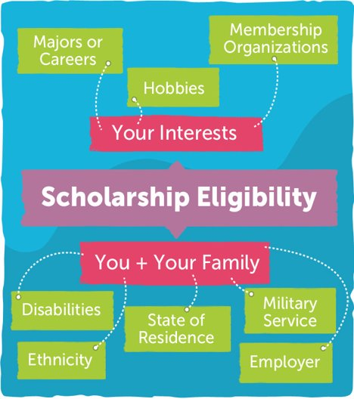
Private/Outside Scholarship
Sources and amounts vary
Must report to colleges
Scholarships may reduce aid
Notes:
In addition to institutional scholarships, there are a number of Private/Outside Scholarships that students can apply for. These can come from local community organizations, national organizations and more. The award amounts & eligibility criteria will vary based on the providing entity.
Any outside scholarships earned must be reported to colleges and universities. It is important to note that scholarships may reduce a student’s institutional aid, depending on how much they receive from said scholarship.
There are scholarships for many different criteria, varying from different interests/hobbies, to differing backgrounds/identities (like being undocumented, LGBTAQ+, various cultural scholarships, etc).
We want to encourage students to search and apply not just for big name scholarships like Burger King Scholars, or Foot Locker Scholar Athletes, but to look for local scholarships too – ask community businesses/places of worship if they offer scholarships for locals. Many of these scholarships are not heavily advertised, so there is less competition than those national ones.
Furthermore, students should ask their parents/guardians if their employers offer scholarships – my parents work in hospitality and through their Hotel Workers Union there is a college scholarship program for employees with children pursuing a post secondary pathway.

Slide 17
Sources of Aid
Loans
Notes:
Another source of financial aid are loans – which unlike grants/scholarships, are not free. This is money that you borrow and will be obligated to pay back with interest. There are both federal and private loans available.
The major differences between federal and private loans are: varying interest rates, subsidizations, how much you can borrow, & your repayment options.
Let's get a bit more familiar with the different loan options available.
*********************************************************************
Subsidized- Gov’t pays the accruing interest while student is in school
Unsubsidized- Interests accrues while student is in college (with no gov. help)
2 Factors: Interests Rates/Subsidizations

Slide 18

Direct Subsidized Loan
Need-based
Fixed interest rate
Loan Fee
Limited forgiveness options
Loan
Notes:
A Direct Subsidized Loan is a type of need based, federal student loan (so the loan is in the student’s name) where the borrower isn’t generally responsible for paying interest while in-school, and during grace*, or deferment periods.
Maximum amount a student can borrow through a direct subsidized loan is $3,500 for the 1st year. The current fixed interest rate is ­­­­­­ 4.99% and the loan fee is 1.057%. Furthermore, the US Dept of Ed pays interest on the loan if you are in school at least half time, and for 6 months after you graduate.
When do I have to pay back my loan?
After you graduate, leave school, or drop below half-time enrollment, you will have a six-month grace period before you are required to begin repayment. During this period, you'll receive repayment information from your loan servicer, and you'll be notified of your first payment due date.
There are a number of repayment options available to students. Students can also begin paying back the loan while in school if they so choose
There are some limited loan forgiveness options for direct subsidized loans, including:
Teaching full-time for 5 years
Being employed in a public service job for approx. 10 years
Special circumstances regarding disability, death, fraud and school closings

Slide 19
Direct Unsubsidized Loan
Open eligibility
Fixed interest rate
Loan fee
Interest accrues while in college
Loan
Notes:
A Direct Unsubsidized Loan is a type of federal student loan (so again the loan would be in the students name) and is available to undergraduate and graduate students; Unlike subsidized loans, unsubsidized loans are considered non-need-based aid — which means students could qualify for them without financial need.
Another important distinction is that with unsubsidized loans, you’ll have to pay all of the interest that accrues (unlike subsidized loans where The U.S. Department of Education pays the interest for certain periods).
The fixed interest rate and loan fees for direct unsubsidized loans are currently the same as subsidized loans (so 4.99% interest rate, loan fee 1.059%) but this is subject to change.
Students eligible for Subsidized Loans will receive the remainder of $5,500 in Unsubsidized Loans (e.g. $5,500-$3,500 subsidized =$2,000 unsubsidized)
When do I have to pay back? - After you graduate, leave school, or drop below half-time enrollment, you will have a six-month grace period before you are required to begin repayment.
There are limited loan forgiveness options as well

Slide 20
Direct PLUS Loan for Parents
Unsubsidized
Good credit required
Fixed interest rate
Loan fee
Loan
Notes:
Then we have the Direct Plus loan, which is a federal loan available to parents of dependent undergraduate students for which the borrower (which again is the parent) is fully responsible for paying the interest regardless of the loan status. So to be clear, this loan cannot be transferred to the student's name.
To receive a parent PLUS loan, you must be the biological or adoptive parent (or in some cases, the stepparent) of a dependent undergraduate student enrolled at least half-time at an eligible school; so it is important to note here: Grandparents (unless they have legally adopted the dependent student) and legal guardians are not eligible to receive parent PLUS loans, even if they have had primary responsibility for raising the student.
Additionally, you must not have an adverse credit history to qualify for a parent plus loan. (there are limited options for parents to still obtain a parent plus loan if they do have adverse credit, visit the federal student aid website to learn more).
The maximum PLUS loan amount a parent can borrow is the cost of attendance at the school their child will attend minus any other financial assistance their child receives. The cost of attendance is determined by the school. The interest rate is 7.54% and fixed for life of the loan. The current loan fee is 4.228%
In terms of repaying the parent plus loan, If you request a deferment, you will not need to make payments while your child is enrolled in school at least half-time and for an additional six months after your child graduates, leaves school, or drops below half-time enrollment.
If you do not request a deferment, you will be expected to begin making payments after the loan is fully disbursed (paid out).
There are limited loan forgiveness options as well.
***************************************************************************************
Limited Loan Forgiveness:
Teach full-time for 5 years
Employed in public service job for approx. 10 years
Disability, death, fraud and school closing

Slide 21
Private or Alternative Loan
From banks/private lenders
High interest rates, un-fixed
Last resort
Loan
Notes:
In addition to federal loans, students and families can also take out private or alternative loans. These loans can come from various lenders such as a bank, credit union, state agency, or a school.
If students and families are considering taking out loans, we definitely want to encourage them to research & inquire about federal loans first, as unlike federal loans, private loans:
Have high, unfixed interest rates
Require a cosigner or established credit record for most students
Many private student loans require payments while you are still in school, but some do allow you to defer (put off) payments while in school.
Private loans cannot be consolidated with federal loans
May not have income-based repayment, forbearance or deferment options
Do not qualify for most loan forgiveness programs

Slide 22
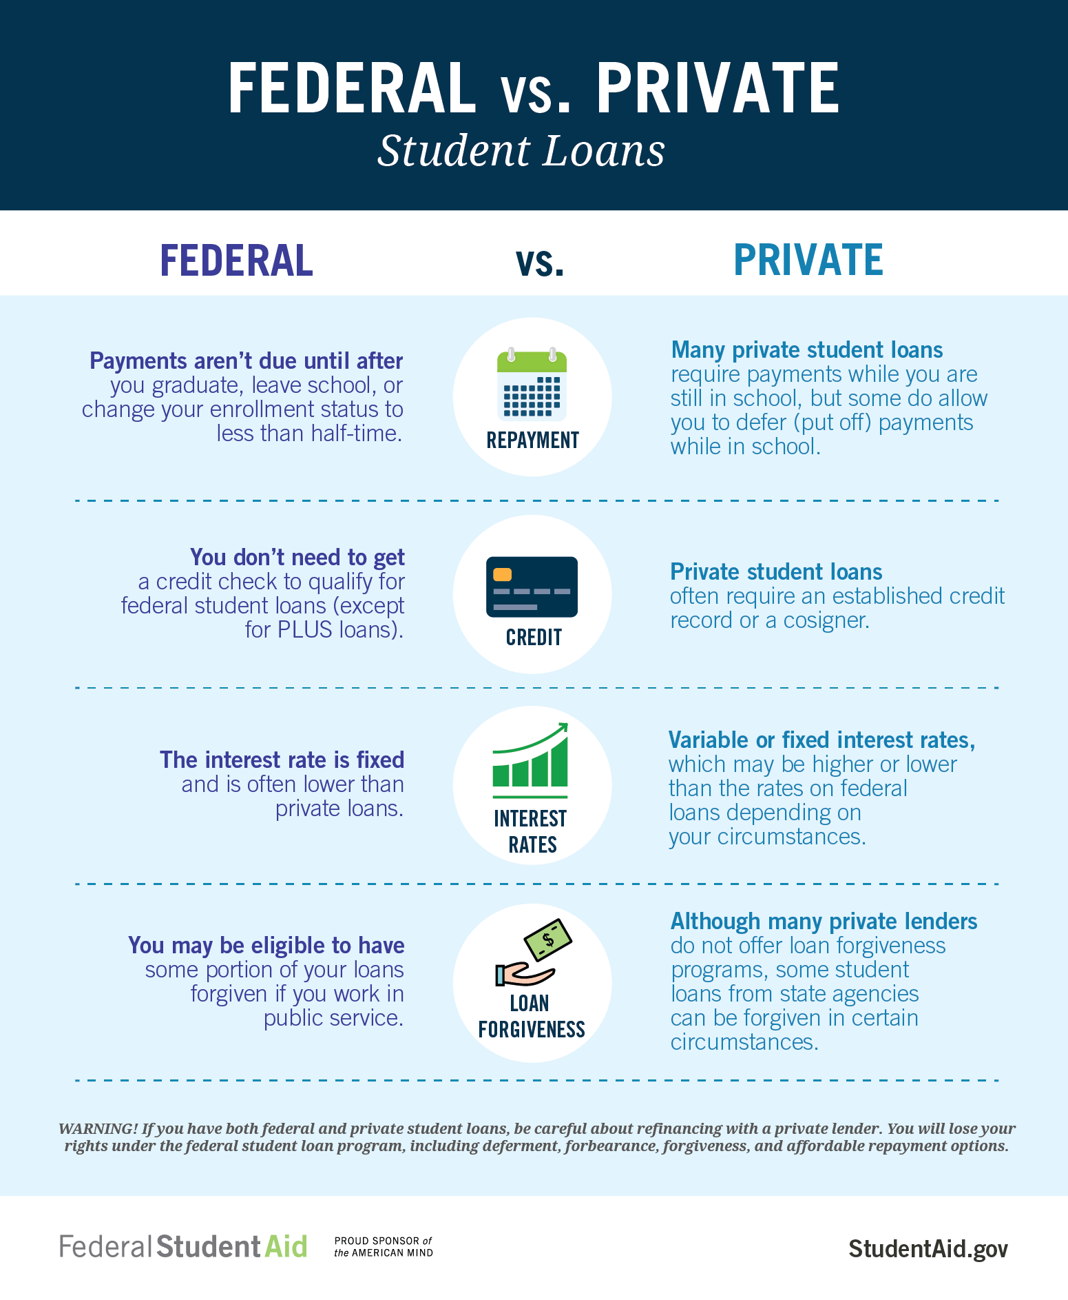
Federal vs Private Loans
Notes:
Here is a great visual that highlights the key differences between federal and private loans. I had this infographic posted on my school's college corner website and hanging in my office for easy access.
Federal student loans offer many benefits that don’t typically accompany private loans. These include:
Lower fixed interest rates
Can also get an interest rate reduction based on repayment method
Many repay options:
income-based repayment plans
loan cancellation for certain types of employment, deferment (postponement) option
Can even consolidate eligible federal student loans into one loan with one monthly payment
Can also deduct student loan interest on taxes
Some federal loans can also be forgiven based on your type of employment
Also, private loans usually require a credit check, while most federal loans for students do not. For these reasons, students and parents should always exhaust federal student loan options first before considering a private loan.

Slide 23

How Do You Calculate Cost?
Notes:
Understanding the various types of financial aid available to students is only part of the equation. Students and families must also understand how to determine if the aid they are receiving will cover their entire cost of attendance. If a college’s financial aid award doesn’t cover all of the student’s need, the student has been “gapped.” (next slide)

Slide 24
Gap & Student Responsibility
GAP is the amount of need that financial aid doesn’t cover
  Documented Need - Financial Aid
  (Cost of Attendance - EFC)
Net Cost is everything a student has to pay up front, earn, and/or pay back in a given year.
or
  Cost of Attendance – Grants/Scholarships
  EFC + Work Study + Loans + GAP
Notes:
Gapping refers to colleges not covering 100% of students’ financial need.
The gap appears when the student’s expected family contribution (EFC) plus the school’s financial aid package don’t equal the cost of attendance. This gap is the student’s responsibility to cover, out of their own pocket, however they see fit.
The total amount a student has to pay, earn, or repay in a given year to attend a particular school equals the student’s “net cost” (this amount includes the students EFC, work study, loans, and gap). A simple way to get this number is to subtract the amount of all grants and scholarships awarded from the Cost of Attendance.
It is important for students and families to understand how to calculate their costs to determine if there is a ‘gap’ that will need to be accounted for. Colleges assist families in this process by providing accepted students with financial aid award packages (next slide)

Slide 25

Analyzing & Understanding Packages
College B
College A
College C
College D
Notes:
A financial aid package (sometimes called an award letter/school aid offer) tells you what financial aid you can receive at a particular college or career school.
The offer includes the types and amounts of financial aid you may receive from federal, state, private, and school sources. This combination of aid is your financial aid package.
Students should be able to determine their net cost (estimate of the actual cost that a student and his family need to pay in a given year to cover education expenses for the student to attend a particular school) from their financial aid packages, so it is vital that students understand how to interpret financial packages and pinpoint key pieces of information in order to make the most informed decision on which offer best meets their needs. If you’ve applied to several schools, be sure to compare aid offers to see which school will be the most affordable.
Let's take a look at some examples.

Slide 26
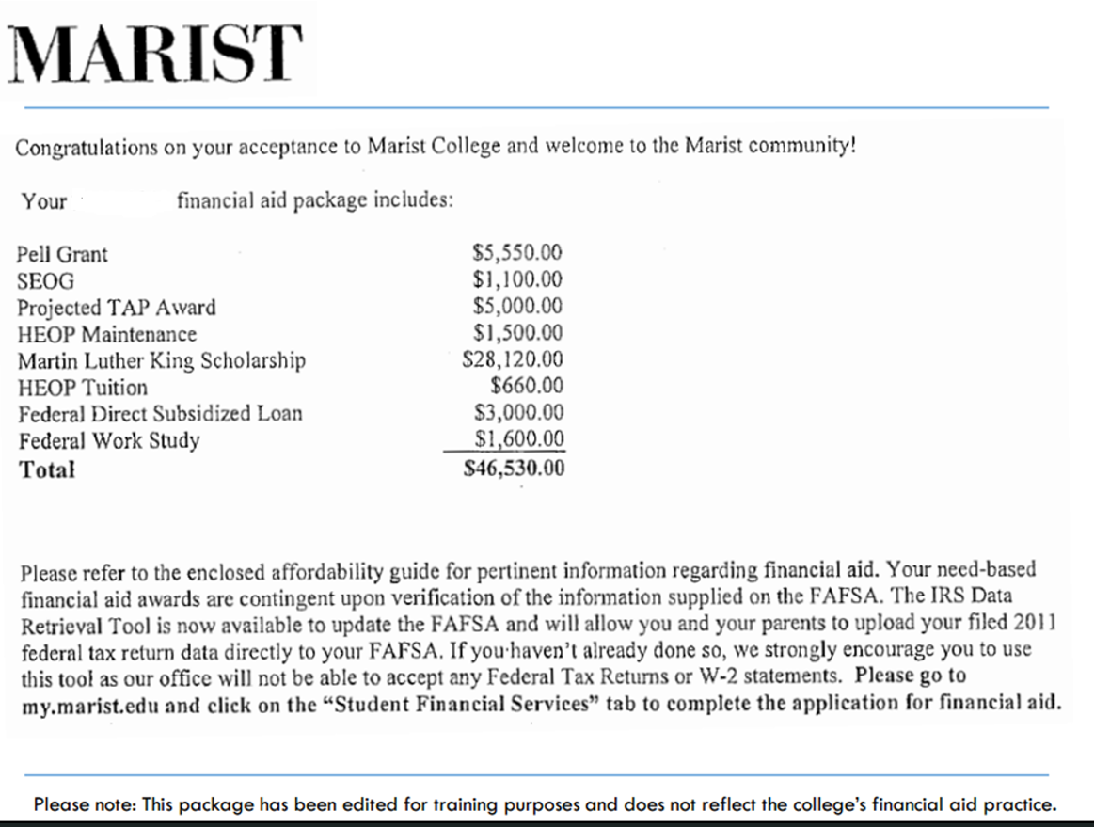
Notes:
Take a min or two to look at this aid letter, take note of what info is provided

Slide 27

Marist Award Package
Is the Marist Package good?
What do we think of this award package?
Notes:
While this aid package does provide some necessary information about aid being offered, it does not include other key pieces of information needed to determine if this is a ‘viable’ offer. For instance:
- not clear if aid amounts are for the full year or per academic term
- does not include COA (direct vs indirect costs)
- while provides site to complete FAFSA if not done, no additional info on who/how to contact with questions/necessary next steps
In order to help demystify the financial aid process, the US dept of Education created the College Financing Plan.

Slide 28
The College Financing Plan
Individualized standard FA award letter
Clarifies college costs and available financial aid
Notes:
In 2013 President Obama set a goal for our nation to lead the world in college completion, and make college more affordable for American families. As a result, the College Financing Plan was presented by Obama administration in which it is supposed to help clarify the financial aid process – specifically, clarify the award letters for our undergraduate students and parent.
The College Financing Plan divides up the parts of the form to show where and what is going to be written in by the schools. (i.e. How much one year of school will cost; Financial aid options to pay this cost, with a clear differentiation between grants and scholarships, loans, etc
Schools are encouraged to adopt this form but not required. Let's take a look at this template.
4) http://www.nasfaa.org/shopping_sheet.aspx Q&A about the shopping sheet (to help w/ the questions that might be asked during this session)

Slide 29
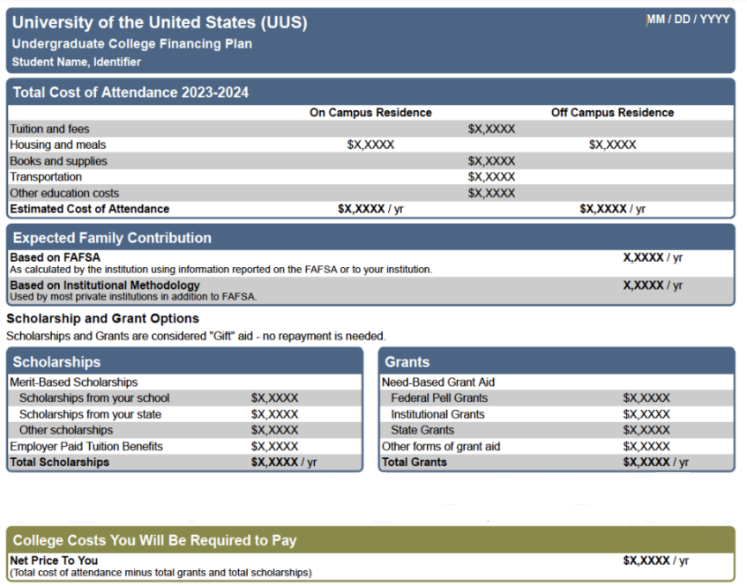
College Financing Plan
Notes:
Notice first thing listed here is cost, highlighting both direct vs indirect costs (and includes diff cost of housing btwn on and off campus living)
It also provides COA for the institution
Then it outlines the estimated EfC gotten from FAFSA as well as from private institution if applicable (CSS Profile)
Institutional Methodology (IM) is a formula developed by financial aid professionals, in consultation with economists, to measure a family’s ability to pay for college. The result of the formula is an expected family contribution (EFC)—the family’s share of college costs. The EFC produced by the IM is not the same as the figure calculated by the federal government to determine eligibility for federal student aid dollars. A basic principle of IM is the idea that a family’s capacity to pay is a function of income and assets.
Then clearly lists gift aid (grants/scholarships first) broken down by merit based and need based, noting the amounts are for the full academic year
Then it does the math for me and outlines my net cost if I choose to only accept free aid first

Slide 30
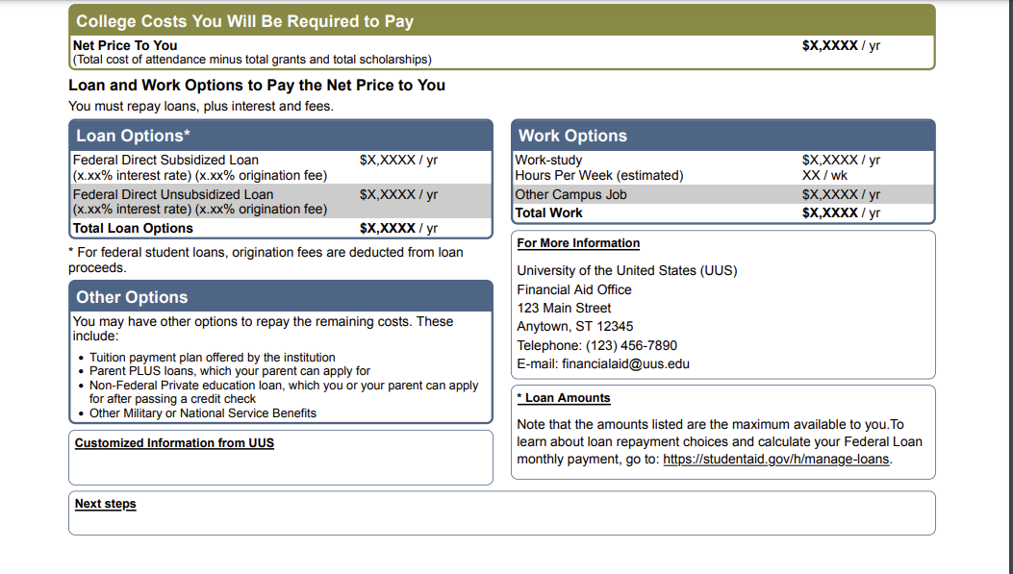
College Financing Plan
Notes:
After providing the COA breakdown, free aid, and what my net cost would be with only free aid, it then breaks down various ways to pay my net costs, thru:
What federal loans I qualify for, even noting the interest rates and loan fees associated with them.
Also notes the listed federal loan amounts reflect the max amt available to you- meaning students if they choose to accept a loan do not necessarily have to accept the full offer shown.
Work study (if eligible)
It even outlines 'other options' for aid (payment plan, parent plus loans, military benefits etc)
Lastly, it provides contact information for your college's financial aid office in order to get more info and guidance on next steps.
Note not shown here but also includes a glossary page that defines various terms on the award package (net price, coa, grant, loans, efc, work study, etc)
This format takes the 'guesswork' out of fin aid letters as it clearly outlines cost, types of aid awarded, & alternative sources to research for potential add'l aid, to help students make the most informed decision.

Slide 31

Action Plan - What's on your shirt?
Imagine that you are wearing a t-shirt that has writing or images on it. The words/images reflect an important point or theme you are taking with you about paying for college.
What does your shirt say?
What images are on your shirt?

Slide 32

Q & A

Slide 33
Resources
Types of aid infographic
  Video
  Fact sheet Federal Grants
Fact sheet Federal Loans
Educational Training Voucher FAQ
HESC Financial Aid Comparison Tool
*NASFAA's Aid Offer Comparison Worksheet – useful tool that students and families can use to decipher different award letters and compare them
  *NASFAA – National Association of Student Financial Aid Administrators
Notes:
Types of aid infographic https://studentaid.gov/sites/default/files/types-of-aid.png
Video: https://www.youtube.com/watch?v=Pn4OECMTh5w
Fact sheet fed grants: https://studentaid.gov/sites/default/files/federal-grant-programs.pdf
Fact sheet fed loans: https://studentaid.gov/sites/default/files/federal-loan-programs.pdf
ETA: https://studentaid.gov/sites/default/files/foster-youth-vouchers.pdf
Hesc fin aid compare tool: https://www.hesc.ny.gov/prepare-for-college/applying-to-college/comparing-college-award-letters/financial-aid-comparison-tool.html
Disc compare tool: https://www.collegecovered.com/award-letter-tool/
*NASFAA's Aid Offer Comparison Worksheet – useful tool that students and families can use to decipher different award letters and compare them

Slide 34



Slide 35
Suggested Presentation Deck
References
Any links to clips, titles, primary sources etc of relevant resource materials

Slide 36
Suggested Presentation Deck
National Standards
List any corresponding Nat'l Content Standards from >
https://www.councilforeconed.org/wp-content/uploads/2012/03/voluntary-national-content-standards-2010.pdf

Slide 37
Suggested Presentation Deck
State Standards
List any corresponding regional standards you may have(New York listed here, for reference) > http://www.nysed.gov/curriculum-instruction

Slide 38
Suggested Presentation Deck
Assessment Questions
A suggested minimum of three guiding questions (e.g. discussion prompts, quiz questions, or activity instructions).
Please also forward any supplements (worksheets, rubrics, etc) to us as attachments with your slide deck.

Slide 39
Suggested Presentation Deck
Supporting Materials
Please include any supplements (worksheets, rubrics, Kahoots etc.) by providing links, images or embedded content

Slide 40

Invest In Girls

Slide 41
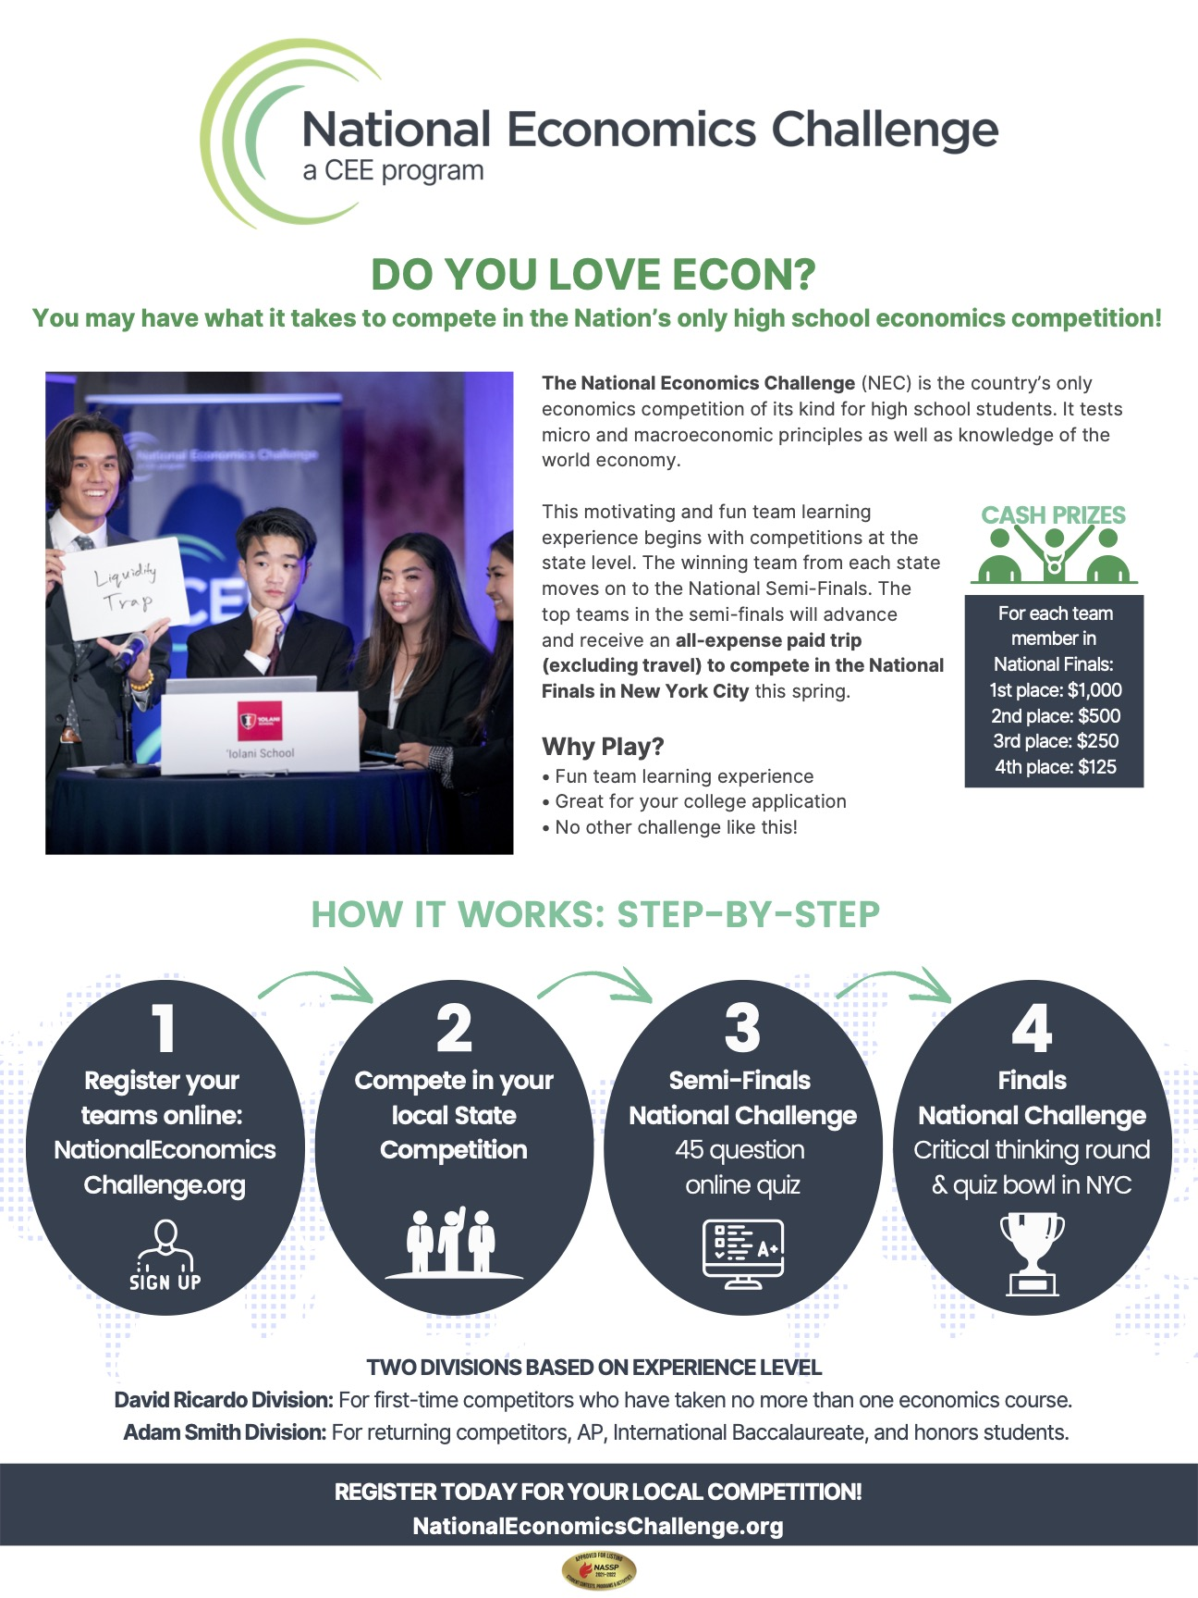
NEC

Slide 42

NPFC

Slide 43

Advocacy

Slide 44

Suggested Presentation Deck
CEE Affiliates
https://www.councilforeconed.org/resources/local-affiliates/
Include your local affiliate page

Slide 45










Thank You to Our Sponsors!

Slide 46
Contact information
Thank You

