Slide 1
Presented by: Tawni Hunt Ferrarini, PhD
Email: tawni.Ferrarini@gmail.com; tawni.org
Date: 2023 Feb 01
Professional Development

Slide 2
EconEdLink Membership
You can now access CEE’s professional development webinars directly on EconEdLink.org! To receive these new professional development benefits, become an EconEdLink member. As a member, you will now be able to:
Automatically receive a professional development certificate via e-mail within 24 hours after viewing any webinar for a minimum of 45 minutes
Register for upcoming webinars with a simple one-click process
Easily download presentations, lesson plan materials and activities for each webinar
Search and view all webinars at your convenience
Save webinars to your EconEdLink dashboard for easy access to the event
Access our new Professional Development page here

Slide 3
Professional Development Opportunities
To earn professional development credit for CEE webinars found on EconEdLink, you must:
Watch a minimum of 45-minutes and you will automatically receive a professional development certificate via e-mail within 24 hours.
Attendees can learn how much credit they will earn per workshop.
Accessing resources:
You can now easily download presentations, lesson plan materials, and activities for each webinar from EconEdLink.org/professional-development/
Local resources:
Insert your local professional development opportunities (if applicable)

Slide 4

Presented by: Tawni Hunt Ferrarini, PhD
Email: tawni.Ferrarini@gmail.com; tawni.org
Date: 2023 Feb 01
Presenter

Slide 5
Agenda
Compelling question
Objectives and Standards
Mystery Nations Interactive
Capitalism and Socialism: Commonalities and Differences
Once Over Lightly
References
Thanks

Slide 6
Question:
Why are some nations and communities “rich” and others “poor?”
Notes:
🍐 This is a Pear Deck Text Slide
🍐 To edit the type of question, go back to the "Ask Students a Question" in the Pear Deck sidebar.

Slide 7
Objectives
Objectives
In this webinar teachers will be able to:
List the 6 guiding principles of a capitalist system
Identify the distinguishing institutional features in capitalist systems relative to alternative methods to resource allocation, drawing attention to the role of private rights to persons and property
Summarize the record of net successes associated with the capitalist system

Slide 8
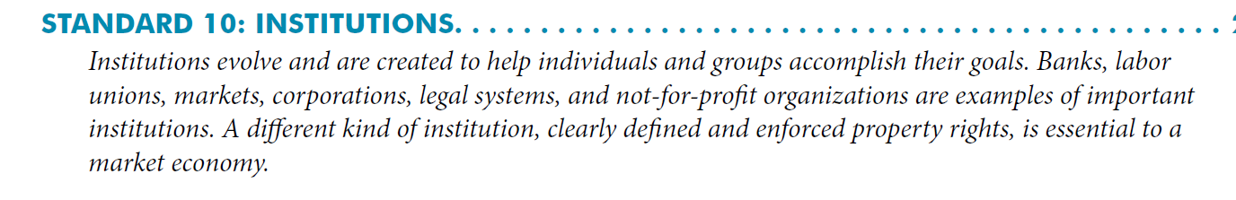
Suggested Presentation Deck
National Standards
Link

Slide 9
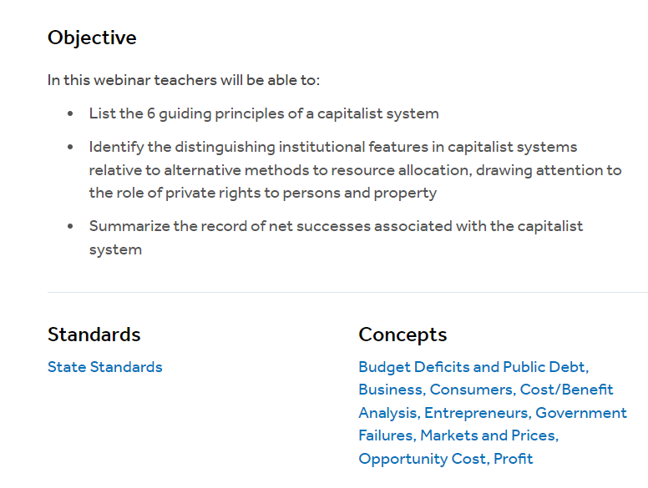
Suggested Presentation Deck
State Standards
LINK

Slide 10
Suggested Presentation Deck
Assessment Questions
Where do you land on Dollar Street where $0 is extreme poverty and $10 absolute wealth? (For simplicity, let’s go in increments of $2.
Let’s watch the Dollar Street Video. Note any changes in your perception and prepare to explain why.
Notes:
🍐 This is a Pear Deck Multiple Choice Slide. Your current options are: A: $0, B: $2, C: $4, D: $6, E: $8, F: $10,
🍐 To edit the type of question or choices, go back to the "Ask Students a Question" in the Pear Deck sidebar.

Slide 11
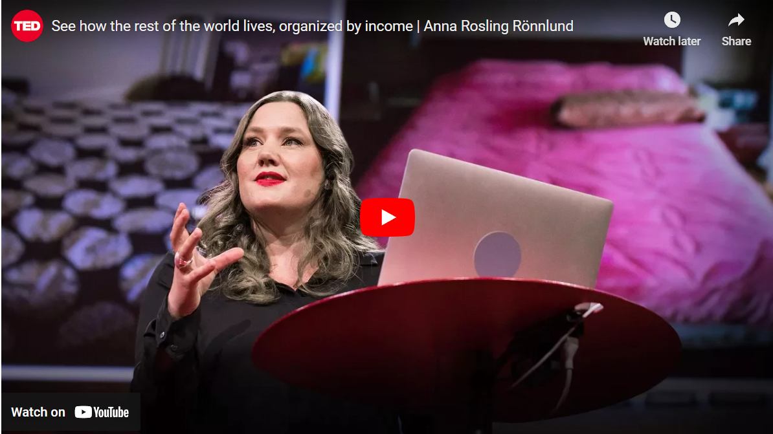
Suggested Presentation Deck
Assessment Questions
Where do you land on Dollar Street where $0 is extreme poverty and $10 absolute wealth?
Let’s watch the Dollar Street Video. Note any changes in your perception and prepare to explain why.
Notes:
🍐 This is a Pear Deck Web Slide.
🍐 To edit the type of question, go back to the "Ask Students a Question" in the Pear Deck sidebar.

Slide 12
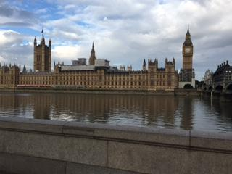
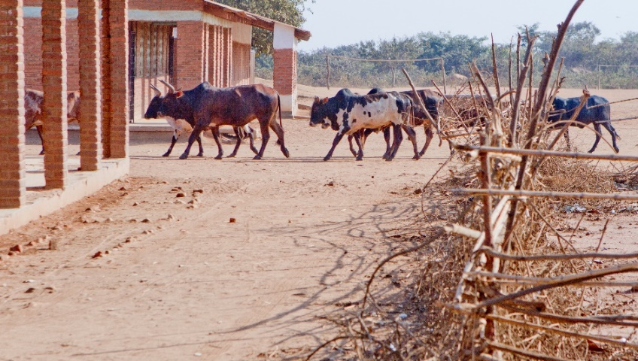
Capitalism and Socialism
Similarities and Differences
In both systems, people choose. In the “capitalist” or free-to-choose system, individuals choose. They are free-to-choose with the protection of rights to person and property, limited government, stable money, and relatively low tax rates and regulations. Plus, they are trade with other communities and regions.

Slide 13
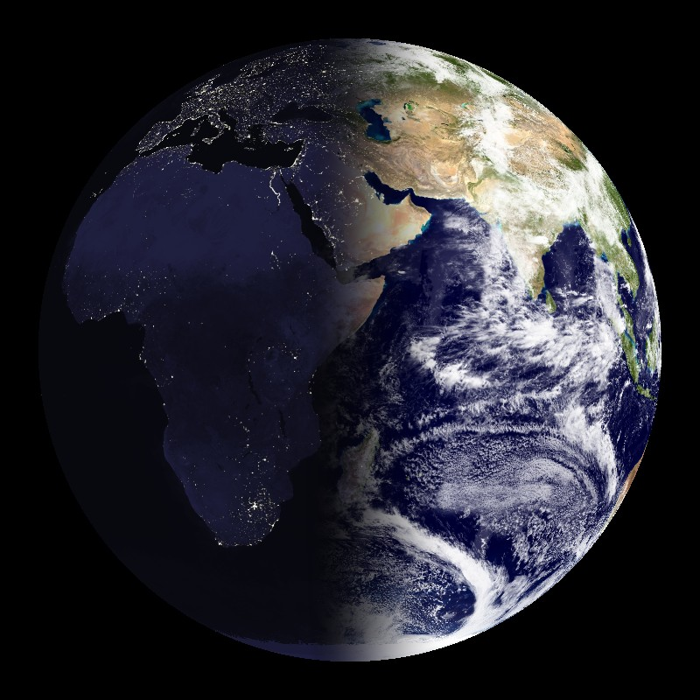

Why Are Some Nations Rich
While Others are Poor?
Some nations of the world relatively wealthy, others are not.
Why is that? What would your students say?
Notes:
🍐 This is a Pear Deck Text Slide
🍐 To edit the type of question, go back to the "Ask Students a Question" in the Pear Deck sidebar.

Slide 14

How to Measure Wealth?
Gross Domestic Product per Capita
    = Income per P:erson
Closely correlated with
  other measures:
    Life expectancy
    Poverty
    Infant mortality
    Literacy
    Access to capital
    Diversity, inclusion, and equity

Slide 15
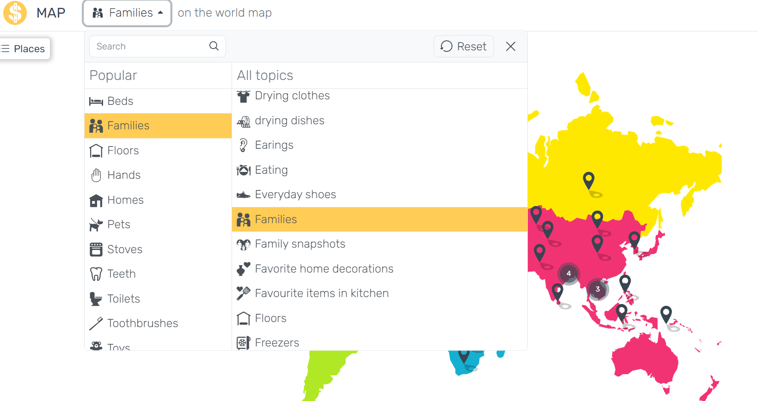
Gapminder.org
Income per capita and….
    Life expectancy
    Infant mortality
    Adult literacy
Notes:
Circle size is proportional to population size.
Color of circle indicates continent.
Press “play” on bottom to see the cross-section graph evolve over time.
Notes:
This slide provides links to some dynamic graphs at Gapminder.org. I strongly encourage you to invest 10-15 minutes exploring this site, and then sharing it with your students.
You can start by checking out some or all of the five graphs I’ve linked to here. For class, I suggest you show the life expectancy graph and one or two of the other ones.
Disclaimers/warnings: Gapminder is an external site not under the control of Worth Publishers. It could be taken down at any time (though this is not likely). I had to use “TinyURL” to create links small enough for PowerPoint to recognize; TinyURL is an external service not under the control of Worth Publishers, and it is possible that the TinyURL service could be interrupted or discontinued (though this is not likely).

Slide 16
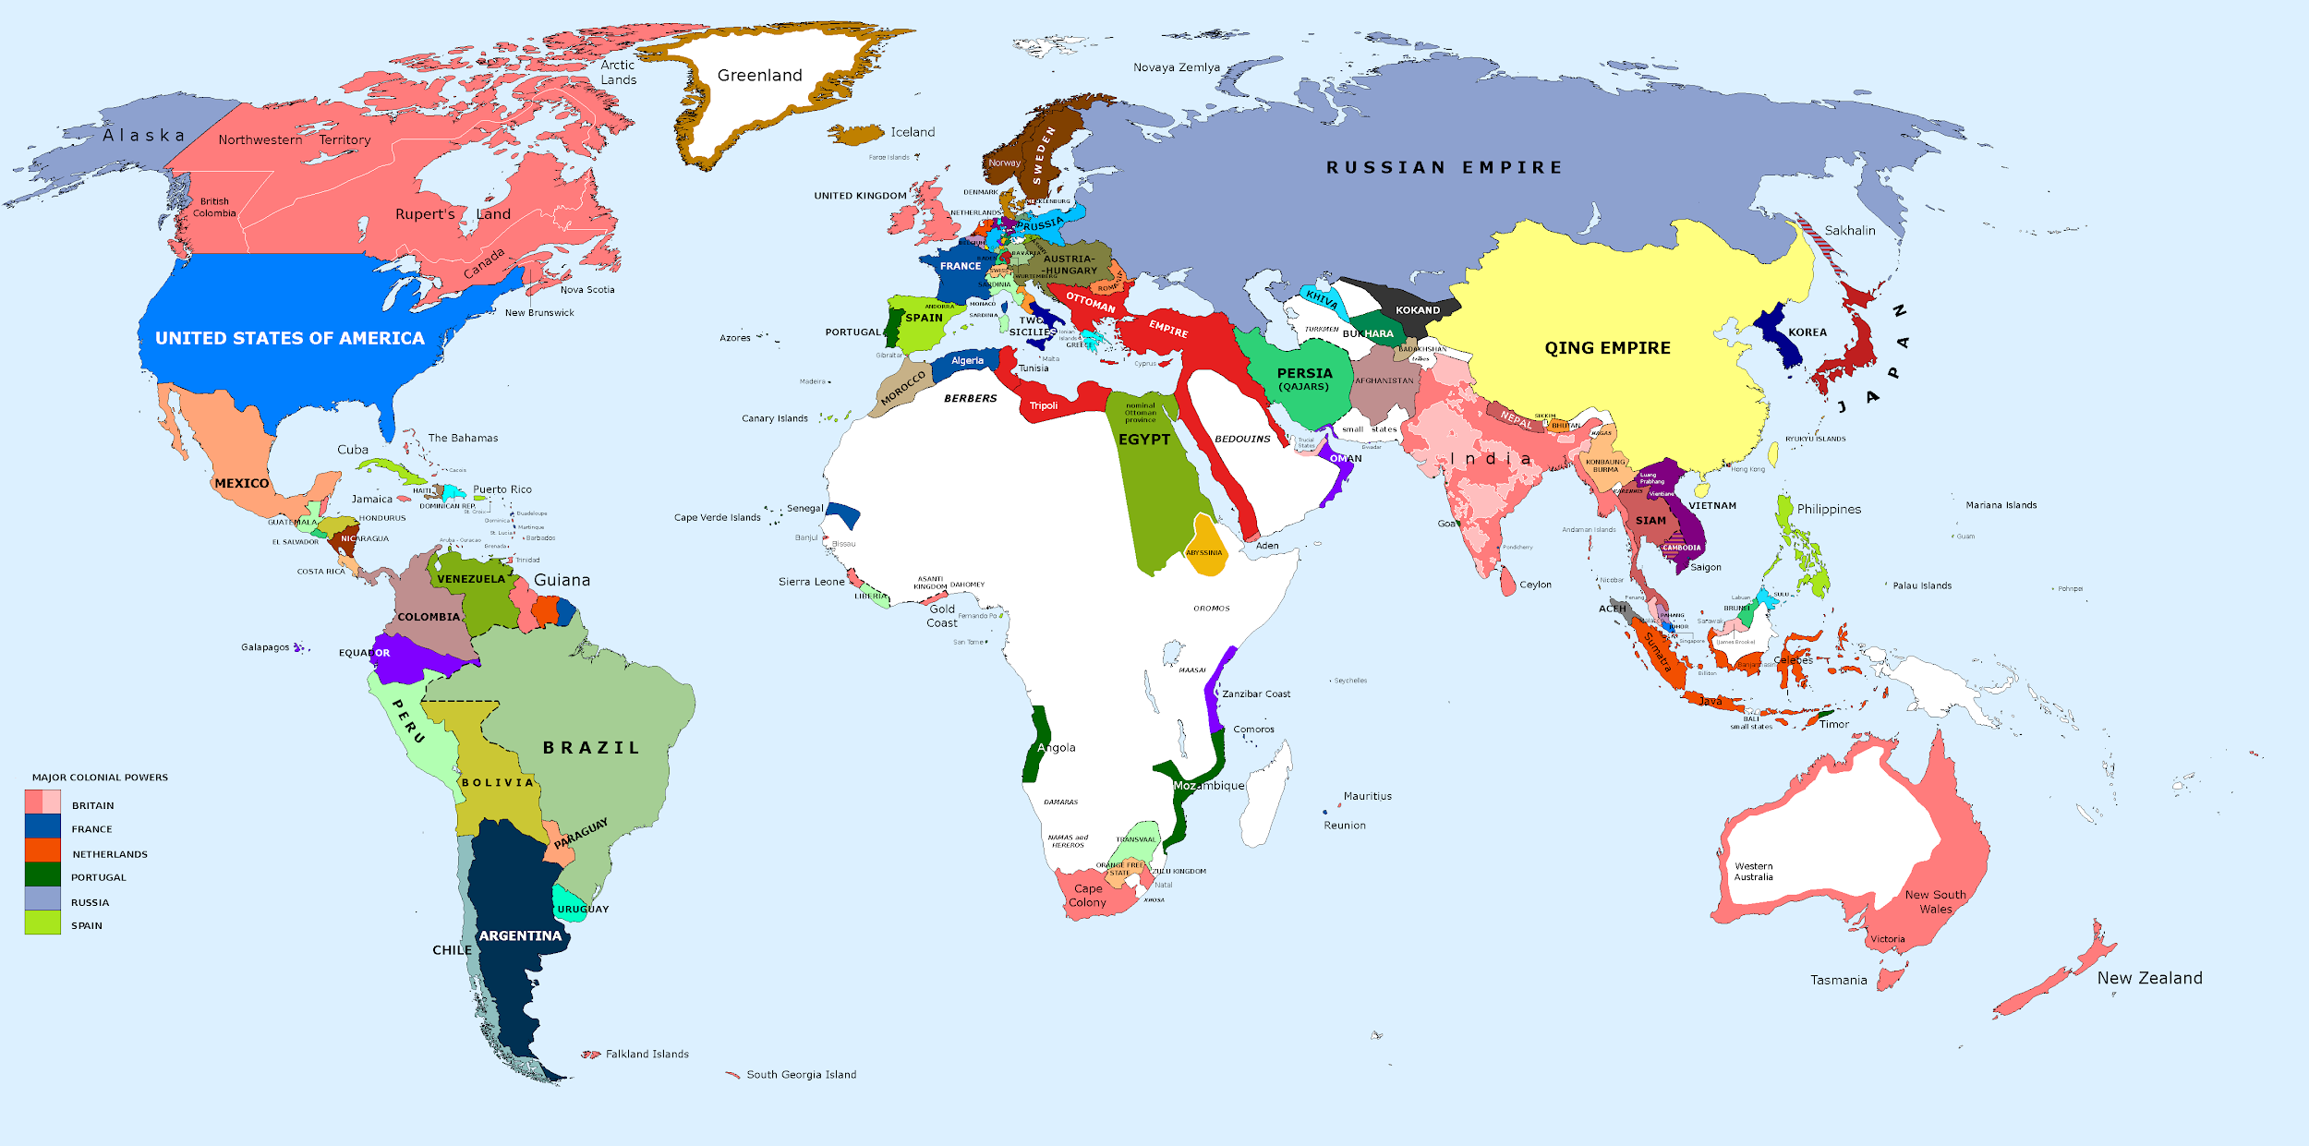
Rank the Nations
Use the following information to rank each nation from 1 to 5 with 1 being the richest and 5 the poorest.
Can you name that nation? And rank it?

Slide 17
Who Is Wealthy?
Rank 1 (high) to 5 (low)
Country A
    Size: 25% the size of Canada
    Population: About 41 million (small for a nation this size)
    Natural Resources: Rich resources with fertile land, lead, zinc, tin, copper, iron ore, oil, uranium
Country B
    Size: About twice the size of New Brunswick
    Population: About 126 million
    Natural Resources: Fish, no mineral resources
Country Name: ____________
Country Name: ____________

Slide 18
Who Is Wealthy?
Country C
  Size: Twice the size of Newfoundland and Labrador
  Population: Large population of 155 million
  Natural Resources: Vast resources including oil, tin, iron ore, coal, limestone, lead, zinc, natural gas
Country D
  Size: 1.6 times the size of Canada
  Population: Nearly 140 million
  Natural Resources: Vast resources with major deposits of oil, natural gas, coal, many strategic minerals, vast timber supplies
Country Name: ____________
Country Name: ____________

Slide 19
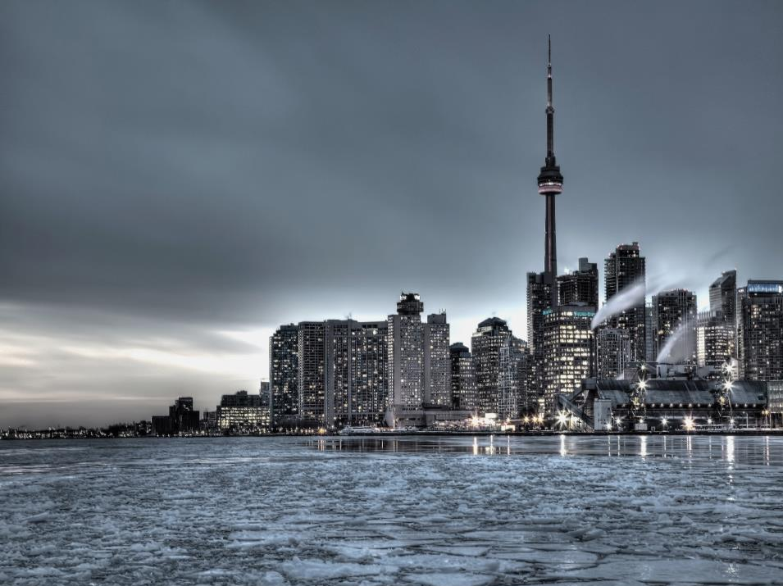

Who Is Wealthy?
Country E
Size: About size of
Toronto (land area)
Population: 5 million
Natural Resources:
Fish, deepwater port
Country Name: ________________

Slide 20
Mystery Nations Revealed

Slide 21

Country A
Name: Argentina
Population: 42,610,981
Per capita income: $18,400
(Purchasing Power Parity)
Life expectancy: 77 years
Literacy Rate: 97.9%
Infant mortality rate: 10.24 deaths/1,000 live births

Slide 22

Country B
Name: Japan
Population: 127,253,075
Per capita income: $36,900
Life expectancy: 84 years
Literacy Rate: 99%
Infant mortality rate: 2.17 deaths/1,000 live births

Slide 23

Country C
Name: Nigeria
Population: 174,507,539
Per capita income: $2,800
Life expectancy: 52 years
Literacy Rate: 61%
Infant mortality rate: 72.97 deaths/1,000 live births

Slide 24
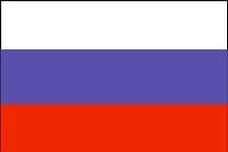
Country D
Name: Russia
Population: 142,500,482
Per capita income:$18,000
Life expectancy: 70 years
Literacy Rate: 99%
Infant mortality rate: 7.19 deaths/1,000 live births

Slide 25

Country E - Economy
Name: Singapore
Population: 5,460,302
Per capita income: $61,400
Life expectancy: 84 years
Literacy Rate: 95.9%
Infant mortality rate: 2.59 deaths/1,000 live births

Slide 26
Rankings
Singapore
Japan
Russia
Argentina
Nigeria

Slide 27

Canada
Name: Canada
Population: 34,300,083
Per capita income: $50,231
Life expectancy: 81.5 years
Literacy rate: 99%
Infant mortality rate: 4.85 deaths/1,000 live births

Slide 28
Free To Choose
The rule of law, safety and security,
Identity and relationships (i.e. the freedom to choose your relationship partner),
Freedom of movement, speech, assembly and religion—alongside economic freedom,
The ability of individuals to make their own economic decisions, including where to work, for how much to work, export, import, and more.

Slide 29

USA
Name: United States
Population: 316,668,567
Per capita income: $57,700
Life expectancy: 77 years
Literacy Rate: 99%
Infant mortality rate: 5.90 deaths/1,000 live births

Slide 30
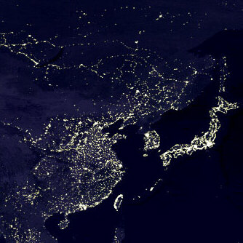
What are we looking at?
Notes:
‹#›
🍐 This is a Pear Deck Text Slide
🍐 To edit the type of question, go back to the "Ask Students a Question" in the Pear Deck sidebar.

Slide 31
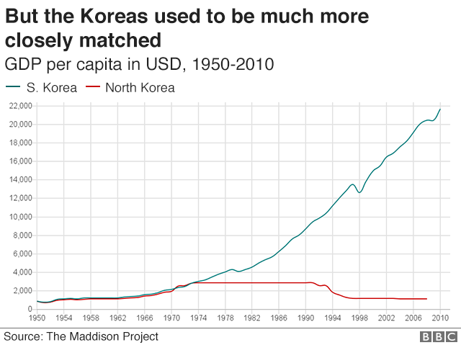

Slide 32
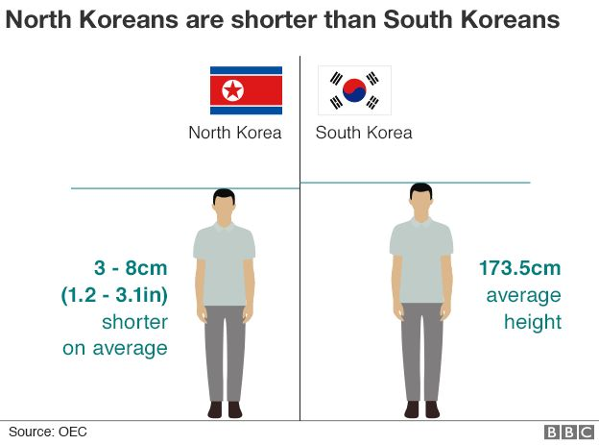
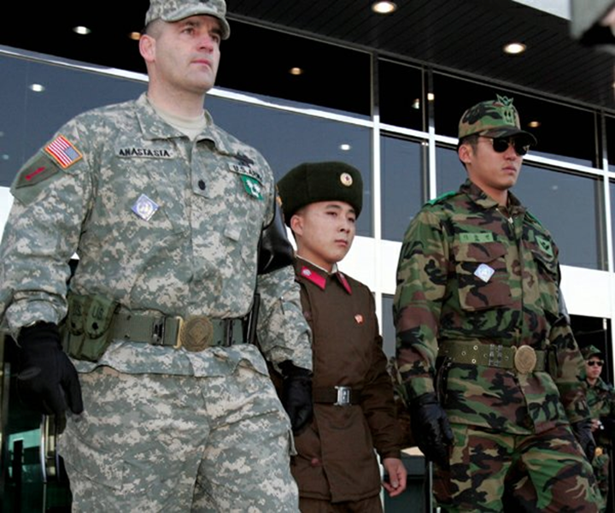

Slide 33
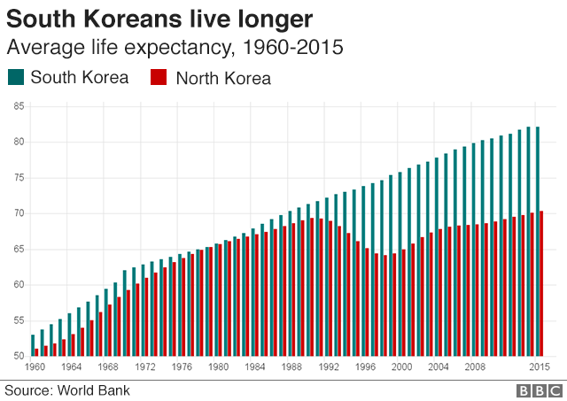

Slide 34
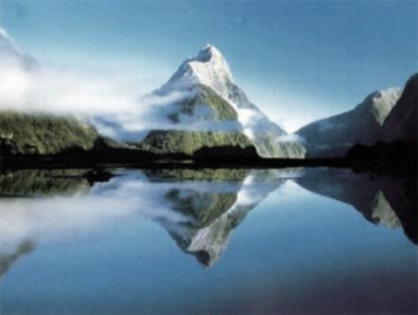
Natural Resources Paradox -
Both nations have resources
Natural resources have contributed to the economic success of some nations.
Yet, many nations with vast stocks of natural resources are poor.
The natural resources curse: decline of other sectors, price volatility, government mismanagement, corruption

Slide 35

Free-to-choose System vs. “Socialist” System with Command Control
South Korea
North Korea
The rule of law, safety and security,
Identity and relationships (i.e. the freedom to choose your relationship partner),
Freedom of movement, speech, assembly and religion—alongside economic freedom,
The ability of individuals to make their own economic decisions, including where to work, for how much to work, export, import, and more.

Slide 36
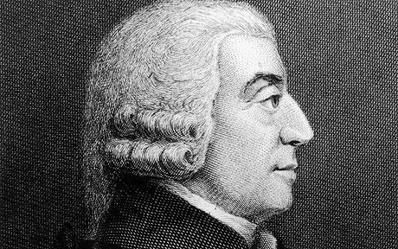
What matters?
Economic freedom and strong institutions produce innovation and ideas
  Political stability
  Secure property rights
  Limited government involvement in economy
  Reasonable regulation
  Sound money
  Legal systems based on the rule of law
  Freedom to trade
“Little else is requisite to carry a state to the highest degree of opulence from the lowest barbarism but peace, easy taxes, and a tolerable administration of justice: all the rest being brought about by the natural course of things.”
  Adam Smith, 1776

Slide 37

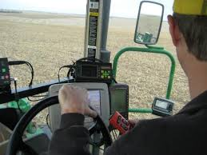
Productivity and
Standard of Living
Wealth increases comes from improvements in productivity
Economic freedom establishes a context which supports long-term investments in:
  Physical capital
  Human capital
  Innovation
A hopeful and liberating finding!

Slide 38
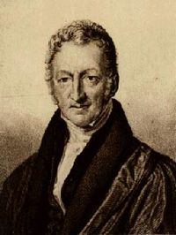
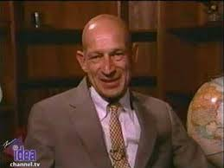
The Ultimate Resource
“The power of population is so superior to the power of the earth to produce subsistence for man, that premature death must in some shape or other visit the human race.”
- Thomas Malthus, 1798
  “The ultimate resource is people—especially skilled, spirited, and hopeful young people endowed with liberty
  -who will exert their wills and imaginations for their own benefit and inevitably benefit the rest of us as well." –
  - Julian Simon, 1995

Slide 39
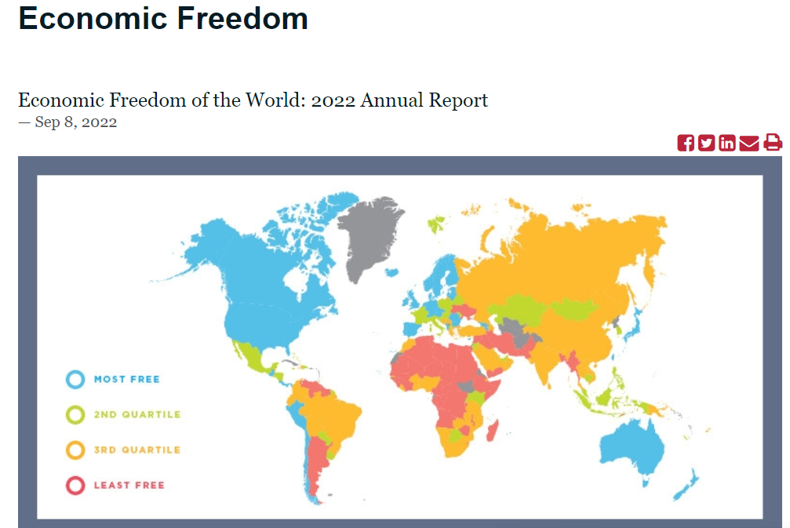
Economic Freedom of the World Report 2020
Measures the degree to which the policies and institutions of 159 countries are supportive of economic freedom, up from 157.
Forty-two data points from year 2020 are used to construct a summary index and to measure the degree of economic freedom.

Slide 40
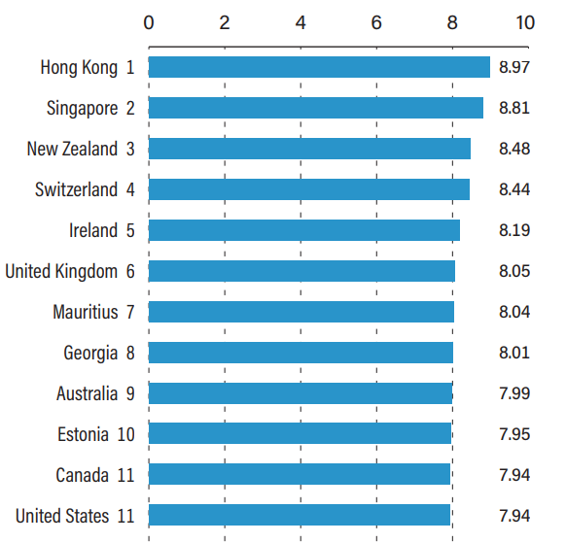
Overall Economic Freedom Index 2020 vs 2015: Where is the U.S. Now and Then?
2015: Where are we today?
Notes:
🍐 This is a Pear Deck Web Slide.
🍐 To edit the type of question, go back to the "Ask Students a Question" in the Pear Deck sidebar.

Slide 41
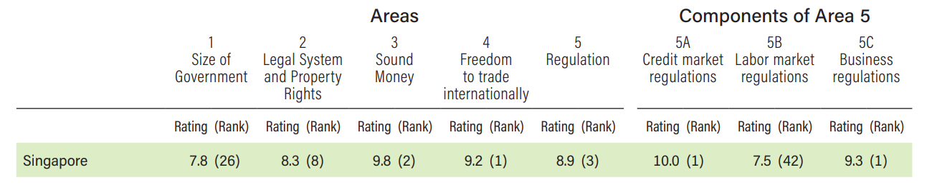
Paths to Prosperity (2015)
Singapore (#1 – again tied with Hong Kong in 2015 Report; chain linked ranks below)
Finland (#7 in 2014 Report; chain linked ranks below)
  Size of Government = 107
  Canada (#11 – tied with the U.S. in 2015 Report, # 5 in 2014 Report)
  U.S. (#11 in 2015 and 2014 after dropping out of top 10 in 2010)
  U.S. fell to 23 in 2019!!! Investigate the drop.

Slide 42
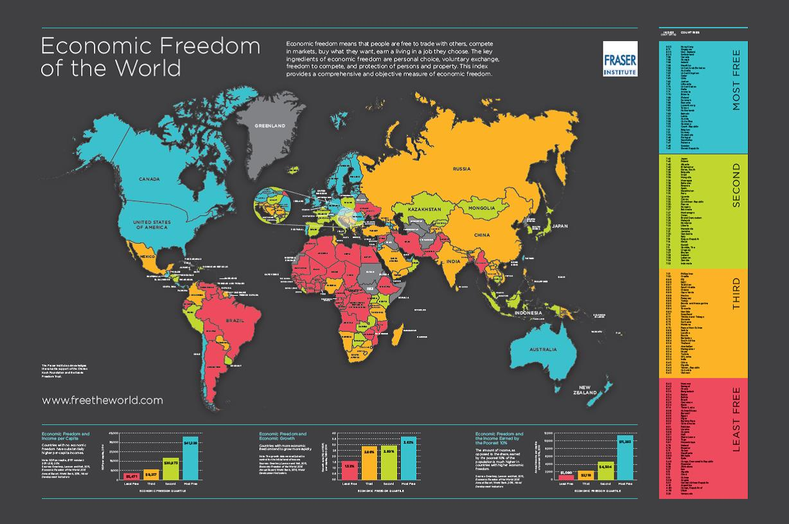

Slide 43
Lesson 10: Why Are Some Nations Wealthy, Focus: Economic Systems, Council for Economic Education
Fraser Institute: Economic Freedom of the World at: https://www.fraserinstitute.org/studies/economic-freedom
Gapminder and Living on Dollar Street at: https://www.gapminder.org/dollar-street/about
Gwartney, J. D., Stroup, R., Lee, D., Ferrarini, T., & Calhoun, J. (2016). Common sense economics: What everyone should know about wealth and prosperity. St. Martin's Press.
The World Factbook - CIA

Slide 44

Questions?

Slide 45

Suggested Presentation Deck
CEE Affiliates
https://www.councilforeconed.org/resources/local-affiliates/
Include your local affiliate page

Slide 46




Thank You to Our Sponsors!

Slide 47
Contact information
Thank You

