Slide 1
Presented by: James Redelsheimer
Email: jred40@gmail.com
Date: 3/6/23
AP Micro: Scarcity,
AP Micro: Supply and Demand

Slide 2
Professional Development Opportunities
To earn professional development credit for CEE webinars found on EconEdLink, you must:
Watch a minimum of 45-minutes and you will automatically receive a professional development certificate via e-mail within 24 hours.
Attendees can learn how much credit they will earn per workshop.
Accessing resources:
You can now easily download presentations, lesson plan materials, and activities for each webinar from EconEdLink.org/professional-development/
Local resources:
Insert your local professional development opportunities (if applicable)

Slide 3

James Redelsheimer
James Redelsheimer has been an AP and Regular Economics teacher at Robbinsdale Armstrong High School in Plymouth, Minnesota since 2003. James received his Bachelor’s degree from St. Olaf College and his Master's degree at the University of St. Thomas. He received the 3M Economics Educator Excellence Award from the Minnesota Council on Economic Education and was named Visa's Practical Money Skills Innovative Educator of the Month.
James enjoys traveling and has been a guest lecturer in the economics department at the Batumi State University in The Republic of Georgia and has received travel grants and fellowships for study travel to learn about the economies of Japan, China, Turkey, Germany, Korea, among others, and studied economics of the environment in Costa Rica. He currently serves as an AP Economics reader, grading AP Economics exams. He enjoys teaching Economics because it relates to students' everyday lives.

Slide 4
Agenda
Define supply and demand with real-world examples.
Practice multiple choice and FRQ Questions.
Activities from CEE’s AP Economics Workbook

Slide 5
Objectives
In this webinar teachers will be able to:
Understand the slope and determinants of both supply and demand.
Implement effective lessons to prepare students for AP exam questions on supply and demand.
Effectively review practice multiple choice and free response questions with their students to prepare them for the AP Exam.

Slide 6
Demand and Supply
Why do roses cost more on Valentine’s Day than during the rest of the year?
Why do TV ads cost more during the Super Bowl ($7 million for 30 sec.) than during Seinfeld reruns?
Why do pro basketball players earn more than pro hockey players?
Why do economics majors earn more than most other majors?
The answer to these and other economics questions boil down to the workings of demand and supply.

Slide 7
MARKETS DEFINED
POTENTIAL
BUYERS
POTENTIAL
SELLERS
MARKETS

Slide 8
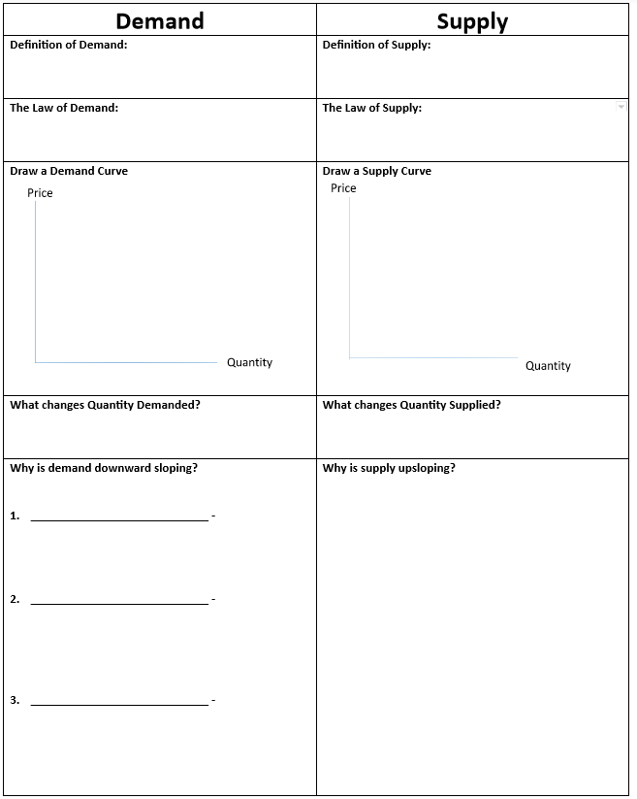

Slide 9
DEFINITION OF DEMAND
Shows the amount of a product consumers are willing
and able to purchase at each series of prices.
P
Q_{D}
Various Amounts
$5
4
3
2
1
10
20
35
55
80
A Series of Possible Prices
…a specified time period
…other things being equal

Slide 10

LAW OF DEMAND
An inverse relationship exists between price and quantity demanded
As Price Falls…
…Quantity Demanded Rises
As Price Rises…
…Quantity Demanded Falls

Slide 11
GRAPHING DEMAND
Price of Corn
P
CORN
$5
4
3
2
1
Plot the Points
P
Q_{D}
$5
4
3
2
1
10
20
35
55
80
o
Q
10 20 30 40 50 60 70 80
Quantity of Corn

Slide 12
GRAPHING DEMAND
Price of Corn
P
CORN
$5
4
3
2
1
Plot the Points
P
Q_{D}
$5
4
3
2
1
10
20
35
55
80
o
55
Q
10 20 30 40 50 60 70 80
Quantity of Corn

Slide 13
GRAPHING DEMAND
Price of Corn
P
CORN
$5
4
3
2
1
Plot the Points
P
Q_{D}
$5
4
3
2
1
10
20
35
55
80
o
Q
10 20 30 40 50 60 70 80
35
Quantity of Corn

Slide 14
GRAPHING DEMAND
Price of Corn
P
CORN
$5
4
3
2
1
Plot the Points
P
Q_{D}
$5
4
3
2
1
10
20
35
55
80
o
Q
10 20 30 40 50 60 70 80
Quantity of Corn

Slide 15
GRAPHING DEMAND
Price of Corn
P
CORN
$5
4
3
2
1
Plot the Points
P
Q_{D}
$5
4
3
2
1
10
20
35
55
80
o
Q
10 20 30 40 50 60 70 80
Quantity of Corn

Slide 16
GRAPHING DEMAND
Price of Corn
P
CORN
$5
4
3
2
1
Connect the Points
P
Q_{D}
$5
4
3
2
1
10
20
35
55
80
D
o
Q
10 20 30 40 50 60 70 80
Quantity of Corn

Slide 17
GRAPHING DEMAND
Price of Corn
What if
Demand
Increases?
P
CORN
$5
4
3
2
1
P
Q_{D}
$5
4
3
2
1
10
20
35
55
80
D
o
Q
10 20 30 40 50 60 70 80
Quantity of Corn

Slide 18
GRAPHING DEMAND
Price of Corn
Increase
in Quantity
Demanded:
P
CORN
$5
4
3
2
1
P
Q_{D}
What changes Qd?
Changes in price only
$5
4
3
2
1
10
20
35
55
80
30
40
60
80
+
Increase
in
Demand
D’
D
o
Q
10 20 30 40 50 60 70 80
Quantity of Corn

Slide 19
GRAPHING DEMAND
Price of Corn
What if
Demand
Decreases?
P
CORN
$5
4
3
2
1
P
Q_{D}
$5
4
3
2
1
10
20
35
55
80
D
o
Q
10 20 30 40 50 60 70 80
Quantity of Corn

Slide 20
GRAPHING DEMAND
Changes in price
DON’T shift
the curve!
Price of Corn
P
Decrease
in Quantity
Demanded
CORN
$5
4
3
2
1
P
Q_{D}
$5
4
3
2
1
10
20
35
55
80
--
10
20
40
60
Decrease
In Demand
D
D’
o
Q
10 20 30 40 50 60 70 80
Quantity of Corn

Slide 21
.
Why is demand downward sloping? (3 Reasons)
1. Income Effect
At lower prices, buyers feel richer and consumption increases. Vice versa
2. Substitution Effect
An increase in the price will encourage
consumers to buy alternative goods.
3. Diminishing Marginal Utility: Utility (satisfaction) decreases as more of the same product is consumed.

Slide 22


Can you see the Law of Diminishing Marginal Utility in Disneyland’s pricing strategy?

Slide 23
Change in Demand
Demand Schedule
Price of Cereal
What if cereal
makes you smarter?
$5
4
3
2
1
Price | Quantity Demanded
$5 | 10
$4 | 20
$3 | 30
$2 | 50
$1 | 80
Demand
o
Q
10 20 30 40 50 60 70 80
Quantity of Cereal
23

Slide 24
Change in Demand
Demand Schedule
Price of Cereal
$5
4
3
2
1
Price | Quantity Demanded
$5 | 10
$4 | 20
$3 | 30
$2 | 50
$1 | 80
Demand
o
Q
10 20 30 40 50 60 70 80
Quantity of Cereal
24

Slide 25
Change in Demand
Demand Schedule
Price of Cereal
$5
4
3
2
1
Price | Quantity Demanded
$5 | 10
$4 | 20
$3 | 30
$2 | 50
$1 | 80
Demand
o
Q
10 20 30 40 50 60 70 80
Quantity of Cereal
25

Slide 26
Change in Demand
Demand Schedule
Price of Cereal
$5
4
3
2
1
Price | Quantity Demanded
$5 | 30
$4 | 40
$3 | 50
$2 | 70
$1 | 80 100
Demand
o
Q
10 20 30 40 50 60 70 80
Quantity of Cereal
26

Slide 27
Change in Demand
Demand Schedule
Price of Cereal
Increase in Demand
Prices didn’t change but people want MORE cereal
$5
4
3
2
1
Price | Quantity Demanded
$5 | 30
$4 | 40
$3 | 50
$2 | 70
$1 | 80 100
D₁
Demand
o
Q
10 20 30 40 50 60 70 80
Quantity of Cereal
27

Slide 28
Determinants of Demand
(Shifters of the demand curve)
S
P
I
C
E
ubstitutes
2
references, Population
ncome
omplements
xpectations

Slide 29
Change in Qd vs. Change in Demand
There are two ways to increase quantity from 10 to 20
Price of Cereal
P
A to B is a change in quantity demand (due to a change in price)
A to C is a change in demand (shift in the curve)
A
C
$3
$2
B
D₂
D₁
o
Q Cereal
10 20
Quantity of Cereal

Slide 30
Identify the determinant (Shifter). 2. Will demand increase
or decrease 3. Which way will the shift be.
Market: Hamburgers (a normal good)
  Population boom
  Incomes fall due to recession
  Price for Chipotle burritos (a substitute for burgers) falls to $1
  Price increases to $5 for hot dogs (a substitute for burgers)
  New health craze- “No ground beef”
  Consumers expect Hamburger restaurants will significantly increase prices NEXT month
  Mice are found in multiple burger restaurants.
  Restaurants lower price of burgers to $.50
30
Notes:
Number of consumers, increase.
Income, decrease.
Substitutes, decrease.
Price doesn’t shift curve, no change.
Tastes and preferences, decrease.
Expectations, increase.
Complements, decrease.
Price doesn’t shift curve, no change.
30

Slide 31
Practice
  Population boom
 | Shifter | Increase or Decrease | Left or Right
1 | Population or Market Size | Increase | Right
Notes:
Number of consumers, increase.
Income, decrease.
Substitutes, decrease.
Price doesn’t shift curve, no change.
Tastes and preferences, decrease.
Expectations, increase.
Complements, decrease.
Price doesn’t shift curve, no change.

Slide 32
Practice
  2. Incomes fall due to recession
 | Shifter | Increase or Decrease | Left or Right
1 | Population or Market Size | Increase | Right
2 | Income | Decrease | Left
Notes:
Number of consumers, increase.
Income, decrease.
Substitutes, decrease.
Price doesn’t shift curve, no change.
Tastes and preferences, decrease.
Expectations, increase.
Complements, decrease.
Price doesn’t shift curve, no change.

Slide 33
Practice
  3. Price for Chipotle burritos (a substitute for burgers) falls to $1
 | Shifter | Increase or Decrease | Left or Right
1 | Population or Market Size | Increase | Right
2 | Income | Decrease | Left
3 | Substitutes | Decrease | Left
Notes:
Number of consumers, increase.
Income, decrease.
Substitutes, decrease.
Price doesn’t shift curve, no change.
Tastes and preferences, decrease.
Expectations, increase.
Complements, decrease.
Price doesn’t shift curve, no change.

Slide 34
Practice
  4. Price increases to $5 for hot dogs (a substitute for burgers)
 | Shifter | Increase or Decrease | Left or Right
1 | Population or Market Size | Increase | Right
2 | Income | Decrease | Left
3 | Substitutes | Decrease | Left
4 | Substitutes | Increase | Right
Notes:
Number of consumers, increase.
Income, decrease.
Substitutes, decrease.
Price doesn’t shift curve, no change.
Tastes and preferences, decrease.
Expectations, increase.
Complements, decrease.
Price doesn’t shift curve, no change.

Slide 35
Practice
  5. New health craze- “No ground beef”
 | Shifter | Increase or Decrease | Left or Right
1 | Population or Market Size | Increase | Right
2 | Income | Decrease | Left
3 | Substitutes | Decrease | Left
4 | Substitutes | Increase | Right
5 | Preferences | Decrease | Left
Notes:
Number of consumers, increase.
Income, decrease.
Substitutes, decrease.
Price doesn’t shift curve, no change.
Tastes and preferences, decrease.
Expectations, increase.
Complements, decrease.
Price doesn’t shift curve, no change.

Slide 36
Practice
  6. Consumers expect Hamburger restaurants will significantly increase prices NEXT month
 | Shifter | Increase or Decrease | Left or Right
1 | Population or Market Size | Increase | Right
2 | Income | Decrease | Left
3 | Substitutes | Decrease | Left
4 | Substitutes | Increase | Right
5 | Preferences | Decrease | Left
6 | Expectations | Increase | Right
Notes:
Number of consumers, increase.
Income, decrease.
Substitutes, decrease.
Price doesn’t shift curve, no change.
Tastes and preferences, decrease.
Expectations, increase.
Complements, decrease.
Price doesn’t shift curve, no change.

Slide 37
Practice
  7. Mice are found in multiple burger restaurants.
 | Shifter | Increase or Decrease | Left or Right
1 | Population or Market Size | Increase | Right
2 | Income | Decrease | Left
3 | Substitutes | Decrease | Left
4 | Substitutes | Increase | Right
5 | Preferences | Decrease | Left
6 | Expectations | Increase | Right
7 | Preferences | Decrease | Left
Notes:
Number of consumers, increase.
Income, decrease.
Substitutes, decrease.
Price doesn’t shift curve, no change.
Tastes and preferences, decrease.
Expectations, increase.
Complements, decrease.
Price doesn’t shift curve, no change.

Slide 38
Trick question alert!
  8. Restaurants lower price of burgers to $.50
 | Shifter | Increase or Decrease | Left or Right
1 | Population or Market Size | Increase | Right
2 | Income | Decrease | Left
3 | Substitutes | Decrease | Left
4 | Substitutes | Increase | Right
5 | Preferences | Decrease | Left
6 | Expectations | Increase | Right
7 | Complements | Decrease | Left
8 | No Shift! Move along curve only. A change in QD
Notes:
Number of consumers, increase.
Income, decrease.
Substitutes, decrease.
Price doesn’t shift curve, no change.
Tastes and preferences, decrease.
Expectations, increase.
Complements, decrease.
Price doesn’t shift curve, no change.

Slide 39
DEFINITION OF SUPPLY
Shows the amount of a product producers are willing
and able to sell at each series of prices.
SUPPLY SCHEDULE
CORN
P
Q_{S}
$1
2
3
4
5
5
20
35
50
60

Slide 40
LAW OF SUPPLY
A direct relationship exists between price and quantity supplied
As Price Rises…
…Quantity Supplied Rises
As Price Falls…
…Quantity Supplied Falls

Slide 41
Why is supply upsloping?
  At higher prices firms have an incentive to produce more.

Slide 42
SUPPLY SCHEDULE
CORN
P
Q_{S}
Various Amounts
$1
2
3
4
5
5
20
35
50
60
A Series of Possible Prices
…a specified time period
…other things being equal

Slide 43
Example of Supply
You own a lawn mower and you are willing to mow lawns.
How many would mow lawns at these prices?
Price per lawn mowed (1 hour) | Quantity Supplied
Supply Schedule
$1
$5
$20
$50
$100
$1000
43

Slide 44
GRAPHING SUPPLY
Price of Corn
Plot the Points
P
$5
4
3
2
1
CORN
P
Q_{S}
$5
4
3
2
1
60
50
35
20
5
o
5
Q
10 20 30 40 50 60 70 80
Quantity of Corn

Slide 45
GRAPHING SUPPLY
Price of Corn
Plot the Points
P
$5
4
3
2
1
CORN
P
Q_{S}
$5
4
3
2
1
60
50
35
20
5
o
Q
10 20 30 40 50 60 70 80
Quantity of Corn

Slide 46
GRAPHING SUPPLY
Price of Corn
Plot the Points
P
$5
4
3
2
1
CORN
P
Q_{S}
$5
4
3
2
1
60
50
35
20
5
o
35
Q
10 20 30 40 50 60 70 80
Quantity of Corn

Slide 47
GRAPHING SUPPLY
Price of Corn
Plot the Points
P
$5
4
3
2
1
CORN
P
Q_{S}
$5
4
3
2
1
60
50
35
20
5
o
Q
10 20 30 40 50 60 70 80
Quantity of Corn

Slide 48
GRAPHING SUPPLY
Price of Corn
Plot the Points
P
$5
4
3
2
1
CORN
P
Q_{S}
$5
4
3
2
1
60
50
35
20
5
o
Q
10 20 30 40 50 60 70 80
Quantity of Corn

Slide 49
GRAPHING SUPPLY
Price of Corn
Plot the Points
P
$5
4
3
2
1
S
CORN
P
Q_{S}
$5
4
3
2
1
60
50
35
20
5
Connect the Points
o
Q
10 20 30 40 50 60 70 80
Quantity of Corn

Slide 50
GRAPHING SUPPLY
Price of Corn
P
What if
Supply
Increases?
$5
4
3
2
1
S
CORN
P
Q_{S}
$5
4
3
2
1
60
50
35
20
5
o
Q
10 20 30 40 50 60 70 80
Quantity of Corn

Slide 51
GRAPHING SUPPLY
Price of Corn
P
Increase
in
Supply
S’
$5
4
3
2
1
S
CORN
P
Q_{S}
$5
4
3
2
1
60
50
35
20
5
80
70
60
45
30
Increase
in Quantity
Supplied
o
Q
10 20 30 40 50 60 70 80
Quantity of Corn

Slide 52
GRAPHING SUPPLY
Price of Corn
P
What if
Supply
Decreases?
$5
4
3
2
1
S
CORN
P
Q_{S}
$5
4
3
2
1
60
50
35
20
5
o
Q
10 20 30 40 50 60 70 80
Quantity of Corn

Slide 53
GRAPHING SUPPLY
Decrease
in
Supply
P
S’
$5
4
3
2
1
S
CORN
P
Q_{S}
$5
4
3
2
1
60
50
35
20
5
45
30
20
0
--
Decrease
in Quantity
Supplied
o
Q
10 20 30 40 50 60 70 80
Quantity of Corn

Slide 54

GRAPHING SUPPLY WITH DEMAND
Price of Corn
$5
$4
$3
$2
$1
S
CORN
P
Q_{S}
Combining
with
Demand
$5
4
3
2
1
60
50
35
20
5
o
Q
10 20 30 40 50 60 70 80
Quantity of Corn

Slide 55
MARKET DEMAND & SUPPLY
Price of Corn
CORN
MARKET
S
CORN
MARKET
$5
4
$3
2
1
P
Q_{D}
P
Q_{S}
$5
$4
$3
$2
$1
2,000
4,000
7,000
11,000
16,000
$5
$4
$3
$2
$1
12,000
10,000
7,000
4,000
1,000
Market
Clearing
Equilibrium
D
o
7
2 4 6 8 10 12 14 16
Q
Quantity of Corn

Slide 56
GRAPHING SUPPLY
Supply Schedule
What if new
companies start making
cereal?
Price of Cereal
Supply
$5
4
3
2
1
Price | Quantity Supplied
$5 | 50
$4 | 40
$3 | 30
$2 | 20
$1 | 10
o
Q
10 20 30 40 50 60 70 80
Quantity of Cereal
56

Slide 57
Change in Supply
Supply Schedule
Price of Cereal
Supply
$5
4
3
2
1
Price | Quantity Supplied
$5 | 50
$4 | 40
$3 | 30
$2 | 20
$1 | 10
o
Q
10 20 30 40 50 60 70 80
Quantity of Cereal
57

Slide 58
Change in Supply
Supply Schedule
Price of Cereal
Supply
$5
4
3
2
1
Price | Quantity Supplied
$5 | 50
$4 | 40
$3 | 30
$2 | 20
$1 | 10
o
Q
10 20 30 40 50 60 70 80
Quantity of Cereal
58

Slide 59
Change in Supply
Supply Schedule
Price of Cereal
Supply
$5
4
3
2
1
Price | Quantity Supplied
$5 | 70
$4 | 60
$3 | 50
$2 | 40
$1 | 10 30
o
Q
10 20 30 40 50 60 70 80
Quantity of Cereal
59

Slide 60
Change in Supply
Supply Schedule
Price of Cereal
Supply
S₂
$5
4
3
2
1
Price | Quantity Supplied
$5 | 70
$4 | 60
$3 | 50
$2 | 40
$1 | 10 30
Increase in Supply
Prices didn’t change but there is MORE cereal produced
o
Q
10 20 30 40 50 60 70 80
Quantity of Cereal
60

Slide 61
Change in Supply
Supply Schedule
What if a drought
destroys corn and wheat
crops?
Price of Cereal
Supply
$5
4
3
2
1
Price | Quantity Supplied
$5 | 50
$4 | 40
$3 | 30
$2 | 20
$1 | 10
o
Q
10 20 30 40 50 60 70 80
Quantity of Cereal
61

Slide 62
Change in Supply
Supply Schedule
Price of Cereal
Supply
$5
4
3
2
1
Price | Quantity Supplied
$5 | 50
$4 | 40
$3 | 30
$2 | 20
$1 | 10
o
Q
10 20 30 40 50 60 70 80
Quantity of Cereal
62

Slide 63
Change in Supply
Supply Schedule
Price of Cereal
Supply
$5
4
3
2
1
Price | Quantity Supplied
$5 | 50
$4 | 40
$3 | 30
$2 | 20
$1 | 10
o
Q
10 20 30 40 50 60 70 80
Quantity of Cereal
63

Slide 64
Change in Supply
Supply Schedule
Price of Cereal
Supply
$5
4
3
2
1
Price | Quantity Supplied
$5 | 30
$4 | 20
$3 | 10
$2 | 1
$1 | 10 0
o
Q
10 20 30 40 50 60 70 80
Quantity of Cereal
64

Slide 65
Change in Supply
Supply Schedule
Price of Cereal
Supply
$5
4
3
2
1
S₂
Price | Quantity Supplied
$5 | 30
$4 | 20
$3 | 10
$2 | 1
$1 | 10 0
Decrease in Supply
Prices didn’t change but there is LESS cereal produced
o
Q
10 20 30 40 50 60 70 80
Quantity of Cereal
65

Slide 66
DETERMINANTS OF SUPPLY
C
O
T
T
E
N
ost of Inputs
ther goods’ prices
axes & Subsidies
echnology
xpectations
umber of Sellers

Slide 67
Supply Practice
Which determinant (SHIFTER)?
Increase or decrease?
Which direction will curve shift?
Market: Hamburgers
  Mad cow disease kills 20% of cows
  Price of hamburgers increase 30%
  Government taxes burger producers
  Restaurants can produce burgers and/or tacos. A demand increase causes the price for tacos to increase 500%
  New bun baking technology cuts production time in half
  Minimum wage increases to $20
Notes:
Decrease in availability of resources, decrease.
Price doesn’t shift curve, no shift.
Government action, decrease.
Opportunity cost of alternative production, decrease.
Technology, increase.
Price of resources, decrease.

Slide 68
Supply Practice
1. Mad cow disease kills 20% of cows
 | Shifter | Increase or Decrease | Left or Right
1 | Cost of Inputs | Decrease | Left
68
Notes:
Number of consumers, increase.
Income, decrease.
Substitutes, decrease.
Price doesn’t shift curve, no change.
Tastes and preferences, decrease.
Expectations, increase.
Complements, decrease.
Price doesn’t shift curve, no change.
68

Slide 69
Supply Practice
  2. Price of hamburgers increase 30%
 | Shifter | Increase or Decrease | Left or Right
1 | Cost of Inputs | Decrease | Left
2 | NO SHIFT! Change in QS only
69
Notes:
Number of consumers, increase.
Income, decrease.
Substitutes, decrease.
Price doesn’t shift curve, no change.
Tastes and preferences, decrease.
Expectations, increase.
Complements, decrease.
Price doesn’t shift curve, no change.
69

Slide 70
Supply Practice
  3. Government taxes burger producers
 | Shifter | Increase or Decrease | Left or Right
1 | Cost of Inputs | Decrease | Left
2 | NO SHIFT! Change in QS only
3 | Taxes | Decrease | Left
70
Notes:
Number of consumers, increase.
Income, decrease.
Substitutes, decrease.
Price doesn’t shift curve, no change.
Tastes and preferences, decrease.
Expectations, increase.
Complements, decrease.
Price doesn’t shift curve, no change.
70

Slide 71
Supply Practice
  4. Restaurants can produce burgers and/or tacos. A demand increase causes the price for tacos to increase 500%.
 | Shifter | Increase or Decrease | Left or Right
1 | Cost of Inputs | Decrease | Left
2 | NO SHIFT! Change in QS only
3 | Taxes | Decrease | Left
4 | Other goods’ prices | Decrease | Left
71
Notes:
Number of consumers, increase.
Income, decrease.
Substitutes, decrease.
Price doesn’t shift curve, no change.
Tastes and preferences, decrease.
Expectations, increase.
Complements, decrease.
Price doesn’t shift curve, no change.
71

Slide 72
Supply Practice
  5. New bun baking technology cuts production time in half
 | Shifter | Increase or Decrease | Left or Right
1 | Cost of Inputs | Decrease | Left
2 | NO SHIFT! Change in QS only
3 | Taxes | Decrease | Left
4 | Other goods’ prices | Decrease | Left
5 | Technology | Increase | Right
72
Notes:
Number of consumers, increase.
Income, decrease.
Substitutes, decrease.
Price doesn’t shift curve, no change.
Tastes and preferences, decrease.
Expectations, increase.
Complements, decrease.
Price doesn’t shift curve, no change.
72

Slide 73
Supply Practice
  6. Minimum wage increases to $20
 | Shifter | Increase or Decrease | Left or Right
1 | Cost of Inputs | Decrease | Left
2 | NO SHIFT! Change in QS only
3 | Taxes | Decrease | Left
4 | Other goods’ prices | Decrease | Left
5 | Technology | Increase | Right
6 | Cost of Inputs | Decrease | Left
73
Notes:
Number of consumers, increase.
Income, decrease.
Substitutes, decrease.
Price doesn’t shift curve, no change.
Tastes and preferences, decrease.
Expectations, increase.
Complements, decrease.
Price doesn’t shift curve, no change.
73

Slide 74
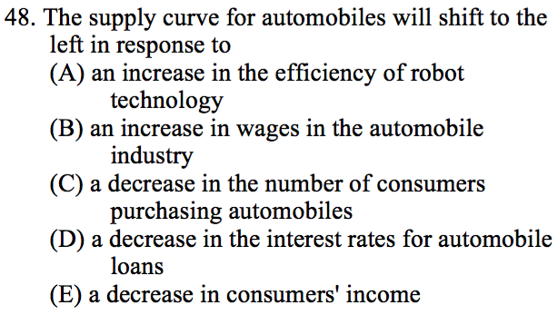
Notes:
B

Slide 75
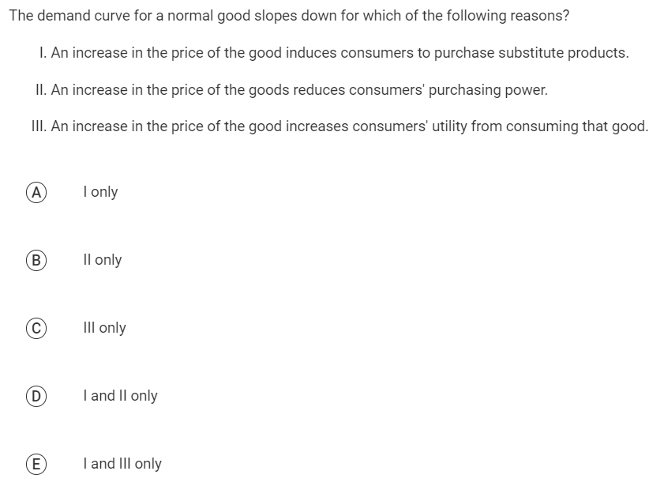

Slide 76
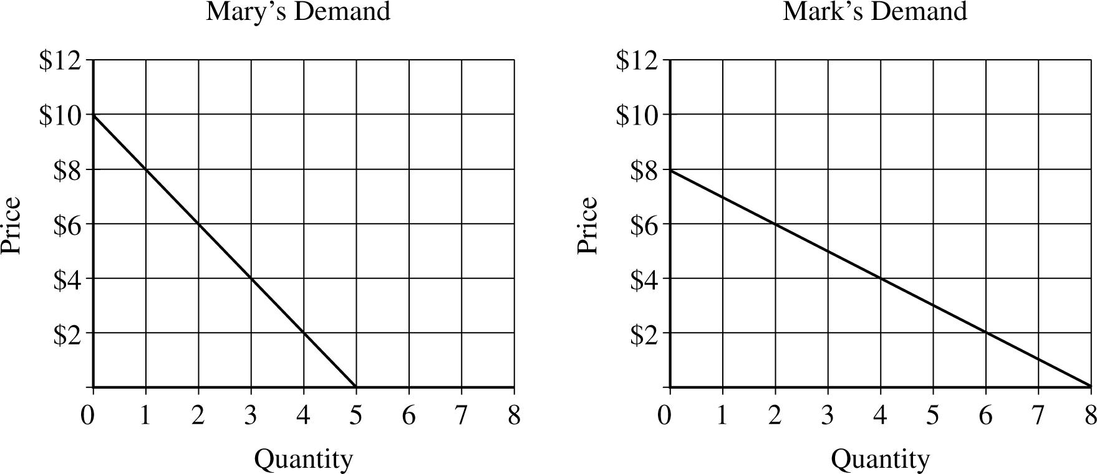
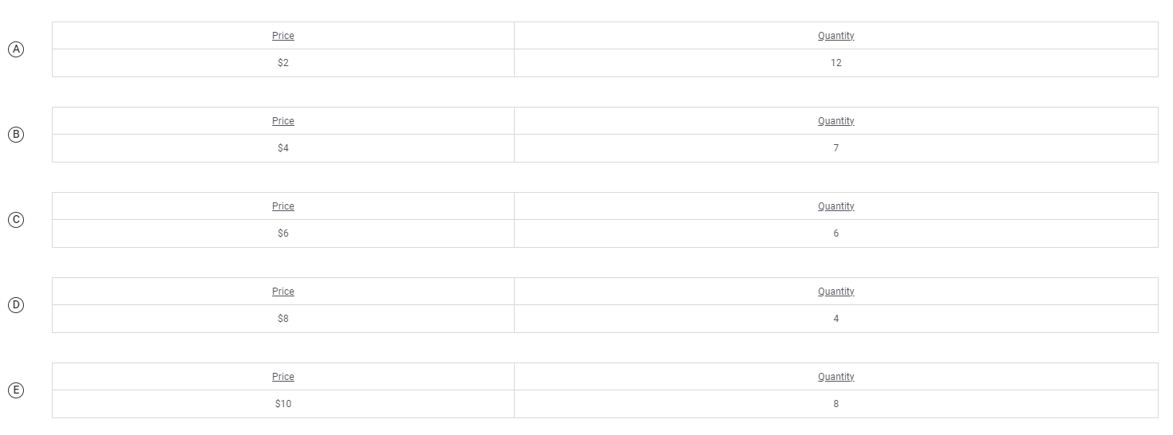
The graphs above show Mary’s demand for hamburgers and Mark’s demand for hamburgers. Suppose Mary and Mark are the only two consumers in the market. Which of the following is a point on the market demand curve for hamburgers?

Slide 77
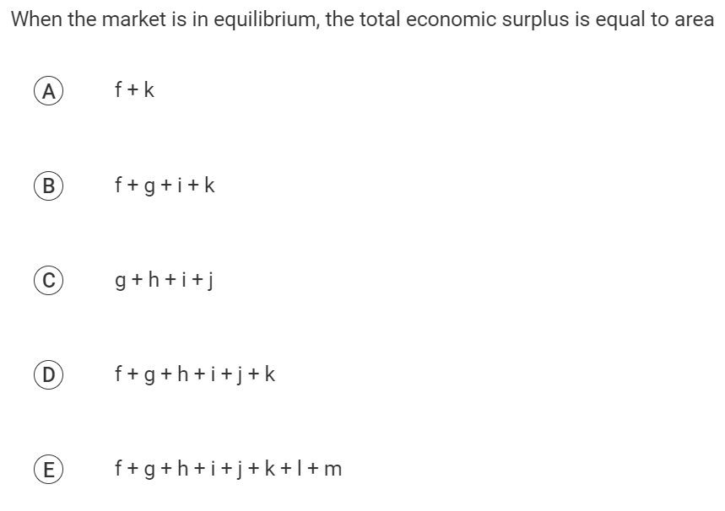
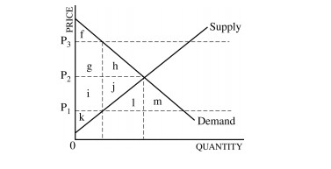

Slide 78

Where is CS and PS on the graph?
P
Calculate the following
(show your work)
1. Consumer surplus at $20
2. Producer surplus at $20
3. Total surplus at $20
Answers
1. $225 = ($35-$20)x30/2
2. $150 = ($20-$10)x30/2
3. $375 = $225 + $150
$35
$30
$25
$20
$15
$10
$5
S
CS
PS
D
10 20 30 40 50 60
Q

Slide 79
P
Calculate the area of:
Consumer Surplus
Producer Surplus
Total Surplus
$22
20
18
16
14
S
CS
CS= $40
PS= $20
Total= $60
PS
D
20
Q

Slide 80
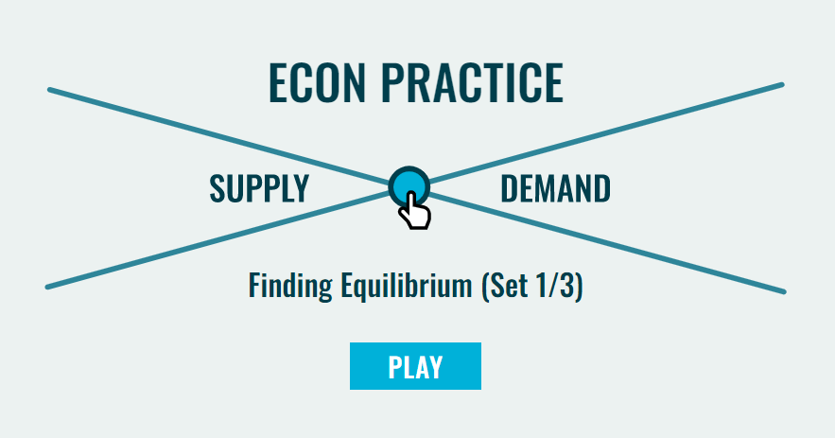

Slide 81
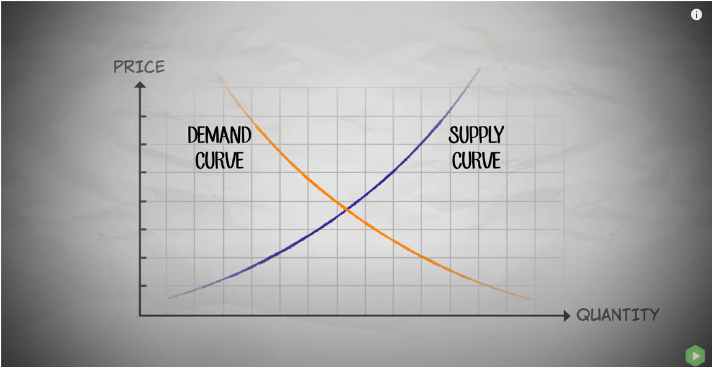

Slide 82
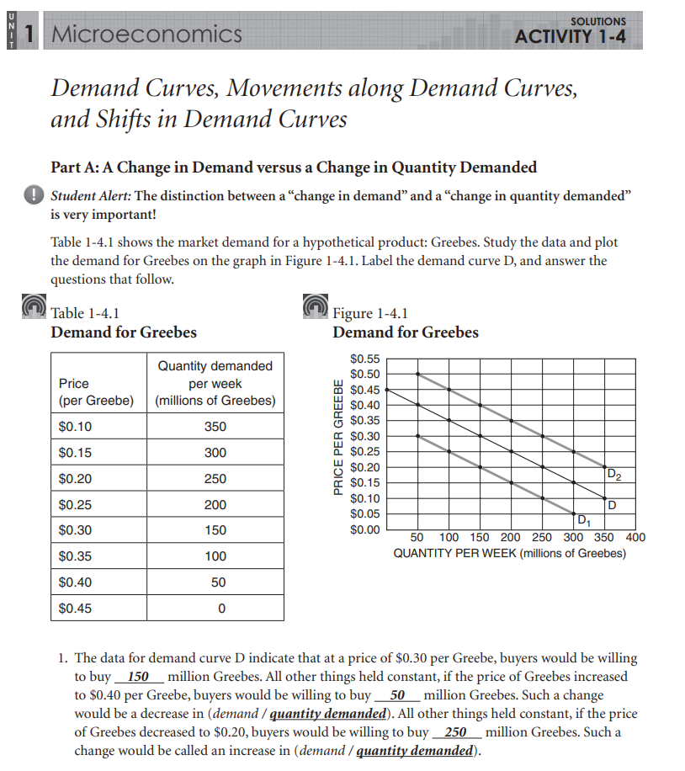
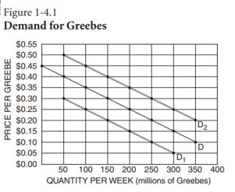

Slide 83
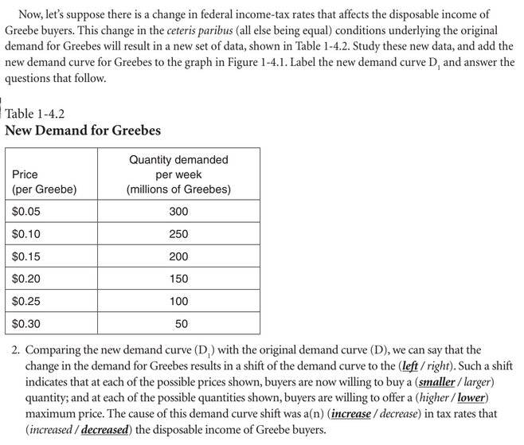

Slide 84
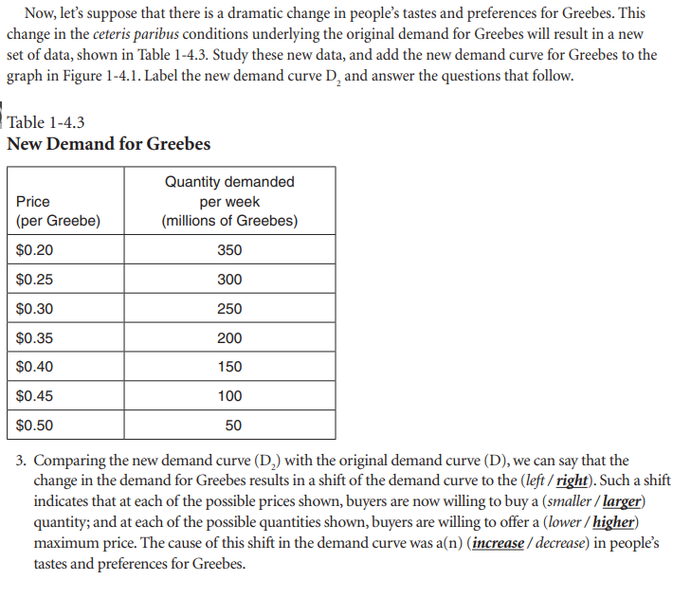

Slide 85
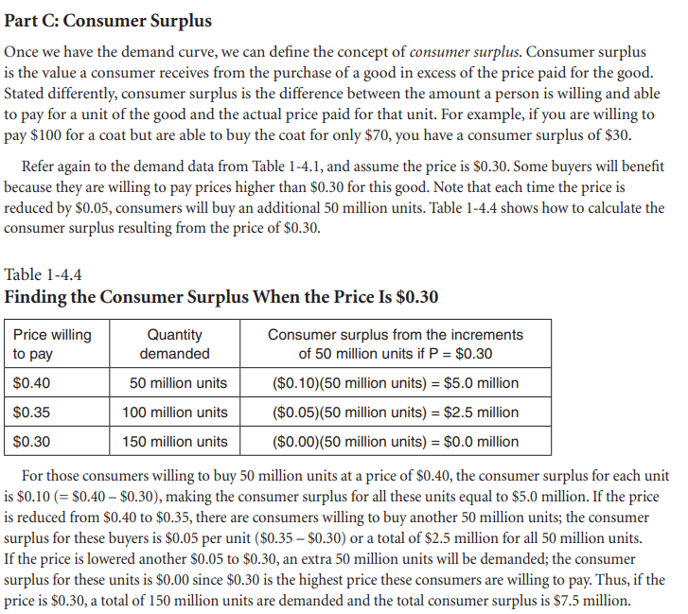

Slide 86
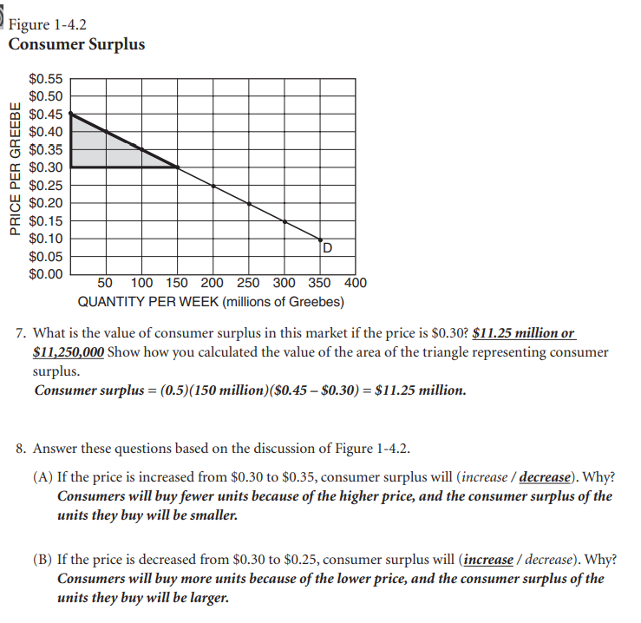

Slide 87
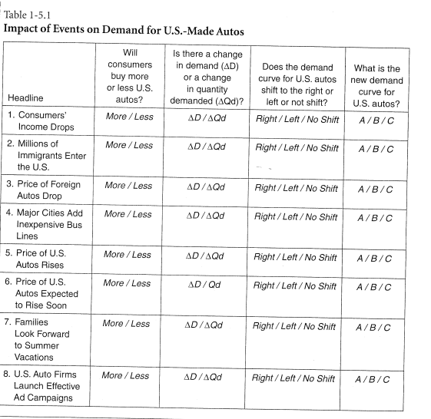
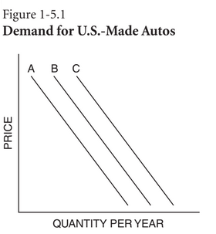

Slide 88
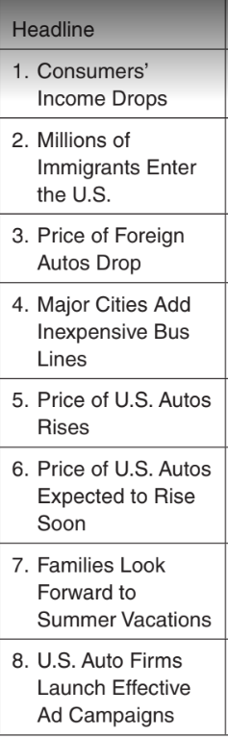
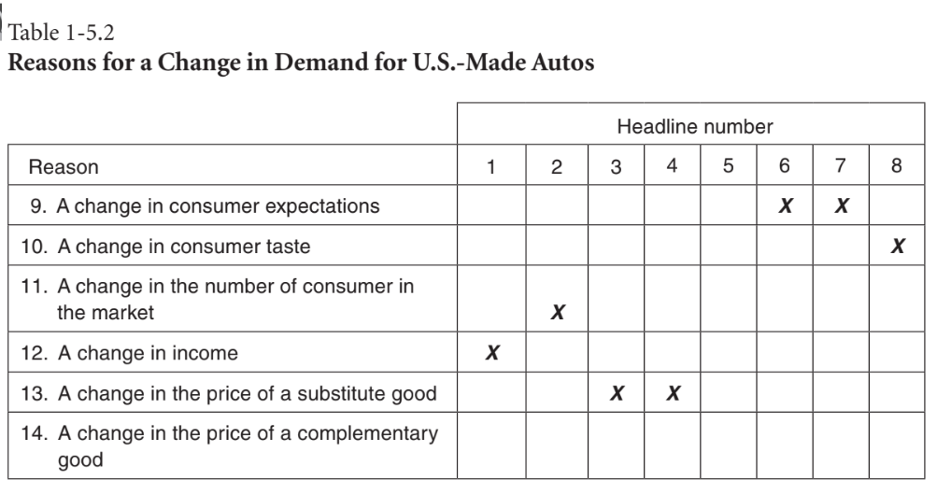

Slide 89
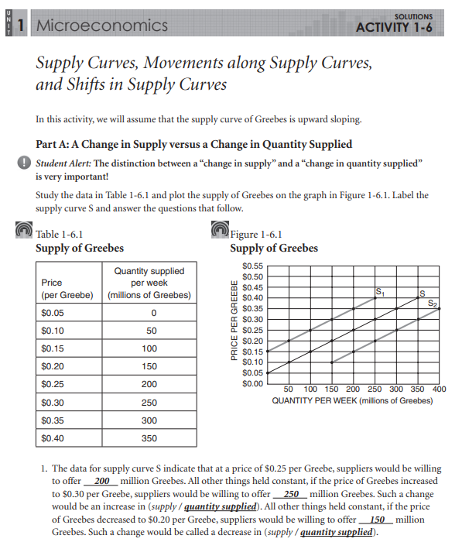

Slide 90
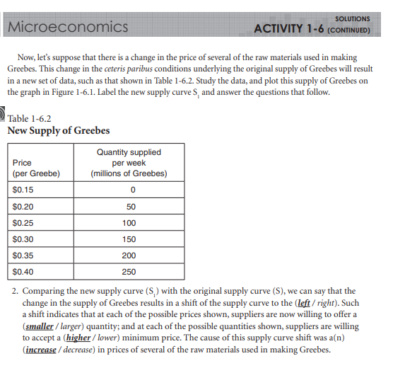
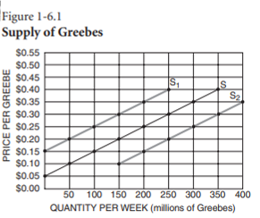

Slide 91
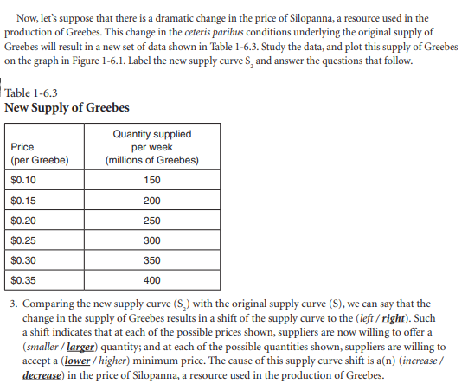

Slide 92
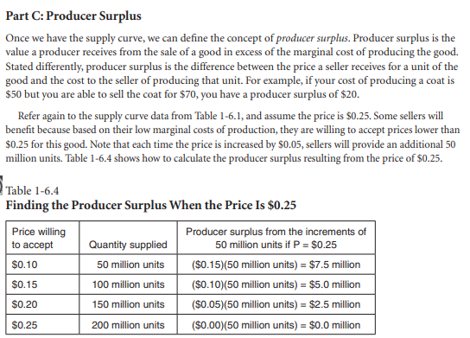

Slide 93
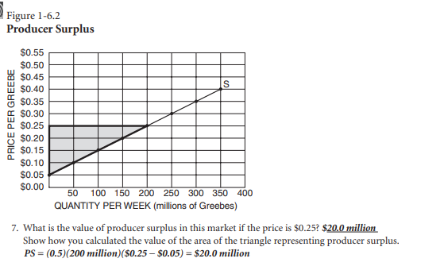
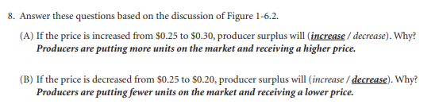

Slide 94
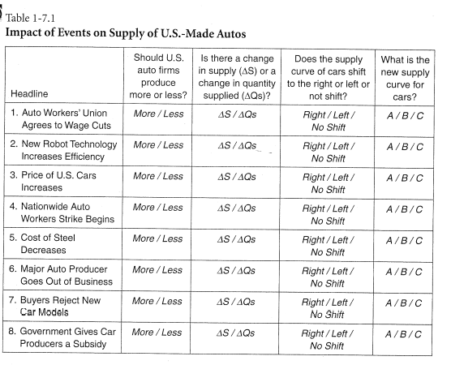
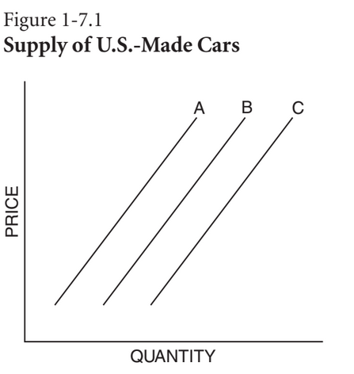

Slide 95
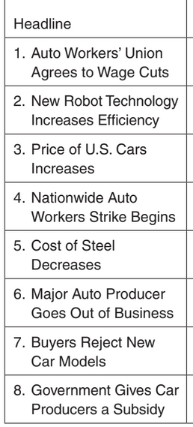
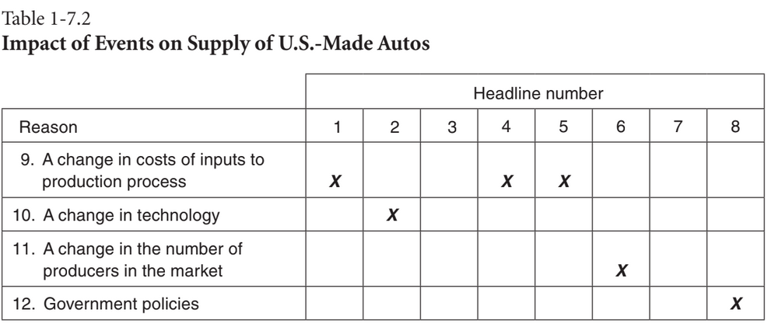

Slide 96
Supply and Demand Shifting Room Activity.
Supply and Demand Room Shifting Activity Questions (click here) and answer template (click here)

Slide 97
EconEdLink Membership
You can now access CEE’s professional development webinars directly on EconEdLink.org! To receive these new professional development benefits, become an EconEdLink member. As a member, you will now be able to:
Automatically receive a professional development certificate via e-mail within 24 hours after viewing any webinar for a minimum of 45 minutes
Register for upcoming webinars with a simple one-click process
Easily download presentations, lesson plan materials and activities for each webinar
Search and view all webinars at your convenience
Save webinars to your EconEdLink dashboard for easy access to the event
Access our new Professional Development page here

Slide 98

Invest In Girls

Slide 99

NEC

Slide 100

NPFC

Slide 101

Advocacy

Slide 102


CEE Affiliates
https://www.councilforeconed.org/resources/local-affiliates/
Minnesota Council on Economics Education: www.mcee.umn.edu

Slide 103










Thank You to Our Sponsors!

Slide 104
James Redelsheimer jred40@gmail.com
Thank You

