Slide 1
Presented by: James Redelsheimer
Email: jred40@gmail.com
Date: 2/13/22
AP Micro: Scarcity,
AP Micro: Scarcity, Opportunity Cost,
and Production Curves

Slide 2
Professional Development Opportunities
To earn professional development credit for CEE webinars found on EconEdLink, you must:
Watch a minimum of 45-minutes and you will automatically receive a professional development certificate via e-mail within 24 hours.
Attendees can learn how much credit they will earn per workshop.
Accessing resources:
You can now easily download presentations, lesson plan materials, and activities for each webinar from EconEdLink.org/professional-development/
Local resources:
Insert your local professional development opportunities (if applicable)

Slide 3

James Redelsheimer
James Redelsheimer has been an AP and Regular Economics teacher at Robbinsdale Armstrong High School in Plymouth, Minnesota since 2003. James received his Bachelor’s degree from St. Olaf College and his Master's degree at the University of St. Thomas. He received the 3M Economics Educator Excellence Award from the Minnesota Council on Economic Education and was named Visa's Practical Money Skills Innovative Educator of the Month.
James enjoys traveling and has been a guest lecturer in the economics department at the Batumi State University in The Republic of Georgia and has received travel grants and fellowships for study travel to learn about the economies of Japan, China, Turkey, Germany, Korea, among others, and studied economics of the environment in Costa Rica. He currently serves as an AP Economics reader, grading AP Economics exams. He enjoys teaching Economics because it relates to students' everyday lives.

Slide 4
Agenda
Define scarcity and opportunity cost with real-world examples.
Practice multiple choice and FRQ Questions.
Activities from CEE’s AP Economics Workbook

Slide 5
Objectives
In this webinar teachers will be able to:
  Learn innovative ways to teach the key concept of scarcity
Understand opportunity cost and be able to give relevant examples.
Teach students to understand the production possibilities curve and how it relates to key economic ideas.

Slide 6
National Standards
STANDARD 1: SCARCITY: Productive resources are limited. Therefore, people cannot have all the goods and services they want; as a result, they must choose some things and give up others.

Slide 7
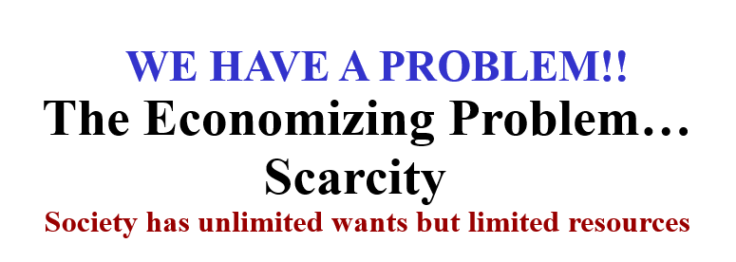

Slide 8

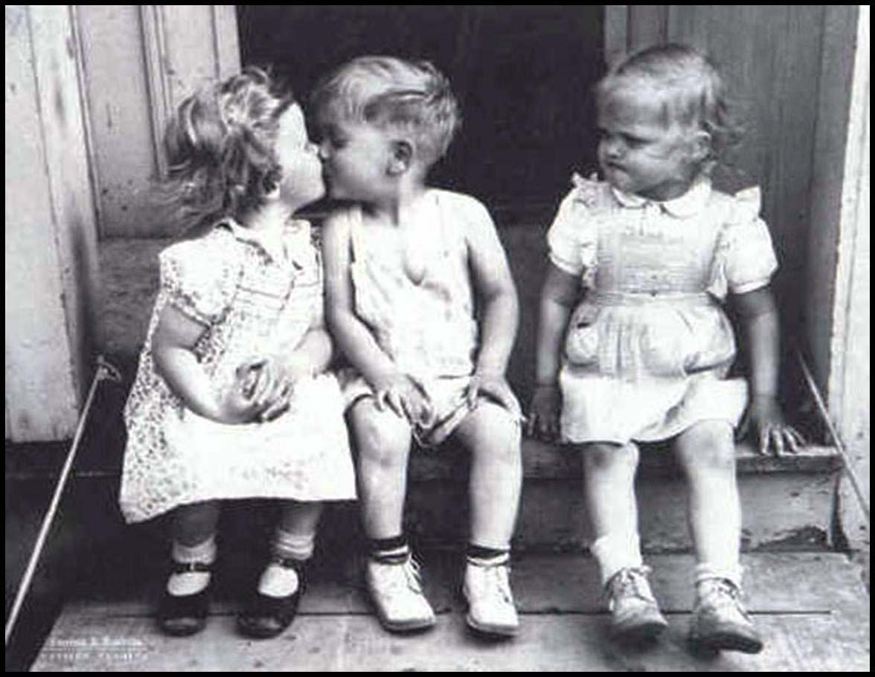
Scarcity: Wants > Availability of Resources

Slide 9
Economics is the science of scarcity.
Scarcity- we have unlimited wants but limited resources.
Since we are unable to have everything we desire, we must make choices on how we will use our resources.
Economics is the study of choices.
In economics we study the choices of individuals, firms, and governments.

Slide 10
Examples:
  You must choose between buying jeans or buying shoes.
  Businesses must choose how many people to hire
  Governments must choose how much to spend on welfare.
Economics- Social science concerned with the efficient use of scarce resources to achieve maximum satisfaction of economic wants.
(Study of how individuals and societies deal with scarcity)

Slide 11
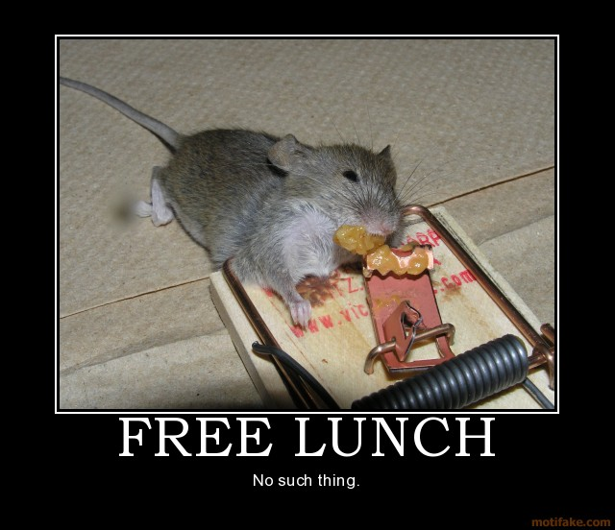


TANSTAAFL

Slide 12
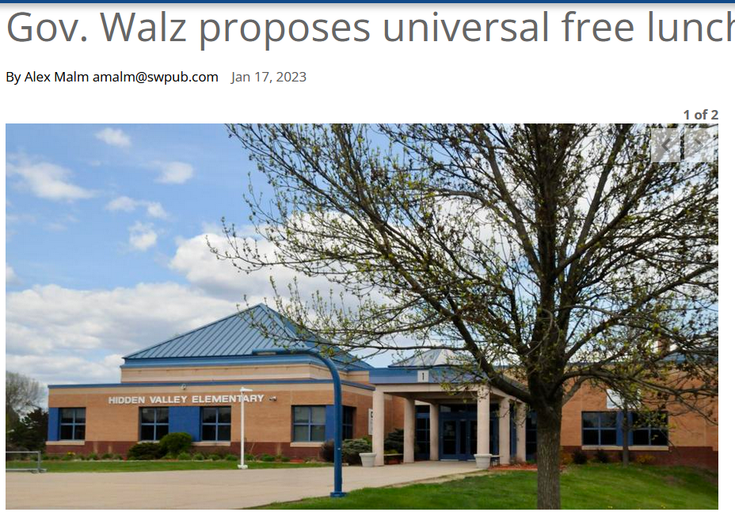
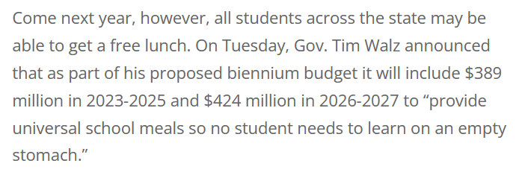

Slide 13
Trade-Offs
…are all the alternatives in making a decision
Opportunity Cost
…the cost of the next best use of money, time, or resources (your 2nd Choice)

Slide 14
You Don’t Have to Spend a Buck to Have a Cost
Event | Explicit | Implicit
A. Decide to go to college
B. Take a job after school
C. Study & take an AP Econ Test(s)
D. A stay at home Dad returns to work
Tuition, books, travel
Income not earned, less job experience
Work clothes, meals, transportation
Less study and social time.
Cost of test & books
Money earned from part-time job, less social time, less study time for other courses.
Work clothes, taxes, child-care expenses
Less time with family, less time for recreation.

Slide 15



.
The Opportunity Cost is the Opportunity Lost
1st Choice
(and a good one)
“what is possible for $10,000”
Opportunity Cost
2nd Choice
Scarcity
Choices
Opportunity Costs

Slide 16
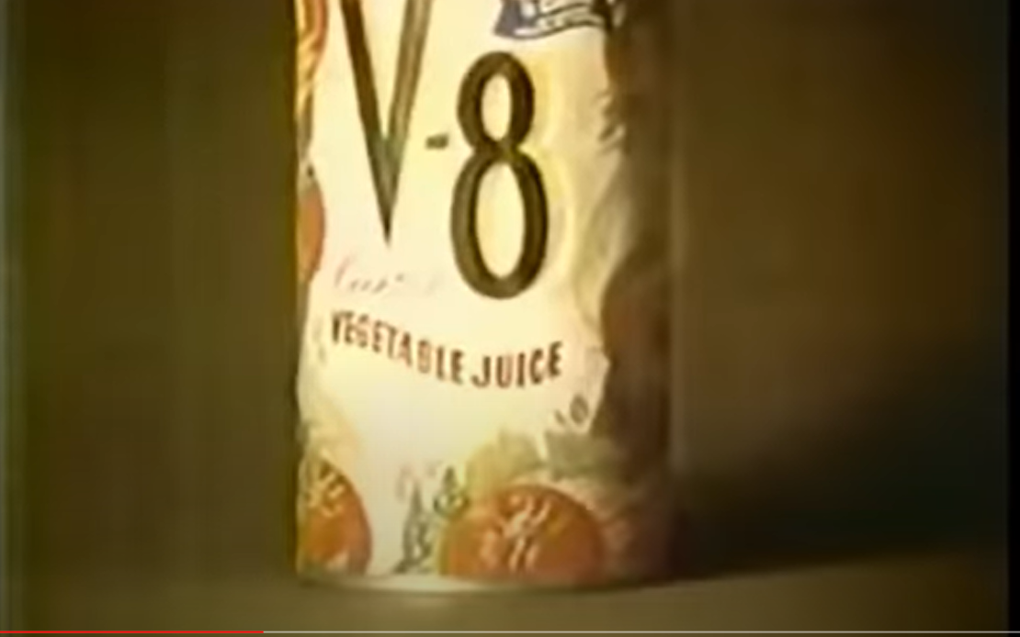
Opportunity Cost: “I coulda had a V8”
Submission missed the deadline for Q1.

Slide 17


Does LeBron James understand opportunity cost?

Slide 18
Trade-offs
… Are all of the alternatives that go into making a decision….
In this case let’s say you have many different choices of what you want to do on Saturday night.

Slide 19
Here are all your Choices on Saturday night…which are…
Go on a Date
Hang out with friends
Watch TV
Read a good book
Hang out with parents
Go to bed early
These are all of your trade-offs
Opportunity Cost is different, though…

Slide 20
Remember… Opportunity Cost is the next highest valued alternative. (The 2nd Best Choice)

Slide 21
As you recall, these are the choices on Saturday night
Go on a Date
Hang out with friends
Watch TV
Read a good book
Hang out with parents
Go to bed early

Slide 22
The rankings are…
1
Go on a Date
Hang out friends
Watch TV
Read a good book
Hang out with parents
Go to bed early
Obviously you do not go through this much thought when making a decision…
3
6
2
4
5

Slide 23
What is the opportunity cost of going on a date?

Slide 24
The opportunity cost was reading a good book, the 2nd Choice
Also, you must consider the financial cost of the date, how else you could have spent the money.

Slide 25
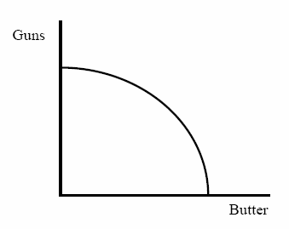
PRODUCTION POSSIBILITIES CURVE

Slide 26

4 PPC Concepts
Scarcity - is represented by the curve.
3. Efficiency - producing maximum output with
available resources.
2. Opportunity Cost.
4. Economic growth – Outward shift

Slide 27

WW II Propaganda

Slide 28


Slide 29


Slide 30
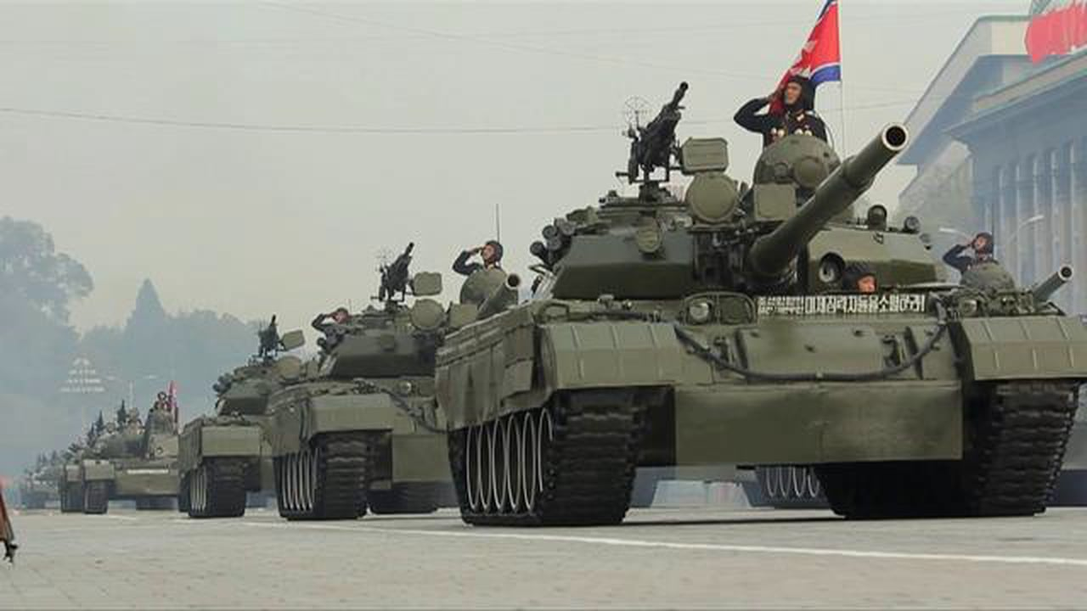
Is this country wealthy?

Slide 31

Is this country wealthy?

Slide 32
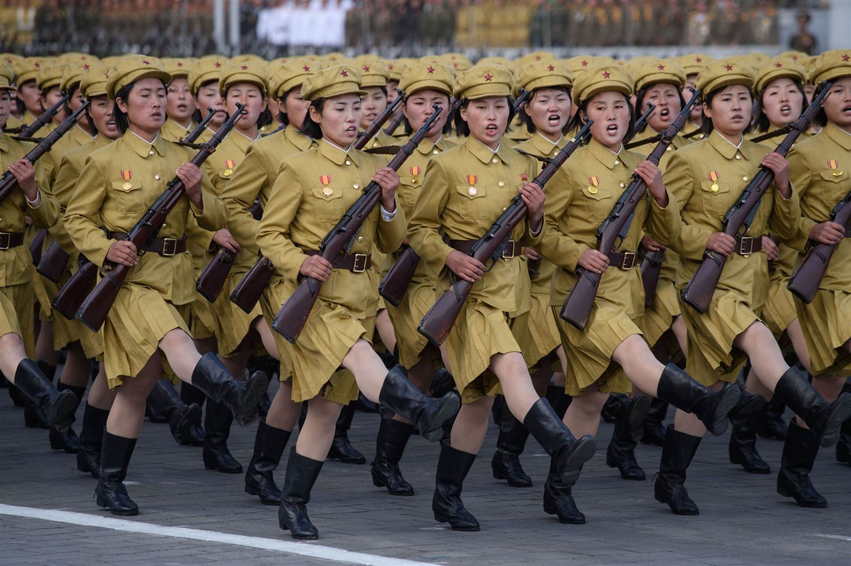
Is this country wealthy?

Slide 33
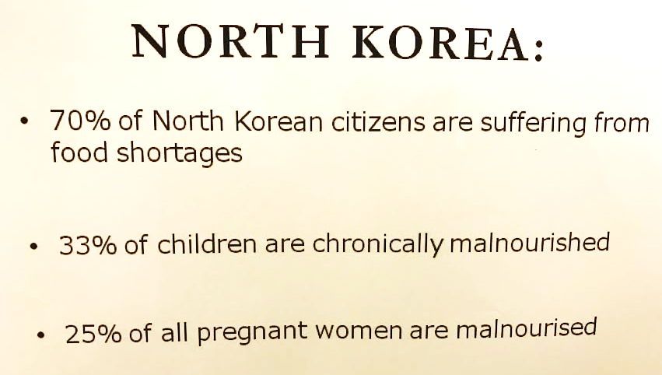

Slide 34
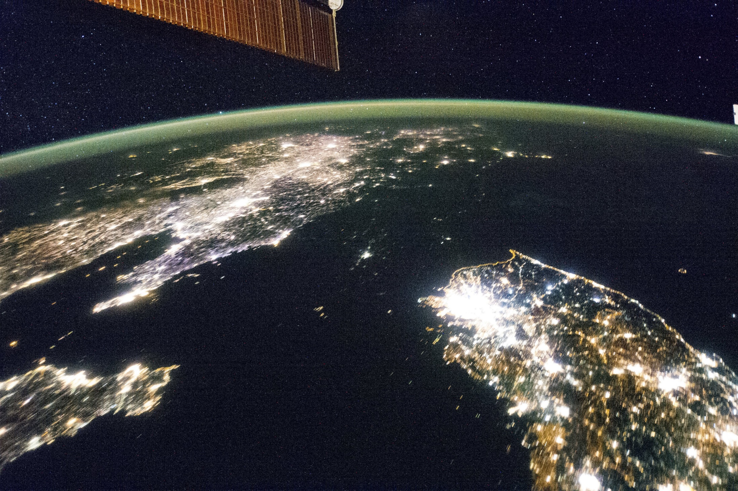

Slide 35
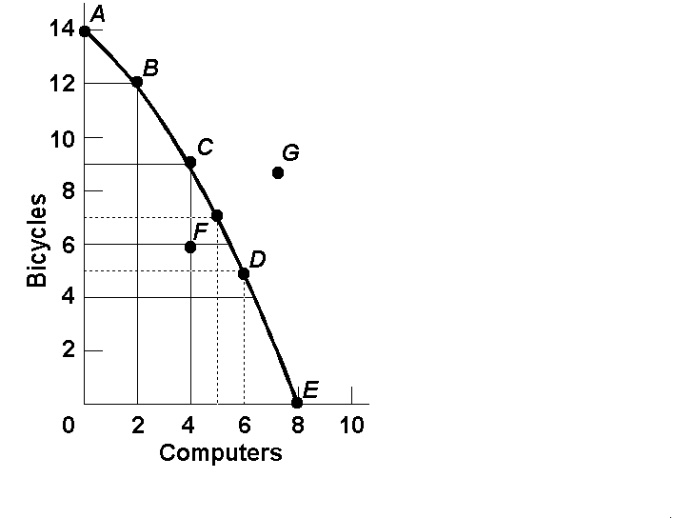
Opportunity Cost
Example:
  1. The opportunity cost of moving from a to b is…
2 Bikes
  2.The opportunity cost of moving from b to c is…
3 Bikes
  3.The opportunity cost of moving from c to d is…
4 Bikes
  4.The opportunity cost of moving from d to e is…
5 Bikes
NOTICE: Increasing Opportunity Costs

Slide 36
Question #1
New robot making technology
Q
A shift only for Robots
Robots
Q
Pizzas

Slide 37
Question #2
Decrease in the demand for pizza
Q
The curve doesn’t shift!
A change in demand doesn’t shift the curve
Robots
Q
Pizzas

Slide 38
Question #3
Mad cow disease kills 85% of cows
Robots
Pizzas

Slide 39
Question #4
Electricity Shortage
Q
Decrease in resources decrease production possibilities for both
Capital Goods (Guns)
Q
Consumer Goods (Butter)

Slide 40
Question #5
Faster computer hardware
Q
Quality of a resource improves shifting the curve outward
Capital Goods (Guns)
Q
Consumer Goods (Butter)

Slide 41
Question #6
Many workers unemployed
Q
The curve doesn’t shift!
Unemployment is just a point inside the curve
Capital Goods (Guns)
Q
Consumer Goods (Butter)

Slide 42
Question #7
Significant increases in education
Q
The quality of labor is improved. Curve shifts outward.
Capital Goods (Guns)
Q
Consumer Goods (Butter)

Slide 43
Capital Goods and Future Growth
More capital goods = more growth in the future.
Costa Rica– Favors Consumer Goods
Mexico – Favors Capital Goods
Current
PPC
Capital Goods
Capital Goods
Current
PPC
Consumer goods
Consumer goods
Costa Rica
Mexico

Slide 44
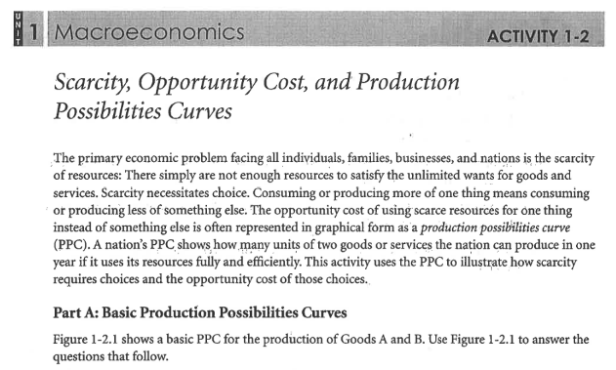

Slide 45
AP Micro Activity 1.2
Figure 2.1 PPC 1
The OC of increasing production of Good A from 0 units to one unit is the loss of ______ unit(s) of Good B.
The OC of increasing production of Good A from 1 unit to 2 units is the loss of ______ unit(s) of Good B.
The OC of increasing production of Good A from 2 units to 3 units is the loss of ______ unit(s) of Good B.
This an example of ___________ OC per unit for Good A.
Figure 2.1
2
12 10 8 6 4 2
2
Good B
2
Constant
0 1 2 3 4 5 6
Good A

Slide 46
AP Micro Activity 1-2
Figure 2.2 PPC 2
The OC of increasing production of Good A from 0 units to one unit is the loss of ______ unit(s) of Good B.
The OC of increasing production of Good A from 1 unit to 2 units is the loss of ______ unit(s) of Good B.
The OC of increasing production of Good A from 2 units to 3 units is the loss of ______ unit(s) of Good B.
This an example of _____________ OC per unit for Good A.
Figure 2.2
2
4
12 10 8 6 4 2
Good B
6
INCREASING
0 1 2 3
Good A

Slide 47
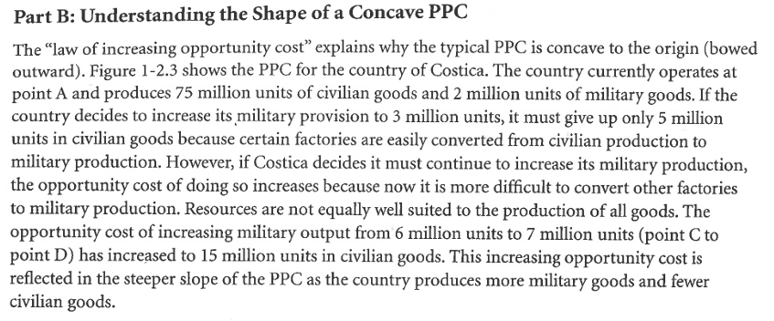
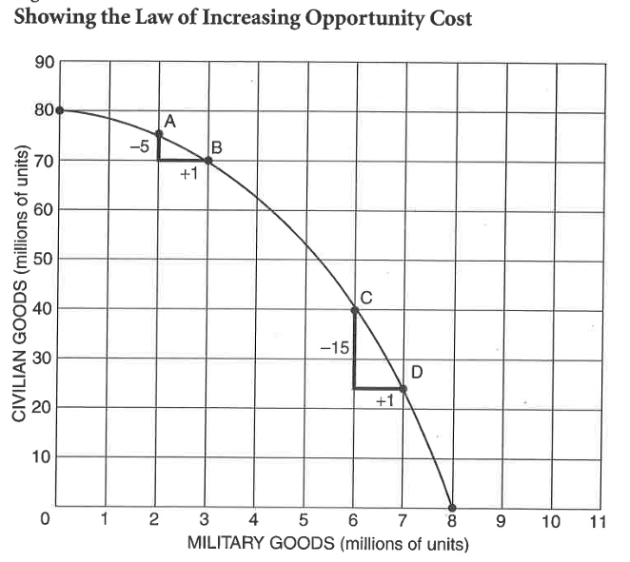

Slide 48
AP Micro Activity 1-2
Part B: Figure 2.3 PPC 3
Increasing OC per unit of Good B
Good B
Good A

Slide 49
AP Micro Activity 1-2
Part B: Figure 2.4 PPC 4
ZERO OC per unit of Good B
Good B
Good A

Slide 50
AP Micro Activity 1-2
Part B: Figure 2.4 PPC 4
CONSTANT OC per unit of Good B
Good B
Good A

Slide 51
AP Micro Activity 1-2
Figure 2.6 PPP: Capital Goods and Consumer Goods
3. Technological breakthrough in the consumer-goods industry?
BD
4. Forbidden use of automation?
AA
5. New oil & coal sources & technological innovation?
CC
A B C
Capital Goods
A B D C
Consumer Goods
6. If BB is a country’s PPC what can be said about point X?
It is impossible by itself to attain w/ existing resources & tech.
7. If BB is a country’s current PPC what can be said about point Y?
The economy is not fully using existing resources & technology. The Great Depression of the 1930’s is an example.

Slide 52
AP Micro Activity 1-2
Part D: PPC:
Capital Goods & Consumer Goods
8. What changes could cause the PPC to shift from XX ot YY?
New resources and/or new tech.
9. Under what conditions might an economy be at point Z?
Resources are not fully employed.
10. Why might a government want to move from B to A?
The govt might want to emphasize the production of capital goods so the economy would grow more in the future. This would shift the PPC outward in the future.
Y
X
A
Capital Goods
B
Z
X Y
Consumer Goods

Slide 53
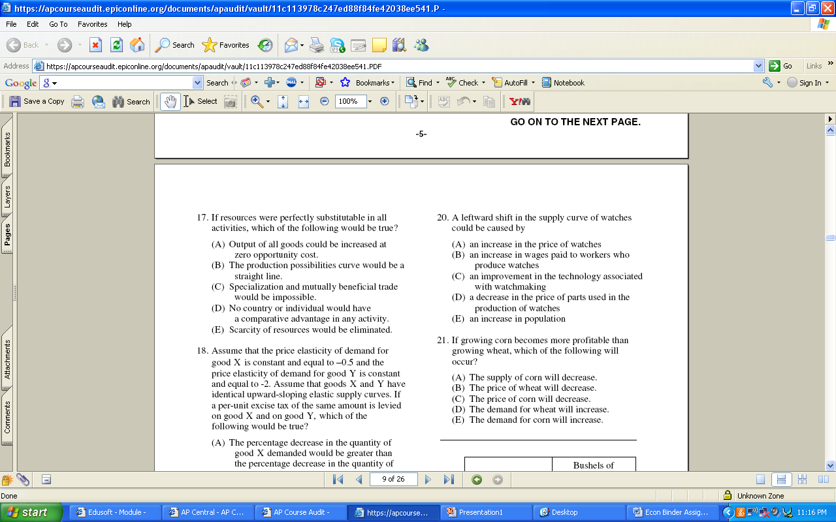
Notes:
17.B

Slide 54
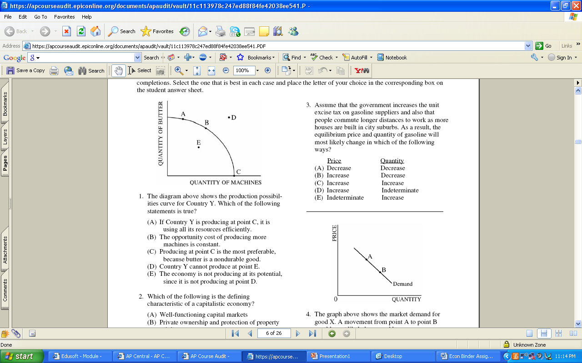
Notes:
A

Slide 55
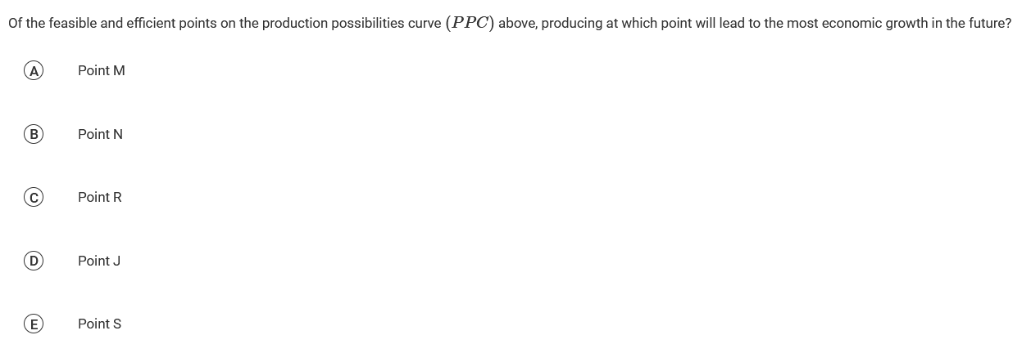
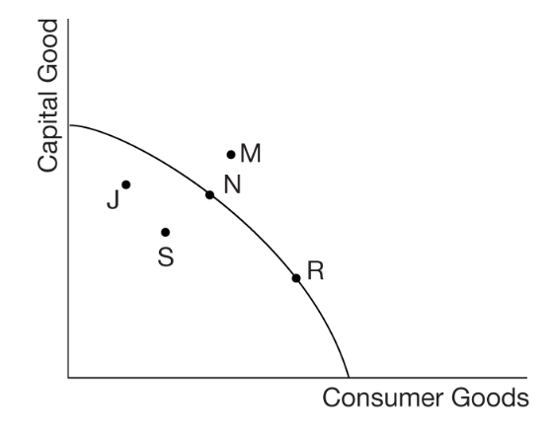

Slide 56
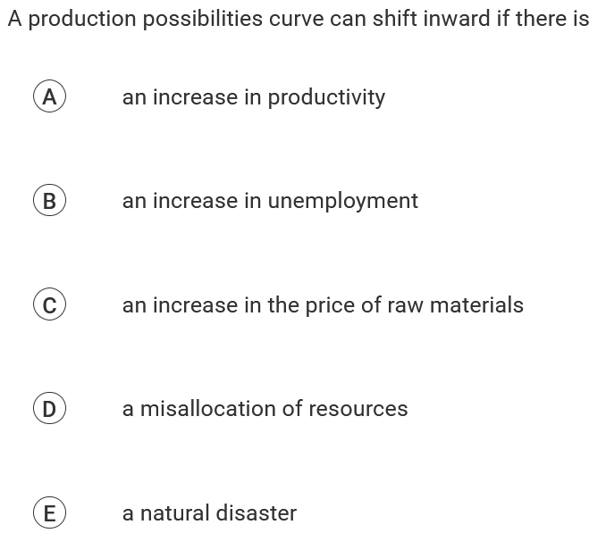

Slide 57
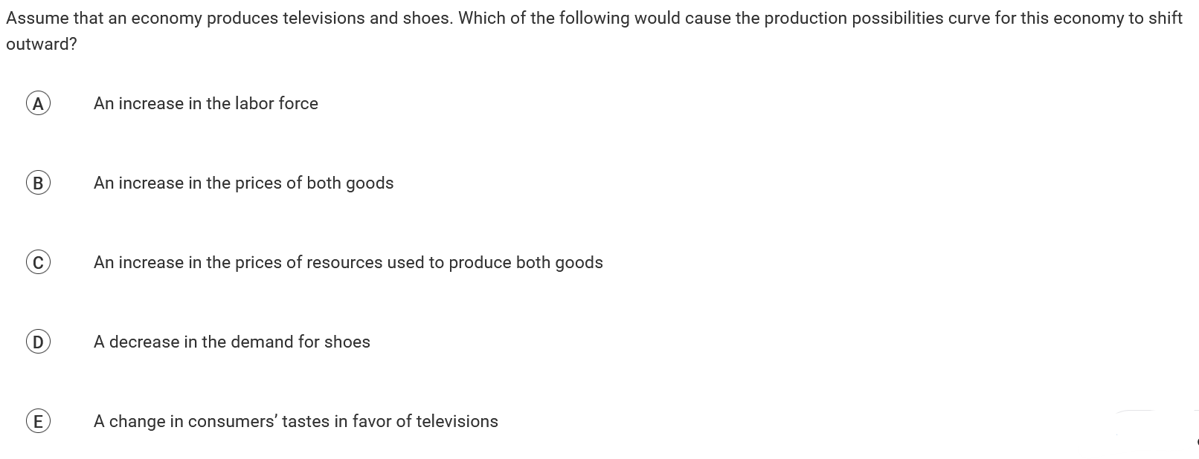

Slide 58
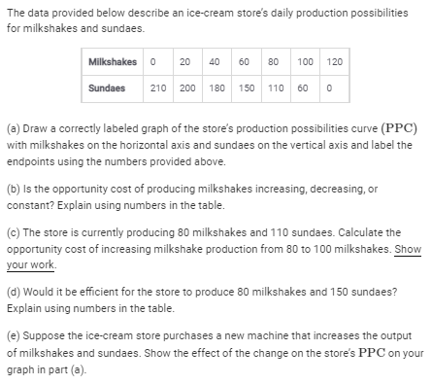
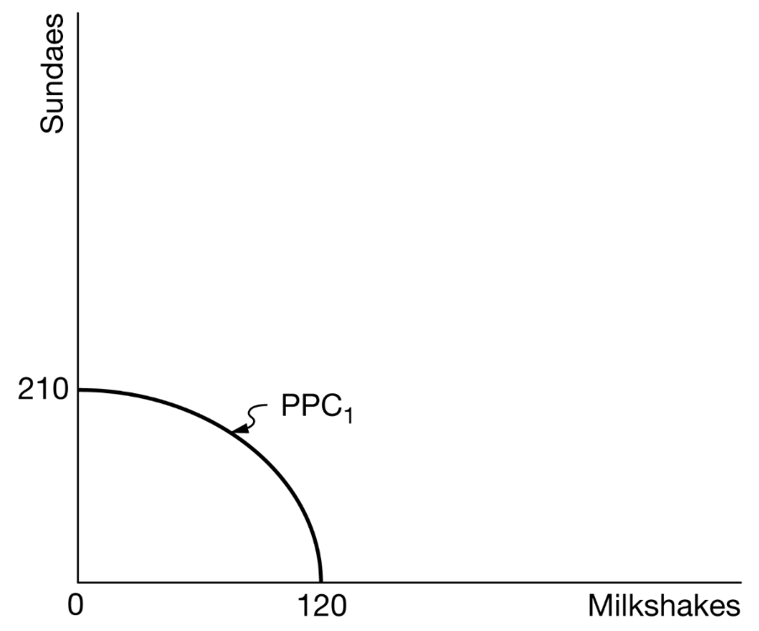

Slide 59
The opportunity cost of producing milkshakes is increasing and as the production of milkshakes increases by the same amount of 20 milkshakes, the production of sundaes decreases at an increasing rate. The first 20 milkshakes cost 10 sundaes. The last 20 milkshakes cost 60 sundaes. Therefore, the opportunity cost of producing milkshakes increases as more milkshakes are produced.

Slide 60
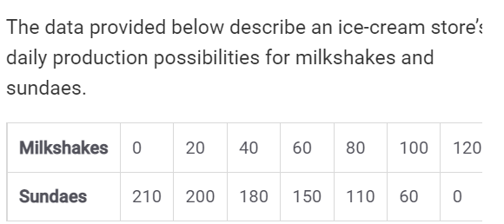
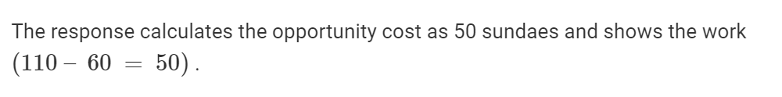

Slide 61
The store cannot produce 80 milkshakes and 150 sundaes using its available resources and explains that it can produce 80 milkshakes and 110 sundaes or 60 milkshakes and 150 sundaes but not a larger combination of both products.

Slide 62
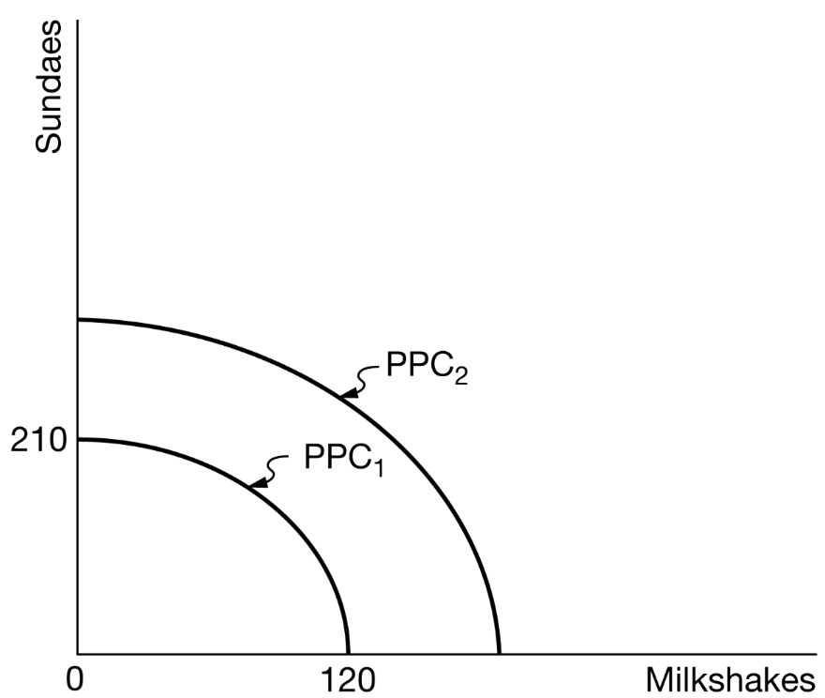

Slide 63
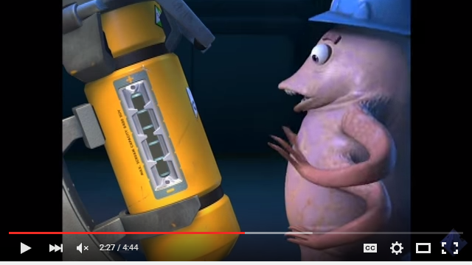
Video: Monsters Inc. and PPC

Slide 64
Q & A

Slide 65


Slide 66
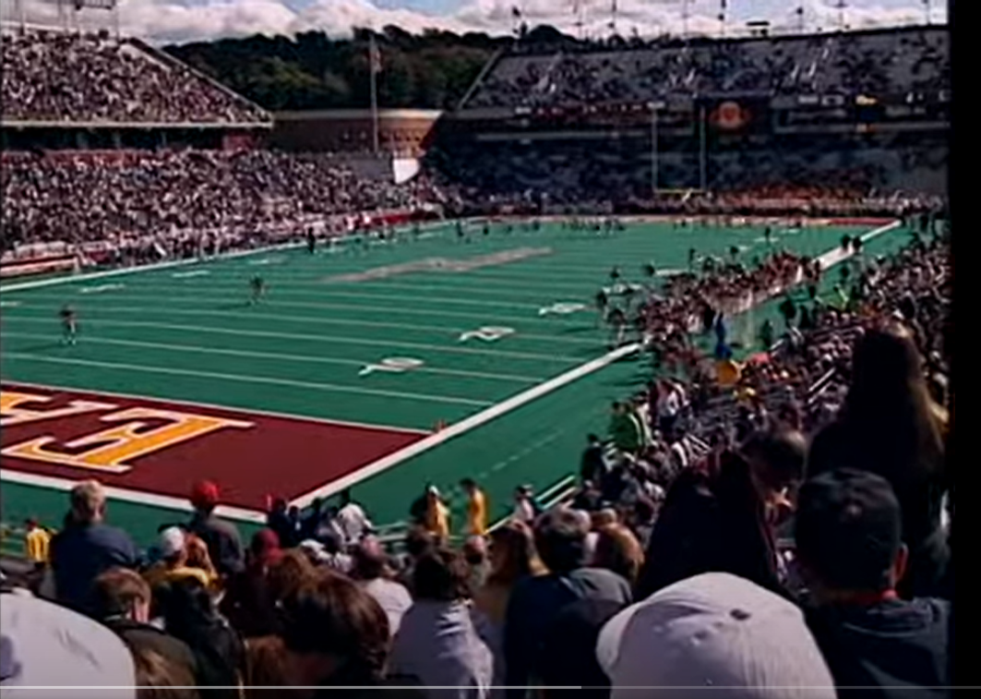
Video Clip: Opportunity Cost of the Football Game

Slide 67
EconEdLink Membership
You can now access CEE’s professional development webinars directly on EconEdLink.org! To receive these new professional development benefits, become an EconEdLink member. As a member, you will now be able to:
Automatically receive a professional development certificate via e-mail within 24 hours after viewing any webinar for a minimum of 45 minutes
Register for upcoming webinars with a simple one-click process
Easily download presentations, lesson plan materials and activities for each webinar
Search and view all webinars at your convenience
Save webinars to your EconEdLink dashboard for easy access to the event
Access our new Professional Development page here

Slide 68

Invest In Girls

Slide 69

NEC

Slide 70

NPFC

Slide 71

Advocacy

Slide 72


CEE Affiliates
https://www.councilforeconed.org/resources/local-affiliates/
Minnesota Council on Economics Education: www.mcee.umn.edu

Slide 73










Thank You to Our Sponsors!

Slide 74
James Redelsheimer jred40@gmail.com
Thank You

