Slide 1
Presented by: Christina Ramos
Email: cramos@goddard.org
Date: February 7, 2023
Professional Development
Master Deck
Proprietary Institutions

Slide 2
EconEdLink Membership
You can now access CEE’s professional development webinars directly on EconEdLink.org! To receive these new professional development benefits, become an EconEdLink member. As a member, you will now be able to:
Automatically receive a professional development certificate via e-mail within 24 hours after viewing any webinar for a minimum of 45 minutes
Register for upcoming webinars with a simple one-click process
Easily download presentations, lesson plan materials and activities for each webinar
Search and view all webinars at your convenience
Save webinars to your EconEdLink dashboard for easy access to the event
Access our new Professional Development page here

Slide 3
Professional Development Opportunities
To earn professional development credit for CEE webinars found on EconEdLink, you must:
Watch a minimum of 45-minutes and you will automatically receive a professional development certificate via e-mail within 24 hours.
Attendees can learn how much credit they will earn per workshop.
Accessing resources:
You can now easily download presentations, lesson plan materials, and activities for each webinar from EconEdLink.org/professional-development/
Local resources:
Insert your local professional development opportunities (if applicable)

Slide 4

About Options
A program of Goddard Riverside (based in NYC)​
Founded 1986 as direct service access center ​
Today​
Access Program​
  Success Program​
  Professional Development Program

Slide 5

Housekeeping
Evaluation
One Mic
Cameras on is Highly Encouraged
Participation Highly Encouraged
Step Up, Step Back

Slide 6

Presenter
Christina Ramos
Trainer/College Access Counselor, Options Institute
Born and raised in the Bronx, New York.
Worked with the Department of Education for about 7 years, as a math teacher, mentor, and coach.
Passionate about bridging the academic achievement gap and supporting students with college and career readiness.
Enjoys traveling, trying new restaurants, drawing and binge-watching Netflix series.

Slide 7
Objectives
After this workshop, attendees will be able to…
Understand and identify proprietary institutions
Provide support and resources to students should they pursue attending a proprietary institution

Slide 8
Agenda
Myth Busters
Proprietary Institutions
Investigating Data
Red Flags & Best Practices
Questions & Answers

Slide 9
Myth or Fact?
OR
myth
For profit institutions and nonprofit institutions have similar graduation rates.
truth
Notes:
This is a myth, for profit and not for profit institutions do not have similar graduation rates. In fact their graduation rates and even their persistence rates are very different. We will explore some data

Slide 10
Myth or Fact?
OR
myth
Proprietary Schools always have the best interest of their students.
truth
Notes:
Unlike their nonprofit counterparts, for-profit institutions focus mainly on earning revenue through tuition and fees paid by students. For-profit colleges channel earned revenue into non-education expenses or directly to investors.

Slide 11
Myth or Fact?
OR
myth
Proprietary Schools always provide enough upfront information in order for students to make an informed decision.
truth
Notes:
This is a myth, and the keyword in this statement is always. Proprietary schools do not always provide enough information in order for students to make an informed decision.

Slide 12
Proprietary Schools

Slide 13
Proprietary Schools
Proprietary colleges are for-profit colleges and universities. They are operated by their owners or investors, rather than a not-for-profit institution, religious organization, or government.

Slide 14
Proprietary Schools
Some popular examples of proprietary schools in the United States are:​
​
University of Phoenix​
DeVry University​
Kaplan University​
Strayer University​
ITT Technical Institute
Notes:
Many for-profit colleges advertise heavily. They also often choose names that sound like legitimate, not-for-profit colleges. As a result, students might face confusion when researching colleges. Below are some well-known for-profit colleges.

Slide 15
What are the Differences?
For-profit Institutions VS Not-for-profit Institutions
Purpose
Funding
Affordability
Admission Process
Course Scheduling
Transfer Opportunities
Notes:
PURPOSE - For-profit and nonprofit colleges differ in purpose and deliver different learner outcomes. For-profit schools typically offer career-oriented programs. They're often focused on making college accessible, but they also emphasize earning revenue over student learning outcomes. Some for-profit schools offer relatively cheap tuition, but not always.
Nonprofit colleges and universities help students explore opportunities by offering a broad, liberal arts education. These institutions also foster community while supporting learners, faculty, and staff in their academic and professional endeavors.
FUNDING - For-profit colleges are mostly funded through student tuition and fees, along with money from investors, corporate entities, and subsidiary businesses. To grow enrollment, for-profit schools use their earnings to advertise their programs and recruit students.
Public nonprofit institutions receive significant financial support from state and federal government bodies, while private nonprofit schools are often funded through private endowments or grants. Tuition and fees also contribute to revenue.
AFFORDABILITY - Generally, for-profit colleges provide online programs with comparable or higher price tags than programs at nonprofit institutions. This becomes especially clear when comparing for-profit college costs with in-state tuition for public schools.
For-profit schools rely on tuition, fees, and donations for funding, which can lead to higher costs, but many charge similar rates for books and course materials as nonprofit institutions. For-profit schools also offer scholarships and tuition discounts, and students can apply for federal financial aid, so long as the school is accredited.
ADMISSION PROCESS - For-profit colleges usually have less rigorous admission standards than nonprofit schools. Many for-profit colleges require a high school diploma or equivalent and a completed application, with no GPA or standardized test score requirements. For-profit institutions typically offer rolling or open enrollment as well.
Unlike nonprofit schools, which generally admit students 2-3 times a year, for-profit institutions enroll learners all year long. High acceptance rates and flexible admission options can make for-profit schools a more accessible option for many learners.
COURSE SCHEDULING - Nonprofit schools typically offer classes on a semester or trimester format. Some provide online coursework across eight- and 15-week periods. By contrast, for-profit schools offer almost exclusively online programs and classes, often starting at any time.
This allows for-profit college learners to take courses on a more flexible timeline. Learners who work full time can take 1-2 classes at a time. Many for-profit schools offer accelerated pathways, along with opportunities for asynchronous classes, allowing enrollees to complete coursework with more flexibility.
TRANSFER OPPORUNITIES - For-profit schools have limited transfer options. These colleges may accept transfer credits from other institutions, but most two- and four-year institutions do not accept transfer credits from for-profit institutions.
However, most for-profit schools enthusiastically accept students transferring from nonprofit institutions. Learners who need just a few credits to complete their degrees or who want to shift to more career-oriented programs can sometimes benefit from transfer policies at for-profit schools.

Slide 16
Investigating the Data

Slide 17
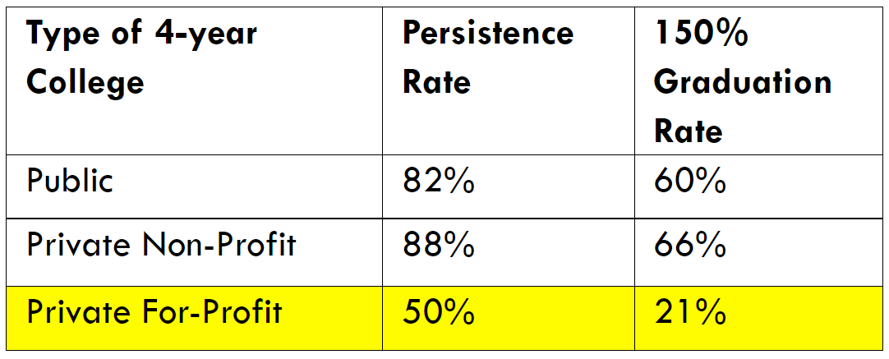
Graduation Rates
Source: National Center for Education Statistics
Notes:
What do we see here?
Public schools have a persistence rate of 82% and a graduation rate of 60%, which means 82% of students are returning for their second year and graduating 60% of students every 5-6 years.
Private Non-profit have a persistence rate of 88% and a graduation rate of 66%, meaning 88% of students are returning for their second year and graduating 66% of students every 5-6 years.
Graduation rates and persistence rates are much lower at for-profits, with a 50% persistence rate and only a 21% graduation rate.
Why do you think that is?
For-profit colleges use money gained from tuition and fees to make their profit. It is not necessarily re-invested into resources for students. This information

Slide 18
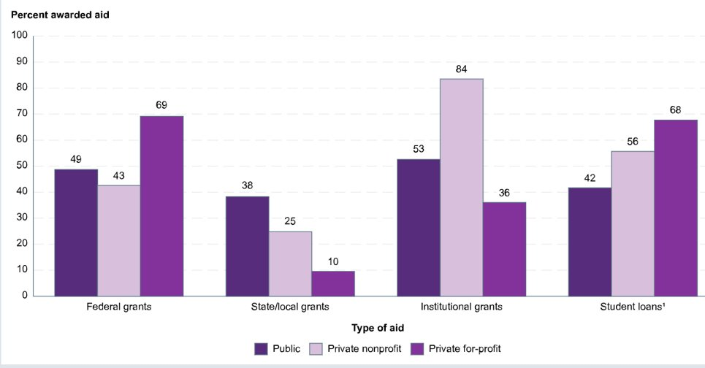
Financial Aid and Where its Going
Source: National Center for Education Statistics
Notes:
Lets take a look at financial aid, and where its going.
First lets look at federal grants, and what percentages are awarded to the different institutions. Federal grants is money award to students through the federal government, and this money is not to be paid back. 69% of federal grants are awarded to students attending a proprietary school, and lets remember the persistence and graduation rate is the lowest when comparing public, private, and forprofit.

Slide 19
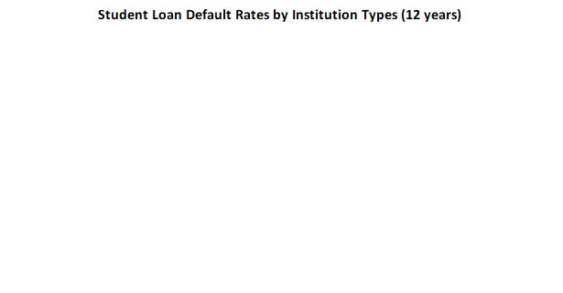
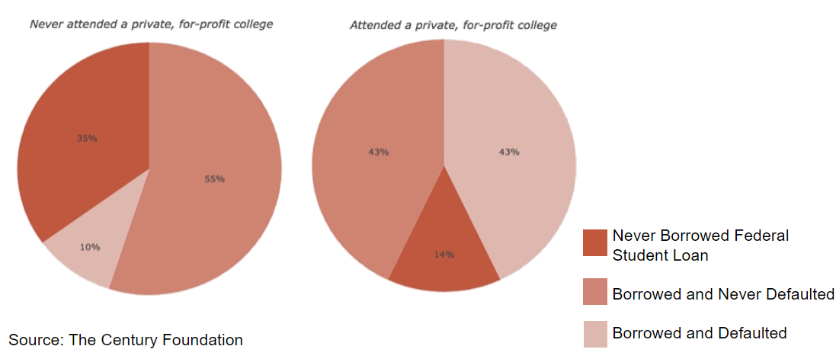
Student Loan Default Rates

Slide 20
Red Flags &
Best Practices

Slide 21
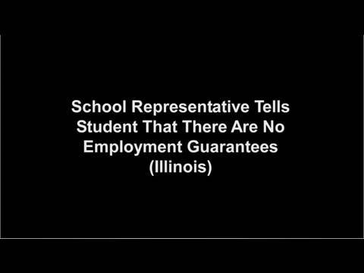
Proprietary Schools
Government Accountability Office (GAO): For-Profit Colleges Encouraged Fraud and Engaged in Deceptive Practices ​
​

Slide 22

Red Flags and Best Practices
Based on the video: ​
What stands out about proprietary colleges? ​
What steps can you take?

Slide 23
Supporting Students

Slide 24
What if My Student Chooses to Attend?
Be Sure to Know:
Is the school licensed?
Is there school credible?
How much will it cost?
How does the cost compare to a not-for-profit institution?
How can I get help paying for my training?
Can I transfer my coursework?
I am going to get a job?
Knowb4youenroll.com
Notes:
Is the school licensed? A list of schools that are licensed to operate in Massachusetts can be found here.
Is there school credible? You should also check to see if the school is accredited by an organization recognized by the U.S. Department of Education.
How much will it cost? Make sure you do the math – a lot of money might be at stake. Make sure you understand the total cost of the program, including the costs of registration, supplies, and equipment. Before you take out a loan, use this loan calculator so that you understand your interest payments and how they’ll add up.
How does the cost compare to a community college? You should check out community colleges in your area. Many programs can be completed for less money, and credits are more likely to be transferable.
How can I get help paying for my training? Once again, shop around. You may find a better financial aid package than the one offered by the school with another lender.
Can I transfer my coursework? If you think you might want to transfer to another school after completing your course or program, ask schools whether their courses can be transferred. Some schools have agreements with specific colleges to accept certain courses. If the school has such an agreement, ask for a copy of it. If the school has no such agreements, do not count on any credits transferring to another school.
I am going to get a job? Be wary if a school guarantees your job placement or makes promises about how much money you will make. Schools can help you get the job you want, but they can’t guarantee it. The school should have information about its placement rate for graduates, as well as the names of companies that hire graduates.

Slide 25

Q & A

Slide 26
Action Plan

Slide 27
Action Plan
Please reflect on today’s material and write the following:
2 things that you are aware of that you did not know this morning
1 actions that you will take with you when you return to your workplace

Slide 28

Action Plan: Create a Workshop
Choose a Target Audience:
  Students, Staff, or Parents
Design a 30” to 60” workshop including:
  Goals
  Intro/Icebreaker
  Content/Activities
  Close/Next Steps
Notes:
Using the Action Planning sheet in the workbook, have participants reflect on the day’s content and decide who most needs the information back at their sites – students or advisors.
Have participants grop together by their seleclted target frop and esign a 45-60 minute workshop they can present to their students or peers. The outline should include:
Goal/Objective
Intro/Icebreaker
Content
Activities
Close/Next Steps
Have participant groups outline their workshop on chart paper. Have each grp choose a volunteer to report out.
DEBRIEF: Summarize highlights of the workshops presented. Tell participants you would love to hear how their workshop goes

Slide 29
Suggested Presentation Deck
References
Any links to clips, titles, primary sources etc of relevant resource materials

Slide 30
Suggested Presentation Deck
National Standards
List any corresponding Nat'l Content Standards from >
https://www.councilforeconed.org/wp-content/uploads/2012/03/voluntary-national-content-standards-2010.pdf

Slide 31
Suggested Presentation Deck
State Standards
List any corresponding regional standards you may have(New York listed here, for reference) > http://www.nysed.gov/curriculum-instruction

Slide 32
Suggested Presentation Deck
Assessment Questions
A suggested minimum of three guiding questions (e.g. discussion prompts, quiz questions, or activity instructions).
Please also forward any supplements (worksheets, rubrics, etc) to us as attachments with your slide deck.

Slide 33

Invest In Girls

Slide 34
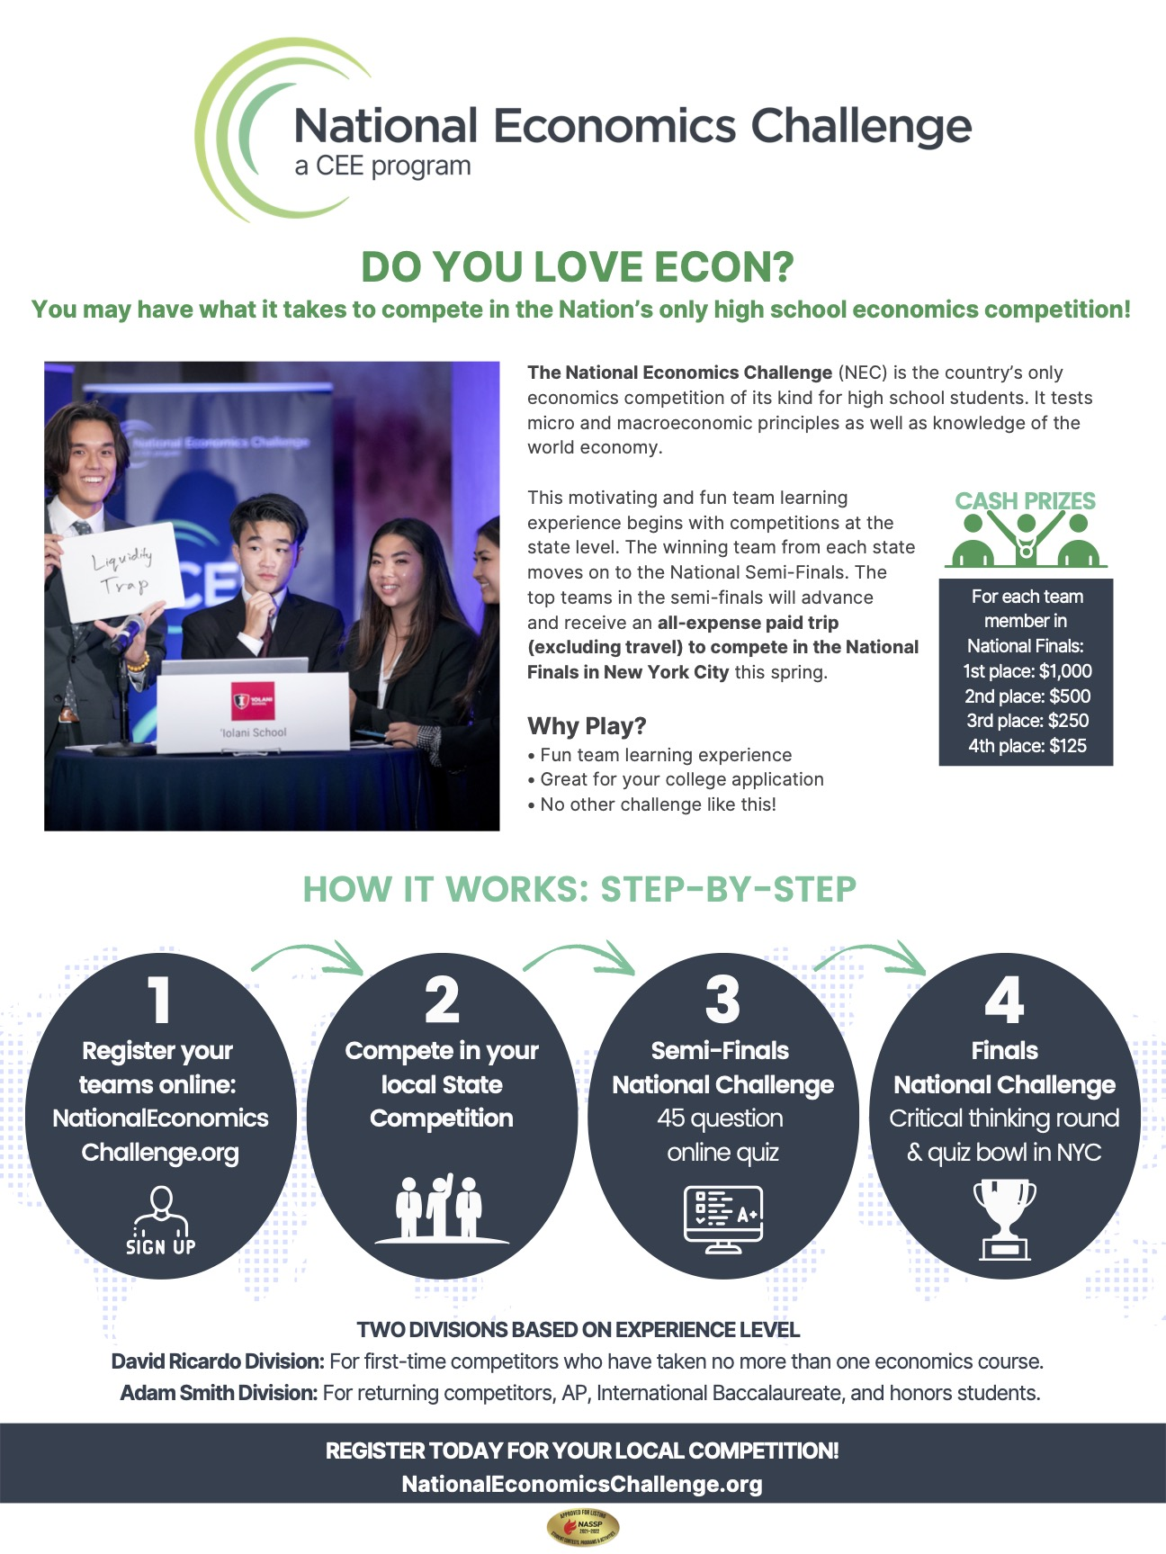
NEC

Slide 35
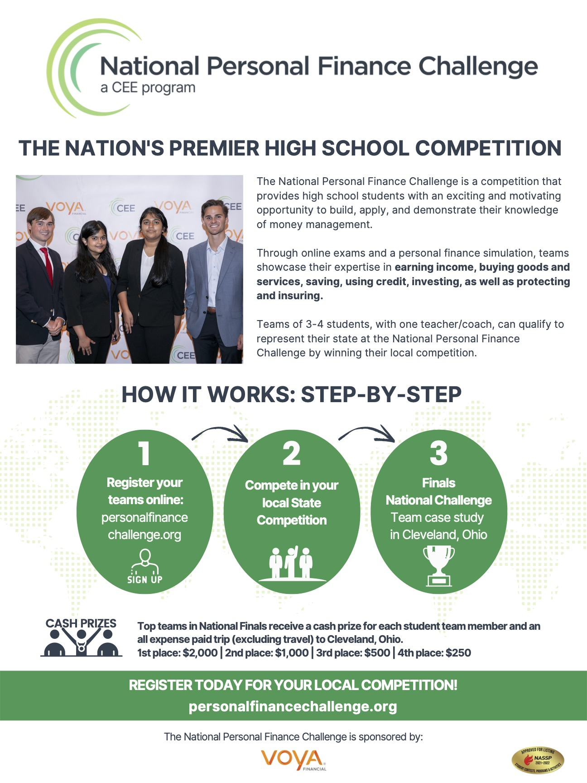
NPFC

Slide 36
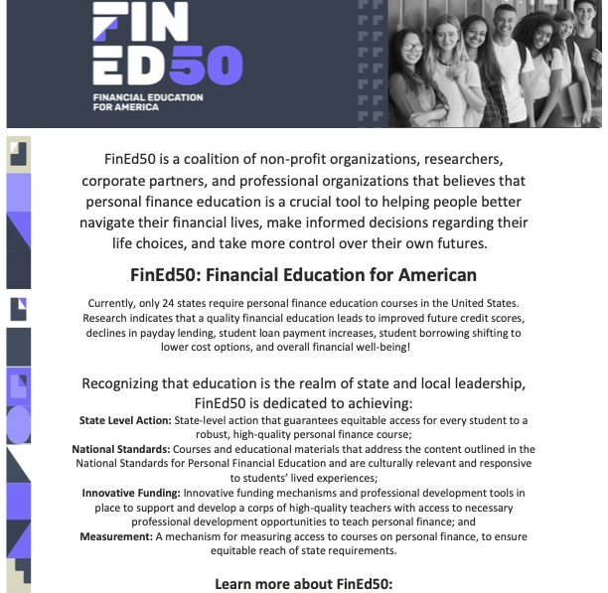
Advocacy

Slide 37
Optionsinstitute@goddard.org
Thank You

Slide 38

Suggested Presentation Deck
CEE Affiliates
https://www.councilforeconed.org/resources/local-affiliates/
Include your local affiliate page

Slide 39








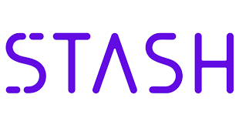

Thank You to Our Sponsors!

Slide 40
Suggested Presentation Deck
Supporting Materials
Please include any supplements (worksheets, rubrics, Kahoots etc.) by providing links, images or embedded content

Slide 41
Contact information
Thank You

