Slide 1
Presented by: James Redelsheimer
Email: jred40@gmail.com
Date: 3/13/23
AP Micro: Scarcity,
AP Micro: Equilibrium Price and Quantity

Slide 2
Professional Development Opportunities
To earn professional development credit for CEE webinars found on EconEdLink, you must:
Watch a minimum of 45-minutes and you will automatically receive a professional development certificate via e-mail within 24 hours.
Attendees can learn how much credit they will earn per workshop.
Accessing resources:
You can now easily download presentations, lesson plan materials, and activities for each webinar from EconEdLink.org/professional-development/
Local resources:
Insert your local professional development opportunities (if applicable)

Slide 3

James Redelsheimer
James Redelsheimer has been an AP and Regular Economics teacher at Robbinsdale Armstrong High School in Plymouth, Minnesota since 2003. James received his Bachelor’s degree from St. Olaf College and his Master's degree at the University of St. Thomas. He received the 3M Economics Educator Excellence Award from the Minnesota Council on Economic Education and was named Visa's Practical Money Skills Innovative Educator of the Month.
James enjoys traveling and has been a guest lecturer in the economics department at the Batumi State University in The Republic of Georgia and has received travel grants and fellowships for study travel to learn about the economies of Japan, China, Turkey, Germany, Korea, among others, and studied economics of the environment in Costa Rica. He currently serves as an AP Economics reader, grading AP Economics exams. He enjoys teaching Economics because it relates to students' everyday lives.

Slide 4
Agenda
Explore equilibrium and disequilibrium with real-world examples.
Practice multiple choice and FRQ Questions.
Activities from CEE’s AP Economics Workbook

Slide 5
Objectives
In this webinar teachers will be able to:
Understand how to interpret graphs that with both equilibrium and disequilibrium.
Implement effective lessons to prepare students for AP exam questions on supply and demand
Effectively review practice multiple choice and free response questions with their students to prepare them for the AP Exam

Slide 6
MARKET DEMAND & SUPPLY
Price of Corn
CORN
MARKET
S
CORN
MARKET
$5
4
$3
2
1
P
Q_{D}
P
Q_{S}
$5
$4
$3
$2
$1
2,000
4,000
7,000
11,000
16,000
$5
$4
$3
$2
$1
12,000
10,000
7,000
4,000
1,000
Market
Clearing
Equilibrium
D
o
7
2 4 6 8 10 12 14 16
Q
Quantity of Corn

Slide 7
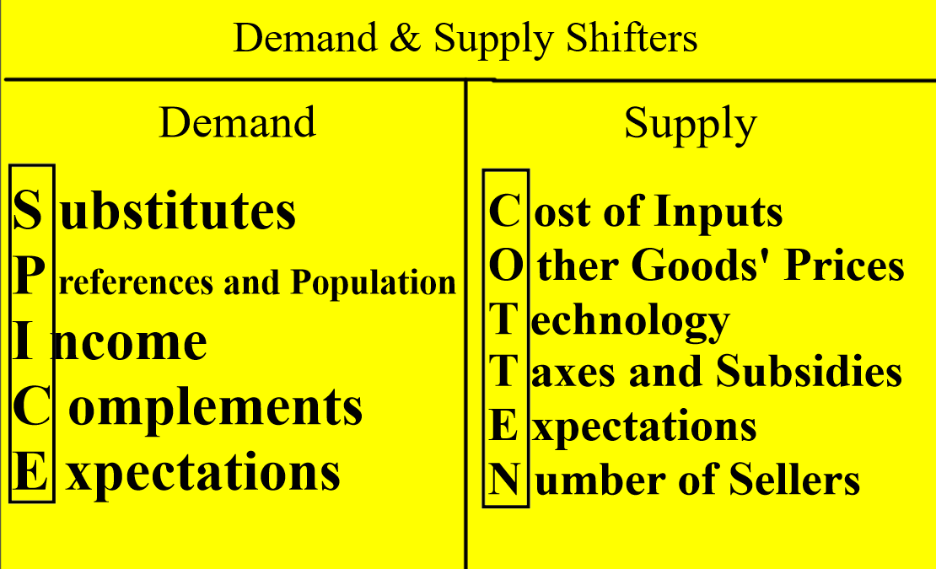

Slide 8
Double Shifts
Double Shift Rule:
If TWO curves shift at the same time, EITHER price or quantity will be indeterminate (ambiguous).

Slide 9
  Demand increases AND supply increases
Price
S
S₁
P₁
P_{e}
D₁
D
P indeterminate
Q increase
Q_{e}
Q₁
Quantity

Slide 10
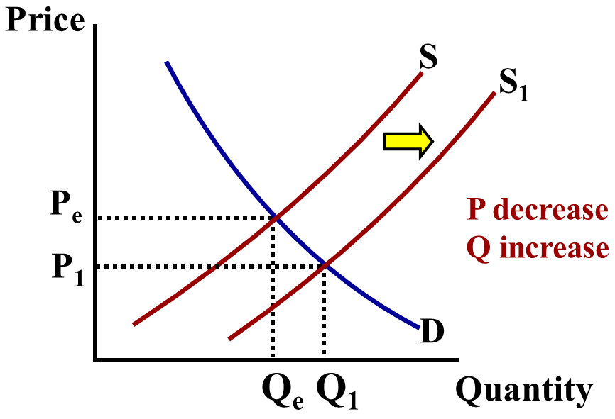
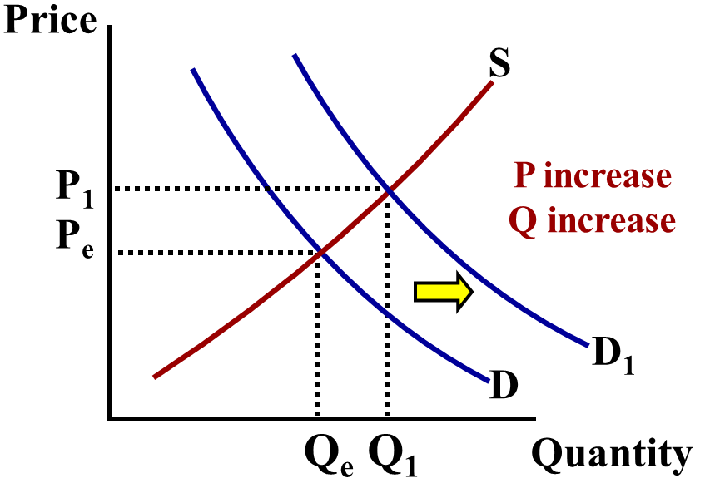
  Trick: Draw it out separately and combine the results
P indeterminate
Q increase

Slide 11
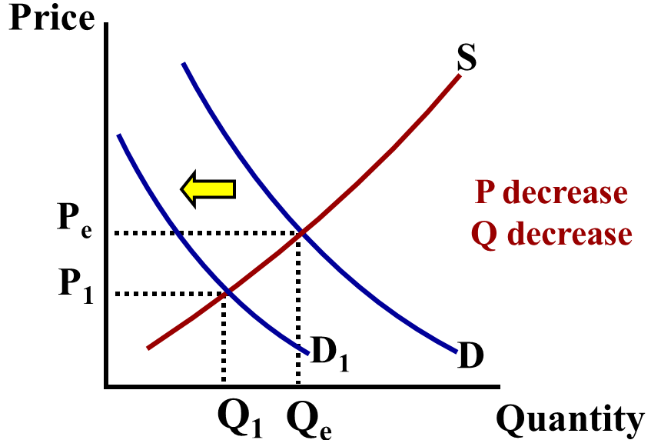
  What if supply increases and demand falls?
P decrease
Q indeterminate

Slide 12
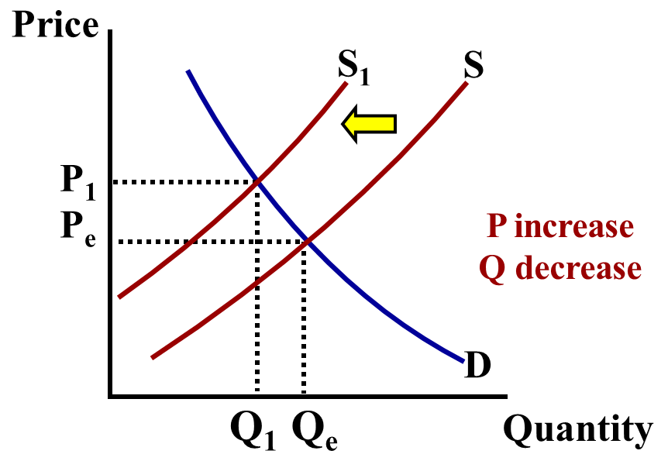
  What if supply decreases and demand falls?
P indeterminate
Q decrease

Slide 13
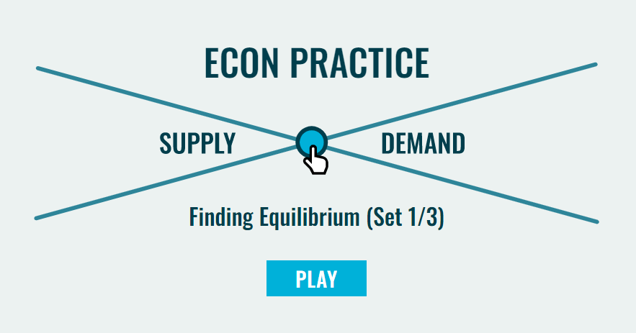

Slide 14
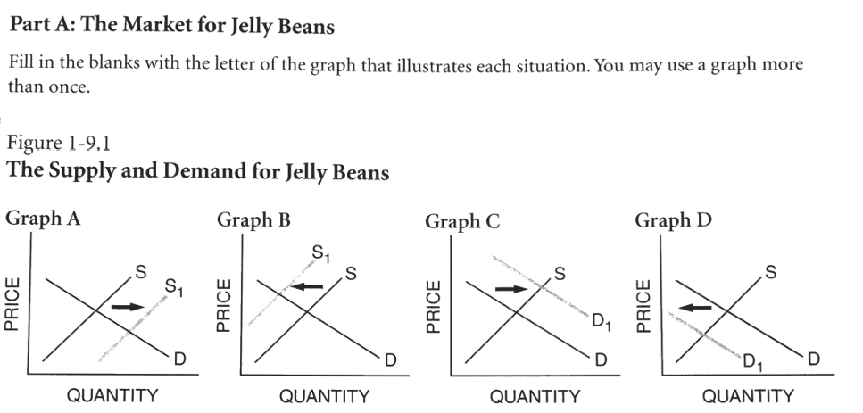
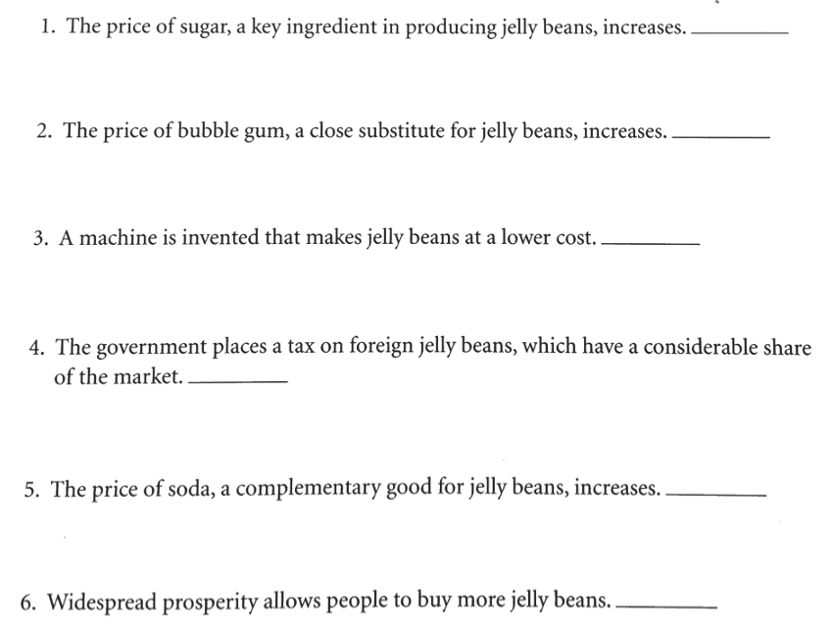
ACTIVITY 9-1
B
C
A
B
D
C

Slide 15
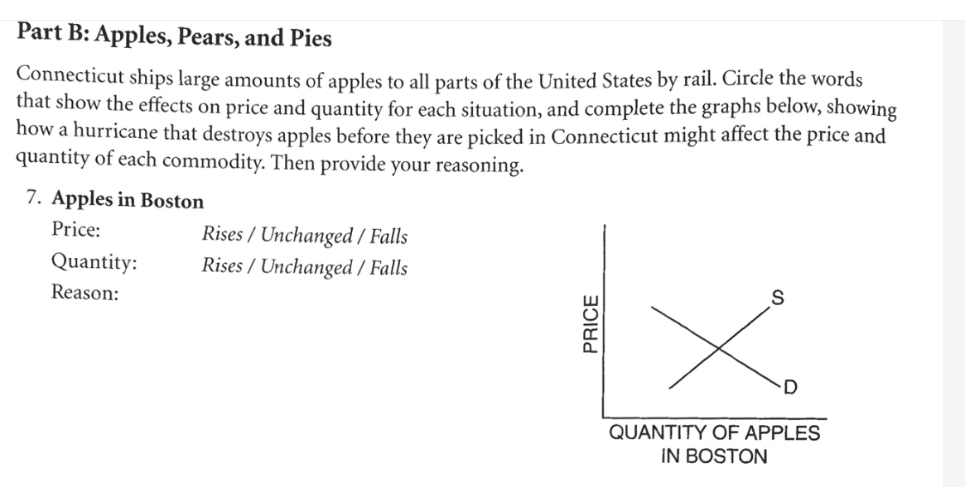
S 1
A hurricane destroyed the apples

Slide 16
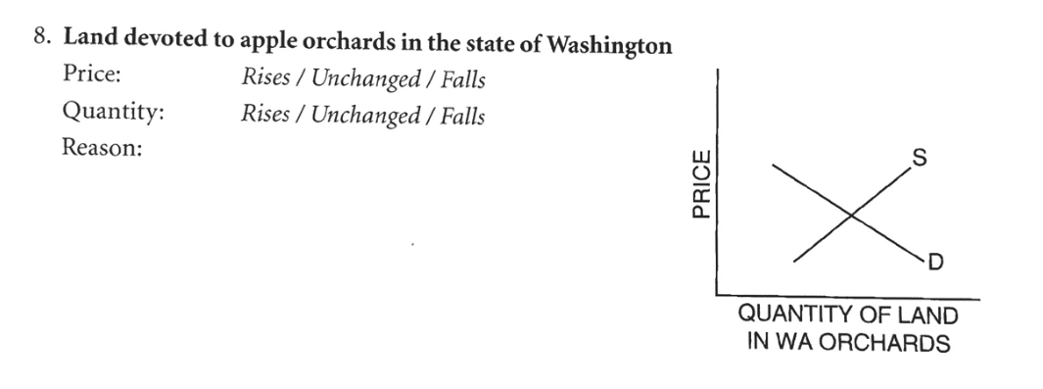
Farmers grow more apples because of the higher price. To do this, they must buy more land.
D 1

Slide 17
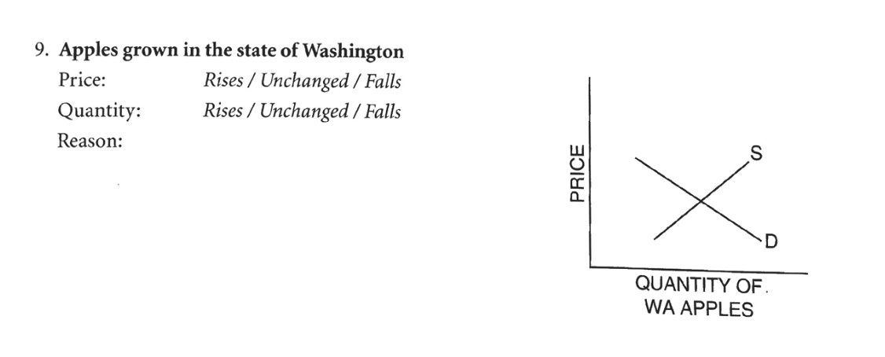
Consumers substitute Washington apples for Connecticut apples.
D 1

Slide 18
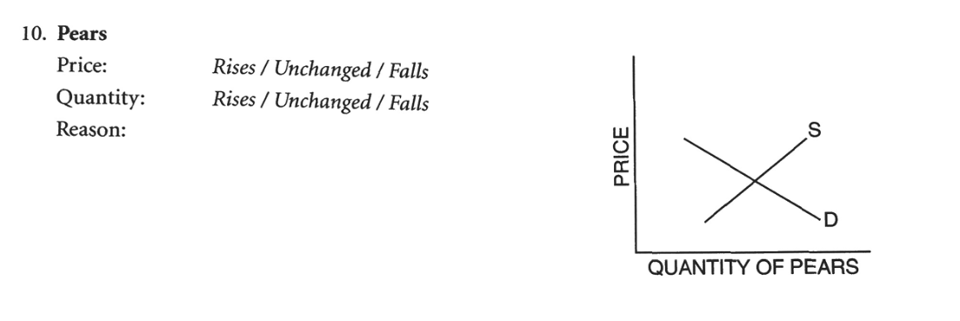
Consumers substitute pears for apples
D 1

Slide 19
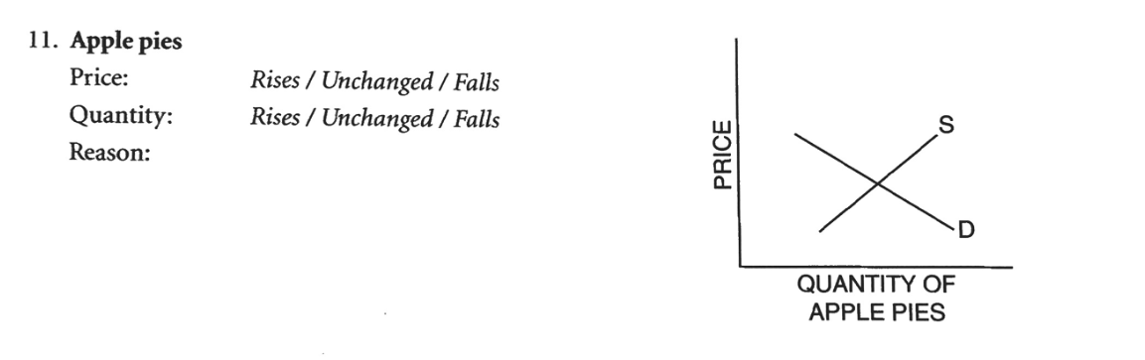
S 1
Apples are used to bake pies. Higher-priced apples increase the cost of producing pies.

Slide 20
Supply and Demand are put together to determine equilibrium price and equilibrium quantity
P
Supply Schedule
Demand Schedule
S
$5
4
3
2
1
P | Qd
$5 | 10
$4 | 20
$3 | 30
$2 | 50
$1 | 80
P | Qs
$5 | 50
$4 | 40
$3 | 30
$2 | 20
$1 | 10
D
10 20 30 40 50 60 70 80
Q

Slide 21
Supply and Demand are put together to determine equilibrium price and equilibrium quantity
P
Supply Schedule
Demand Schedule
S
$5
4
3
2
1
P | Qd
$5 | 10
$4 | 20
$3 | 30
$2 | 50
$1 | 80
P | Qs
$5 | 50
$4 | 40
$3 | 30
$2 | 20
$1 | 10
Equilibrium Price = $3 (Qd=Qs)
D
10 20 30 40 50 60 70 80
Q
Equilibrium Quantity is 30

Slide 22
At $4, there is disequilibrium. The quantity demanded is less than quantity supplied.
P
Supply Schedule
Demand Schedule
S
$5
4
3
2
1
Surplus
(Qd<Qs)
P | Qd
$5 | 10
$4 | 20
$3 | 30
$2 | 50
$1 | 80
P | Qs
$5 | 50
$4 | 40
$3 | 30
$2 | 20
$1 | 10
How much is the surplus at $4?
Answer: 20
D
10 20 30 40 50 60 70 80
Q

Slide 23
At $2, there is disequilibrium. The quantity demanded is greater than quantity supplied.
P
Supply Schedule
Demand Schedule
S
$5
4
3
2
1
P | Qd
$5 | 10
$4 | 20
$3 | 30
$2 | 50
$1 | 80
P | Qs
$5 | 50
$4 | 40
$3 | 30
$2 | 20
$1 | 10
How much is the shortage at $2?
Answer: 30
Shortage
(Qd>Qs)
D
10 20 30 40 50 60 70 80
Q

Slide 24
How much is the shortage if the price is $1?
P
Supply Schedule
Demand Schedule
S
$5
4
3
2
1
P | Qd
$5 | 10
$4 | 20
$3 | 30
$2 | 50
$1 | 80
P | Qs
$5 | 50
$4 | 40
$3 | 30
$2 | 20
$1 | 10
Answer: 70
D
10 20 30 40 50 60 70 80
Q

Slide 25
The FREE MARKET system automatically pushes the price toward equilibrium.
P
Supply Schedule
Demand Schedule
S
$5
4
3
2
1
When there is a surplus, producers lower prices
P | Qd
$5 | 10
$4 | 20
$3 | 30
$2 | 50
$1 | 80
P | Qs
$5 | 50
$4 | 40
$3 | 30
$2 | 20
$1 | 10
When there is a shortage, producers raise prices
D
10 20 30 40 50 60 70 80
Q

Slide 26
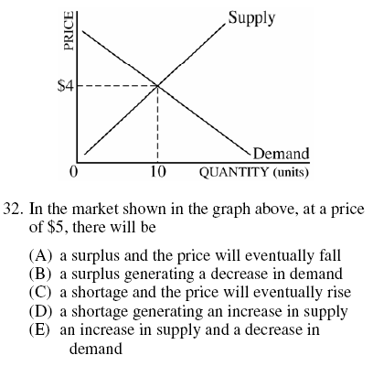
2008 Audit Exam
Notes:
A

Slide 27

Where is CS and PS on the graph?
P
Calculate the following
(show your work)
1. Consumer surplus at $20
2. Producer surplus at $20
3. Total surplus at $20
Answers
1. $225 = ($35-$20)x30/2
2. $150 = ($20-$10)x30/2
3. $375 = $225 + $150
$35
$30
$25
$20
$15
$10
$5
S
CS
PS
D
10 20 30 40 50 60
Q

Slide 28
Where is CS and PS on the graph?
P
Assume only 10 units where produced, what would happen to total surplus?
$35
$30
$25
$20
$15
$10
$5
S
CS
Total surplus would decrease. This is called deadweight loss.
PS
D
10 20 30 40 50 60
Q

Slide 29
Review
P
Calculate the area of:
Consumer Surplus
Producer Surplus
Total Surplus
$22
20
18
16
14
S
CS
CS= $40
PS= $20
Total= $60
PS
D
20
Q

Slide 30
PRICE CONTROLS
Who likes the idea of having a price ceiling on gas so prices will never go over $1 per gallon? A maximum of $500 for rent?

Slide 31
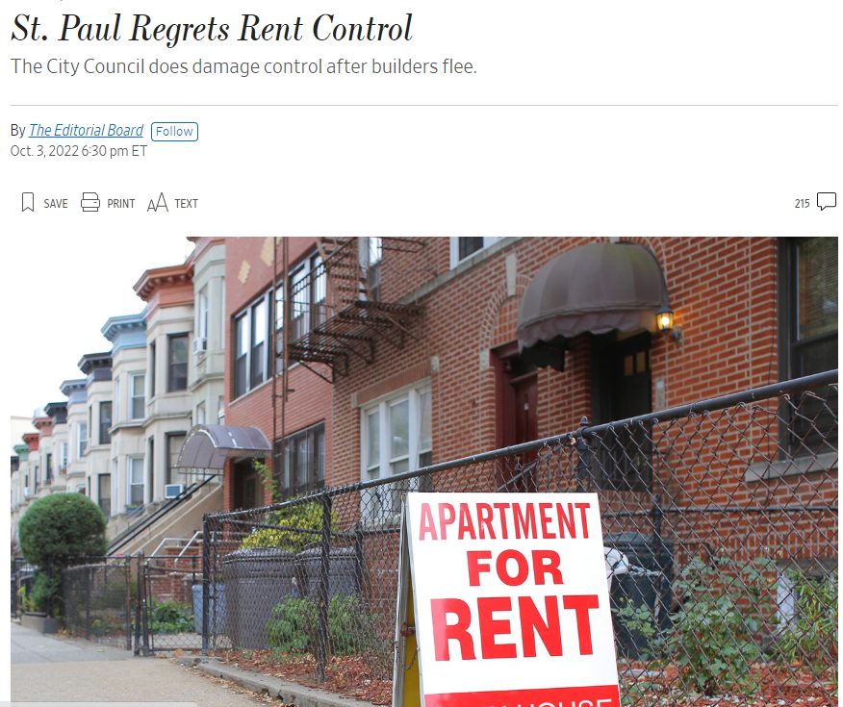

Slide 32


Slide 33
Price Ceiling
Maximum legal price a seller can charge for a product.
Goal: Make affordable by keeping price from reaching Eq.
To have an effect,
a price ceiling must be
below equilibrium
P
Gasoline
S
$5
4
3
2
1
Price Ceiling
Shortage
(Qd>Qs)
D
o
Q
10 20 30 40 50 60 70 80
33

Slide 34
Price Floor
Minimum legal price a seller can sell a product.
Goal: Keep price high by keeping price from falling to Eq.
To have an effect,
a price floor must be
above equilibrium
P
Corn
S
$
4
3
2
1
Surplus
(Qd<Qs)
Price Floor
D
o
Q
10 20 30 40 50 60 70 80
34

Slide 35
Price Ceiling
Maximum legal price a seller can charge for a product.
Goal: Make affordable by keeping price from reaching Eq.
$8
6
4
2
1
Price
Gasoline
S
Price Ceiling
D
10 20 30 40 50 60 70 80
Q

Slide 36
Price Floor
Minimum legal price a seller can sell a product.
Goal: Keep price high by keeping price from falling to Eq.
P
Corn
S
$
4
3
2
1
Surplus
(Qd<Qs)
Price Floor
Does this policy help corn producers?
D
10 20 30 40 50 60 70 80
Q

Slide 37


Slide 38
Are Price Controls Good or Bad?
To be “efficient” a market must maximize consumers and producers surplus
P
S
CS
P_{c}
PS
D
Q_{e}
Q

Slide 39
Are Price Controls Good or Bad?
To be “efficient” a market must maximize consumers and producers surplus
P
S
CS
Price FLOOR
DEADWEIGHT LOSS The Lost CS and PS.
INEFFICIENT!
P_{c}
PS
D
Q_{floor}
Q_{e}
Q

Slide 40
Are Price Controls Good or Bad?
To be “efficient” a market must maximize consumers and producers surplus
P
S
CS
P_{c}
PS
D
Q_{e}
Q

Slide 41
Are Price Controls Good or Bad?
To be “efficient” a market must maximize consumers and producers surplus
P
S
DEADWEIGHT LOSS The Lost CS and PS.
INEFFICIENT!
P_{c}
CS
Price CEILING
PS
D
Q_{ceiling}
Q
Q_{e}

Slide 42


Slide 43
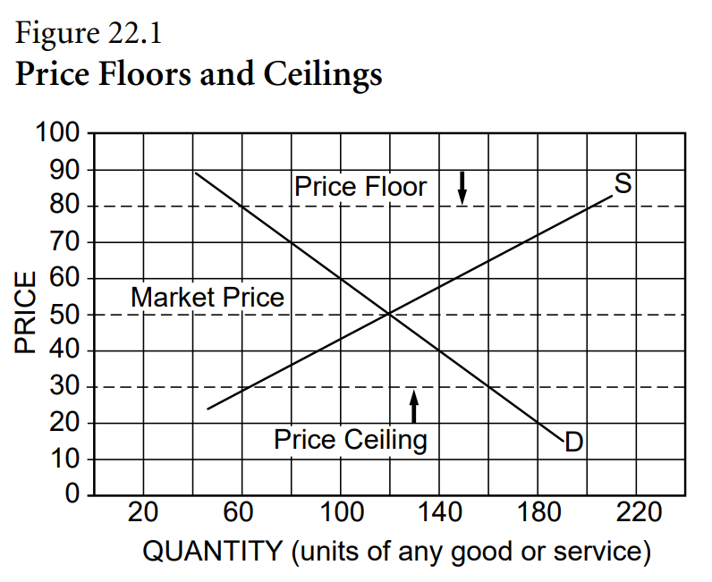
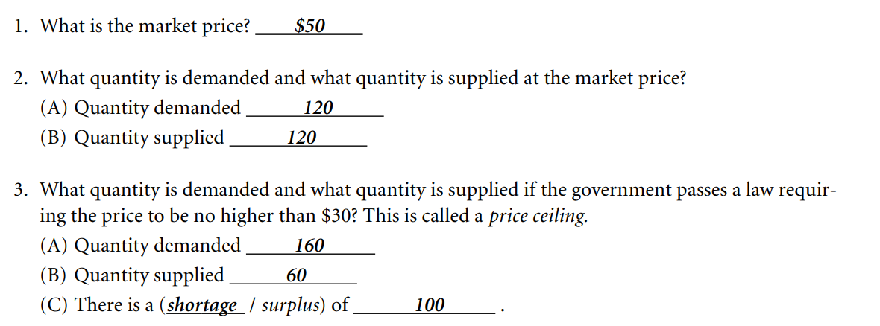
Activity 2-7

Slide 44
Activity 2-7
160

Slide 45
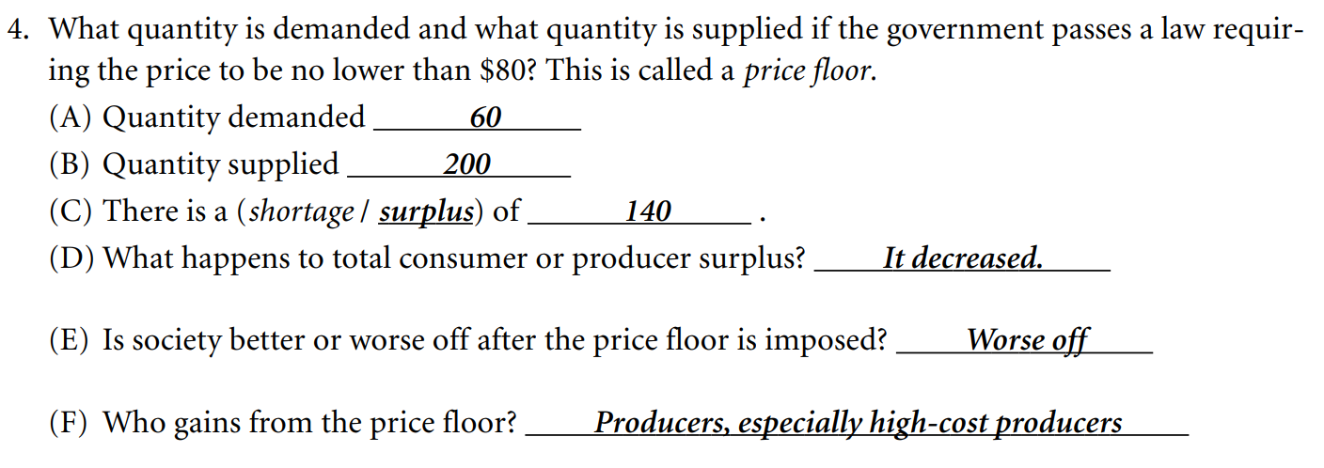
Activity 2-7
200

Slide 46
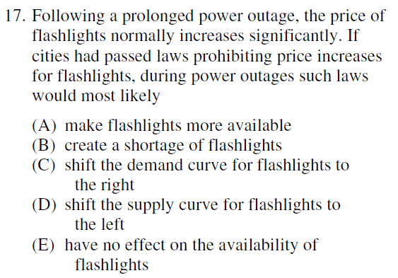
Notes:
B

Slide 47
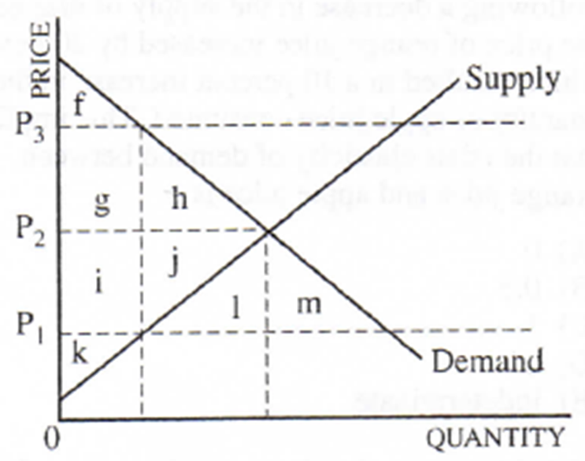
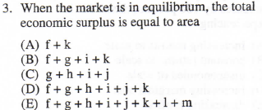
Notes:
D

Slide 48
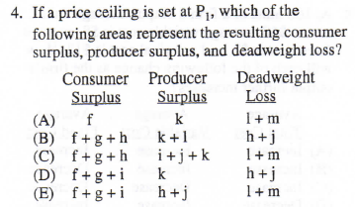
Notes:
D

Slide 49
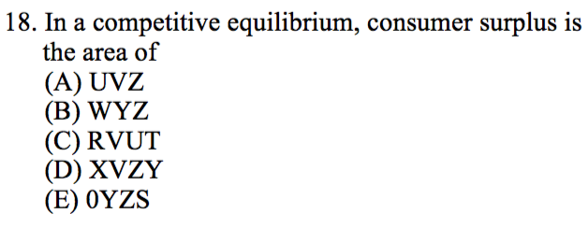
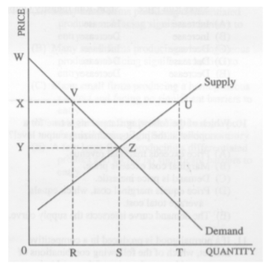
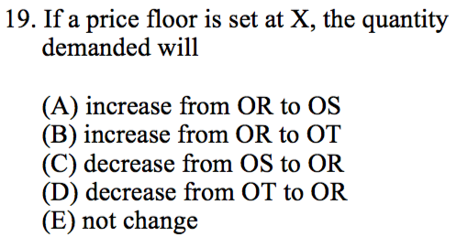
Notes:
B
C

Slide 50
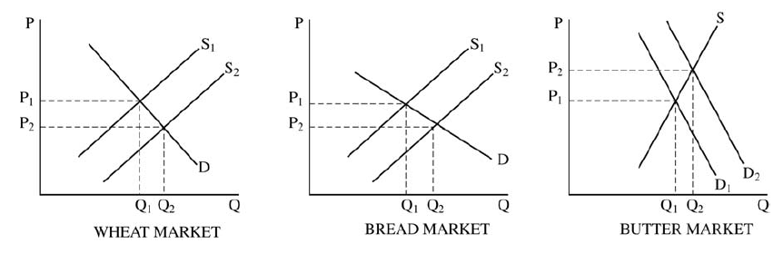
1. Assume that bread and butter are complementary goods. The government begins to subsidize the production of wheat, which is an input in the production of bread.
For each of the following markets, draw correctly labeled supply and demand graphs and show the effect of the subsidy on the equilibrium price and quantity in the short run.
      i. The wheat market
      ii. The bread market
    iii. The butter market
4 points:
One point is earned for correctly labeled supply and demand graphs for all three markets.
One point is earned for showing a rightward shift of the supply curve in the wheat market with price decreasing and quantity increasing.
One point is earned for showing a rightward shift of the supply curve in the bread market with price decreasing and quantity increasing.
One point is earned for showing a rightward shift of the demand curve in the butter market with price increasing and quantity increasing.

Slide 51
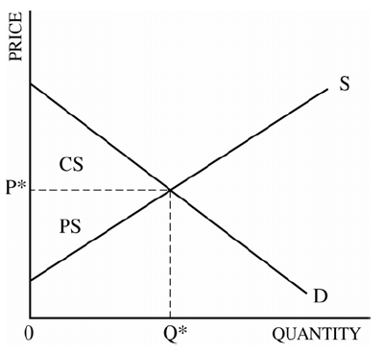
2. Assume that the market for home security systems is perfectly competitive and currently in equilibrium.
a. Using a correctly labeled graph of supply and demand, show each of the following.
  The equilibrium price and quantity, labeled as P* and Q*, respectively
  The area representing consumer surplus, labeled as CS
  The area representing producer surplus, labeled as PS
3 points:
One point is earned for a correctly labeled graph with equilibrium price and quantity.
One point is earned for showing the correct area of consumer surplus.
One point is earned for showing the correct area of producer surplus.

Slide 52
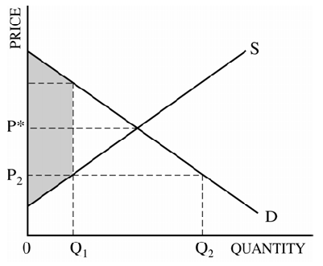
b. Suppose that the government imposes an effective (binding) price ceiling. Redraw your graph in part (a), and label the ceiling price as P₂. Completely shade the area representing the sum of the consumer surplus and the producer surplus after the imposition of the price ceiling.
2 points:
One point is earned for showing the price ceiling below the equilibrium.
One point is earned for shading the correct area of consumer surplus and producer surplus.

Slide 53
c. Suppose the demand for home security systems decreases and the price ceiling remains binding. Indicate what will happen to each of the following.
  Consumer surplus
  Producer surplus
2 points:
One point is earned for indicating that consumer surplus will decrease.
One point is earned for indicating that producer surplus will not change.
PC
D 1

Slide 54


Slide 55
Supply and Demand Shifting Room Activity.
Supply and Demand Room Shifting Activity Questions (click here) and answer template (click here)

Slide 56
EconEdLink Membership
You can now access CEE’s professional development webinars directly on EconEdLink.org! To receive these new professional development benefits, become an EconEdLink member. As a member, you will now be able to:
Automatically receive a professional development certificate via e-mail within 24 hours after viewing any webinar for a minimum of 45 minutes
Register for upcoming webinars with a simple one-click process
Easily download presentations, lesson plan materials and activities for each webinar
Search and view all webinars at your convenience
Save webinars to your EconEdLink dashboard for easy access to the event
Access our new Professional Development page here

Slide 57

Invest In Girls

Slide 58

NEC

Slide 59

NPFC

Slide 60

Advocacy

Slide 61


CEE Affiliates
https://www.councilforeconed.org/resources/local-affiliates/
Minnesota Council on Economics Education: www.mcee.umn.edu

Slide 62










Thank You to Our Sponsors!

Slide 63
James Redelsheimer jred40@gmail.com
Thank You

