Slide 1
Presented by: James Redelsheimer
Email: jred40@gmail.com
Date: 3/27/23
AP Micro: Scarcity,
AP Micro: Marginal Analysis

Slide 2
Professional Development Opportunities
To earn professional development credit for CEE webinars found on EconEdLink, you must:
Watch a minimum of 45-minutes and you will automatically receive a professional development certificate via e-mail within 24 hours.
Attendees can learn how much credit they will earn per workshop.
Accessing resources:
You can now easily download presentations, lesson plan materials, and activities for each webinar from EconEdLink.org/professional-development/
Local resources:
Insert your local professional development opportunities (if applicable)

Slide 3

James Redelsheimer
James Redelsheimer has been an AP and Regular Economics teacher at Robbinsdale Armstrong High School in Plymouth, Minnesota since 2003. James received his Bachelor’s degree from St. Olaf College and his Master's degree at the University of St. Thomas. He received the 3M Economics Educator Excellence Award from the Minnesota Council on Economic Education and was named Visa's Practical Money Skills Innovative Educator of the Month.
James enjoys traveling and has been a guest lecturer in the economics department at the Batumi State University in The Republic of Georgia and has received travel grants and fellowships for study travel to learn about the economies of Japan, China, Turkey, Germany, Korea, among others, and studied economics of the environment in Costa Rica. He currently serves as an AP Economics reader, grading AP Economics exams. He enjoys teaching Economics because it relates to students' everyday lives.

Slide 4
Agenda
Explore marginal analysis and consumer choice with real-world examples.
Practice multiple choice and FRQ Questions.
Activities from CEE’s AP Economics Workbook

Slide 5
Objectives
In this webinar teachers will be able to:
Understand consumer choice theory and marginal analysis
Implement effective lessons to prepare students for AP exam questions applying consumer choice theory and marginal analysis
Effectively review practice multiple choice and free response questions with their students to prepare them for these concepts AP Exam

Slide 6
Topic 1.6-
Marginal Analysis and Consumer Choice

Slide 7
Marginal Analysis
In economics, the term marginal = additional
Marginal analysis (aka: thinking on the margin) making decisions based on increments.
Example:
When you decide to go to the mall, you consider the additional benefit and the additional cost (your opportunity cost).
Once you get to the mall, you continue to use marginal analysis when you shop, buy food, and talk to friends.
Since your marginal benefits and costs can quickly change, you’re analyzing them every second.
What if your ex-girlfriend shows up?
The Point: You will continue to do something as long as the marginal benefit is greater than the marginal cost.
7

Slide 8
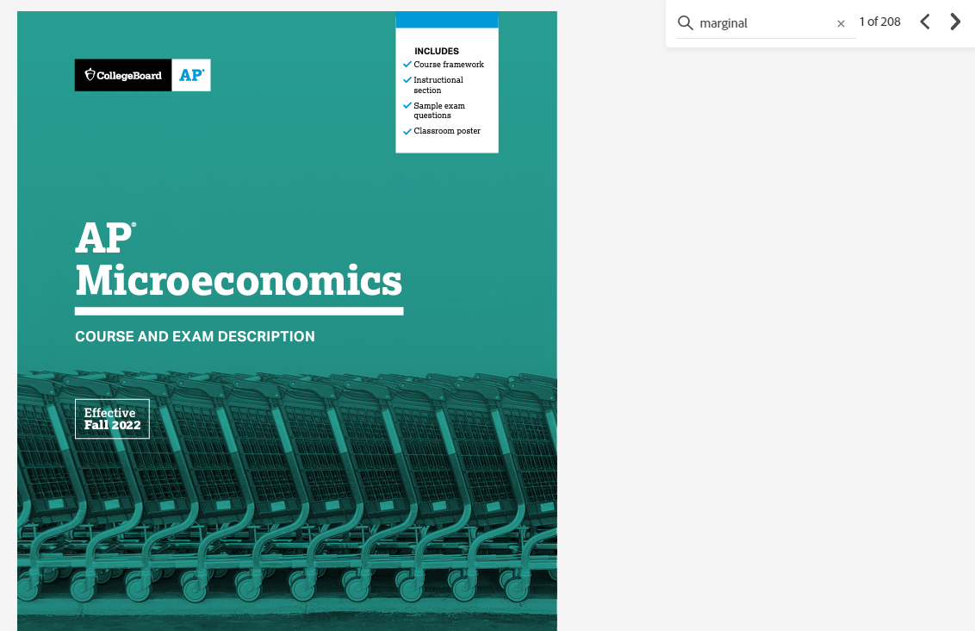
The word marginal is mentioned 208 times in the AP Micro CED!

Slide 9
Consumer Choice and Utility Maximization
Notes:
https://www.youtube.com/watch?v=WglpOZOZyDI

Slide 10

According to the Guinness Book of World Records, how long was the longest roller coaster marathon?
Over 16 Days (405 Hours, 40 Minutes)
What does this have to do with the Law of Diminishing Marginal Utility?
Notes:
https://www.youtube.com/watch?v=YGOGTmQ-v7o

Slide 11
Marginal Utility
Imagine that it’s really hot day and that you’re thirsty. Which sip of water will have the highest marginal utility for you?
Why?
What will happen to the marginal utility of each sip of water as you drink more?
Now somebody offers you 12 bottles of water. How much utility does that 12th bottle of water have for you right then?

Slide 12
Law of Diminishing Marginal Utility
The law of diminishing marginal utility states that as you consume anything, the additional satisfaction that you will receive will eventually start to decrease
In other words, the more you buy of ANY GOOD the less satisfaction you get from each new unit consumed.
The Point: You will continue to do something as long as the marginal benefit is greater than the marginal cost.

Slide 13


Slide 14
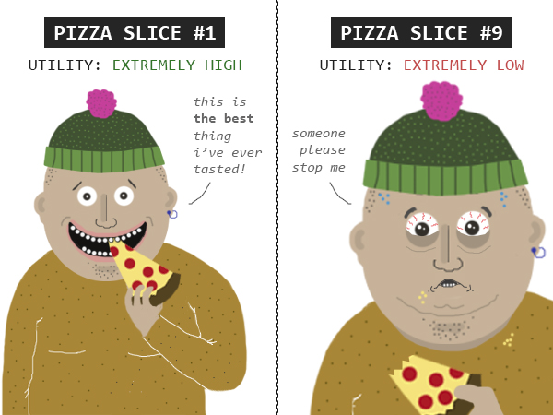

Slide 15
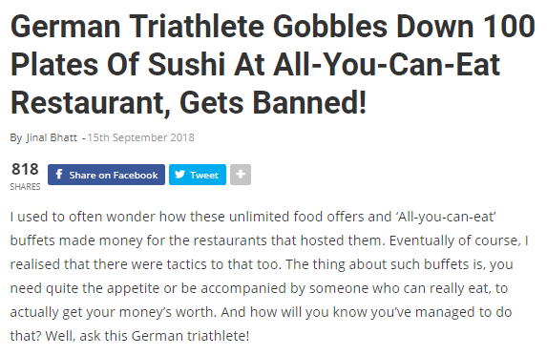

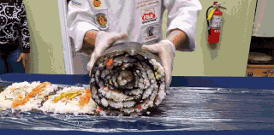

Slide 16
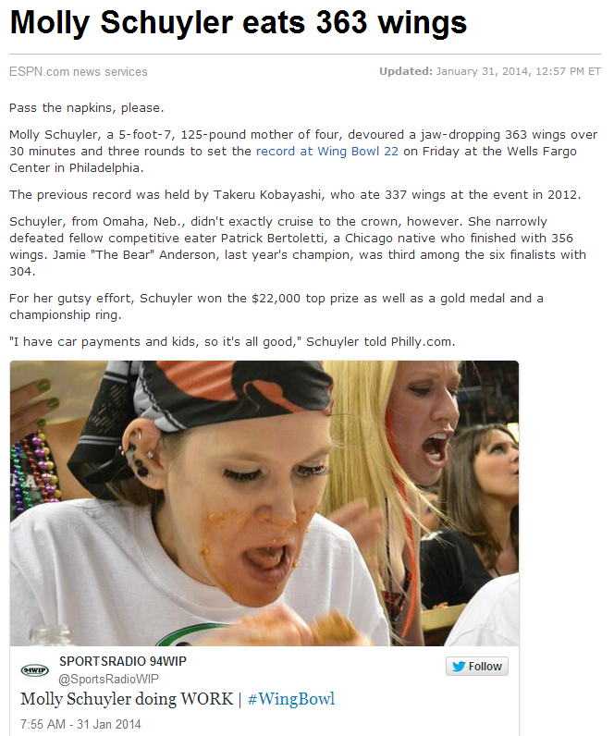
Diminishing
Marginal
Utility

Slide 17
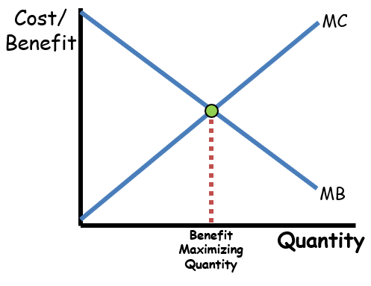

Slide 18
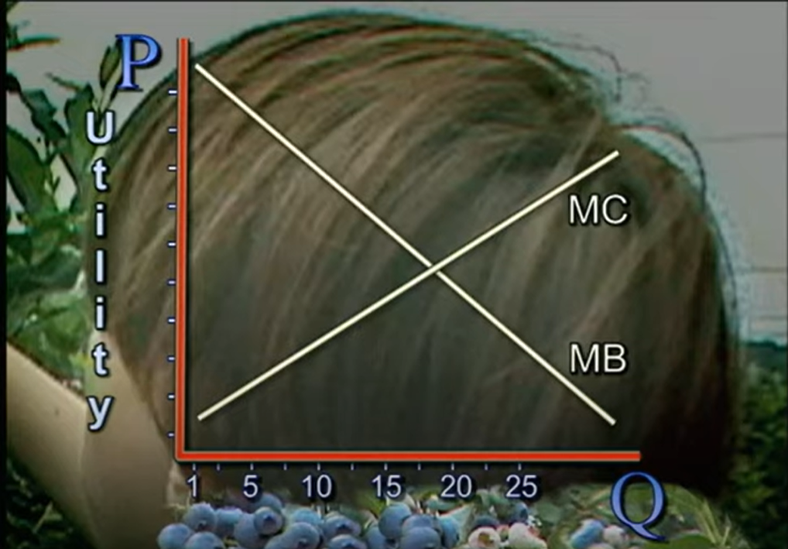

Video Clip: Marginal Benefit vs. Marginal Cost

Slide 19
Calculate Marginal Utility
# of Slices of Pizza | Total Utility (in dollars) | Marginal Utility/Benefit
0 | 0
1 | 8
2 | 14
3 | 19
4 | 23
5 | 25
6 | 26
7 | 26
8 | 24
How many pizzas would you buy if the price per slice was $2?

Slide 20
Calculate Marginal Utility
# of Slices of Pizza | Total Utility (in dollars) | Marginal Utility/Benefit
0 | 0 | 0
1 | 8 | 8
2 | 14 | 6
3 | 19 | 5
4 | 23 | 4
5 | 25 | 2
6 | 26 | 1
7 | 26 | 0
8 | 24 | -2
Marginal Cost
$2
$2
$2
$2
$2
$2
$2
$2
$2
How many pizzas would you buy if the price per slice was $2?

Slide 21

Calculate Marginal Utility
# of Slices of Pizza | Total Utility (in dollars) | Marginal Utility/Benefit
0 | 0 | 0
1 | 8 | 8
2 | 14 | 6
3 | 19 | 5
4 | 23 | 4
5 | 25 | 2
6 | 26 | 1
7 | 26 | 0
8 | 24 | -2
Marginal Cost
2
2
2
2
2
2
2
2
2
You will continue to consume until Marginal Benefit = Marginal Cost
How many pizzas would you buy if the price per slice was $2?

Slide 22
But what if...
# of Slices of Pizza | Total Utility (in utils) | Marginal Utility/Benefit
0 | 0 | 0
1 | 8 | 8
2 | 14 | 6
3 | 19 | 5
4 | 23 | 4
5 | 26 | 3
6 | 27 | 1
7 | 27 | 0
8 | 26 | -1
How many pizzas would you buy if the price per slice was $2?

Slide 23
MB doesn’t ever = MC!
# of Slices of Pizza | Total Utility (in dollars) | Marginal Utility/Benefit
0 | 0 | 0
1 | 8 | 8
2 | 14 | 6
3 | 19 | 5
4 | 23 | 4
5 | 26 | 3
6 | 27 | 1
7 | 27 | 0
8 | 26 | -1
Marginal Cost
$2
$2
$2
$2
$2
$2
$2
$2
$2
Why should you buy 5 slices? Why shouldn’t you buy a 6th slice?

Slide 24
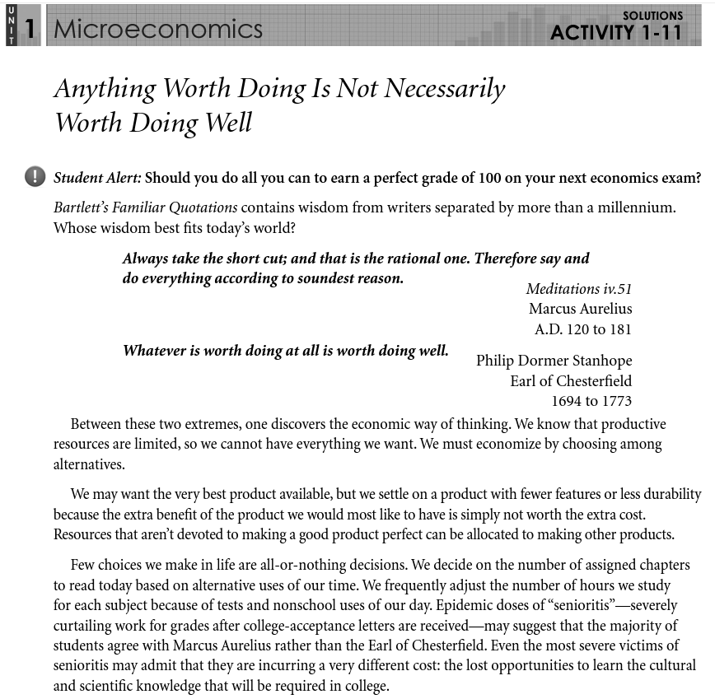

Slide 25
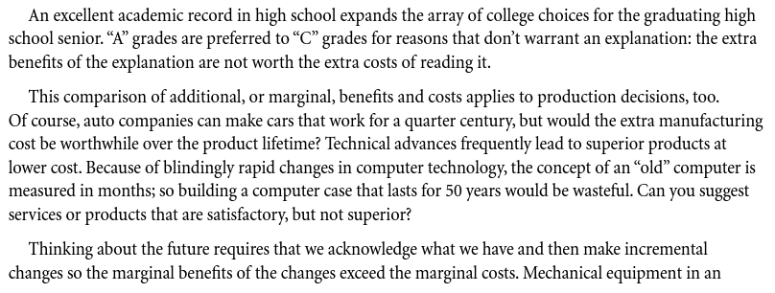
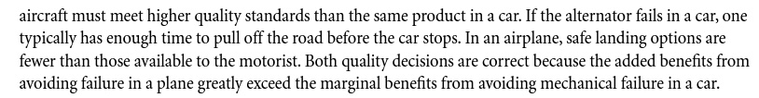

Slide 26
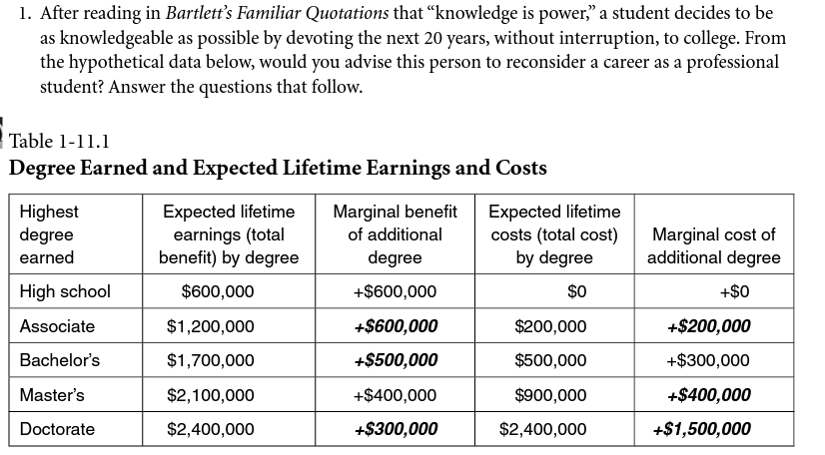
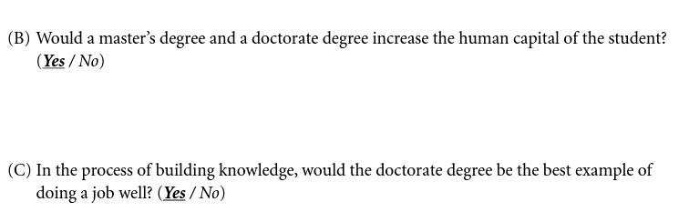

Slide 27
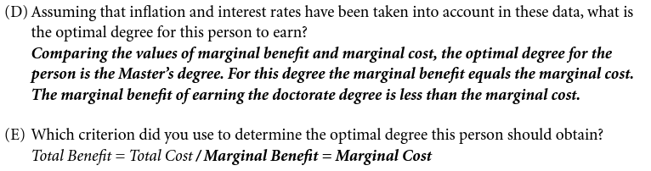

Slide 28
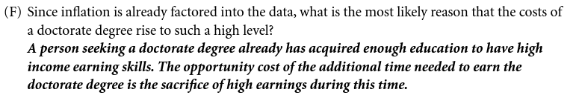

Slide 29
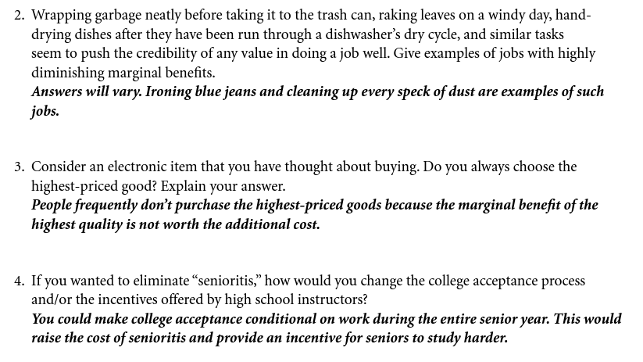

Slide 30

Video Clip: Introduction to Consumer Choice
Notes:
https://www.youtube.com/watch?v=5nmyzM6KTnc

Slide 31
What is Happiness?
Measure someone’s UTILITY
Uses units known as UTILS
Everything we buy has utility
Everything you buy makes up your CONSUMPTION BUNDLE

Slide 32
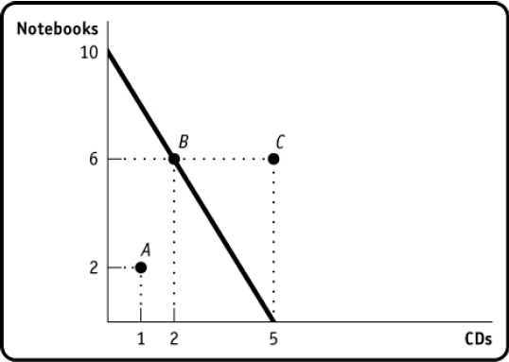
Budget Constraint
Assumptions
Income = $50
Notebooks = $5
CDs = $10
Combination not possible

Slide 33
Utility Maximizing Rule
The consumer’s money should be spent so that the marginal utility per dollar of each goods equal each other.
MUx = MUy
P_{x} P_{y}
You use this rule subconsciously every day!

Slide 34
Optimum Consumption
MU_{X}/P_{X} = MU_{Y}/P_{Y}
Maximize utility given budget constraint
Done through marginal analysis
Look to marginal utility per dollar

Slide 35


Utility Maximization
$10
$5
# Times Going | Marginal Utility (Movies) | MU/P (Price =$10) | Marginal Utility (Go karts) | MU/P (Price =$5)
1st | 30 |  | 10
2nd | 20 |  | 5
3rd | 10 |  | 2
4th | 5 |  | 1
If you only have $40, what combination of movies and go karts maximizes your utility?

Slide 36
Utility Maximization
$10
$5
# Times Going | Marginal Utility (Movies) | MU/P (Price =$10) | Marginal Utility (Go karts) | MU/P (Price =$5)
1st | 30 | 3 | 10 | $2
2nd | 20 | $2 | 5 | $1
3rd | 10 | $1 | 2 | $.40
4th | 5 | $.50 | 1 | $.20
If you only have $40, what combination of movies and go karts maximizes your utility?

Slide 37
Utility Maximization
$10
$5
# Times Going | Marginal Utility (Movies) | MU/P (Price =$10) | Marginal Utility (Go Karts) | MU/P (Price =$5)
1st | 30 | 3 | 10 | 2
2nd | 20 | $2 | 5 | $1
3rd | 10 | $1 | 2 | $.40
4th | 5 | $.50 | 1 | $.20
If you only have $40, what combination of movies and go karts maximizes your utility?

Slide 38
Utility Maximization
$10
$5
# Times Going | Marginal Utility (Movies) | MU/P (Price =$10) | Marginal Utility (Go Karts) | MU/P (Price =$5)
1st | 30 | 3 | 10 | 2
2nd | 20 | 2 | 5 | 1
3rd | 10 | 1 | 2 | .40
4th | 5 | .50 | 1 | .20
If you only have $40, what combination of movies and go karts maximizes your utility?
3 Movies and 2 Go Karts

Slide 39
Utility Maximization
$10
$5
# Times Going | Marginal Utility (Movies) | MU/P (Price =$10) | Marginal Utility (Go Karts) | MU/P (Price =$5)
1st | 30 | 3 | 10 | 2
2nd | 20 | 2 | 5 | 1
3rd | 10 | 1 | 2 | .40
4th | 5 | .50 | 1 | .20
1. How much is the total utility from 3 movies and 2 go carts?
2. Total utility from 2 movies and 4 go karts?

Slide 40
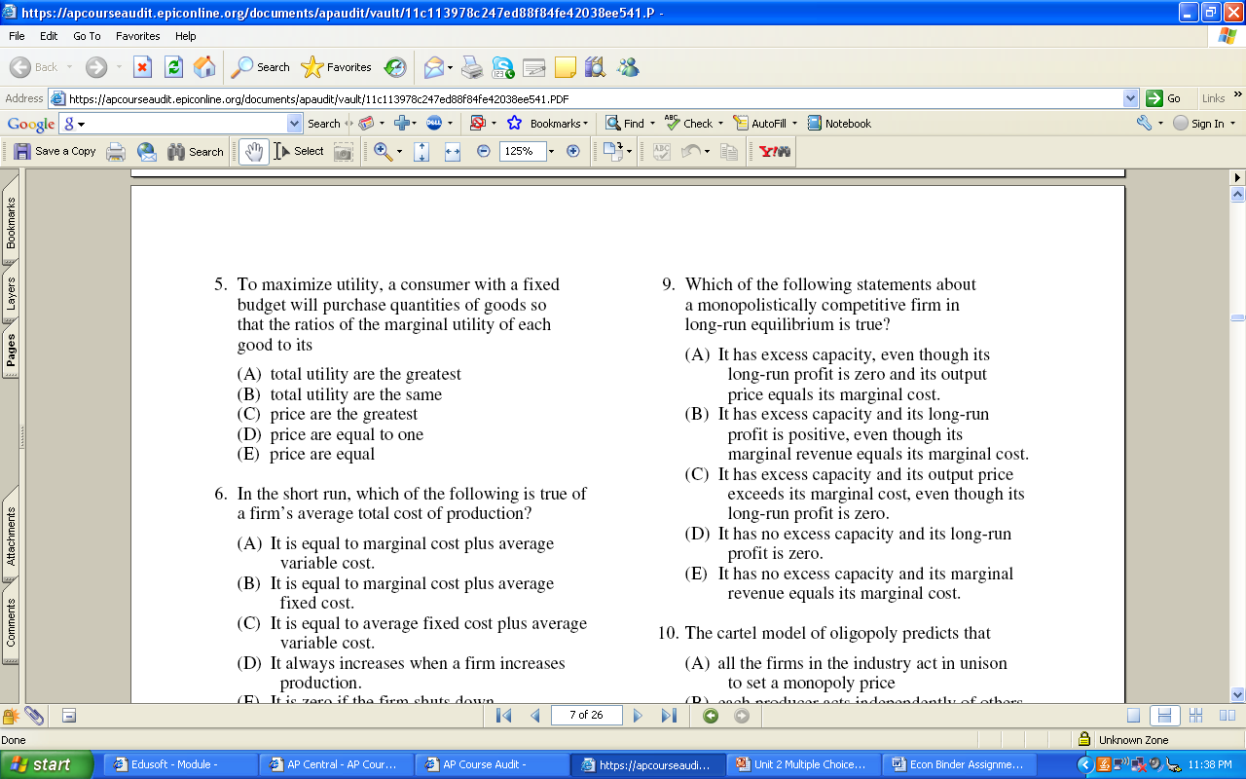

Slide 41
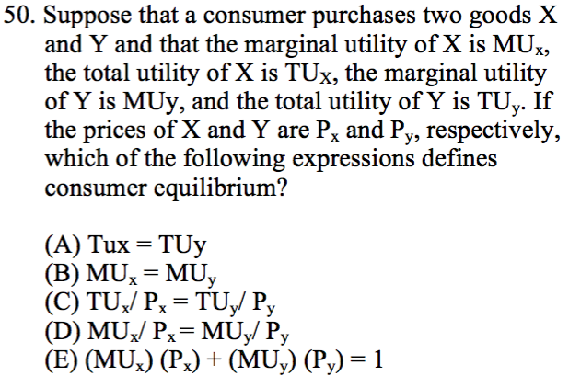

Slide 42
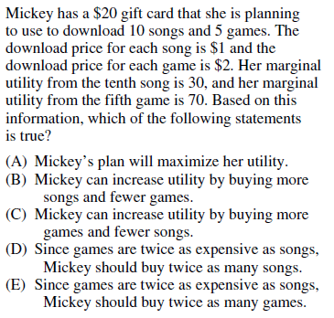

Slide 43
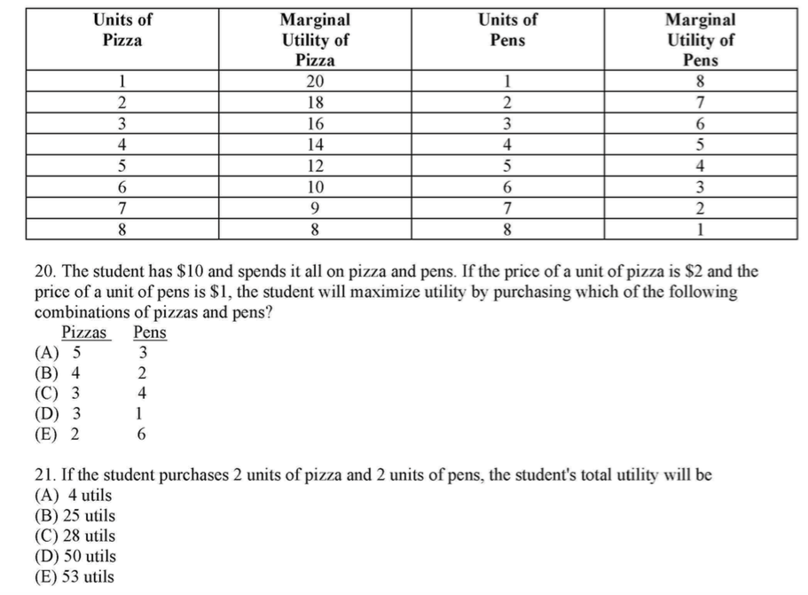
Pizza $2
MU/P
1 – 10
2 – 9
3 – 8
4 – 7
5 – 6
6 – 5
7 – 4.5
8 – 4
Pens $1
MU/P
1 – 8
2 – 7
3 – 6
4 – 5
5 – 4
6 – 3
7 – 2
8 – 1

Slide 44
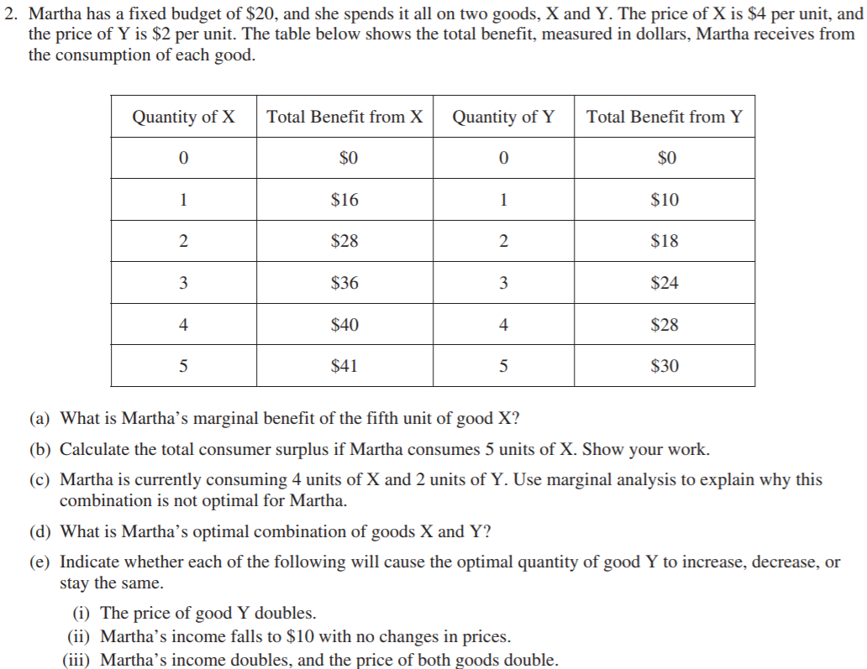
X - $4
Y - $2
Q of X | MU/$ - X | Qty of Y | MU/$ of Y
0 | - | 0 | --
1 | 4 | 1 | 5
2 | 3 | 2 | 4
3 | 2 | 3 | 3
4 | 1 | 4 | 2
5 | .25 | 5 | .5
$1
$41 - $20 = $21
MBy/Py > MBx/Px
3 X and 4 Y: See Chart
decrease
decrease
stay the same

Slide 45
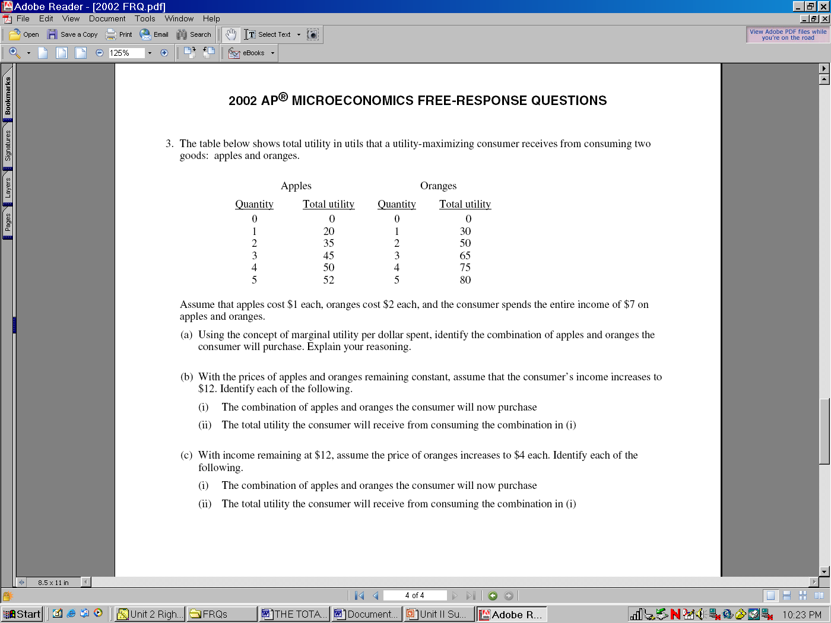
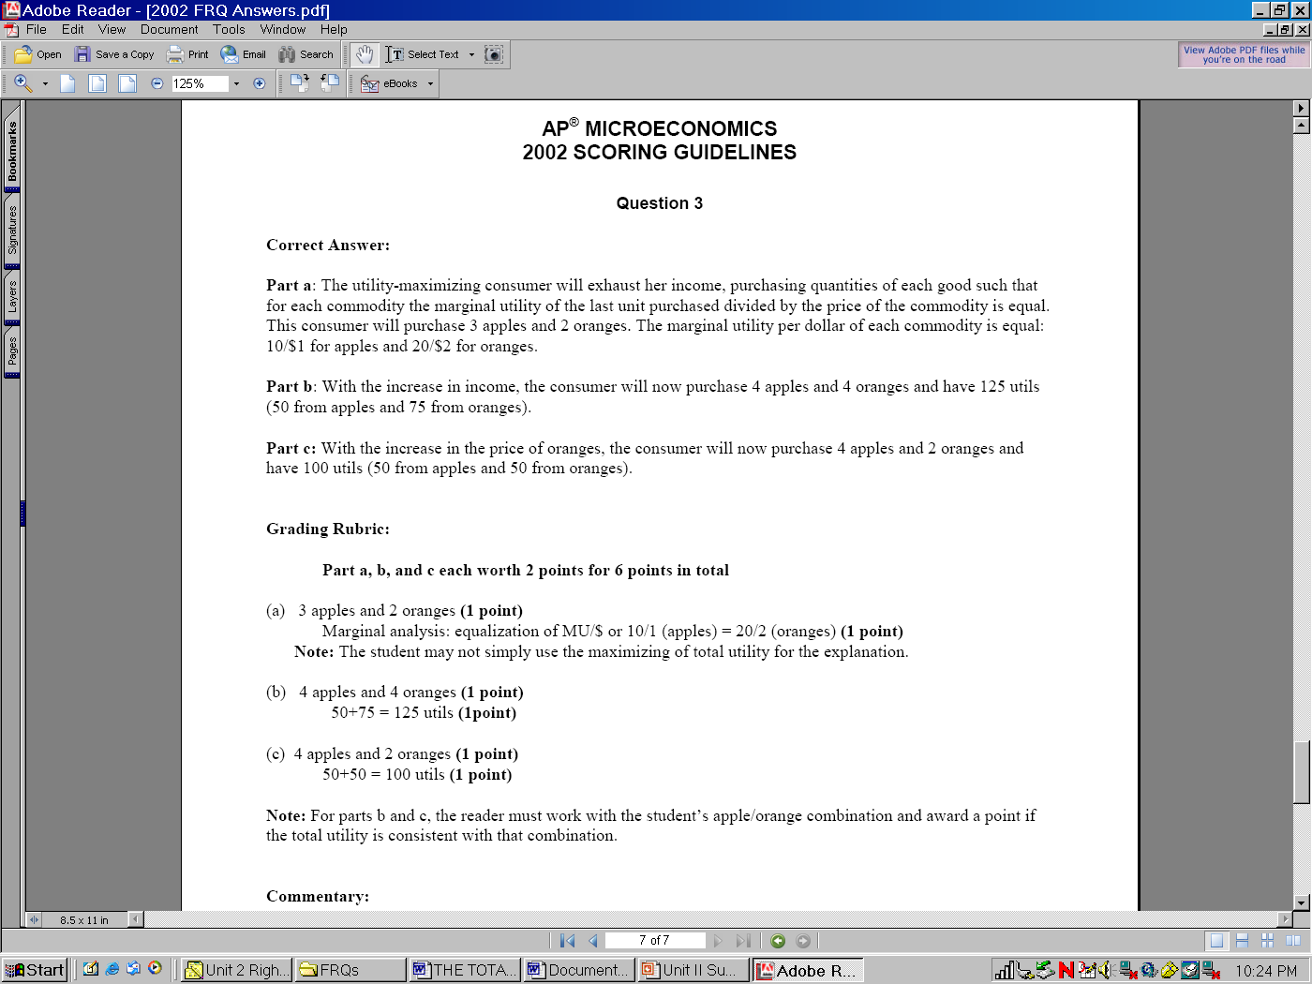
$1
$2
Q of Apples | MU/$ - Apples | Qty of Oranges | MU/$ of Oranges
0 | - | 0 | --
1 | 20 | 1 | 15
2 | 15 | 2 | 10
3 | 10 | 3 | 7.5
4 | 5 | 4 | 5
5 | 2 | 5 | 2.5

Slide 46
$1
$2
Q of Apples | MU/$ - Apples | Qty of Oranges | MU/$ of Oranges
0 | - | 0 | --
1 | 20 | 1 | 15
2 | 15 | 2 | 10
3 | 10 | 3 | 7.5
4 | 5 | 4 | 5
5 | 2 | 5 | 2.5

Slide 47
$1
$4
Q of Apples | MU/$ - Apples | Qty of Oranges | MU/$ of Oranges
0 | - | 0 | --
1 | 20 | 1 | 7.5
2 | 15 | 2 | 5
3 | 10 | 3 | 3.75
4 | 5 | 4 | 2.5
5 | 2 | 5 | 1.25

Slide 48

Notes:
https://www.youtube.com/watch?v=5nmyzM6KTnc

Slide 49

49
Notes:
https://www.youtube.com/watch?v=_0eGegYjBRs

Slide 50

50
Notes:
https://www.youtube.com/watch?v=h9wV7J7bef0

Slide 51
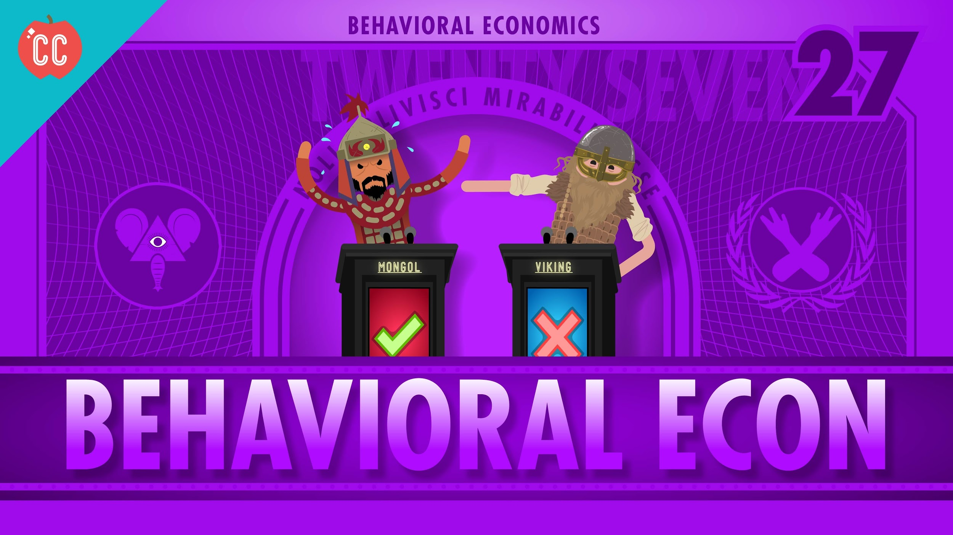
51
Notes:
https://www.youtube.com/watch?v=dqxQ3E1bubI&index=28&list=PL1oDmcs0xTD-dJN1PL2N1urX0EKupBJCQ

Slide 52
EconEdLink Membership
You can now access CEE’s professional development webinars directly on EconEdLink.org! To receive these new professional development benefits, become an EconEdLink member. As a member, you will now be able to:
Automatically receive a professional development certificate via e-mail within 24 hours after viewing any webinar for a minimum of 45 minutes
Register for upcoming webinars with a simple one-click process
Easily download presentations, lesson plan materials and activities for each webinar
Search and view all webinars at your convenience
Save webinars to your EconEdLink dashboard for easy access to the event
Access our new Professional Development page here

Slide 53

Invest In Girls

Slide 54

NEC

Slide 55

NPFC

Slide 56

Advocacy

Slide 57


CEE Affiliates
https://www.councilforeconed.org/resources/local-affiliates/
Minnesota Council on Economics Education: www.mcee.umn.edu

Slide 58










Thank You to Our Sponsors!

Slide 59
James Redelsheimer jred40@gmail.com
Thank You!

