Slide 1
Presented by: James Redelsheimer Email: jred40@gmail.com Date: 04/03/23
AP Micro: Scarcity, AP Micro: Economic Systems

Slide 2
Professional Development Opportunities
To earn professional development credit for CEE webinars found on EconEdLink, you must:
Watch a minimum of 45-minutes and you will automatically receive a professional development certificate via e-mail within 24 hours.
Attendees can learn how much credit they will earn per workshop.
Accessing resources:
You can now easily download presentations, lesson plan materials, and activities for each webinar from EconEdLink.org/professional-development/
Local resources:
Insert your local professional development opportunities (if applicable)

Slide 3
James Redelsheimer
James Redelsheimer has been an AP and Regular Economics teacher at Robbinsdale Armstrong High School in Plymouth, Minnesota since 2003. James received his Bachelor’s degree from St. Olaf College and his Master's degree at the University of St. Thomas. He received the 3M Economics Educator Excellence Award from the Minnesota Council on Economic Education and was named Visa's Practical Money Skills Innovative Educator of the Month.
James enjoys traveling and has been a guest lecturer in the economics department at the Batumi State University in The Republic of Georgia and has received travel grants and fellowships for study travel to learn about the economies of Japan, China, Turkey, Germany, Korea, among others, and studied economics of the environment in Costa Rica. He currently serves as an AP Economics reader, grading AP Economics exams. He enjoys teaching Economics because it relates to students' everyday lives.

Slide 4
Agenda
Explore different economic systems with real-world examples.
Practice multiple choice questions similar to the AP Exam.
Activities from CEE’s AP Economics Workbook

Slide 5
Objectives
In this webinar teachers will be able to:
Understand resource allocation in relation to the three basic economic questions: what, how, and for whom to produce
Understand the characteristics of market, command, and mixed economies
Effectively review practice multiple choice and free response questions with their students to prepare them for the AP Exam

Slide 6
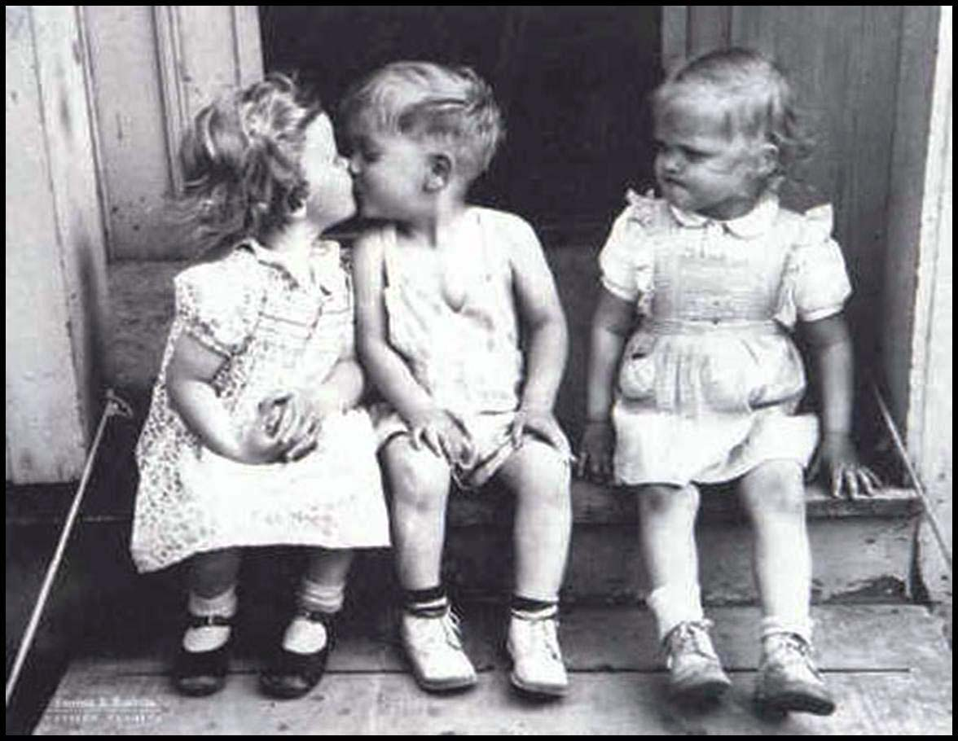
Scarcity Means There Is Not Enough For Everyone
Government must step in to help allocate (distribute) resources

Slide 7
Scarcity Bus Ride
Scenario:
A group of 40 college students get on a bus to go to a dance 30 miles away.
Shortly after leaving, the bus finds that it is too heavy to go over a large hill
10 students need to get off the bus
You and your partner need to find 5 different ways to decide who should get off the bus.
Are any of the solutions fair?
How are resources allocated in communism?
How are resources allocated in capitalism?
What role do prices play in capitalism?

Slide 8
The Three Economic Questions
Every society must answer three questions:
What goods and services should be produced?
How should these goods and services be produced?
Who consumes these goods and services?
The way these questions are answered determines the economic system
An economic system is the method used by a society to produce and distribute goods and services.

Slide 9
Economic Systems
Centrally-Planned (Command) Economy
Free Market Economy
Mixed Economy

Slide 10
Centrally-Planned Economies
(aka Communism)

Slide 11
Centrally Planned Economies
In a centrally planned economy (communism) the government…
Owns all the resources.
Answers the three economic questions
Examples: Cuba, North Korea, former Soviet Union, and China?
Why do centrally planned economies face problems of poor-quality goods, shortages, and unhappy citizens?
Little incentive to work harder and central planners have a hard time predicting preferences

Slide 12
Advantages and Disadvantages
What is GOOD about Communism?
What is BAD about Communism?
Low unemployment-everyone has a job
Great Job Security-the government doesn’t go out of business
Equal incomes
“Free” Health Care
No incentive to work harder
No incentive to innovate or come up with good ideas
No Competition keeps quality of goods poor.
Corrupt leaders
Few individual freedoms

Slide 13
Free Market System
(aka Capitalism)

Slide 14
Characteristics of The Free Market
Little government involvement in the economy. (Laissez Faire = Let it be)
Individuals OWN resources and answer the three economic questions.
The opportunity to make PROFIT gives people INCENTIVE to produce quality items efficiently.
Wide variety of goods available to consumers.
Competition and Self-Interest work together to regulate the economy (keep prices down and quality up).

Slide 15
The Invisible Hand of the Market Economy

Slide 16
Example of The Free Market
Example of how the free market regulates itself:
If consumers want smartphones and only one company is making them…
Other businesses have the INCENTIVE to start making smartphones to earn PROFIT.
This leads to more COMPETITION….
Which means lower prices, better quality, and more product variety.
We produce the goods and services that society wants because “resources follow profits”.
The End Result: Most efficient production of the goods that consumers want, produced at the lowest prices and the highest quality.

Slide 17
Example of Central Planners
Example of why communism failed:
If consumers want smartphones and only one company is making them…
Other businesses CANNOT start making computers.
There is NO COMPETITION….
Which means higher prices, lower quality, and less product variety.
More phones will not be made until the government decides to create a new factory.
The End Result: There is a shortage of goods that consumers want, produced at the highest prices and the lowest quality.

Slide 18
The Invisible Hand
The concept that society’s goals will be met as individuals seek their own self-interest.
Example: Society wants fuel efficient cars…
Profit seeking producers will make more.
Competition between firms results in low prices, high quality, and greater efficiency.
The government doesn’t need to get involved since the needs of society are automatically met.
Competition and self-interest act as an invisible hand that regulates the free market.

Slide 19
Mixed Economies
A system with free markets but also some government intervention.
Almost all countries, including the US, have mixed economies

Slide 20
Productivity Creates Wealth
Countries with free markets, property rights, and The Rule of Law, have historically seen greater economic growth because they are more productive
Developing Countries
Developed Countries
Index of Economic Freedom

Slide 21
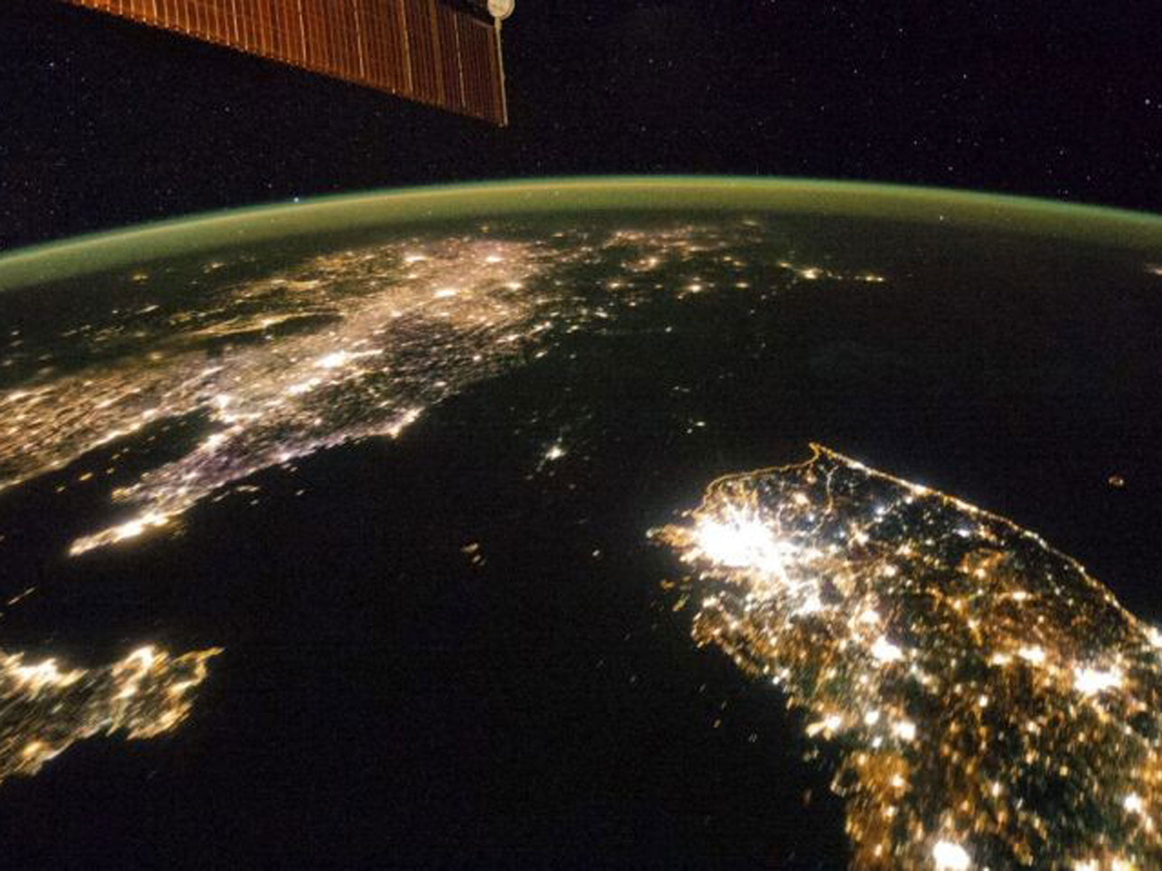

Slide 22
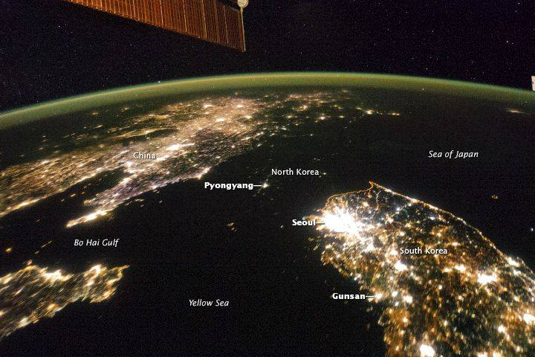
The difference between North and South Korea at night South Korea's nominal GDP was around 57 times greater than that of North Korea.

Slide 23
Video: The Importance of Institutions

Slide 24
Economic Mystery #1
Why did Yasiel Puig’s salary increase by 2,333,232% in such a short period of time?
(Google Doc Activity Link)

Slide 25
Why did Yasiel Puig’s salary increase by 2,333,232% in such a short period of time?

Slide 26
The Mystery of Yasiel Puig
Clue #1- Yasiel Puig is a very rare talent. He can hit, throw and field at an extremely high level.

Slide 27
The Mystery of Yasiel Puig
Clues #2, 5, 7- Cuba has a command economy which results in the government deciding how much players earn. All Cuban baseball players get paid at very similar levels.

Slide 28
The Mystery of Yasiel Puig
Clue #6- The Los Angeles Dodgers are a very wealthy team with enormous television revenues coming in each year. Because the Dodgers are in search of a profit, they seek out the best players in hopes that these players will lead them to victory.

Slide 29
The Mystery of Yasiel Puig
Clue #8- By leaving his native Cuba, Yasiel Puig was no longer constrained by the state-mandated pay scale in Cuba.

Slide 30
Why did Yasiel Puig’s salary increase by 2,333,232% in such a short period of time?
Clues 1, 2, 5, 6, 7, 8 explain the mystery of the 2,333,332% increase in Yasiel Puig’s yearly/monthly salary.

Slide 31
Conclusion
By deciding to leave his home country of Cuba for the United States of America, baseball player Yasiel Puig was able to sell his labor to the highest bidder in a free market economy. Unlike the command economy he left behind in Cuba in 2012, the free market economy of the United States allowed him to earn a much higher income from his employer, the Los Angeles Dodgers. While playing for Cienfuegos in Cuba, Puig earned a monthly state salary of roughly $25 per month. While playing for the Dodgers in Los Angeles, Puig earns roughly $583,333 per month.

Slide 32
How can the Cuban government change economic incentive structures to get Cuban baseball players to stay in Cuba?
The government will need to drastically increase the pay of Cuban baseball players
The Cuban government might eliminate travel restrictions for players, or the Cuban government may need to privatize Cuban professional baseball teams.

Slide 33
True or False
#1- Up until 2008, Cubans were not allowed to stay in Cuban tourist hotels.
TRUE

Slide 34
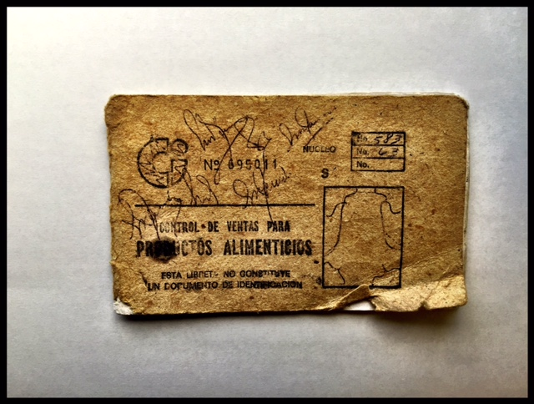
True or False
#2- Ration cards are still being used by millions of Cubans on a daily basis.
True

Slide 35
True or False
#3- The average age of a house or apartment in Cuba is 75 years old.
True

Slide 36
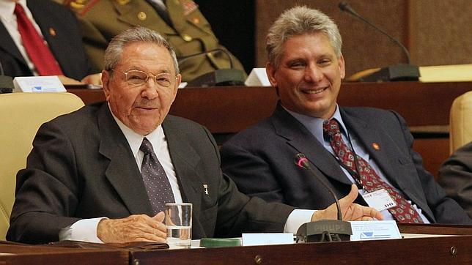
True or False
#4- Fidel Castro’s oldest son took over as President of Cuba when Raul Castro retired in 2018.
(False, Miguel Diaz-Canel)
Raúl Castro
Miguel Díaz-Canel

Slide 37
True or False
#5- Cuba imports about 70% of its food?
True

Slide 38
True or False
#6- Cuban tour guides must get special permission from the government to ride on boats.
True

Slide 39
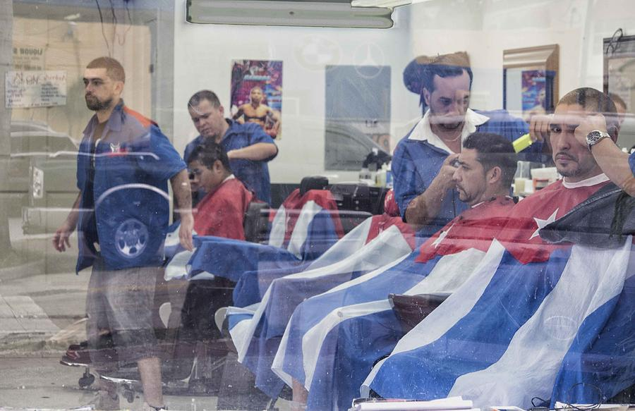
True or False
#7- Roughly 97% of Cuban workers work for the government.
False 72%

Slide 40
True or False
#8- The Cuban government often sends Cuban doctors to work in other countries.
TRUE

Slide 41
True or False
#9- 90% of Cubans have access to the Internet.
False, 68%

Slide 42
True or False
#10- It is illegal for a farmer to kill a cow in Cuba.
True

Slide 43
MYSTERY: Why are there so many vintage cars on the streets of Cuban cities and towns?

Slide 44
MYSTERY: Why are there so many vintage cars on the streets of Cuban cities and towns? Which numbers explain this?
___ 1. Cuban consumers only like vintage vehicles.
___ 2. The Soviet Union was the #1 financial backer of Cuba in the 1960’s, 70’s and 80’s.
___ 3. The U.S. government placed a total trade embargo on Cuba in 1962.
___ 4. After coming to power in 1959, the Cuban government made it illegal to import vehicles without government permission.
___ 5. Between 1959 and 2011, Cubans could not legally buy or sell a vehicle made after 1959.
___ 6. The climate in Cuba is good for vintage vehicles.
___ 7. Gasoline prices are very low in Cuba.
3, 4, and 5

Slide 45
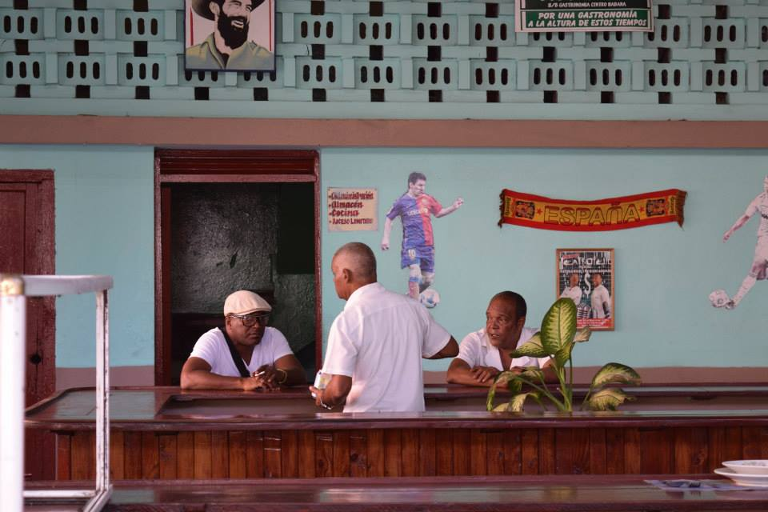
Mystery #2: The Mystery of the Cuban Tour Guide With a Law Degree

Slide 46
Mystery #2: During a recent stay in Cuba, an American visitor learned that many of the tour guides, bartenders, wait staff, and taxi drivers he met along the way had law or engineering degrees from top Cuban universities. Upon further investigation, the American visitor learned that these service industry workers were not just working these service jobs after their day jobs as lawyers and engineers. They had, in fact, given up successful careers as lawyers and engineers to become full-time tour guides, bartenders, wait staff, and taxi drivers.

Slide 47
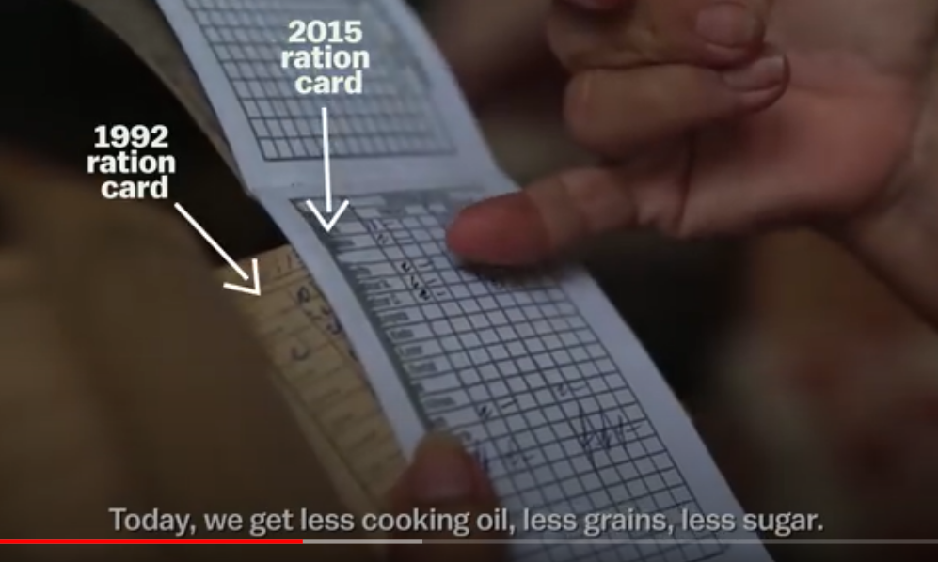
Video: Why Cuban taxi drivers earn more than Doctors

Slide 48
Mystery #2:Why do so many service workers in Cuba have advanced college degrees?
The Clues…Place a check next to the clues that you think explain the mystery.
___ 1. The average wage in Cuba for a professional employee is between $20.00 and $40.00 per month.
___ 2. Education is free in Cuba.
___ 3. Roughly 3,000,000 tourists visited Cuba in 2016.
___ 4. Service industry workers can accept tips and gratuities from their customers.
___ 5. The Cuban government has recently eased travel restrictions for Cuban citizens.
___ 6. Many Cuban families receive remittances (money) from family members living abroad.

Slide 49
Key:
Clues 1, 3 and 4 explain the mystery.
A Cuban bartender or taxi driver can often times earn more in one day than he or she could earn working as a lawyer or engineer in an entire month. During a recent visit to Cuba, a group of Americans tipped their tour guide $800.00 for eight days of work. This tour guide, who was formerly a lawyer, would have had to work for 20 months to earn the same amount of money in his previous profession.
The tourism industry in Cuba is growing. As more tourists arrive, there will be more opportunities for Cubans to work in the lucrative service sector.
Mystery:Why do so many service workers in Cuba have advanced college degrees?
The Clues…Place a check next to the clues that you think explain the mystery.
___ 1. The average wage in Cuba for a professional employee is between $20.00 and $40.00 per month.
___ 2. Education is free in Cuba.
___ 3. Roughly 3,000,000 tourists visited Cuba in 2016.
___ 4. Service industry workers can accept tips and gratuities from their customers.
___ 5. The Cuban government has recently eased travel restrictions for Cuban citizens.
___ 6. Many Cuban families receive remittances (money) from family members living abroad.

Slide 50
Yasmani Bérbes, 27, quit his job as a physical education teacher to run a restaurant in his family’s house in Contramaestre, a town near Santiago de Cuba. As a teacher, he made 500 pesos a month, or about $21.
“Here, there are days now when I can make 500 pesos,” he said.
-NYTimes. January, 2015

Slide 51
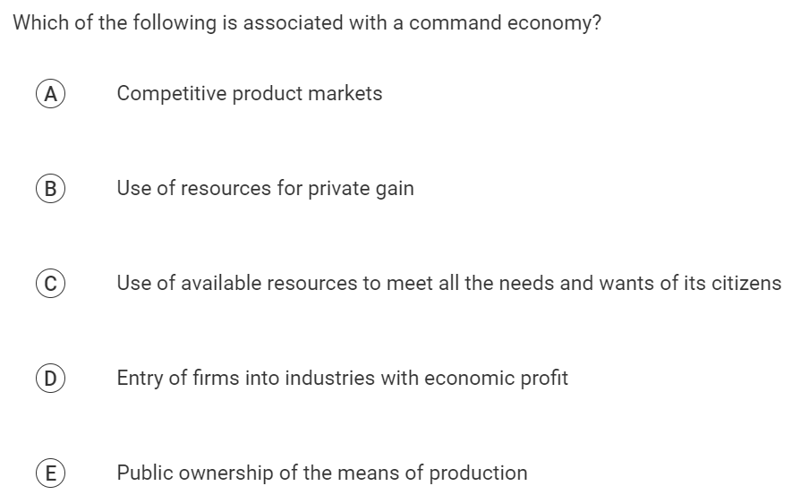

Slide 52
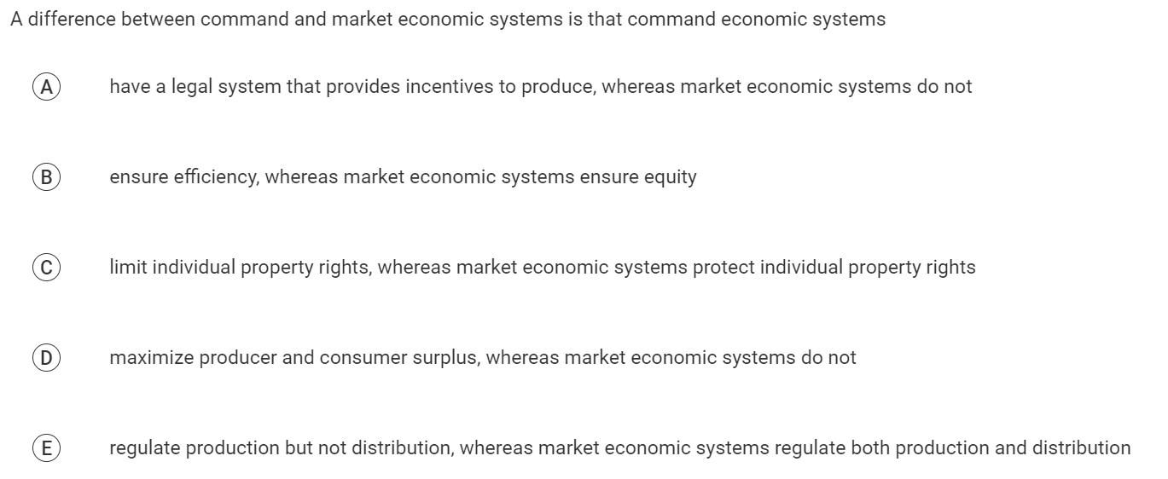

Slide 53
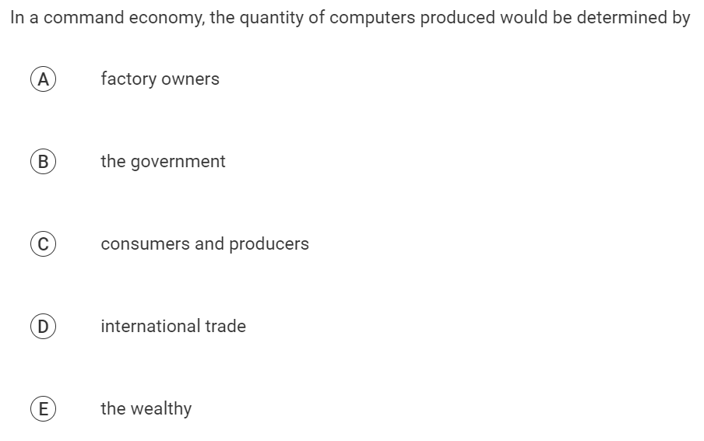

Slide 54
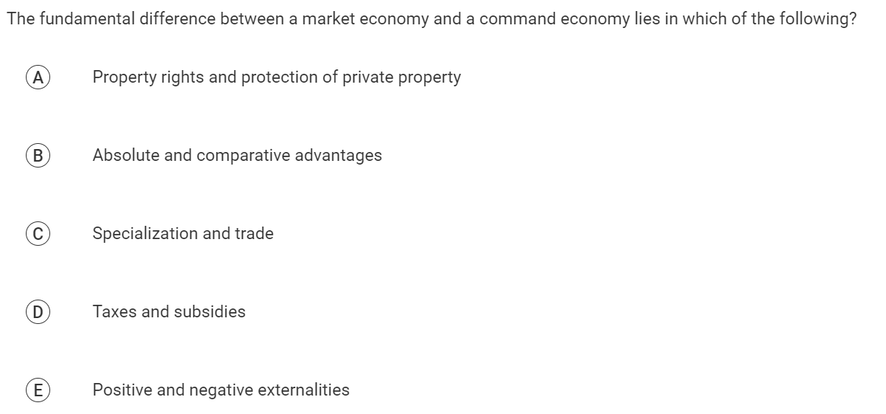

Slide 55
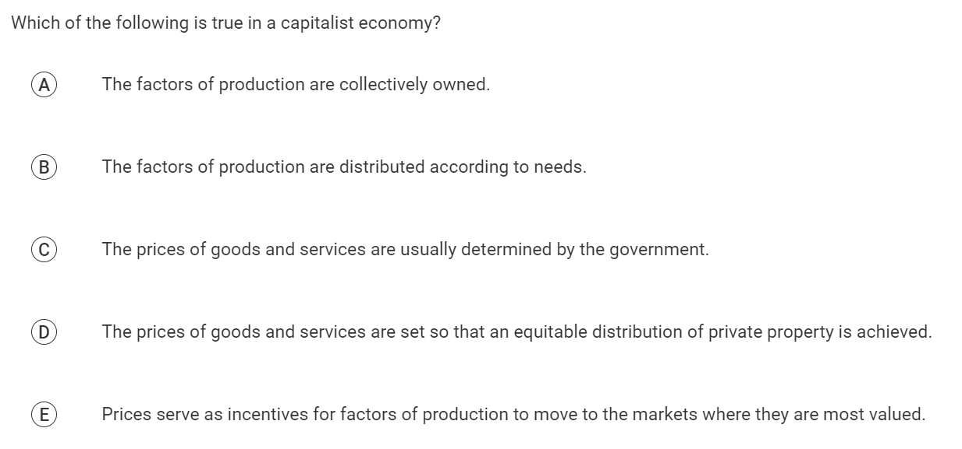

Slide 57
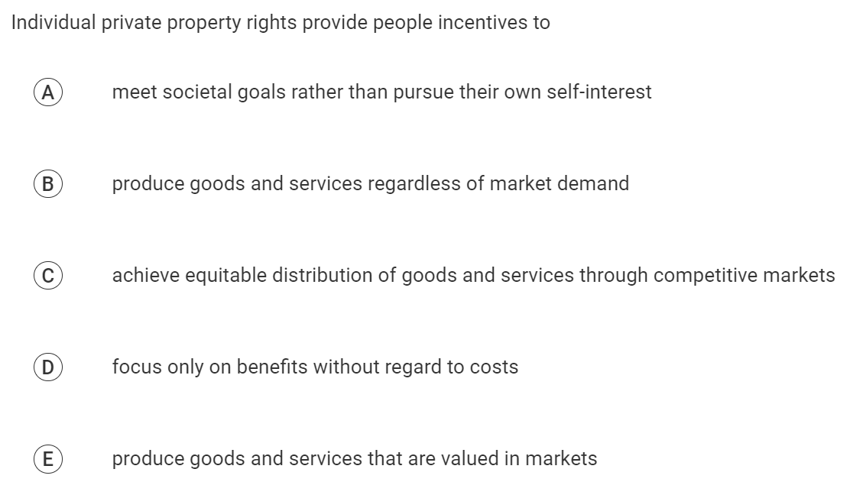

Slide 58
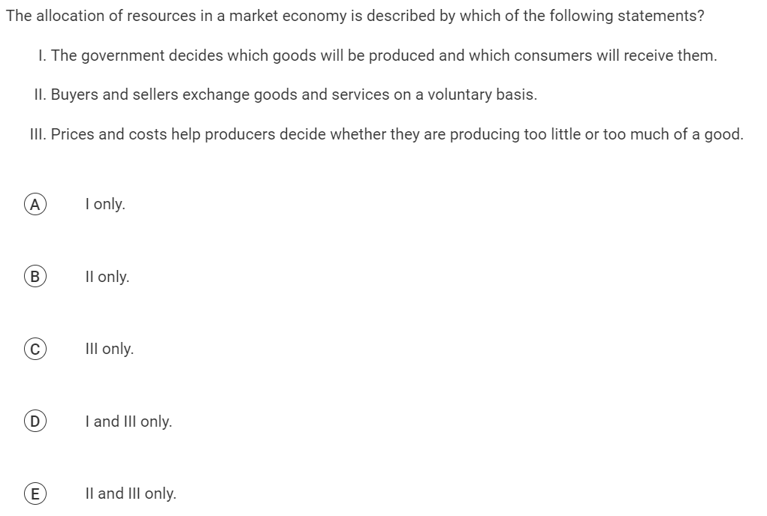

Slide 59
Video: The Invisible Hand

Slide 60
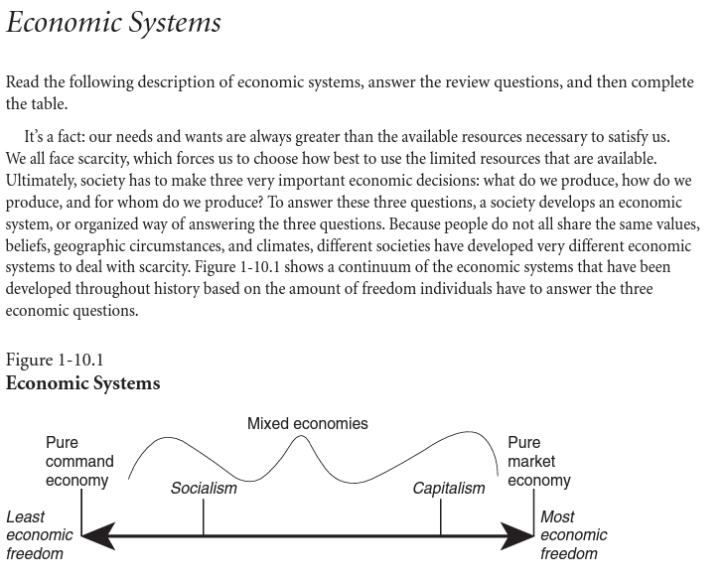
CEE AP Micro Activity 1-10

Slide 61
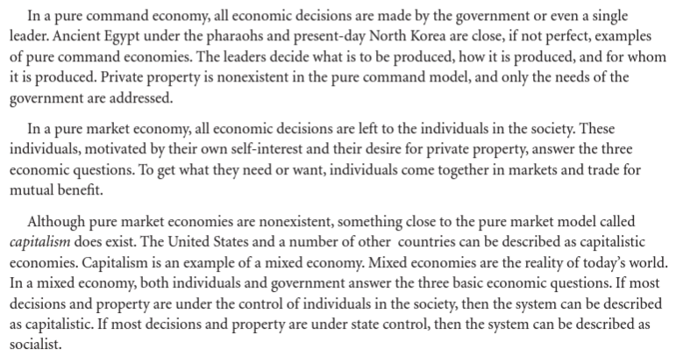
CEE AP Micro Activity 1-10

Slide 62
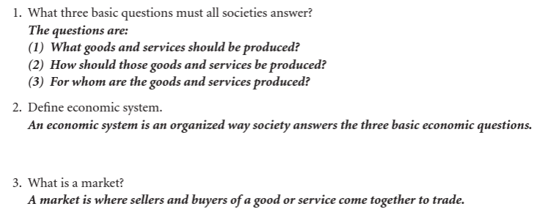
CEE AP Micro Activity 1-10

Slide 63
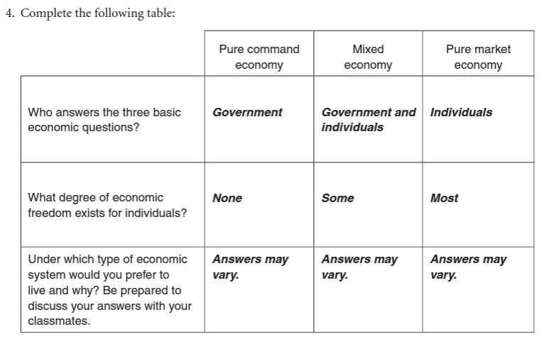
CEE AP Micro Activity 1-10

Slide 64
EconEdLink Membership
You can now access CEE’s professional development webinars directly on EconEdLink.org! To receive these new professional development benefits, become an EconEdLink member. As a member, you will now be able to:
Automatically receive a professional development certificate via e-mail within 24 hours after viewing any webinar for a minimum of 45 minutes
Register for upcoming webinars with a simple one-click process
Easily download presentations, lesson plan materials and activities for each webinar
Search and view all webinars at your convenience
Save webinars to your EconEdLink dashboard for easy access to the event
Access our new Professional Development page here

Slide 65
Invest In Girls

Slide 66
NEC

Slide 67
NPFC

Slide 68
Advocacy

Slide 69
CEE Affiliates
https://www.councilforeconed.org/resources/local-affiliates/
Minnesota Council on Economics Education: www.mcee.umn.edu

Slide 70
Thank You to Our Sponsors!

Slide 71
James Redelsheimer jred40@gmail.com
Thank You

