Slide 1
Voters and Elections

Slide 2
The Costs of Voting
Dollar Costs. No dollar costs may be imposed by fees or taxation. Amendment 24 to the U.S. Constitution rules out dollar costs:
Section 1. The right of citizens of the United States to vote in any primary or other election for President or Vice President, for electors for President or Vice President, or for Senator or Representative in Congress, shall not be denied or abridged by the United States or any State by reason of failure to pay any poll tax or other tax.
Other costs. While the Constitution prohibits monetary charges, this does not mean that voting is entirely without costs. Voters will incur opportunity costs. The opportunity costs of voting is what a voter gives up in choosing to vote. Here are some possible opportunity costs:
Time taken to register.
Time to find a voting location, or to vote via absentee ballot.
Time taken to vote, which may also mean lost wages for voters who miss work; or babysitting or transportation costs.
Time needed to investigate candidates and issues.
Fear of Covid (2020 election)

Slide 3
Top ten reasons registered voters gave for not voting in 2016
Reason All Voters 18-24 Year Old
10. Inconvenient polling place 2.1 2.3
9. Transportation problems 2.6 1.5
8. Don't know or refused 2.7 3.1
7. Forgot to vote 3.0 4.7
6. Registration problems 4.4 5.5
5. Out of town 7.9 13.2
4. Illness or disability 11.7 2.7
3. Too busy, conflicting schedule 14.3 18.3
2. Not interested 15.4 17.3
1. Did not like candidates or campaign issues 24.8 20.6
In 2016, citizens aged 18-24 made up 12.0% of the population, but only 8.4% of the voters.

Slide 4
Top ten reasons registered voters gave for not voting in 2020
Reason All Voters 18-24 Year Old
10. Transportation problems 2.4 3.0
9. Inconvenient polling place 2.6 2.5
8. Forgot to vote 3.7 5.7
7. Covid concerns 4.3 2.3
6. Registration problems 4.9 4.9
5. Out of town 6.1 8.8
4. Illness or disability 13.0 4.5
3. Too busy, conflicting schedule 13.1 18.4
2. Did not like candidate/campaign issues 14.5 11.0
1. Not interested 17.6 19.2
In 2020, citizens aged 18-24 made up 11% of the population, but only 8% of the voters.
Notes:
Bad weather was 11th place .01 for all voters and 0% for 18-24 year olds
Other 14.5 for all voters and 15.7 for 18-24 year olds
Don’t know/refused 3.2 and 4.0

Slide 5
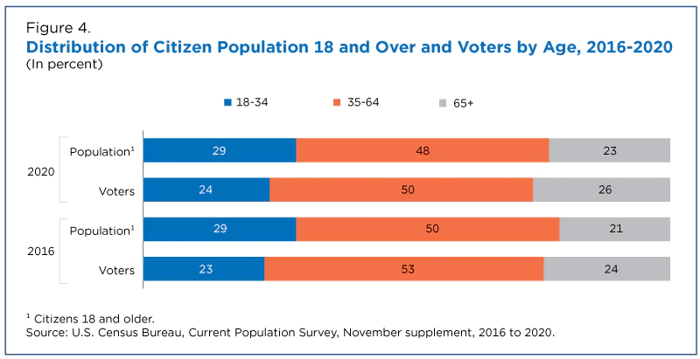
Notes:
https://www.census.gov/library/stories/2021/04/record-high-turnout-in-2020-general-election.html

Slide 6
Why Do People Vote
When the election is likely to be close and the person’s vote may change the election result:
People may vote to support a particular politician.
People may vote to remove incumbents (“Throw the rascals out.”)
When the election is not likely to be close and a person’s vote is not likely to change the election result:
People may believe it is their civic duty to vote.
People may vote to voice their opinions regardless of the likely outcome.
People may vote in order to feel they are part of the winning team.

Slide 7
Who Voted More in 2016? Of all voters, who voted most, percentage-wise, in the 2016 election?
Men or Women …………………………………………………………
White or Black or Asian ……………………………………………..
Naturalized Citizen or Native Born …………………………….
Married or Never Married …………………………………………
Separated or Divorced ………………………………………………
HH Income Under $30k or Over $100k ……………………..
Employed or Unemployed …………………………………………
H.S. Degree or Bachelor’s Degree ……………………………..
Mainer or Floridian or Hawaiian ……………………………….
Veteran or Non-Veteran ……………………………………………
Renter or Homeowner ………………………………………………
Young (18-24) or Old (55-64) …………………………………….
Women 63.3 to 59.3
White 62.9 | Black 59.4 | Asian 49.0
Native 62.1 to 54.3
Married 69.4 to 47.4
Divorced 59.2 to 49.3
High Income 78.3 to 48.5
Employed 63.7 to 49.8
Bachelor’s Degree 74.2 to 51.5
ME 72.7-FL 59.5-HI 47.3
Veteran 69.6 to 60.6
Homeowner 66.9 to 48.9
Old 67.9 to 43.0

Slide 8
Who Voted More in 2020? Of all voters, who voted most, percentage-wise, in the 2020 election?
Men or Women ……………………………………………………
White or Black or Asian ………………..……………………..
Naturalized Citizen or Native Born ……………………….
Married or Never Married or Divorced ..………………
Income Under $10k or Over $150k ………….……..
Employed or Unemployed ……………………………………
H.S. Degree or Bachelor’s Degree ………………………..
Highest and lowest state…………..………………………….
Veteran or Non-Veteran ………………………………………
Renter or Homeowner …………………………………………
Young (18-24) or Old (65-74) ……………………………….
Women 68.4 to 65.0
White 68.3 Black 62.4 Asian 60.1
Native 67.4 to 60.8
Married 69.4 Divorced 65.6 Never Married 56.6
High Income 84.8 to 47.1
Employed 68.5 to 57.8
Bachelor’s Degree 77.9 to 55.5
New Jersey – 78.3 Arkansas – 54.0
Veteran 74.1 to 66.1
Homeowner 71.4 to 55.0
Old 76.0 to 51.4
Notes:
https://www.census.gov/data/tables/time-series/demo/voting-and-registration/p20-585.html
Note: Federal surveys now give respondents the option of reporting more than one race. Therefore, two basic ways of defining a race group are possible. A group such as Asian may be defined as those who reported Asian and no other race (the race-alone or single-race concept) or as those who reported Asian regardless of whether they also reported another race (the race-alone-or-in-combination concept). These statistics are for race-alone-or-in-combination reporting.

Slide 9
Reported Voting
YEAR | VOTERS AS A PERCENTAGE OF THE U.S. CITIZEN VOTING-AGE POPULATION
1980 | 64.0
1984 | 64.9
1988 | 62.2
1992 | 67.7
1996 | 58.4
2000 | 59.5
2004 | 63.8
2008 | 63.6
2012 | 61.8
2016 | 61.4
2020 | 66.8

