Slide 1
The Advice I Would Give Myself
During My First Year of Teaching Presented by Andrew Menfi September 21th, 2022 amenfi3@gmail.com

Slide 2
Purpose
30%-50% of teachers leave the profession within the first five years.
New teachers are 2-3 times more likely to leave the profession than veteran teachers.
Notes:
-Tell personal story, shower, work till late, goes poorly, repeat

Slide 3
Objective
Give a few words of wisdom, strategies, and tools to first year teachers [or those supporting first year teachers] that I wish I knew at the beginning of my first year.

Slide 4
Agenda
Advice built from quotes that have stuck with me

Slide 5
“There is no ONE correct way of doing something”
What works for me might not work for you
Listen to every idea and try everything

Slide 6
“The best teachers steal”
Observe colleagues
Ask colleagues for materials/feedback
The internet is your friend
Steal & then make it your own

Slide 7
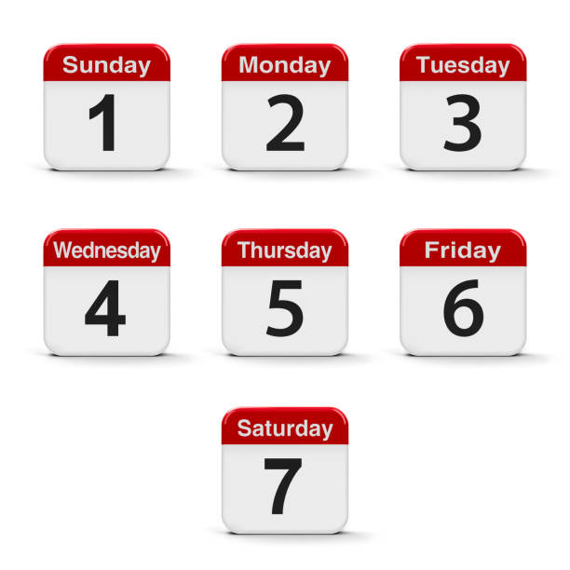
“If one lesson a week goes well in your first year, you’re winning”
It’s okay to mess up
You will mess up often

Slide 8
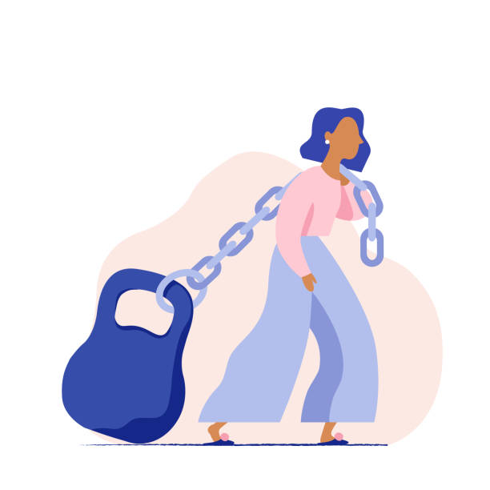
“It’s not just you, EVERYONE is struggling”
New teacher group
The internet is your friend

Slide 9
“Choose the 1 or 2 things you will NOT let go.”
Classroom management
Less rules enforced consistently is better than more rules enforced inconsistently

Slide 10
“Don’t be afraid to change horses midstream.”
Unpredictable what routines will NOT work
After a break / End of semester
Notes:
Desks In Groups Story
Grade every week story

Slide 11
“If you don’t care…the students won’t care either.”
Teach the content & lessons you want to teach, not what you think you are supposed to teach.
Passion/ lack of passion from an educator is infectious
Notes:
I focus more on the American Civil War because I’m knowledgeable/ interested in it, and the kids

Slide 12
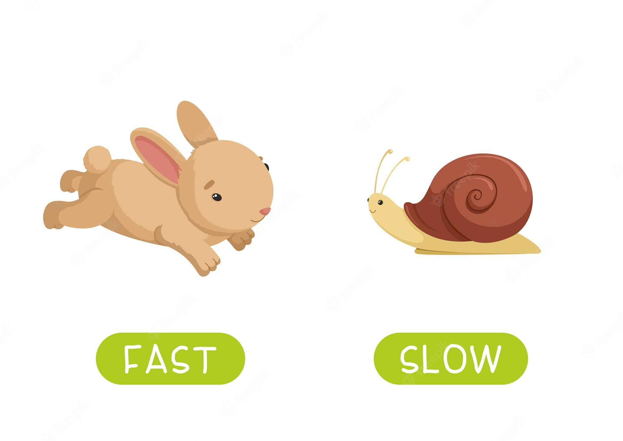
“If you are lucky then you will be going at the correct speed for 1 student. For everyone else you will be too fast or too slow”
Differentiation: One of the biggest challenges even veteran teachers face
Make lessons malleable
Notes:
Document trick, most important in the beginning, 7 is the average, 10 is for faster kids, 5 is for slower kids.

Slide 13
“The opinions that matter most are right in front of you all day.”
Ask students what they think as much as possible

Slide 14
“Our work is NEVER finished”
Everyone: A lesson, assignment, routine, relationship with student can ALWAYS be improved
Perfectionists: Choose a time to stop and be okay with it
X
Notes:
Pet Peeve of mine is when a teacher syas a lesson was great and there was nothing they would change

Slide 15
“The best day of your career is your first day…of your 2nd year of teaching.”
Last Day: Sit down & reflect
Light at the end of the tunnel

Slide 16
Contact & Questions?
Andrew Menfi
Social Studies Teacher
New Visions Charter High School
for Advanced Math & Science
amenfi3@gmail.com
Thanks For Your Time!
Notes:
What can I add? Sharecropping Farming
Which do we do? Price, Barter System, Business Reg

