Slide 1
WELCOME!
Housekeeping Items:
Please use the chat and/or Q & A function to ask questions or to notify moderator of issues
The session will be recorded and emailed to participants in the next few days
Thank you for joining us.
The webinar will begin shortly.

Slide 2
AP Macro Unit 4:
Banking and the Expansion of the Money Supply
Live Webinar: October 17th, 2022

Slide 3

Instructor Bio
James Redelsheimer has been an AP and Regular Economics teacher at Robbinsdale Armstrong High School in Plymouth, Minnesota since 2003. James received his Bachelor’s degree from St. Olaf College and his Master's degree at the University of St. Thomas. He received the 3M Economics Educator Excellence Award from the Minnesota Council on Economic Education and was named Visa's Practical Money Skills Innovative Educator of the Month.
James enjoys traveling and has been a guest lecturer in the economics department at the Batumi State University in The Republic of Georgia and has received travel grants and fellowships for study travel to learn about the economies of Japan, China, Turkey, Germany, Korea, among others, and studied economics of the environment in Costa Rica. He currently serves as an AP Economics reader, grading AP Economics exams. He enjoys teaching Economics because it relates to students' everyday lives.

Slide 4
Webinar Objectives
In this webinar teachers will be able to:
  Describe the key characteristics and significance of the Phillips Curve model.
  Effectively implement multiple lessons to help students master the Phillips Curve.
  Prepare their students for AP Exam questions on the Phillips Curve.

Slide 5

THE PHILLIPS CURVE CONCEPT
7
6
5
4
3
2
1
0
As inflation declines...
Unemployment
increases
Annual rate of inflation
SRPC
1 2 3 4 5 6 7
Unemployment rate (percent)

Slide 6
7
6
5
4
3
2
1
0
As inflation increases...
Unemployment
decreases
Annual rate of inflation
SRPC
1 2 3 4 5 6 7
Unemployment rate (percent)

Slide 7
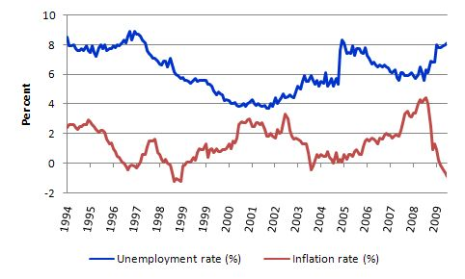

At times in history there has been an inverse relationship between unemployment and inflation
7

Slide 8
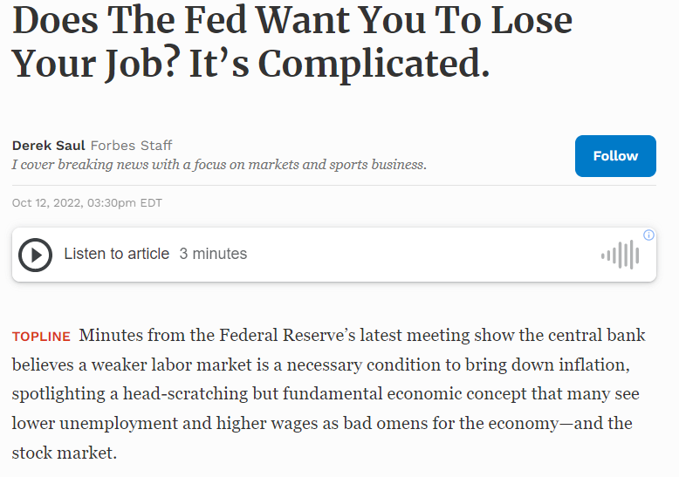
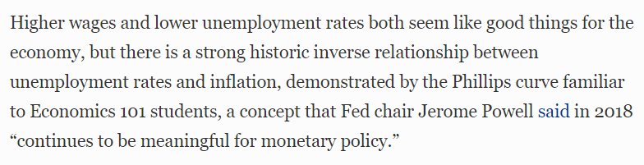

Slide 9


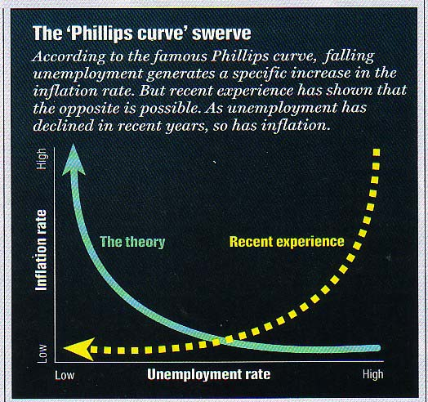
Inverted Phillips Curve [“Swerve] ”[late 90s]
98
97
Alban William Housego Phillips was a violinist, crocodile hunter,
and electrician who became a W.W.II hero.
Many say the link between unemployment and inflation has
been weakened by technology-driven productivity advances
and global competition.

Slide 10
THE INFLATION-UNEMPLOYMENT
RELATIONSHIP
Normally, there is a short-run trade-off between the rate of inflation and the rate of unemployment.

Slide 11
Short Run Phillips Curve
When the economy is overheating, there is low unemployment but high inflation
Inflation
5%
When there is a recession, unemployment is high but inflation is low
1%
SRPC
2%
9%
Unemployment
11
Notes:
Short Run -AD Falls, PL and Q fall
Long Run- AS Increases as workers accept lower wages and production costs fall. PL goes down, Q goes back to Full Employment

Slide 12





Change in AD = Move Along SRPC
AD UP = Up SRPC
AD Down = Down SRPC
Increases in AD causes . . .
AS
PC
Phillips curve
AD₃
AD₂
AD₁
C
PRICE LEVEL
C
INFLATION RATE
B
B
A
A
REAL OUTPUT
UNEMPLOYMENT RATE

Slide 13
AD/AS and the Phillips Curve
AD UP = UP the SRPC
Price Level
LRAS
LRPC
Inflation
AS
PL_{e}
AD₁
AD
SRPC
Q_{Y}
GDP_{R}
U_{Y}
Unemployment
13

Slide 14
AD/AS and the Phillips Curve
AD Down = Down the SRPC
Price Level
LRAS
LRPC
Inflation
AS
PL_{e}
AD
SRPC
AD₁
Q_{Y}
GDP_{R}
U_{Y}
Unemployment
14

Slide 15
Change in As = Shift in SRPC
Stagflation
Shifts in AS
Cause shifts in the PC
PC5
PL
AD
PC4
AS5
PC3
AS4
PC2
AS3
PC1
AS2
AS1
Inflation
Output & Employment
Unemployment
The unemployment-inflation experience of the 1970s & 1980s
demolished the idea of an always-stable Phillips Curve.

Slide 16


Slide 17
AD/AS and the Phillips Curve
Correctly draw the LRPC and SRPC at full employment. What happens when AS falls?
Price Level
LRAS
LRPC
Inflation
AS₁
AS
PL_{e}
SRPC₁
AD
SRPC
Q_{Y}
GDP_{R}
U_{Y}
Unemployment
17

Slide 18
AD/AS and the Phillips Curve
Correctly draw the LRPC and SRPC with an recessionary gap. What happens when AS goes up?
Price Level
LRAS
LRPC
Inflation
AS
AS₁
PL_{e}
SRPC
AD
SRPC₁
Q_{Y}
GDP_{R}
U_{Y}
Unemployment
18

Slide 19
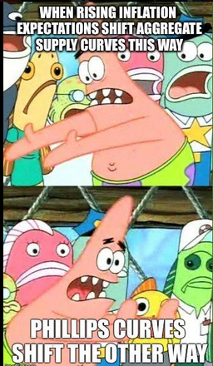

Slide 20
Short Run Phillips Curve
What happens when AS falls causing stagflation?
Increase in unemployment and inflation
Inflation
5%
SRPC₁
1%
SRPC
2%
9%
Unemployment
20
Notes:
Short Run -AD Falls, PL and Q fall
Long Run- AS Increases as workers accept lower wages and production costs fall. PL goes down, Q goes back to Full Employment

Slide 21
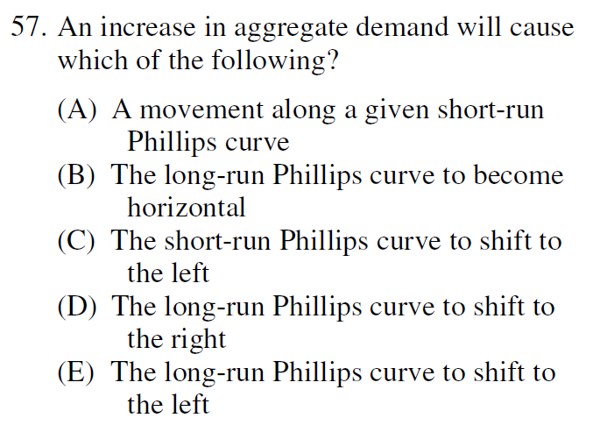
2008 Audit Exam
Notes:
A

Slide 22
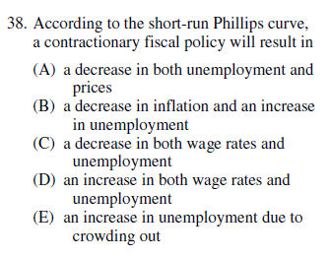
2015 Exam

Slide 23


Slide 24
Short Run vs. Long Run
In the long run there is no tradeoff between inflation and unemployment
Inflation
Long Run Phillips Curve
5%
The LRPC is vertical at the Natural Rate of Unemployment
3%
1%
2%
5%
9%
Unemployment
24
Notes:
Short Run -AD Falls, PL and Q fall
Long Run- AS Increases as workers accept lower wages and production costs fall. PL goes down, Q goes back to Full Employment

Slide 25
Short Run vs. Long Run
What happens when AD increases?
What happens in the long run?
Inflation
Long Run Phillips Curve
In the long run, wages and resource prices increase. AS falls. SRPC shifts right.
5%
3%
SRPC₁
1%
SRPC
2%
5%
9%
Unemployment
25
Notes:
Short Run -AD Falls, PL and Q fall
Long Run- AS Increases as workers accept lower wages and production costs fall. PL goes down, Q goes back to Full Employment

Slide 26
Short Run vs. Long Run
What happens when AD falls?
What happens in the long run?
Long Run
Phillips Curve
Inflation
5%
In the long run wages fall and there is no tradeoff between inflation and unemployment
3%
1%
SRPC
SRPC₁
2%
5%
9%
Unemployment
26
Notes:
Short Run -AD Falls, PL and Q fall
Long Run- AS Increases as workers accept lower wages and production costs fall. PL goes down, Q goes back to Full Employment

Slide 27
The Phillips Curve Trade-Off
C to B would be like AD1 to AD2
C to A like AD1 to AD3
C to D like AD3 to AD2
C to E like AD3 to AD1
PL
Y/Empl.
Increases in AD causes . . .
A Phillips Curve trade-off between unemployment and inflation.
AS
PC
Phillips curve
PL3
PL2
PL1
AD₃
AD₂
A
AD₁
PRICE LEVEL
INFLATION RATE
B
C
D
E
REAL GDP
UNEMPLOY. RATE

Slide 28
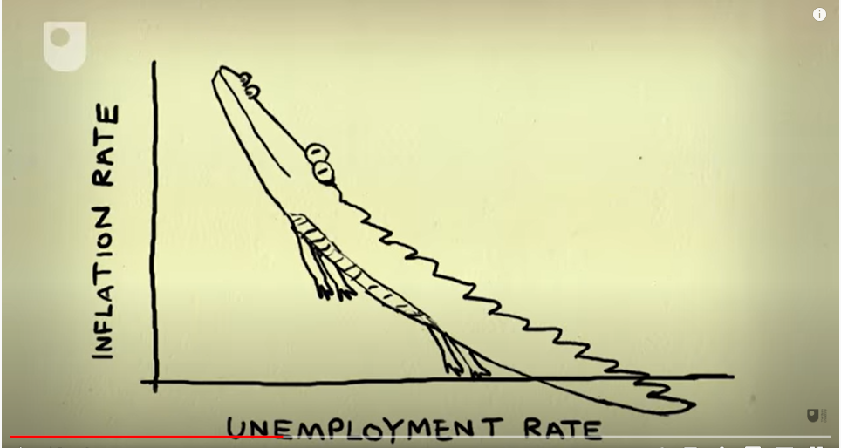

Slide 29
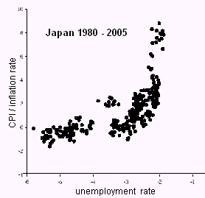
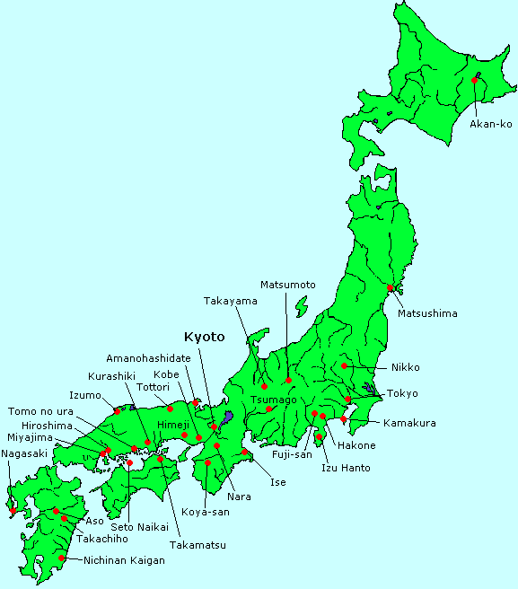

Slide 30
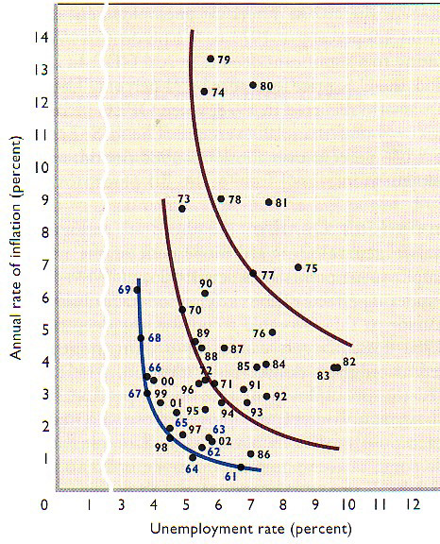
Phillips Curve Shifting in the 70s and 80s

Slide 31
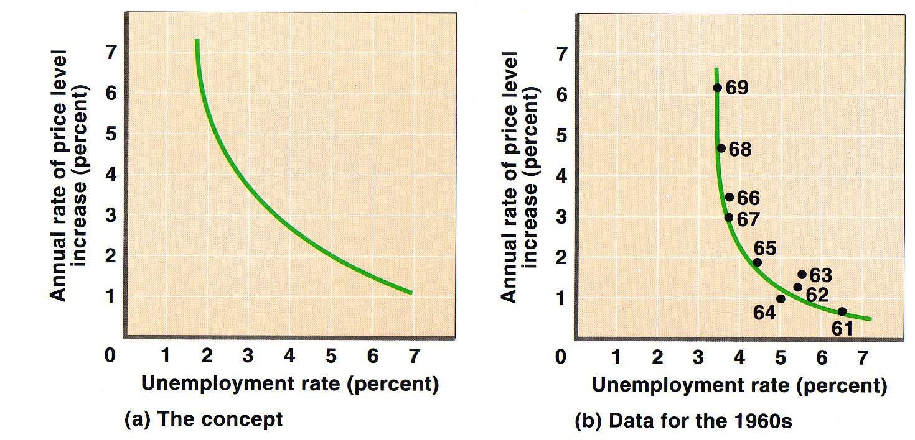
Phillips Curve in the 1960s

Slide 32
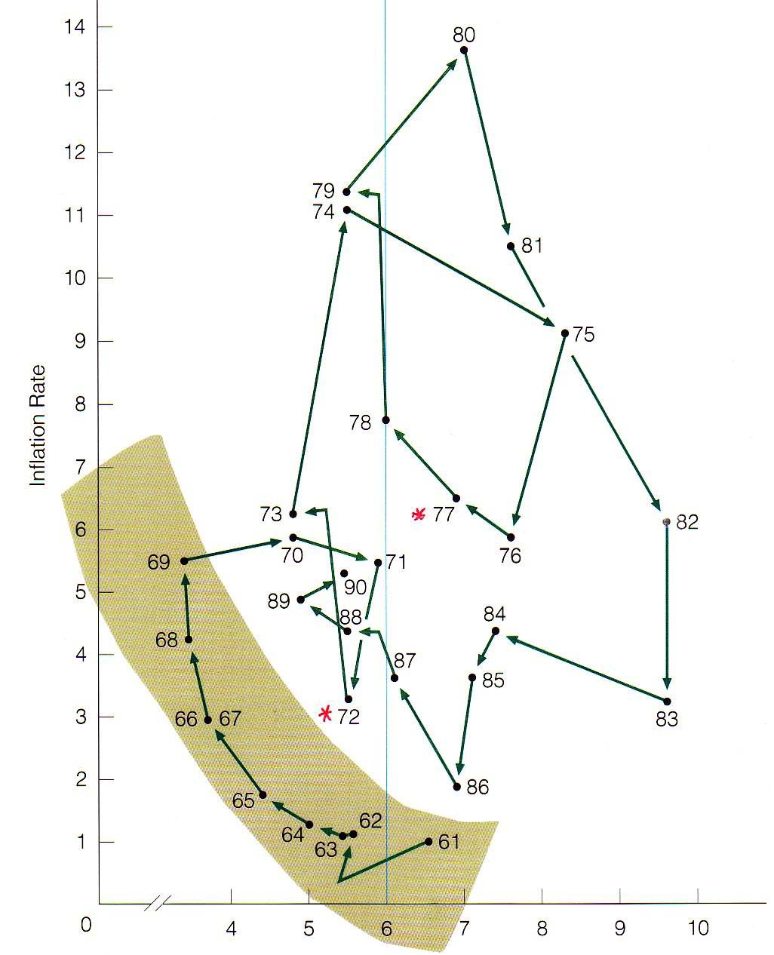
Phillips “Curl”
Unemployment got
worse but so did inflation.

Slide 33
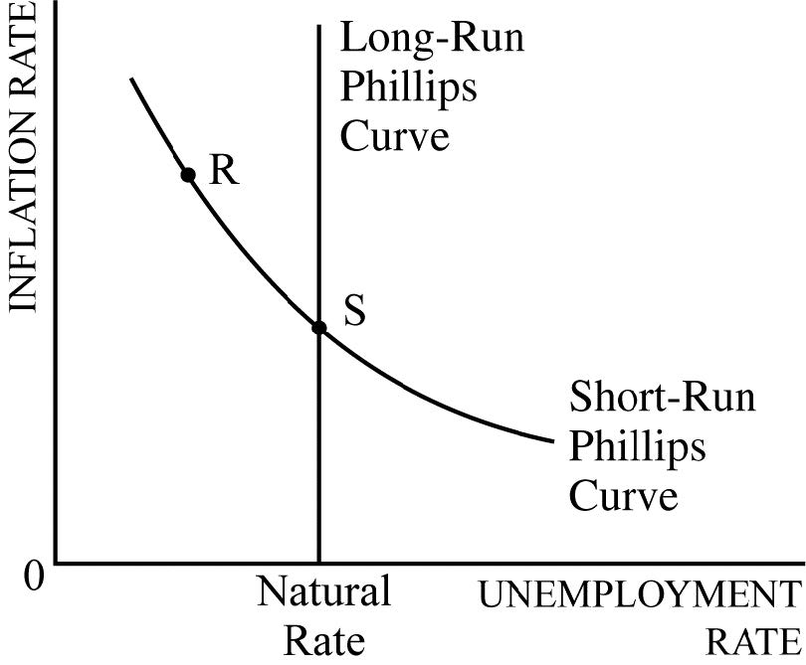
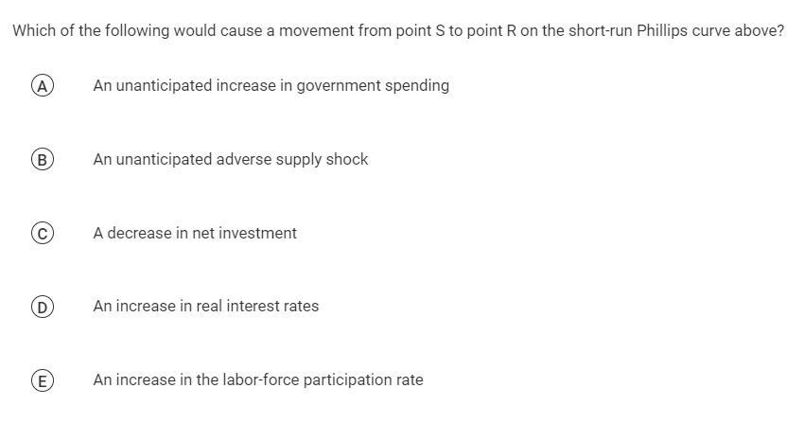

Slide 34
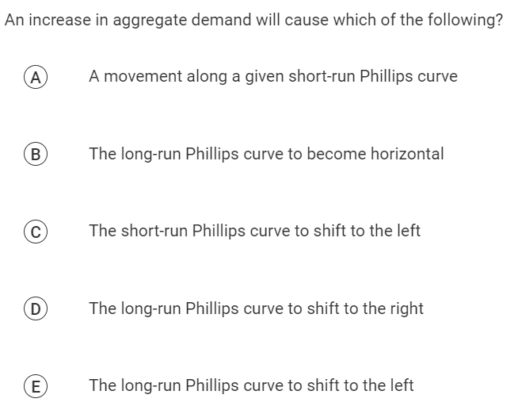

Slide 35
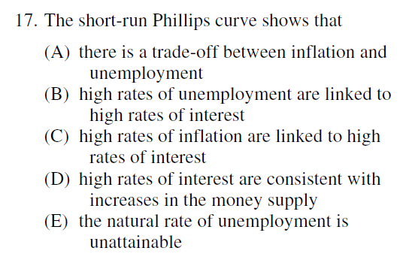
2015 Exam

Slide 36
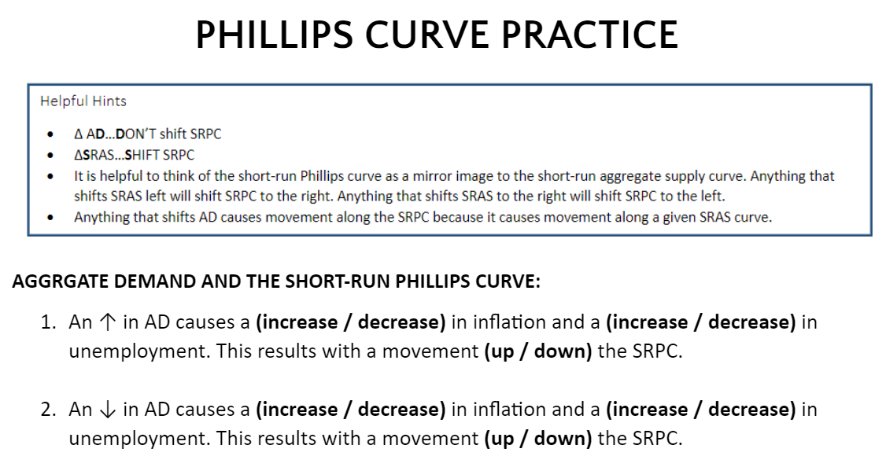


Slide 37
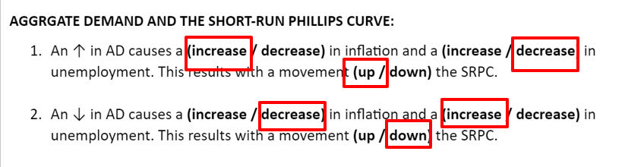
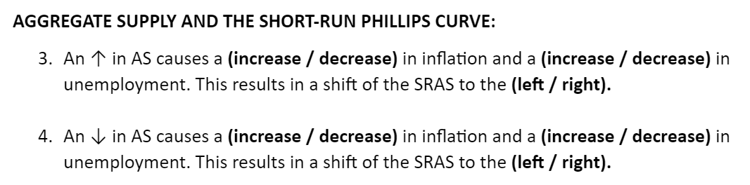

Slide 38
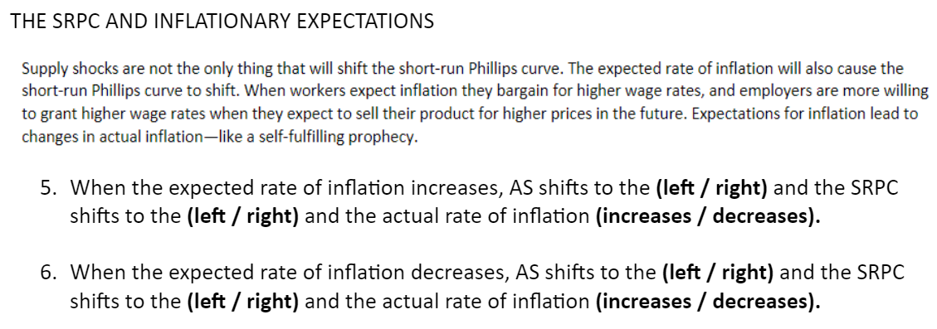

Slide 39
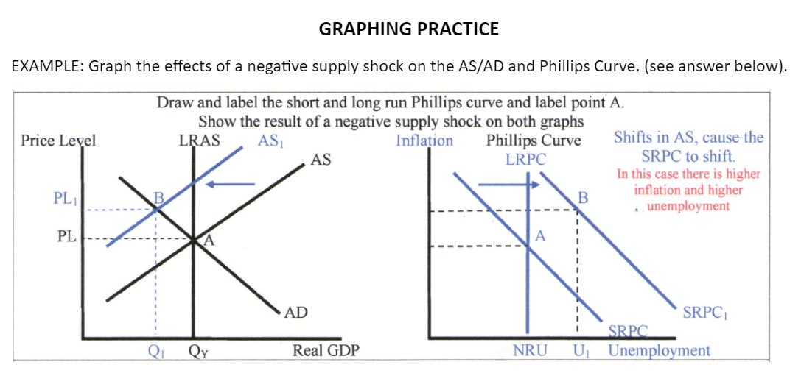

Slide 40
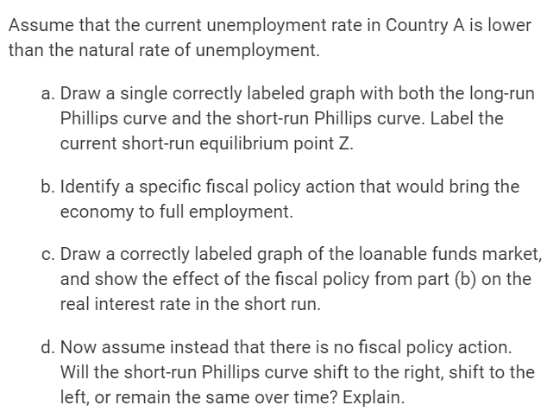
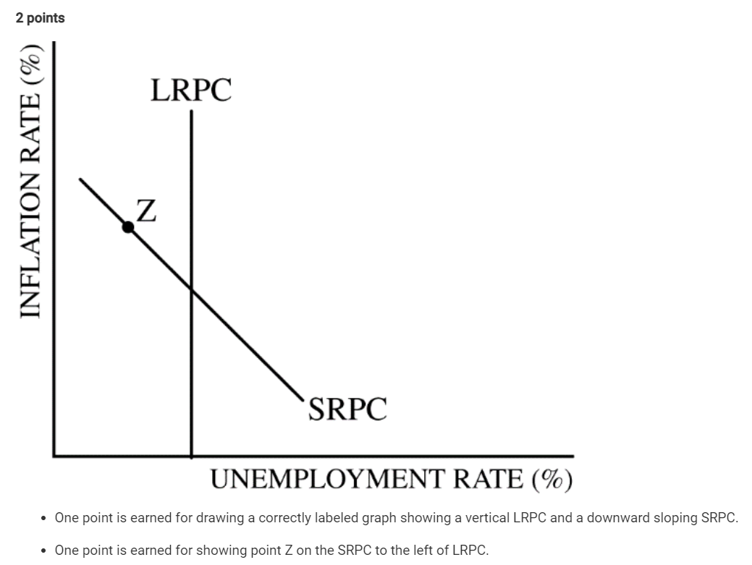

Slide 41
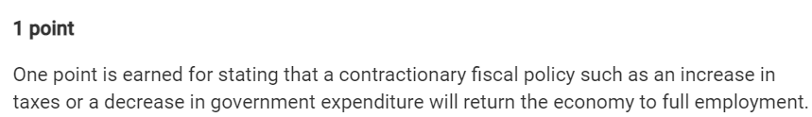

Slide 42
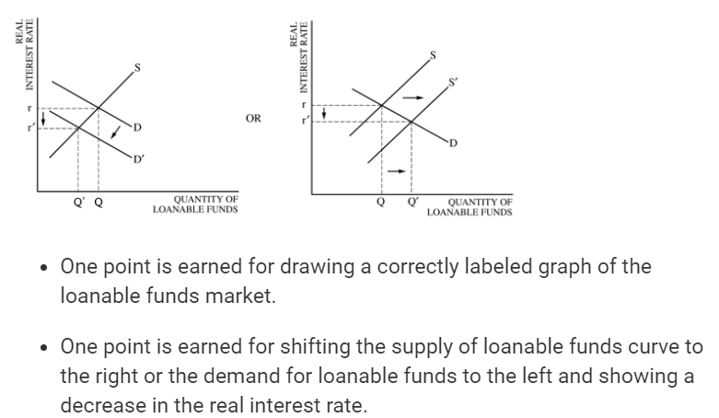

Slide 43
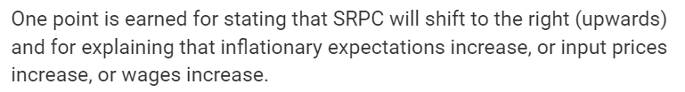

Slide 44
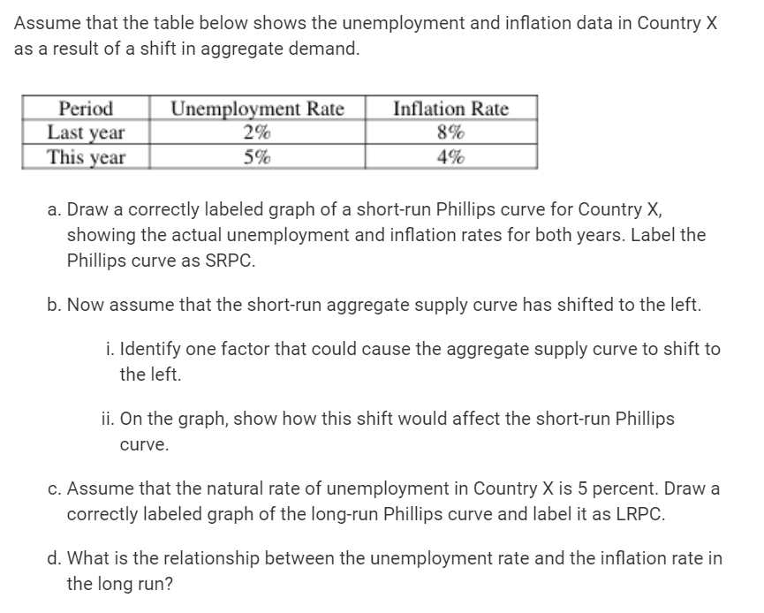
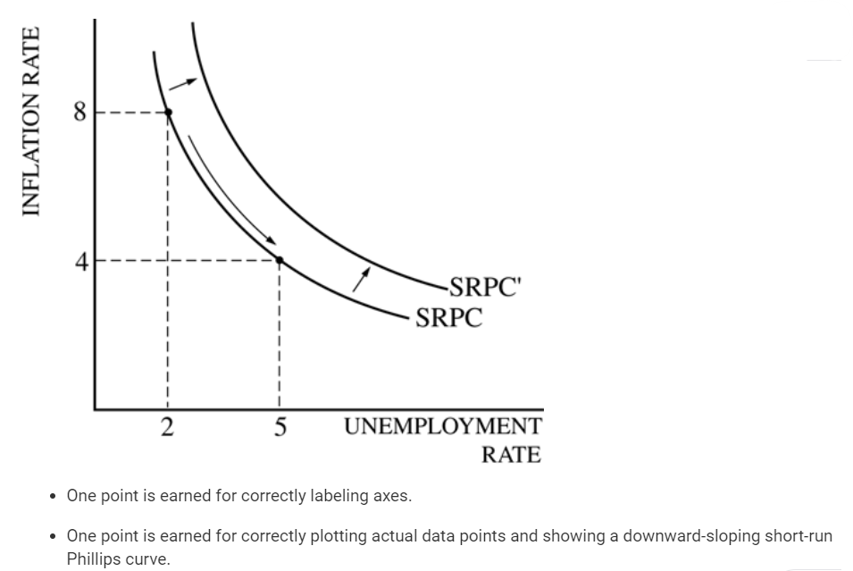

Slide 45
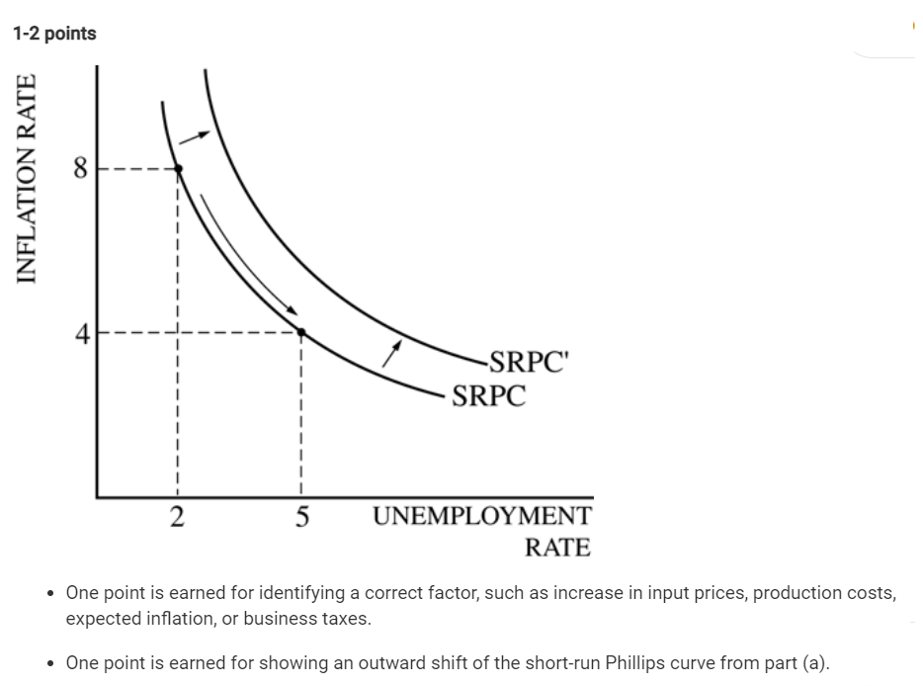

Slide 46
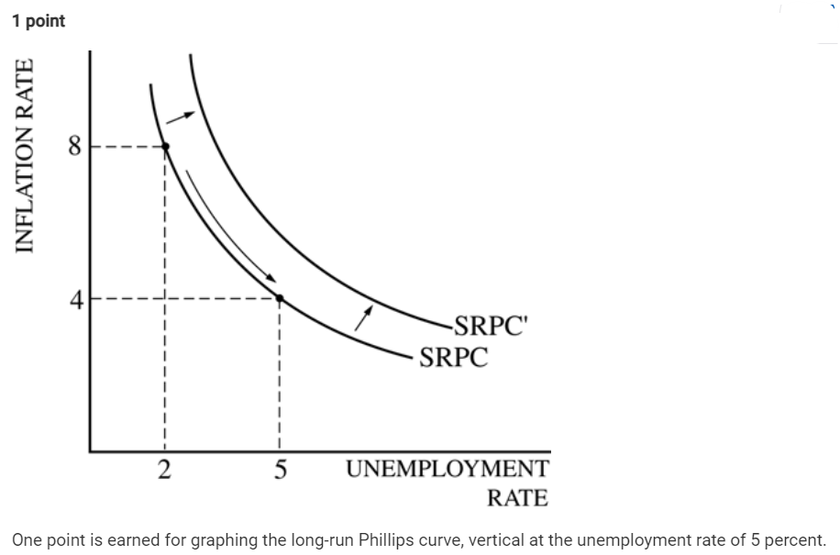
LRPC

Slide 48
Any Questions?
James Redelsheimer | jred40@gmail.com
mcee.umn.edu | mcee@umn.edu | 612.625.3727

Slide 49
Thank You!
James Redelsheimer | jred40@gmail.com
mcee.umn.edu | mcee@umn.edu | 612.625.3727

