Slide 1
WELCOME!
Housekeeping Items:
Please use the chat and/or Q & A function to ask questions or to notify moderator of issues
The session will be recorded and emailed to participants in the next few days
Thank you for joining us.
The webinar will begin shortly.

Slide 2
AP Macro Unit 5:
Government Deficits and the National Debt
Live Webinar: October 31st, 2022

Slide 3

Instructor Bio
James Redelsheimer has been an AP and Regular Economics teacher at Robbinsdale Armstrong High School in Plymouth, Minnesota since 2003. James received his Bachelor’s degree from St. Olaf College and his Master's degree at the University of St. Thomas. He received the 3M Economics Educator Excellence Award from the Minnesota Council on Economic Education and was named Visa's Practical Money Skills Innovative Educator of the Month.
James enjoys traveling and has been a guest lecturer in the economics department at the Batumi State University in The Republic of Georgia and has received travel grants and fellowships for study travel to learn about the economies of Japan, China, Turkey, Germany, Korea, among others, and studied economics of the environment in Costa Rica. He currently serves as an AP Economics reader, grading AP Economics exams. He enjoys teaching Economics because it relates to students' everyday lives.

Slide 4
Webinar Objectives
In this webinar teachers will be able to:
  Define and understand the significance of government deficits and the national debt.
  Implement effective lessons to prepare students for AP exam questions on deficits and the national debt.

Slide 5

What is the difference
between debt and deficit?

Slide 6

When the government spends more than it takes in taxes, in a given year.
A deficit is
GS > T
Gov’t spending greater than taxes
In a Year
The National Debt is
the accumulation of yearly
deficits over time.

Slide 7
All Policies Have Trade-offs
What’s the trade-off of increasing government spending without raising taxes to close a recessionary gap?
Deficit Spending
Budget Surplus- when annual government spending and transfer payments are less than tax revenue.
If the Government increases spending without increasing taxes they will increase the annual deficit and the national debt.
7

Slide 8
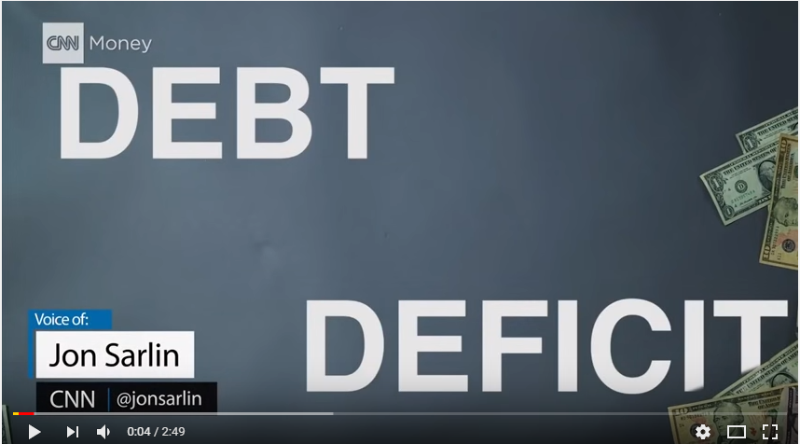

Slide 9
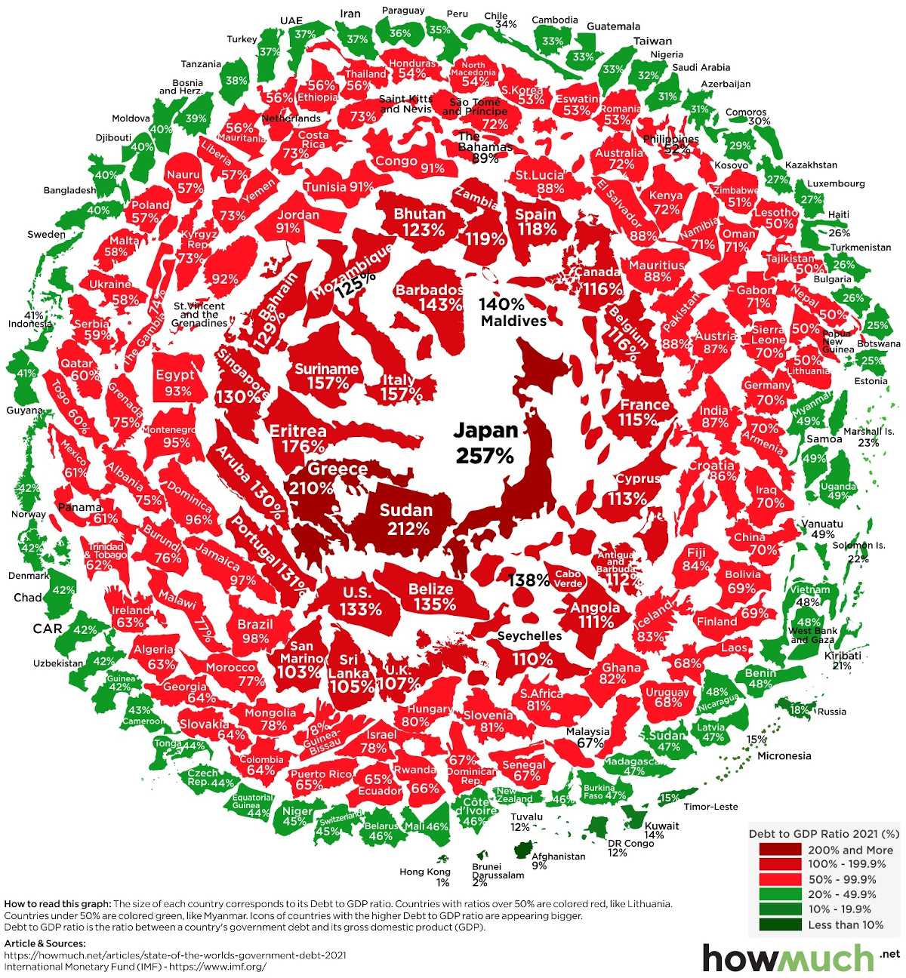


Slide 10
So again, debt is the accumulation of all our deficits and surpluses.
Yearly deficits are added to the debt

Slide 11
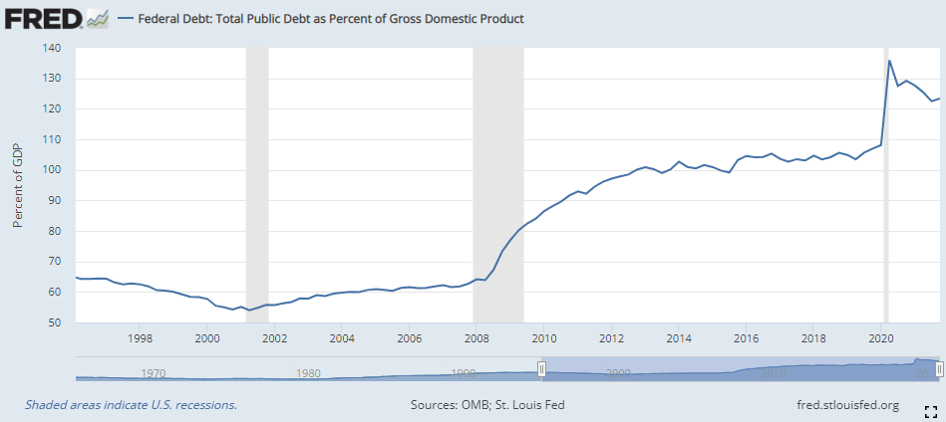

Slide 12
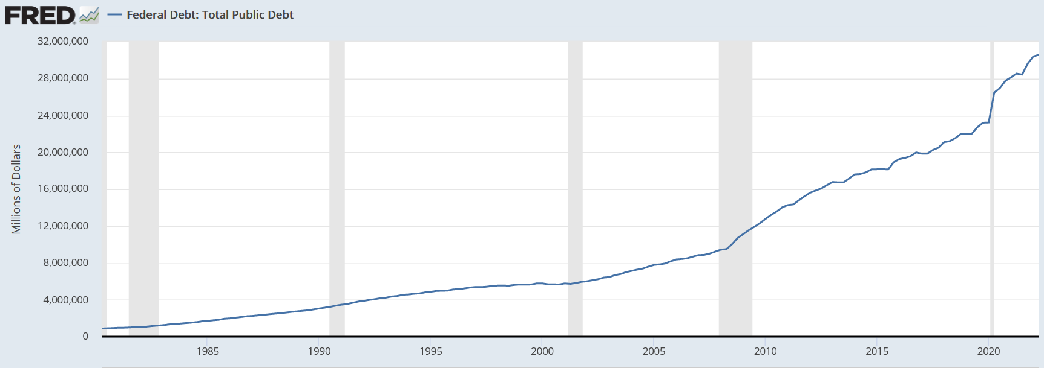

Slide 13
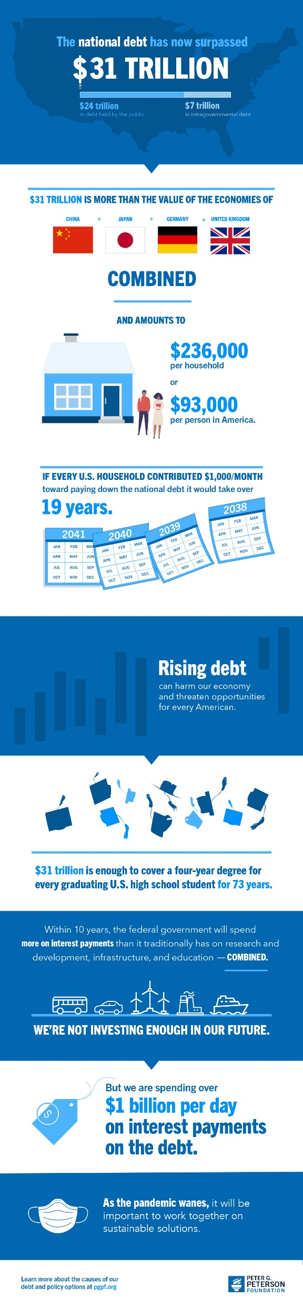

Slide 14

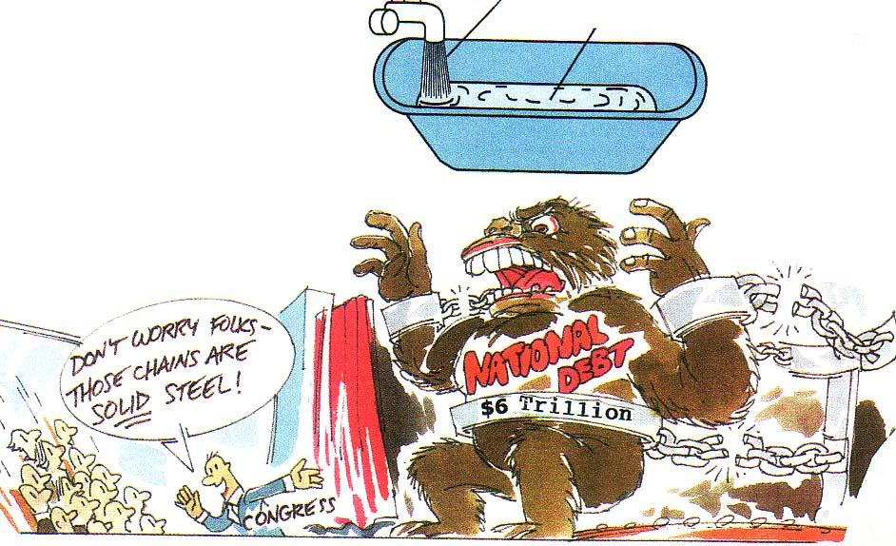


The “Debt” and The “Deficit”
Deficit
($1 Trillion)
Reasons for Debt
1. Lack of political will
2. Fiscal Policy
3. Recessions
4. National Defense
Debt
($31 Trillion)
Attention Deficit
Hyperactivity Disorder
[ADHD]
Congressmen have
trouble focusing
attention on the deficit.
$31

Slide 15
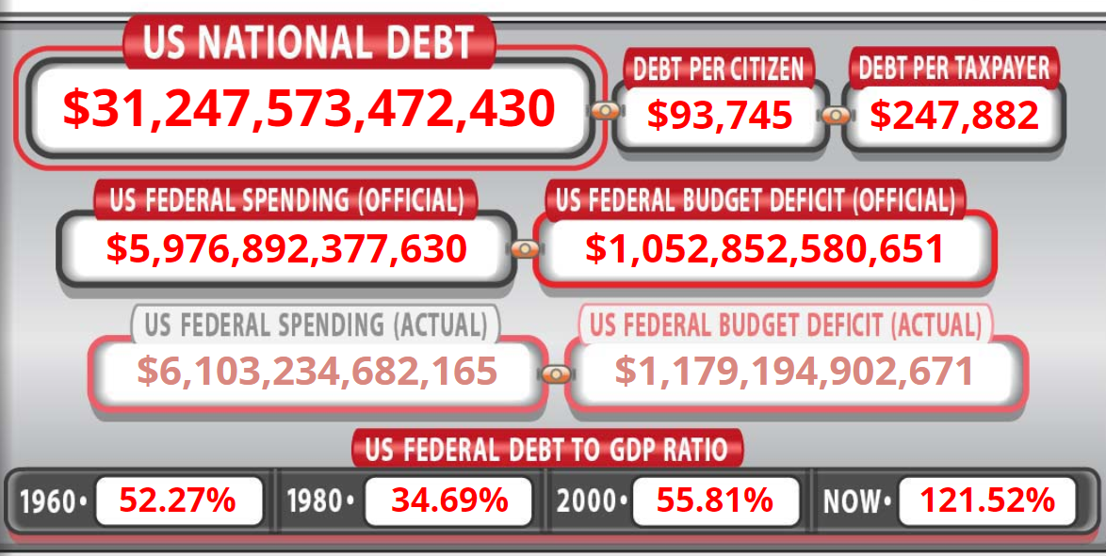

US Debt Clock

Slide 16
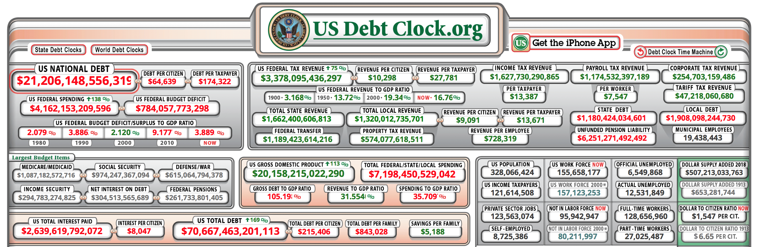
US National Debt
US Debt Clock

Slide 17
What does a Trillion Dollars Look Like?

Slide 18
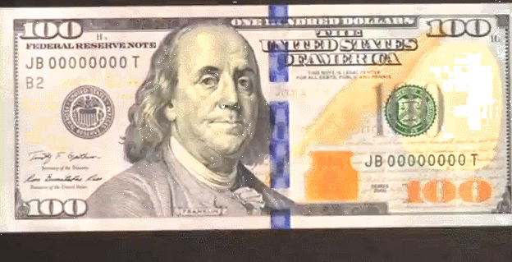
One $ 100 dollar bill

Slide 19

$10,000
100 $100 Bills

Slide 20
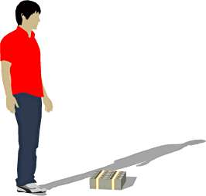
One Million Dollars!!!
Believe it or not, this next little pile is $1 million dollars (100 packets of $10,000). You could stuff that into a grocery bag and walk around with it.
Sa-weet!

Slide 21
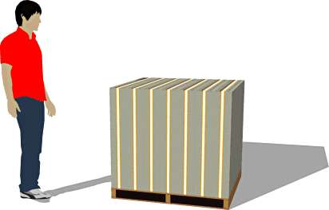
“$100 Million. That’s what I’m talkin’ about!”
While a measly $1 million looked a little unimpressive, $100 million is a little more respectable. It fits neatly on a standard pallet...
“Lemme get my Truck”

Slide 22
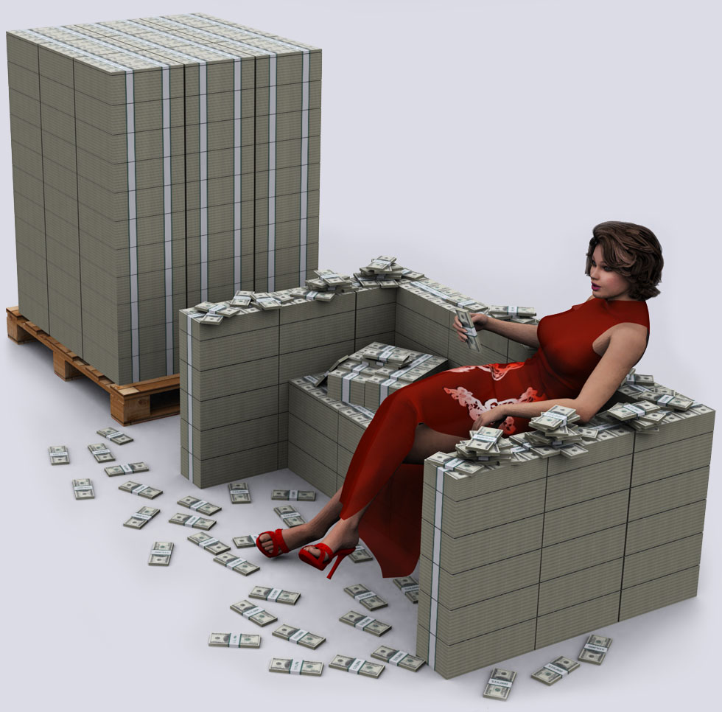
$100 Million
The couch is worth $46.7 million. Made out of crispy $100 bills.

Slide 23
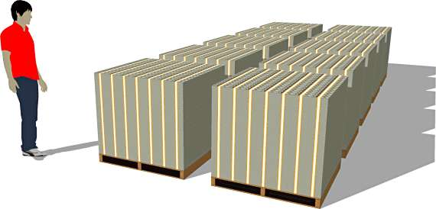
Holy cow!
And $1 BILLION dollars... now we’re really getting somewhere...
Whoa, Dude!

Slide 24
Please have a seat
Next we’ll look at ONE TRILLION dollars.
What is a trillion dollars?
Well, it’s a million million.
It’s a thousand billion.
It’s a one followed by 12 zeros.
You ready for this?

Slide 25
ARE YOU READY FOR A TRILLION?

Slide 26
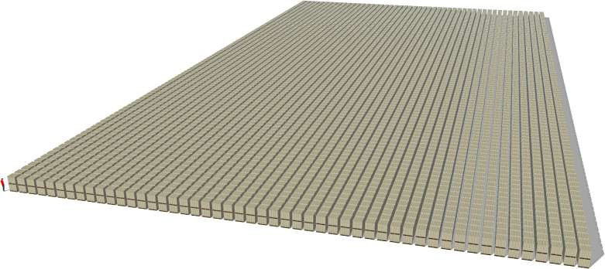
And notice those pallets are double stacked $100 dollar bills! So the next time you hear someone toss around the phrase “trillion dollars”... that’s what they’re talking about.
“NO FLIPPIN’
Way!”

Slide 27
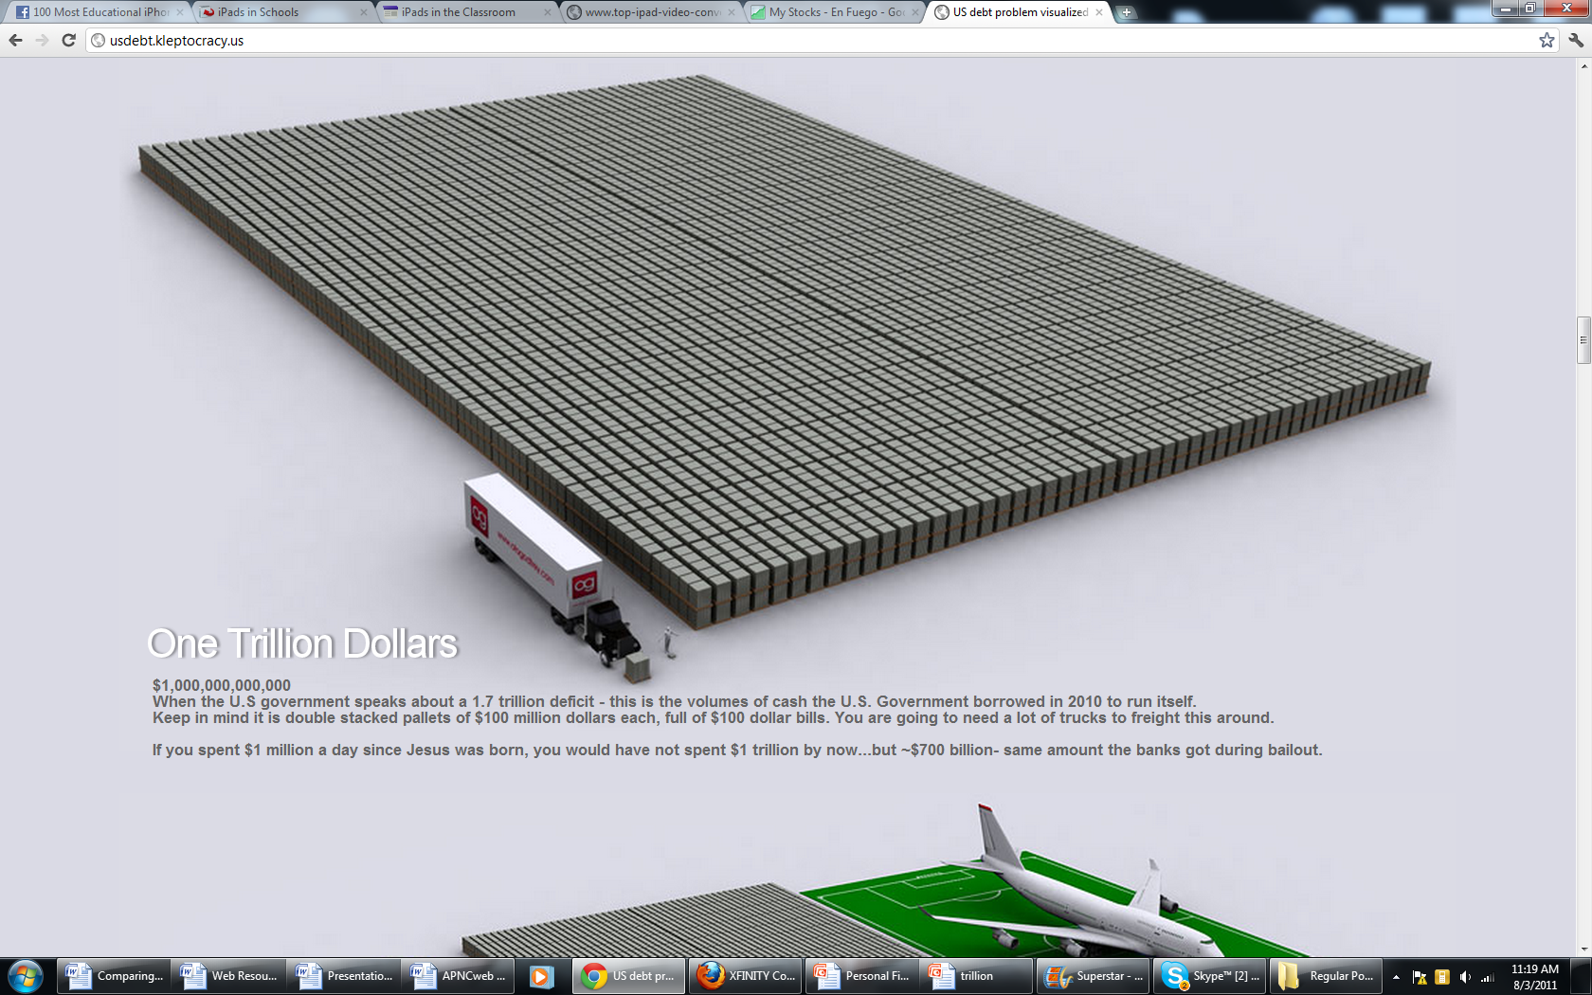
HERE’S SOME MORE….

Slide 28
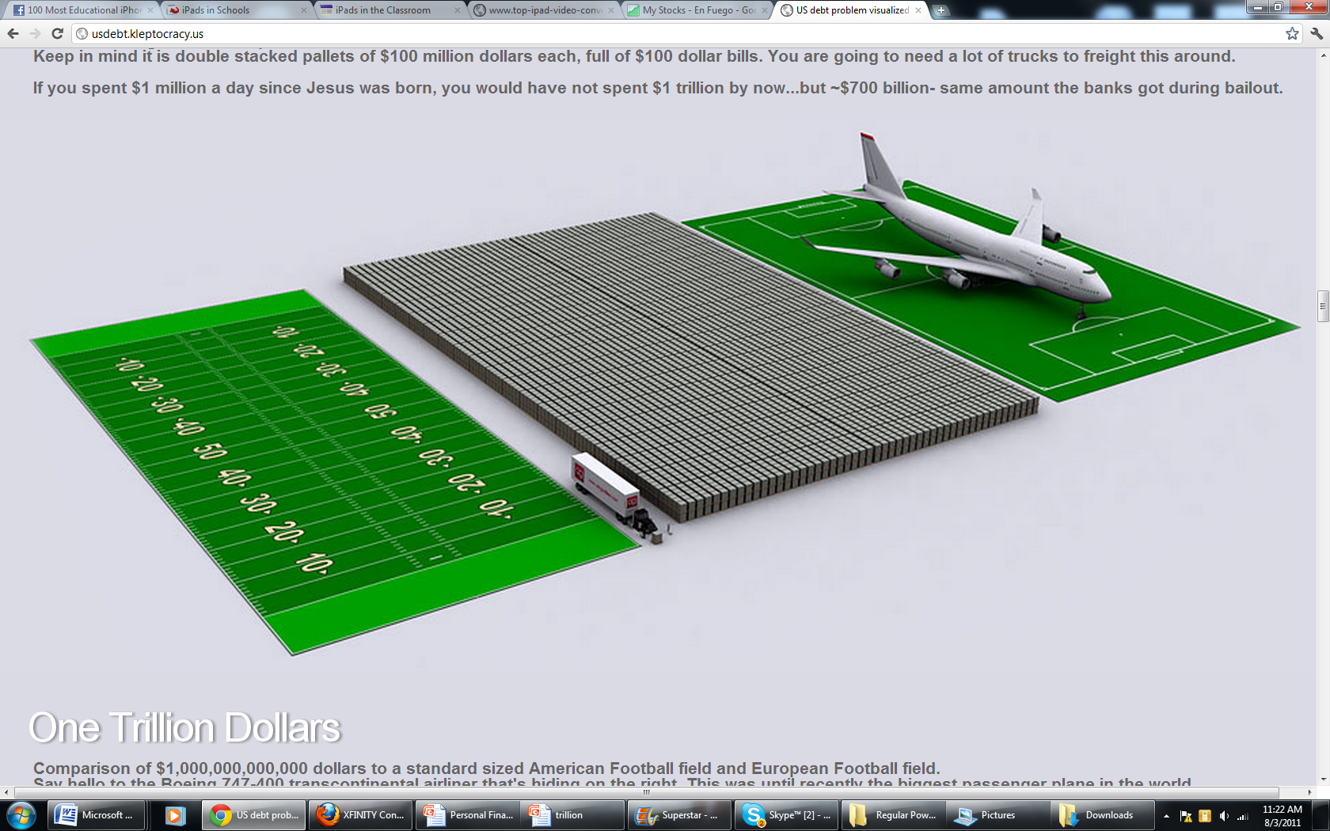

Slide 29
Are you ready for 15 Trillion?

Slide 30
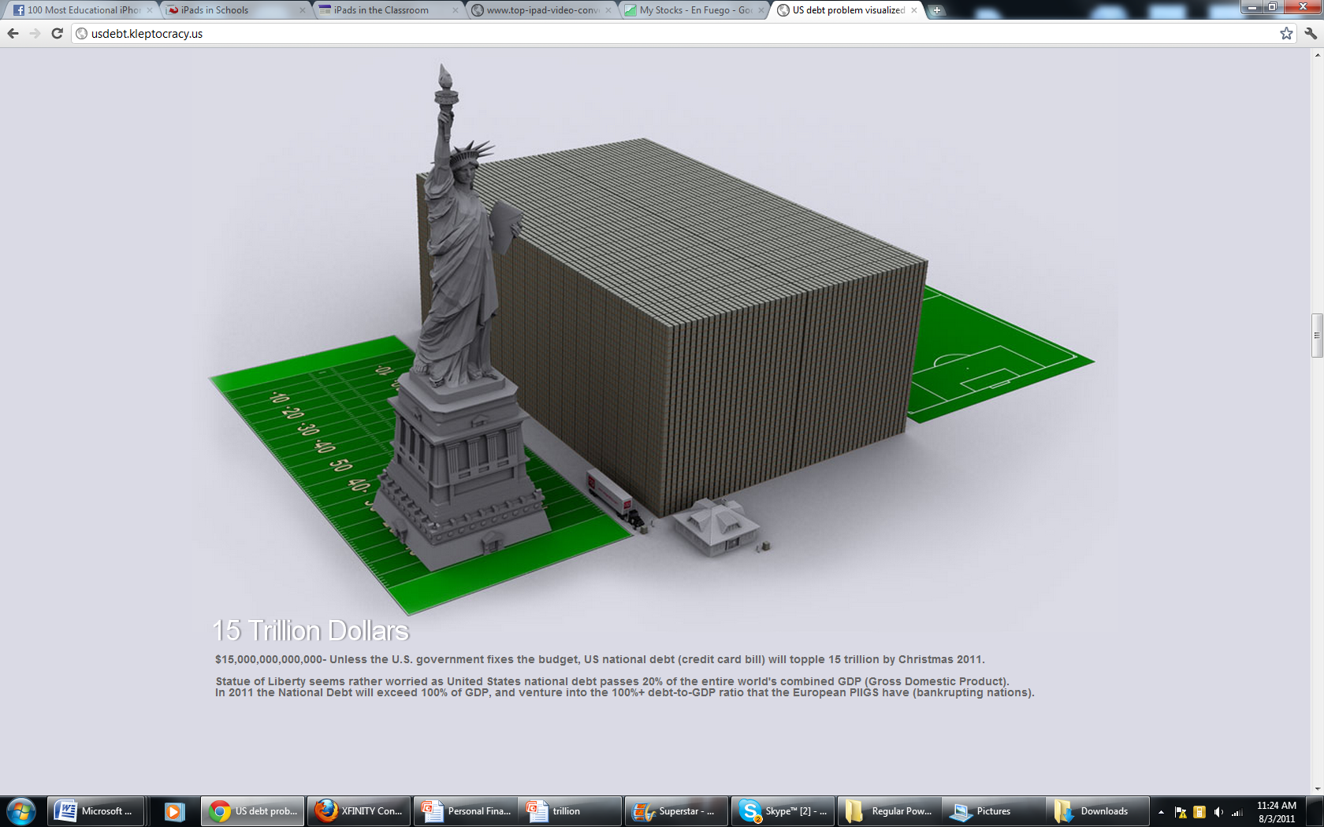
15 TRILLION!

Slide 31
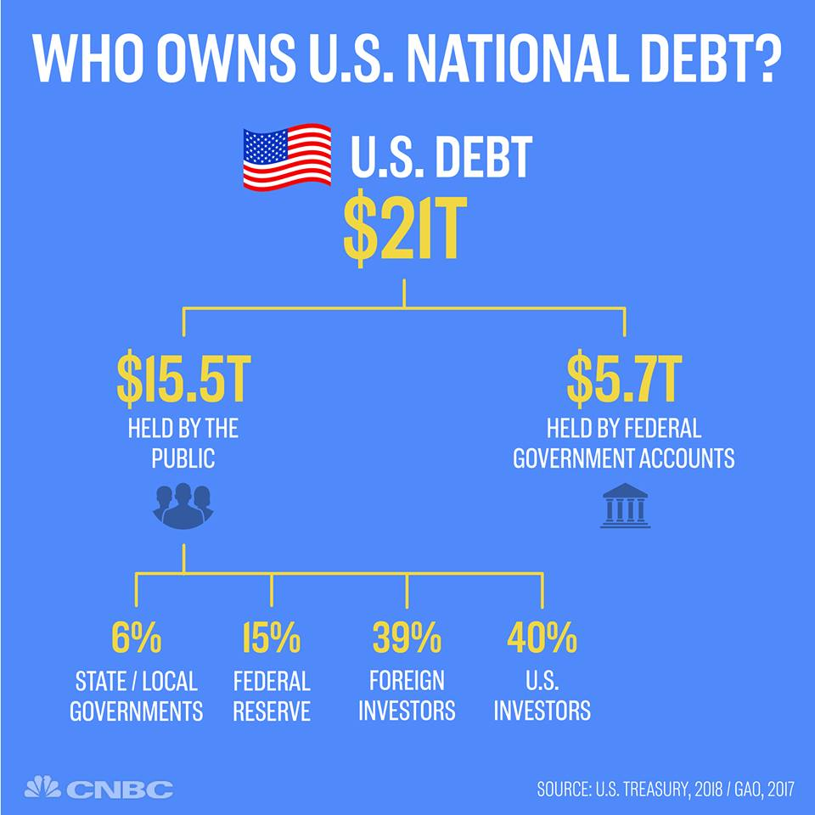

Slide 32
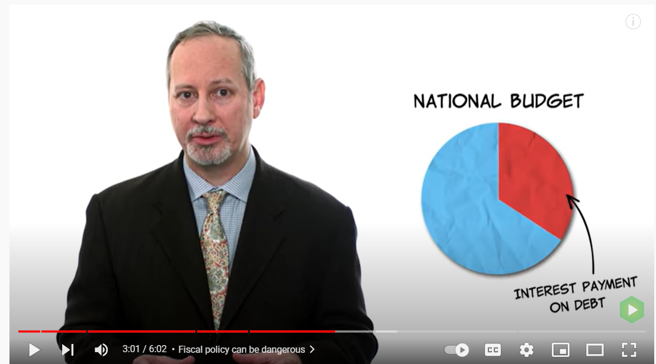

Slide 33
Negative Impact of the Debt
A problem is interest must be paid to the debt holders as the debt continues to grow.
    Interest payments on the national debt projected to be one of the Gov’s biggest expenditures in the Future
    This takes away from other government programs, or increases the debt and/or taxes

Slide 34
Crowding Out Effect:
The negative effect of budget deficits on private investment, which occurs because government borrowing drives up interest rates.
Thus, there will be less investment in our economy, less capital stock, and leading to a potential decrease in the standard of living in the future

Slide 35
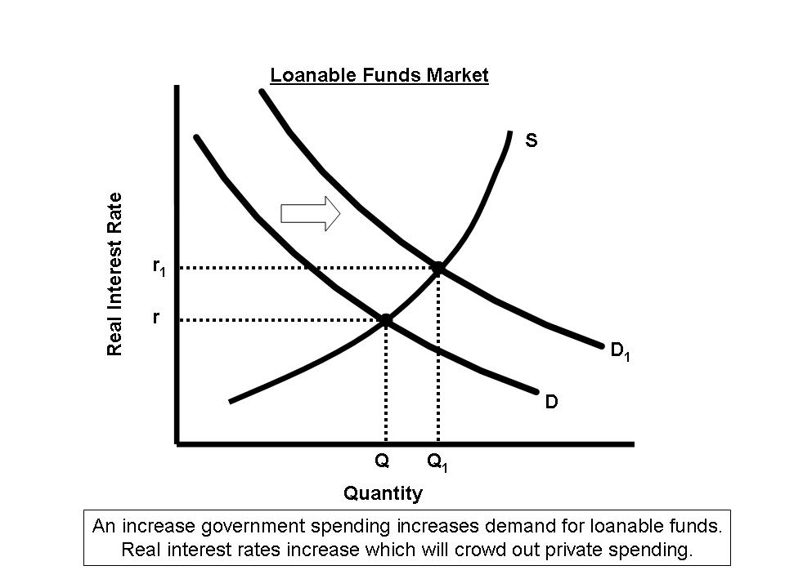
The Crowding Out Effect
Chapter 18 Figure 18.2
The crowding out effect

Slide 36
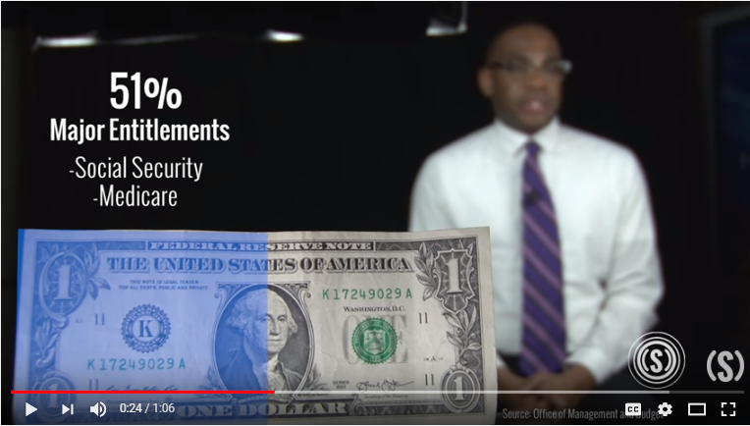

Slide 37
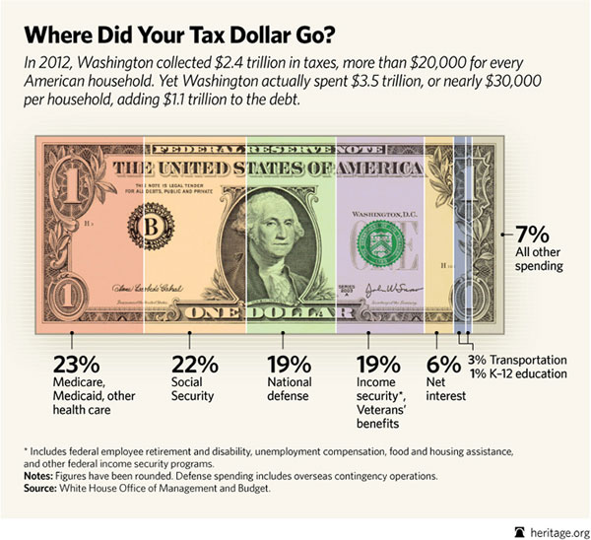

Slide 38
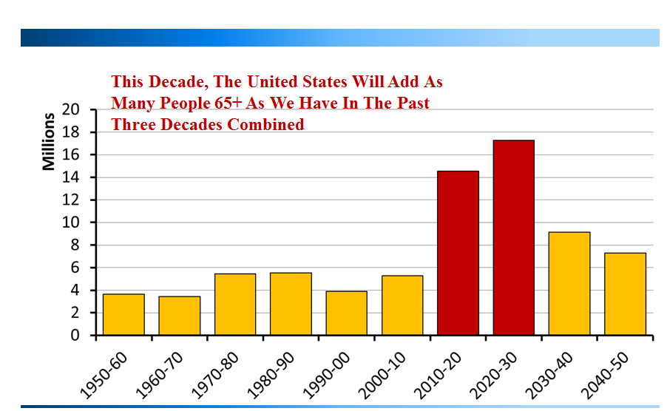

Slide 39
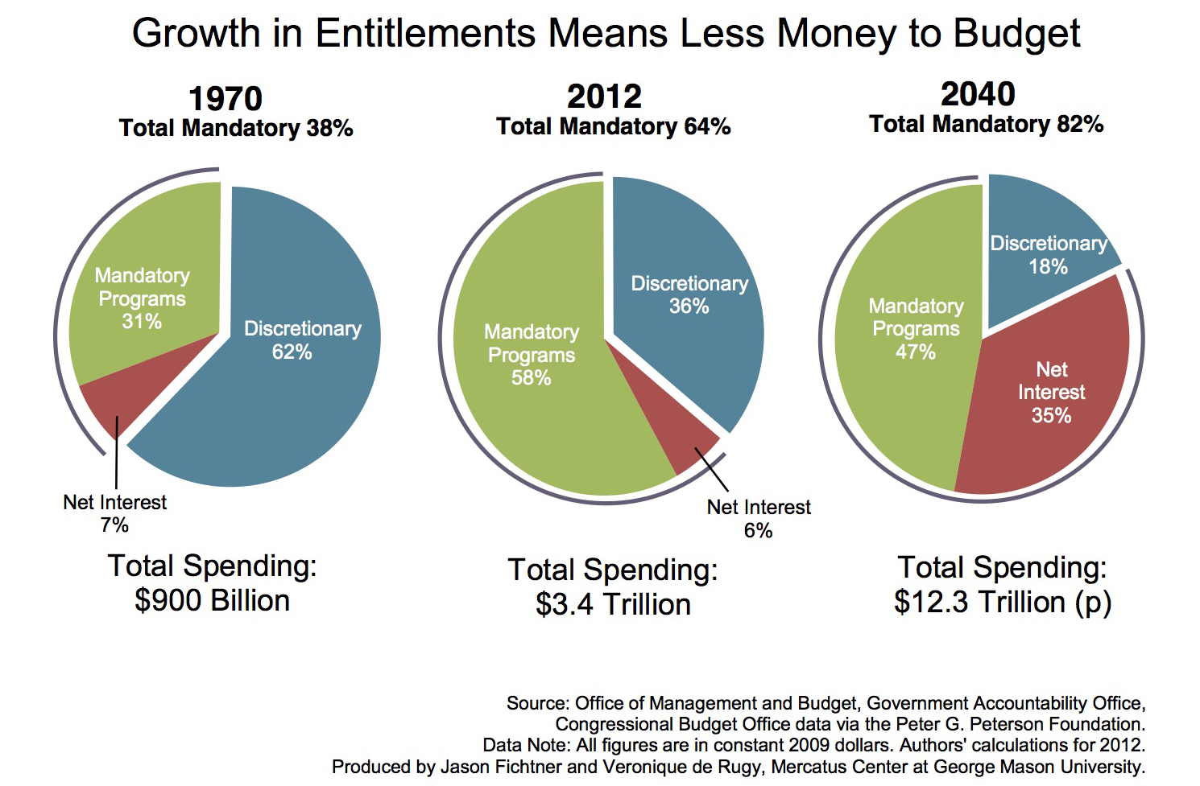
Entitlements- A Federal program that requires payments to any eligible person or unit of government. This mandatory spending must be paid (e.g. Social Security)
Notes:
https://www.nytimes.com/2018/09/25/business/economy/us-government-debt-interest.html

Slide 40
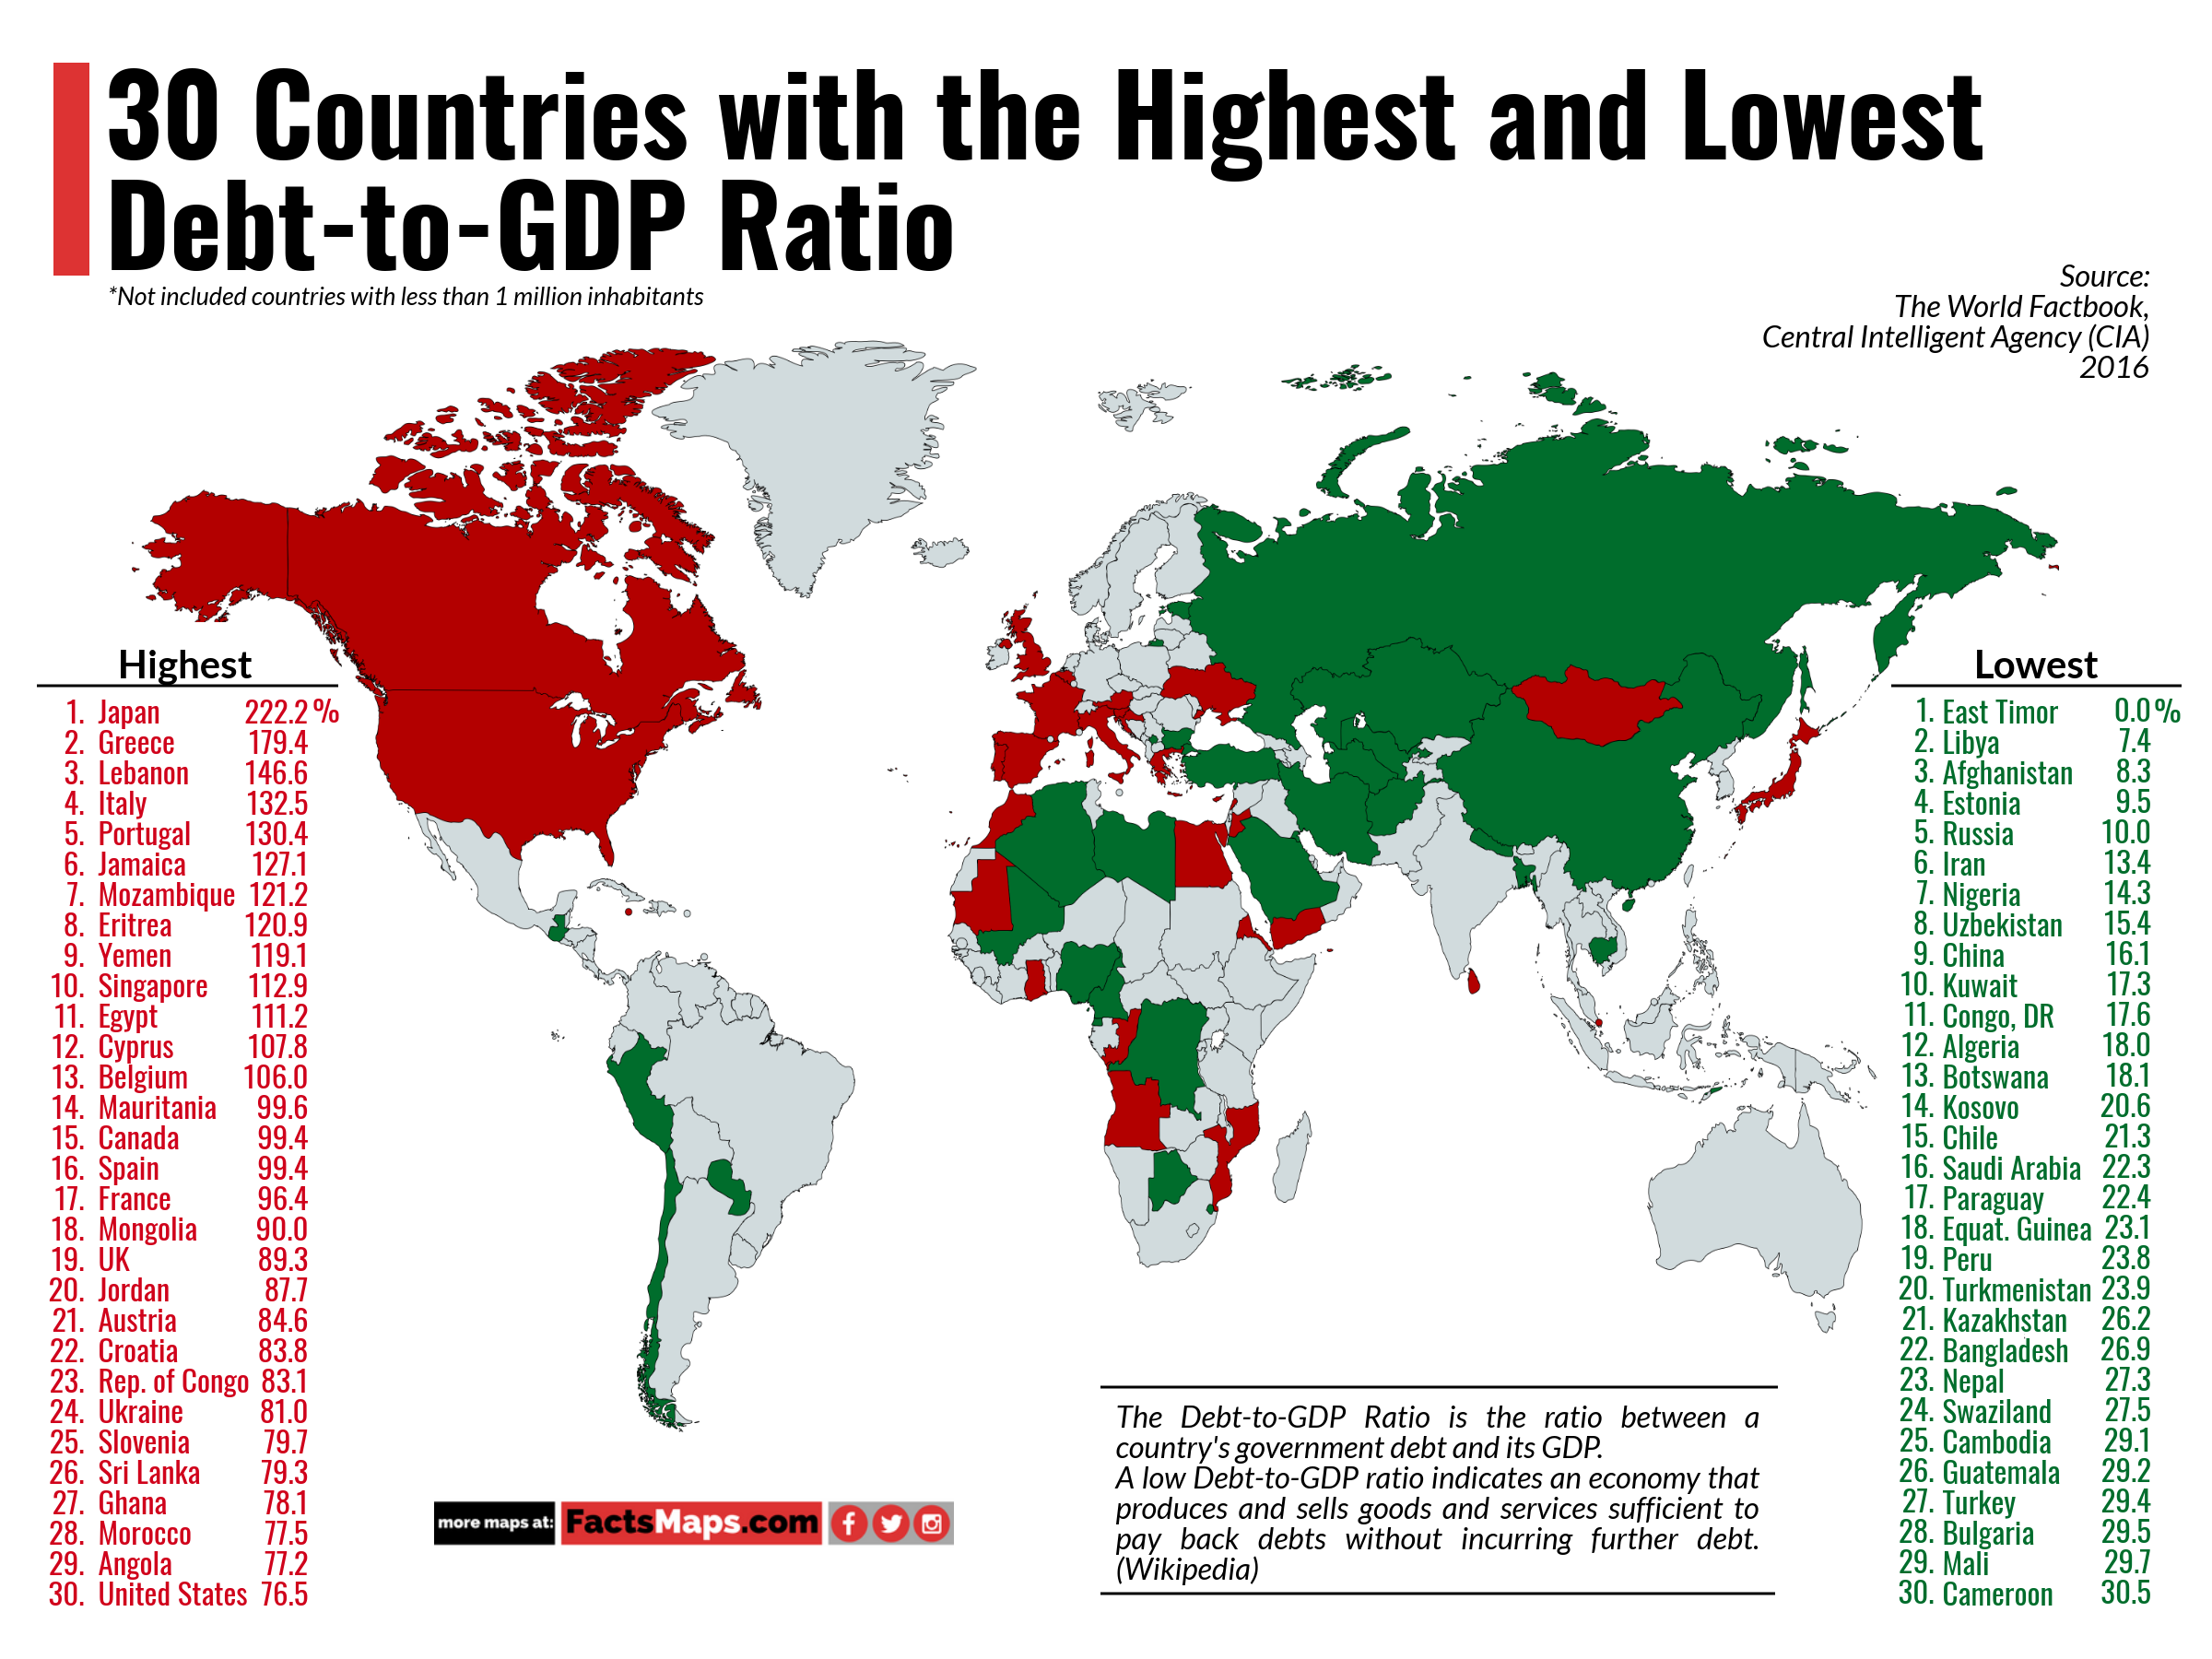

Slide 41
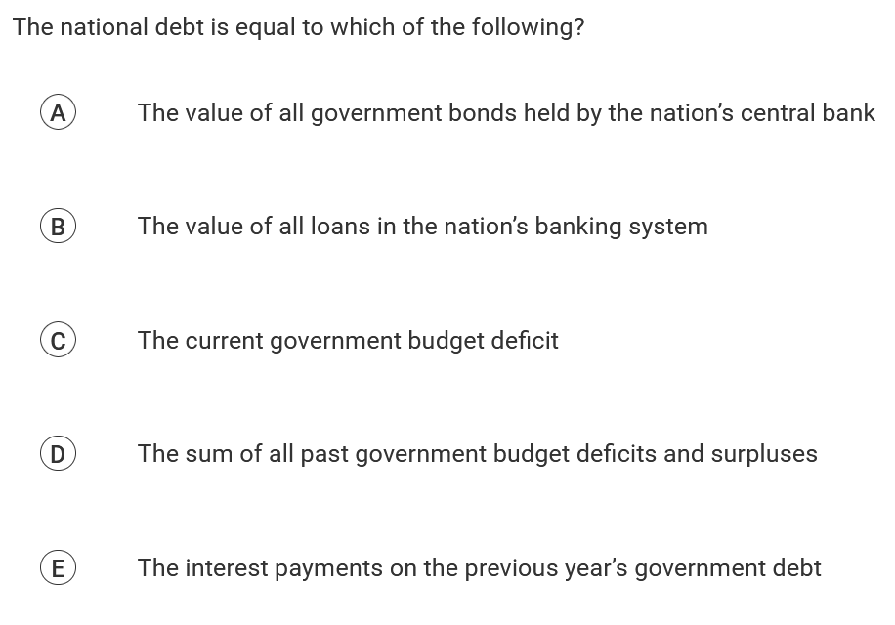

Slide 42
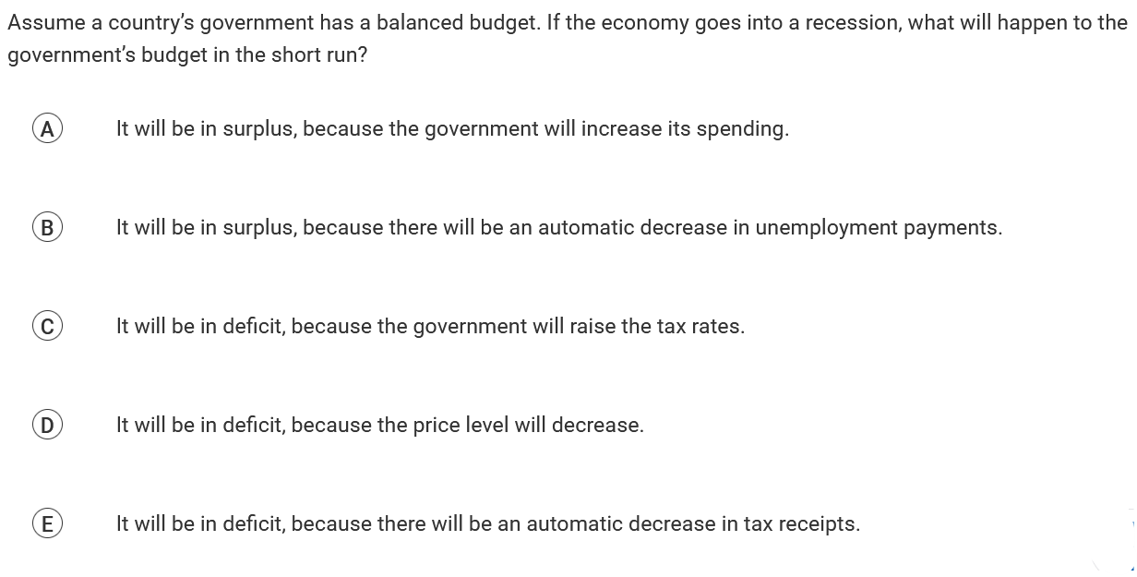

Slide 43
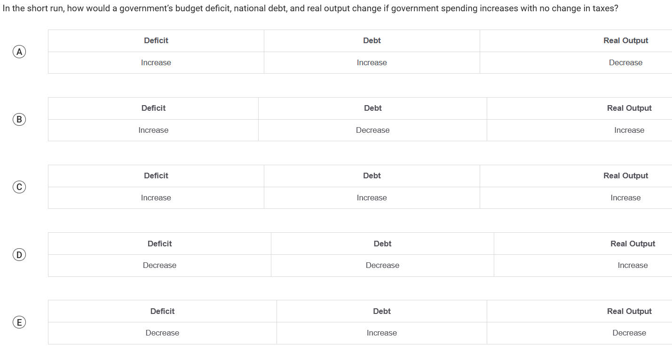

Slide 44
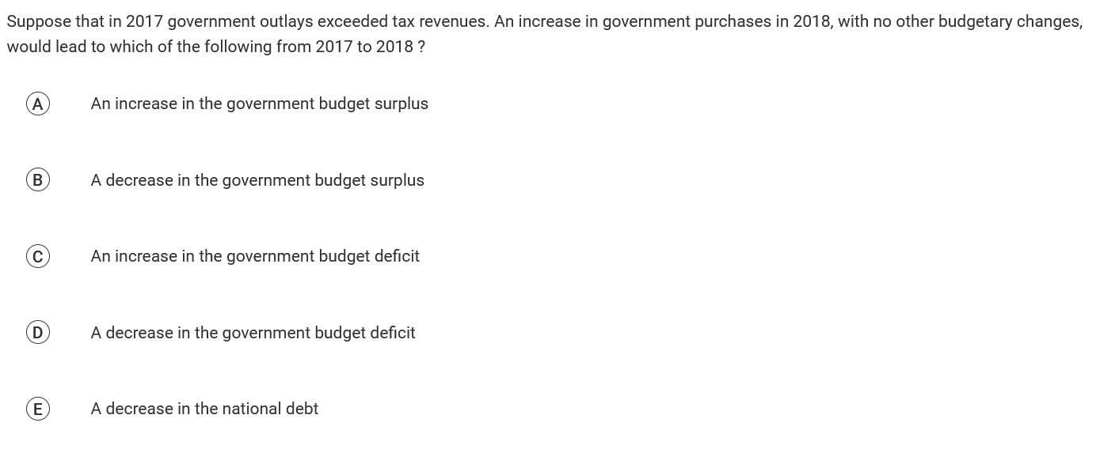

Slide 45
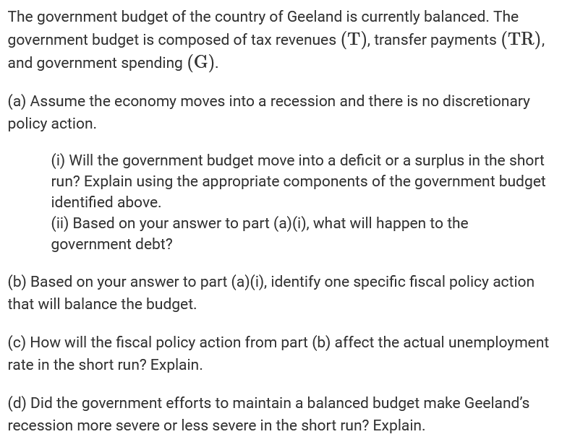
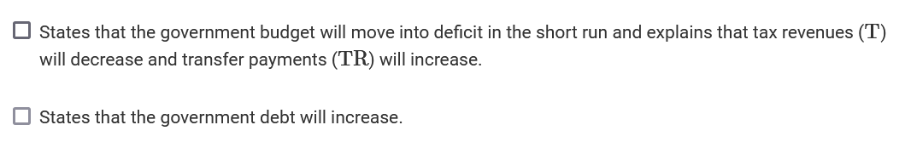

Slide 46
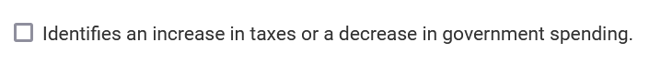

Slide 48
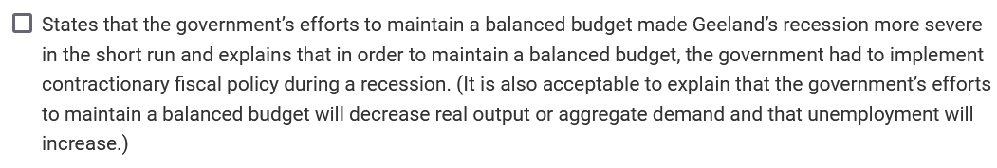

Slide 49
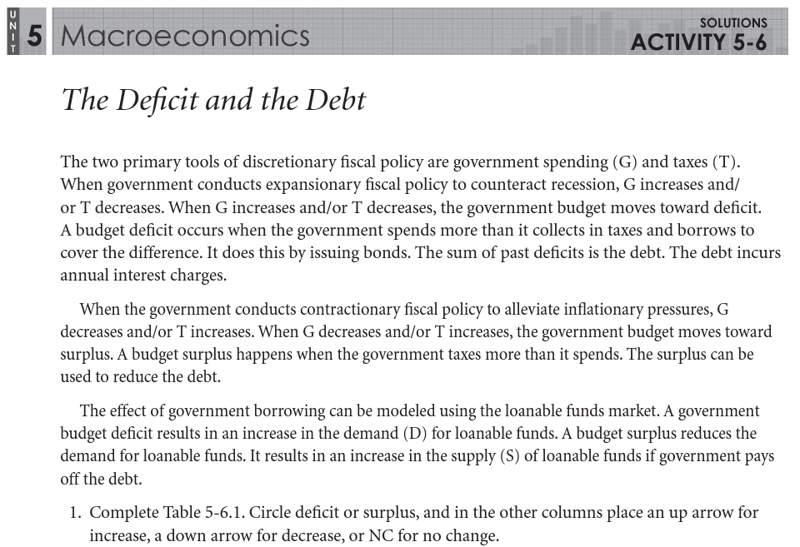

Slide 50
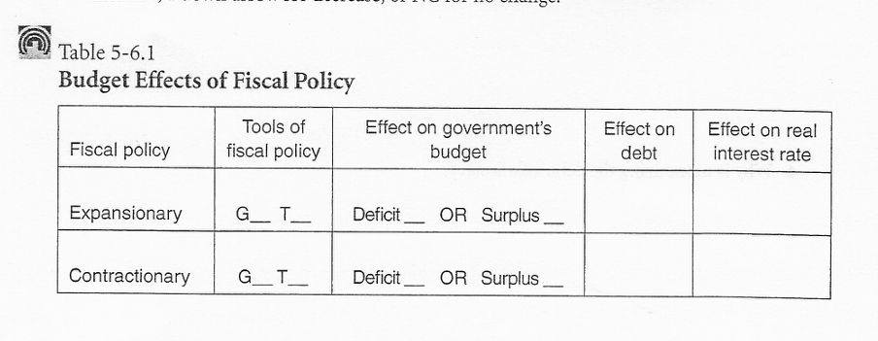
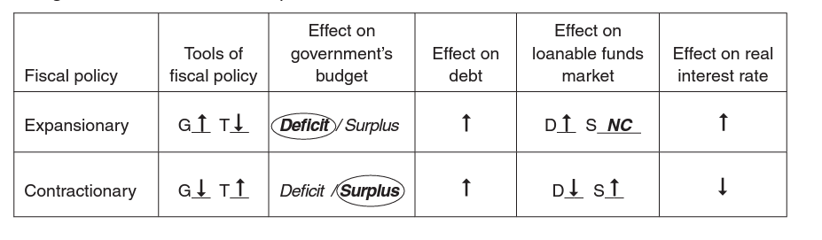

Slide 51
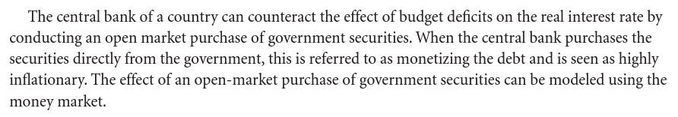
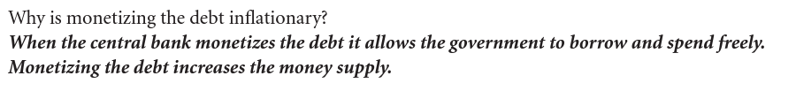

Slide 52
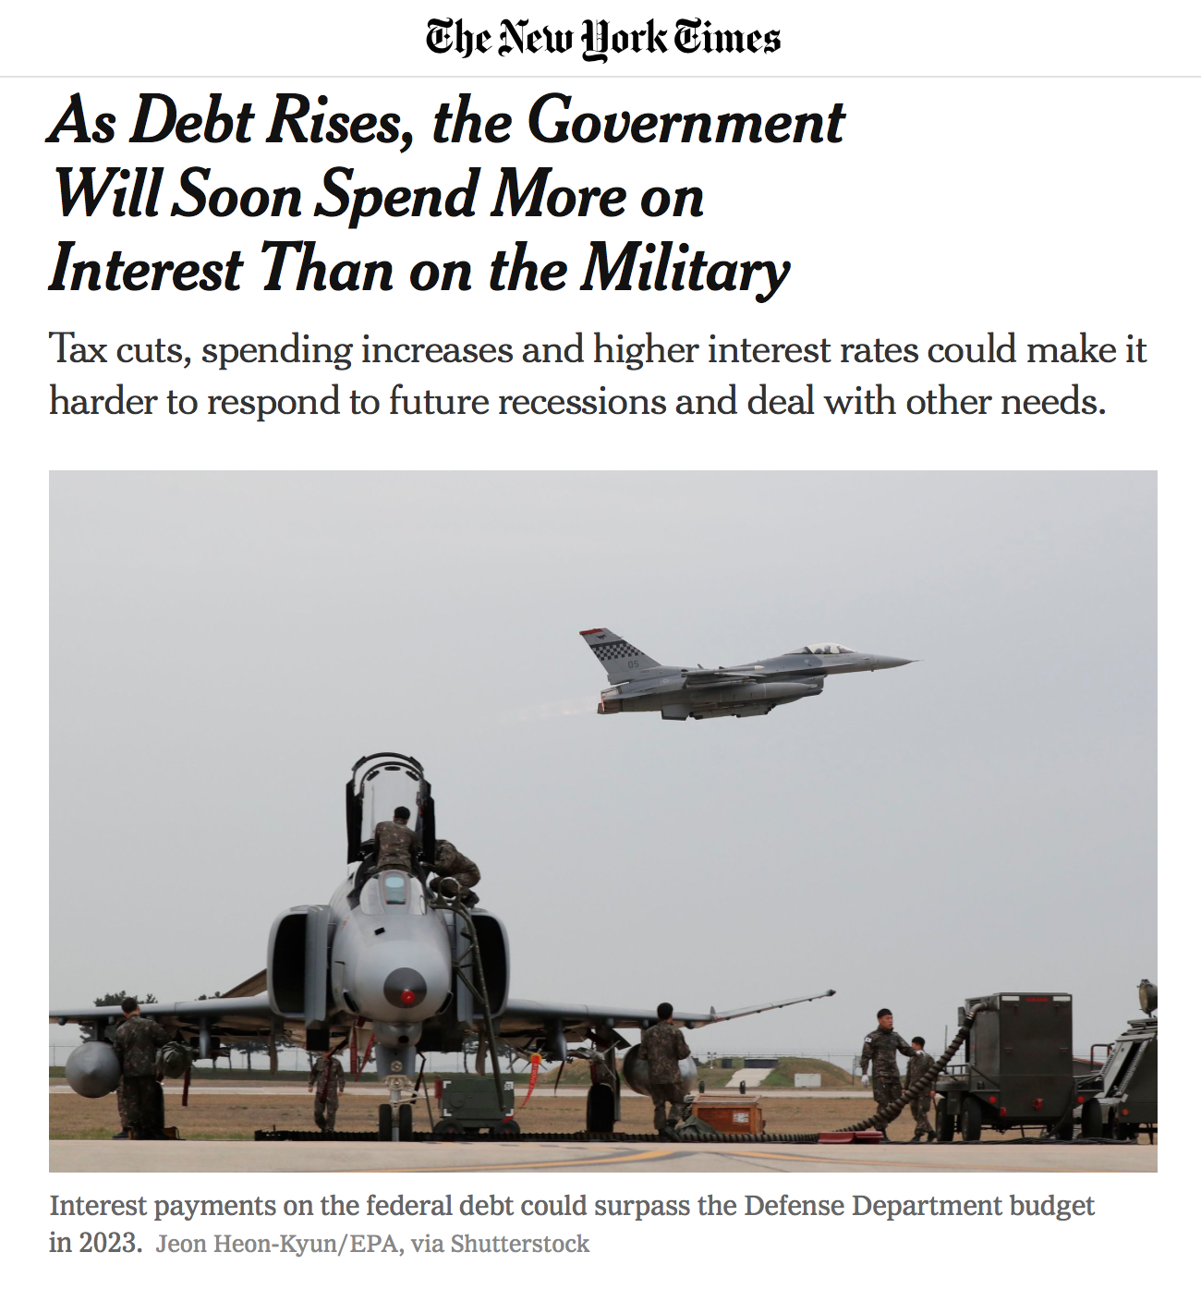
In the News: The Cost of Debt
1. What is the opportunity cost of debt.
2. How does an increase in the national debt effect the future government spending?
3. What are the costs of decreasing the national debt?
Notes:
https://www.nytimes.com/2018/09/25/business/economy/us-government-debt-interest.html

Slide 53

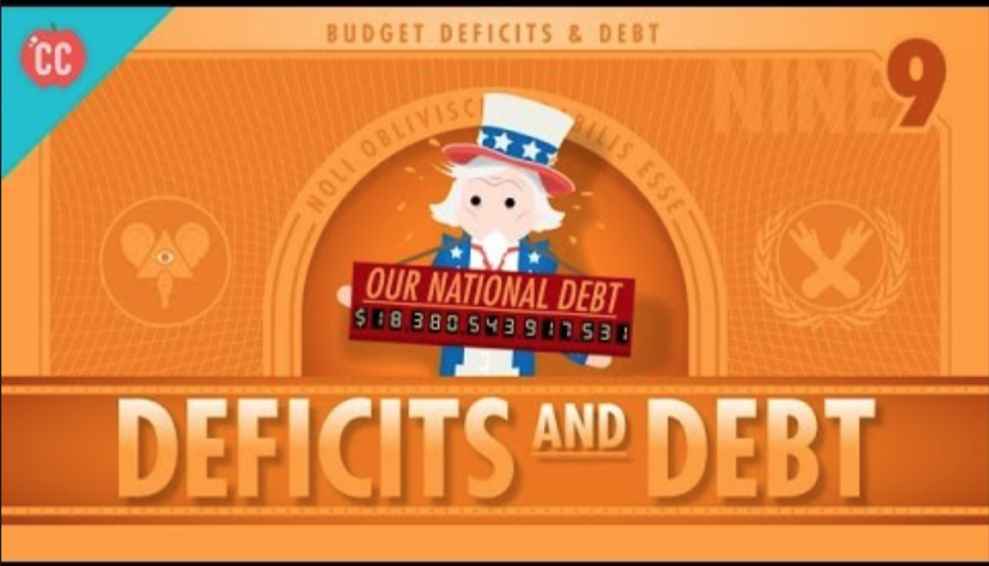

53
Notes:
https://www.youtube.com/watch?v=3sUCSGVYzI0

Slide 54
Any Questions?
James Redelsheimer | jred40@gmail.com
mcee.umn.edu | mcee@umn.edu | 612.625.3727

Slide 55
Thank You!
James Redelsheimer | jred40@gmail.com
mcee.umn.edu | mcee@umn.edu | 612.625.3727

