Slide 1
Teaching Finance in the 21st Century
Buy Now Pay Later Apps
Presented by
Kathleen Brennan
October 4, 2022 kbrennan@mountsaintmary.org

Slide 2
Disclaimer
All information provided in this session is for educational purposes only and is not intended in any way to be interpreted as financial advice.

Slide 3
National Standards
Standard 5 Managing Credit, Grade 12, Benchmark 7 – Lenders assess the creditworthiness of potential borrowers from reports compiled by credit bureaus.
Standard 5 Managing Credit, Grade 12, Benchmark 8 – Credit scores assess a person’s credit risk based on information in their credit report.
Standard 5 Managing Credit, Grade 12, Benchmark 9- Credit reports and scores may be used by entities other than lenders.
Standard 5 Managing Credit, Grade 12, Benchmark 13 – Alternative financial services can provide easy access to credit, often at a relatively high cost.

Slide 4
Objectives
Students will be able to:
Recognize the difference between traditional vs. non-traditional credit
Understand how credit boosters can improve credit scores
Analyze the pros and cons of Buy Now Pay Later Options
Review the features of Credit Builder Loans

Slide 5
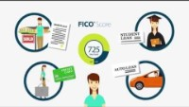
What is a FICO Score?

Slide 6
Credit Types
Traditional Non-traditional
Banks
Mortgage lenders
Auto loan companies
Credit card companies
Student Loans
Rental Payments
Childcare/School Tuition
Utilities
Phone/Internet/cable
Rent-to-own, layaway

Slide 7
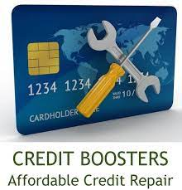

Credit Boosters
Credit improvement programs that are designed to help improve your credit score by considering non-traditional credit.

Slide 8

Experian Boost

Slide 9
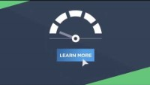
ultraFICO Score

Slide 10

Ecredable

Slide 11


Dive Deeper into Credit Boosters
Ecredable
Difference Between Experian Boost and ultraFICO
Rent reporting services

Slide 12
Credit Boosters
Pros
Cons
Report payments from non-traditional accounts
Experian Boost and UltraFico are free services
Experian Boost includes only on-time payments
eCredable charges a fee
Not all landlords will be willing to report rent payments
Mortgage lenders don’t consider boosting programs

Slide 13
Buy Now Pay Later Apps
BNPL use skyrocketed during pandemic
Buy something today, pay for it over time
No set credit score to use BNPL app; some perform a soft inquiry
Many BNPL apps don’t charge interest as long as payments are made on time; if you miss a payment a late fee may be charged
May report negative payment history to credit bureaus
BNPL app earns a fee from the merchant, similar to credit cards

Slide 14

Tik Tok Pitches BNPL

Slide 15

Mrs. Dow Joes Weighs In…..

Slide 16


Additional BNPL Reviews
Blog Post: After Pay vs Affirm

Slide 17
Credit Builder Options
Become an authorized user on someone else’s credit card to leverage their credit history
Apply for a secured credit card that requires a security deposit
Obtain a credit builder loan
  Borrow a small amount of money
  Lender deposits it into CD or savings account
  Pay back the amount over time
  Lender reports the payment history to credit bureaus
  Once the balance is paid, borrower gets the sum
  Source: Creditrepair.com

Slide 18
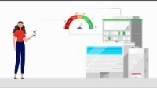
Self Credit Builder Account
Self Credit Building Pricing
Research: Self Credit Building Loans

Slide 19
Wallet Hub’s Best Credit Builder Loans (2022)
Republic Bank -Overall
AlltruCredit Union –Interest refund
Sunrise Banks – Interest-bearing account
Self – online lender
Money Lion – no credit check
Digital Federal Credit Union –low APR

Slide 20
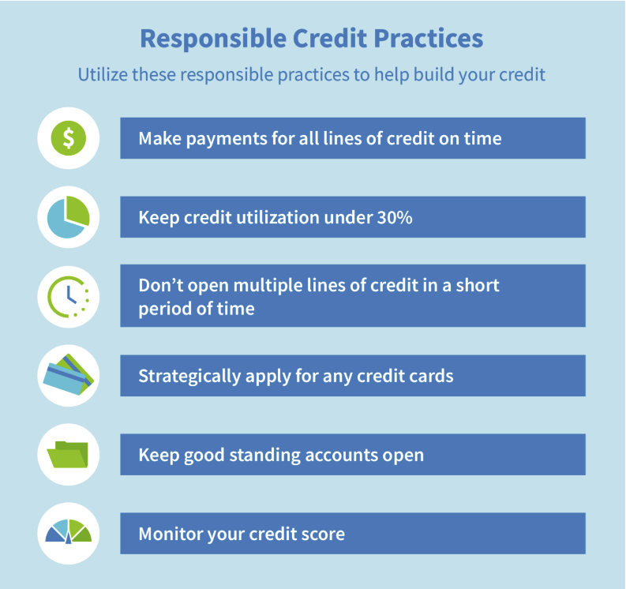
Source: Creditrepair.com

Slide 21

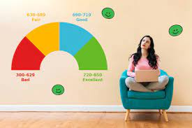

Student Resources
Research: Self Credit Building Loans
Research: How Can I Improve My Credit Score?
Source: NGPF

Slide 22




Conclusion
Technology is changing rapidly, so teachers need to provide our students with the understanding, skills, and tools to make well-informed financial decisions.

Slide 23


Slide 24


https://store.councilforeconed.org/

Slide 25
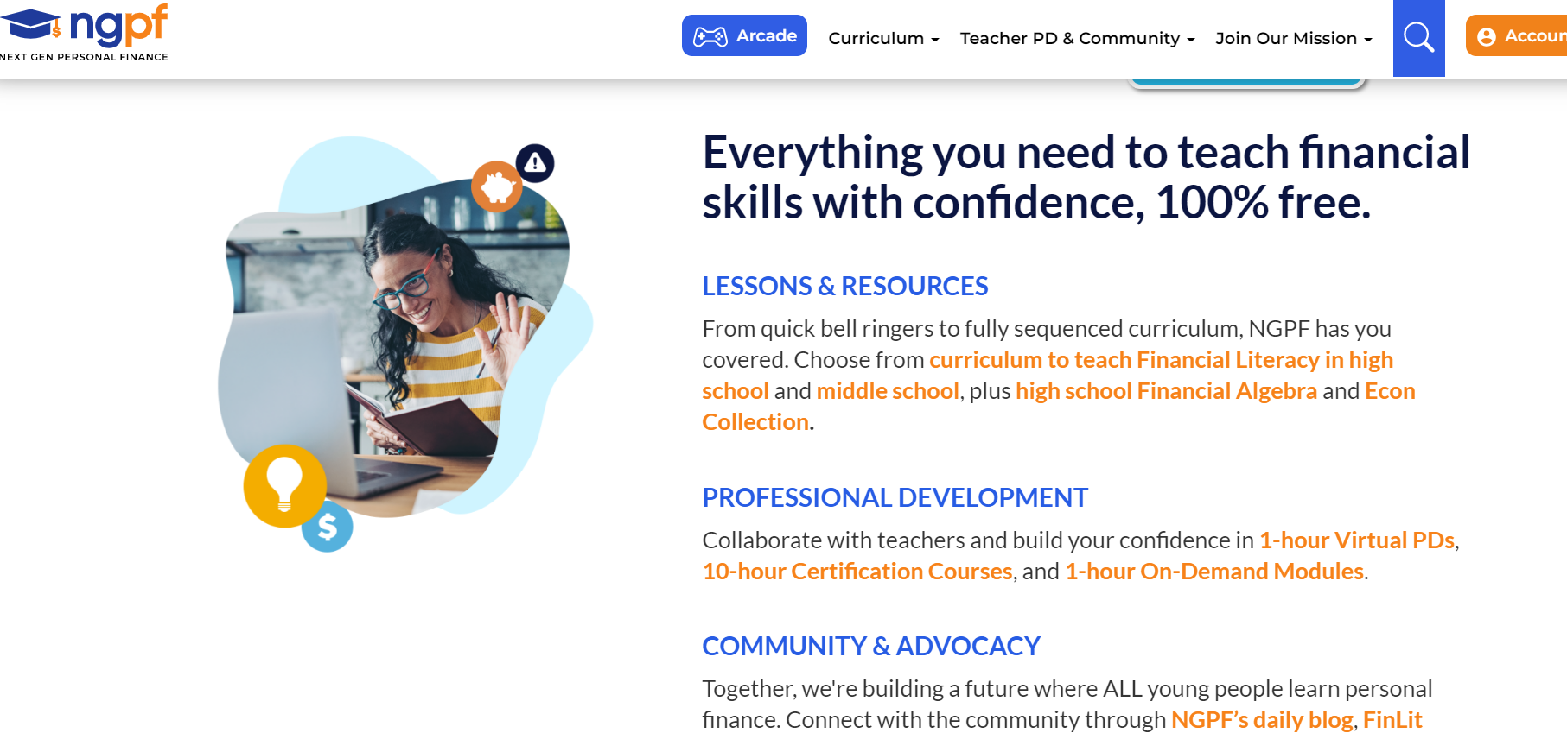

Slide 26
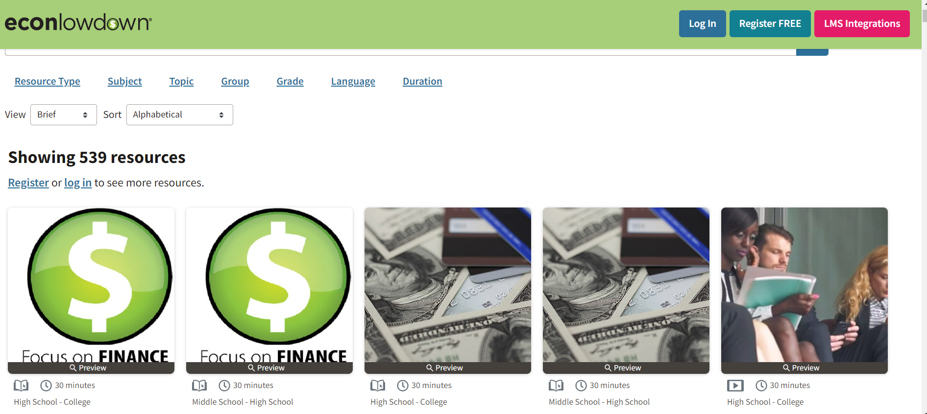

Slide 27
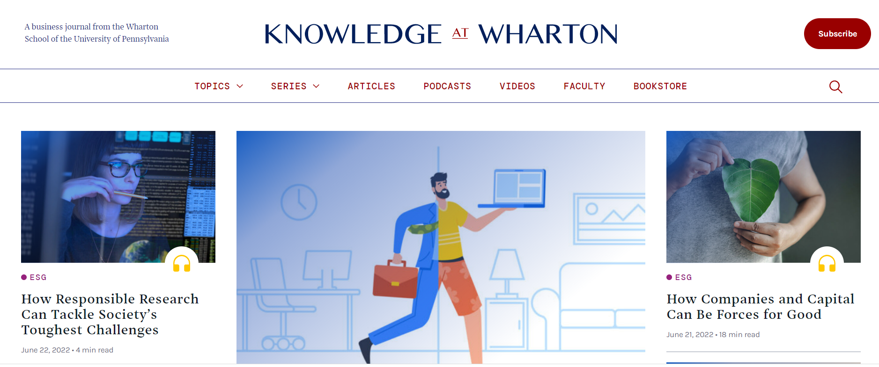

Slide 28

CEE Affiliates
https://www.councilforeconed.org/resources/local-affiliates/

Slide 29
Thank You to Our Sponsors!

