Slide 1
Digital Banking v Traditional Banking

Slide 2
Do you prefer digital or traditional banking?
ⓘ Start presenting to display the poll results on this slide.

Slide 3
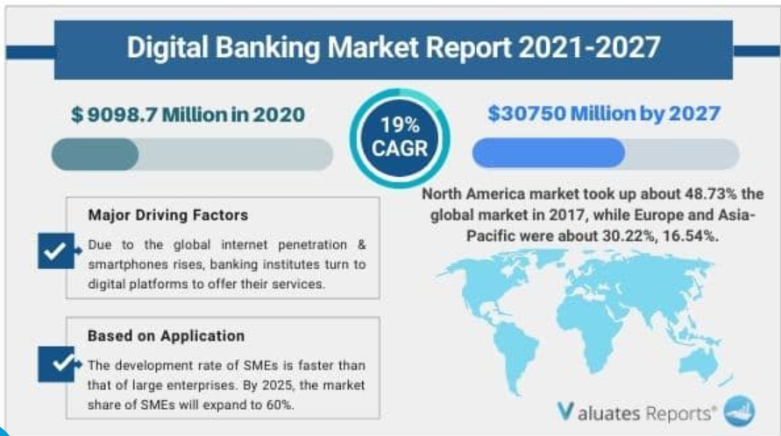
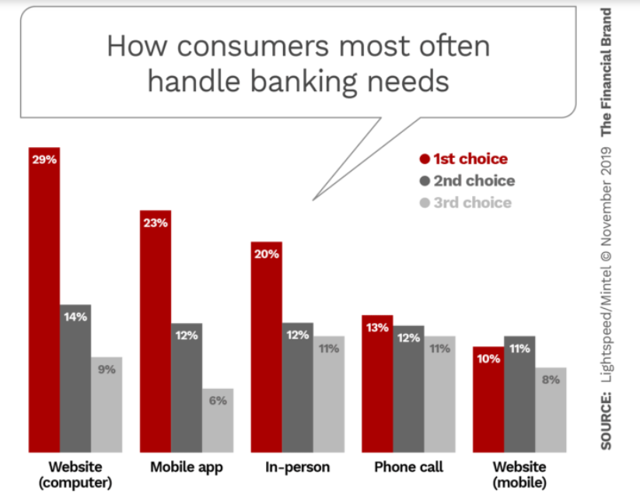
Compound Annual Growth Rate

Slide 4
Traditional Banking
Digital Banking
What is Traditional Banking
Traditional v. Digital Banking?
What is Digital Banking?
Resource Page

Slide 5
Let’s Take a look Theme: Digital Banking v. Traditional Banking
Standards
Lesson Plans

Slide 6
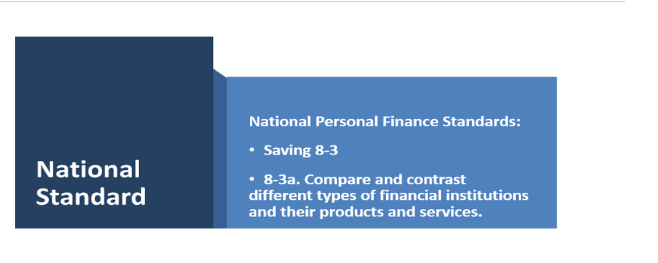

Slide 7
Georgia Standards of Excellence –Personal Finance
Standard SSPLF6
Analyze the purpose and function of financial institutions.

Slide 8
In this lesson, students are comparing the services of traditional and digital banking; and using the scenarios to decide on the appropriate banking system per scenarios.
Register for Nearpod using Google. It is Free!
Lesson: All resources are editable.
https://np1.nearpod.com/sharePresentation.php?code=eceaa9f6660904e6e2bb7e40bdda7536-1
Resource Articles
What Is a Bank and How Does It Work? – Forbes Advisor)
What Is Digital Banking? – Forbes Advisor
Online Banking vs. Traditional Banking: What’s Better? - Experian
LESSON PLAN

Slide 10
Do you find digital investment applications useful?
ⓘ Start presenting to display the poll results on this slide.

Slide 11
Why do you believe digital investment apps are growing in consumer use?
ⓘ Start presenting to display the poll results on this slide.

Slide 12
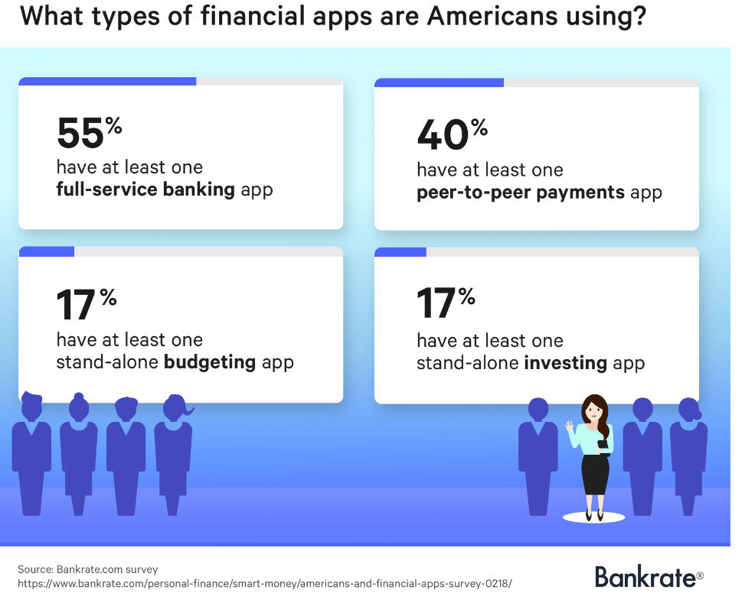
Why are digital investment platforms growing?
Accessibility
Training and Educational resources
Diverse Financial Products
Security

Slide 13
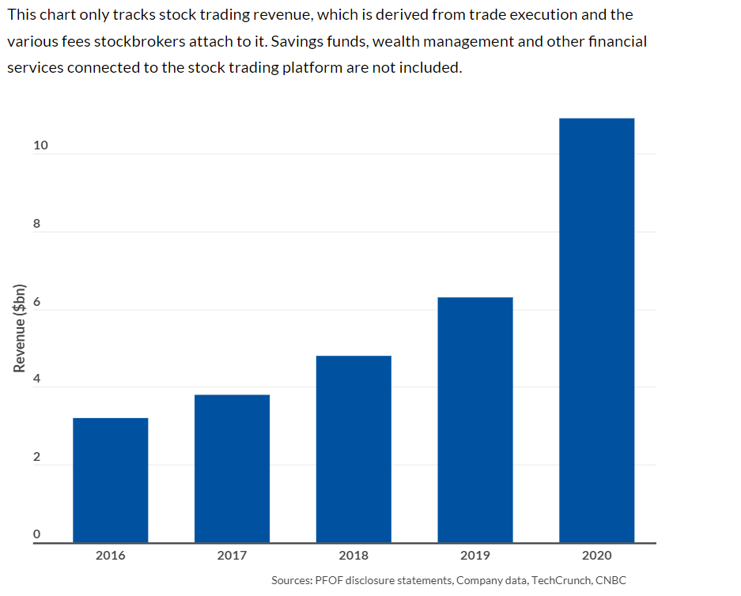
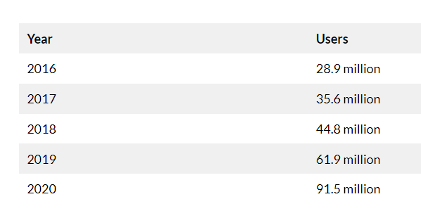
Digital Investment Tools

Slide 16
Advantages of Digital Investment Banking
Disadvantages of Digital Investment Banking
Lower fees
Immediate Transparency of Account
Ease of Access
No Middle Person or Broker
Technology/Internet Reliant
Lack of Live Help
Higher Risk of Scam
Greater Risk of Investment Mistakes

Slide 17
Theme: Digital Investment Platforms
Standards
II. Lesson Plans

Slide 19
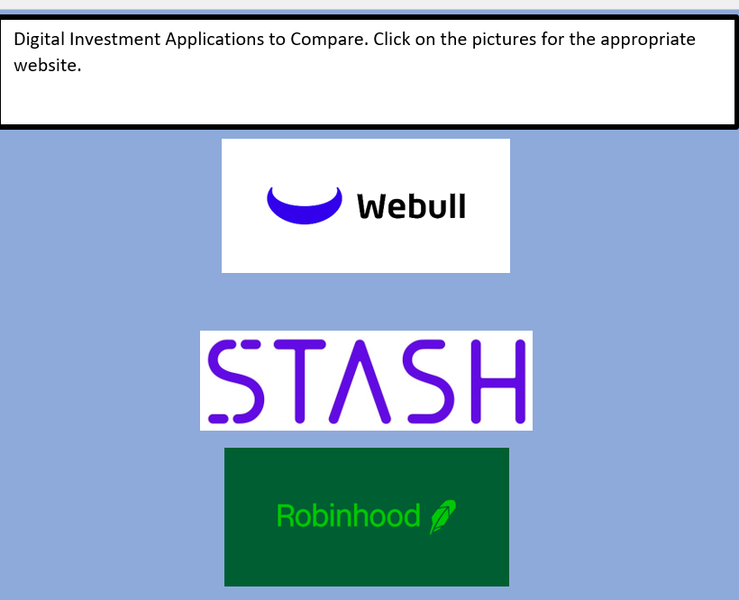
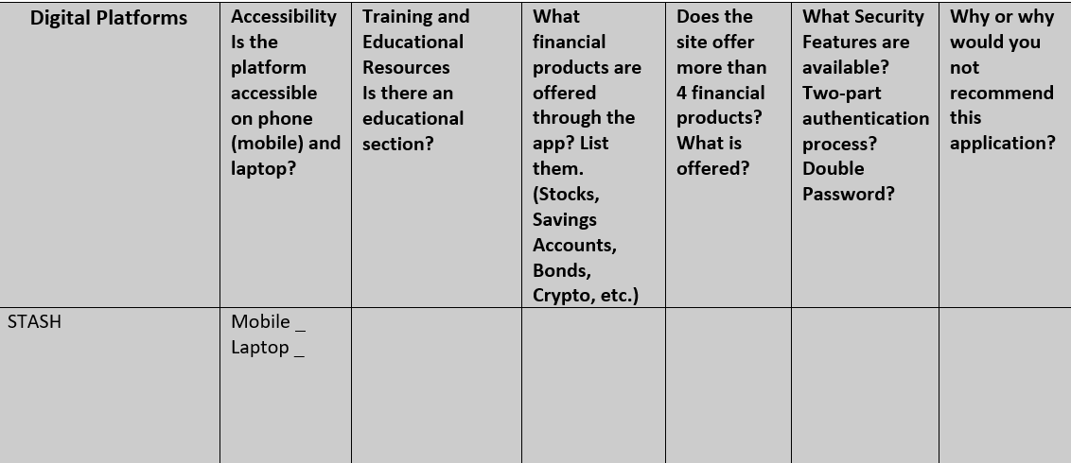
Lesson Plan 2 - Judging Digital Investment Apps
Objective: Students will rate digital platforms by using the categories below.
Accessibility
Training and Educational resources
Diverse Financial Products
Security
Resource: Website page
Comparative Chart

Slide 20
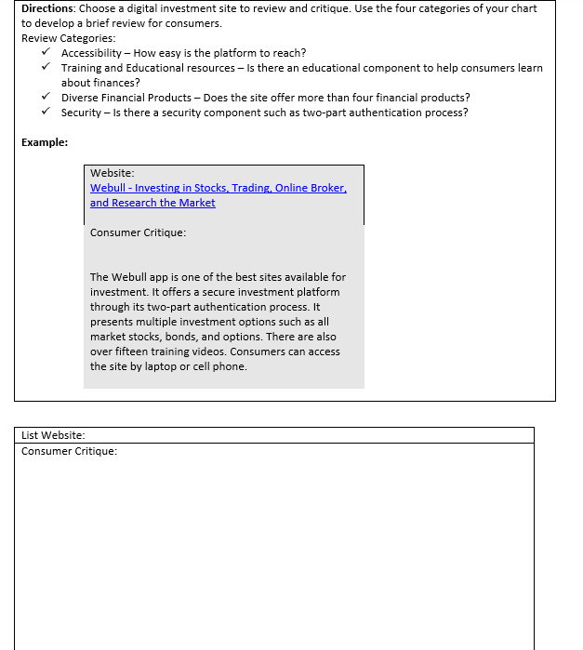
Part 2- Lesson Plan 2 - Judging Digital Investment Apps
Objective: Students will judge digital platforms by using the categories below.
Accessibility
Training and Educational resources
Diverse Financial Products
Security
Objective: Students will describe and critique a platform using the form below. Digital Review.docx

Slide 21
Resources
Best Investment App Article 1
Best Investment Apps Article 2

