Slide 1




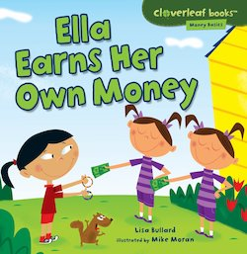
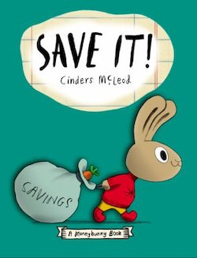
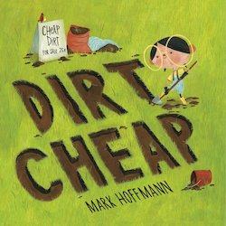
Using Picture Books to Celebrate April’s Financial Literacy Month
Lynne Farrell Stover
JMU Center for Economic Education
stoverlf@jmu.edu

Slide 2
EconEdLink Membership
You can now access CEE’s professional development webinars directly on EconEdLink.org! To receive these new professional development benefits, become an EconEdLink member. As a member, you will now be able to:
Automatically receive a professional development certificate via e-mail within 24 hours after viewing any webinar for a minimum of 45 minutes
Register for upcoming webinars with a simple one-click process
Easily download presentations, lesson plan materials and activities for each webinar
Search and view all webinars at your convenience
Save webinars to your EconEdLink dashboard for easy access to the event
You may access our new Professional Development page here

Slide 3
Professional Development Certificate
To earn your professional development certificate for this webinar, you must:
Watch a minimum of 45-minutes and you will automatically receive a professional development certificate via e-mail within 24 hours.
Accessing resources:
You can now easily download presentations, lesson plan materials, and activities for each webinar from EconEdLink.org/professional-development/

Slide 4
Session Agenda
In this webinar we will:
Discuss using children’s literature to teach in the content areas.
Review associated national and state standards
Explore featured titles and the lessons and activities based on their content.
Discover online links to websites and resources
Share a related bibliography & additional resources.

Slide 5
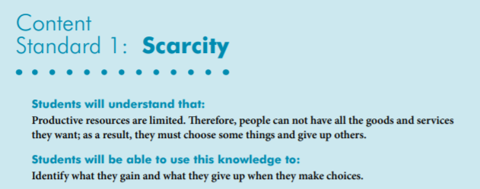
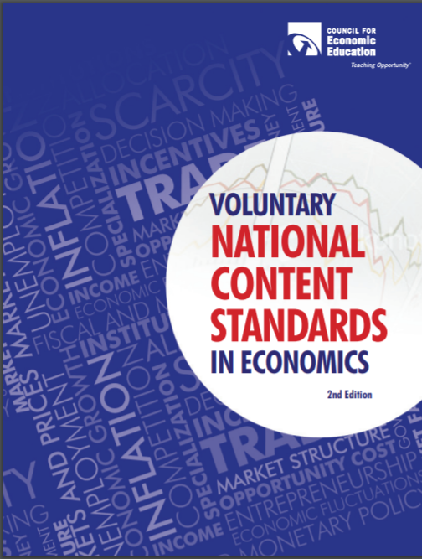
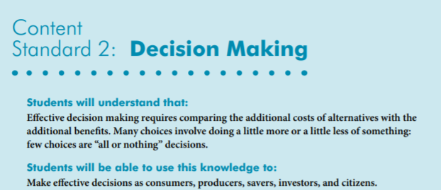
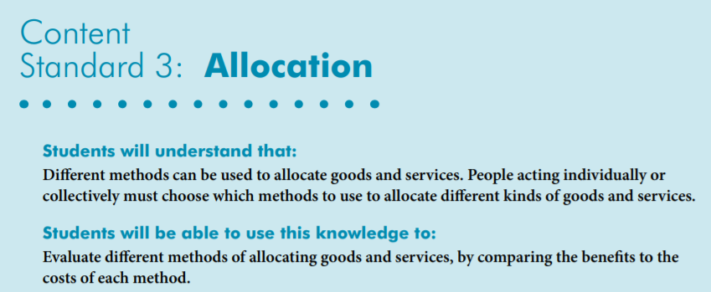
National Standards
https://www.councilforeconed.org/wp-content/uploads/2012/03/voluntary-national-content-standards-2010.pdf

Slide 6
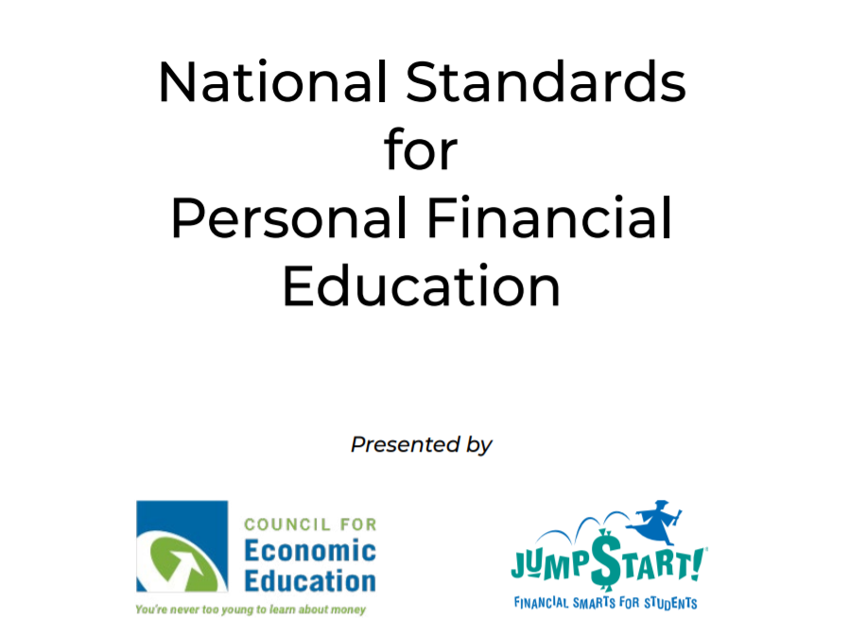
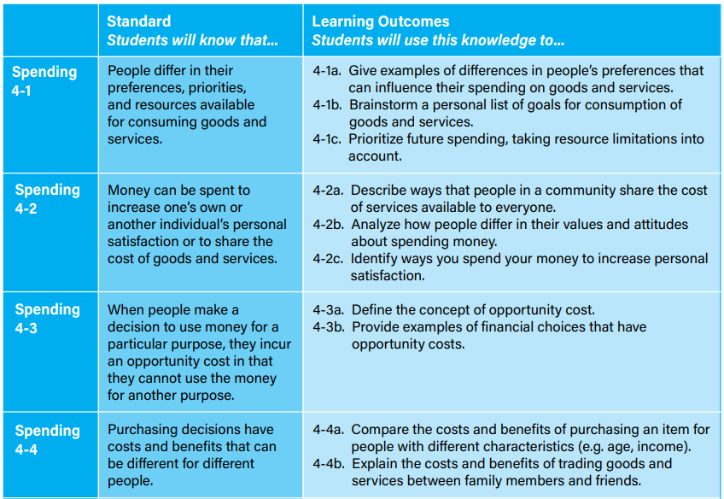
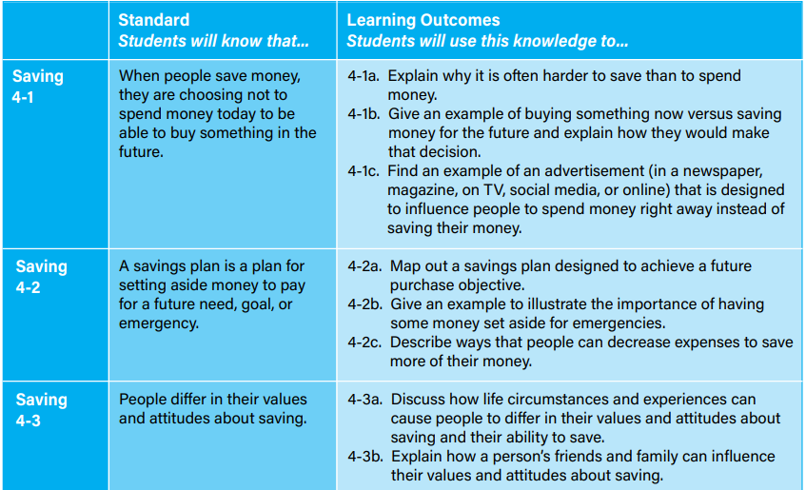
https://www.councilforeconed.org/national-standards-for-personal-financial-education/

Slide 7

Virginia HISTORY & SOCIAL SCIENCE Standards of Learning
Economics
1.7 The student will explain the difference between goods and services and describe how people are consumers and producers of goods and services.
2.8 The student will describe natural resources (water, soil, wood, and coal), human resources (people at work), and capital resources (machines, tools, and buildings)
2.10 The student will explain that scarcity (limited resources) requires people to make choices about producing and consuming goods and services.
3.8 The student will demonstrate an understanding of different cultures and the natural, human, and capital resources they used in the production of goods and services.
3.9 The student will recognize that because people and regions cannot produce everything they want, they specialize in what they do best and trade for the rest.
CE.12 The student will apply social science skills to understand the United States economy by
c) describing the types of business organizations and the role of entrepreneurship;
Economics/Personal Finance
EPF.2 The student will demonstrate knowledge of the role of producers and consumers in a market economy by
c) identifying the role of entrepreneurs;
Civics
1.10 The student will apply the traits of a good citizen by
a) focusing on fair play, exhibiting good sportsmanship, helping others, and treating others with respect.

Slide 8

Why Use Children’s Literature to Teach in the Content Areas?
Personal finance and economic concepts become more interesting when students can make connections to a story. Students learn to recognize that economic decision-making is part of everyday life when reading or listening to a book.
Research shows that using children’s literature to teach in the content areas can enrich learning. It can help build an awareness of economic concepts through storytelling as well as help students develop problem solving skills, recognize ethical dilemmas and comprehend social commentary.

Slide 9
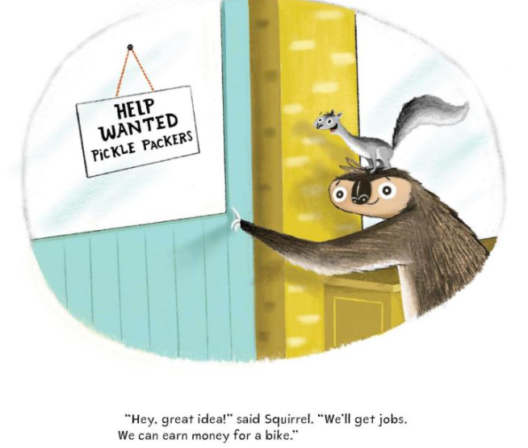
SLOTH & SQUIRREL IN A PICKLE
Publisher: Kids Can Press
Copyright Date: 2021
Reading Level: 2.0
Interest Level: PK-2
https://www.youtube.com/watch?v=lpwVwa8GaxI
5 minutes

Slide 10
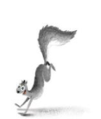
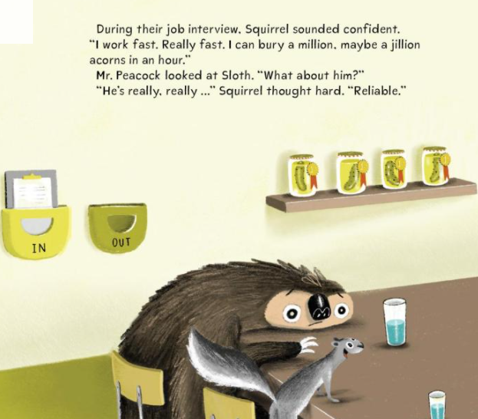

SLOTH & SQUIRREL IN A PICKLE
Story Synopsis: A quick squirrel and a slow sloth try to earn some money by applying for and getting a job in a pickle factory.
Funny and heartwarming this tale of two unlikely friends includes positive themes that feature perseverance, resourcefulness and teamwork.

Slide 11
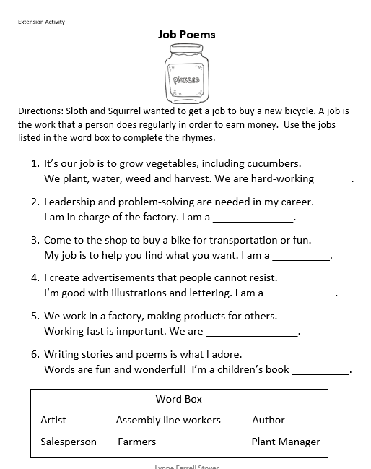
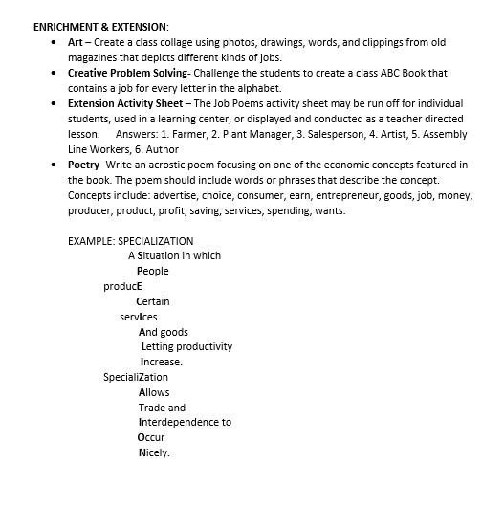
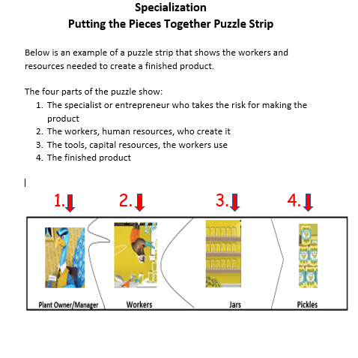
SLOTH & SQUIRREL IN A PICKLE
Lessons and Activities

Slide 12
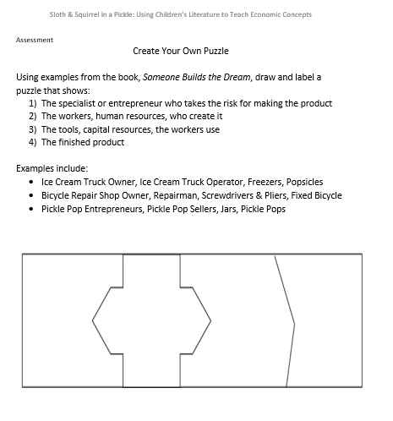
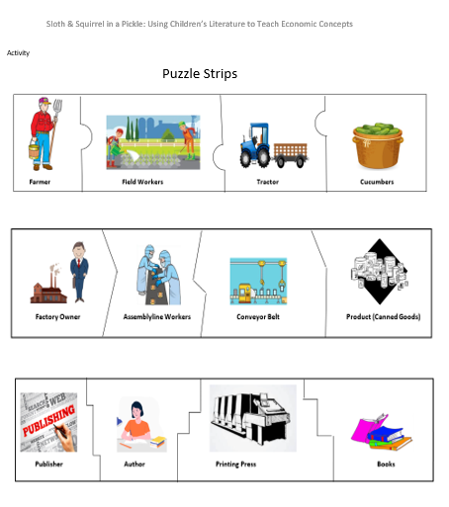

SLOTH & SQUIRREL IN A PICKLE

Slide 13
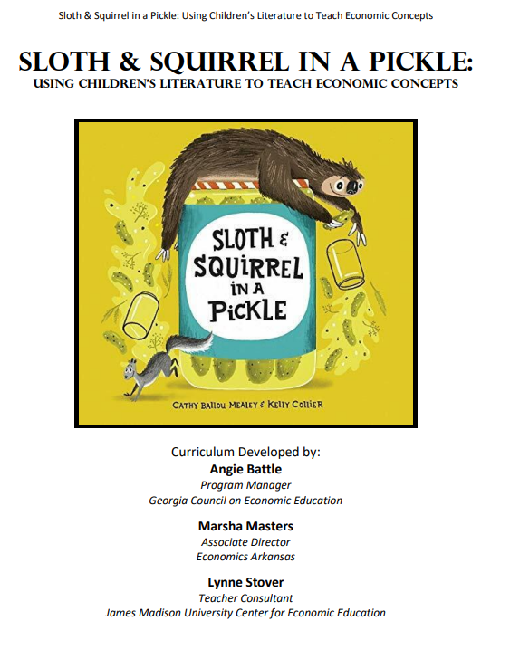
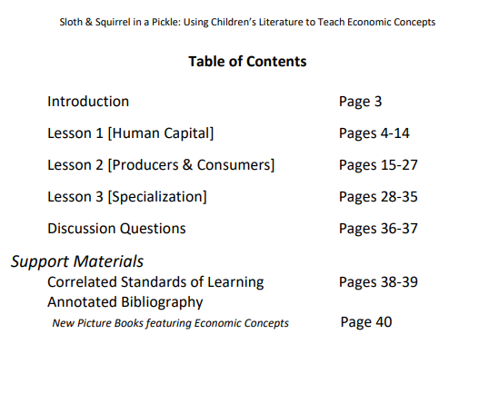
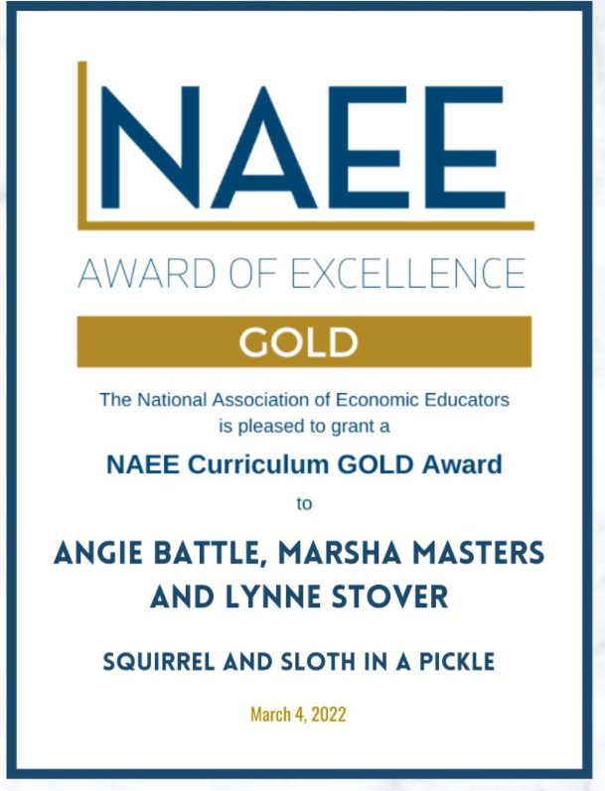
https://youreconomicsuccess.org/wp-content/uploads/2022/01/Sloth-and-Squirrel-in-a-Pickle-K-3-Lessons-.pdf

Slide 14
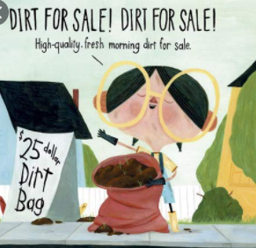
Dirt Cheap by Mark Hoffmann
Publisher: Alfred A. Knopf, Inc.
Copyright Date: 2020
Reading Level: 1.0
Interest Level: P-2
https://www.youtube.com/watch?v=0axD7bRxHXs
6 minutes

Slide 15
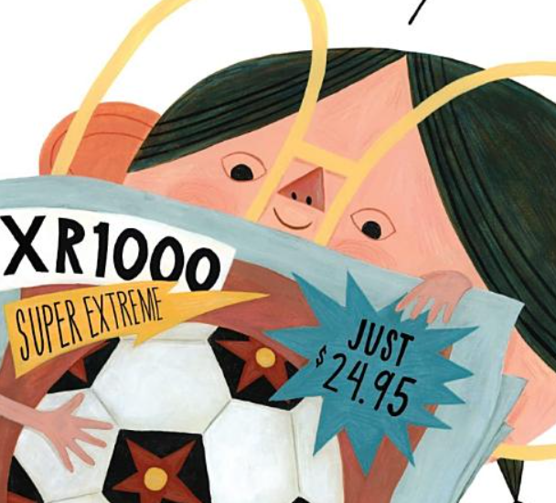
Dirt Cheap
Story Synopsis: Birdie, a young entrepreneur, doesn't know much about money. She is motivated to learn so that she can purchase a new soccer ball for $24.95. When she observes her neighbors all working in their yards, she realizes that she has something that they all could use…dirt!
After digging and bagging her product she has accumulated a bag full of quarters, dimes, nickels, pennies, and even dollar bills!
However, she may not have thought through her enterprise as well as she could have.

Slide 16
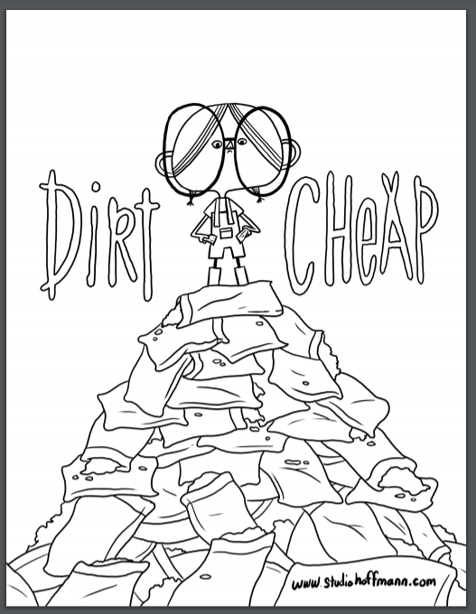
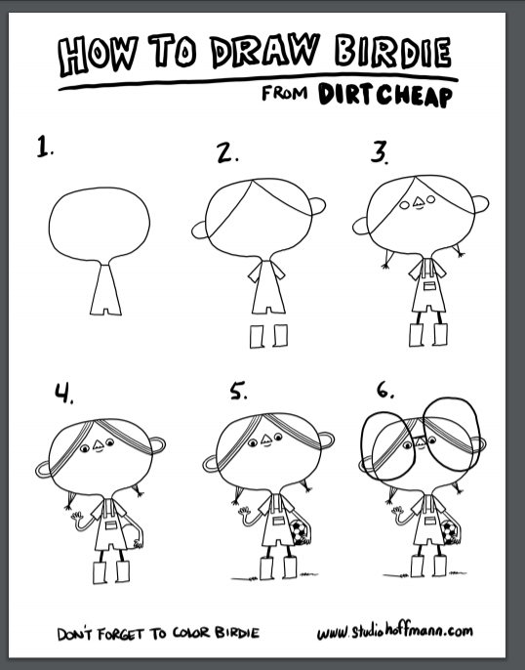
Activity Pages
https://static1.squarespace.com/static/596301cc3a0411d39d8b2f47/t/5ebf5e393072bb7b9d246b9c/1589599840669/Dirt_Cheap_1.pdf
https://static1.squarespace.com/static/596301cc3a0411d39d8b2f47/t/5ebf5e72e5e653713b79f82e/1589599926254/Dirt_Cheap_2.pdf

Slide 17

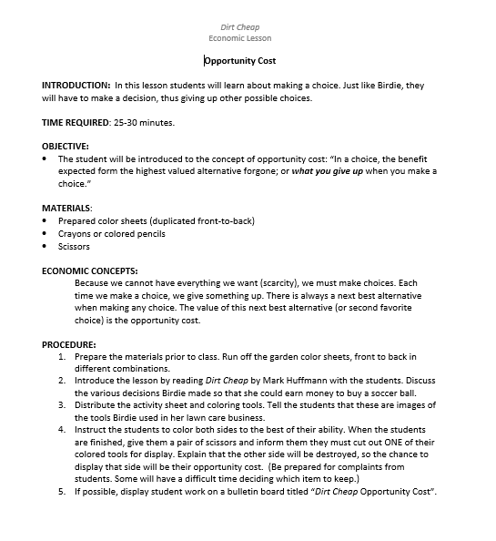



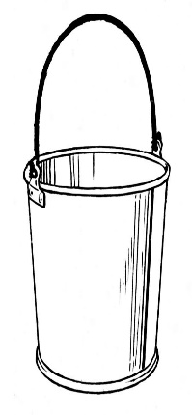

Dirt Cheap Opportunity Cost Lesson

Slide 18
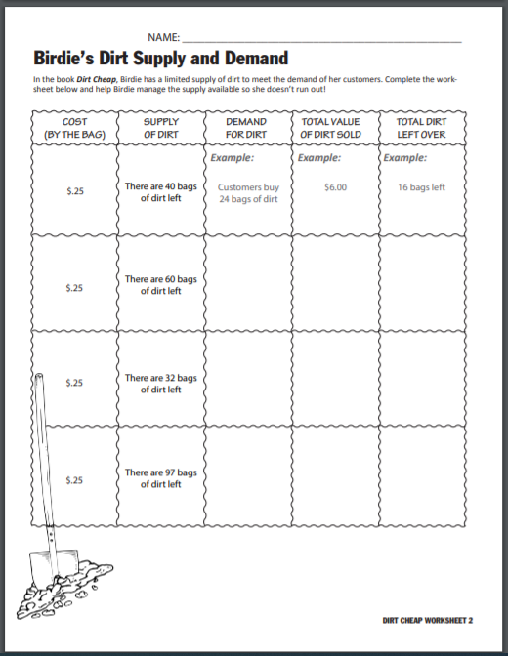
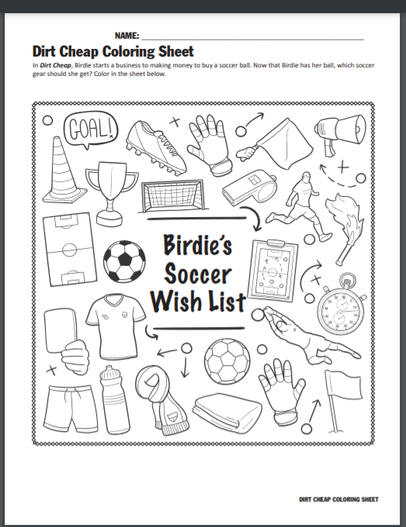
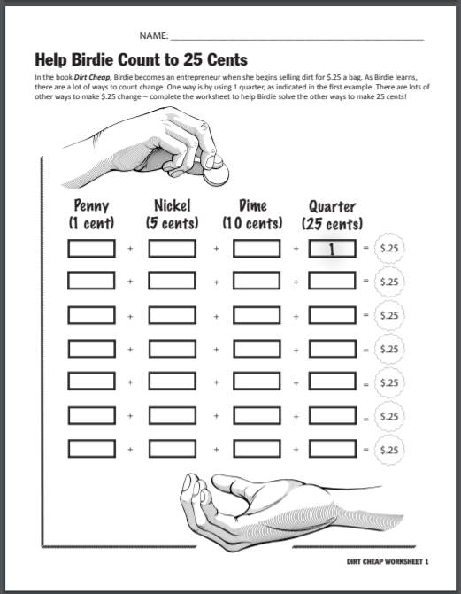
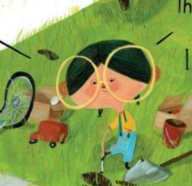
https://www.vermonttreasurer.gov/sites/treasurer/files/Financial_Literacy/PDF/2020/Dirt%20Cheap%20Worksheets%2020-21.pdf

Slide 19
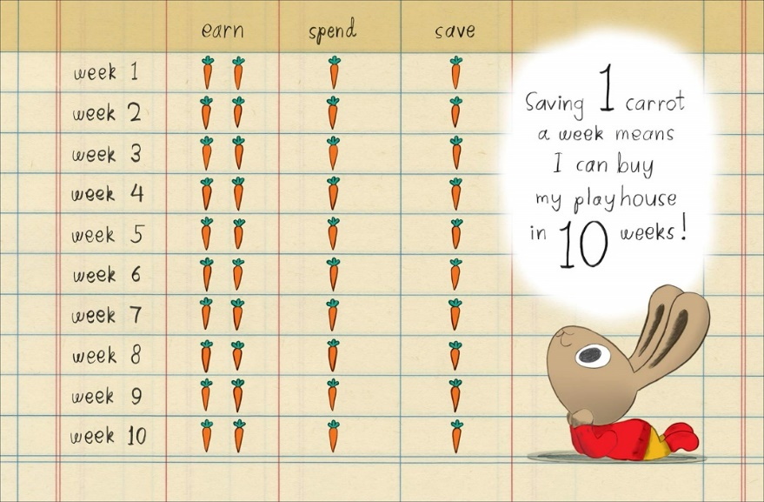
Save It!
Saving Goals
Publisher: Penguin
Copyright Date: 2019
Reading Level: 1.0
Interest Level: PK-2
https://www.youtube.com/watch?v=-x97ApD-Cd0
3.5 minutes

Slide 20
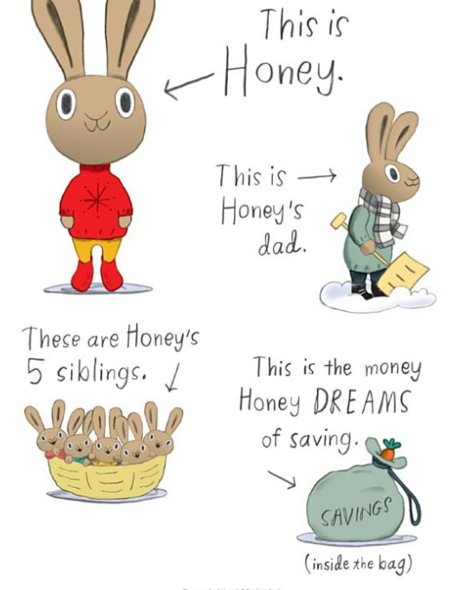
Save It!
Story Synopsis: Honey works hard taking care of her five younger siblings for which she earns two carrots a week. She would really like to have a quiet place of her own. Her father suggests she save her money to buy her own playhouse. After some creative problem solving, Honey decides to save a portion of her weekly allowance. This method might take a while longer, but she will still be able to enjoy some of her favorite treats.

Slide 21

ENRICHMENT AND EXTENSION
Save It!
Rhyming – Tell the students that in this story Honey, bunny, and money are rhyming words. They sound alike. Challenge them to think of other words in the story and find words that rhyme with them. Possible words include: Dad, Earn, Playhouse, Save, and Spend.
Creative Problem Solving – Carrots are money in Bunnyland. We save our money in banks and credit unions where it is safe. Do you think there are banks in Bunnyland? If so, what would they look like? Would there be wallets and pocket books in Bunnyland? What do you think they would look like?

Slide 22
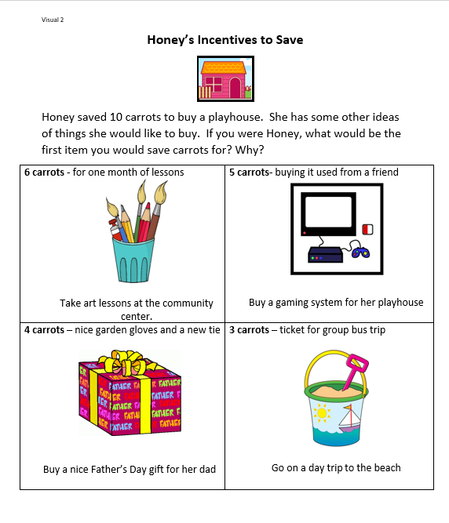
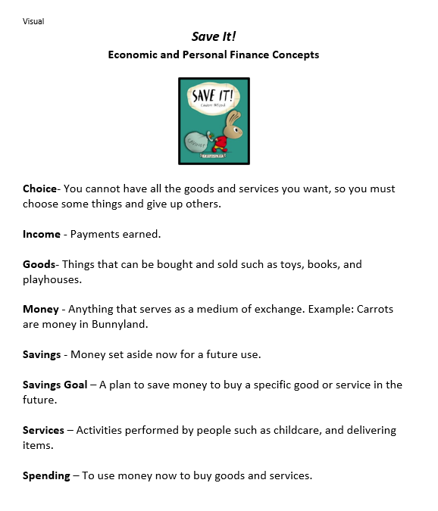
Visuals
Save It!

Slide 23
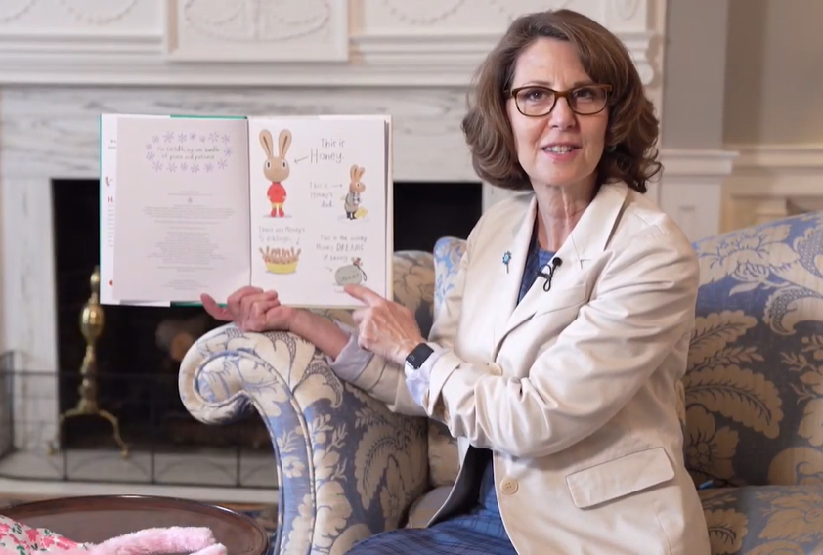
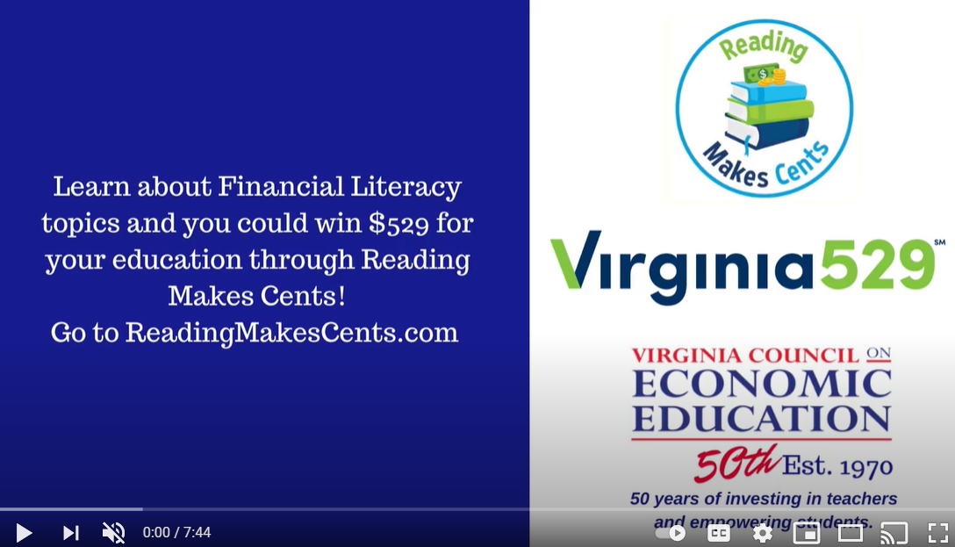
Unintended Consequences?
First Lady Northam reading "Save It!"
https://www.youtube.com/watch?v=1BDayN0lEEY
(7:45 Reading Time)

Slide 24

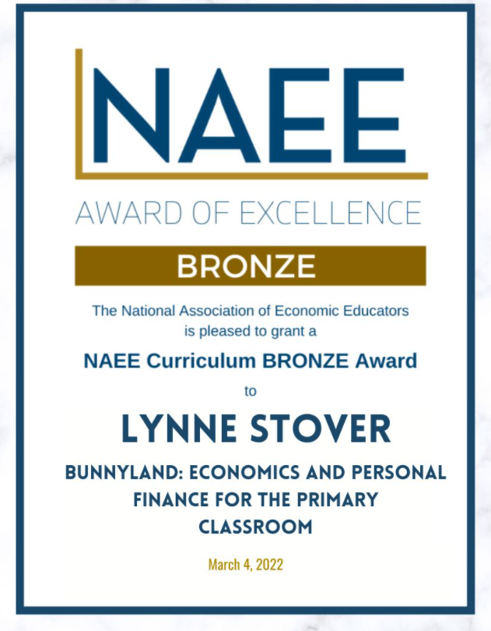
Note: Bunnyland Series Unit is available.
http://youreconomicsuccess.org/kidlit/

Slide 25
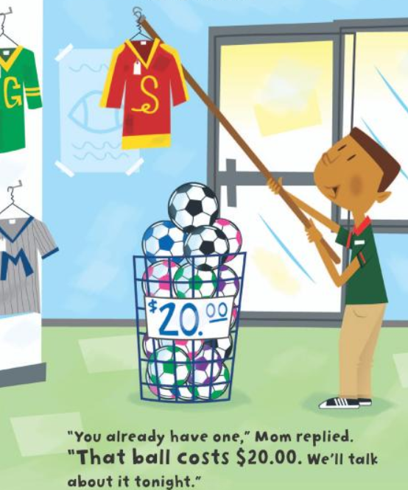
Ella Earns Her Own Money
Reading Level: 2.3
Interest Level: K-3
Publisher: Lerner
Copyright Date: 2014
https://www.youtube.com/watch?v=gZ9j3DZtMok
[Reading Time 4:42]

Slide 26
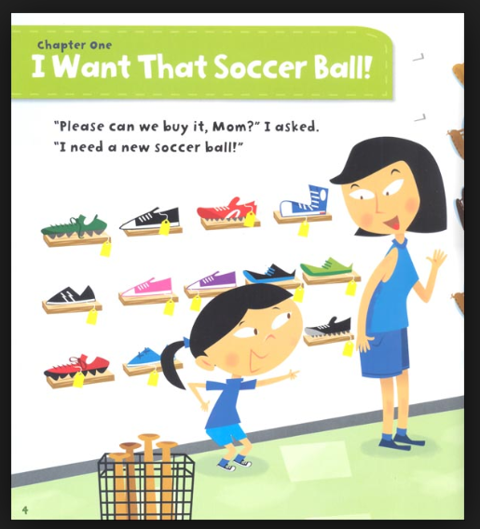
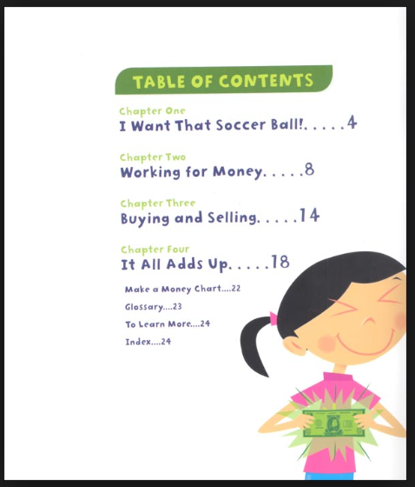
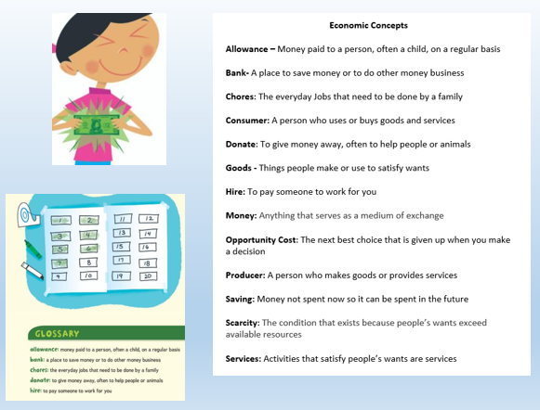
Ella Earns Her Own Money
Story Synopsis: Ella really wants a soccer ball. But she doesn't have enough money to buy one. So she decides to earn her own money. Ella cleans the car for her mom, gives the neighbor's dog a bath, and sells bracelets to her friends to earn cash. Will she have enough money to buy the ball in the end?

Slide 27
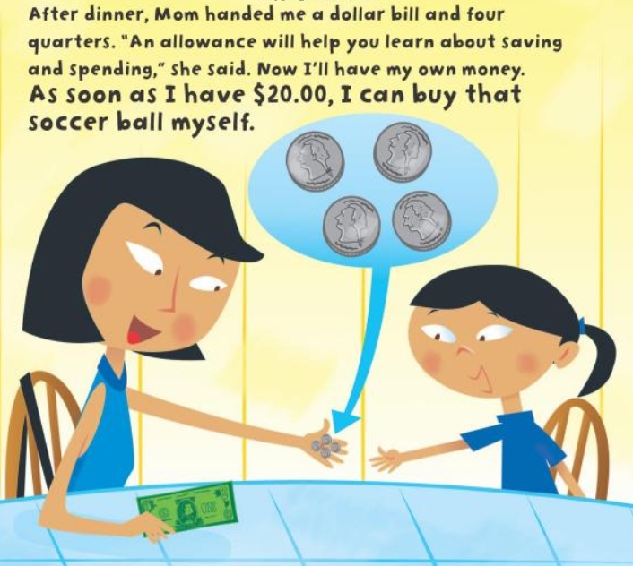
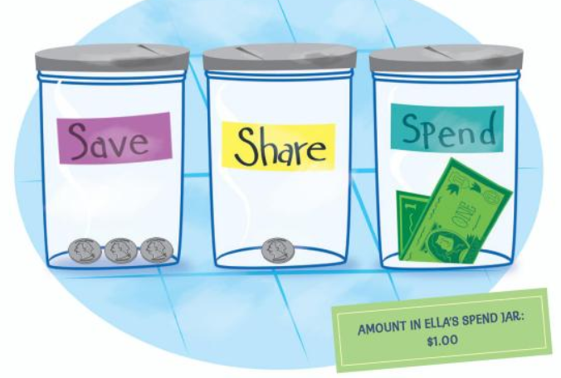
Thoughtful Saving

Slide 28
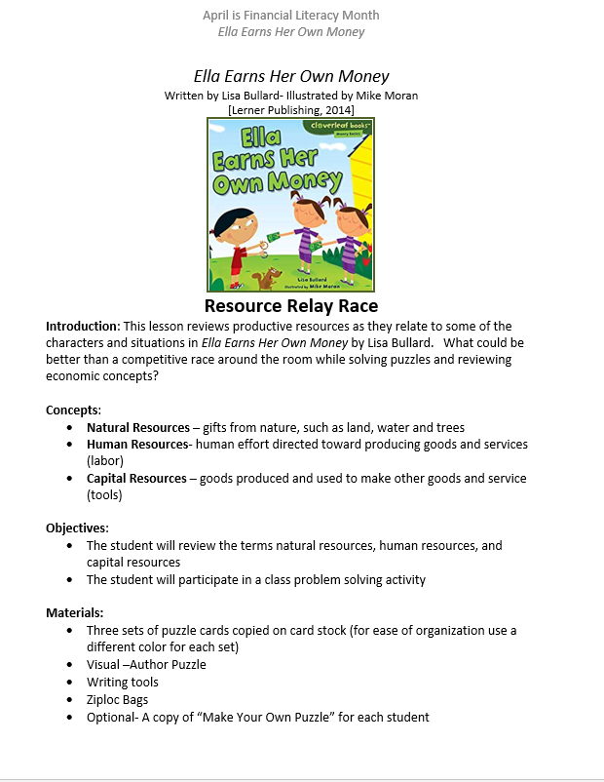
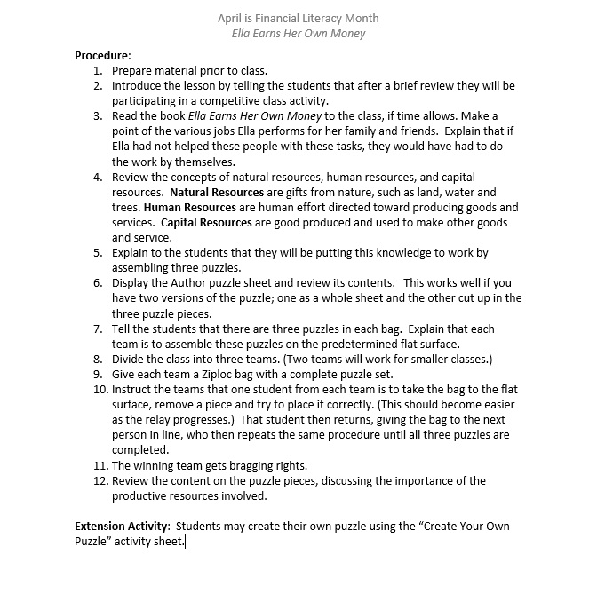


Slide 29
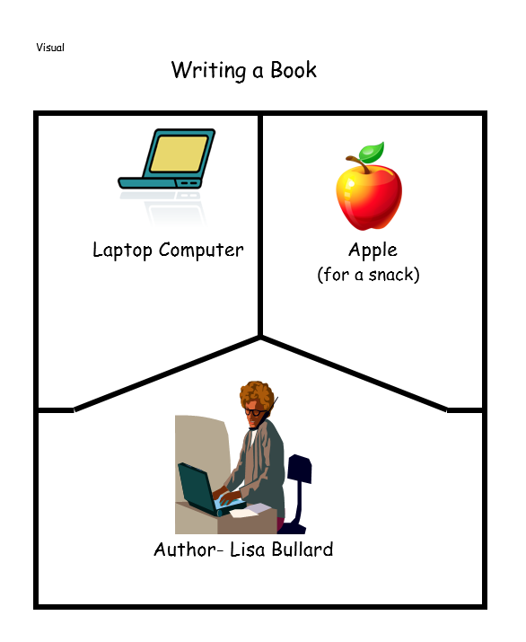
Introduction
Ella Earns Her Own Money
Display the Author puzzle sheet and review its contents. This works well if you have two versions of the puzzle; one as a whole sheet and the other cut up in the three puzzle pieces.

Slide 30
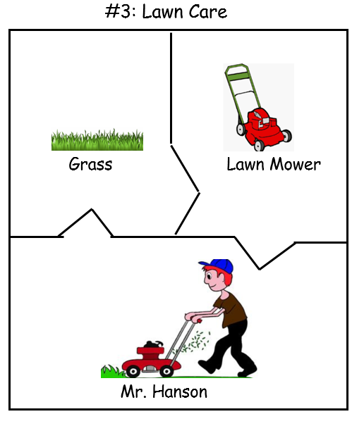
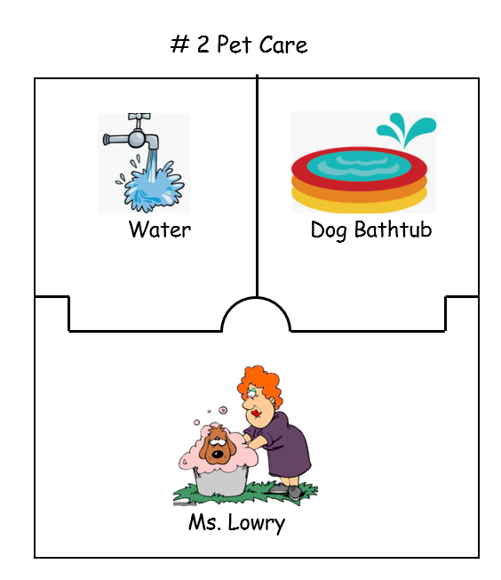
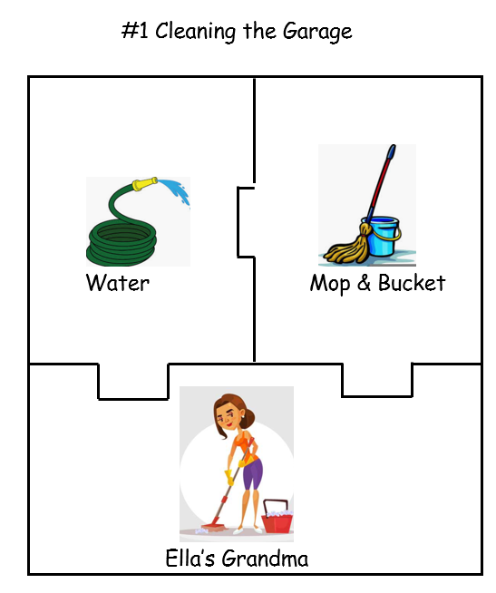
Completed Puzzles

Slide 31


Ella Earns Her Own Money
Extension Activity: Students may create their own puzzle using the “Create Your Own Puzzle” activity sheet.

Slide 32

Lemonade in Winter: A Book About Two Kids Counting Money
Publisher: Random House
Copyright Date: 2012
Reading Level: 2.5
Interest Level: P-2
https://www.youtube.com/watch?v=oM-IA8TIlzc
8 minutes

Slide 33


Book Synopsis: Determined Pauline and little brother John-John decide to sell lemonade on a blustery winter day. The two siblings count money, buy the needed resources, make their product, and set up a lemonade stand. As their mother predicted, they have few customers and during the slow spells they create advertisements, make decorations, create a jingle, and lower prices. They return to the store and purchase popsicles to help them forget their disappointment and celebrate a fun-filled day.

Slide 34




Slide 35




Slide 36



https://files.consumerfinance.gov/f/documents/cfpb_book-club_lemonade_in_winter_singlepage.pdf
12-page Parent Guide

Slide 37




Earning Money
https://files.consumerfinance.gov/f/documents/cfpb_building_block_activities_earning-money_worksheet.pdf
https://amhistory.si.edu/ourstory/pdf/money/money_reading.pdf

Slide 38


Rock, Brock, and the Savings Shock
Publisher: Albert Whitman
Copyright Date: 2006
Reading Level: 5.0
Interest Level: 1-4
https://www.youtube.com/watch?v=fbSOf2_jHc4
5 minutes

Slide 39


Book Synopsis: Rock and Brock may be twins but they are not alike when it comes to physical appearance, personalities, and spending habits. Neat and organized Rock cannot resist spending his money, while messy and free-spirited Brock has amazing constraint when it came to saving his. The brothers learn a valuable lesson when their grandfather pays them each a dollar for doing chores and promises that for each dollar they save, he will double it for the next ten weeks. Rock quickly spends his money on silly toys, gum, and used yard-sale items. Brock resists the temptation to spend and has amassed $512 by the end of the summer. All ends well when Brock shows his brother that it’s never too late to start a saving plan.

Slide 40



Author’s Notes:

Slide 41



Slide 42




https://www.econedlink.org/wp-content/uploads/2020/12/CEE-RMC-Rock-Brock-Lesson_Investo_Million_Pennies.pdf

Slide 43







New Picture Books featuring Economics and Personal Finance

Slide 44
Assessment Questions
Something to think about…
What are the benefits of using children’s literature to teach economics and personal finance?
The book Rock, Brock and the Savings Shock was published in 2006 and contains dated monetary values and good & services. Would you still consider using it with your students? Why or Why not?
The concept of “money” is rapidly changing. Do young students understand currency? Can they identify coins? Do you think it is important for them to have these skills?
How can picture books be used with older students?

Slide 45

CEE Affiliates
https://www.councilforeconed.org/resources/local-affiliates/

Slide 46




Thank You to Our Sponsors!

