Slide 1
WELCOME!
Housekeeping Items:
Please use the chat and/or Q & A function to ask questions or to notify moderator of issues
The session will be recorded and emailed to participants in the next few days
Thank you for joining us.
The webinar will begin shortly.

Slide 2
AP Macro Unit 4:
Banking and the Expansion of the Money Supply
Live Webinar: May 31st, 2022

Slide 3

Instructor Bio
James Redelsheimer has been an AP and Regular Economics teacher at Robbinsdale Armstrong High School in Plymouth, Minnesota since 2003. James received his Bachelor’s degree from St. Olaf College and his Master's degree at the University of St. Thomas. He received the 3M Economics Educator Excellence Award from the Minnesota Council on Economic Education and was named Visa's Practical Money Skills Innovative Educator of the Month.
James enjoys traveling and has been a guest lecturer in the economics department at the Batumi State University in The Republic of Georgia and has received travel grants and fellowships for study travel to learn about the economies of Japan, China, Turkey, Germany, Korea, among others, and studied economics of the environment in Costa Rica. He currently serves as an AP Economics reader, grading AP Economics exams. He enjoys teaching Economics because it relates to students' everyday lives.

Slide 4
Webinar Objectives
In this webinar teachers will be able to:
  Describe how Monetary Policy is implemented to achieve goals such as price stability and full-employment
  Explain the specific tools of Monetary Policy, and review practice AP Exam questions with their students.

Slide 5
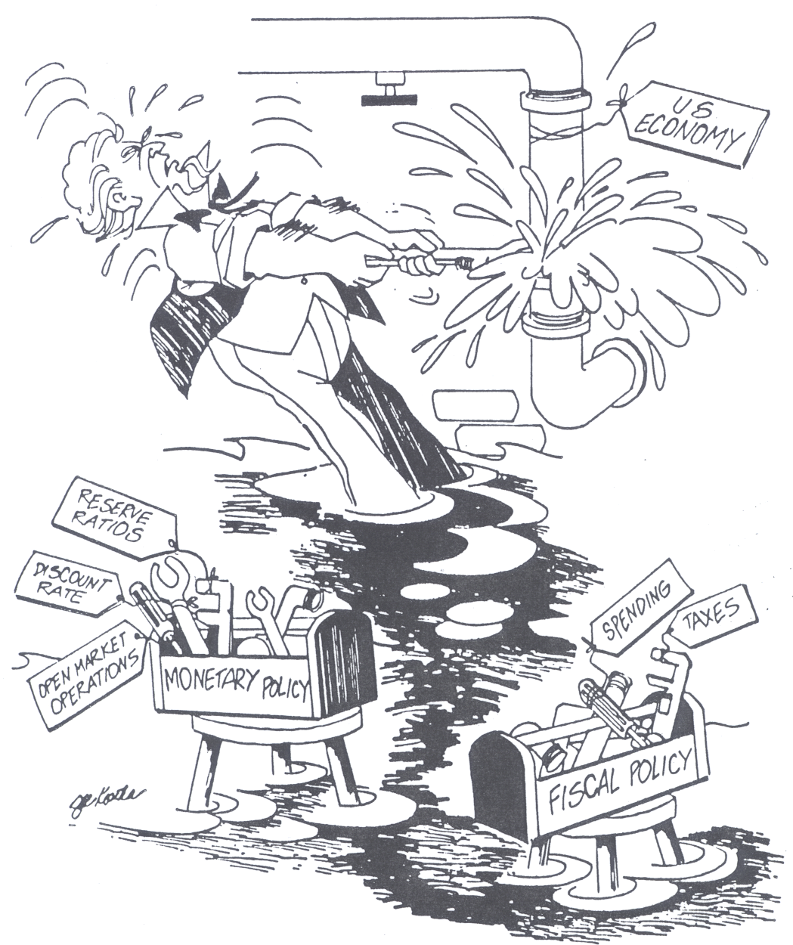

Slide 6
How can the Government try to Stabilize the Economy?
The Government has two different tool boxes it can use:
1. Fiscal Policy-
Actions by Congress to stabilize the economy.
OR
2. Monetary Policy-Actions by the Fed to stabilize the economy.

Slide 7
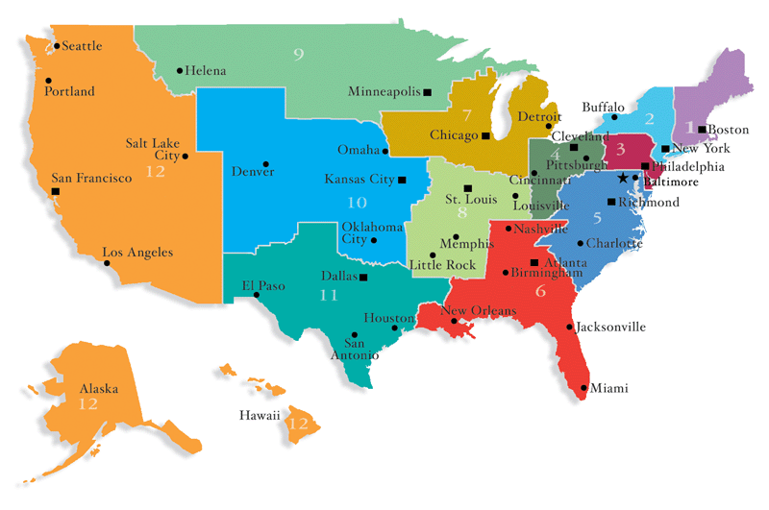
12 Federal Reserve Districts

Slide 8
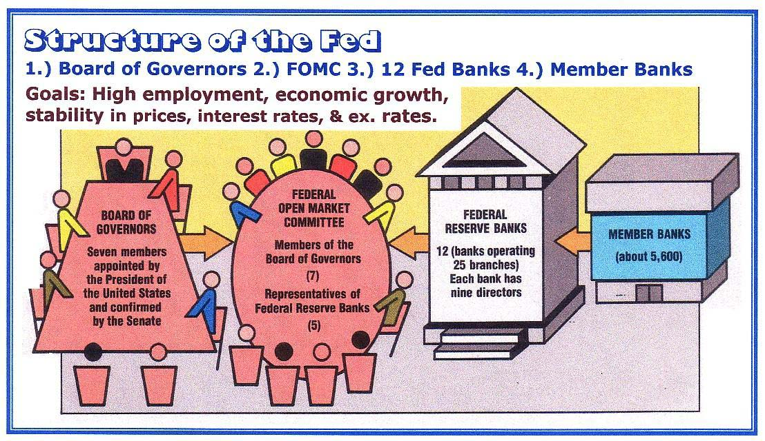

Slide 9
Fed Buys A $1,000 Bond From a Bank
New reserves
$1,000
Excess
Reserves
20% RR
$5,000
PMC thru Bank Lending
TMS is $5000

Slide 10
When the Fed buys bonds, there is
NO RESERVE REQUIREMENT
$1,000
Excess
Reserves
20% RR
New reserves
$5,000
PMC thru Bank Lending
TMS is $5000

Slide 11
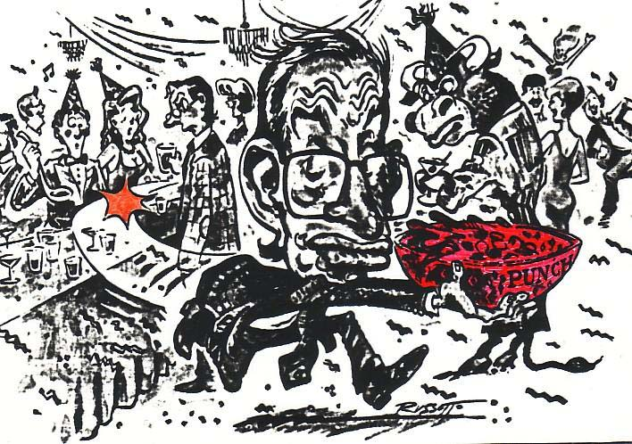

“When the party gets too good, it’s the job of the Fed to take away the punch bowl.”
During a recession, the Fed is happy to “spike the punch.”

Slide 12
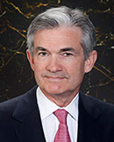
3 Shifters of Money Supply
The Fed adjusts the money supply by changing :
1. The Reserve Requirements (Ratios)
2. The Discount Rate
3. Open Market Operations
The Fed is now chaired by Jerome H. Powell

Slide 13
#1. The Reserve Requirement
If you have a bank account, where is your money?
Only a small percent of your money is held in reserve. The rest of your money has been loaned out.
This is called “Fractional Reserve Banking”.
The Fed sets the amount that banks must hold.
The reserve requirement (reserve ratio) is the percent of deposits that banks must hold in reserve (the percent they can NOT loan out).
  When the Fed increases the money supply, it increases the amount of money held in bank deposits.
  Banks keep some of the money in reserve and loan out their excess reserves.
  These loans eventually become deposits for another bank that will loan out their excess reserves.

Slide 14
Using The Reserve Requirement
1. If there is a recession, what could the Fed do to the reserve requirement? (Explain the steps.)
Decrease the Reserve Ratio
Banks hold less money and have more excess reserves.
Banks create more money by loaning out excess.
Money supply increases, interest rates fall, AD up.
2. If there is inflation, what could the Fed do to the reserve requirement? (Explain the steps.)
Increase the Reserve Ratio
Banks hold more money and have fewer excess reserves
Banks create less money.
Money supply decreases, interest rates up, AD down.

Slide 15
#2. The Discount Rate
The Discount Rate is the interest rate that the Fed charges commercial banks.
Example:
  If Banks of America needs $10 million, they borrow it from the U.S. Treasury (which the Fed controls) but they must pay it bank with 3% interest.
To increase the Money supply, the Fed should _________ the Discount Rate (Easy Money Policy).
To decrease the Money supply, the Fed should _________ the Discount Rate (Tight Money Policy).
DECREASE
INCREASE

Slide 16
#3. Open Market Operations
Open Market Operations is when the Fed buys or sells government bonds (securities).
This is the most important and widely used monetary policy.
To increase the Money supply, the Fed should _________ government securities.
To decrease the Money supply, the Fed should _________ government securities.
BUY
SELL
How are you going to remember?
Buy-BIG- Buying bonds increases money supply.
Sell-SMALL- Selling bonds decreases money supply.

Slide 17
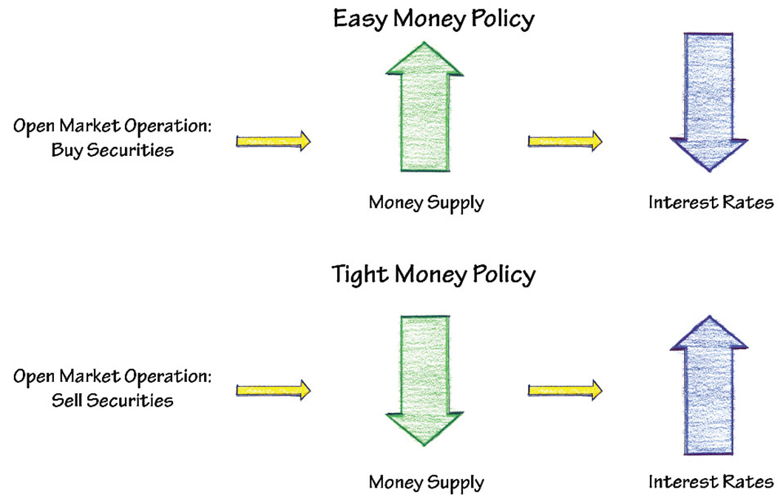
Open Market Operations

Slide 18
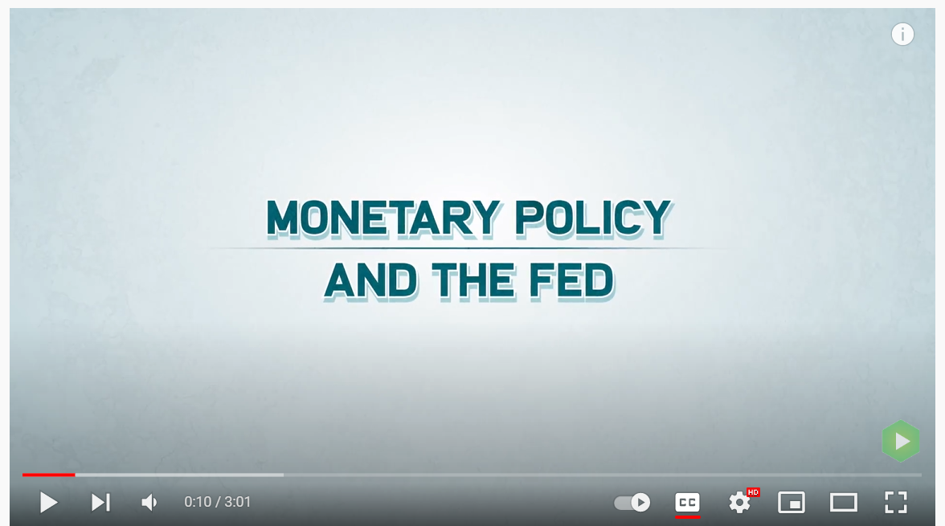

Slide 19

Federal Funds Rate
The Federal funds rate is the interest rate that banks charge one another for one-day loans of reserves.
The Fed can’t simply tell banks what interest rate to use. Banks decide on their own.
The Fed influences them by setting a target rate and using open market operation to hit the target.
The Federal funds rate fluctuates due to market conditions, but it is heavily influenced by monetary policy (buying and selling of bonds).

Slide 20
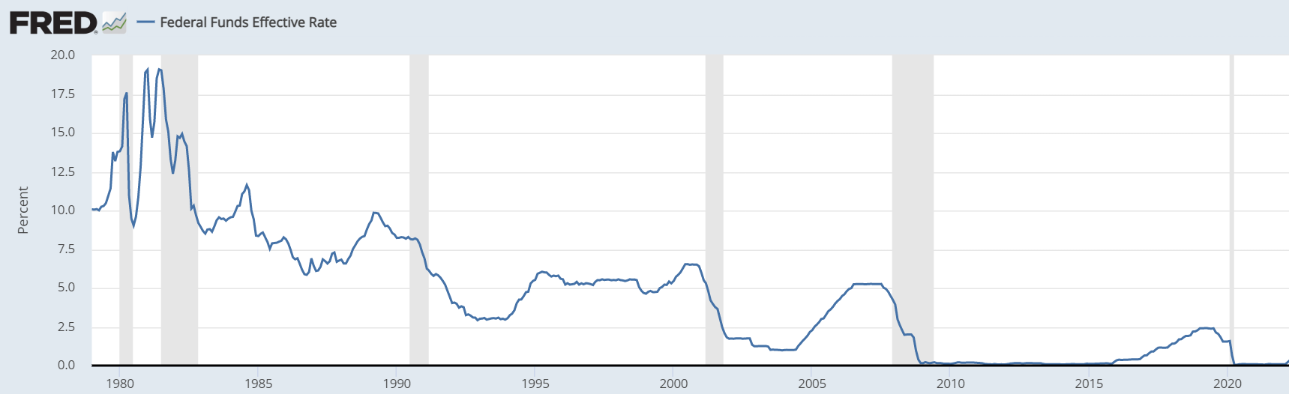
Federal Funds Rate
Explain the cause for the differences between the year 1979 and the year 2022.

Slide 21
Monetary Policy
and AD-AS

Slide 22
Interest Rate (i)
S&D of Money
Interest Rate (i)
Investment Demand
S_{M}
S_{M1}
10%
5%
2%
10%
5%
2%
D_{M}
D_{I}
200
250
Quantity
Quantity of Investment
PL
AD/AS
The Fed increases the money supply to stimulate the economy…
AS
PL₁
PL_{e}
Interest Rates Decreases
Investment Increases
AD, GDP and PL Increases
AD
AD₁
Q_{e}
Q₁
GDP_{R}

Slide 23
Interest Rate (i)
S&D of Money
Interest Rate (i)
Investment Demand
S_{M1}
S_{M}
10%
5%
2%
10%
5%
2%
D_{M}
D_{I}
175
200
Quantity
Quantity of Investment
PL
AD/AS
The Fed decreases the money supply to slow down the economy…
AS
PL_{e}
Interest Rates increase
Investment decreases
AD, GDP and PL decrease
PL₁
AD
AD₁
Q₁
Q_{e}
GDP_{R}
23

Slide 24

Wait, why would the Fed ever want to slow down the economy?
To fight inflation!
The role of the Fed is to “take away the punch bowl just as the party gets going”.

Slide 25
Central banks indirectly change the money supply by changing the monetary base
Monetary Base =
Bank Reserves +
Currency in Circulation
Money
Supply
Checkable
Deposits
Bank
Reserves
Currency in
Circulation

Slide 26
What is the initial change in the money supply when the Fed buys $1000 of bonds?
Money
Supply
Monetary
Base
Checkable
Deposits
NO CHANGE
Bank
Reserves
Money supply doesn’t change until the money is loaned out
+$1000
Currency in
Circulation

Slide 27
Central banks indirectly change the money supply by changing the monetary base
Money
Supply
Monetary
Base
Checkable
Deposits
Bank
Reserves
Currency in
Circulation

Slide 28
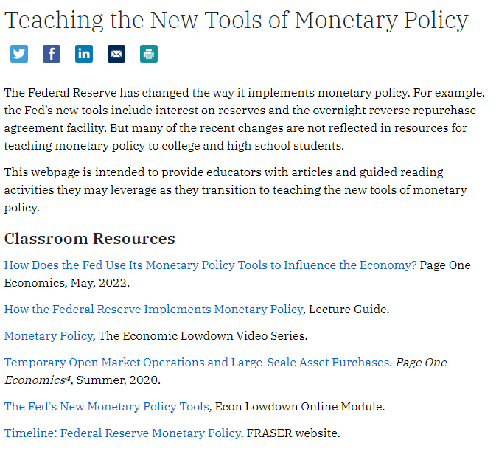

Slide 29
Practice Multiple Choice Questions

Slide 30
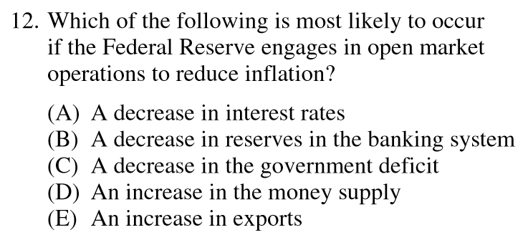
2008 Audit Exam
Notes:
B

Slide 31
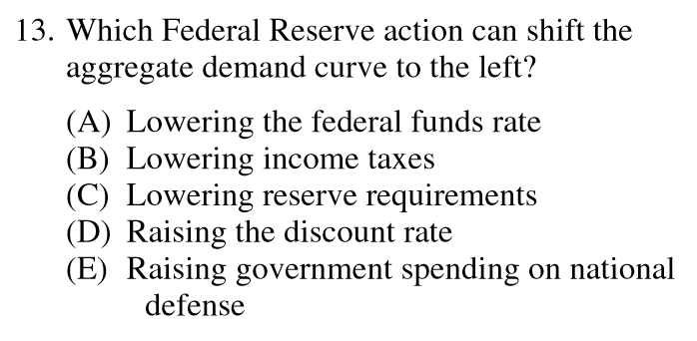
2008 Audit Exam
Notes:
D

Slide 32
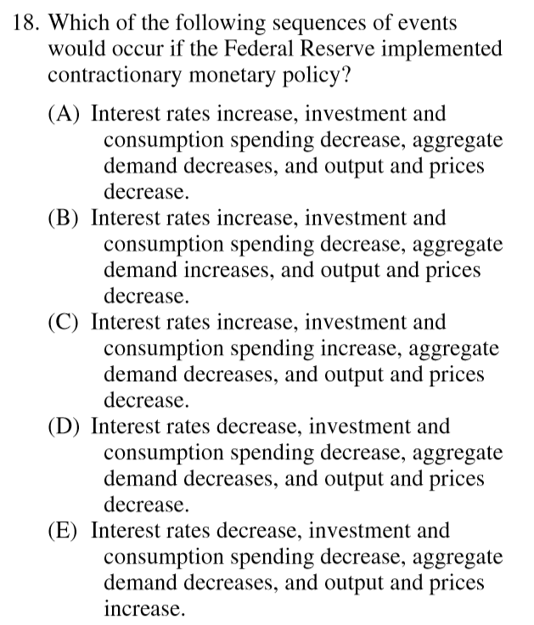
2008 Audit Exam
Notes:
A

Slide 33
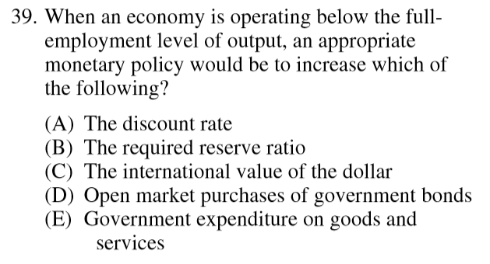
2008 Audit Exam
Notes:
D

Slide 34
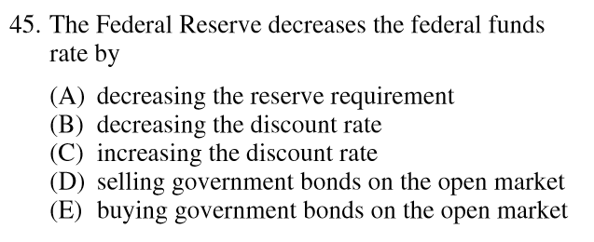
2008 Audit Exam
Notes:
E

Slide 35
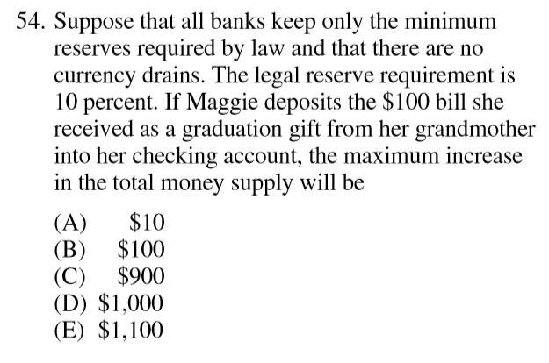
2008 Audit Exam
Notes:
C

Slide 36
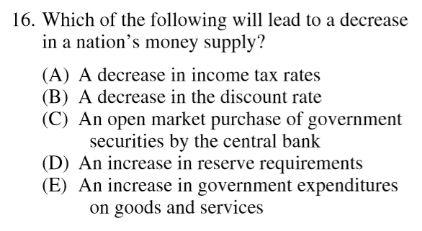
2012 Audit Exam

Slide 37
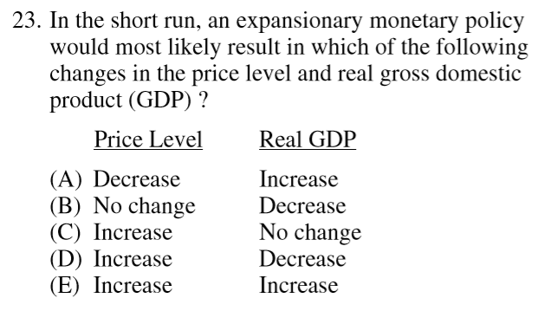
2012 Audit Exam

Slide 38
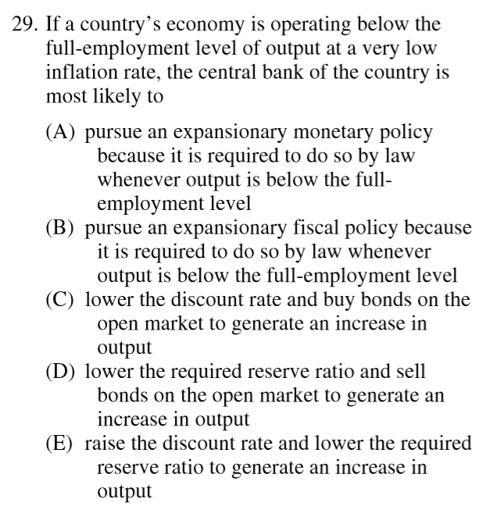
2012 Audit Exam
Notes:
C

Slide 39
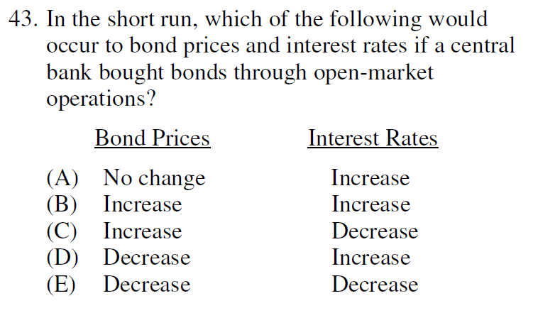
2012 Audit Exam
Notes:
C

Slide 40
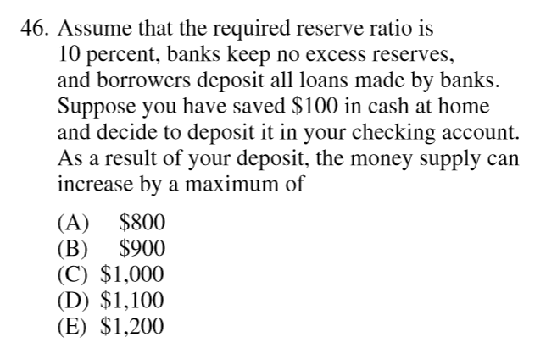
2012 Audit Exam
Notes:
B

Slide 41
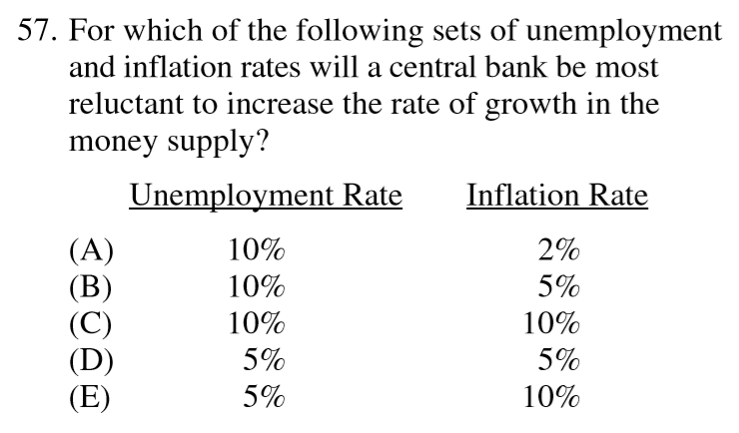
2012 Audit Exam
Notes:
E

Slide 42
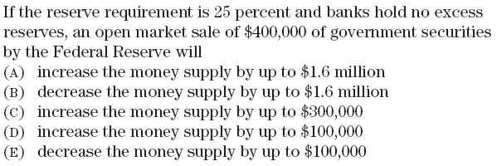
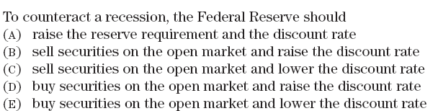
Notes:
B
E

Slide 43
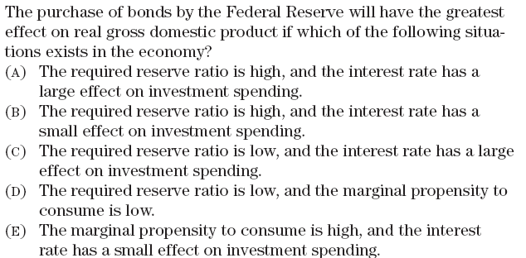
Notes:
C

Slide 44



Notes:
https://www.youtube.com/watch?v=RaeIBeJT5hY&list=PLD7C33AB80B405B9A&index=9

Slide 45
Practice FRQs

Slide 46
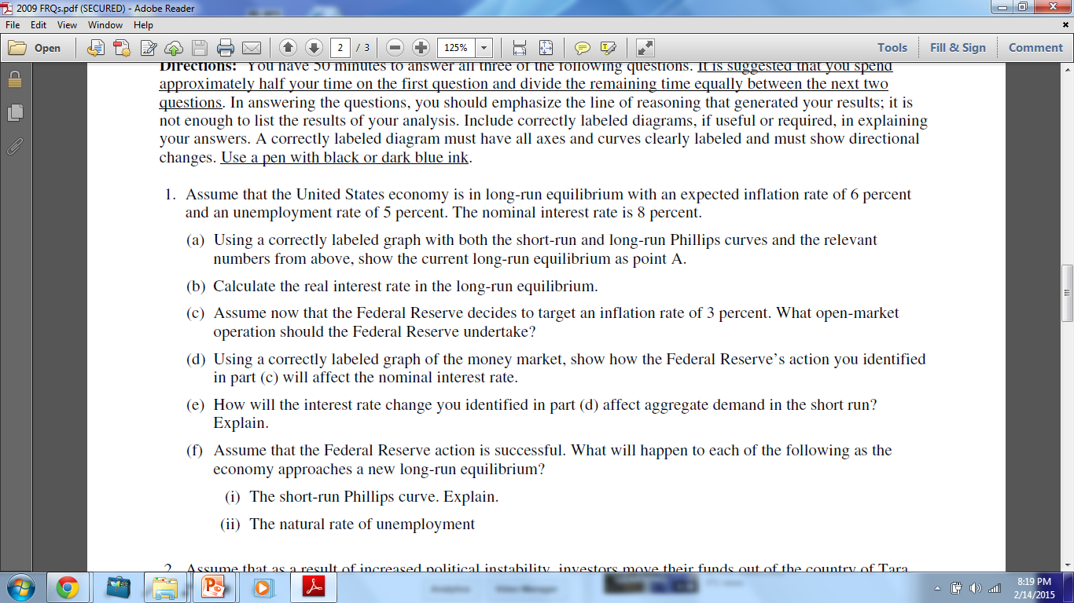
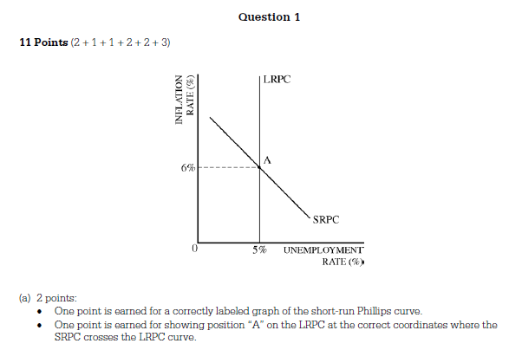
Practice FRQ
Notes:
https://www.youtube.com/watch?v=ntq89ccHrQs

Slide 47
Practice FRQ
(b) 1 pt: 8%-6% = 2%
Notes:
https://www.youtube.com/watch?v=ntq89ccHrQs

Slide 48
Practice FRQ
(c) 1 pt: Sell bonds
Notes:
https://www.youtube.com/watch?v=ntq89ccHrQs

Slide 49
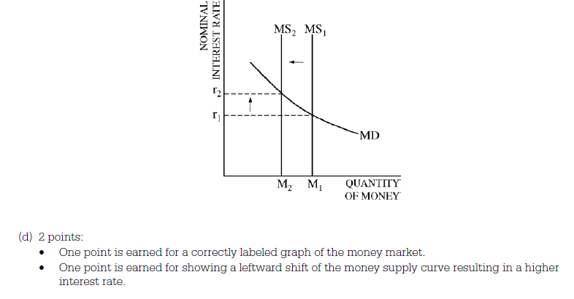
Practice FRQ
Notes:
https://www.youtube.com/watch?v=ntq89ccHrQs

Slide 50
Practice FRQ
(e) 2 pts:
Aggregate demand decreases
Higher interest rates decrease investment and interest sensitive consumption.

Slide 51
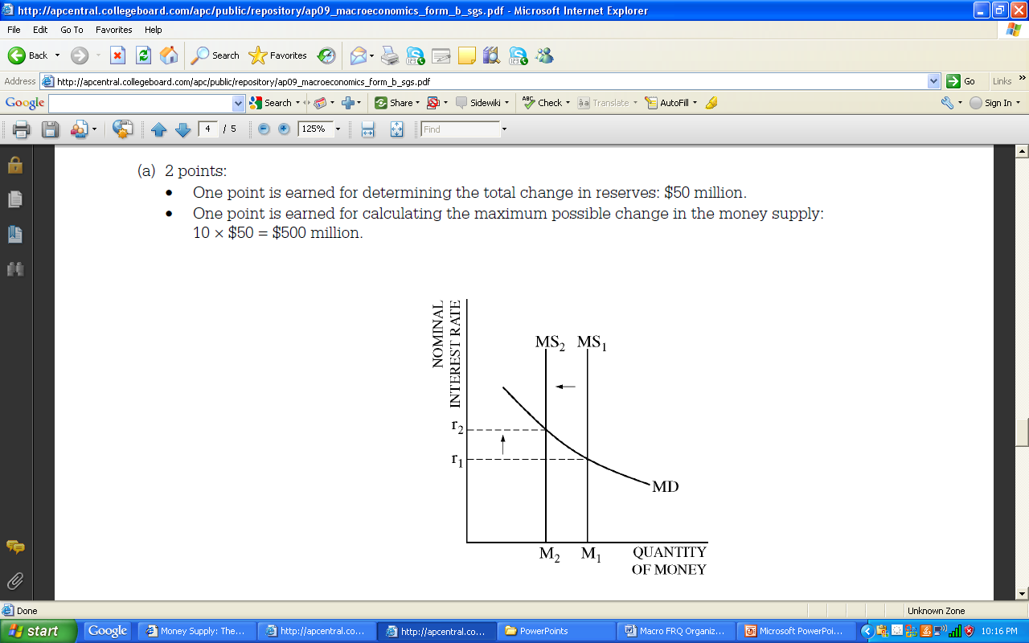
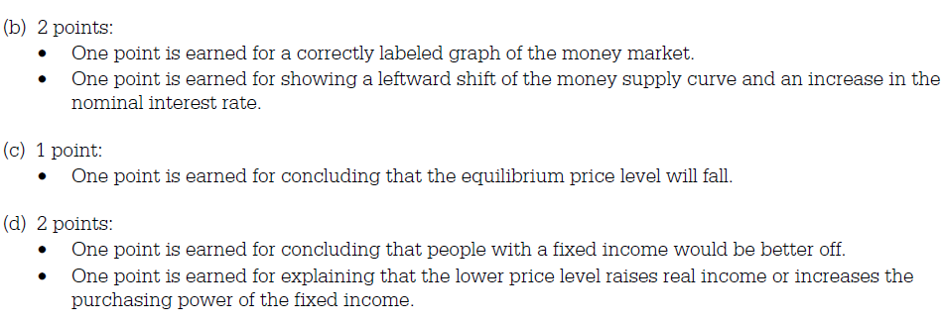
51

Slide 52
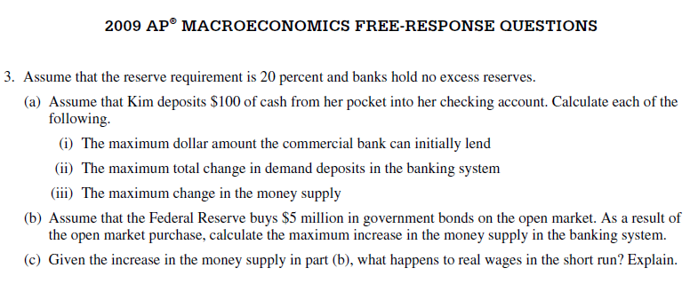
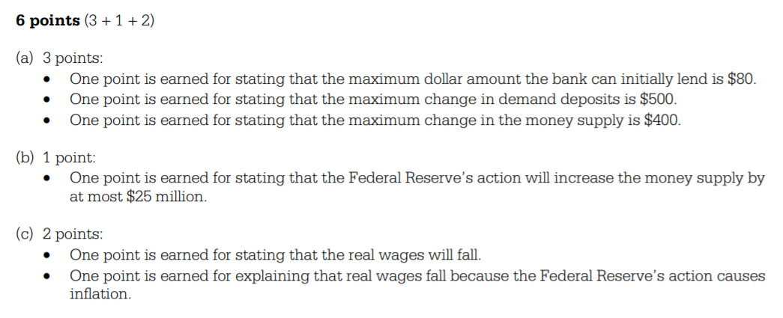

Slide 53
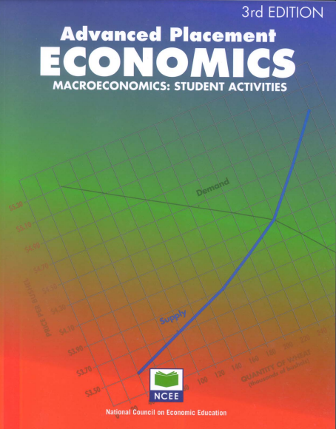
AP Economics 3rd Edition
Lesson 42

Slide 54
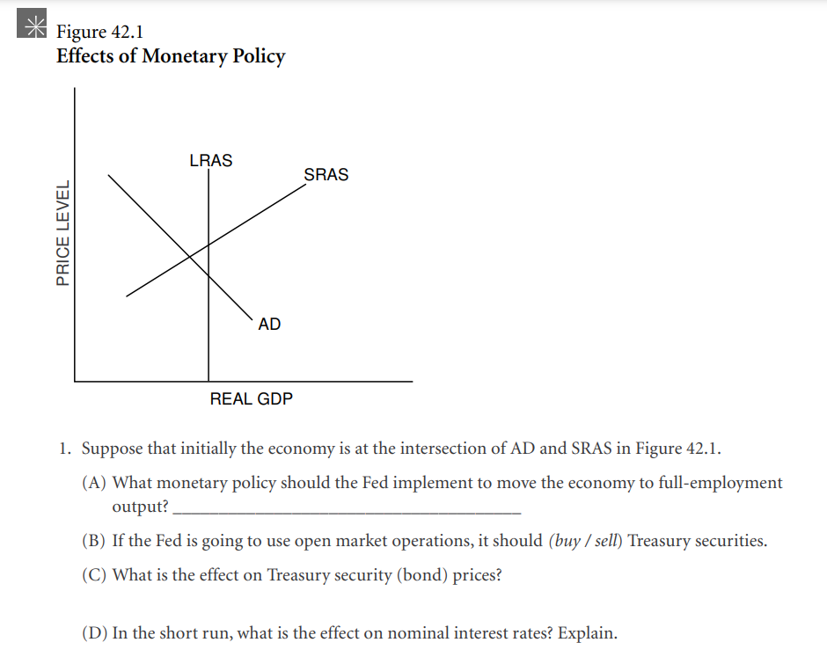
Expansionary Monetary Policy
Increase: interest rates and the price of previously existing bonds are inversely related
Decrease: financial institutions have more money to lend, increasing the supply of money and decreasing the price of money (interest rate)

Slide 55
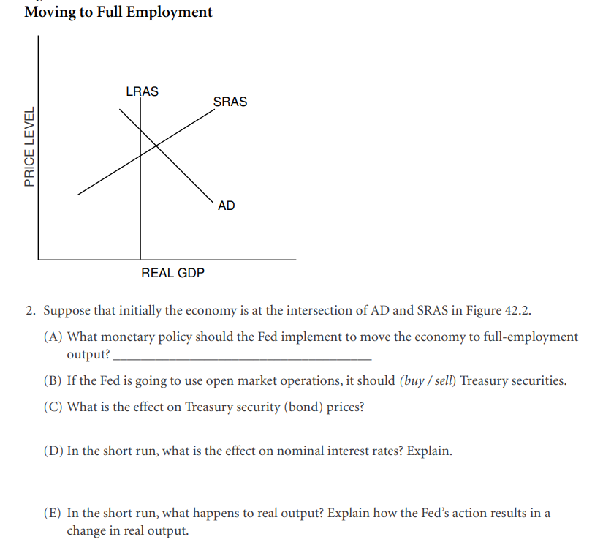
Contractionary Monetary Policy
Decrease: interest rates and the price of previously existing bonds are inversely related
Increase: financial institutions have less money to lend, decreasing the supply of money and decreasing the price of money (interest rate)

Slide 56
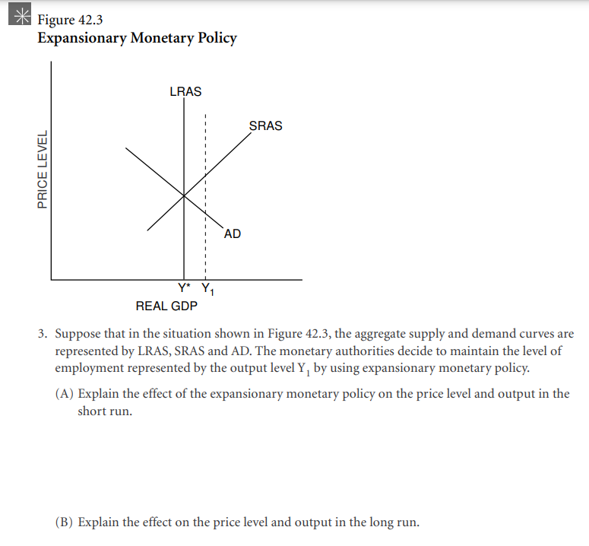

Slide 57
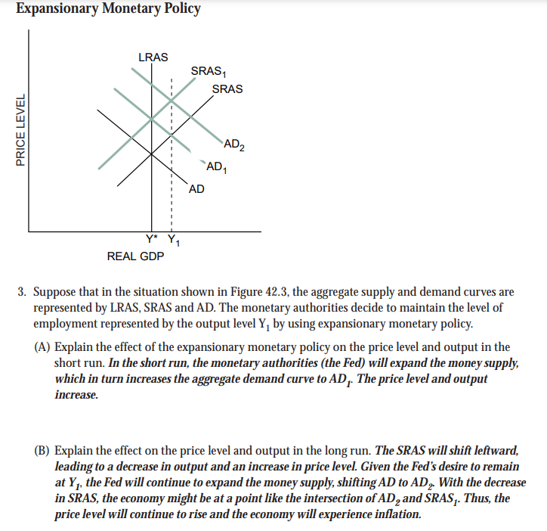

Slide 58
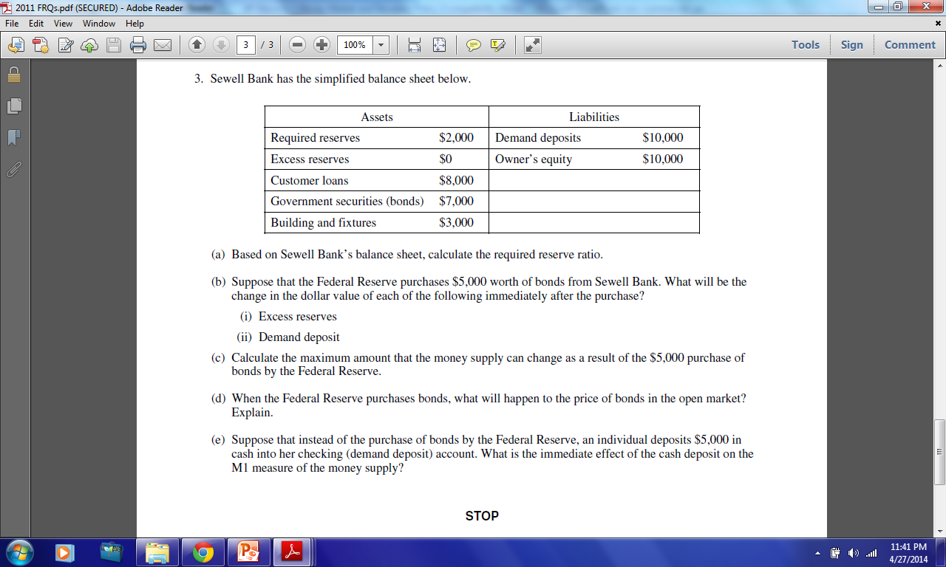
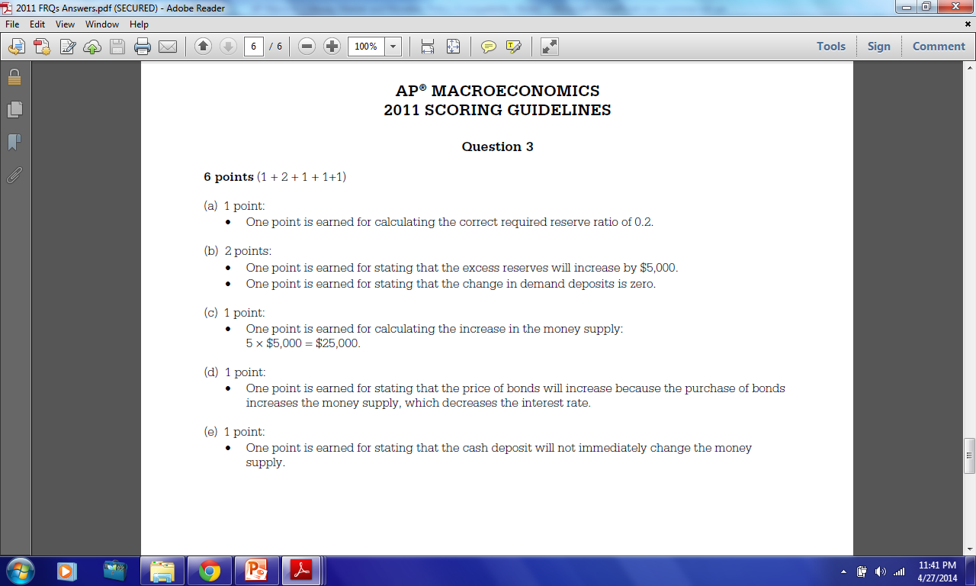
58

Slide 61
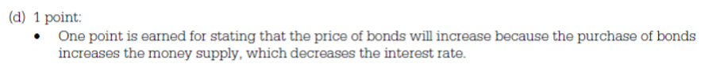

Slide 63
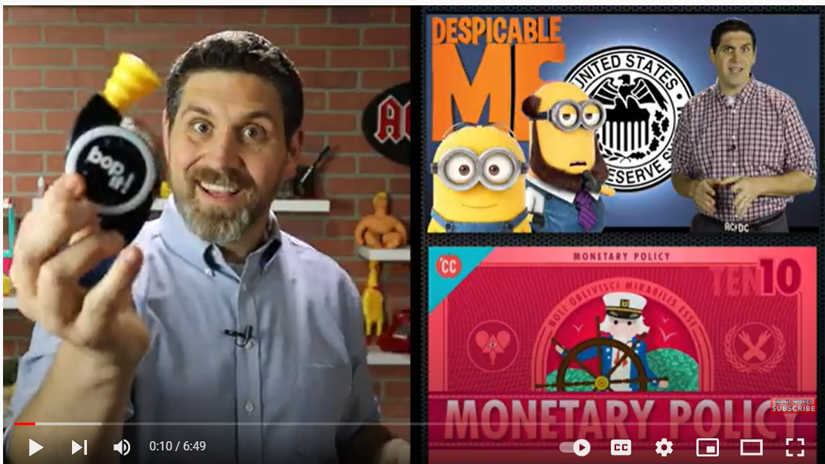

Slide 64
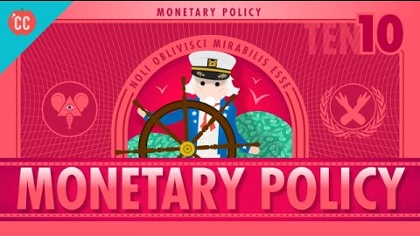
Notes:
https://www.youtube.com/watch?v=1dq7mMort9o

Slide 65
Any Questions?
James Redelsheimer | jred40@gmail.com
mcee.umn.edu | mcee@umn.edu | 612.625.3727

Slide 66
Thank You!
James Redelsheimer | jred40@gmail.com
mcee.umn.edu | mcee@umn.edu | 612.625.3727

