Slide 1
WELCOME!
Housekeeping Items:
Please use the chat and/or Q & A function to ask questions or to notify moderator of issues
The session will be recorded and emailed to participants in the next few days
Thank you for joining us.
The webinar will begin shortly.

Slide 2
AP Macro Unit 4:
Banking and the Expansion of the Money Supply
Live Webinar: May 23rd, 2022

Slide 3

Instructor Bio
James Redelsheimer has been an AP and Regular Economics teacher at Robbinsdale Armstrong High School in Plymouth, Minnesota since 2003. James is a graduate of St. Olaf and received his Master's degree at the University of St. Thomas. He received the 3M Economics Educator Excellence Award from the Minnesota Council on Economic Education and was named Visa's Practical Money Skills Innovative Educator of the Month.
James enjoys traveling and has been a guest lecturer in the economics department at the Batumi State University in The Republic of Georgia and has received travel grants and fellowships for study travel to learn about the economies of Japan, China, Turkey, Germany, Korea, among others, and studied economics of the environment in Costa Rica. He currently serves as an AP Economics reader, grading AP Economics exams. He enjoys teaching Economics because it relates to students' everyday lives.

Slide 4
Webinar Objectives
In this webinar, teachers will be able to identify and explain
  How banks create money through lending, and the maximum change in the money supply through the banking system
  How a bank balance sheet shows a bank’s assets and liabilities

Slide 5
Topic 4.4-
Banking and the Expansion of the Money Supply

Slide 6






The Very Early Days Of Banking
“Wow, you mean we can create money out of thin air.?”
The fractional banking system
began when someone issued
claims for gold that already
belonged to someone else.
Once upon a time there was a goldsmith who offered to store people’s
gold in his vault. He issued paper receipts for the gold, and it was not long
before the townsfolk used the paper to purchase eggs and beer. The smithy’s
paper receipts became as “good as gold.”
Our Smithy was not stupid. He said to himself. “I have 2000 ounces of gold
stored in my vault, but in the last year I was never called upon to pay out
more than 100 ounces in a single day. What harm could it do if I lent out say,
half the gold I now have? I’ll still have more than enough to pay off any
depositors that come in for a withdrawal. No one will know the difference. I
could earn 30 additional ounces of gold each week. I think I’ll do it.”
“The goldsmith has invented the Fractional Reserve Banking System.”

Slide 7

How Banks and Thrifts Create Money

Slide 8
BALANCE SHEET OF A
COMMERCIAL BANK
ASSETS = LIABILITIES + NET WORTH

Slide 9
FORMATION OF A
COMMERCIAL BANK
(OWN)
(OWE)
ASSETS
LIABILITIES

Slide 10
FORMATION OF A
COMMERCIAL BANK
LIABILITIES AND
NET WORTH
ASSETS
TRANSACTION
1
Accepting
Deposits
$100,000 Cash

Slide 11
FORMATION OF A
COMMERCIAL BANK
LIABILITIES AND
NET WORTH
ASSETS
Cash $100,000
Demand
Deposits $100,000

Slide 12

FORMATION OF A
COMMERCIAL BANK
LIABILITIES AND
NET WORTH
ASSETS
Cash $100,000
Checkable
Deposits $100,000
NOTES:
Bank deposits are
subject to a reserve
requirement.
Reserve
Ratio = 20%

Slide 13
FORMATION OF A
COMMERCIAL BANK
LIABILITIES AND
NET WORTH
ASSETS
Cash $100,000
Checkable
Deposits $100,000
Actual Reserves $100,000
Required Reserves - $20,000
Excess Reserves $ 80,000

Slide 14
FORMATION OF A
COMMERCIAL BANK
LIABILITIES AND
NET WORTH
ASSETS
Cash $100,000
Checkable
Deposits $100,000

Slide 15
FORMATION OF A
COMMERCIAL BANK
LIABILITIES AND
NET WORTH
ASSETS
Cash $100,000
Checkable
Deposits $100,000
TRANSACTION 2
Deposits
at the FED
$100,000 Cash

Slide 16
FORMATION OF A
COMMERCIAL BANK
LIABILITIES AND
NET WORTH
ASSETS
Cash $ 0
Reserves $100,000
Checkable
Deposits $100,000

Slide 17
FORMATION OF A
COMMERCIAL BANK
LIABILITIES AND
NET WORTH
ASSETS
Cash $ 0
Reserves $ 100,000
Checkable
Deposits $100,000
TRANSACTION 3
A check is drawn against the bank
$50,000

Slide 18
FORMATION OF A
COMMERCIAL BANK
LIABILITIES AND
NET WORTH
ASSETS
Cash $ 0
Reserves $ 50,000
Checkable
Deposits $ 50,000

Slide 19
FORMATION OF A
COMMERCIAL BANK
LIABILITIES AND
NET WORTH
ASSETS
Cash $ 0
Reserves 50,000
Checkable
Deposits $ 50,000
NOTES:
Banks create money
by lending excess
reserves and destroy
it by loan repayment.

Slide 20
FORMATION OF A
COMMERCIAL BANK
LIABILITIES AND
NET WORTH
ASSETS
Demand
Deposits $ 50,000
Reserves $ 50,000
TRANSACTION 4
Make a loan from excess reserves
$40,000

Slide 21

FORMATION OF A
COMMERCIAL BANK
LIABILITIES AND
NET WORTH
ASSETS
Reserves $ 50,000
Loans $ 40,000
Checkable
Deposits $90,000
Making the loan
created money!

Slide 22
FORMATION OF A
COMMERCIAL BANK
LIABILITIES AND
NET WORTH
ASSETS
Reserves $ 10,000
Loans 40,000
Checkable
Deposits $ 50,000
After a check for the $40,000
is drawn against the bank

Slide 23
Bank Balance Sheets
Demand Deposits- Money deposited in a commercial bank in a checking account.
Required Reserves- The percent that banks must hold by law.
Excess Reserves- The amount that the bank can loan out.
Balance Sheet- A record of a bank’s assets, liabilities, and net worth.
Are demand deposits in a bank an asset or a liability?
Liability for the bank, asset to the depositor.

Slide 24
Bank Balance Sheets
Assets |  | Liabilities
Loans | $8,000 | Demand Deposits | $5,000
Reserves | $500 | Owner’s Equity | $5,000
Treasury Bonds | $1,500
Total Assets | $10,000 | Total Liabilities | $10,000
It is “balanced” because the totals must equal.
If the bank is holding no excess reserves, how much is the required reserve ratio?
.1 or 10%

Slide 25

Bank Balance Sheets
Assets |  | Liabilities
Req. Reserves | $2,000 | Demand Deposits | $20,000
Excess Reserves | $3,000 | Owner’s Equity | $5,000
Treasury Bonds | $5,000
Loans | $15,000
If Bob deposits $1000 into this bank:
What is the required reserve ratio?
Will M1 money supply initially ↑, ↓, stay same?
How much is the required reserves?
How much is the excess reserves?
How much more can the bank initially lend out?
Maximum change in money supply from deposit?

Slide 26
Bank Balance Sheets
Assets |  | Liabilities
Req. Reserves | $2,100 | Demand Deposits | $21,000
Excess Reserves | $3,900 | Owner’s Equity | $5,000
Treasury Bonds | $5,000
Loans | $15,000
If Bob deposits $1000 into this bank:
What is the required reserve ratio? 10%
Will M1 money supply initially ↑, ↓, stay same? same
How much is the required reserves? $2100
How much is the excess reserves? $3900
How much more can the bank initially lend out? $3900
Maximum change in money supply from deposit?
    $900 X 10 = $9000

Slide 27
Bank Balance Sheets
Assets |  | Liabilities
Req. Reserves | $2,000 | Demand Deposits | $20,000
Excess Reserves | $3,000 | Owner’s Equity | $5,000
Treasury Bonds | $5,000
Loans | $15,000
If Bob withdrawals $3000 from this bank:
Will M1 money supply initially ↑, ↓, stay same?
How much is the required reserves?
How much is the excess reserves?
Assume Bob burned the money, what is the maximum change in money supply?

Slide 28
Bank Balance Sheets
Assets |  | Liabilities
Req. Reserves | $1,700 | Demand Deposits | $17,000
Excess Reserves | $300 | Owner’s Equity | $5,000
Treasury Bonds | $5,000
Loans | $15,000
If Bob withdrawals $3000 from this bank:
1. Will M1 money supply initially ↑, ↓, stay same? Stay the same
2. How much is the required reserves? $1700
3. How much is the excess reserves? $300
4. Assume Bob burned the money, what is the maximum change in money supply? 1/.1 X $3000 = Decrease $30,000

Slide 29
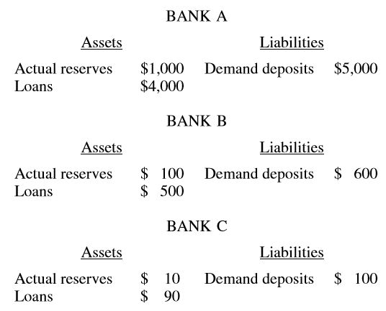
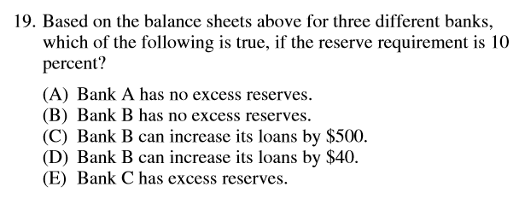
2012 Audit Exam

Slide 30
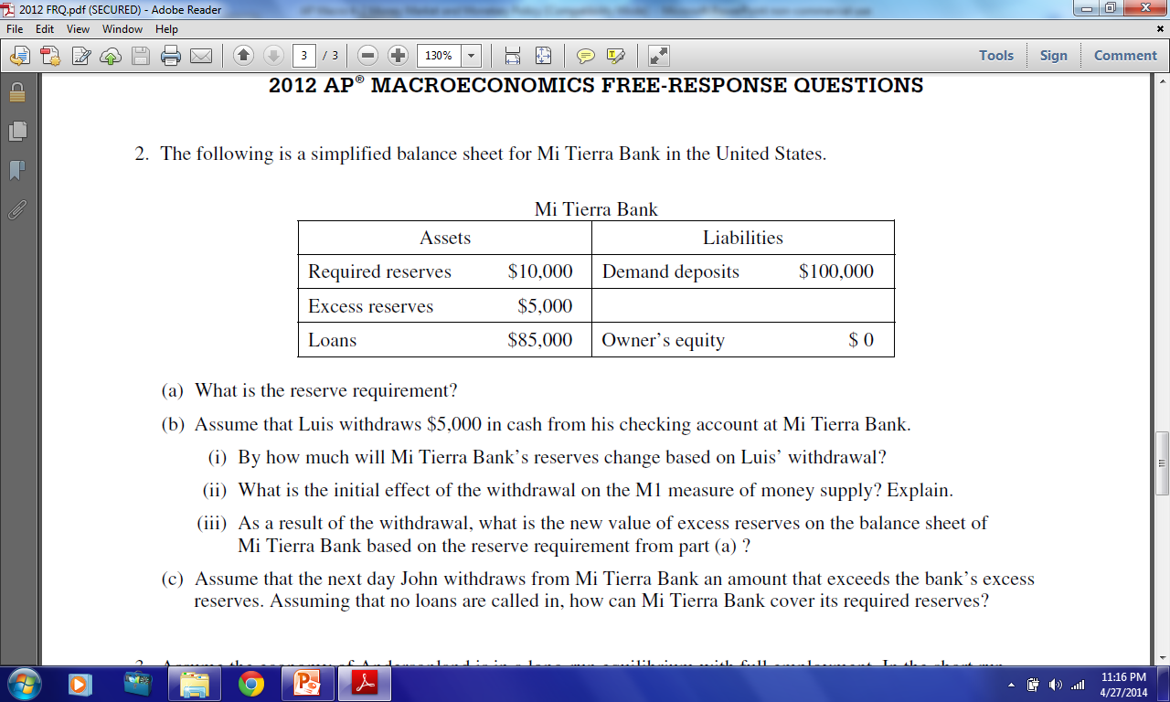

Slide 31
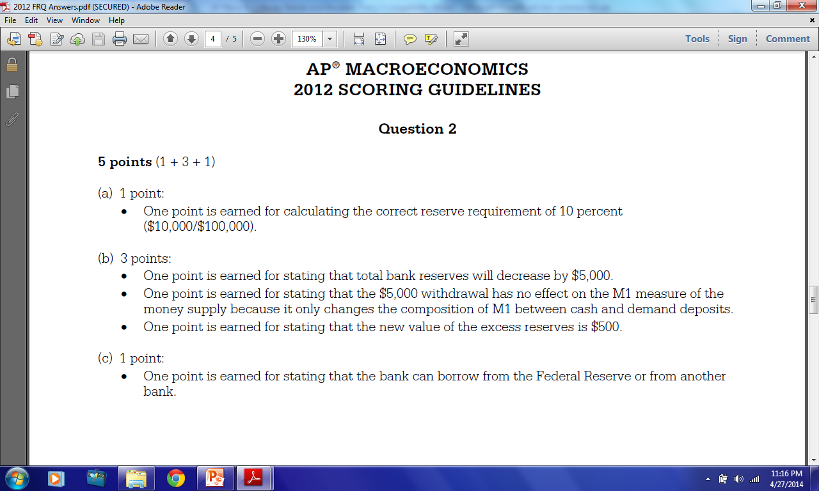


Slide 32
MULTIPLE DEPOSIT EXPANSION PROCESS
Amount bank
can lend - New
money created
Acquired reserves
and deposits
Required
reserves
Excess
reserves
Bank
A
B
C
D
E
F
G
H
I
J
K
L
M
N
Other banks
$100.00
80.00
64.00
51.20
40.96
32.77
26.21
20.97
16.78
13.42
10.74
8.59
6.87
5.50
21.99
$20.00
16.00
12.80
10.24
8.19
6.55
5.24
4.20
3.36
2.68
2.15
1.72
1.37
1.10
4.40
$80.00
64.00
51.20
40.96
32.77
26.21
20.97
16.78
13.42
10.74
8.59
6.87
5.50
4.40
17.59
$80.00
64.00
51.20
40.96
32.77
26.21
20.97
16.78
13.42
10.74
8.59
6.87
5.50
4.40
17.59
Total amount of money created by the banking system
$400.00

Slide 33
MULTIPLE DEPOSIT EXPANSION PROCESS
Amount bank
can lend - New
money created
Acquired reserves
and deposits
Required
reserves
Excess
reserves
Bank
A
B
C
D
E
F
G
H
I
J
K
L
M
N
Other banks
$100.00
80.00
64.00
51.20
40.96
32.77
26.21
20.97
16.78
13.42
10.74
8.59
6.87
5.50
21.99
$20.00
16.00
12.80
10.24
8.19
6.55
5.24
4.20
3.36
2.68
2.15
1.72
1.37
1.10
4.40
$80.00
64.00
51.20
40.96
32.77
26.21
20.97
16.78
13.42
10.74
8.59
6.87
5.50
4.40
17.59
$80.00
64.00
51.20
40.96
32.77
26.21
20.97
16.78
13.42
10.74
8.59
6.87
5.50
4.40
17.59
Money
destruction works
in exactly the same
multiple way!
Total amount of money created by the banking system
$400.00

Slide 34
THE MONETARY MULTIPLIER
=
1
Monetary
Multiplier
Required reserve ratio
Maximum
checkable-
deposit
creation
=
x
Excess
reserves
Monetary
Multiplier

Slide 35
OUTCOME OF MONEY EXPANSION
$100
New reserves
$20
Required
reserves
$80
Excess
reserves
$400
Bank system lending
$100
Initial
Deposit
Money Created

Slide 36
OUTCOME OF MONEY EXPANSION:
Central Bank Buys $100 of Bonds
$100
New reserves
$0
Required
reserves
$100
Excess
reserves
$500
Bank system lending
Money Created

Slide 37
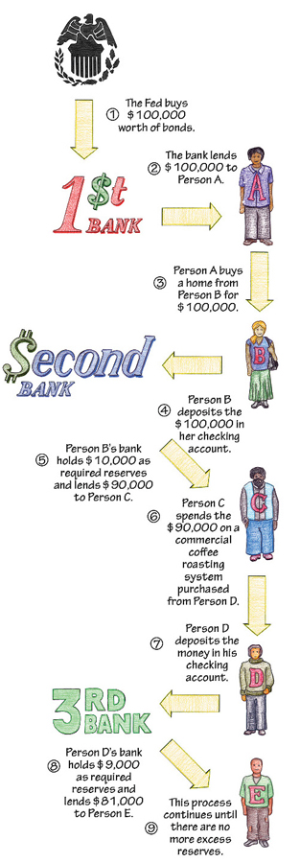

Slide 38
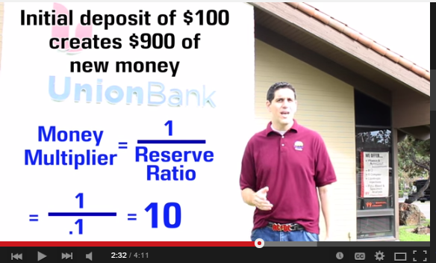

Slide 39
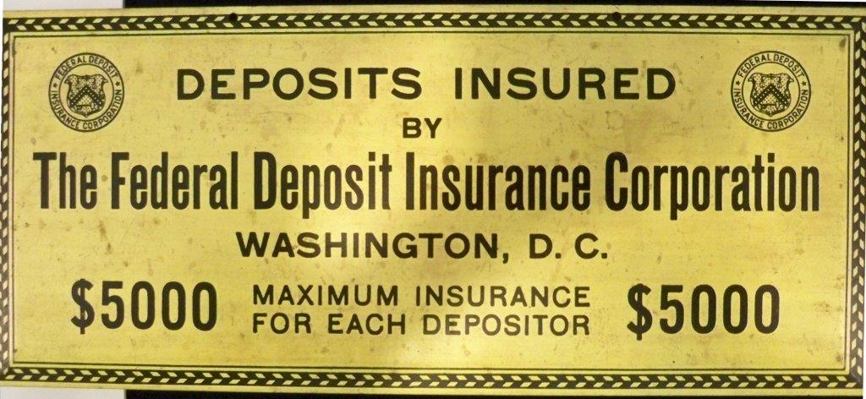
NOW $250,000

Slide 40
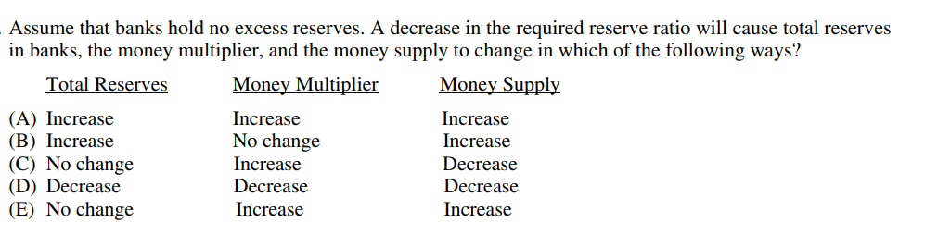

Slide 41
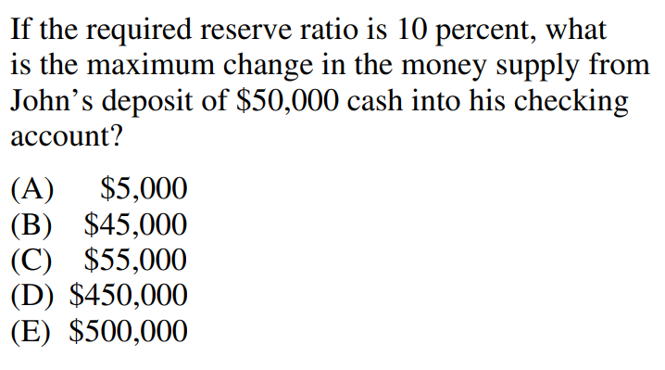
1/.1 = 10
10 X $45,000 = $450,000

Slide 42
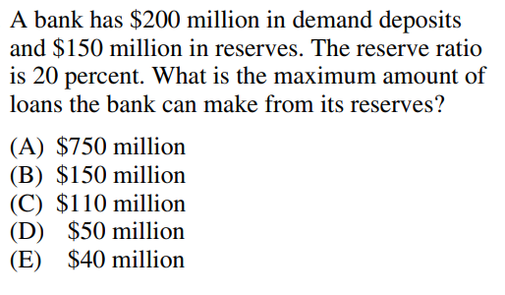
$200 X .2 = $40
$150 - $40 = $110

Slide 43
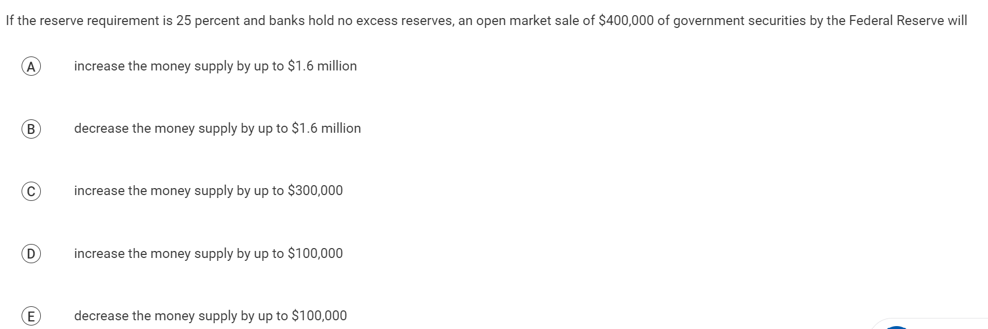

Slide 44
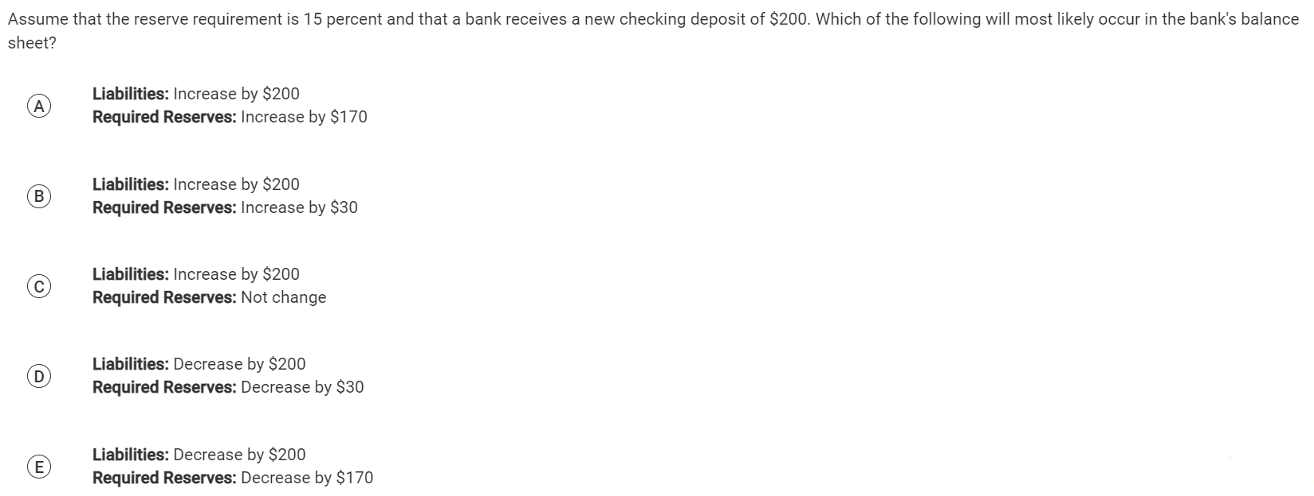

Slide 45
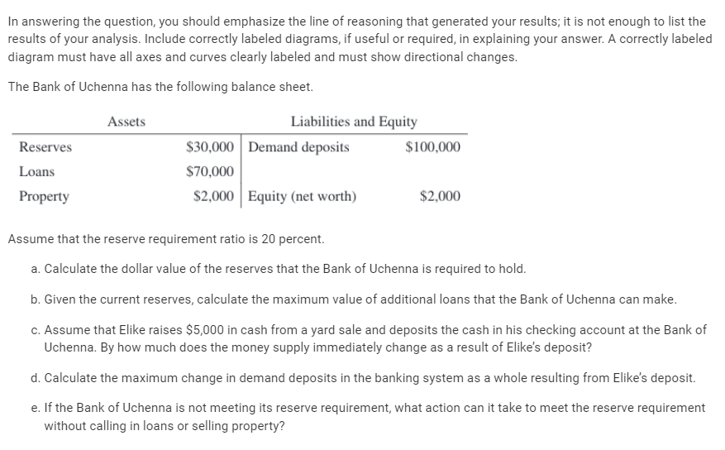


Slide 47


Slide 50
CEE AP Economics 3rd Edition
Activity 37
The Multiple Expansion of Checkable Deposits

Slide 51
Assume that the required reserve ratio is 10% of checkable deposits and banks lend out the other 90% (banks wish to hold no excess reserves) and all money lent out by one bank is re-deposited in another bank
1. Under these assumptions, if a new checkable deposit of $1,000 is made in Bank 1
(A) how much will Bank 1 keep as required reserves?
(B) how much will Bank 1 lend out?
(C) how much will be re-deposited in Bank 2?
(D) how much will Bank 2 keep as required reserves?
(E) how much will Bank 2 lend out?
(F) how much will be re-deposited in Bank 3?
$100.00
$900.00
$900.00
$90.00
$810.00
$810.00

Slide 52
Checkable deposits, Reserves and Loans in seven banks
Bank # | New checkable deposits | 10% fractional reserves | Loans
1 | $1,000 | $100.00 | $900.00
2 | 900.00 |  | 810.00
3 |  | 81.00
4 |  |  | 656.10
5
6 |  | 59.05
7 | 531.44 |  | 478.30
All other banks combined
Total for all banks | $10,000.00 |  | $9,000.00

Slide 53
Figure 37.1
Checkable deposits, Reserves and Loans in seven banks
Bank # | New checkable deposits | 10% fractional reserves | Loans
1 | $1,000 | $100.00 | $900.00
2 | 900.00 | 90.00 | 810.00
3 | 810 | 81.00 | 729.00
4 | 729.00 | 72.90 | 656.10
5 | 656.10 | 65.61 | 590.49
6 | 590.49 | 59.05 | 531.44
7 | 531.44 | 53.14 | 478.30
All other banks combined | 4782.98 | 478.30 | 4304.67
Total for all banks | $10,000.00 | 1,000.00 | $9,000.00

Slide 54
In the example from figure 37.1:
$1000
The original deposit of $1,000 increased total bank reserves by ________ . Eventually this led to a total $10,000 expansion of bank deposits, ________ of which was because of the original deposit, while ________ was because of repeated bank lending activity.
Therefore, if the fractional reserve had been 15% instead of 10%, the amount of deposit expansion would have been (more / less) than in this example.
Therefore, if the fractional reserve had been 5% instead of 10%, the amount of deposit expansion would have been (more / less) than in this example.
If banks had not loaned out all of their excess reserves, the amount of deposit expansion would have been (more / less) than in this example.
If all loans had not been re-deposited in the banking system, the amount of deposit expansion would have been (more / less) than in this example.
$1000
$9000

Slide 55
Assume that $1000 is deposited in a bank, that each bank lends out all excess reserves (banks wish to hold no excess reserves) all money lent out by one bank is re-deposited in another bank
Required Reserve Ratio
 | 1% | 5% | 10% | 12.5% | 15% | 25%
Required reserves |  |  | $100
Excess reserves |  |  | $900
Deposit expansion multiplier |  |  | 10
Maximum increase in the money supply |  |  | 10,000 -1,000 =9,000

Slide 56
Assume that $1000 is deposited in a bank, that each bank lends out all excess reserves (banks wish to hold no excess reserves) all money lent out by one bank is re-deposited in another bank
Required Reserve Ratio
 | 1% | 5% | 10% | 12.5% | 15% | 25%
Required reserves | $10
Excess reserves | $990
Deposit expansion multiplier | 100
Maximum increase in the money supply | =$99,000

Slide 57
Assume that $1000 is deposited in a bank, that each bank lends out all excess reserves (banks wish to hold no excess reserves) all money lent out by one bank is re-deposited in another bank
Required Reserve Ratio
 | 1% | 5% | 10% | 12.5% | 15% | 25%
Required reserves | $10 | $50
Excess reserves | $990 | $950
Deposit expansion multiplier | 100 | 20
Maximum increase in the money supply | =$99,000 | =$19,000

Slide 58
Assume that $1000 is deposited in a bank, that each bank lends out all excess reserves (banks wish to hold no excess reserves) all money lent out by one bank is re-deposited in another bank
Required Reserve Ratio
 | 1% | 5% | 10% | 12.5% | 15% | 25%
Required reserves | $10 | $50 | $100
Excess reserves | $990 | $950 | $900
Deposit expansion multiplier | 100 | 20 | 10
Maximum increase in the money supply | =$99,000 | =$19,000 | =$9,000

Slide 59
Assume that $1000 is deposited in a bank, that each bank lends out all excess reserves (banks wish to hold no excess reserves) all money lent out by one bank is re-deposited in another bank
Required Reserve Ratio
 | 1% | 5% | 10% | 12.5% | 15% | 25%
Required reserves | $10 | $50 | $100 | $125
Excess reserves | $990 | $950 | $900 | $875
Deposit expansion multiplier | 100 | 20 | 10 | 8
Maximum increase in the money supply | =$99,000 | =$19,000 | =$9,000 | =$7,000

Slide 60
Assume that $1000 is deposited in a bank, that each bank lends out all excess reserves (banks wish to hold no excess reserves) all money lent out by one bank is re-deposited in another bank
Required Reserve Ratio
 | 1% | 5% | 10% | 12.5% | 15% | 25%
Required reserves | $10 | $50 | $100 | $125 | $150
Excess reserves | $990 | $950 | $900 | $875 | $850
Deposit expansion multiplier | 100 | 20 | 10 | 8 | 6.67
Maximum increase in the money supply | =$99,000 | =$19,000 | =$9,000 | =$7,000 | =$5,669

Slide 61
Assume that $1000 is deposited in a bank, that each bank lends out all excess reserves (banks wish to hold no excess reserves) all money lent out by one bank is re-deposited in another bank
Required Reserve Ratio
 | 1% | 5% | 10% | 12.5% | 15% | 25%
Required reserves | $10 | $50 | $100 | $125 | $150 | $250
Excess reserves | $990 | $950 | $900 | $875 | $850 | $750
Deposit expansion multiplier | 100 | 20 | 10 | 8 | 6.67 | 4
Maximum increase in the money supply | =$99,000 | =$19,000 | =$9,000 | =$7,000 | =$5,669 | =$3,000

Slide 62
6. If the required reserve requirement were 0%, then the money supply expansion would be infinite.
Why don’t we want an infinite growth of the money supply? (remember the equation of exchange)
The result would be hyperinflation

Slide 63
7. If the Federal Reserve wants to increase the money supply,
Should it raise or lower the reserve requirement?
Why?
The Fed should lower the reserve requirement.
Lowering the percentage of required reserves, increases the excess reserves available in the banking system
Increasing the deposit expansion multiplier

Slide 64
8. If the Federal Reserve increases the reserve requirement and velocity remains stable,
What will happen to nominal GDP?
Why?
Nominal GDP would decrease.
If the money supply (M) decreases,
  because of the increase in required reserves reduces excess reserves for loans;
and velocity (V) remains constant
Then (PQ) nominal GDP must also decrease

Slide 65
9. What economic goal might the Federal Reserve try to meet by reducing the money supply?
Maximum employment
Maintain price stability
Moderate long term interest rates
(B) Price stability

Slide 66
10. Why might the money supply not expand by the amount predicted by the deposit expansion multiplier?
Banks may not choose to lend out all excess reserves
Banks may be unable to lend out all excess reserves because households or firms may not want to borrow
All loans may not be re-deposited into the banking system

Slide 67
Any Questions?
James Redelsheimer | jred40@gmail.com
mcee.umn.edu | mcee@umn.edu | 612.625.3727

Slide 68
Thank You!
James Redelsheimer | jred40@gmail.com
mcee.umn.edu | mcee@umn.edu | 612.625.3727

