Slide 1
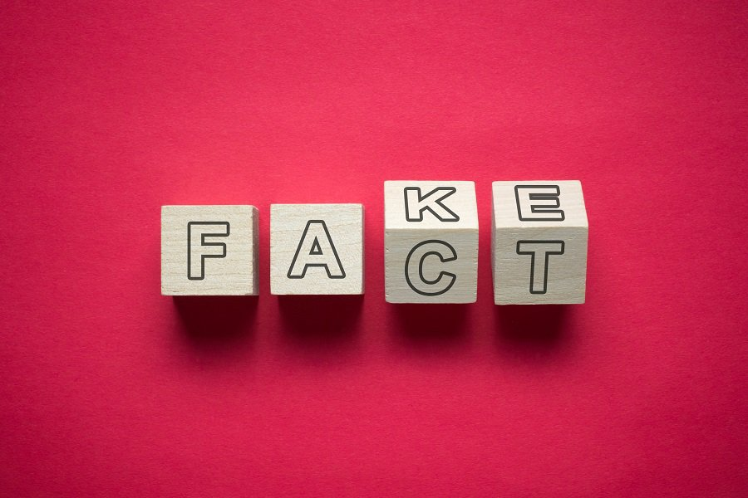
Fake News Fibbage
Presented by Andrew Menfi March 8th, 2022 amenfi3@gmail.com

Slide 2
Professional Development Certificate
To earn your professional development certificate for this webinar, you must:
Watch a minimum of 45-minutes and you will automatically receive a professional development certificate via e-mail within 24 hours.
Accessing resources:
You can now easily download presentations, lesson plan materials, and activities for each webinar from EconEdLink.org/professional-development/

Slide 3
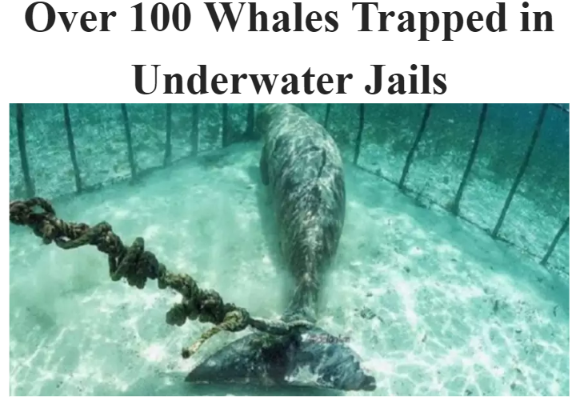
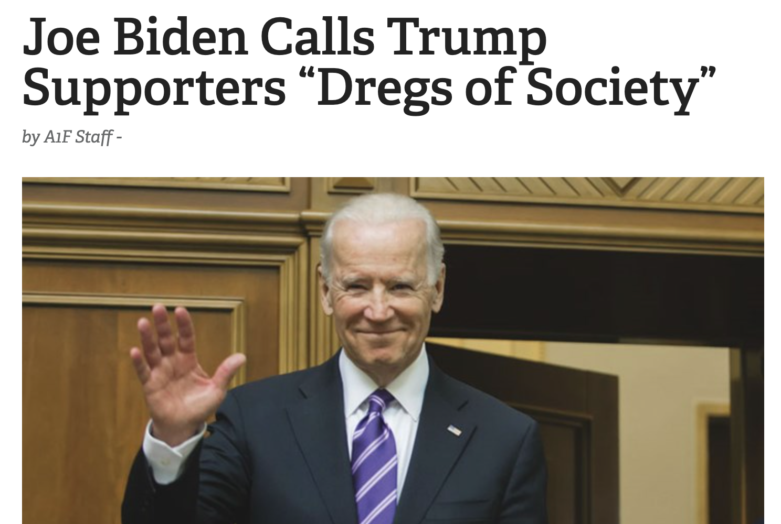
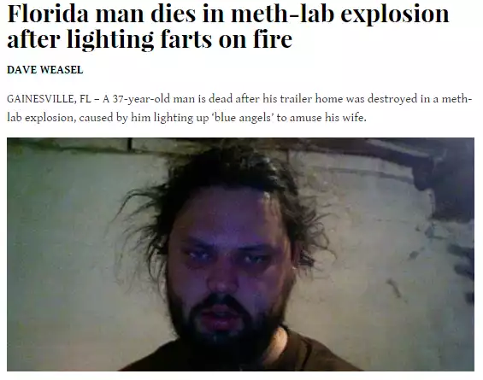
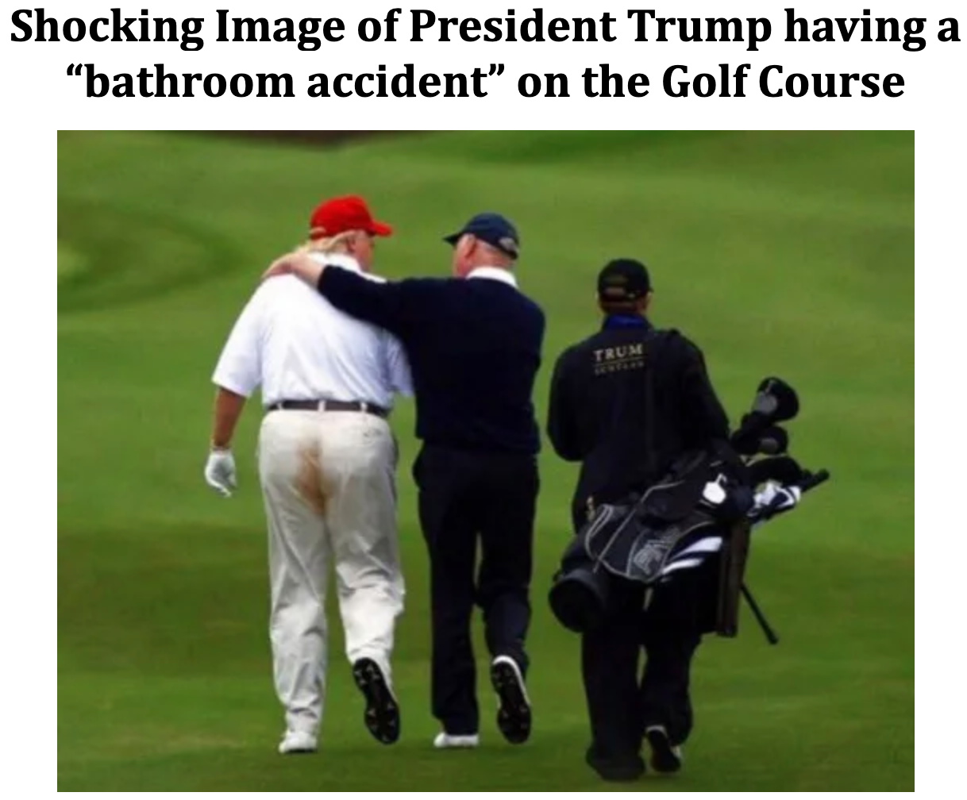
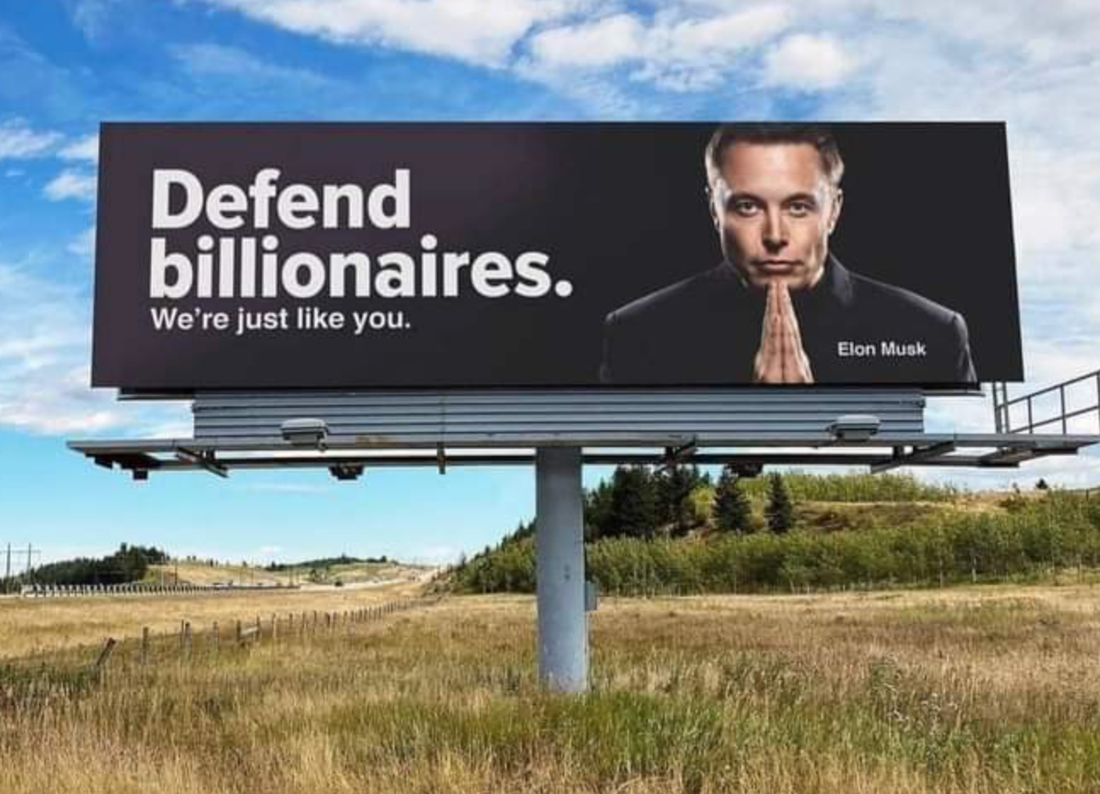
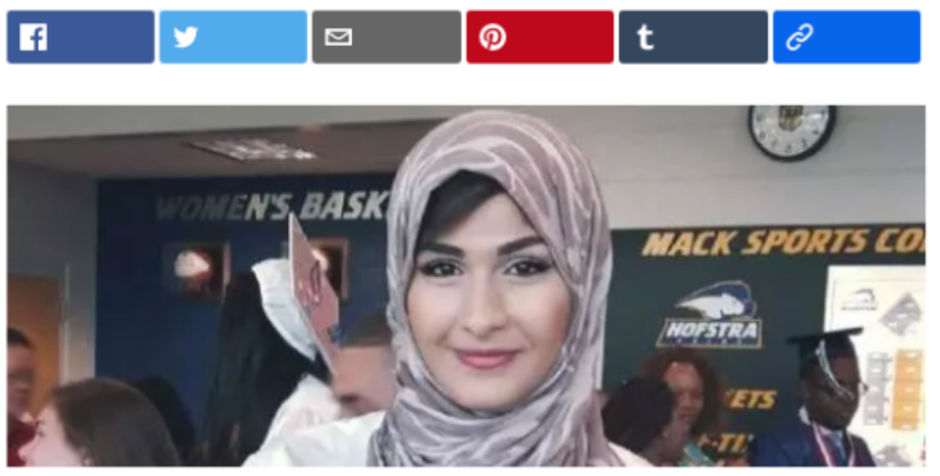
1
2
3
Elon Musk slammed for “Defend Billionaires” Billboards
4
5
6

Slide 4
Objective
To learn an engaging and useable lesson/game on misinformation in the media.

Slide 5
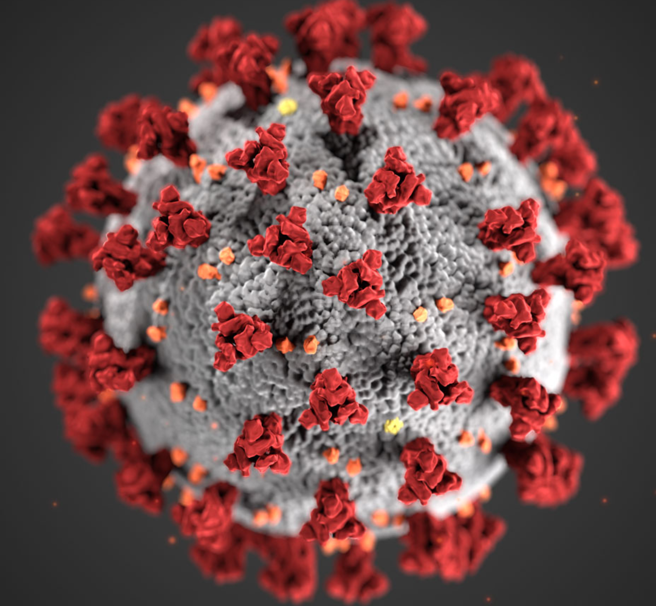
Why?
The Problem of Misinformation
Common/Effective [Social Media]
Covid-19 & The 2020 Election

Slide 6
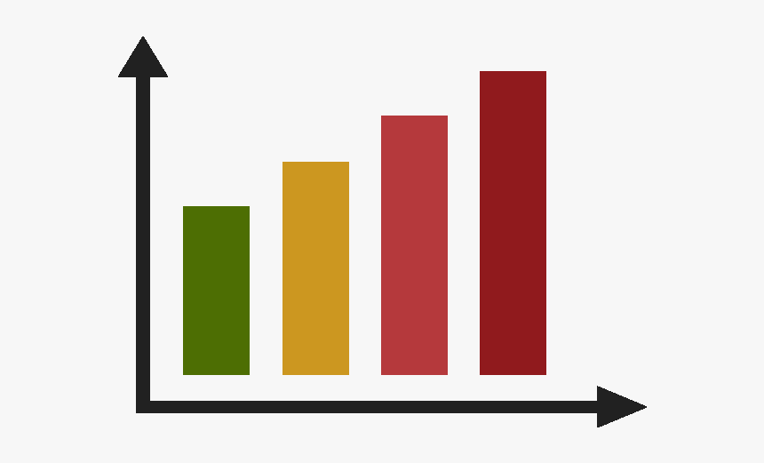
Other Activities
Fake News Activities/Lessons
Fake News Guessing Game
Fact Checking
Reverse Image Search
Manipulative Graphs/Statistics
Fake News Fibbage

Slide 7
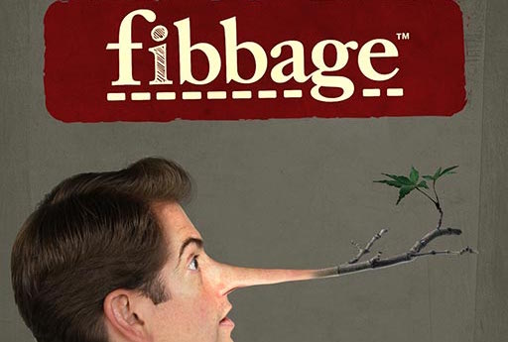
Fake News Fibbage

Slide 8
Fake News Fibbage
Fake News Fibbage
Goal: Trick the most people to believing your lie!
Requirements: Google Account [Backup: E-mail]

Slide 9
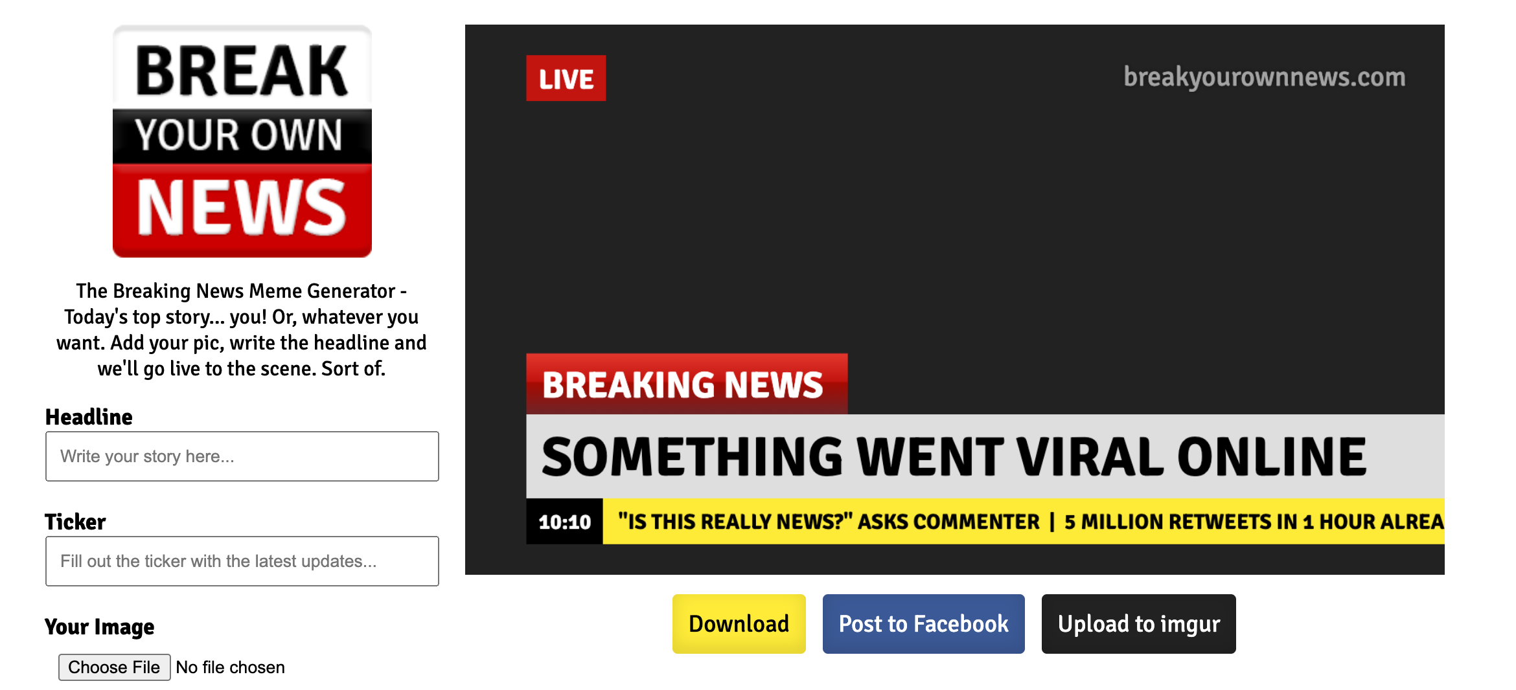
Fake News Fibbage
Fake News Fibbage
Step 1: Create Convincing Fake News [1-2]
https://breakyourownnews.com/

Slide 10
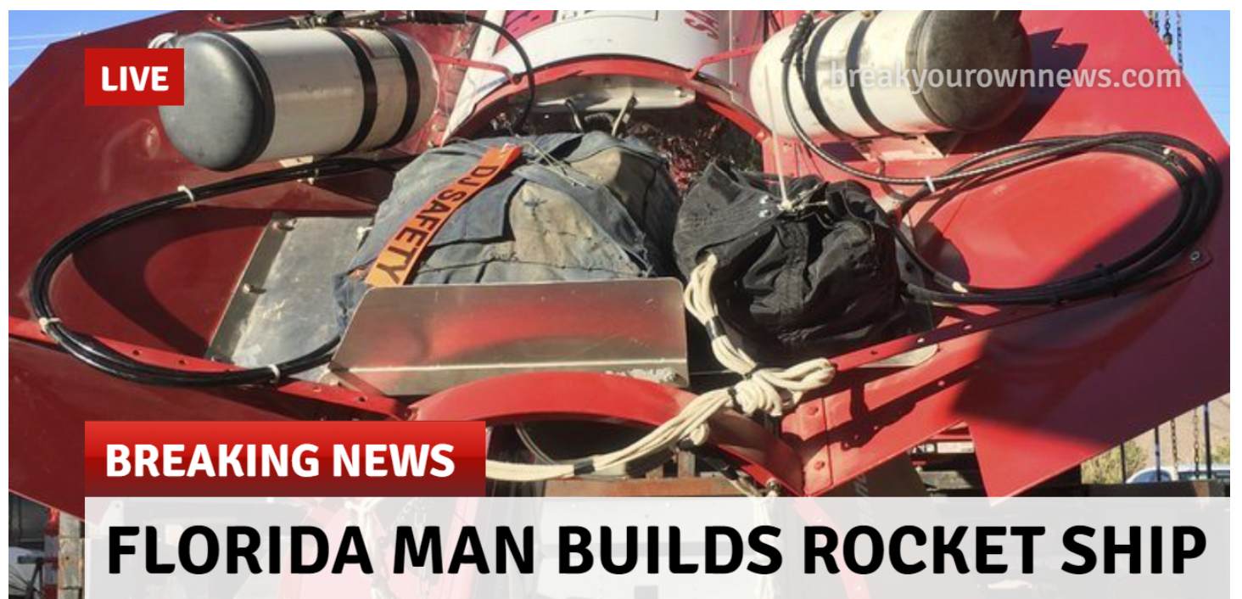
Fake News Fibbage
Fake News Fibbage
Step 1: Create Convincing Fake News [1-2]
https://breakyourownnews.com/

Slide 11
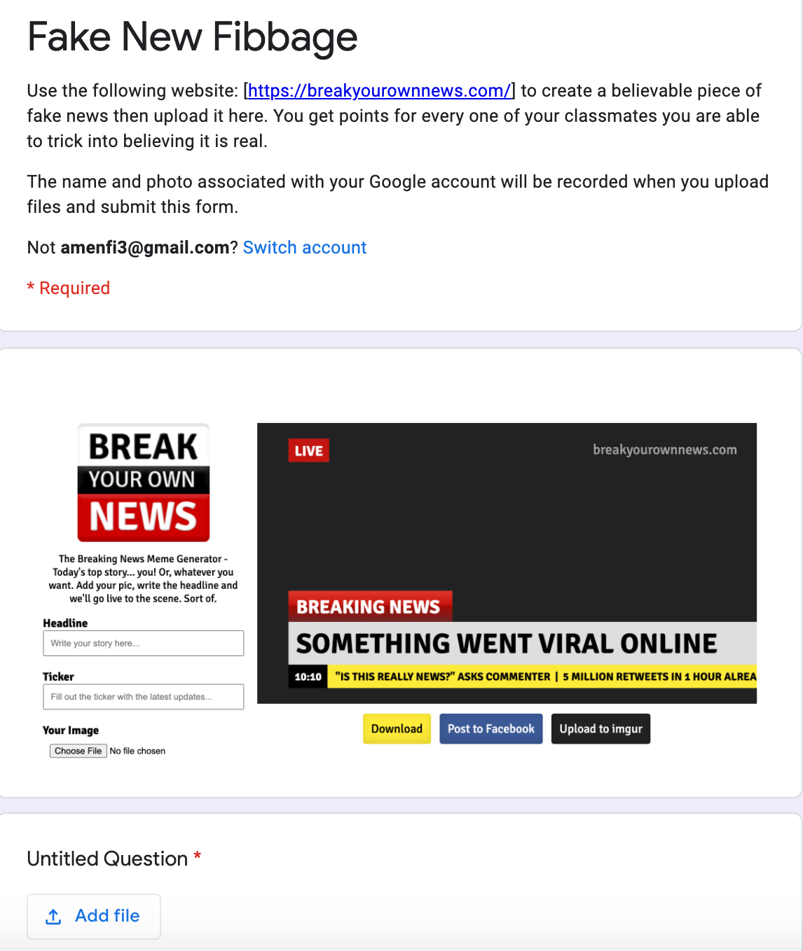
Fake News Fibbage
Fake News Fibbage
Step 2: Upload Image
Backup [E-mail]
amenfi3@gmail.com

Slide 12
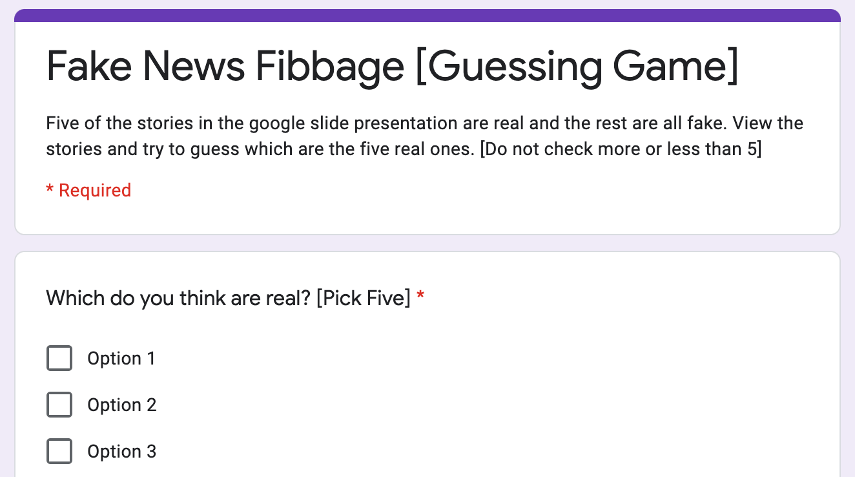
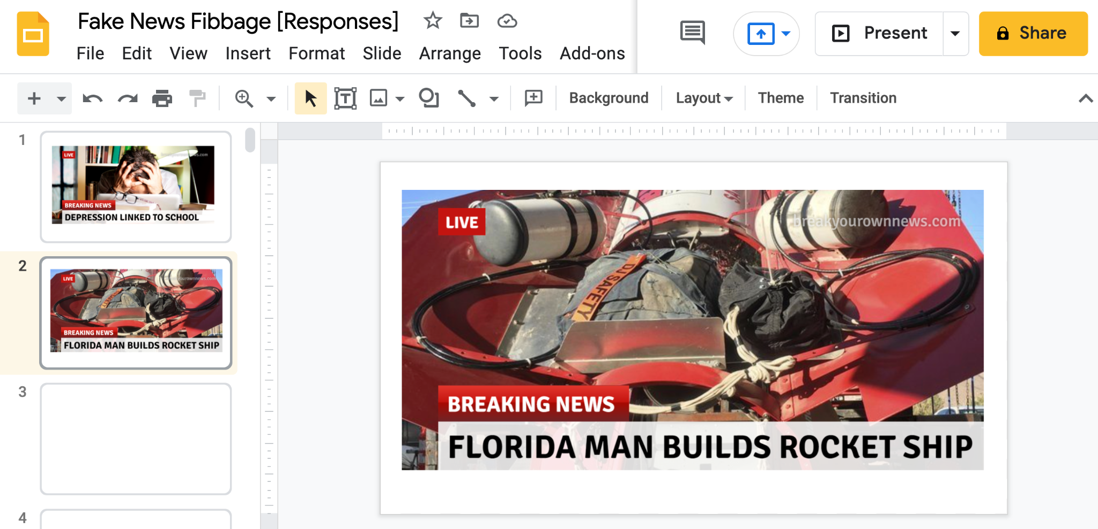
Fake News Fibbage
Fake News Fibbage
Step 3: Make Your Guesses!

Slide 13
Fake News Fibbage
Fake News Fibbage [Let’s Play!]
Step 1: Create Convincing Fake News [1-2]
https://breakyourownnews.com/
Step 2: Upload Image
amenfi3@gmail.com
Step 3: Make Your Guesses!

Slide 14
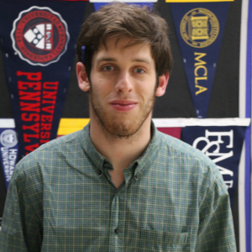
Contact & Questions?
Andrew Menfi
Social Studies Teacher
New Visions Charter High School
for Advanced Math & Science
amenfi3@gmail.com
Thanks For Your Time!
Notes:
1, 2, 5, 7, 14 [Real]

