Slide 1
NCCEE
Presents
Women–The Power of Side Hustlers
and Influencers

Slide 2
NCCEE
Who We Are

Slide 3
Webinar Summary
During this webinar, we will focus on how women tap into the side hustling and influencer world and why it may be helpful.

Slide 4
Objectives
Teachers will be able to:
Describe why creating a side hustle is an excellent source of income for women.
Explain how influencers provide a way to earn income and influence markets.

Slide 5
Standards Covered
Personal Financial Education
  Standard 1: Earning Income
Economics
  Standard 4: Incentives

Slide 6
Agenda
Statistics
Highlight 5 points about influencers & side hustles
Self-paced mini activity
How can this can be used in your classroom
Q&A

Slide 7
Statistics About Influencers

Slide 8
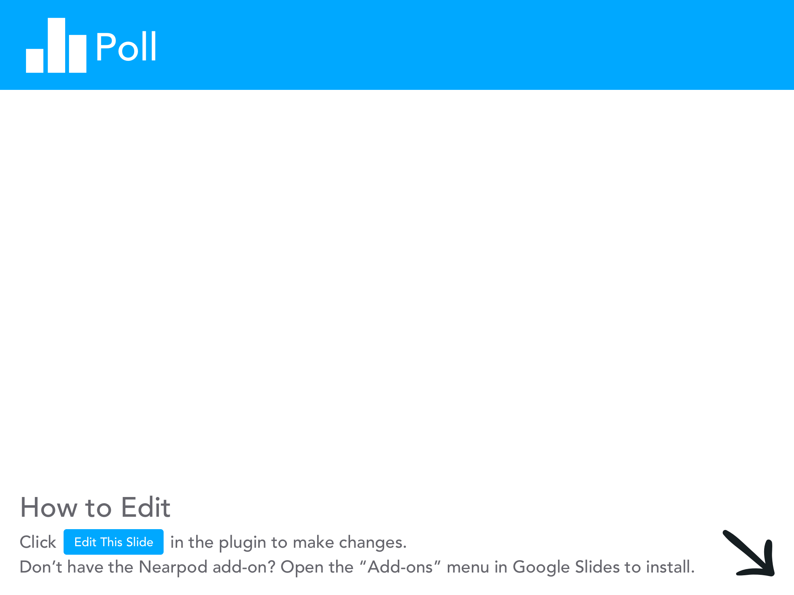

Slide 9
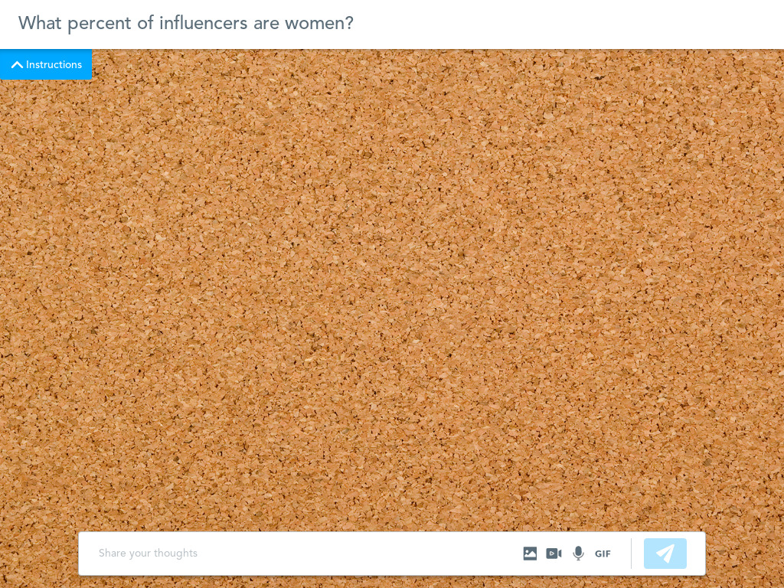
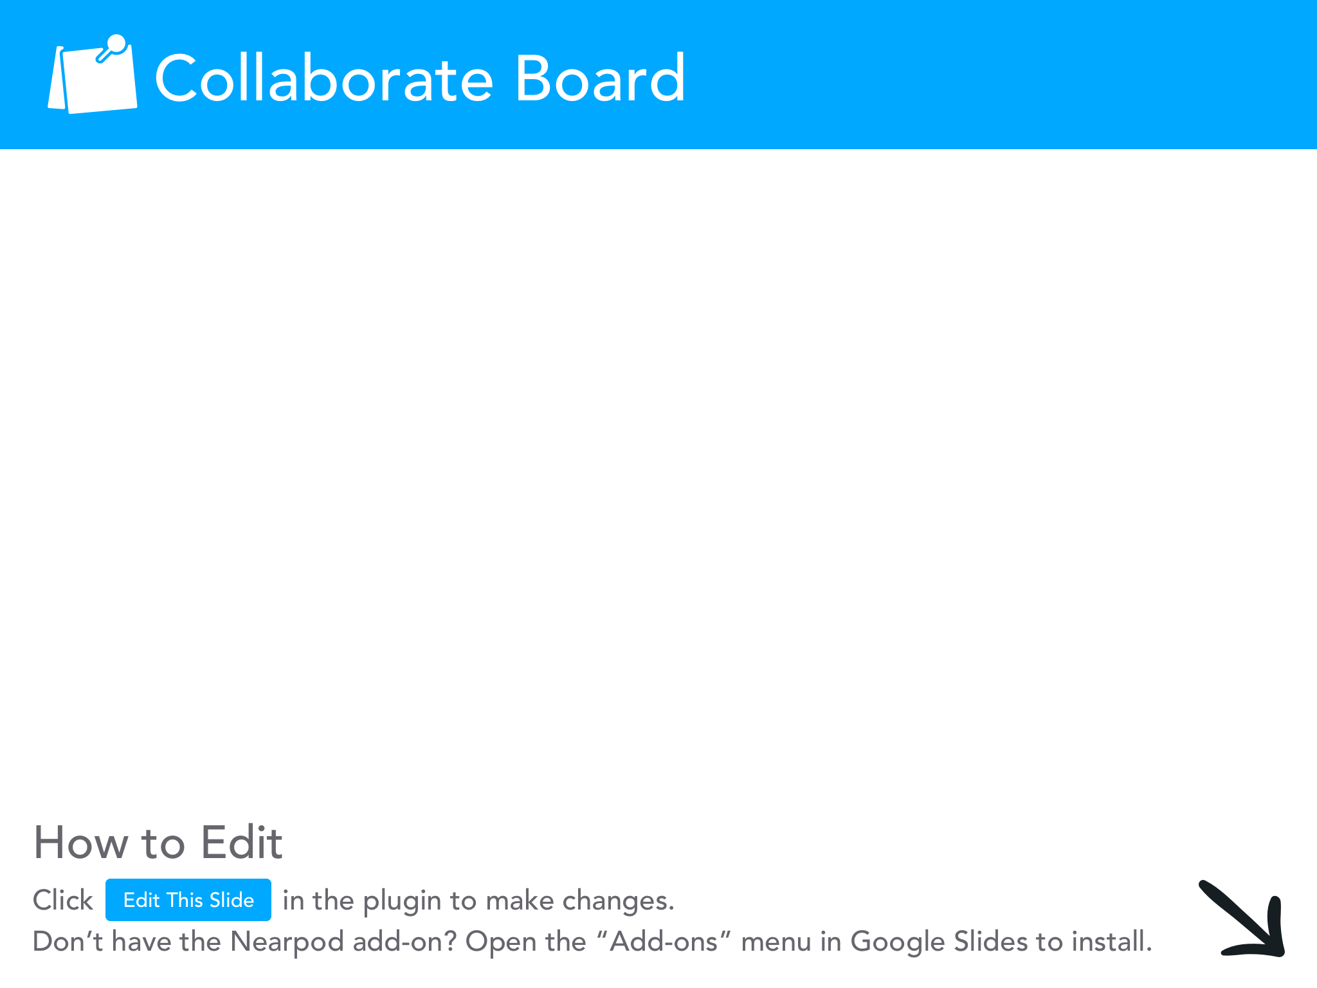

Slide 10
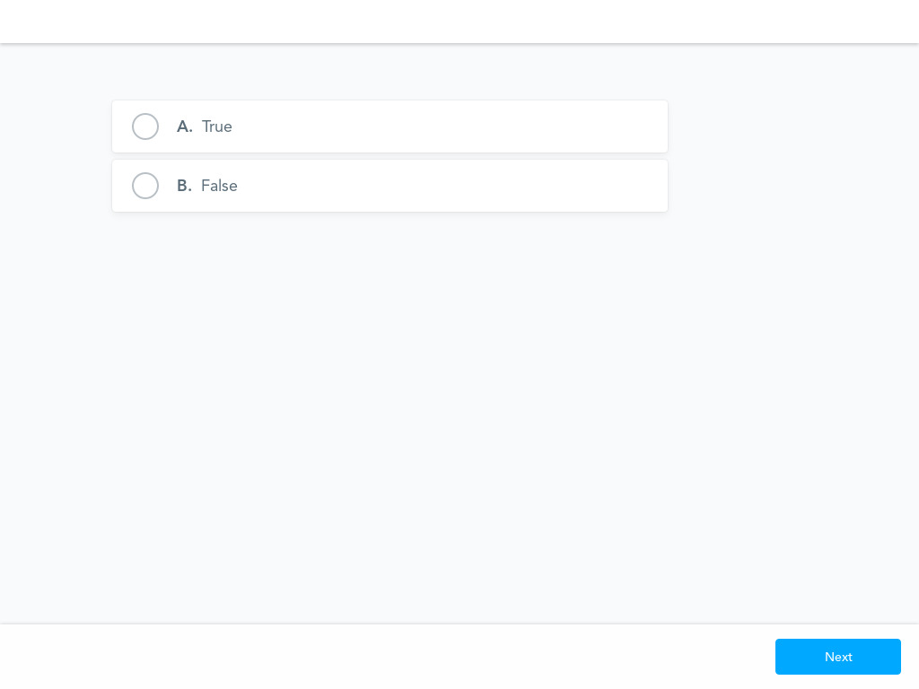

Slide 11
Key Stats
Influencer Marketing Industry predicted to Reach $16.4B in 2022
The Lifestyle Industry has the Greatest Distribution of Instagram Influencers. (followed by beauty, music, photography, and family)
86% of Women Use Social Media for Purchasing Advice
Instagram is the Preferred Social Media Channel for Brands Who Engage in Influencer Marketing

Slide 12
What is an influencer?

Slide 13
What is a side hustle?

Slide 14
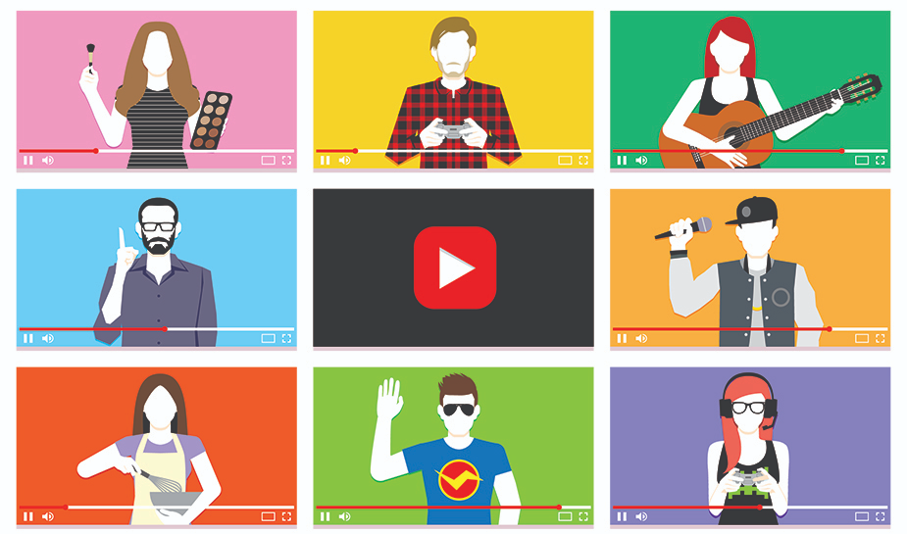
How influencers make money

Slide 15
How do influencers make money?
Sponsored content
Brand ambassadors
Affiliate marketing
Website advertising
eCourses and digital products
Tipping donations, subscriptions
Reselling clothing
Sales from live events
Product lines designed for them

Slide 16
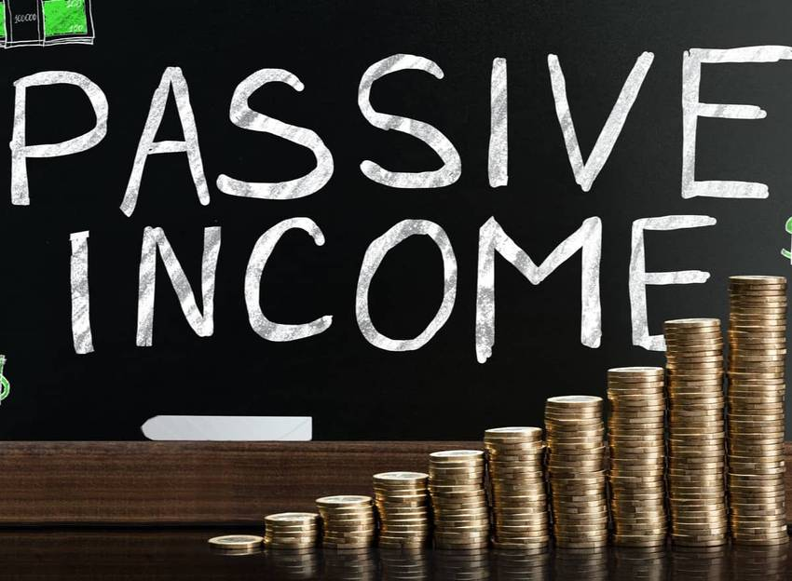
Make Money by Getting Your House in Order

Slide 17
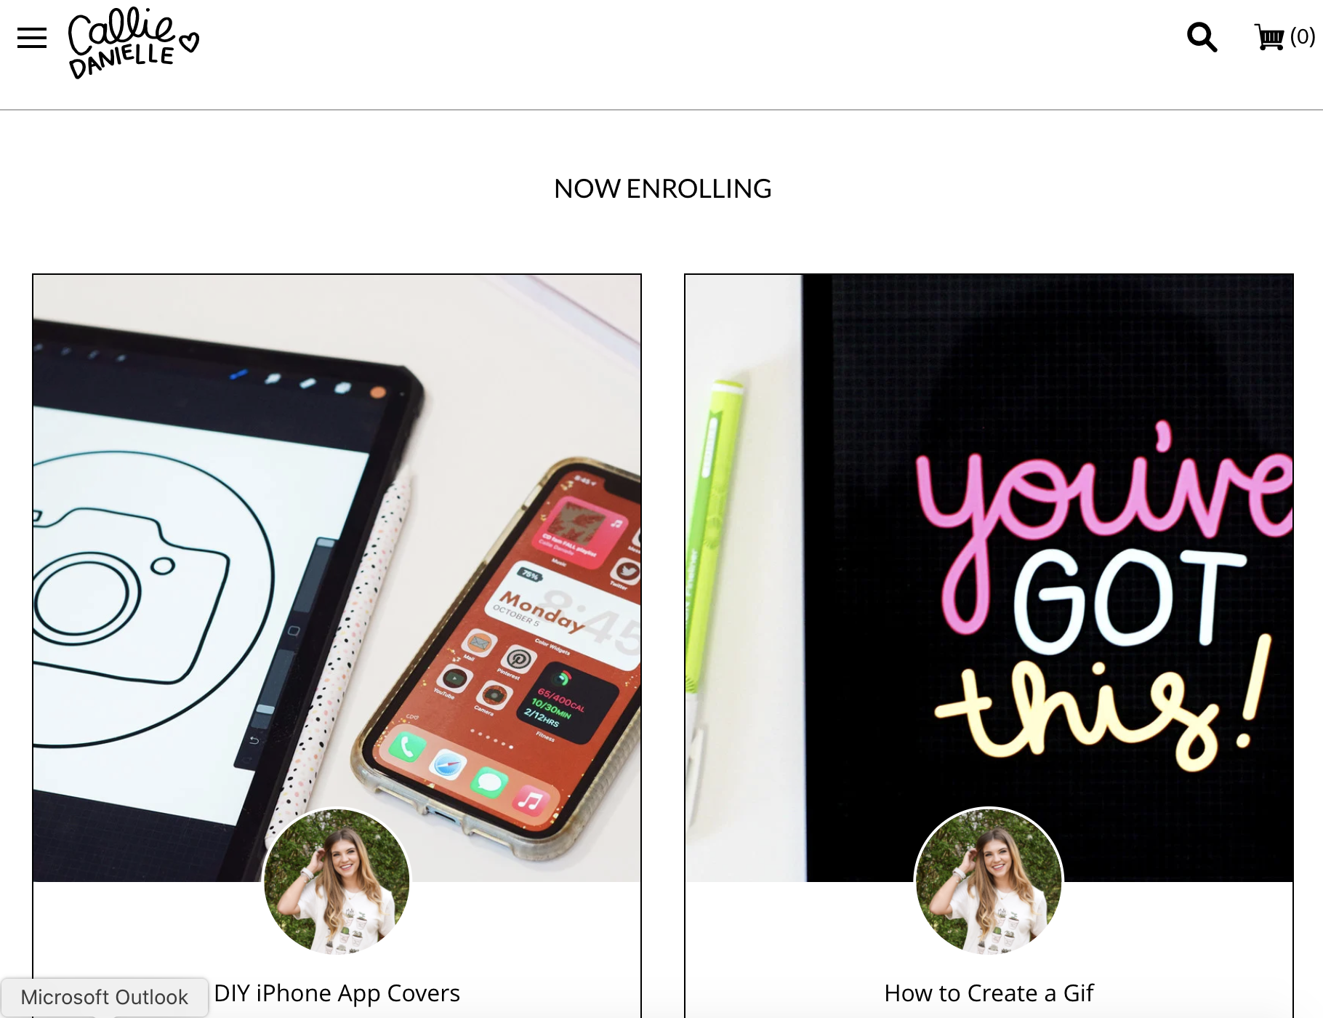
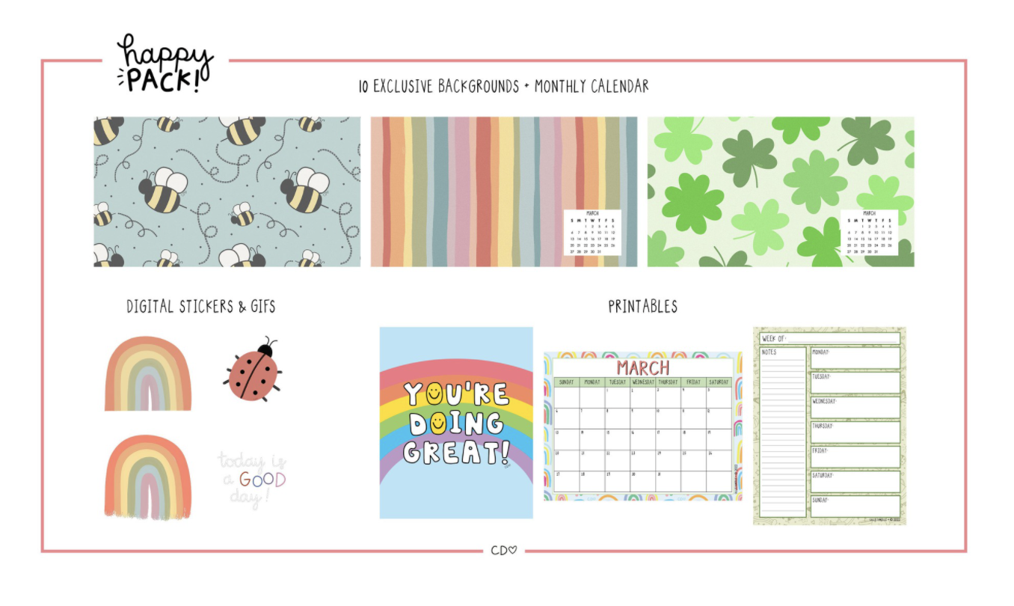
Top Ways to Earn Passive Income
eBook
Get Paid for Being You
  Online Courses
Turn a Hobby into a payday
Cashback
YouTube Tutorials
Real Estate

Slide 18
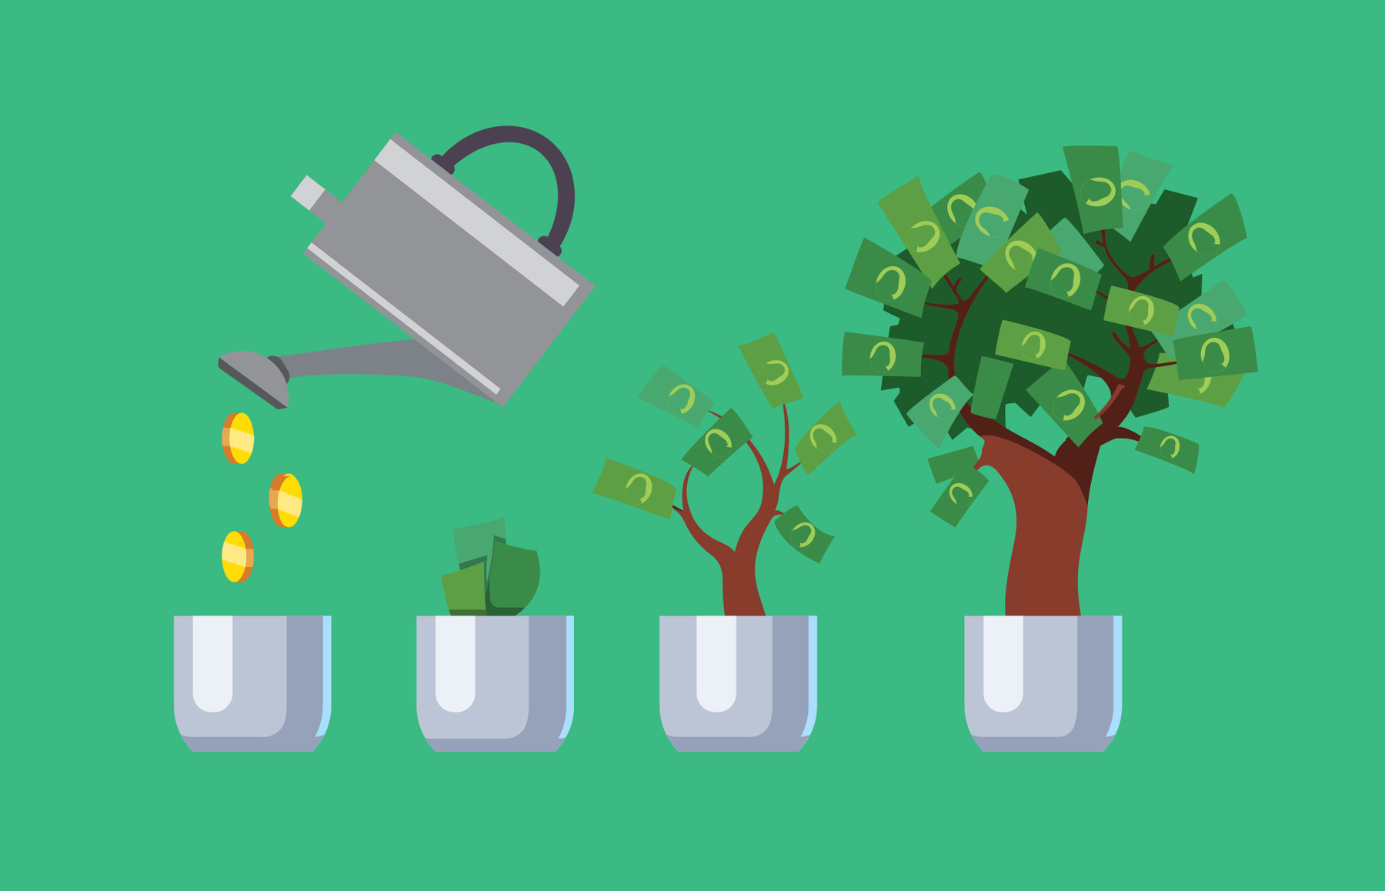
My favorite way to earn passive income….

Slide 19
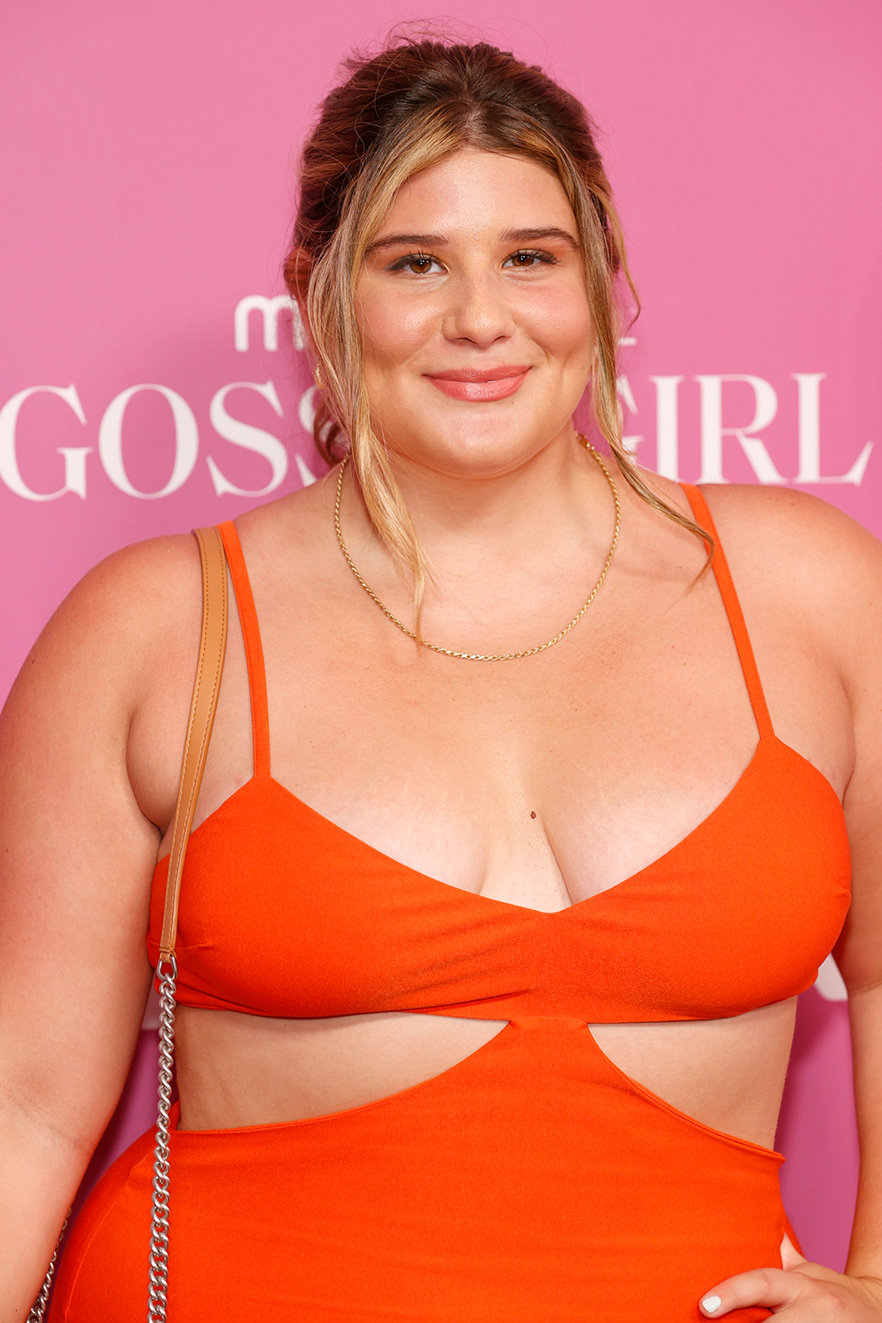
Side Hustle Turned Full Time Business

Slide 20
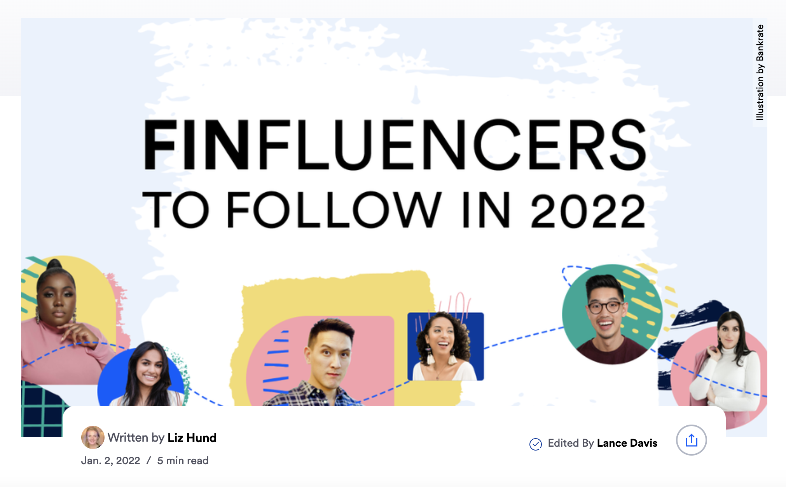
Finfluencers

Slide 21
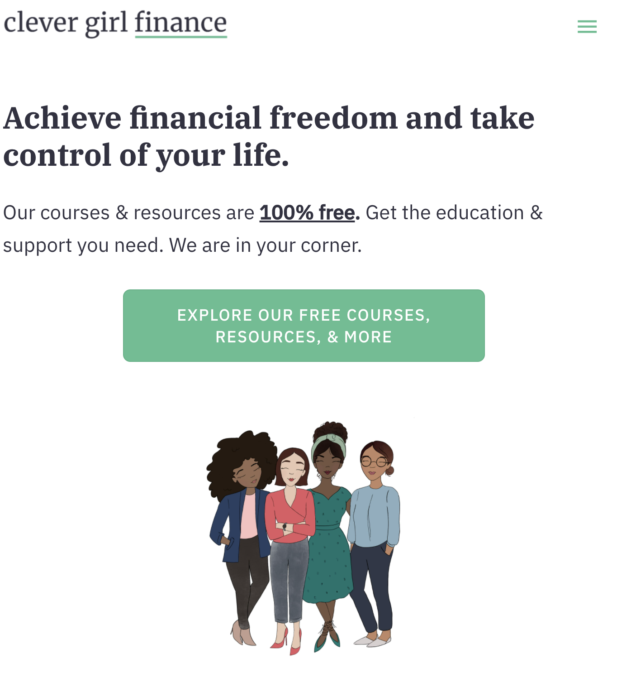
Clever Girl Finance

Slide 22

Farnoosh Torabi

Slide 23
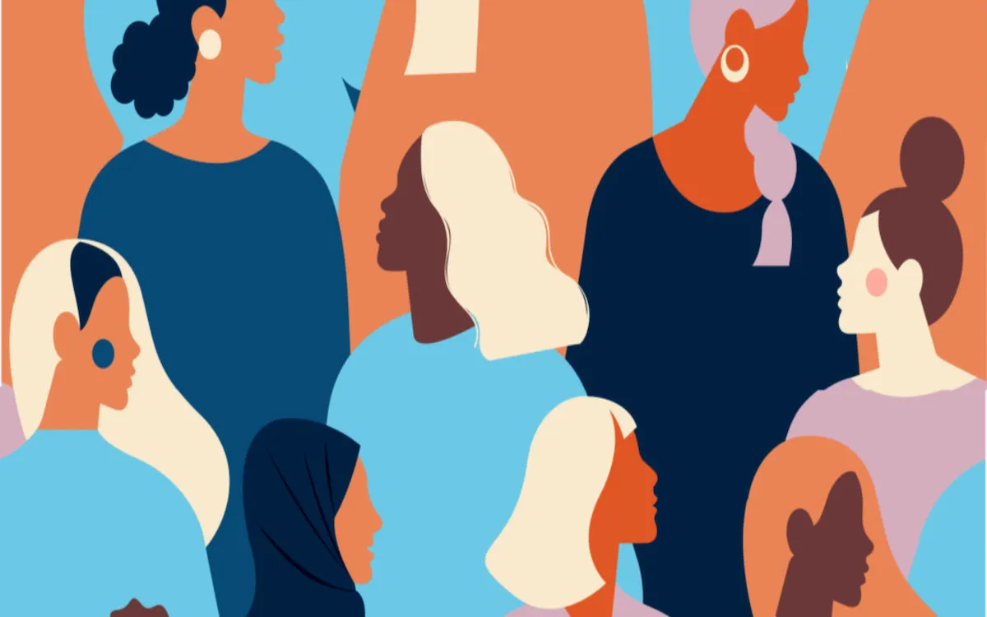
Employing other Women

Slide 24
Why is this important for women?

Slide 25
Mini Activity
You are trying to create a side hustle or become an influencer.
Choose one.
Decide what you’re going to do.
Come up with a way to influence people within a given generation.
  Determine their online behavior.
  How they spend their online time.
  Online preferences.

Slide 26
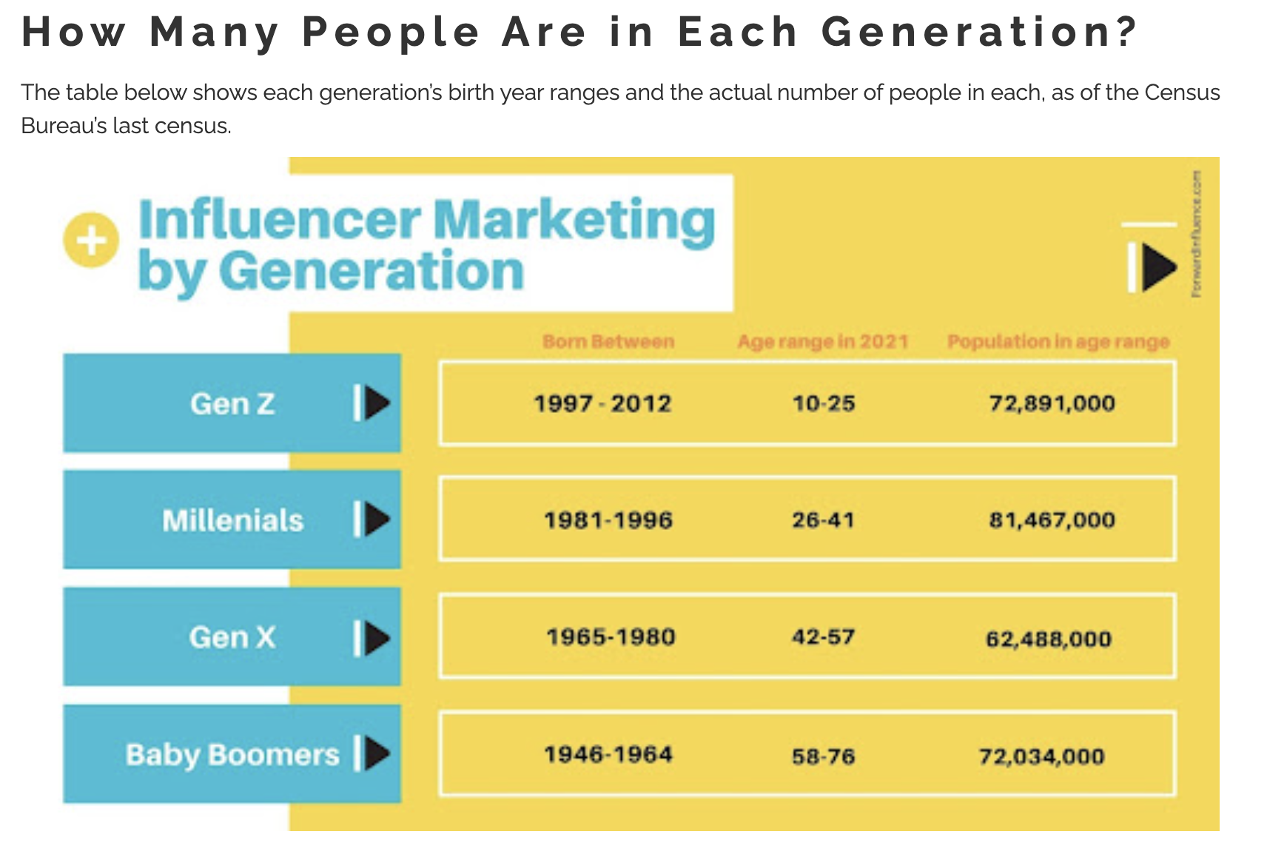

Slide 27
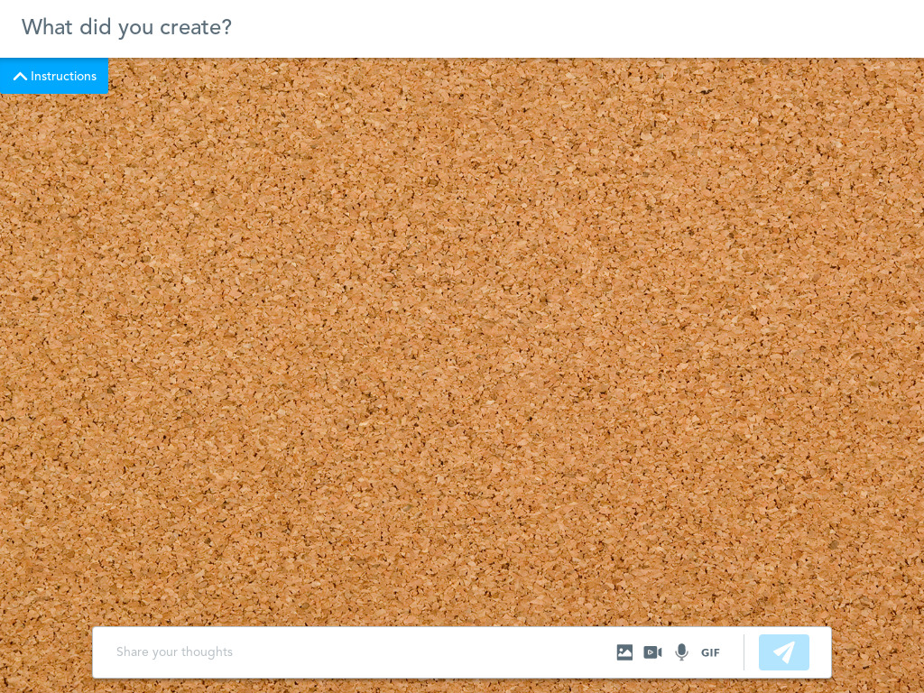

Slide 28


Slide 29
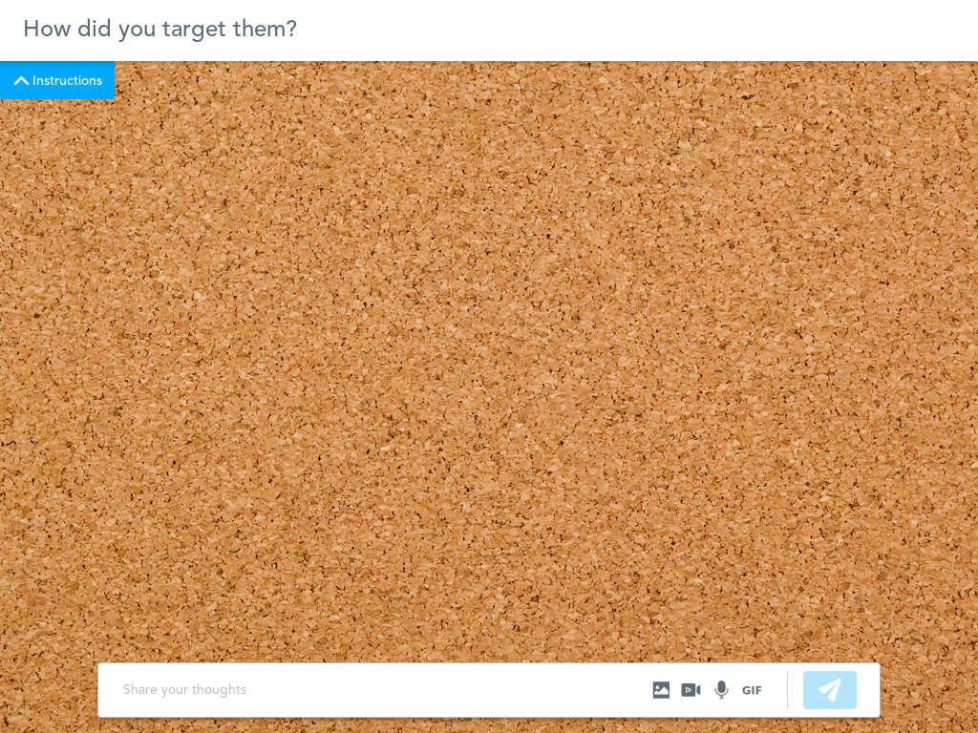

Slide 30
How can this be used in the classroom?

Slide 31
Lesson Plan Ideas
NGPF–INTERACTIVE: Influenc’d
Can you trust social media influencers?
Social Media Influencers Class Activity
How to Teach Like an Influencer
Everfi–Social Media Influencers and their Impact

Slide 32
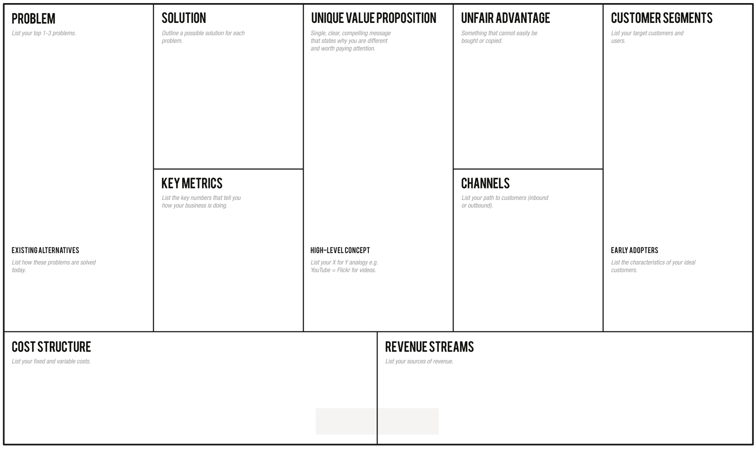
The Lean Canvas Business Model Approach

Slide 33
Resources
https://digitalmarketinginstitute.com/blog/20-influencer-marketing-statistics-that-will-surprise-you
https://influencermarketinghub.com/influencer-marketing-statistics/
https://www.digitalinformationworld.com/2021/11/here-are-biggest-upcoming-influencer.html
https://www.shopify.com/blog/influencer-marketing-statistics#:~:text=Approximately%2084%25%20of%20all%20social,compared%20to%20just%2016%25%20men
https://www.nytimes.com/2019/07/16/technology/vidcon-social-media-influencers.html
https://www.thebalancecareers.com/good-ideas-for-side-hustles-4146460
https://www.clevergirlfinance.com/blog/how-do-influencers-make-money/
https://www.clevergirlfinance.com/blog/best-passive-income-ideas/
https://calliedanielleshop.com/
https://www.forbes.com/sites/forbesagencycouncil/2021/03/08/what-you-need-to-know-about-working-with-nano-influencers/?sh=214b577e6851
https://www.linkedin.com/in/remibader
https://www.intheknow.com/post/remi-bader-nyfw/
https://www.investopedia.com/financial-influencers-to-know-5217608
https://brokemillennial.com
https://www.kasasa.com/blog/personal-finance/female-finance-bloggers
https://www.thepennyhoarder.com/budgeting/female-financial-influencers/
https://www.instagram.com/farnooshtorabi/?hl=en
https://podcast.farnoosh.tv/
https://izea.com/resources/social-media-influencer-jobs/

Slide 34
Closing and Questions

