Slide 1
NCCEE
Presents
Women in Entrepreneurship Using
"How I Built This" Podcast

Slide 2
NCCEE
Who We Are

Slide 3
Webinar Summary
During this webinar, we will highlight the power of women in entrepreneurship by using the “How I Built This” podcast.

Slide 4
Objectives
Teachers will be able to:
Describe the benefits of women seeking entrepreneurship roles.
Explain how entrepreneurship can provide an ideal career opportunity for women.

Slide 5
Standards Covered
Personal Financial Education
Standard 1: Earning Income
Economics
Standard 14: Entrepreneurship

Slide 6
Agenda
Statistics
Opportunities for female entrepreneurs
5 companies that have female founders
Self-paced mini activity
How can this can be used in your classroom
Q&A

Slide 7
Statistics About Women in Entrepreneurship
Notes:
https://whattobecome.com/blog/women-entrepreneurs-statistics/

Slide 8
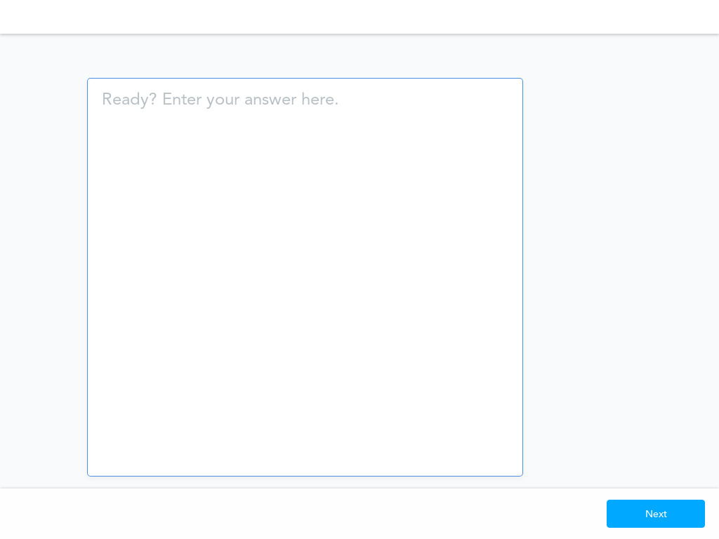

Slide 9
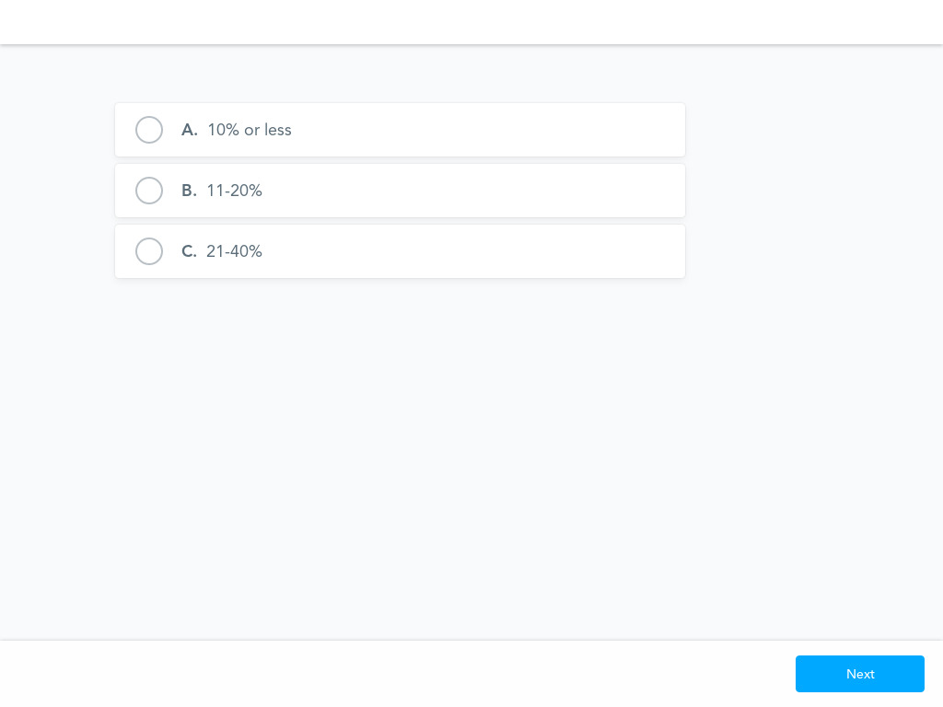
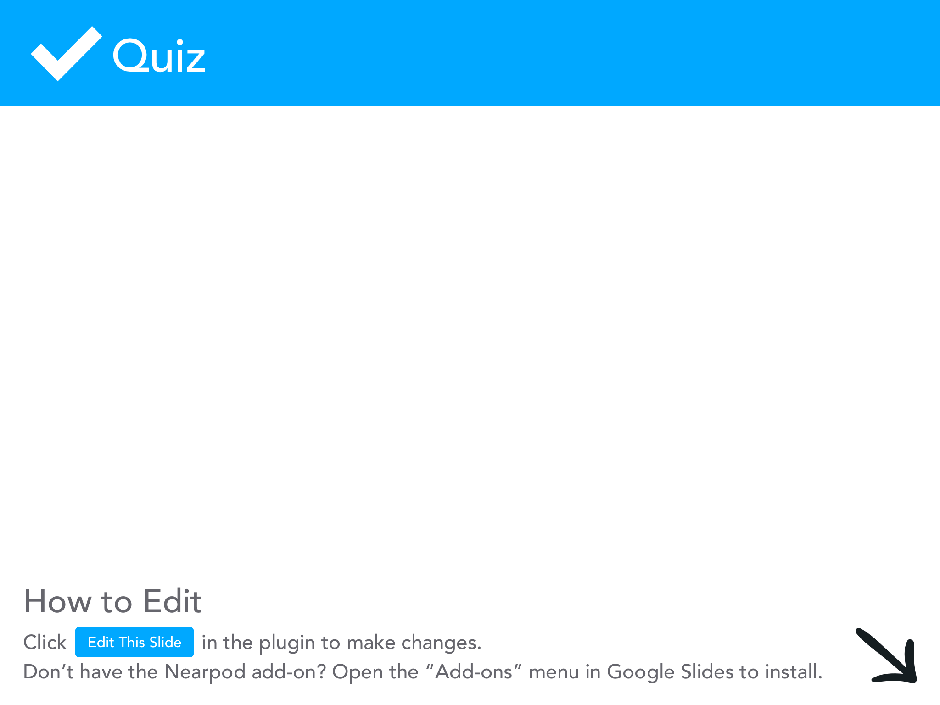

Slide 11
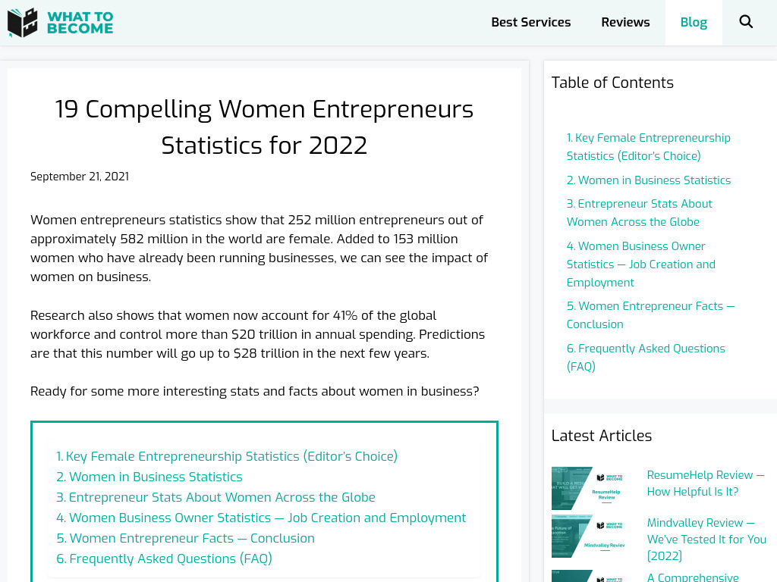
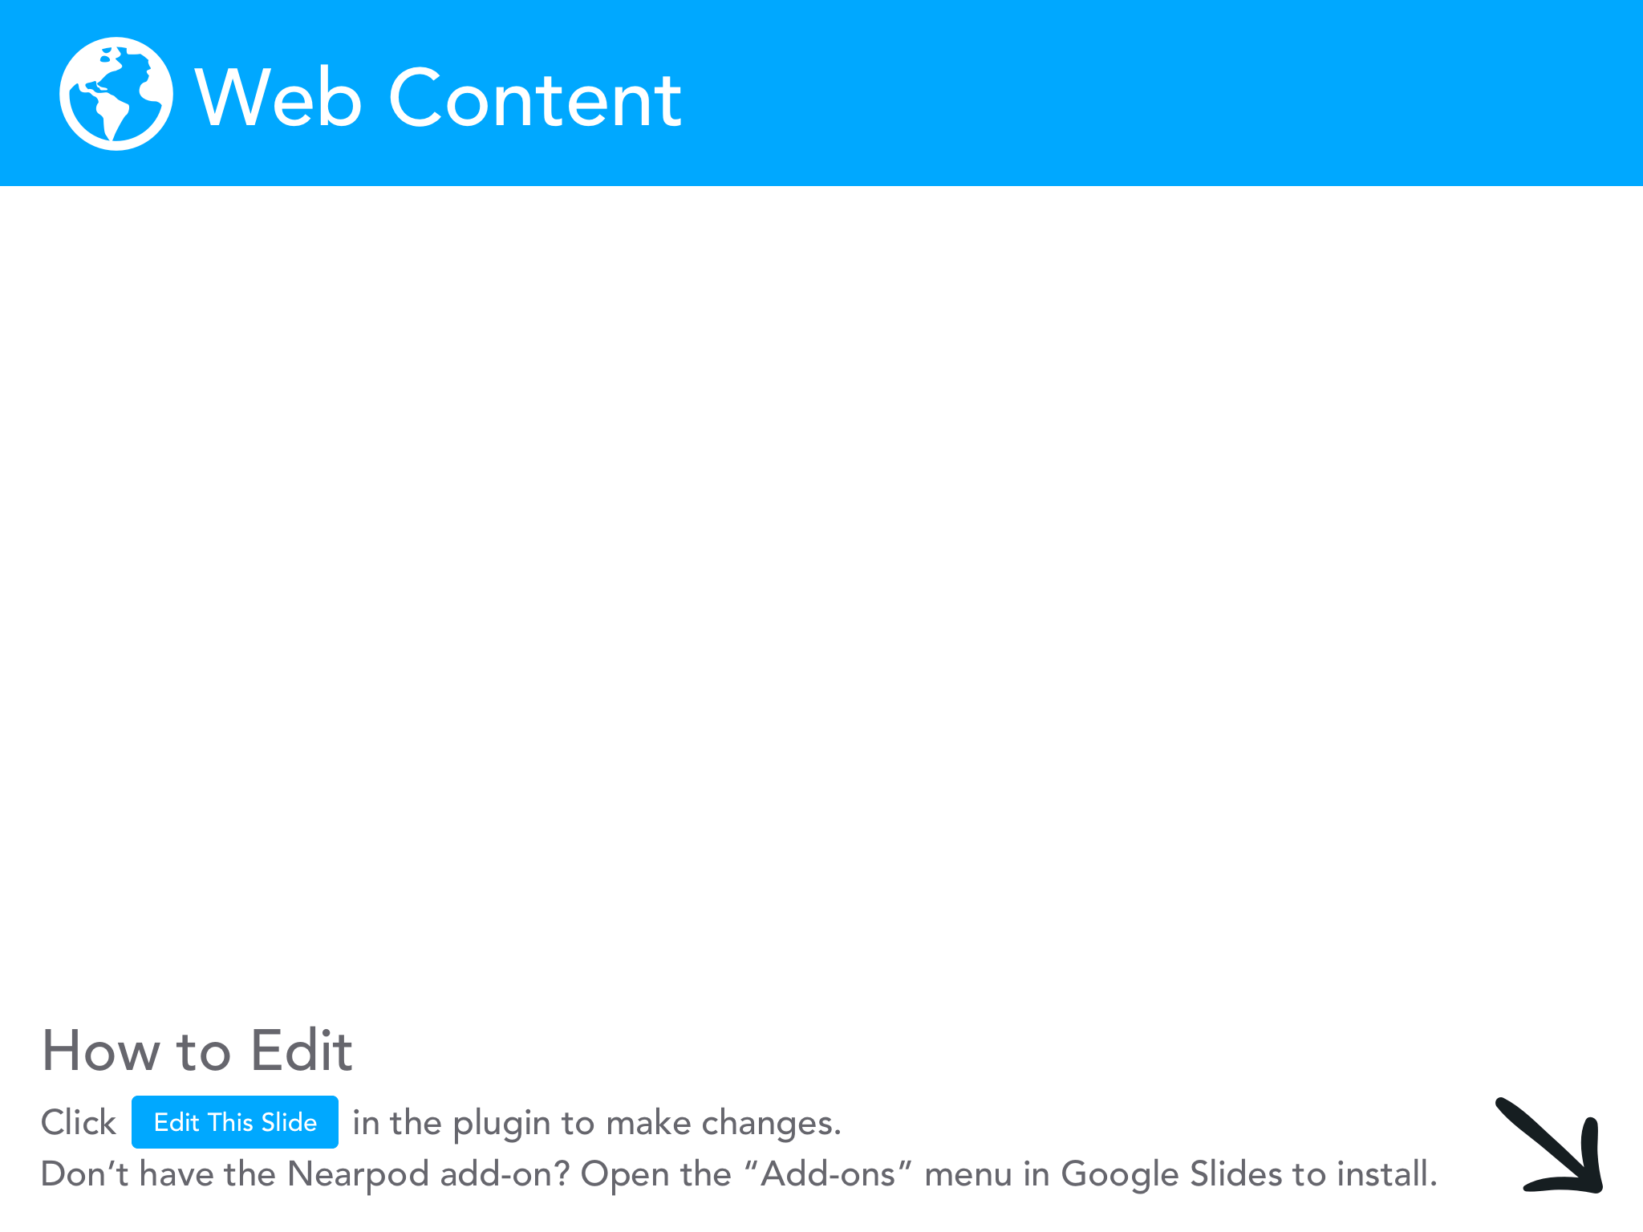
Notes:
Explore for 3 minutes.

Slide 12
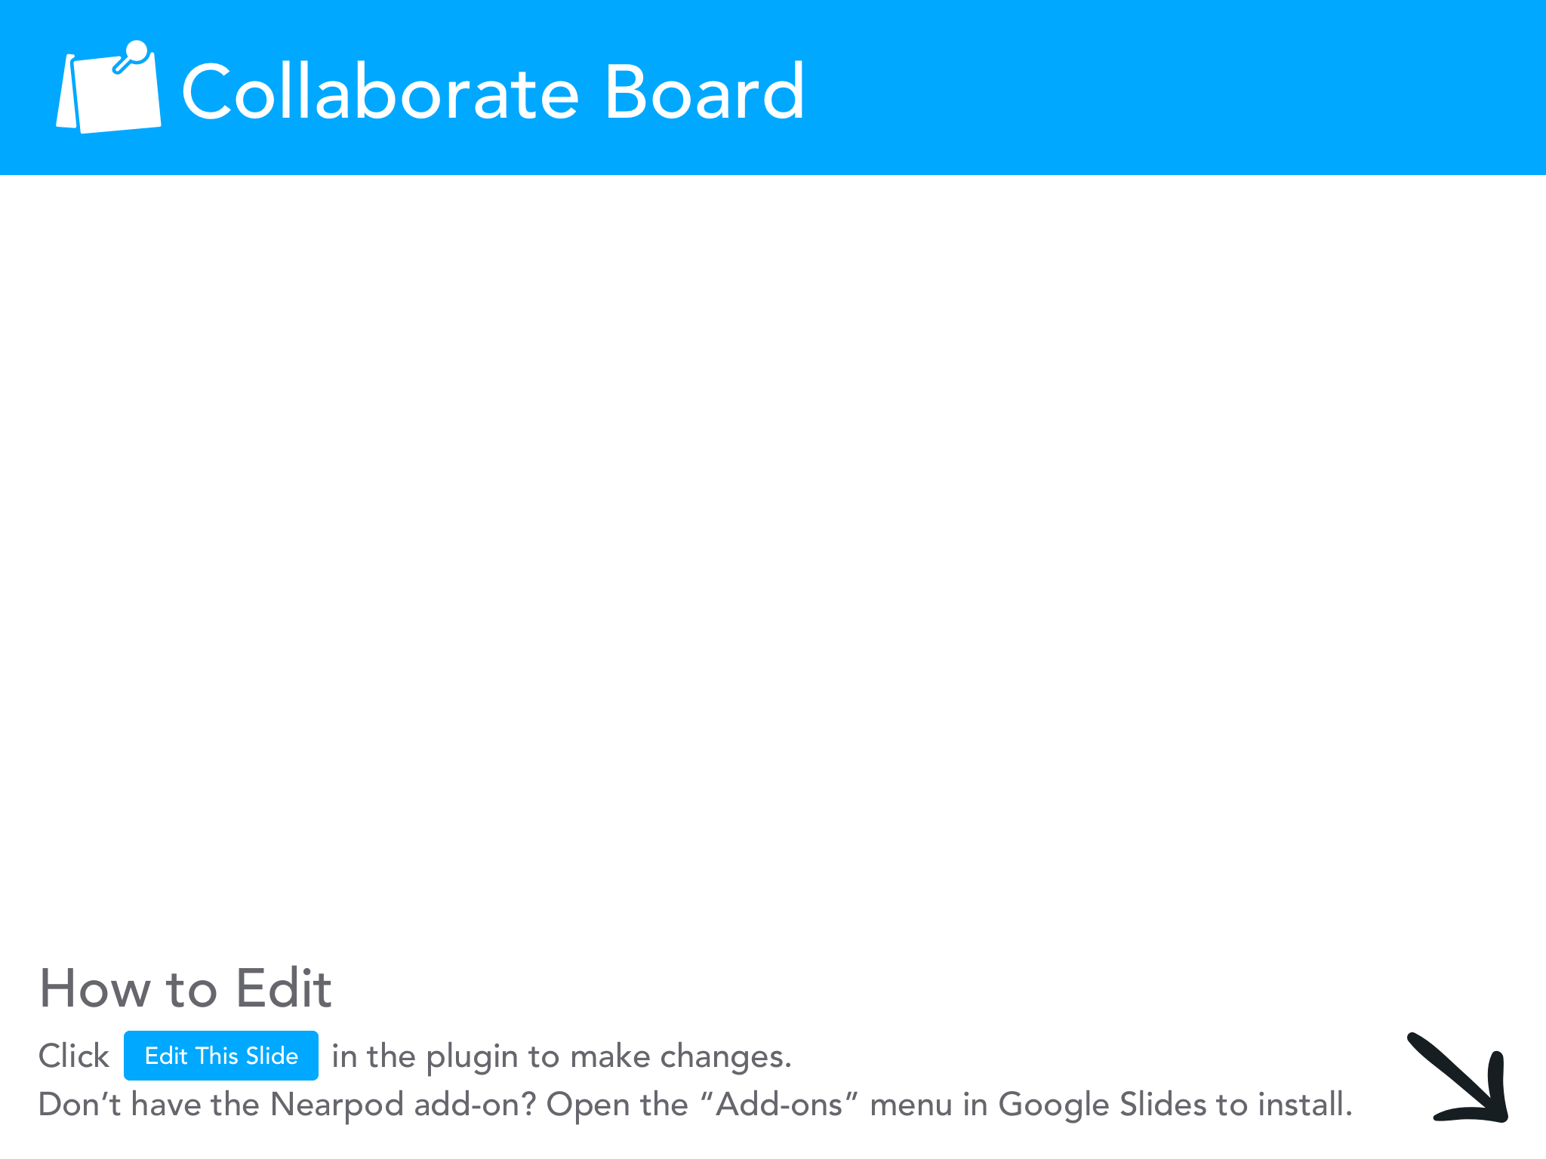

Slide 13
Key Stats

Slide 14
Why do we need women entrepreneurs?

Slide 16
How I Built This Podcast
Notes:
We really want to highlight that getting students and teachers interested is half the battle. This podcast does a good job of getting your excited about entrepreneurship.

Slide 17
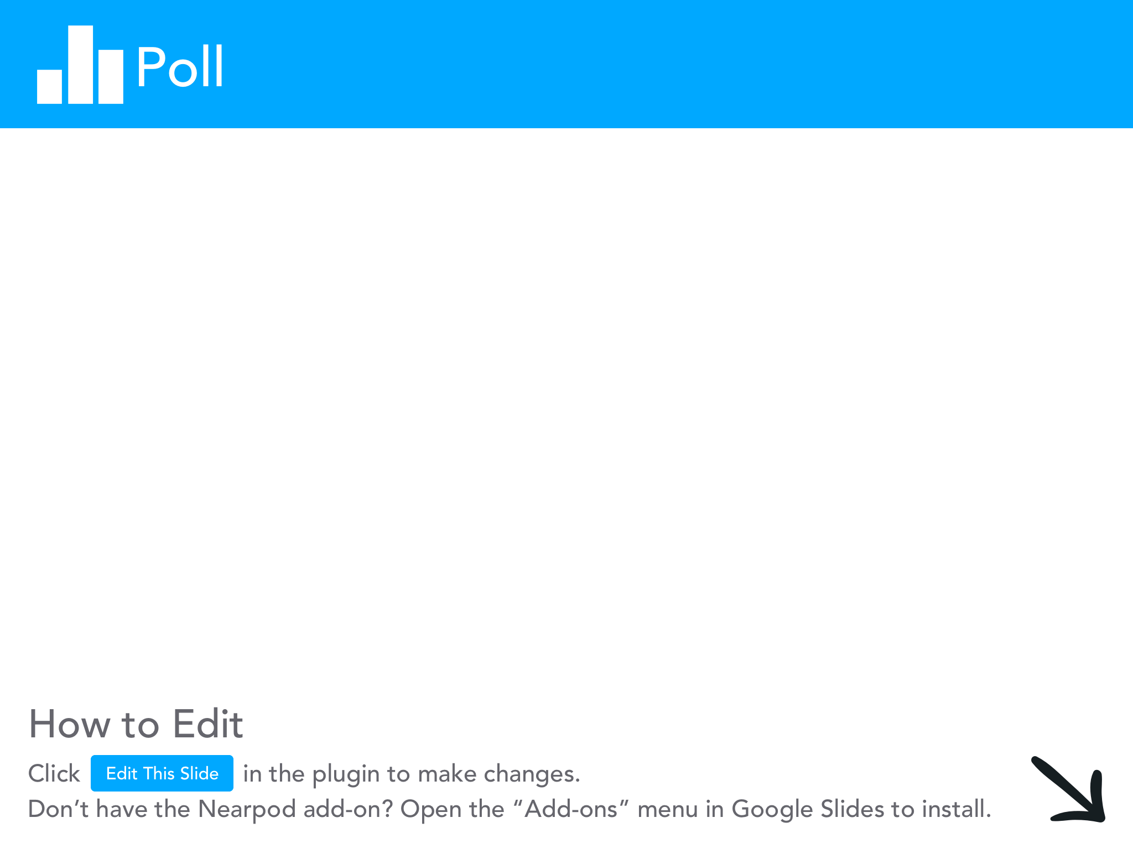

Slide 18
McBride Sisters Wine
Robin and Andréa McBride
Notes:
Background
Starting
Importing wine, cold calling restaurants, small stores
Challenges
Time! 90 days to get enough wine to supply Kroger nationwide
Keepin’ On, Keepin’ on!
Released a new line.
said they would sell if the number was right.
Unique Fact
Their entire story…

Slide 19
2. Bumble
Whitney Wolfe
Notes:
Background
Starting
Challenges
Keepin’ On, Keepin’ on!
Unique Fact

Slide 20
3. Canva
Melanie Perkins
Notes:
Background
Starting
19 year old
Yearbooks
Challenges
Young and little experience
Pitch Deck
Keepin’ On, Keepin’ on!
FedEx and Office Depot
Valued at $6 Billion Dollars
Use this in class
Resumes, slide decks, social media, etc.
Unique Fact
Made profit from printing

Slide 21
4. Burt’s Bees
Roxanne Quimby
Notes:
Background
Starting
Challenges
Keepin’ On, Keepin’ on!
Unique Fact

Slide 22
5. Rent the Runway
Jenn Hyman
Notes:
Background
Starting
Honeymoon registry
One fashion designer + many
Clientele (experience generation)
Investors were scarce
Challenges
Expensive Inventory
Pop Ups
Keepin’ On, Keepin’ on!
Rental service has gained traction
Other clothing companies do this now too
Prom dresses!
Unique Fact
Came up with idea after conversation of little sister
Meeting with a very well known designer, just showed up!

Slide 24
How do we get women to pursue careers as entrepreneurs?

Slide 25
Opportunities for Female Entrepreneurs

Slide 26
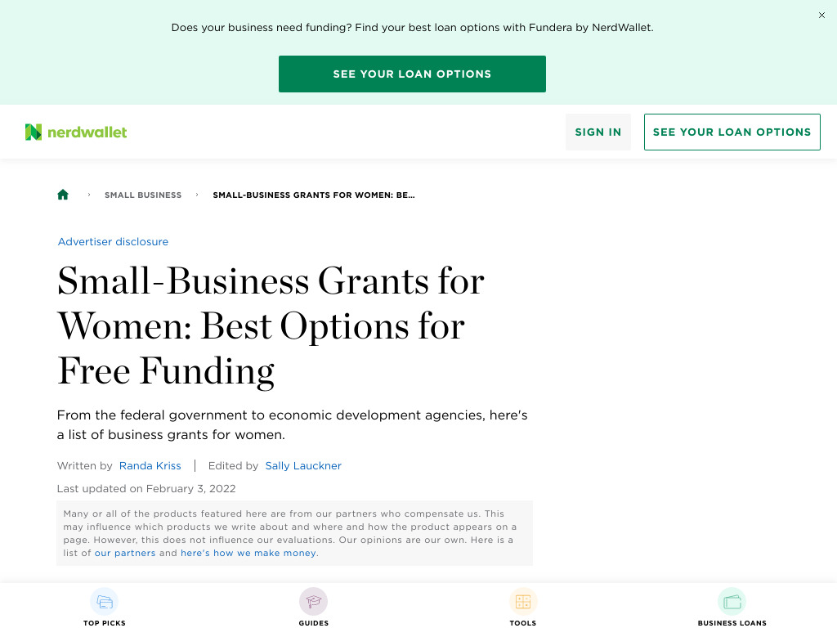
Notes:
3 minutes to explore these opportunities and find one that is interesting to you.

Slide 27
Mini Activity
Notes:
Go to HIBT podcast, pick an episode you’re interested in and one your students would be interested in, report back 2 questions you have about this entrepreneur before listening

Slide 28
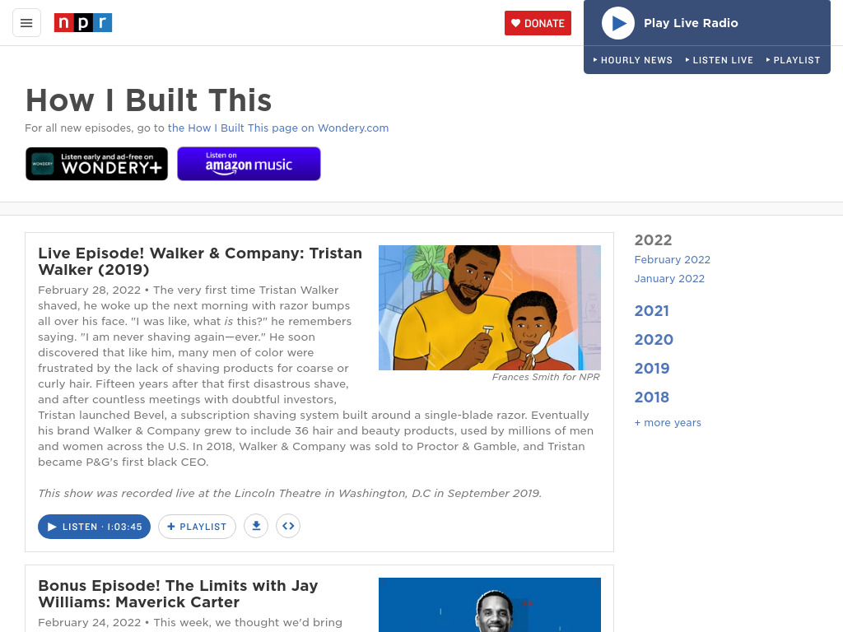

Slide 29
How can this be used in the classroom?

Slide 30
Lesson Plan Ideas
Mini Project: Women in Finance
Create a PowerPoint/Google Slideshow focusing one of Barron’s 100 Most Influential Women
Why is important to be in this industry?
What path did she take?
Research the career path she took
Job Outlook
What do you need to do if you wanted to achieve this?

Slide 31
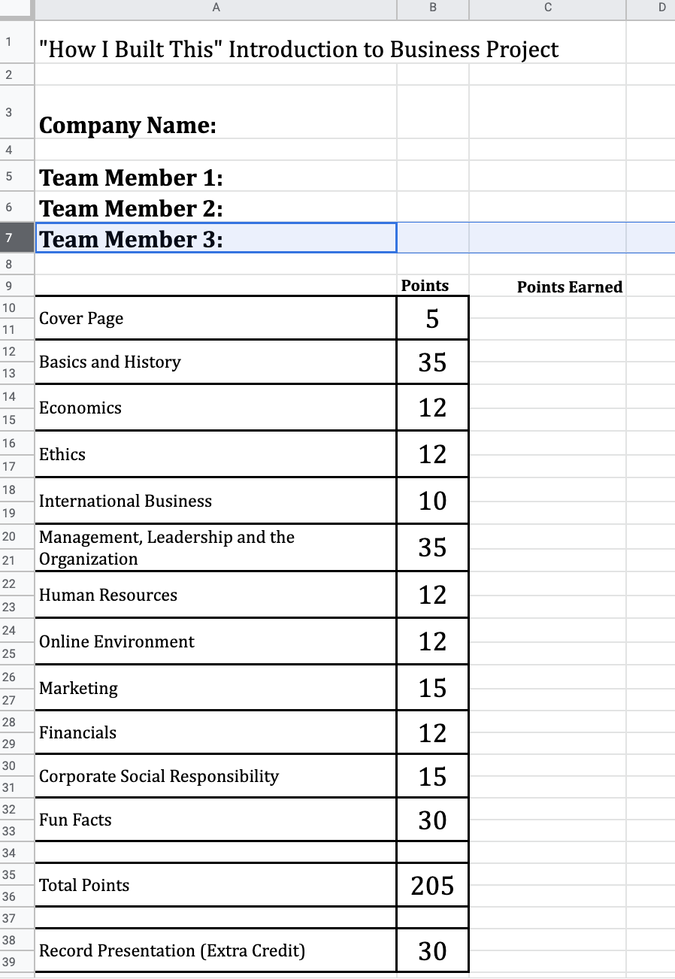
Lesson Plan Ideas
Project Used in Introduction to Business Course.

Slide 33
Resources to Help!
“How I Built This” Book
“How I Built This” Podcast
Where?

Slide 34
Closing and Questions

