Slide 1
Spice Up Your Econ and Personal Finance Lessons! Presented by Amanda Stiglbauer February 1, 2022 astiglbauer@richland2.org

Slide 2
Agenda
NearPod - A “How to” guide
GimKit - more than just another game show!
The New and Improved Kahoot!
Go to Video Clips - EconMovies and Two Cents & more
Planet Money and the Indicator
Spice up your slide shows with Slides Mania and Slides Carnival!

Slide 3
Objectives
I can:
Examine EdTech tools, games, and fun videos to use in econ and personal finance lessons.
Learn how to create their own GimKit games and NearPod interactive presentations.

Slide 4
What is NearPod?
“Freemium”
One platform that allows teachers multiple ways to teach and assess students.
Easy to import Google Slides into platform
Provides interactives to check student progress at any point in the lesson, insert websites or videos
Student paced vs teacher led options

Slide 5
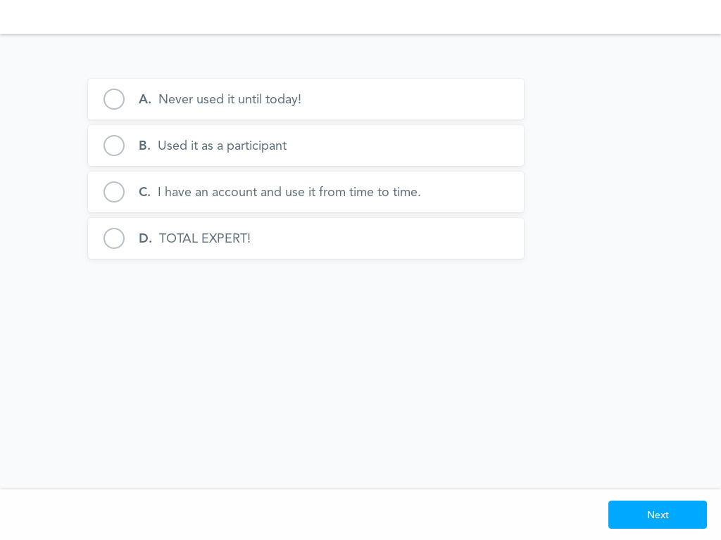
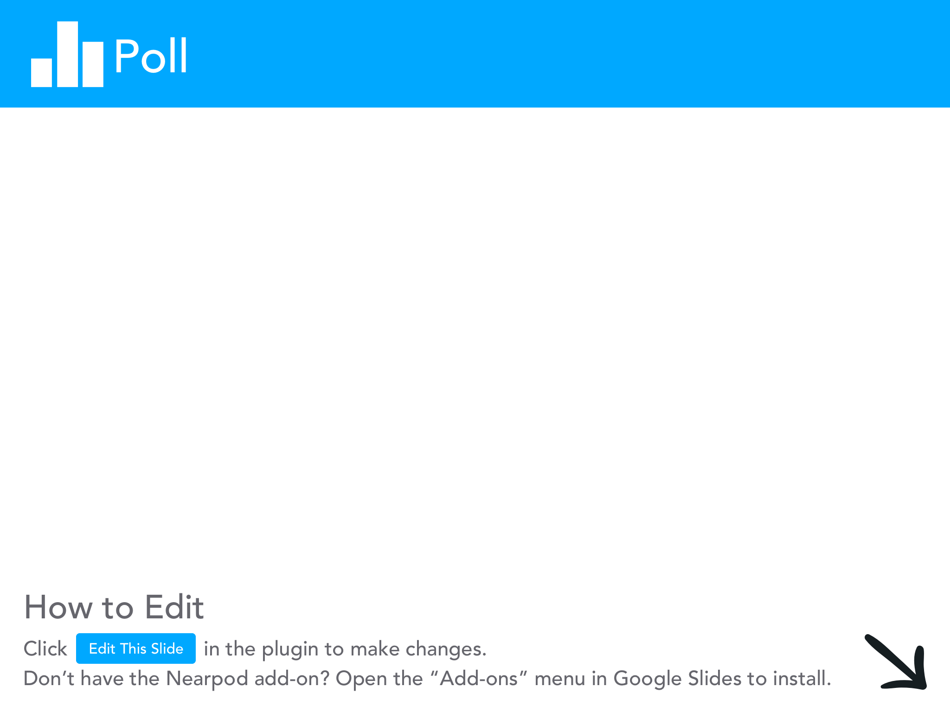

Slide 6
My favorite features
Collaborate board
Draw it - especially for econ graphs!
Fill in the blanks
Matching pairs
Open Ended Questions
Poll
Quiz
Time to Climb
Web Content

Slide 7
NearPod Demonstration
Creating your own is easy peasy!

Slide 8
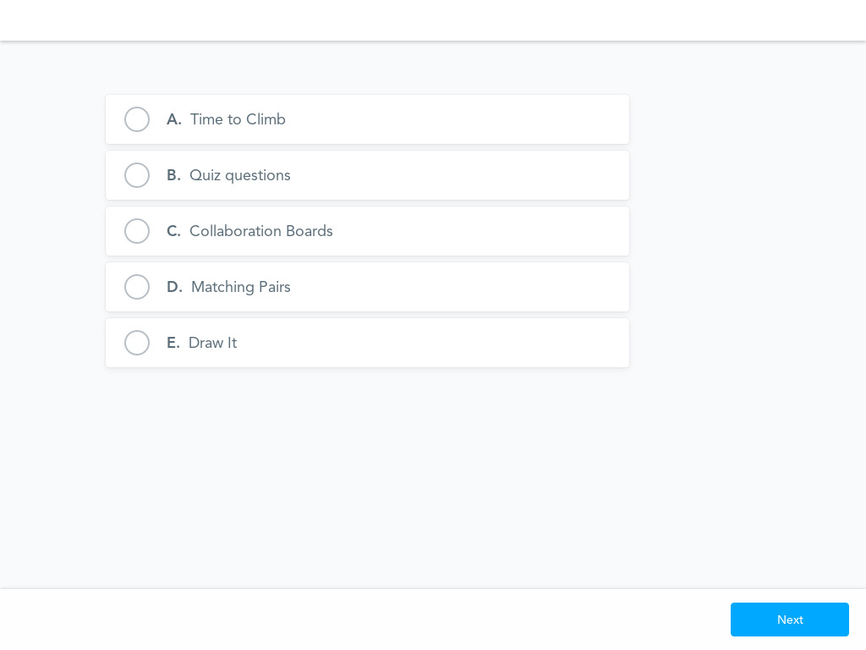

Slide 9
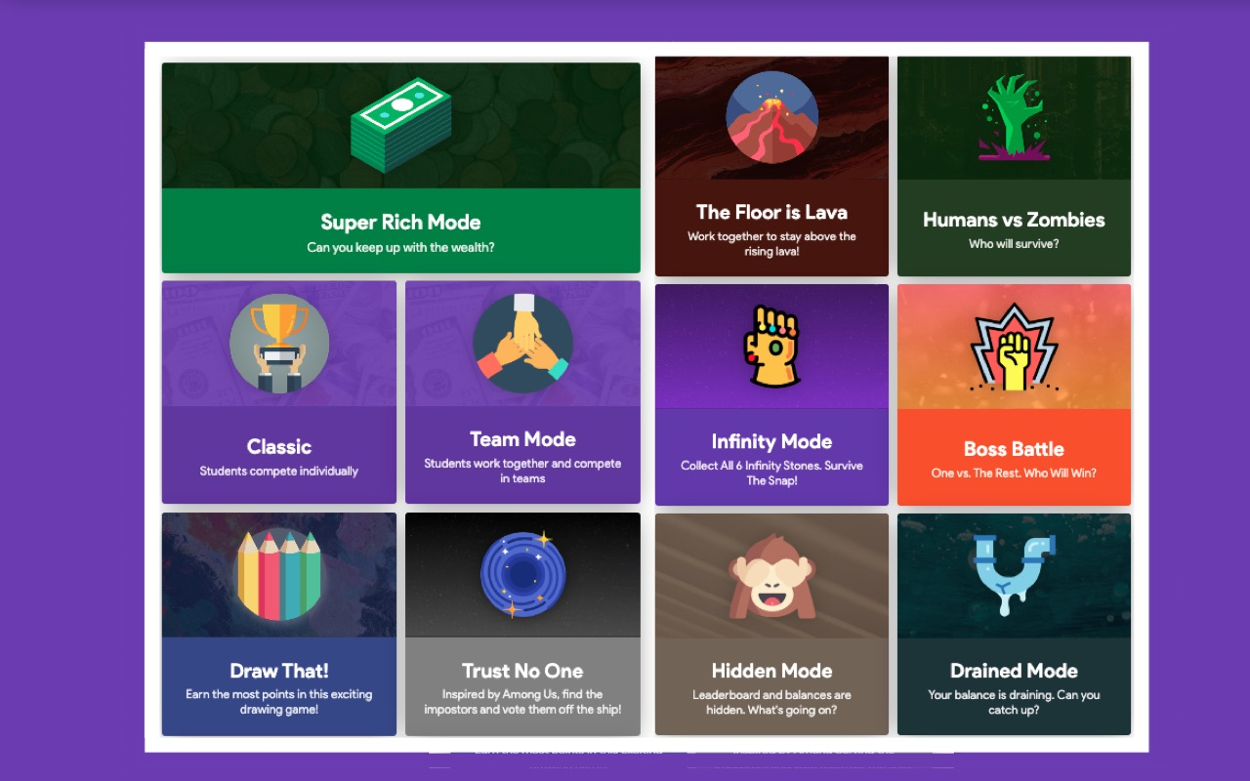
Gimkit! Another fun “freemium”
A gamer’s game! Created by gamers for gamers!

Slide 10
Keys to Success with Gimkit
Don’t be intimidated! Be a student yourself!
preview/play before you play
Allow for student choice
Take advantage of Kits that are already created
Make a copy and use questions that fit your objective; delete those that aren’t helpful.
The game goes quickly, so create a kit with LOTS of questions
Beware technology challenges
Chromebooks and images

Slide 11
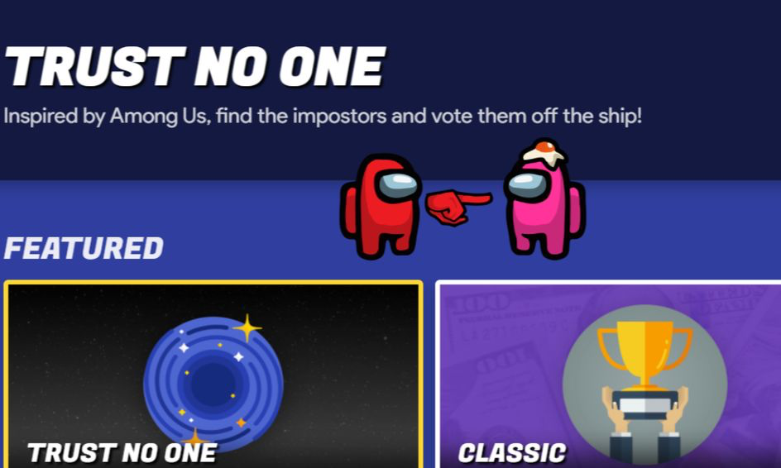
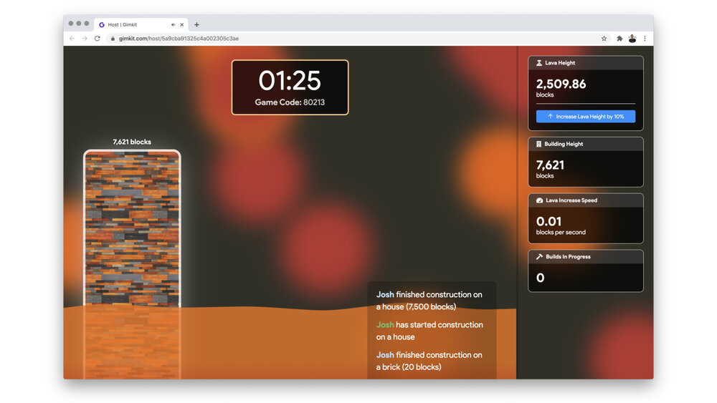
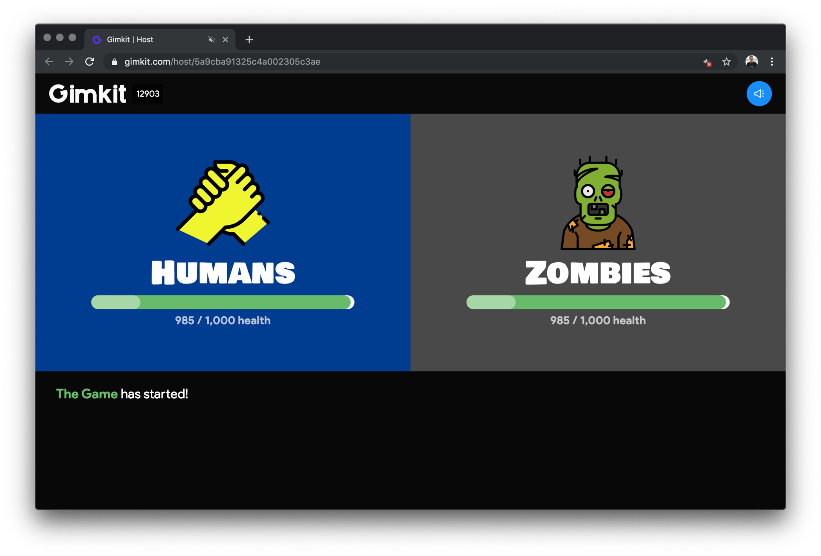
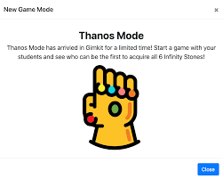

Slide 12
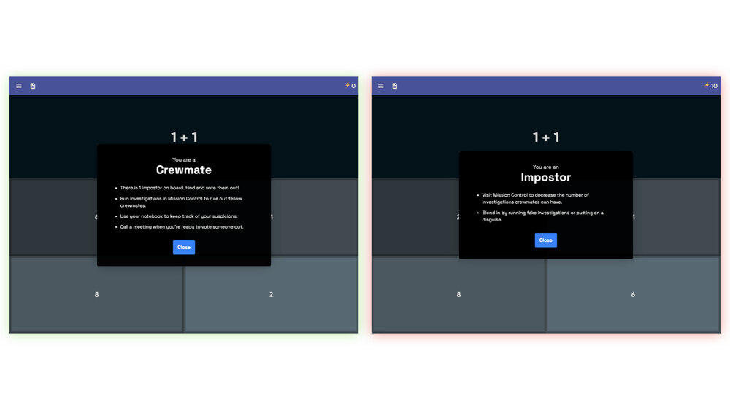
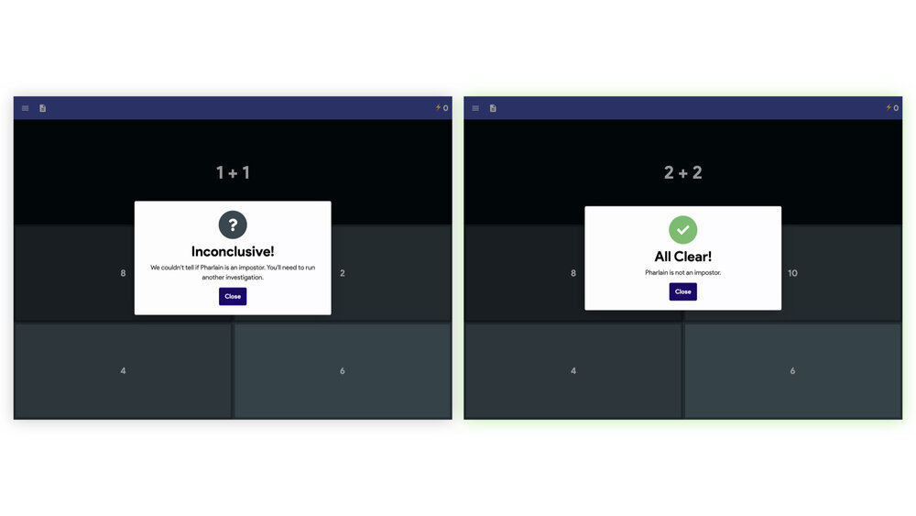
Trust No One
Roles assigned
Investigations conducted
Class discussion/voting on suspects

Slide 13
Kit Collab
Pros
Less time consuming for you
Students become leaders of their learning and review
Questions reviewed by teacher
Data
Review during and after
Cons
Students can submit questions without answer choices
Can’t create true/false questions
Each Gimkit can only have 400 terms
Fill in the blank questions are tough

Slide 14
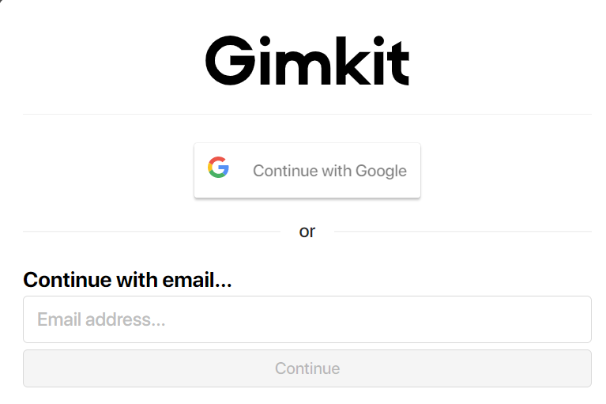
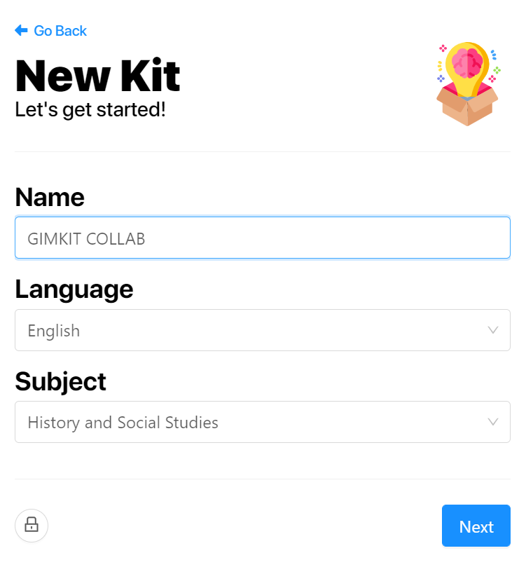
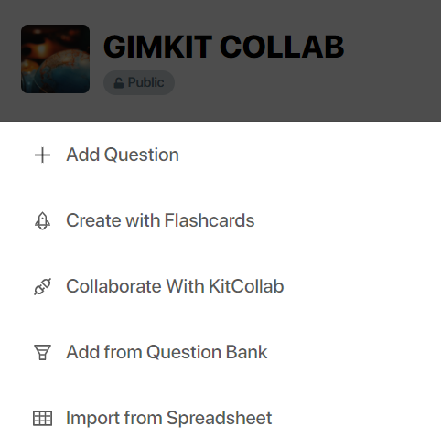
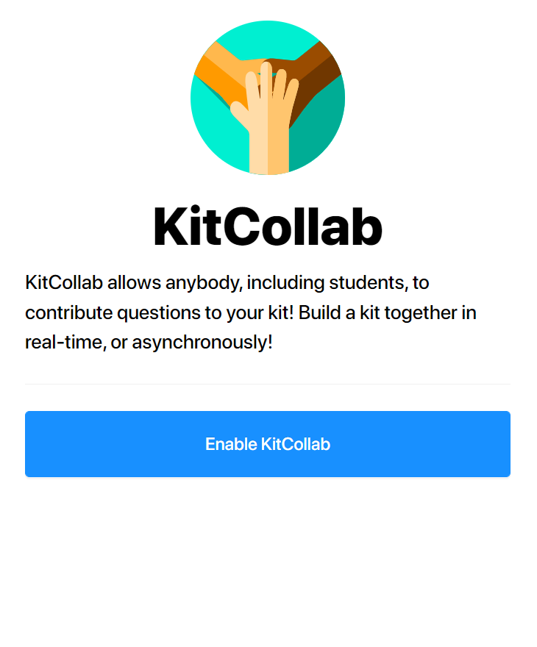
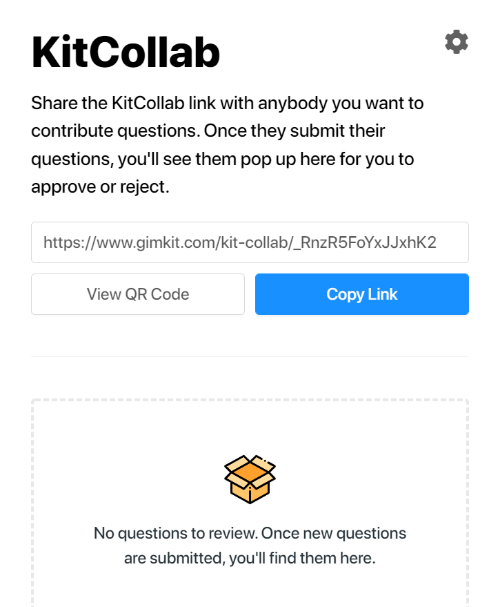
HOW TO
LOG IN
Create a New Kit
01
02
03
Collaborate with KitCollab
Enable KitCollab
04
Share!
05

Slide 15
https://www.gimkit.com/kit-collab/sIZlGzHbVeRqs3sy
Let’s Play!
Create 2 of your own questions about economics or personal finance!

Slide 16
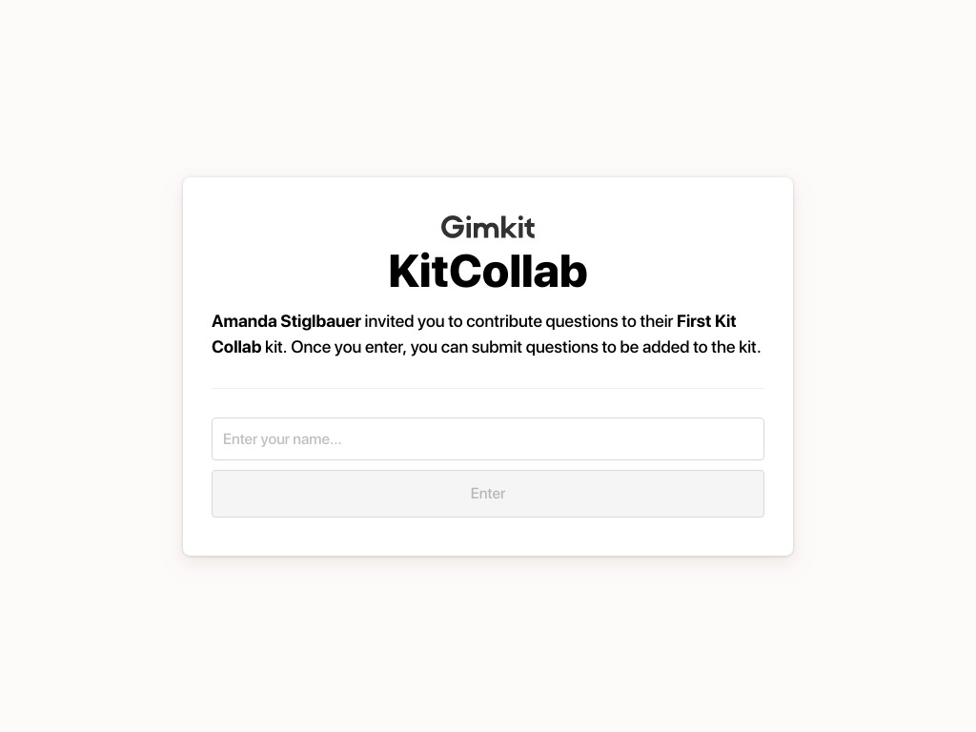
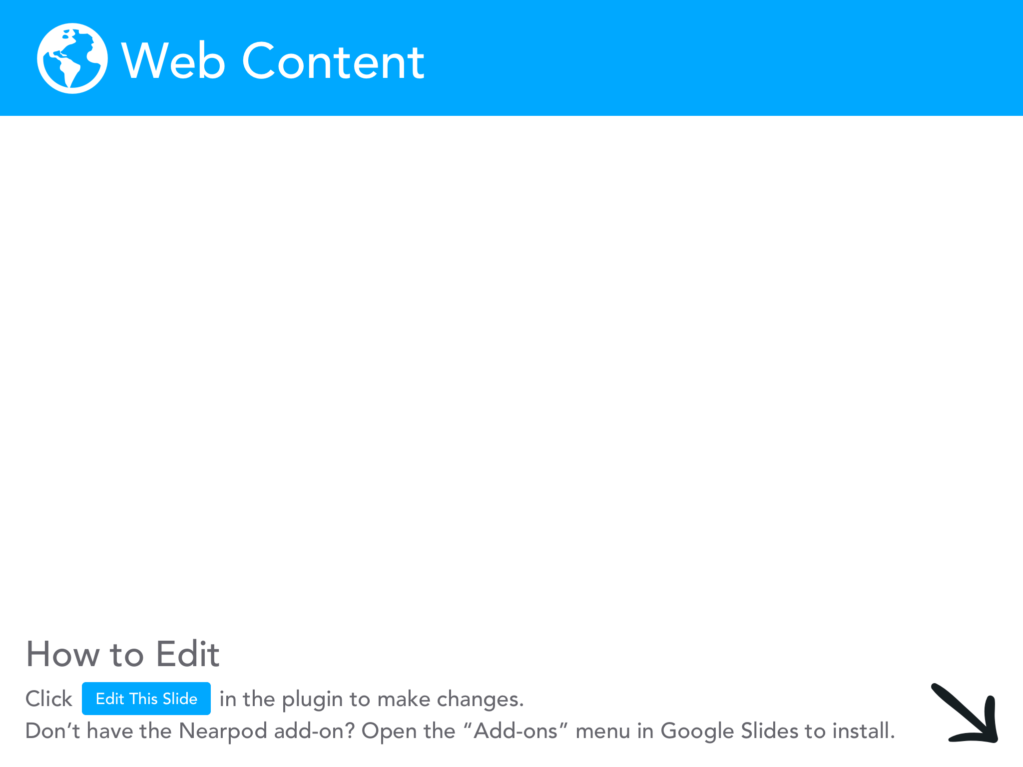

Slide 17
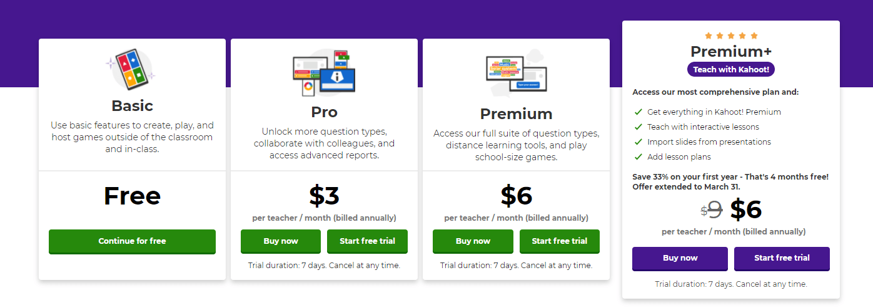
Kahoot - New and Improved
Different question types
Teacher led or student paced with reports
Import Lesson plans/create interactive lessons*
Let’s play around!

Slide 18
Some of the BEST Econ and Personal Finance Clips
EconMovies
TwoCents
CrashCourse
MRU

Slide 19
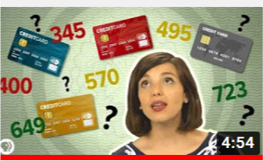
What Goes Into Your Credit Score?
Notes:
https://www.youtube.com/watch?v=ozbGWLtZdoY
PBS Two Cents
Edpuzzlehttps://edpuzzle.com/media/5f9b013cf2d23f409379dc54

Slide 20
Podcasts:
Planet Money and the Indicator

Slide 22
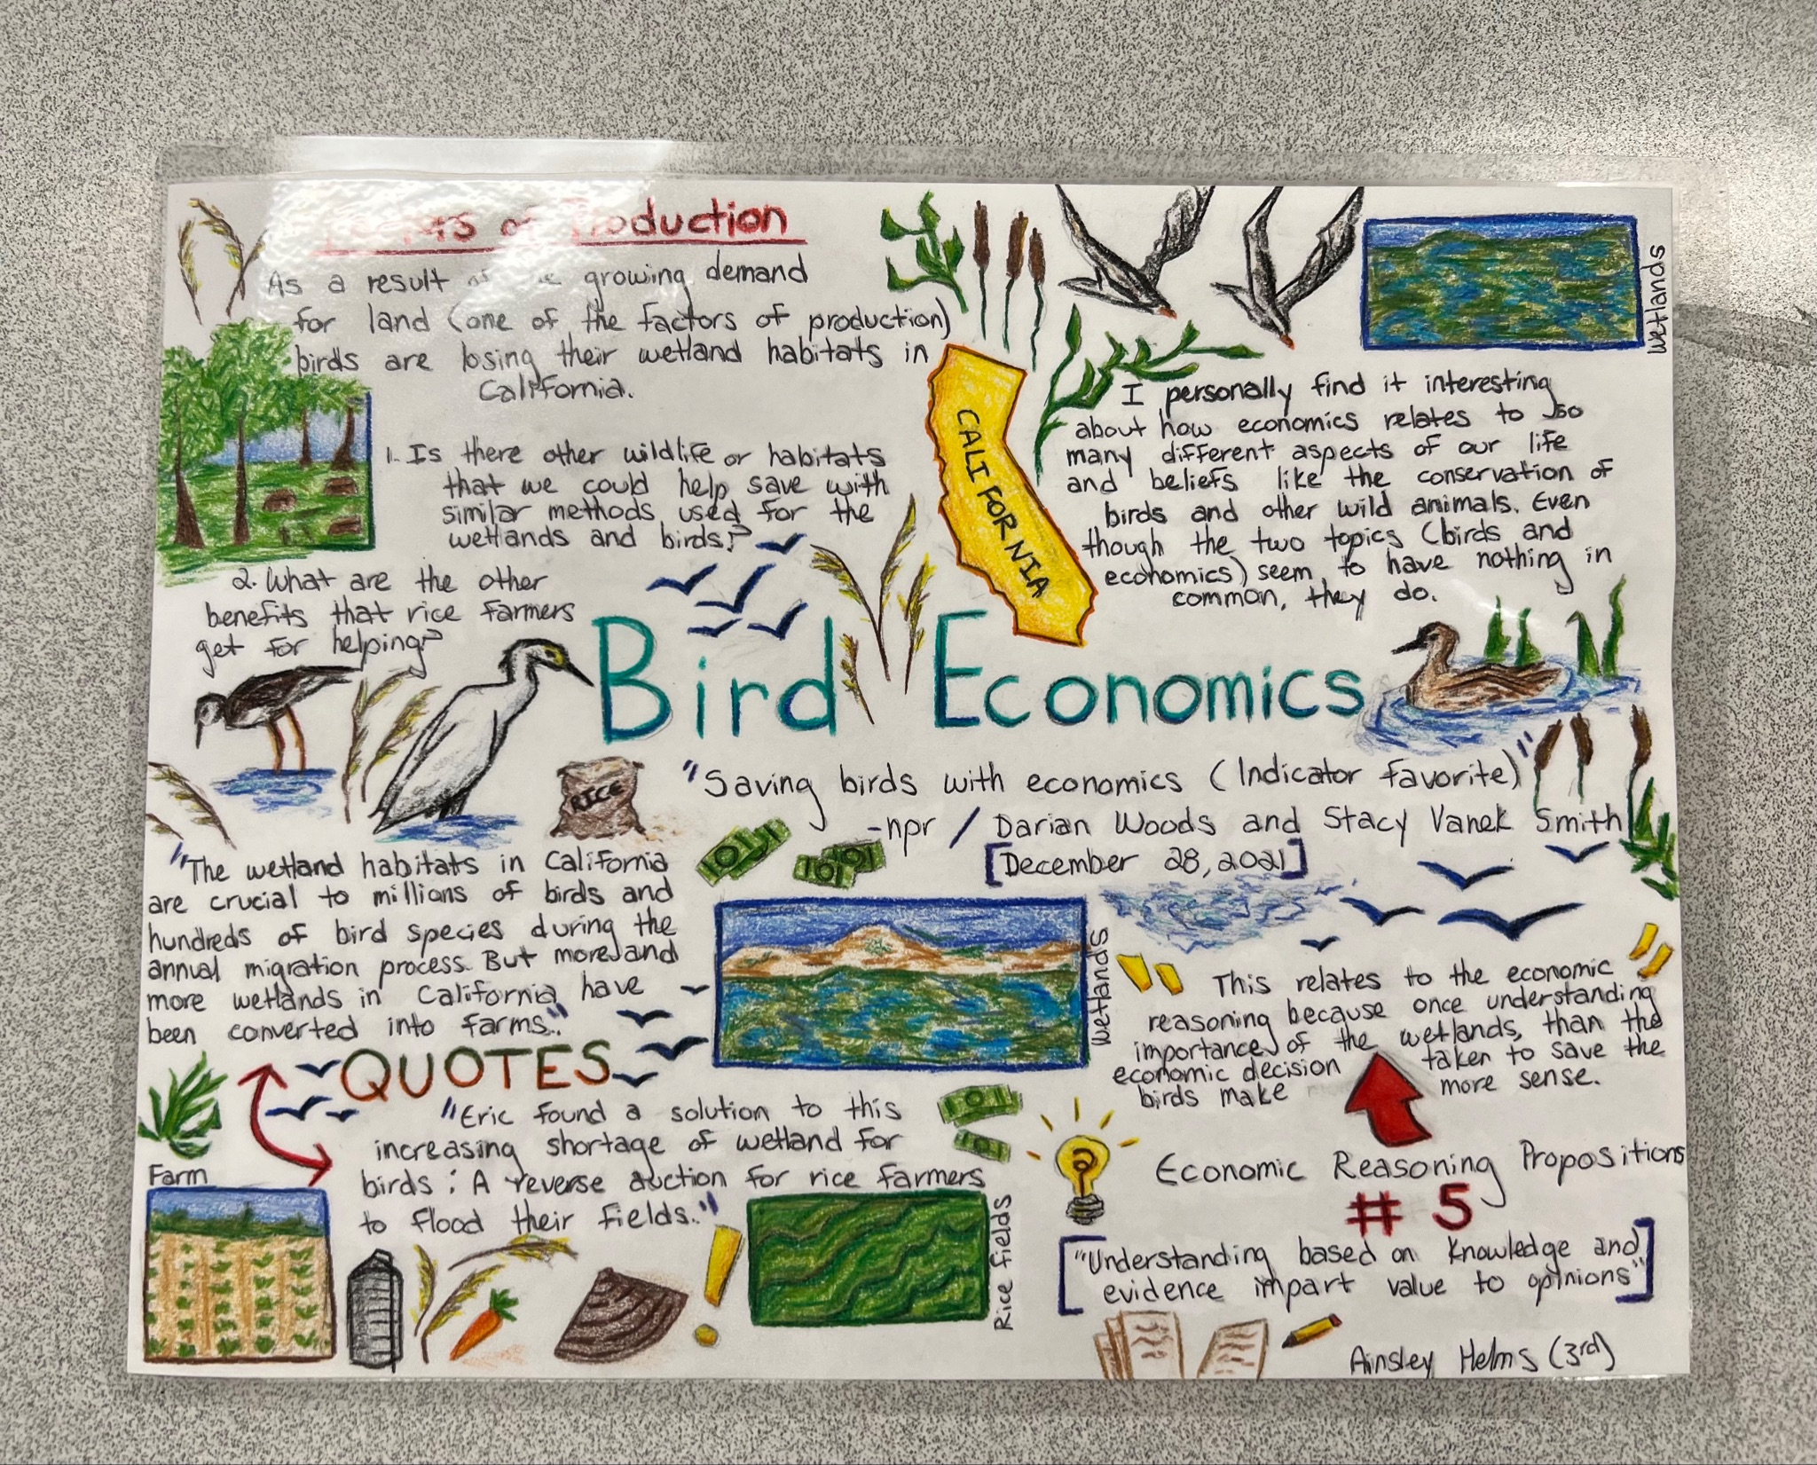

Slide 24
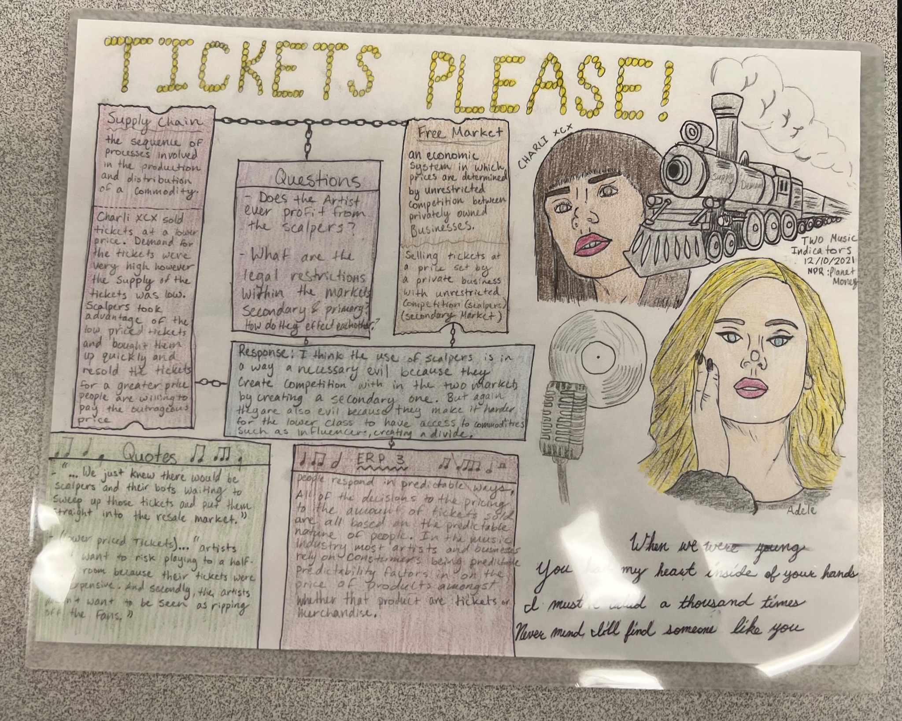

Slide 25
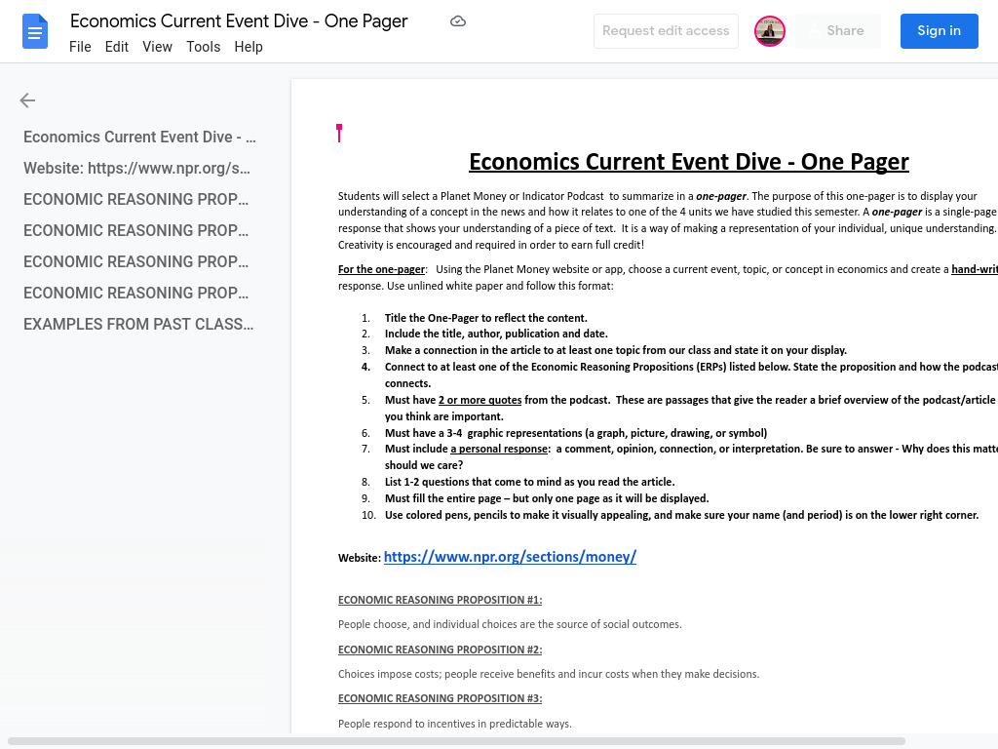

Slide 26
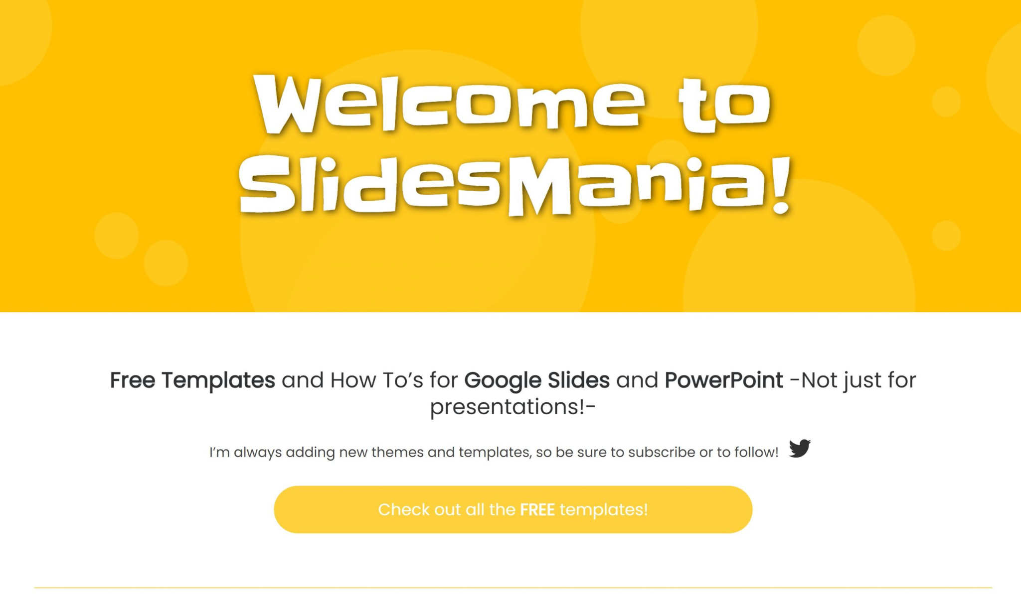
Cool Slides!
Slides Mania
Slides Carnival

Slide 27
Spice Up Your Econ and Personal Finance Lessons! Presented by Amanda Stiglbauer February 1, 2022 astiglbauer@richland2.org

Slide 28
CEE Affiliates
https://www.councilforeconed.org/resources/local-affiliates/

