Slide 1
AP Microeconomics Bootcamp
Market Structures & Labor Markets
Presented by Amanda Stiglbauer Blythewood High School Blythewood, SC February 22, 2022
astiglbauer@richland2.org

Slide 2
Objectives
I can differentiate the characteristics of perfectly and imperfectly competitive market structures.
I can evaluate monopoly power during the COVID-19 pandemic.

Slide 3
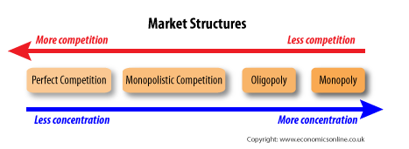

Slide 4
Characteristics of Perfect Competition
Many sellers— “price takers”
Price taken from market
Sell all they supply at market price
Buyers/sellers too small to have impact
No incentive to lower price
identical product
Free entry and exit
Zero economic profits (long run)**
Same as earning a normal profit
(return equivalent to opportunity cost of their time)
Still may earn ACCOUNTING profit

Slide 5
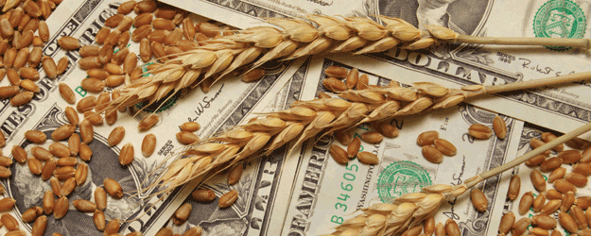
Examples

Slide 6
Monopoly

Slide 7
Pure Monopolies
Single Seller
No close substitutes
“Price Maker”
Blocked Entry
Examples:
De Beers diamonds
Professional sports teams
Utilities
Cable
Taxis*
lottery
Patents on prescriptions
Small, isolated communities
Natural monopolies – downward sloping ATC (economies of scale)

Slide 8
RIP MR.DARP
October 30 - Today

Slide 9
Monopolist’s MR<D
Because monopolist must set a lower price to obtain greater sales, marginal revenue is less than price for every level of output except the first.
Lower price applies to all units sold.
Think about it this way: MR decreases for all units sold previously because you must charge same price for all.

Slide 10
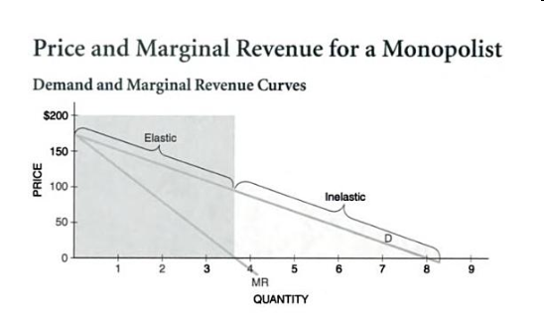

Slide 11
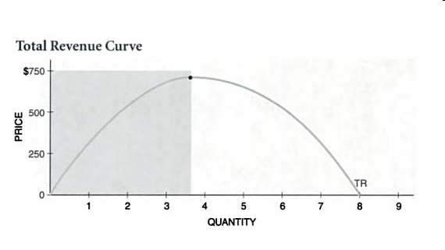

Slide 12
Graphing Monopoly

Slide 13
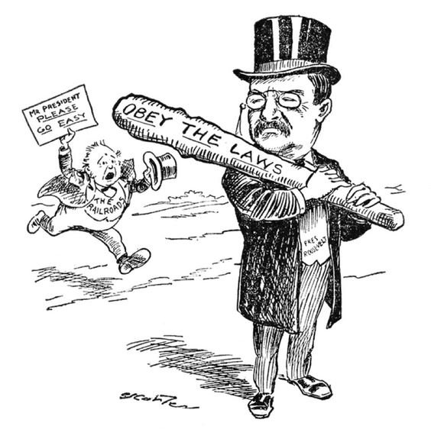
Ways to Deal With Monopolies
Do Nothing
Break Up Using Anti-Trust Regulation
Publically own
Price Regulation
Price ceiling
Socially optimal price/fair return price

Slide 14
Price Discriminating Monopolists
A monopolist who charges different prices to different buyers.
Why would a monopolist do this? To increase profit!
Legal examples:
Airlines
Movie theaters
Cell phone companies
Golf courses
Hotels
Textbook companies

Slide 15
Monopoly Articles Related to COVID-19
Instructions:
Odd break out rooms - Read and consider the discussion questions for “Here’s How Covid-19 Is Boosting Monopolization and Market Power”
Even break out rooms - Read and consider the discussion questions for “Price Discrimination - Remdesivir”
Share key takeaways with your breakout group, beginning with the person wearing the brightest color shirt.
Person with LIGHTEST color shirt- share out for group on collaboration board.

Slide 16
Additional Resources for Monopoly
Market Structure Simulation – Mr. Clifford
Monopoly Overview – MR University
Price Discrimination – MR University
Monopoly and Imperfect Competition – Crash Course
AP Micro – Monopoly Lesson Plan - EconEdLink

Slide 17
Monopolistic Competition

Slide 19
Monopolistic Competition
Like Monopoly | Like Perfect Competition | Unique
-Downward sloping demand and marginal revenue -some control over price | -normal profits in the long run -Easy entry and exit -large number of sellers | -non price competition and advertising -differentiated products

Slide 20
Activities to Introduce Oligopoly
Play Tic-Tac-Toe with a partner
Play Connect 4

Slide 21
Oligopoly

Slide 22
Characteristic | In Oligopolies….
# of Firms | Few large producers
Products | Homogeneous or differentiated
Barriers to Entry | Yes--significant Economies of scale (requires large capital expenditures to enter)
Profit Potential (SR and LR) | Yes -supernormal profits possible in SR and LR
Price Setting Power | Price maker BUT must consider possible reaction of rivals (interdependence)
Non-price competition | Some use advertising
Efficiency | No!
Examples | Airlines, Banks, Cigarettes, Beer, Household appliances, Breakfast Cereal

Slide 23
Oligopoly
Interdependent behavior – profits depend on others
Businesses are best off when they collude (make an agreement about price/quantity)
Cartel: group of firms acting in unison to produce a monopoly outcome
Game theory: Study of how people act in strategic situations. “Do unto others BEFORE they do to you”
Prisoner’s Dilemma: Game between two prisoners that illustrates why cooperation is difficult to maintain, even when mutually beneficial.
Dominant Strategy: best for a player, no matter what the other does BUT STILL MUST CONSIDER WHAT OTHER PLAYER IS DOING TO DETERMINE YOUR DOMINANT STRATEGY

Slide 24
Drawing!
What’s your favorite monopolistically competitive firm? Draw its logo!
Notes:
Drawing Conclusions
Being able to draw a conclusion after hearing new information is an important skill. Ask students to articulate the conclusions they are drawing from the new information. Show the responses anonymously on the projector screen to see if students came to different conclusions, then discuss.
🍐 This is a Pear Deck Drawing Slide
🍐 To edit the type of question, go back to the "Ask Students a Question" in the Pear Deck sidebar.

Slide 25
03
Cartels & Competition
FTE Activity
Notes:
https://docs.google.com/spreadsheets/d/1Cpb0_i6o3Gd1dFZM21WpteZ8NZt5ga6DSXBLzYO5WT0/edit?usp=sharing

Slide 26
Come up with a Team Name
Choose a Captain that will submit your production decisions
Meet Your Team
4 minutes
3. Choose an
accountant to screen
share the balance sheet.
4. Practice the screen share
5. Enter team member
names on balance
sheet
Notes:
Send students to 6 breakout rooms.
Post this link in the zoom chat so students can access and make a copy of the Balance Sheet: https://docs.google.com/spreadsheets/d/1I6X4qiEwt5swLeYt6-pd_ijo04d66IWF1AK-mgr8vIQ/edit?usp=sharing

Slide 27
Welcome Back
Team Captains: Submit your team name and captain on your mobile device in this format:
Team 1: Invisible Hands
Team 1 Captain: Sammy
(Team number is your breakout room number)
Notes:
🍐 This is a Pear Deck Text Slide
🍐 To edit the type of question, go back to the "Ask Students a Question" in the Pear Deck sidebar.
Record the students’ team numbers and names so you can keep score (preferably on a spreadsheet that you can share at the end).

Slide 28
The Producers…
6 companies…
Do 98% of the business in this industry.

Slide 29
The Incentive
Your goal: make as much profit as possible
Prizes for ALL companies that earn MORE than $200 profit!
$1 Stiglbuck per person
Additional prize for company that earns the MOST profit!
$5 Stiglbucks per person

Slide 30
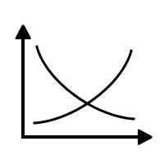
Directions
The interaction of market demand and market supply will determine the market-clearing price, the price at which the units you produce will sell.
In each round, a forecast of market demand will be displayed. Remember that this is only a forecast, and actual demand may vary from the forecast somewhat.

Slide 31
Demand Forecast
Market Demand (QD) | Price
0-6 | $125
7-13 | $100
14-19 | $75
20-26 | $50
27-32 | $30
33-40 | $25
41-50 | $20
Notes:
Does this follow the law of demand? (Yes. At higher prices, QD is less and vice versa.)

Slide 32
Directions
You will have to make your own forecast, or prediction, of market supply. You will know how many units your own company will produce, but the TOTAL market supply will include not only your own production, but also that of the other companies in the class.

Slide 33
Example
Market Demand (QD) | Price
0-6 | $125
7-13 | $100
14-19 | $75
20-26 | $50
27-32 | $30
33-40 | $25
41-50 | $20
If you produce 1 unit and so do all the other companies, the total supply will be 6 units.
According to the demand forecast, what will the market price be? Drag your dot...
Notes:
🍐 This is a Pear Deck Draggable™ Slide.
🍐 To edit the type of question, go back to the "Ask Students a Question" in the Pear Deck sidebar.
Answer: $125

Slide 34
Example (continued)
Your decision must also take into account your production cost.
Suppose your cost is $25 per unit and you sell that unit for $125:
$125 total revenue
- $25 total cost
$100 profit

Slide 35
Now you try...
Market Demand (QD) | Price
0-6 | $125
7-13 | $100
14-19 | $75
20-26 | $50
27-32 | $30
33-40 | $25
41-50 | $20
Suppose your company produces 3 units, total market supply is 19 units, and your production cost is $25 per unit.
Cost of production x #units produced = Total cost of production.
Units sold x price = Total Revenue
Total Revenue - Total cost = profit or loss
Enter profit/loss number on your mobile device.
Notes:
🍐 This is a Pear Deck Number Slide
🍐 To edit the type of question, go back to the "Ask Students a Question" in the Pear Deck sidebar.
Display student answer results. Discuss correct answer.
Answer $150
TR: 3x75=225
TC: 3x25=75
Profit: 225-75 = $150
OR Calculate per unit profit and multiply by units produced: 75-25 = 50… 50x3 = 150

Slide 36
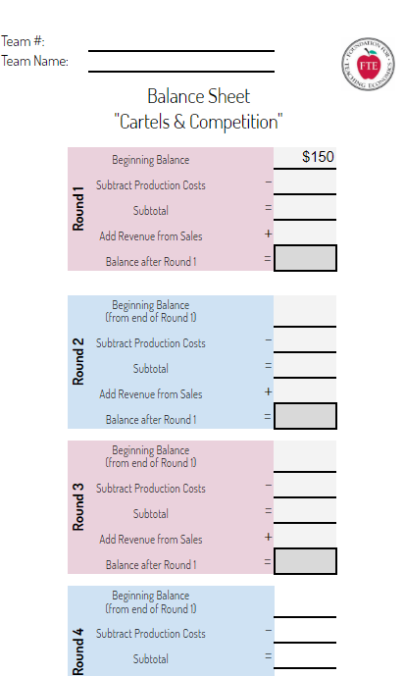
Production Decision Worksheet
Open the Balance Sheet using the link shared in the Zoom chat.
Make a copy for yourself so you can edit.
Notes:
Share this link in Zoom chat. Students: Make your own copy to edit. One team member will screen share and edit the official balance sheet for the team.
https://docs.google.com/spreadsheets/d/1Cpb0_i6o3Gd1dFZM21WpteZ8NZt5ga6DSXBLzYO5WT0/edit?usp=sharing

Slide 37
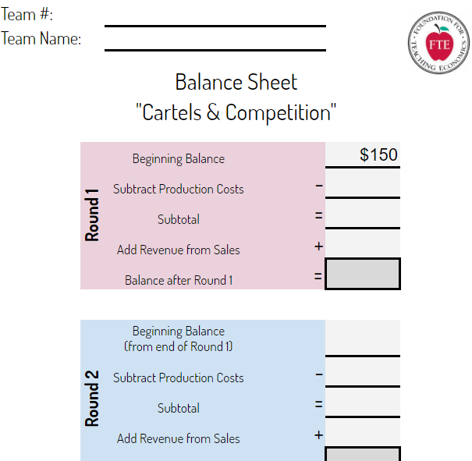
Production Decision Worksheet
Open the Balance Sheet using the link shared in the Zoom chat.
Make a copy for yourself so you can edit.
Notes:
Share this link in Zoom chat. Students: Make your own copy to edit. One team member will screen share and edit the official balance sheet for the team.
https://docs.google.com/spreadsheets/d/1Cpb0_i6o3Gd1dFZM21WpteZ8NZt5ga6DSXBLzYO5WT0/edit?usp=sharing

Slide 38
Production Decision Worksheet
Notice Balance is $150 to start.
What must your balance be at the end to have $200 profit?
Enter number on your mobile device.
Notes:
🍐 This is a Pear Deck Number Slide
🍐 To edit the type of question, go back to the "Ask Students a Question" in the Pear Deck sidebar.

Slide 39
Production Costs
You must pay your production costs up front (from your balance).
Production costs for all rounds will be $30.
What is the most any team could produce in round 1?
Enter number on your mobile device.
Notes:
🍐 This is a Pear Deck Number Slide
🍐 To edit the type of question, go back to the "Ask Students a Question" in the Pear Deck sidebar.
Correct answer: 5 ($30 x 5 = $150)

Slide 40
Breakout Rooms:
About 4 minutes
Round 1
Market Demand (QD) | Price
0-6 | $125
7-13 | $100
14-19 | $75
20-26 | $50
27-32 | $30
33-40 | $25
41-50 | $20
Make your production decisions.
Team captains submit to me by Pear Deck.
“Team 1: # Produced”
Return to the main room after you have submitted your production decision.
Use the Zoom “ask for help” button if you have a question.
Notes:
🍐 This is a Pear Deck Text Slide
🍐 To edit the type of question, go back to the "Ask Students a Question" in the Pear Deck sidebar.

Slide 41
Round 1 Results
Market Demand (QD) | Price
0-6 | $125
7-13 | $100
14-19 | $75
20-26 | $50
27-32 | $30
33-40 | $25
41-50 | $20
Market supply is…..
So price is….
Notes:
Announce production decisions (anonymously), total market supply and price.
Use the animate tool in Zoom if you want to circle the price.

Slide 42
Round 1 Results
When you return to breakout rooms.
Calculate your revenue from Round 1 sales. (price x # produced)
Calculate your new balance going into Round 2.
Questions?
Notes:
Explain how to calculate revenue and new balance.
Ask if there are any questions then dismiss to breakout rooms for Round 2.

Slide 43
Breakout Rooms:
About 4 minutes
Round 2
Calculate your revenue from Round 1 sales. (price x # produced)
Calculate your new balance going into Round 2.
Make production decision for Round 2.
Team captains submit by Pear Deck.
“Team 1: # Produced”
Return to the main room after you have submitted your production decision.
Use the Zoom “ask for help” button if you have a question.
Market Demand (QD) | Price
0-6 | $125
7-13 | $100
14-19 | $75
20-26 | $50
27-32 | $30
33-40 | $25
41-50 | $20
Notes:
🍐 This is a Pear Deck Text Slide
🍐 To edit the type of question, go back to the "Ask Students a Question" in the Pear Deck sidebar.
Dismiss to break-out rooms.
End breakout rooms when all production decisions have been submitted.
Use broadcast messages or pop into rooms as needed to move students along.

Slide 44
Round 2 Results
Market Demand (QD) | Price
0-6 | $125
7-13 | $100
14-19 | $75
20-26 | $50
27-32 | $30
33-40 | $25
41-50 | $20
Market supply is…..
So price is….
Update Balance Sheet back in break-out rooms
Notes:
End Breakout room.
Announce production decisions (anonymously), total market supply and price.
Explain how to calculate revenue and new balance.
Ask if there are any questions then dismiss to breakout rooms for Round 2.

Slide 45
Round 3
Market Demand (QD) | Price
0-6 | $125
7-13 | $100
14-19 | $75
20-26 | $50
27-32 | $30
33-40 | $25
41-50 | $20
Update Balance Sheet.
Discuss production decision for Round 3.
Notes:
Dismiss to break-out rooms

Slide 46
Round 3
Market Demand (QD) | Price
0-6 | $125
7-13 | $100
14-19 | $75
20-26 | $50
27-32 | $30
33-40 | $25
41-50 | $20
Exciting News!
Trade Convention for Industry Executives.
Each company can send 1 person (does not have to be team captain)
Round 3 production decisions will not be made until they return.
To attend: Leave the breakout room and return to the main room.
Notes:
Display this slide after students have returned to the breakout rooms.
Broadcast a message to the breakout rooms to see slides for exciting announcement.
Use additional messages or pop into rooms to encourage reps to quickly attend the conference (leave breakout and return to main room).
Listen in on the meeting in the main room so you know when to send them back to their break-out rooms.

Slide 47
Round 3
Market Demand (QD) | Price
0-6 | $125
7-13 | $100
14-19 | $75
20-26 | $50
27-32 | $30
33-40 | $25
41-50 | $20
Executives Returning….
Make production decision for Round 3.
Team captains submit by Pear Deck.
“Team 1: # Produced”
Everyone return to the main room after you have submitted your production decision.
Use the Zoom “ask for help” button if you have a question.
Notes:
🍐 This is a Pear Deck Text Slide
🍐 To edit the type of question, go back to the "Ask Students a Question" in the Pear Deck sidebar.
Dismiss to break-out rooms

Slide 48
Round 3 Results
Market Demand (QD) | Price
0-6 | $125
7-13 | $100
14-19 | $75
20-26 | $50
27-32 | $30
33-40 | $25
41-50 | $20
Market supply is…..
So price is….
Questions?
Notes:
Stop sharing your screen in zoom so class can see each other when you announce the production decisions. (They will still have your slides on their mobile device.)
Announce production decisions (anonymously), total market supply and price.
Ask if there are questions. Anticipate some questions/comments directed to other teams.
If collusion did not happen, or they colluded and stuck to the agreement, continue with Round 4. Notice next 4 slides say “Next Round” so they can be re-used for a 4th or 5th round if necessary.
If they colluded and cheated on the agreement, end the game here. Quickly click past the next 4 “next round” slides. Have teams submit their balance sheets by sharing the link via Canvas message or private zoom chat.

Slide 49
Round 4
Market Demand (QD) | Price
0-6 | $125
7-13 | $100
14-19 | $75
20-26 | $50
27-32 | $30
33-40 | $25
41-50 | $20
Exciting News!
Trade Convention for Industry Executives.
Each company can send 1 person (does not have to be team captain)
Round 3 production decisions will not be made until they return.
To attend: Leave the breakout room and return to the main room.
Notes:
Display this slide after students have returned to the breakout rooms.
Broadcast a message to the breakout rooms to see slides for exciting announcement.
Use additional messages or pop into rooms to encourage reps to quickly attend the conference (leave breakout and return to main room).
Listen in on the meeting in the main room so you know when to send them back to their break-out rooms.

Slide 50
Round 4
Market Demand (QD) | Price
0-6 | $125
7-13 | $100
14-19 | $75
20-26 | $50
27-32 | $30
33-40 | $25
41-50 | $20
Executives Returning….
Make production decision for Round 3.
Team captains submit by Pear Deck.
“Team 1: # Produced”
Everyone return to the main room after you have submitted your production decision.
Use the Zoom “ask for help” button if you have a question.
Notes:
🍐 This is a Pear Deck Text Slide
🍐 To edit the type of question, go back to the "Ask Students a Question" in the Pear Deck sidebar.
Dismiss to break-out rooms

Slide 51
Round 4 Results
Market Demand (QD) | Price
0-6 | $125
7-13 | $100
14-19 | $75
20-26 | $50
27-32 | $30
33-40 | $25
41-50 | $20
Market supply is…..
So price is….
Questions?
Notes:
Stop sharing your screen in zoom so class can see each other when you announce the production decisions. (They will still have your slides on their mobile device.)
Announce production decisions (anonymously), total market supply and price.
Ask if there are questions. Anticipate some questions/comments directed to other teams.
If collusion did not happen, or they colluded and stuck to the agreement, continue with Round 4. Notice next 4 slides say “Next Round” so they can be re-used for a 4th or 5th round if necessary.
If they colluded and cheated on the agreement, end the game here. Quickly click past the next 4 “next round” slides. Have teams submit their balance sheets by sharing the link via Canvas message or private zoom chat.

Slide 52
And the winners are...
Profit = Current Balance - $150 (your starting balance)
Accountants calculate your company’s profit and be prepared to submit via Pear Deck at the end of the session.
Notes:
🍐 This is a Pear Deck Text Slide
🍐 To edit the type of question, go back to the "Ask Students a Question" in the Pear Deck sidebar.

Slide 53
Debrief
What happened?
Why did you want to talk to the other companies?
Did it work?
What motivated you to collude?
What motivated you to cheat on that collusive agreement?
Notes:
🍐 This is a Pear Deck Text Slide
🍐 To edit the type of question, go back to the "Ask Students a Question" in the Pear Deck sidebar.
Consider just displaying student answers while you ask a series of debriefing questions. They can all participate and continue to submit new answers to each question. The stream of answers will appear.
Suggested debrief questions from lesson:
Which team made the most money? What was your strategy?
• Which team made the least? What was your strategy and why did it fail?
• Why did you want to talk to the other teams/companies?
• Why did you agree to set production levels? What was the impact on the market of such an agreement? What was the impact on your profit?
• How did you decide how much to produce?
• Did agreeing to set production levels work? Why? Why not?
• How did the profit motive, the desire of teams to make profit, act as an incentive? What behaviors did this incentive encourage?
• Looking at all the rounds of the simulation, make a generalization about the relationship between price and level of production (supply)
• How does the creation of a cartel affect consumers - both in terms of product availability and in terms of price?
• Predict what happens - in the short run and in the long run - in markets that do NOT prohibit collusion among producers.
• Evaluate the argument that it doesn’t matter if producers try to collude; the system of incentives Will undermine their efforts. (You might want to read excerpts from Adam Smith at this point, or have ready a reading assignment for homework.)
• Predict the impact on the market of rules or laws that prohibit collusion between producers.
• Predict the impact on the market of rules or laws that enforce cooperation among producers – for example: licensing requirements for doctors, teachers, hairdressers, taxicabs; or regulatory agencies etc.

Slide 54
Debrief
Whose voice isn’t represented in this conversation?
Consumers!
How would consumers they perceive this outcome?
People respond to incentives…
Buyers, sellers, business executives… even high school students!
There’s an incentive to collude.
Notes:
🍐 This is a Pear Deck Text Slide
🍐 To edit the type of question, go back to the "Ask Students a Question" in the Pear Deck sidebar.
Consider just displaying student answers while you ask a series of debriefing questions. They can all participate and continue to submit new answers to each question. The stream of answers will appear.

Slide 55
Conclusion
Incentives matter.
Desire for profit and competition undermine collusive agreements.
Profit is the motivator. Competition is the regulator.

Slide 56
Oligopoly Resources
Cartels & Competition - FTE Lesson
EconMovies – The Dark Knight
Oligopoly and Game Theory – Crash Course
The Evolution of Trust-https://ncase.me/trust/

Slide 57
Utilizing AP Classroom

Slide 58
Perfectly Competitive Labor Market and Firm
Market
Firm
S_{L}
Wage
Wage
?
$10
D_{L}
5000
Q
Q
‹#›

Slide 59
The Push Up Machine
MRP = MRC
‹#›

Slide 60
Perfect Competition Product Market vs. Resource Market
Price
S=MC
Product Market
Firm Producing Oranges
D=MR
Q
Wage
Q_{e}
Resource Market
Firm Hiring Orange Pickers
S_{L}=MRC
D_{L}=MRP
Q_{e}
Q

Slide 61
The Push-Up Machine
A new generator converts human push ups into safe and clean electrical energy.
Each push up generates $1 worth of energy.
Supply and demand in the labor market has resulted in a equilibrium wage of $10 (MRC = $10).
The supply curve for the firm is perfectly elastic at $10…how much will you work for?
Assuming identical skills, hire the first worker
Let’s figure out how many workers to hire!
‹#›

Slide 62
Marginal Resource Cost (MRC)
The additional cost of an additional resource (worker).
In perfectly competitive labor markets the MRC equals the wage set by the market and is constant.
Ex: The MRC of an unskilled worker is $7.25
Another way to calculate MRC is:
Change in
Total Cost
Marginal
Resource
Cost
=
Change in Q
Inputs
‹#›

Slide 63
Marginal Revenue Product
The additional revenue generated by an additional worker (resource).
In perfectly competitive product markets the MRP equals the marginal product of the resource times the price of the product (MPxP).
Ex: If the Marginal Product of the 3rd worker is 5 and the price of the good is constant at $20 the MRP is…….
$100
Another way to calculate MRP is:
Change in
Total Revenue
Marginal
Revenue
Product
=
Change in
Q Inputs
‹#›

Slide 64
The Push Up Machine
Calculate MP and MRP
Quantity Labor | Total Product | Marginal Product | MRP @ $1 Price
‹#›
Notes:
https://docs.google.com/document/d/12_jxUchSrLXRjPQsRujIps4oYchlYxH5ZuC-nsG9h2I/edit?usp=sharing

Slide 65
The Push-Up Machine
Supply
Supply and demand in the INDUSTRY GRAPH has resulted in a equilibrium wage of $10.
How much MUST each worker work for?
Why not ask for more? Why not less?
Demand
If each push up generates $1 worth of energy, what is the MRP for each worker?
How much is each worker worth to the firm?
‹#›

Slide 66
Debrief: The Push-Up Machine
Why does the MRP eventually fall?
Diminishing Marginal Returns.
Fixed resources means each worker will eventually add less than the previous workers.
The MRP determines the demand for labor
The firm is willing and able to pay each worker up to the amount they generate.
Each worker is worth the amount of money they generate for the firm.
‹#›

Slide 67
How do you know how many resources (workers) to employ?
Continue to hire until…
MRP = MRC
‹#›

Slide 68
Perfectly Competitive Labor Market and Firm
S_{L}
Wage
Wage
?
W_{E}
D_{L}
Q_{E}
Q
Q
Industry
Firm
‹#›

Slide 69
Side-by-side graph showing Market and Firm
S_{L}
Wage
Wage
W_{E}
S_{L}=MRC
D_{L}
D_{L}=MRP
Q_{E}
Q
Q_{e}
Q
Industry
Firm
‹#›

Slide 70
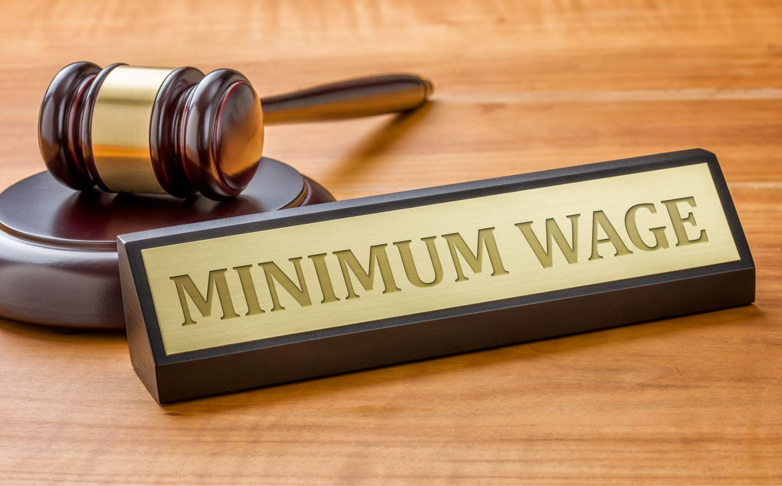
Minimum Wage
A minimum amount employers are allowed to pay their workers (a wage floor)

Slide 71
The government should raise the federal minimum wage to $15 per hour.
Agree
Disagree
Notes:
Agree or Disagree
Use this template to do a quick check of students’ opinions during your lesson.
🍐 This is a Pear Deck Draggable™ Slide.
🍐 To edit the type of question, go back to the "Ask Students a Question" in the Pear Deck sidebar.

Slide 72
Should the government raise the federal minimum wage to $15/hour?
What would be the purpose of this policy?
Do you believe that a $15 minimum wage would successfully accomplish its goal? Why or why not?

Slide 73
Wage
S
$15
$8
$6
The government wants to “help” workers because the equilibrium wage is too low
D
5 6 7 8 9 10 11 12
Q Labor
‹#›

Slide 74
SALES ASSOCIATES
Wage
S
$15
$8
$6
Minimum wage is a “WAGE FLOOR.”
Where?
D
5 6 7 8 9 10 11 12
Q Labor
‹#›

Slide 75
Wage
Minimum Wage
S
$15
$8
$6
Wage Floor above equilibrium
D
Q Labor
5 6 7 8 9 10 11 12

Slide 76
Minimum Wage
Wage
Surplus of workers
(Unemployment)
S
$15
$8
$6
What’s the result?
Q demanded falls.
Q supplied increases.
D
5 6 7 8 9 10 11 12
Q Labor
‹#›

Slide 77
Wage
Supply
$20
$10
Demand
70
100
120
Quantity

Slide 78
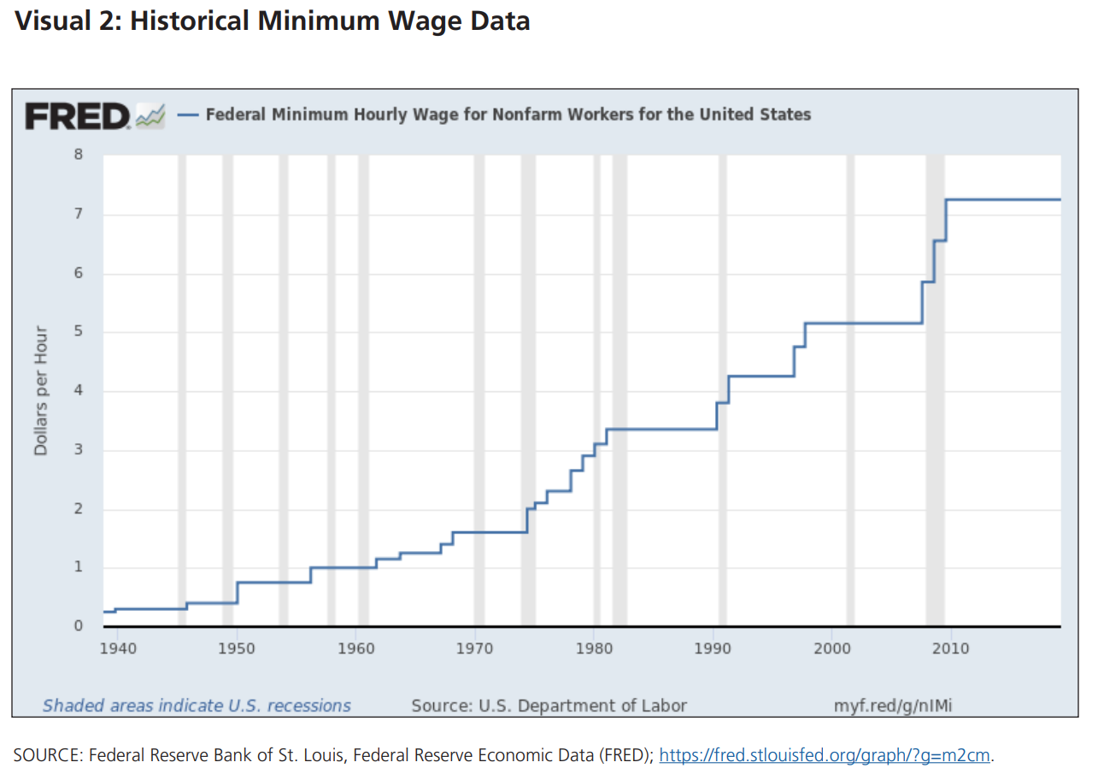

Slide 79
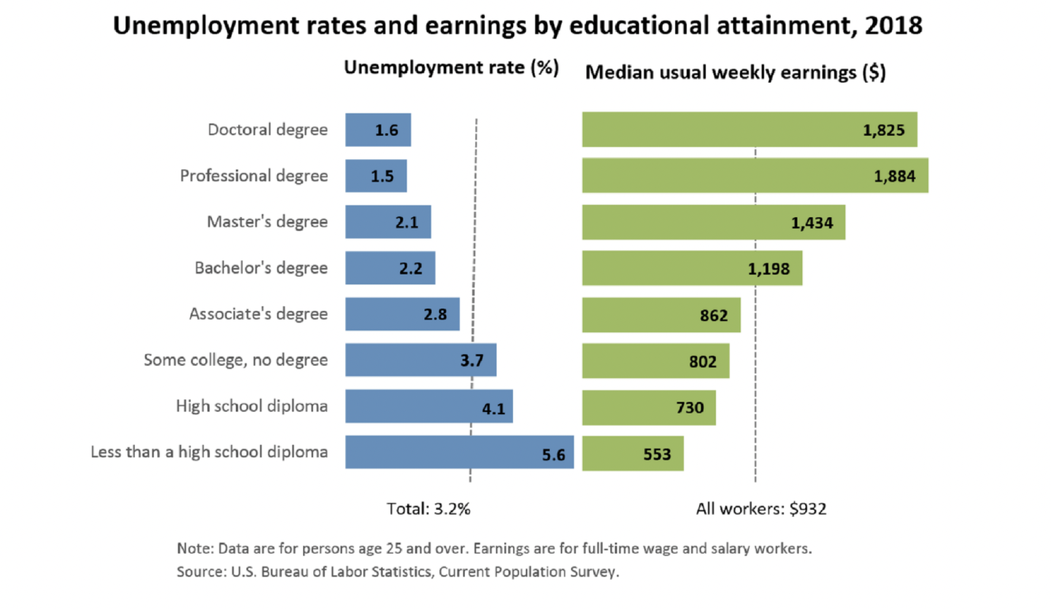

Slide 80
Minimum Wage Debate
Padlet
Notes:
https://padlet.com/astiglbauer/kxkjzzswvregp8q0

Slide 81
Minimum Wage Structured Debate (EconLowDown)
As a class, we will be debating the minimum wage issue in class.
The central debate topic (advocacy statement) for this debate is, “The minimum wage should be increased to $15 per hour.”
• Those who support and will argue for increasing the minimum wage to $15
• Those who oppose and will argue against increasing the minimum wage to $15
• A panel of debate moderators composed of four students who will prepare and ask the debate questions

Slide 82
Good Suggestions/Practices
Pro: find key arguments provided by “left-leaning” think tanks such as the Center for American Progress, Political Economy Research Institute, Urban Institute, and National Employment Law Project. A search engine inquiry of “pro minimum wage increase arguments” will result in many sources.
Anti-minimum wage: could include short articles from libertarian or “right-leaning” think tanks such as the Cato Institute, Acton Institute, Heritage Foundation, and American Enterprise Institute. A search engine inquiry of “anti minimum wage increase arguments” will result in many sources.
Moderators: Prepare at least 10 questions for each side. These should be targeted toward each side of the issue and range from very broad to very specific. https://research.stlouisfed.org/ publications/page1-econ/2014/03/01/would-increasing-the-minimum-wage-reduce-poverty.

Slide 83
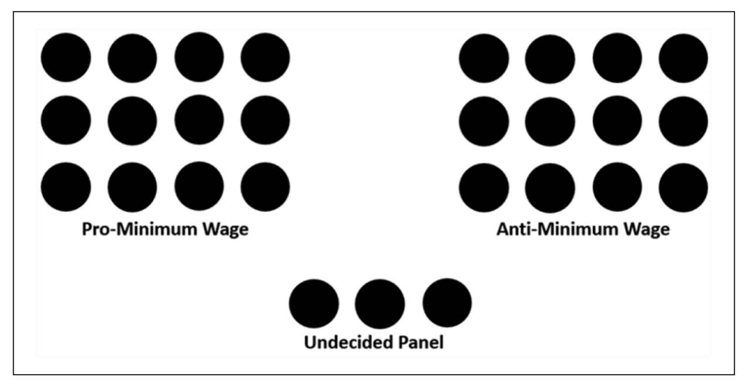
Class Layout

Slide 84
Reasons for Wage Differences
Labor Market Imperfections-
Insufficient/misleading job information-
This prevents workers from seeking better employment.
Geographical Immobility-
Many people are reluctant or too poor to move so they accept a lower wage
Unions
Collective bargaining and threats to strike often lead to higher that equilibrium wages
Wage Discrimination-
Some people get paid differently for doing the same job based on race or gender (Very illegal!).

Slide 85
AP Microeconomics Bootcamp
Market Structures & Labor Markets
Presented by Amanda Stiglbauer Blythewood High School Blythewood, SC February 22, 2022
astiglbauer@richland2.org

