Slide 1
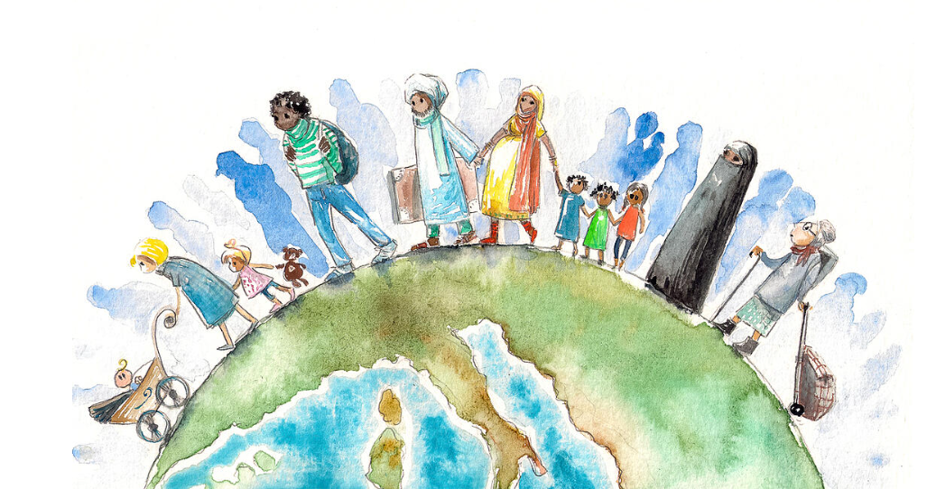
Dreamers and Wishers Part II
Children’s Chapter Books Featuring the Immigrant Experience
Lynne Farrell Stover
JMU Center for Economic Education
stoverlf@jmu.edu

Slide 2
Professional Development Certificate
To earn your professional development certificate for this webinar, you must:
Watch a minimum of 45-minutes and you will automatically receive a professional development certificate via e-mail within 24 hours.
Accessing resources:
You can now easily download presentations, lesson plan materials, and activities for each webinar from EconEdLink.org/professional-development/

Slide 3
Session Agenda
In this session we will:
Examine Educational Standards
Review basic vocabulary
Explore featured titles and the lessons and activities based on their content
Share a related bibliography & additional resources

Slide 4
Objectives
Teachers will be able to:
Review related concepts.
Explore children’s chapter books and identify the economic concepts found in them.
Learn how to use book content to teach age- appropriate lessons and activities based on the featured concepts.
Discuss the new titles’ social commentary and how to implement this in the classroom.

Slide 5
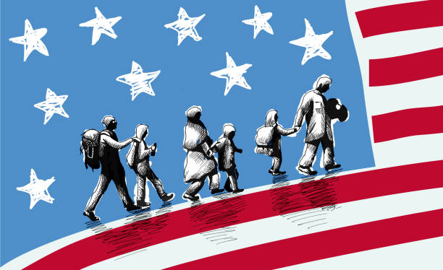
Teaching Immigration
Possible considerations and topics:
Define immigration
Discuss why people immigrate
Explore immigration stories
Consider themes such as economic issues, living conditions, education, language difficulties, issues of prejudice

Slide 6
National Standards
https://www.councilforeconed.org/wp-content/uploads/2012/03/voluntary-national-content-standards-2010.pdf

Slide 7
Virginia HISTORY & SOCIAL SCIENCE Standards of Learning
On January 28, 2021, The Virginia Board of Education authorized the Virginia Department of Education (VDOE) proceed with the review and revision process of the History and Social Science Standards of Learning consistent with the schedule adopted by the Board in September 2000. It is anticipated that the Standards revision will be completed before November 2022.

Slide 8
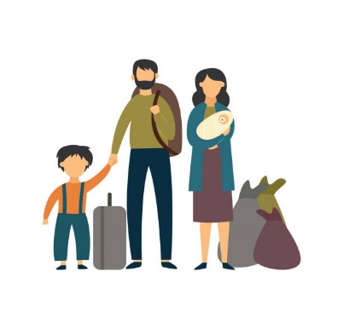
Terms and Definitions:
Migration can take place over short or long distances and it can be a one-way movement or temporary. Some people choose to migrate (voluntary) or others may be forced to move (forced).
Emigration is when people are leaving or exiting a country
Immigration is when people are moving into a country
A refugee is someone who has left their home and does not have a new home to go to. Often refugees do not carry many possessions and have no idea of where they may finally settle.

Slide 9
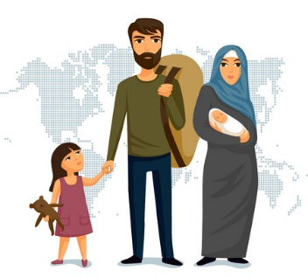
Why do people migrate?
Economic migration - to find work or follow a particular career path.
Social migration - for a better quality of life or to be closer to family or friends.
Political migration - to escape political persecution or war.
Environmental - to escape natural disasters such as flooding.
Push Factors - negative things that make people want to move to a new area.
Pull Factors - positive aspects that attract people to move to a place.
Migration usually happens as a result of a combination of these push and pull factors.

Slide 10
Push Pull Factors in Immigration
Migration usually happens as a result of a combination of these push and pull factors.

Slide 11
Push Factors are negative things that make people want to relocate to a new are, such a war.
Pull Factors are positive aspects that attract people to relocate to a place such a good job opportunities
https://www.bbc.co.uk/bitesize/guides/z3p4b82/revision/1

Slide 12
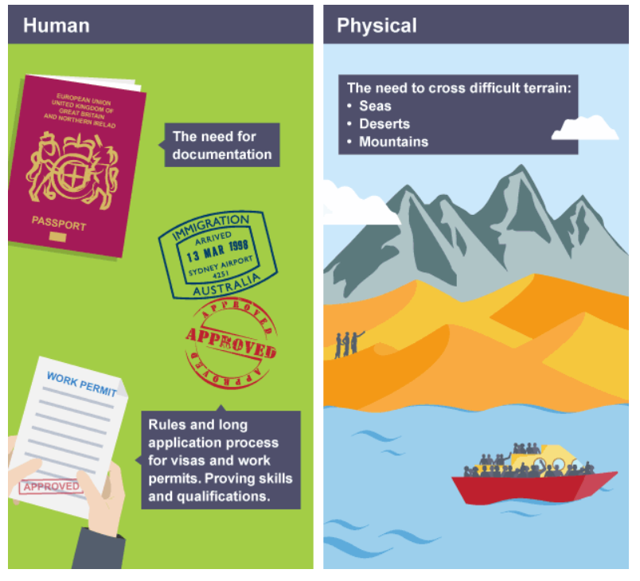
Barriers to Migration
Migration movements are rarely smooth.
People who are migrating have to negotiate a number of barriers when moving between countries.
A number of obstacles can get in the way such as legal restrictions, family attachments, and costs incurred.

Slide 13
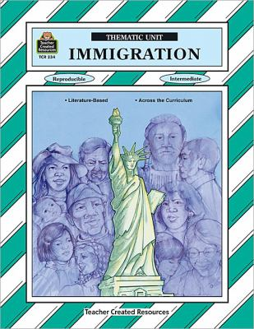
Times have changed…
Immigration: Thematic Unit
Teacher Created Materials, Inc., 1993
Content includes:
Family Trees & Genealogy
Teaching Units: Molly’s Pilgrim, How Many Days to America, and Hello My Name is Scrambled Eggs
Immigration Word Bank
Statue of Liberty Math
Ellis Island
Easy-to-make Pinata
Thanksgiving
Idioms

Slide 14
Front Desk
by Kelly Yang
Publisher: Scholastic
Copyright Date: 2019
Reading Level: 4.5
Interest Level: 4-7

Slide 15
Story Synopsis: It is the early 1990s in Anaheim, California and ten-year-old Mia Tang and her parents are desperate for work and money.
Mia’s parents take a job managing a rundown motel. Exploited by the motel’s owner, the family struggles physically and financially. As her mother -- who was an engineer in China -- does the cleaning, Mia works the front desk and tries to cope with demanding customers and other recent immigrants, not to mention being only one of two Chinese students in her class, the other being Mr. Yao's son, Jason.

Slide 16
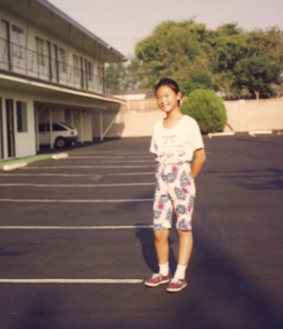
Author Kelly Yang immigrated to America when she was 6 years old and grew up in Southern California, where she and her parents worked in three different motels. She eventually left the motels and went to college at the age of 13 and law school at the age of 17. She is a graduate of UC Berkeley, where she majored in Political Science, and Harvard Law School. After law school, she gave up law to pursue her passion of writing and teaching children writing. She is the founder of The Kelly Yang Project (kellyyang.edu.hk), a leading writing and debating program for kids in Asia. Before turning to fiction, she was also a columnist for the South China Morning Post for many years. Her writing has been published in The New York Times, The Washington Post, and The Atlantic. She has three children and splits her time between Hong Kong and San Francisco, California.

Slide 17
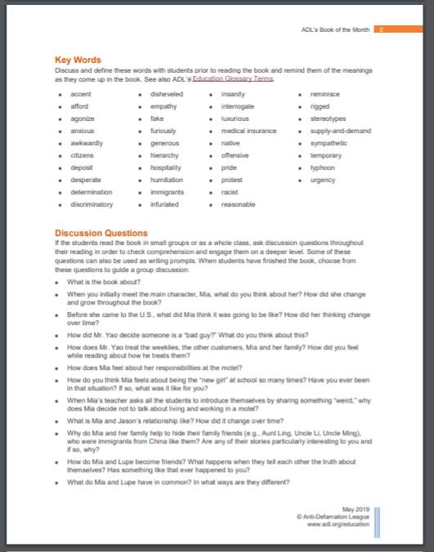
Anti-Defamation League’s 4 page Educator’s Guide
https://www.adl.org/media/12859/download

Slide 18
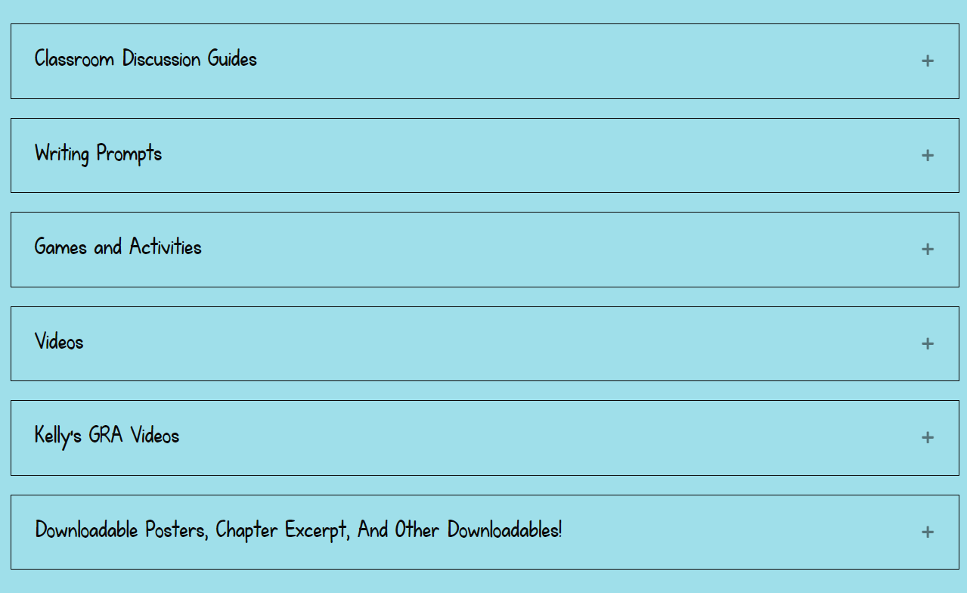
https://frontdeskthebook.com/for-teachers/

Slide 19
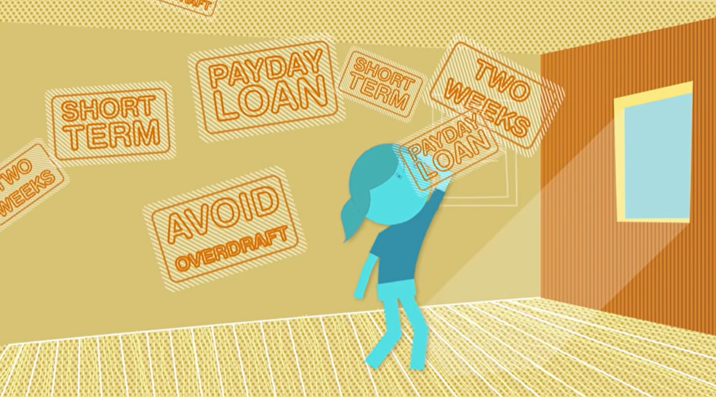
Introduction to Pay Day Loans
What is a payday loan and why is it getting so many of the Tangs’ friends in trouble?
https://www.youtube.com/watch?v=vyFlz0XpbTc

Slide 20
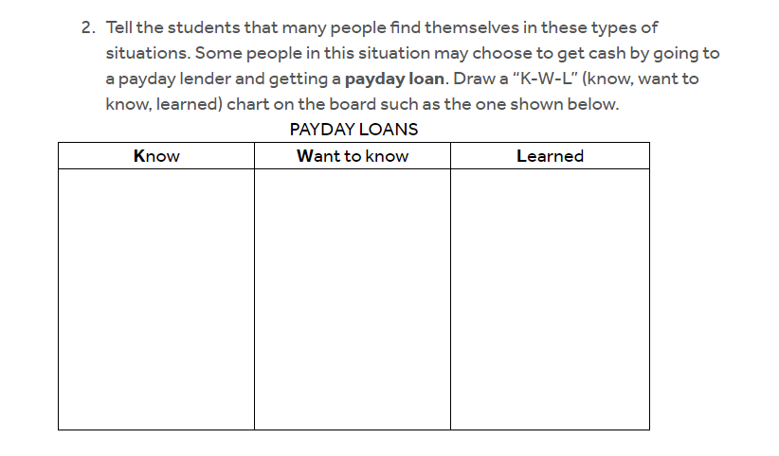
https://www.econedlink.org/resources/how-expensive-are-payday-loans/?view=teacher

Slide 21
Three Keys
by Kelly Yang
Publisher: Scholastic
Copyright Date: 2020
Reading Level: 4.8
Interest Level: 4-7

Slide 22
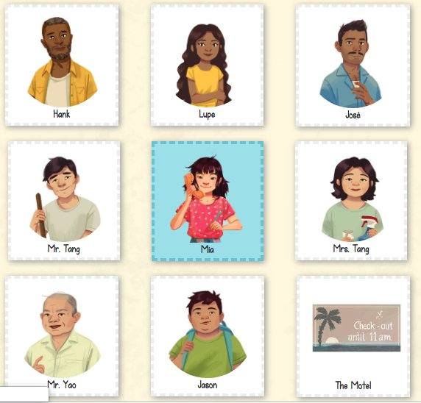
Story Synopsis: In this sequel to Front Desk, sixth grade Chinese- American Mia Tang continues to help run their motel in Anaheim, California. While business is good, negative political ads during the impending 1994 gubernatorial election proposing to kick undocumented children out of California schools are making life difficult for Mia and other marginalized classmates. When Mia's best friend Lupe reveals she and her family are undocumented, matters intensify. Lupe’s mother is stranded in Mexico and her father is arrested and threatened with deportation. Mia and her friends work hard to find a way to sway public opinion, and keep Lupe’s family from being separated.
Character Cards

Slide 23
The year is 1994 and Mrs. Tang, Mia’s mother, would like to have her own credit card. She discovers applying for a credit card is not going to be as easy as she thought…
Vocabulary
Credit
The ability of a customer to obtain goods or services before payment, based on an agreement to pay later.
Credit Application
A request for a loan, submitted to a lender (for example, a bank or a credit union) by a prospective borrower. The credit application provides background information which the lender uses to assess the prospective borrower’s creditworthiness — his or her ability to repay the loan.
Credit Card
A small, specially coded plastic card issued by a bank, business, etc., authorizing the cardholder to purchase goods or services on credit.

Slide 24
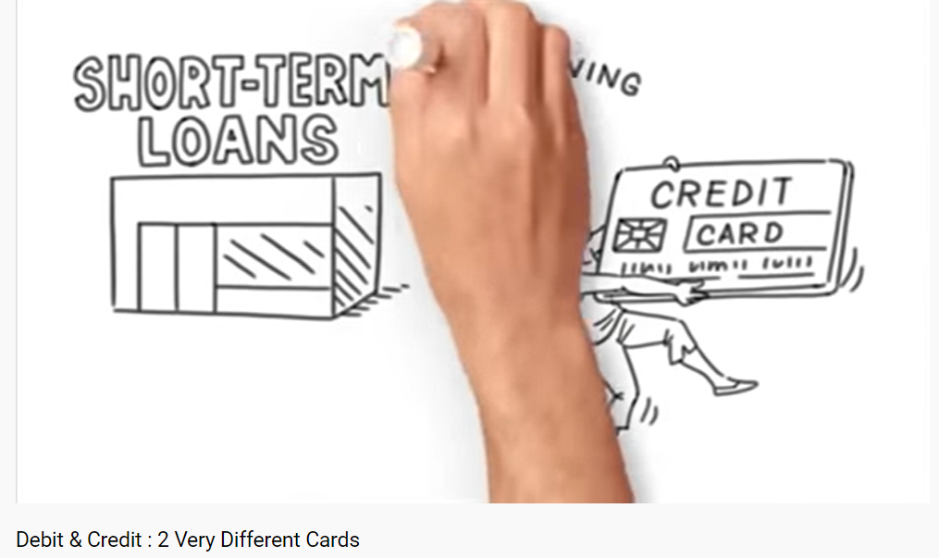
https://www.youtube.com/watch?v=XbtSftL6dbY

Slide 25
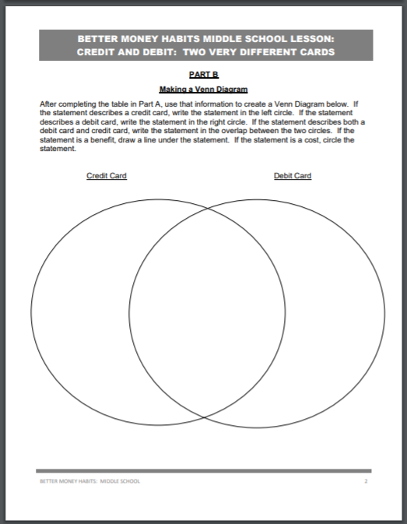
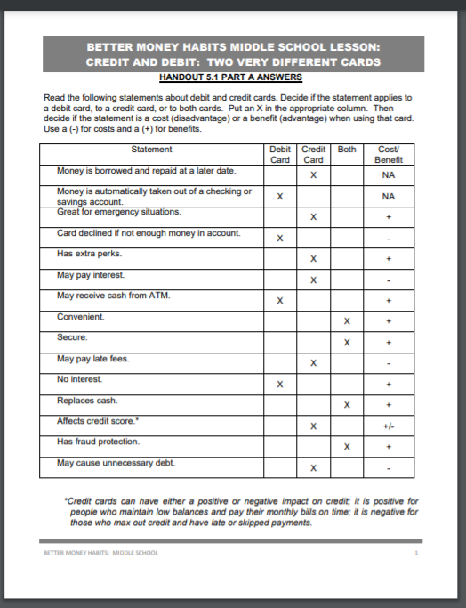
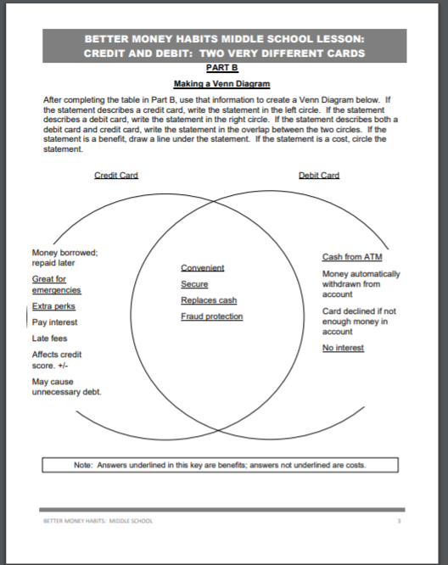
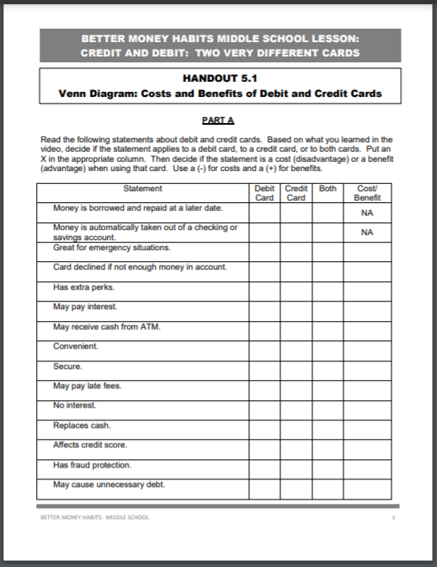
https://www.econedlink.org/resources/debit-cards-vs-credit-cards/

Slide 26
Room to Dream
Story Synopsis: Seventh grader Mia Tang’s family is busy running the Calivista Motel and businesses is doing well. However, a big cooperation is systematically taking over all the Mom & Pop shops in their neighborhood. Mia’s friends Jason and Lupe are finding their roles in life as Mia and her family return to China for a six-week visit. They discover that China, as well a family members have changed a great deal. Mia learns to use her voice to address racism, exploitation and personal consent.
Publisher: Scholastic
Copyright Date: 2021
Reading Level: 4.5
Interest Level: 4-7

Slide 27
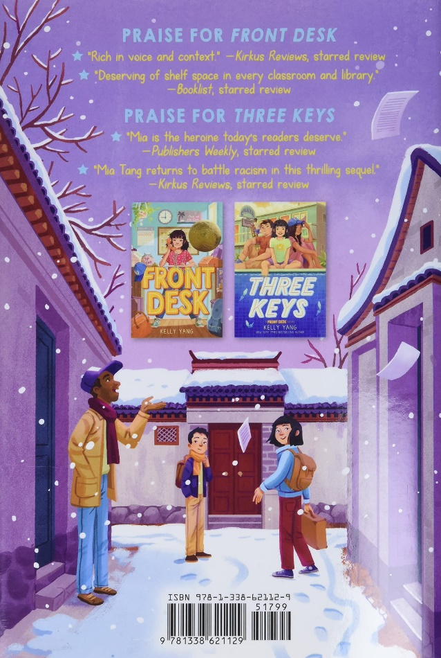
Room to Dream
Featuring the concepts of…
Cost-Benefit Analysis
Debt
Dividend
Division of Labor
Human capital
Investment
Monopoly
Profit
Scarcity
Specialization
Unemployment

Slide 28
Publisher: Simon & Schuster
Copyright Date: 2022
Reading Level: 4.0
Interest Level: 4-7

Slide 29
New From Here
Story Synopsis: When the coronavirus hits Hong Kong, ten-year-old Knox Wei-Evans’s mom makes the last-minute decision to move him and his siblings back to California, where they think they will be safe. Suddenly, Knox has two days to prepare for an international move—and for leaving his dad, who has to stay for work. At his new school in California, Knox struggles with being the new kid. His classmates think that because he’s from Asia, he must have brought over the virus. At home, Mom just got fired and is panicking over the loss of health insurance, and Dad doesn’t even know when he’ll see them again, since the flights have been cancelled. And everyone struggles with Knox’s blurting-things-out problem. As racism skyrockets during COVID-19, Knox tries to stand up to hate, while finding his place in his new country. Can you belong if you’re feared; can you protect if you’re new? And how do you keep a family together when you’re oceans apart? Sometimes when the world is spinning out of control, the best way to get through it is to embrace our own lovable uniqueness.

Slide 30
STEF SOTO, Taco Queen
Can Mexican-American Stef Soto break free from her overprotective parents and embarrassing reputation from her family's taco truck business?
Publisher: Little Brown & Co.
Copyright Date: 2018
Reading Level: 4.8
Interest Level: 3-6

Slide 31
Lesson Plans & Activities
https://texasbluebonnetaward2019.wordpress.com/stef-soto-taco-queen/

Slide 32
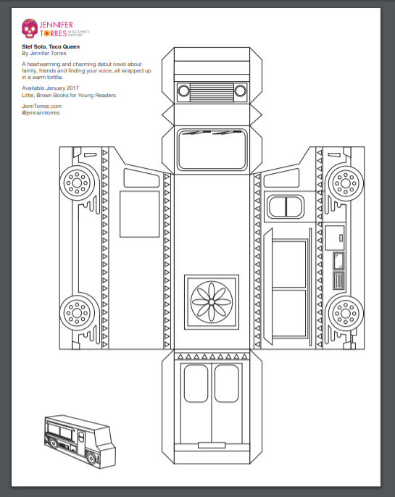
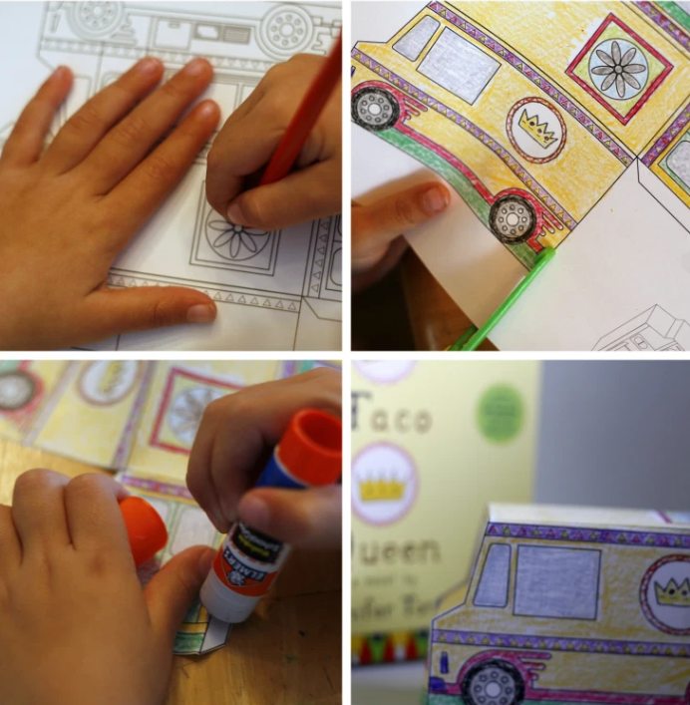
https://jenntorres.files.wordpress.com/2016/09/taco-truck_printable.pdf

Slide 33
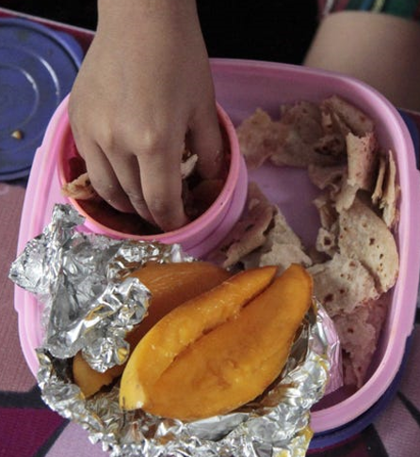
Save Me a Seat
Book Synopsis: Recent immigrant Ravi and lifelong U.S. resident Joe become friends the first week of fifth grade when they are brought together by a common enemy, the biggest bully in school, and a shared need to take control of their lives.
Publisher: Scholastic Books
Copyright Date: 2018
Reading Level: 4.8
Interest Level: 3-6

Slide 34
The Year I Flew Away
Story Synopsis: It’s 1985 and ten-year-old Gabrielle is excited to be moving from Haiti to America. Unfortunately, her parents won’t be able to join her yet and she’ll be living in a place called Brooklyn, New York, with relatives she has never met.
She promises her parents that she will behave, but life proves to be difficult in the United States, from learning the language to always feeling like she doesn’t fit in to being bullied. So when a witch offers her a chance to speak English perfectly and be “American,” she makes the deal. But soon she realizes how much she has given up by trying to fit in and, along with her two new friends (one of them a talking rat), takes on the witch in an epic battle to try to reverse the spell.
Publisher: HarperCollins
Copyright Date: 2022
Reading Level: 4.0
Interest Level: 4-7

Slide 35
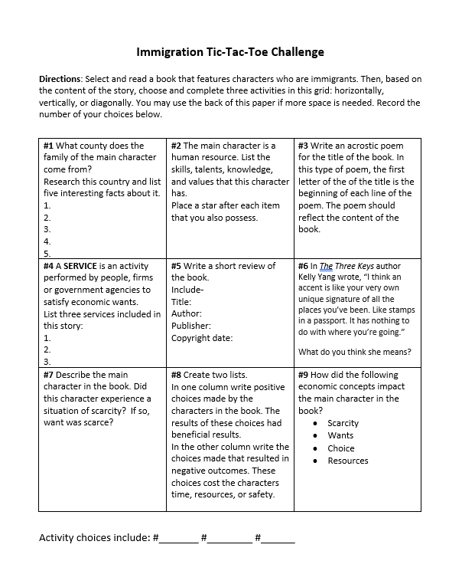

Slide 36
Generic Diversity Activities
Write a short synopsis of the book.
Include:
Title:
Author:
Publisher:
Copyright Date:

Slide 37
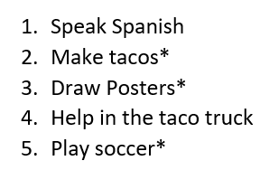
Generic Diversity Activities
The main character is a human resource. List the skills, talents, knowledge, and values that this character has. Place a star after each item that you also possess.
Example:

Slide 38
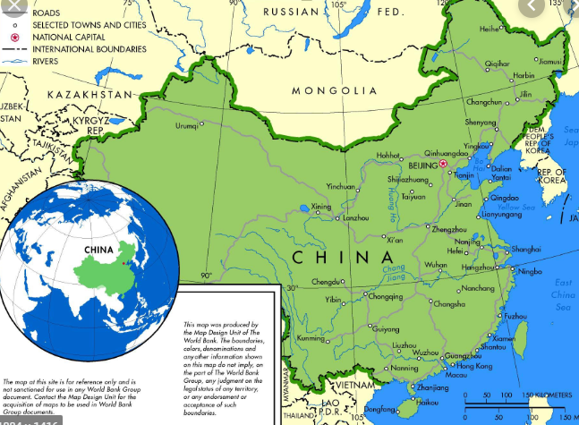
Generic Diversity Activities
What county does the family of the main character come from?
Research this country and list five interesting facts about it.
1.
2.
3.
4.
5.

Slide 39
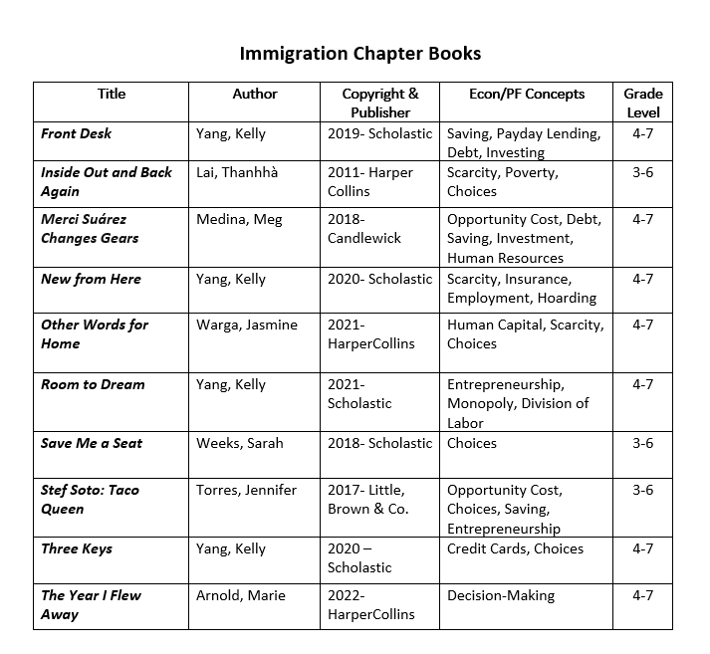

Slide 40
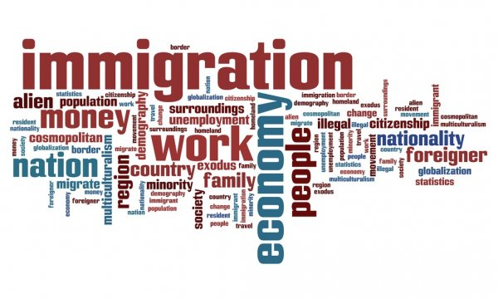
For your consideration:
Do you think situations dealing with immigration and refugees are appropriate to address with younger students?
Is it helpful for students to learn about how experiences characters in books were resolved…or not? Are they able to apply “lessons learned” to their own lives?
Which do you think is more challenging: adapting a secondary lesson for an elementary classroom, or advancing an elementary lesson for high school students?
It seems that many new children’s books are addressing controversial social issues. Why do you think this is so?

Slide 41
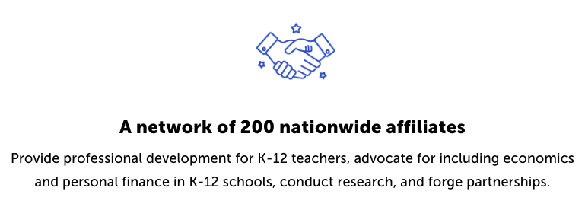
CEE Affiliates
https://www.councilforeconed.org/resources/local-affiliates/

Slide 42
Thank You to Our Sponsors!

