Slide 1
WELCOME
Housekeeping Items
Please use the chat function to ask questions or to notify moderator of issues
Session will be recorded and emailed to participants following the webinar
Attendance certificates can be accessed following webinar
The webinar will begin shortly

Slide 2
AP Econ Unit 3: National Income and Price Determination
Aggregate Demand
Curriculum Written By: Steven Cullison
Live Webinar: January 10, 2022

Slide 3
Instructor Bio
Steven Cullison serves as a Master Teacher for the Minnesota Council on Economics Education and is a past winner of the Minnesota Secondary Economics Teacher of the Year Award. He teaches AP Economics and Philosophy at Edina High School in Minnesota. Besides social studies, he is licensed in special education and school administration.

Slide 4
Webinar Objectives
To prepare educators to teach about aggregate demand in an engaging and effective manner.

Slide 5
Agenda
Instruction on economic indicators and aggregate demand
Areas where students struggle
Resources
Lessons
Questions

Slide 6
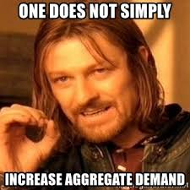
Learning Goals
To be able to:
Describe several economic indicators
Explain why economic data began to be collected
Define aggregate demand and and describe factors that affects it
Notes:
I believe that it is best practice to explicitly state learning goals or objectives at the outset of a lesson. This is on the screen as my students enter.

Slide 7
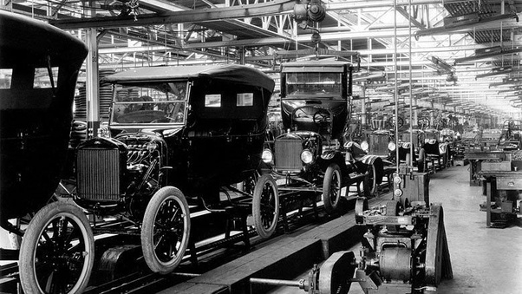
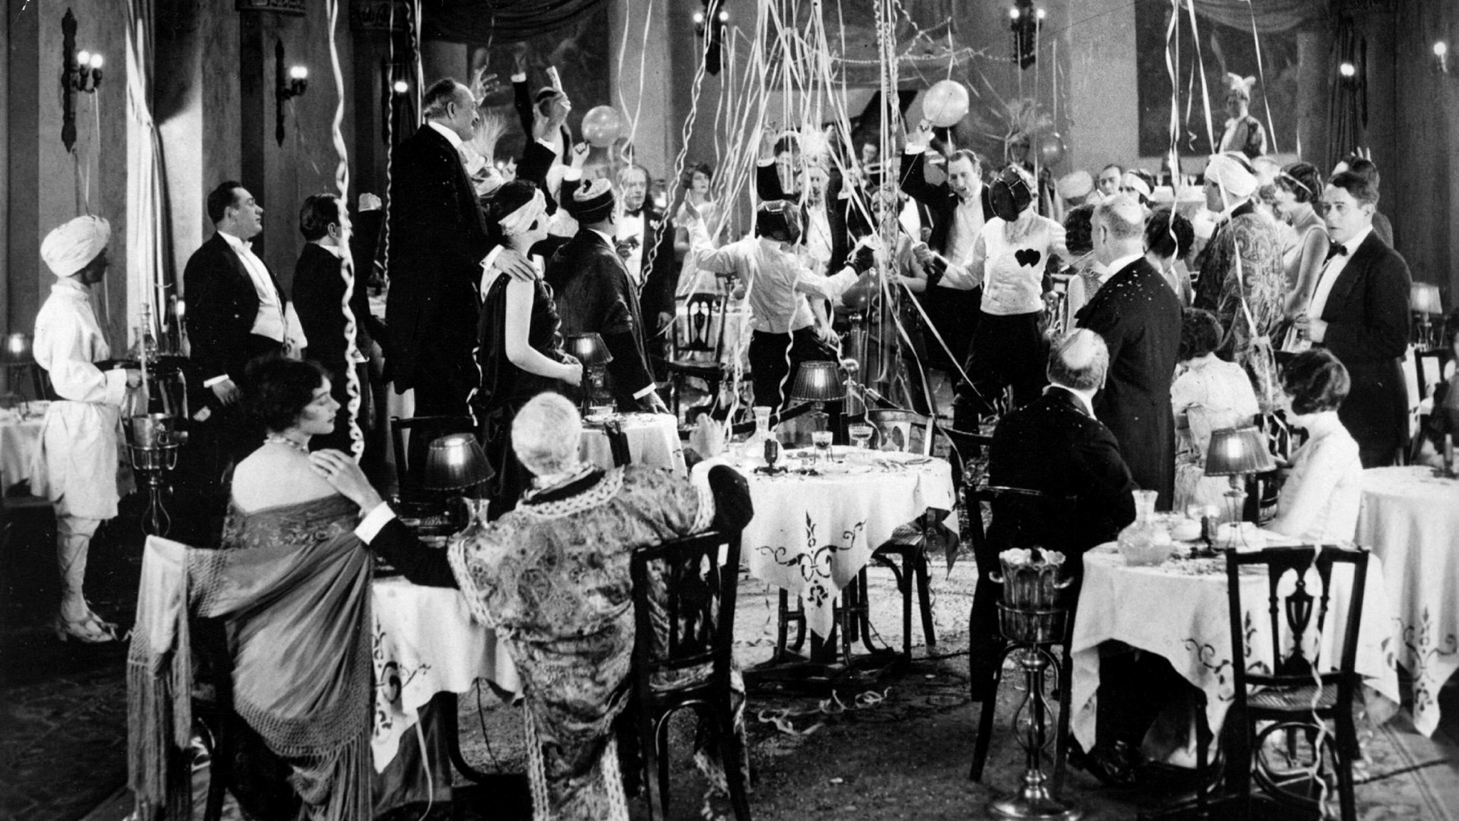
Notes:
So a bit of history. For much of American history, right up through the 1920’s, a lassez faire approach to the economy seemed, to many, to be working pretty well. The government stayed out of things and economic progress seemed inevitable.

Slide 8
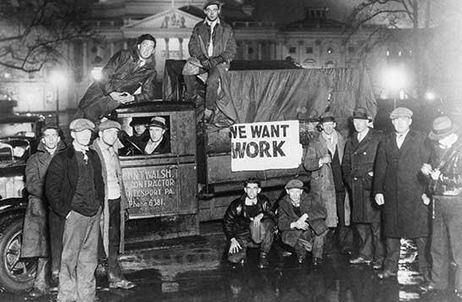
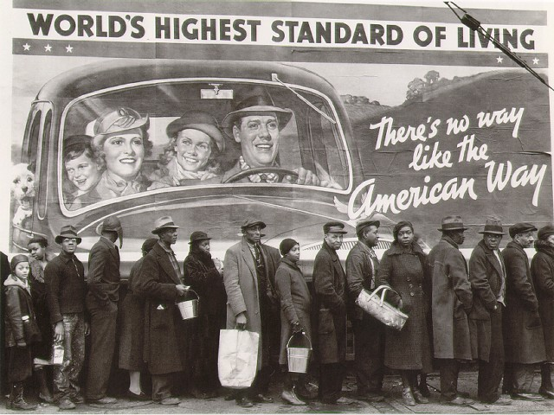
Notes:
Then the great depression hits. This was, to use the technical term coined by the foremost economists of the age, “awful.” People begin to open up to the idea of governmental intervention in the economy. But, if the government is, sometimes, going to involve itself, how will it know when? And how will it know if its efforts are successful? We needed ways to measure the economy.

Slide 9
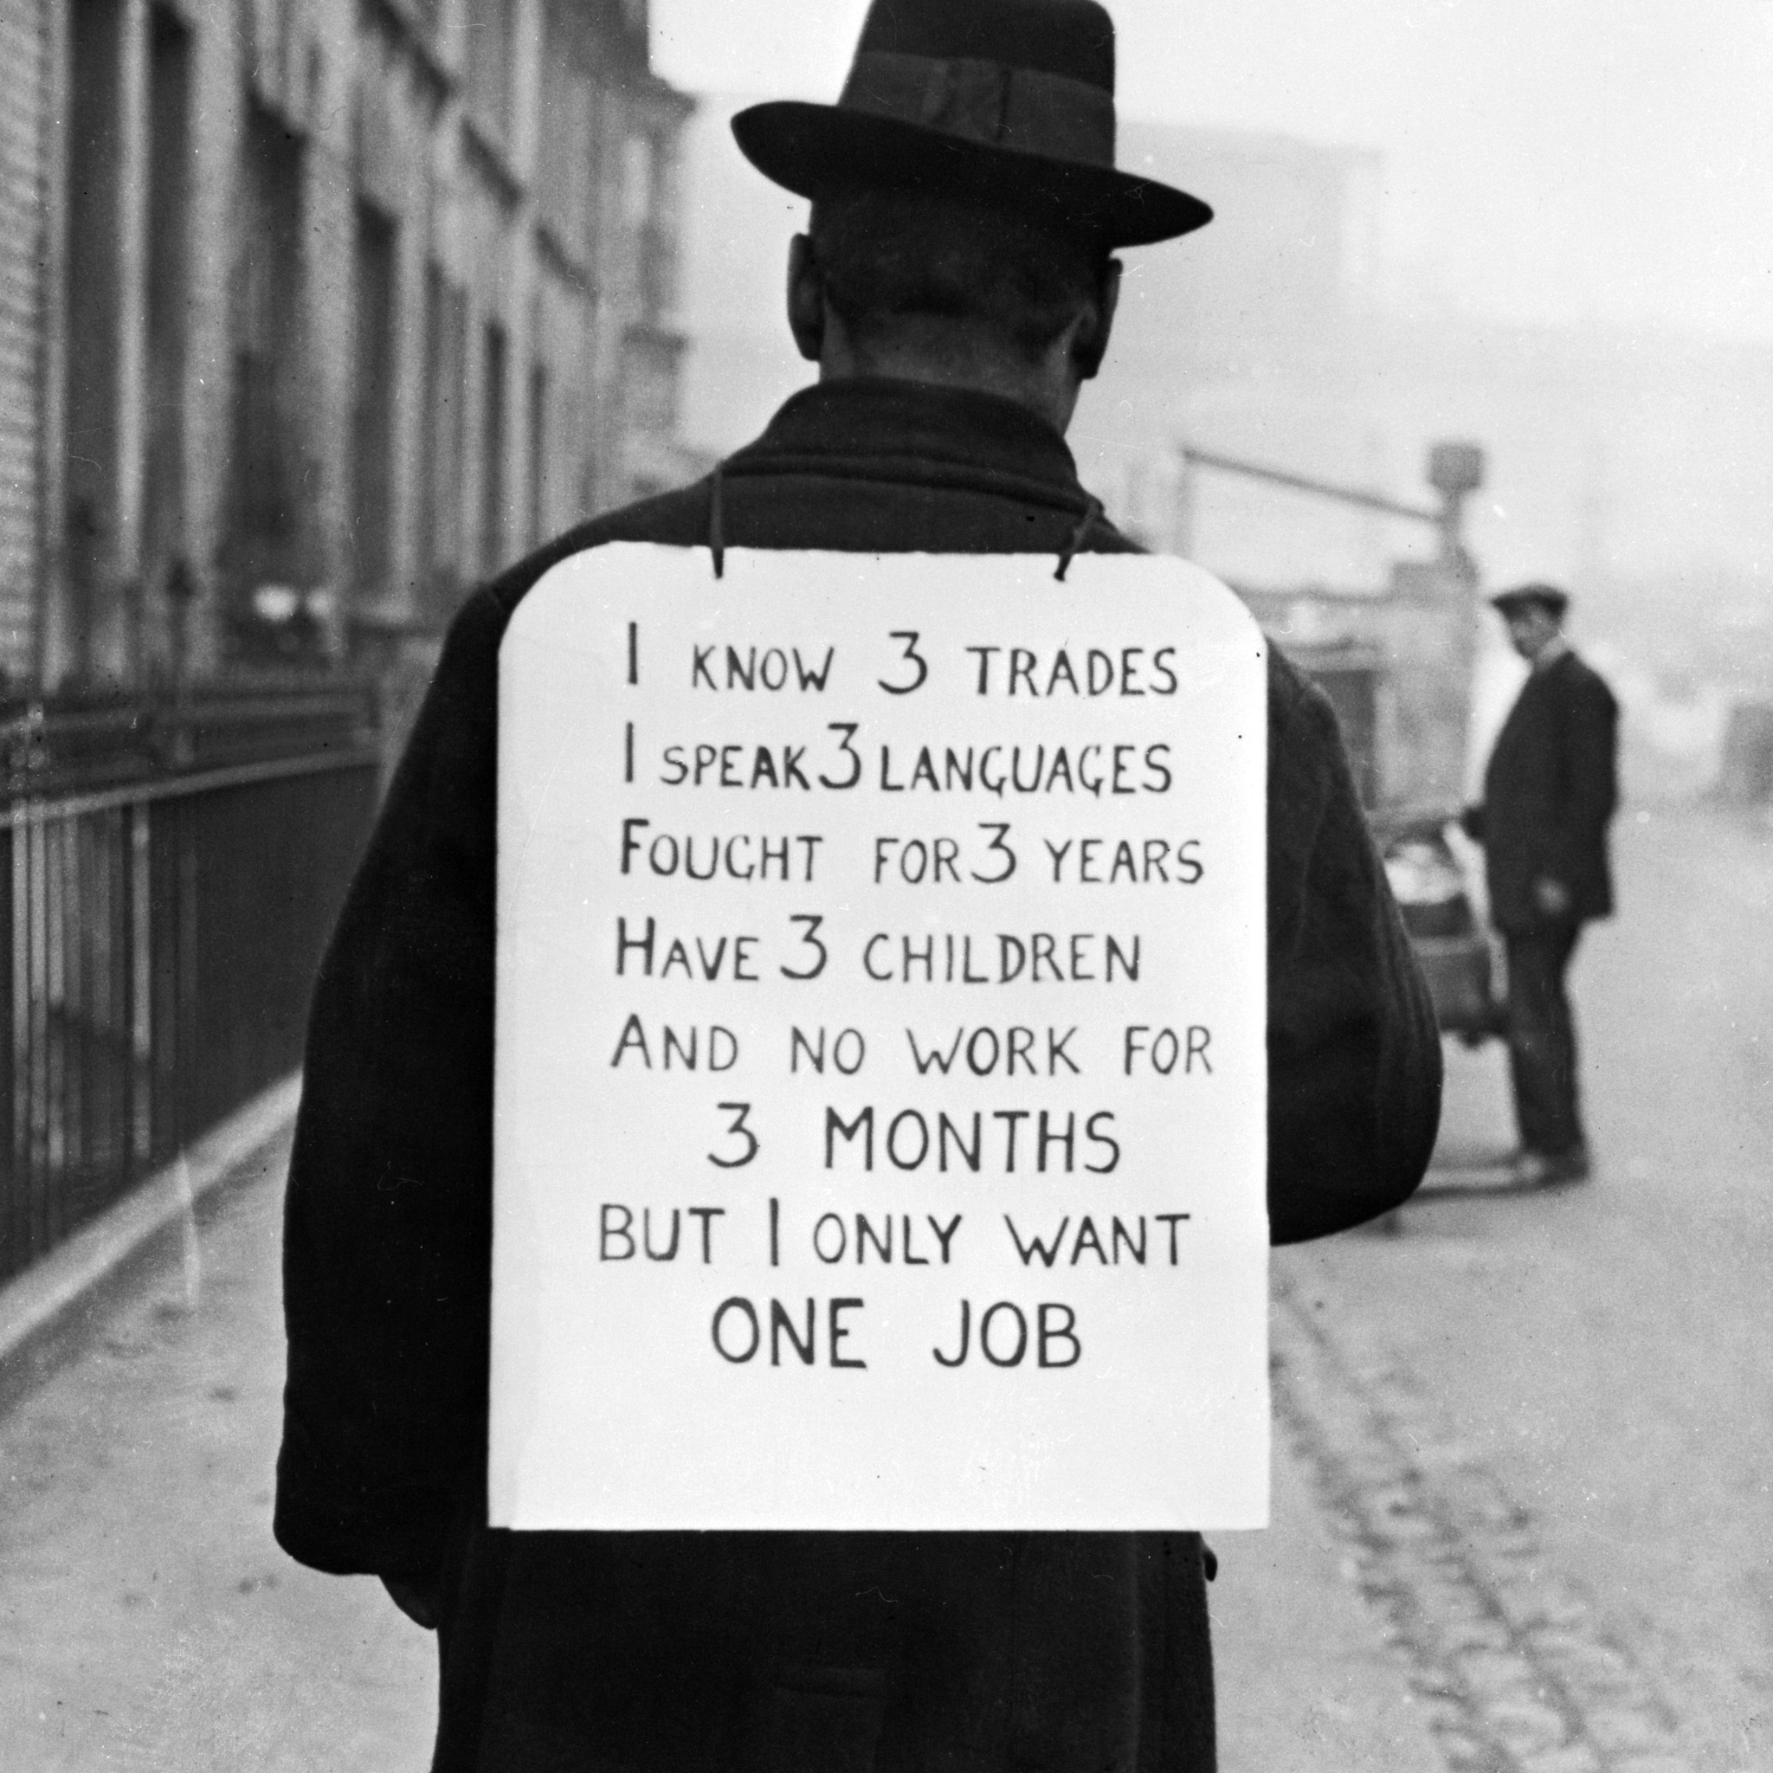
Notes:
A great many people were out of work, and that wasn’t good. So one major indicator of economic health is the employment rate. If the employment rate was to become too low (or, put differently, if unemployment was to grow too great,) that might suggest that it was time for the government to do something.

Slide 10
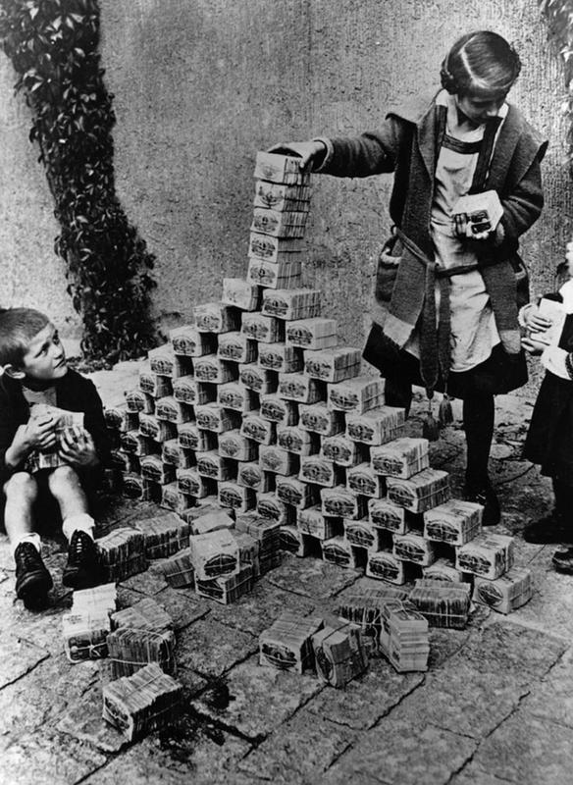
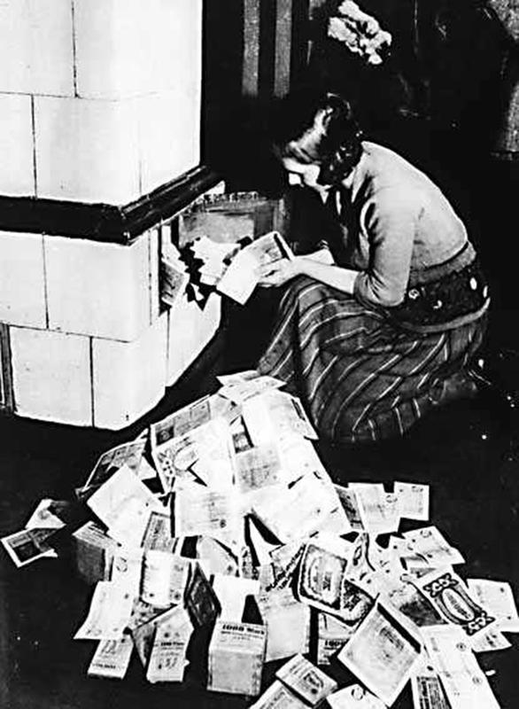
Notes:
Another important economic indicator was, and is, inflation. Germany, in the wake of WWI, working to pay reparations printed gobs of money (again, gobs is the technical term preferred by economists.) One potential goal of a government, when it involves itself in managing an economy, might be to prevent a mess like that.

Slide 11
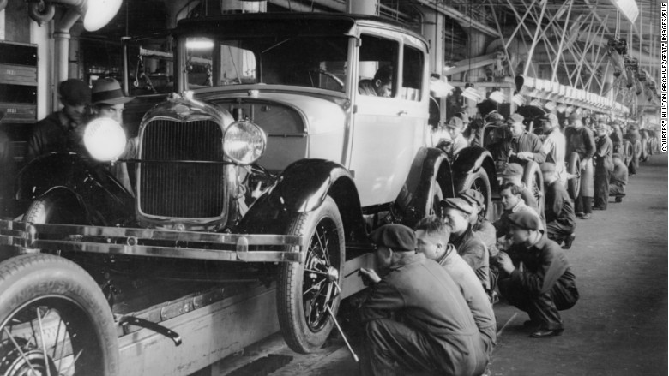
Notes:
One last indicator: output. How much stuff is the country producing, including both goods and services. The more goods and services we produce, the more we can consume and the higher standards of living will be.

Slide 12
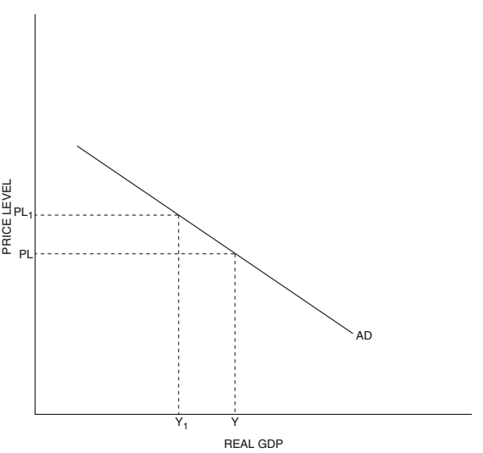
Notes:
Let’s bring these economic indicators together. On the y-axis, at the left, we have price level. As we move up the y-axis, prices are rising, what we call inflation. We don’t want too much of that.

Slide 13
Notes:
On the x-axis we have output. We’ll measure output in dollars. This is called gross domestic product, or GDP. GDP is the sum total of all goods and services produced or provided by a nation. When we add the word “real,” to this, it means we’re adjusting for inflation. All else held equal, the more output, the better. If a nation makes more stuff, that means it gets to enjoy more stuff.

Slide 14
Notes:
Traditional macroeconomic theory suggests that price level and GDP are generally connected. At high price levels, people won’t buy as much stuff, so output will be lower. At low price levels, people will buy more, and so output will be higher.

Slide 15
REAL GDP/EMPLOYMENT
Notes:
You could also put employment on the x-axis. The more stuff a nation produces, the more workers it needs. The two are connected. Some instructors will put both on the graph at the same time for this reason. But, of course, they’re measured in different ways. Output is measured in dollars, and employment as number of people, or as a percentage.

Slide 16
Aggregate
Demand (AD)
The amount of real output (GDP) that buyers collectively wish to purchase at each possible price level.
Notes:
This line is the aggregate demand curve. For those of you who have studied microeconomics and are familiar with regular demand, aggregate demand is all of those individual demand curves smooshed together. Every domestic car that we buy, or which is exported to another country, every haircut we get, and every new school or new factory that gets built. Just as the individual demand curves the individual products are downward sloping, so aggregate demand is.
This graphic, by the way, and those that follow, are drawn from The Council on Economics Educations AP Macroeconomics Teacher’s Manual, 4th edition.

Slide 17
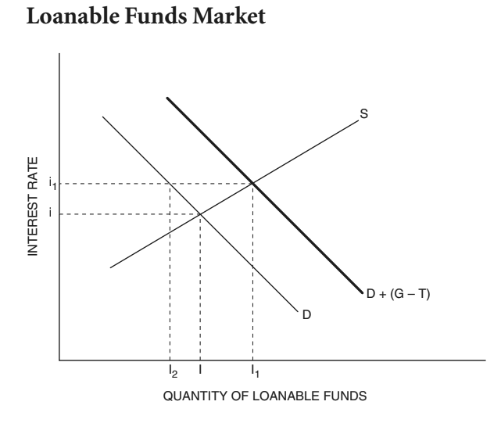
Why is AD downward sloping?
1. The interest rate effect
Notes:
The interest rate effect The interest rate is the price of borrowing to purchase capital or durable goods (like houses or cars). It is argued that, at higher price levels, people need to borrow more to buy the same amount, or even fewer, goods. This increase in demand for loanable funds, then, drives up interest rates. Higher interest rates lead to decreases in purchases of interest-rate-sensitive goods, like houses, cars, and physical capital for firms. Too-long-didn’t-read: higher price levels can lead to higher interest rates which can lead to drops in some types of consumption and investment.

Slide 18
Why is AD downward sloping?
1. The interest rate effect
2. The wealth effect
Notes:
To quote from The Council on Economics Education’s Advanced Placement 4th Edition book: “As the price level increases, it takes more dollars to purchase goods. In other words, an increase in the price level decreases the purchasing power of cash balances. Faced with a decrease in purchasing power (real wealth), people decrease consumption. A decrease in the price level causes an increase in purchasing power so that people increase consumption—giving the AD curve a negative slope.”

Slide 19
Why is AD downward sloping?
1. The interest rate effect
2. The wealth effect
3. The net export effect
Notes:
If price level falls for domestic goods, then people will buy more local goods and import less. At the same time, if, say, American-made goods become less expensive, this will also help to increase exports as people around the world are more open to buying them. This increase in local consumption of domestically produced goods, coupled with increased exports, leads to an increase in output at lower price levels.

Slide 20
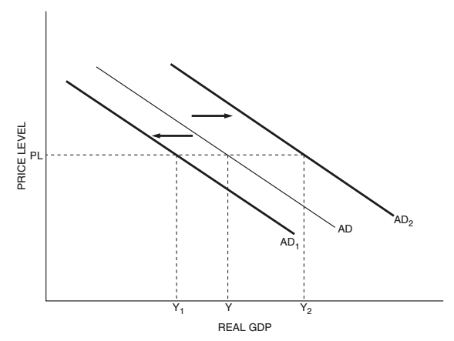
Aggregate Demand Can Shift
Consumer spending (tied to confidence, income, taxes, and expectations)
Notes:
If people are suddenly willing to buy more or less stuff, at the same price level, aggregate demand shifts. In my AP Economics class, we would have already studied those factors which can affect aggregate demand. They are the components of GDP. If you attended our Unit 2 sessions, then this will be review. First, changes in consumer spending can affect aggregate demand. To be clear: these must be changes in consumer spending due to causes other than inflation. Let’s say consumer confidence rises. In this graph, AD shifts to the right. Suddenly people, who were only willing to buy Y amount of stuff at the current price level are willing to buy Y2. Changes in income, income taxes, and consumer expectations can also affect consumer spending. Consumer spending, by the way, in the U.S. is the largest component of aggregate demand.

Slide 21
Aggregate Demand Can Shift
Consumer spending (tied to confidence, income, taxes, and expectations)
Government spending
Notes:
The second largest buyer of goods and services in the U.S., after consumers, is the government. Changes in government spending, as we’ll see in later sessions, affect aggregate demand, and so affect the economy at large.

Slide 22
Aggregate Demand Can Shift
Consumer spending (tied to confidence, income, taxes, and expectations)
Government spending
Private investment
Notes:
Whenever businesses buy materials or services to aid in production, we call that private investment, and it’s the third largest contributor to aggregate demand in the U.S. In my class, during this unit, we study private investment in detail. Students would learn about its determinants, the things that can affect it.

Slide 23
Aggregate Demand Can Shift
Consumer spending (tied to confidence, income, taxes, and expectations)
Government spending
Private investment
Net exports
Notes:
Lastly, whenever a country ships goods to or provides services for the people of another country, that’s an export and it counts as a part of aggregate demand. When calculating AD, we subtract imports because things that consumers, the government, and firms buy which were produced in other countries is NOT part of aggregate demand. In the U.S., net exports are actually negative - we import more than we export. In the Council on Economics Education’s materials, imports and exports are studied in detail in Unit 7. AP Classroom will do this in Unit 6. Either way, many classes save this for later.
In Unit 2, when we studied GDP, we would have been introduced to these ideas. In my class we would

Slide 24
Aggregate Demand Can Shift
Consumer spending (tied to confidence, income, taxes, and expectations)
Government spending
Private investment
Net exports
AD =
C + G + I + X(n)
Notes:
I introduce this equation in Unit 2 as the equation for calculating GDP. It also works for aggregate demand. GDP is simply the level of aggregate demand at macroeconomic equilibrium. Macroeconomic equilibrium, the confluence of aggregate demand and aggregate supply, will be the subject of a webinar on January 31st. I hope you’ll join us.

Slide 25
Where Students May Struggle: Aggregate Demand
Shifts vs. Movements
.
.
Notes:
Just as they likely did when studying demand in microeconomics, students may be confused with the difference between a movement along a curve verses a shift of a curve. The determinants of aggregate demand that we just studied are changes in conditions OTHER THAN PRICE LEVEL. These shift the curve. When consumer confidence falls, people will buy less stuff, EVEN IF PRICES STAY THE SAME. This is the situation on the left when moving from AD to AD1.
In contrast, in the graph on the right, people’s willingness to buy things at price level PL has not changed. What HAS changed is that prive level has risen, inflation. And this has caused people to buy less stuff.
What I tell students is this: a change in something that is a label on one of the axis always means movement along a curve. A change in some other condition can cause a shift.
The best way to help students through this is just practice, reminders and repetition.

Slide 26
Where Students May Struggle: Aggregate Demand
Shifts vs. Movements
Ceteris Paribus
Notes:
Ceteris Paribus, as I’ve alluded already, refers to one of the many simplifying assumptions that we make in economics, especially at the lower levels. It means, roughly speaking, all else held equal. By considering what might happen in the economy if government spending changes, but absolutely nothing else does, we can arrive at a potential understanding of cause and effect: that is, we can see how an increase in government spending could create jobs. In real life, of course, governments may increase spending at just the moment that a whole bunch of other things are changing, say pandemics are ramping up. For our purposes, we will generally assume one thing changes at a time, unless a question specifies otherwise.

Slide 27
Where Students May Struggle: Aggregate Demand
Shifts vs. Movements
Ceteris Paribus
Consumer Expectations
Notes:
This is the most complex determinant of aggregate demand, in my opinion. Here’s an example: if consumers expected price level to rise in the future, they may make more major purchases now. So, even though the inflation has not yet occurred (and may never,) the expectation of it influences people’s behavior today. An expectation of a change in one of the other determinants of demand could also affect consumer behavior. If they expected a change in income taxes, for example, that could do it.
As a form of instruction, I like to make students come up with their own examples of things that can shift aggregate demand. This is the hardest one for them to think of examples for.

Slide 28
Where Students May Struggle: Aggregate Demand
Shifts vs. Movements
Ceteris Paribus
Consumer Expectations
Investment
Notes:
Additionally, if you haven’t already covered this with students, you’ll need to be clear about what we mean and don’t mean when we say ‘investment.’ This is one of those places where economists and normal people use a word differently. Investment, for our purposes, is firms buying materials or services to aid in future production. Building a new factory. Buying steel to use in cars. Spending money training workers. It is NOT people buying stock. That is NOT a part of aggregate demand or GDP because nothing is being produced.

Slide 29
Ways to Teach This: Aggregate Demand
Lecture/Screencast/Textbook
Notes:
There are a great many topics in economics which I like to introduce through simulations and games. There are some things, and aggregate demand may be one of them, where some direct instruction can be valuable. Each of these traditional methods of instruction has its strengths and weaknesses, which is why I at least try to offer all three. I have a pre-recorded screencast and offer students the opportunity to either watch it or to take notes from me in-person. I’ve arranged with my administration permission to split my class and send those who would rather listen to the screencast to a supervised location to do so. When they finish, they can get a start on that night’s homework. The other half of the class stays with me while I teach the same information live. I also assign a reading that covers the same content. Students have figured out that the most vital learning is replicated in the lecture and textbook, so some students pay greater attention to one or the other, whichever serves their learning style best. Some go all in on both, which is excellent. Either way, before we start on practice and review, you have to get the information out there somehow.

Slide 30
Ways to Teach This: Aggregate Demand
Lecture/Screencast/Textbook
Practice problems
Notes:
Once students have been introduced to aggregate demand, it’s time to practice. Practice problems are a vital part of instruction in an AP class. They not only provide practice with the content, but also practice understanding College Board’s writing style, which can sometimes be a bit confusing for students. Additionally, of course, they provide useful information for an instructor regarding ongoing areas of need for students.

Slide 31
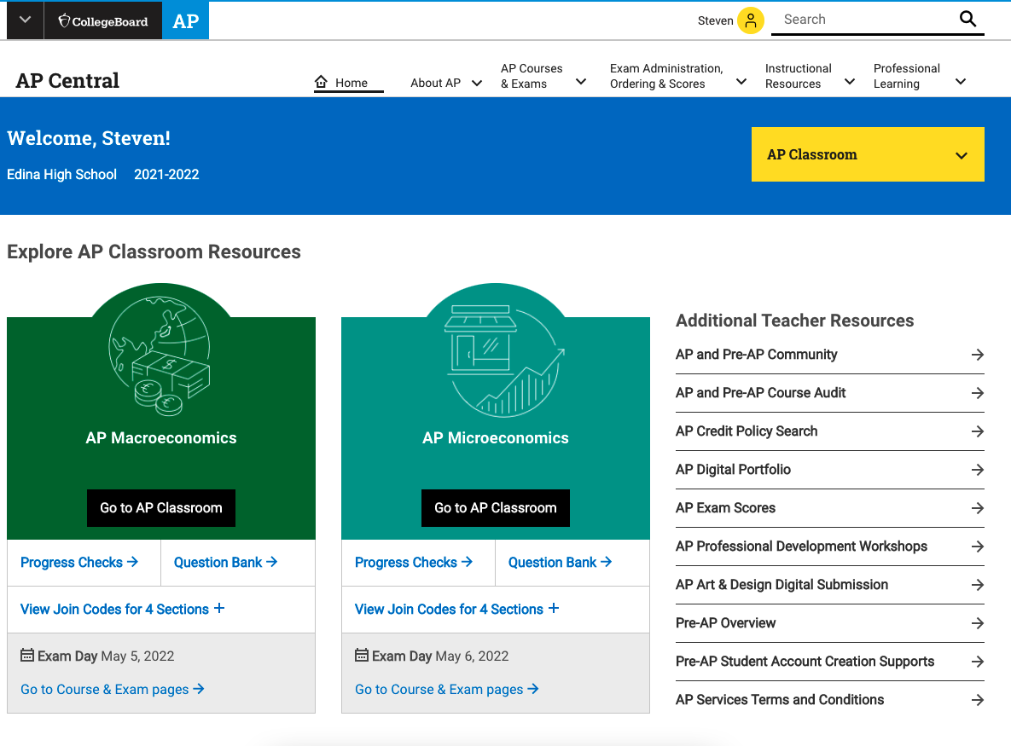
Notes:
If you’ve attended some of the earlier webinars in this series, you’ve already heard about the usefulness of AP Classroom. You will have access to it once your district registers you as an instructor of AP Macroeconomics with them.

Slide 32
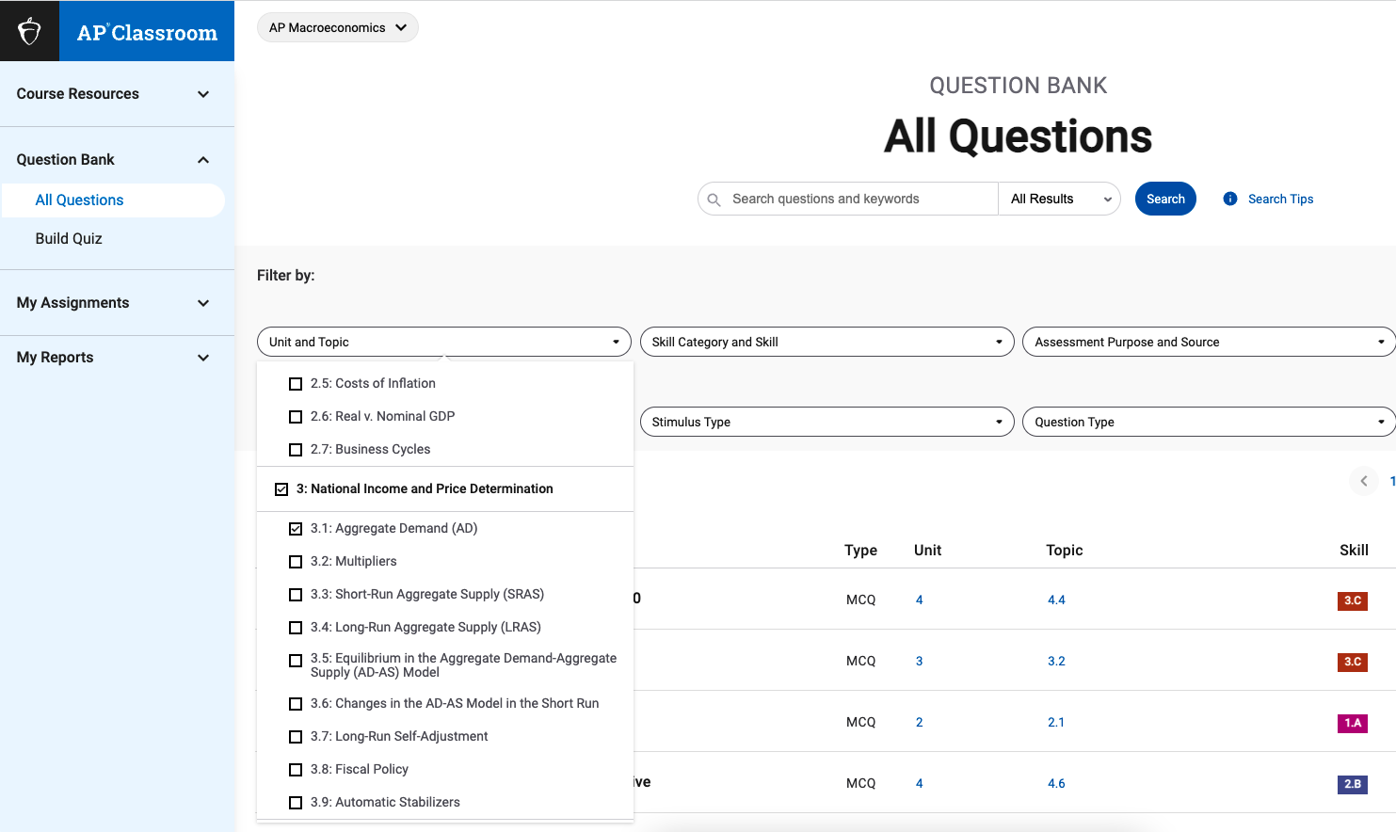
Notes:
In it you can specify a topic and type of question and get questions of identical style and difficulty to those which students will encounter on the AP test. If students are going to take the AP test, then they will need a login for this site anyway, so you can assign the questions to students directly through this system. It’s a good way to proceed, because AP doesn’t want you posting the questions elsewhere.

Slide 33
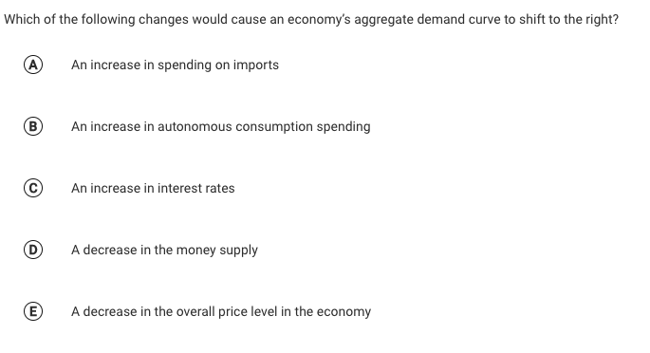

Slide 34
Ways to Teach This: Aggregate Demand
Lecture/Screencast/Textbook
Practice problems
Worksheets
Notes:
The Council for Economics Education’s Advanced Placement 4th Edition Macroeconomics book provides a couple of things for you. (Click on the link above.) First, in the teacher’s manual, there’s a guide to help you in a lecture on aggregate demand. This will include a review of a lot of the information from this presentation, and will also try to anticipate places where students may make mistakes. Then, in the student book, there’s a worksheet. I like to have students work in groups on these. In this way, students support each other. When one student teaches another, they both benefit. And sometimes a fellow student can explain something in a different way than the teacher does, and it just clicks. If I’m honest, I frequently don’t grade these. Instead I’ll move throughout the room, providing feedback, and then we’ll go over the assignment together.
I wish I had something

Slide 35
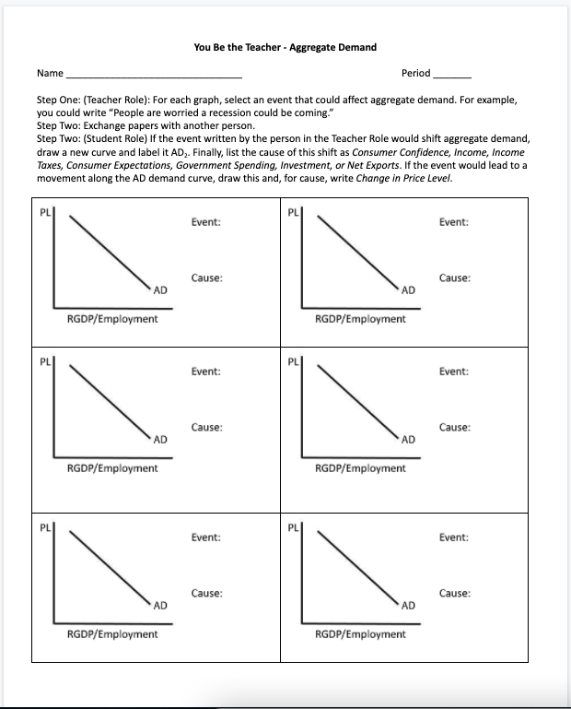
Ways to Teach This: Aggregate Demand
Lecture/Screencast/Textbook
Practice problems
Worksheets
Notes:
Another one I like is called ‘You Be the Teacher.’ I wish I could say this was my idea. I built this based upon a worksheet that was provided to me when I began teaching AP Econ. The idea is that one student must provide the scenarios which could, conceivably, shift aggregate demand then they trade with a classmate, who must show the effect of the event on AD and categorize the cause. Then the teacher, who created the problems, grades it, often leading to productive discussion.

Slide 36
Ways to Teach This: Aggregate Demand
Lecture/Screencast/Textbook
Practice problems
Worksheets
Review Games
Notes:
Review games are, of course, one of the funnest parts of being a student OR a teacher. By now many of you will be familiar with Kahoot, which is an easy way to go and which students enjoy… but which they may also be getting a little bit tired of.

Slide 37
Ways to Teach This: Aggregate Demand
Lecture/Screencast/Textbook
Practice problems
Worksheets
Review Games
Notes:
One of our earlier presenters, Theodore Opderbeck, brought Blooket to my attention, during his session on equilibrium in supply and demand. Blooket operates a lot like Kahoot, but with a wider variety of game options, so it’s a nice change of pace for students.

Slide 38
Ways to Teach This: Aggregate Demand
Lecture/Screencast/Textbook
Practice problems
Worksheets
Review Games
Notes:
One of my favorite parts of teaching economics is the annual Economics Challenge, a national competition and also a state competition in many places. Part of this competition is a quizbowl round, in which students buzz in and answer economics trivia questions. If you can get your hands on a set of old-school buzzers, this is an engaging classroom activity. It can also serve to whet students’ appetites for the competition, which is run at the national level by the council for economic education and which got its start under the guidance of my own Minnesota Council on economic education. You may find that some teacher in your building has buzzers, or you can do as I did and write a grant proposal to find funds for your own.

Slide 39
Ways to Teach This: Aggregate Demand
Lecture/Screencast/Textbook
Practice problems
Worksheets
Review Games
Roleplay
architect parent of two ping-pong enthusiast
Notes:
Here’s something to try: give every student a role in the economy. Maybe they could be a consumer or a producer of a specific good or service. You could print these on pieces of paper and hand them out. Then call out events which could affect aggregate demand and have all those who whose behavior would be affected stand up. For example, when you say ‘households get COVID stimulus checks’ all of the consumers would stand. Then, have them indicate physically, with a thumbs up or down, or something more easily visible (in my example an arrow is printed on the back of their role) whether they would demand more or fewer goods and services. This could then be translated to a graph you draw on the board.

Slide 40
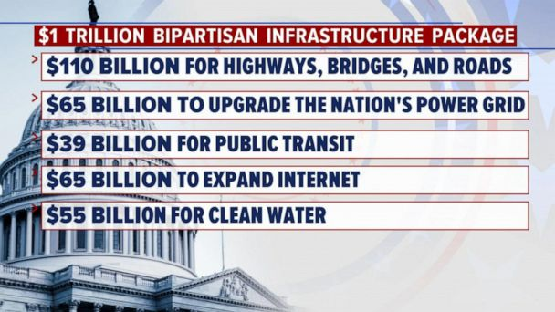
Ways to Teach This: Aggregate Demand
Lecture/Screencast/Textbook
Practice problems
Worksheets
Review Games
Roleplay
Watch the news
Notes:
In the olden times, when we all taught by the light of whale oil-fueled lamps, we would ask students to bring in a printed newspaper or magazine article. A lot of households won’t have those now. Instead, we might have them submit a link for an event they saw in the news which would affect aggregate demand. The student would have to explain which determinant of AD has changed, and it effect it should have on aggregate demand (increase or decrease.)

Slide 41
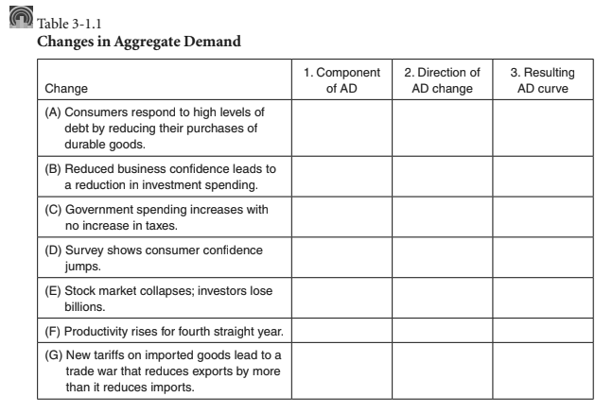
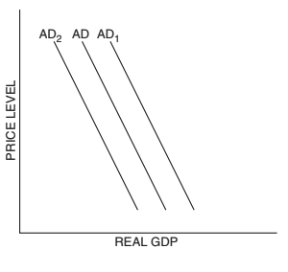
Time Permitting: Practice

Slide 42
Time Permitting: Real Life
PL1
Notes:
Demand for goods and services has actually increased in recent years. Consumer confidence, despite the pandemic, has been relatively strong. Government actions, like efforts to keep interest rates low, pauses on student-loan repayments, and stimulus checks have left people, on average, in strong financial positions. While people aren’t travelling or eating in restaurants as much, they’re buying lots of stuff - cars, electronics, you name it. An increase in AD means in increase in output and a greater demand for labor. That’s not the whole story, of course, but it’s all we can really examine before studying aggregate supply in our next session.

Slide 43
Questions?

Slide 44
MINNESOTA COUNCIL ON ECONOMIC EDUCATION (MCEE)
Our Vision
To equip all Minnesotans with the economic and personal financial understanding needed to succeed in today's complex economy.
Teaching Teachers, Engaging Students, and Reaching Communities
mcee.umn.edu | mcee@umn.edu | 612.625.3727
Notes:
Some upcoming webinars produced by the Minnesota council on economics education, which are open to educators world over include one on Jacob Lawrence and the Great Migration tomorrow and one titled ‘refresh your economics instruction on January 20th.

Slide 45
NATIONAL COUNCIL FOR ECONOMIC EDUCATION (CEE)
The Council for Economic Education’s (CEE’s) mission is to equip K-12 students with the tools and knowledge of personal finance and economics so that they can make better decisions for themselves, their families, and their communities.
We carry out our mission by providing resources and training to K-12 educators and have done so for over 70 years. Nearly two-thirds of the teachers we reach in-person are in low to moderate income schools. All resources and programs are developed by educators and delivered by our 188 affiliates across the country in every state. We reach over 50,000 teachers a year through in-person professional development and those teachers, in turn, reach approximately 5 million students throughout the country. EconEdLink, our free online educator gateway for economic and personal finance lessons and resources, attracts more than 700,000 unique visitors per year.
We also advocate for more and better education in personal finance and economics, primarily through the biennial Survey of the States.
Notes:
On January 24th I’ll lead the next session of our ongoing AP Macroeconomics series in which we’ll study aggregate supply. The council on economics education also has on ongoing series which uses TurboTax to teach personal finance to students. It has sessions on January 19th and 26th. Each is a standalone event covering different content.

Slide 46
Thank You
Steven Cullison | steven.cullison@edinaschools.org
Notes:
Advertise upcoming sessions: Aggregate Supply on MLK Day in a week, Macroeconomic Equilibrium in which we bring AD and AS together on Monday Jan 31st, and Fiscal Policy on Feb. 7th.

