Slide 1
Your Personal Finance for Teachers:
Planning for Retirement
Teachers Can Be Financially Fit, Too!
Tawni Hunt Ferrarini, PhD
Lindenwood University tferrarini@lindenwood.edu
Tawni.org

Slide 2
EconEdLink Membership
You can now access CEE’s professional development webinars directly on EconEdLink.org! To receive these new professional development benefits, become an EconEdLink member. As a member, you will now be able to:
Automatically receive a professional development certificate via e-mail within 24 hours after viewing any webinar for a minimum of 45 minutes
Register for upcoming webinars with a simple one-click process
Easily download presentations, lesson plan materials and activities for each webinar
Search and view all webinars at your convenience
Save webinars to your EconEdLink dashboard for easy access to the event
You may access our new Professional Development page here

Slide 3
Professional Development Certificate
Earn your professional development certificate for this webinar:
Watch a minimum of 45-minutes, and a professional development certificate will automatically be e-mailed to you within 24 hours.
Access resources:
Download presentations, lesson plan materials, and activities for each webinar at EconEdLink.org/professional-development/

Slide 4
Agenda
Welcome to Retirement 101
Review key retirement objectives
Link the investment decisions of today to future retirement
Do a case study
Identify resources
Once over lightly

Slide 5
Objectives
Establish links to national standards
Define retirement for teachers
Link today’s spending and saving to future retirement
Explore strategies to meet retirement goals
Consider alternative plans
Identify resources
Commit to devising a plan and taking the first step

Slide 6
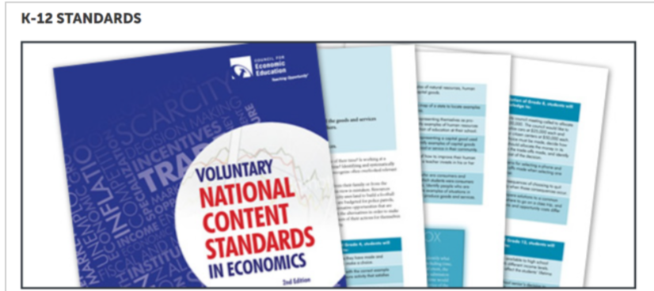
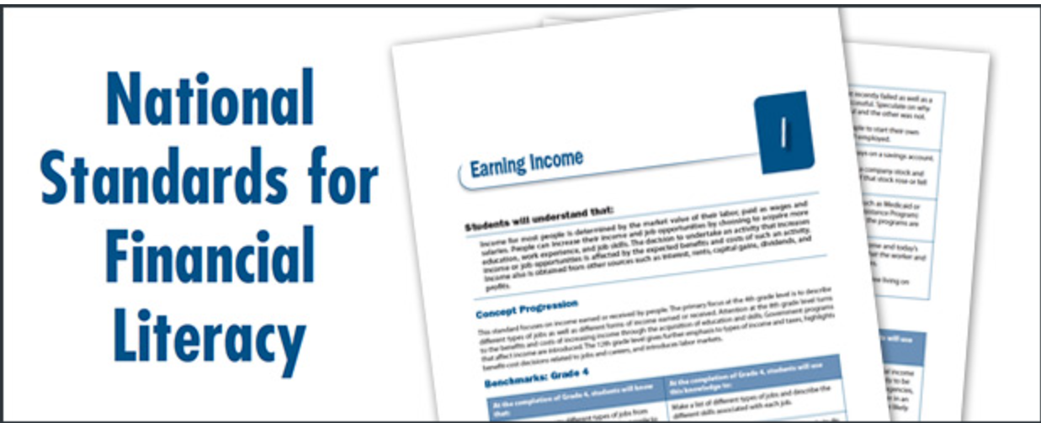
National Standards
3. Allocation & 12. Interest Rates
5. Financial Investing

Slide 7
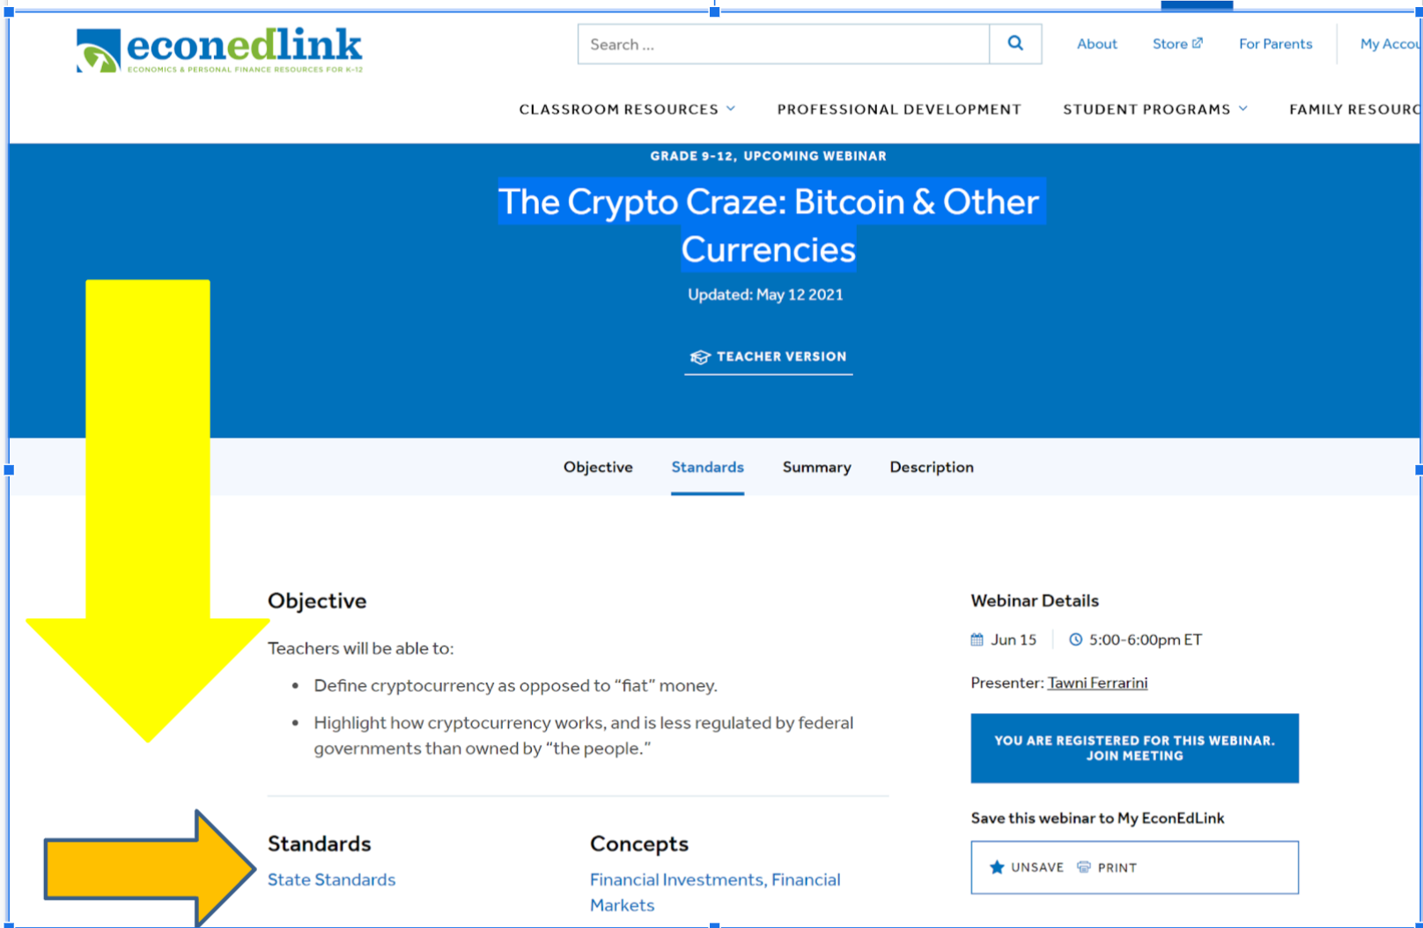
State Standards
Find your list of corresponding regional standards with your favorite browser.

Slide 8

Discussion Starter
Return to March 2020.
The pandemic lock-downs began. How long did you think the pandemic would last? Were you right?

Slide 9
Teacher’s Retirement Challenges
Name two challenges

Slide 10



Drag your dot to indicate whether you agree or disagree:
Agree
Disagree
Plan is in place. I could “retire” at the end of this academic term if offered 50% of one year’s pay as severance.
Notes:
Agree or Disagree
Use this template to do a quick check of students’ opinions during your lesson.
🍐 This is a Pear Deck Draggable™ Slide.
🍐 To edit the type of question, go back to the "Ask Students a Question" in the Pear Deck sidebar.

Slide 11
The Problem
Every living being retires.
How do you want to retire?
What plans can YOU make given the viable alternatives?

Slide 12
Framing the Task
Different people save and invest for different reasons, including large purchases (such as higher education, autos, and homes), retirement and unexpected events.
People’s choices about how much to save and for what to save are based on their tastes, preferences, and circumstances.
Choose comfortable and secure retirement as a key goal.

Slide 13
Financial Investing
Financial investment is the purchase of financial assets to increase income or wealth in the future.
Investors must choose among stocks, bonds, savings and such. Each has different risks and expected rates of return.
Investments with higher expected rates of return tend to have greater risk.
Diversification of investment among a number of choices can lower investment risk.

Slide 14
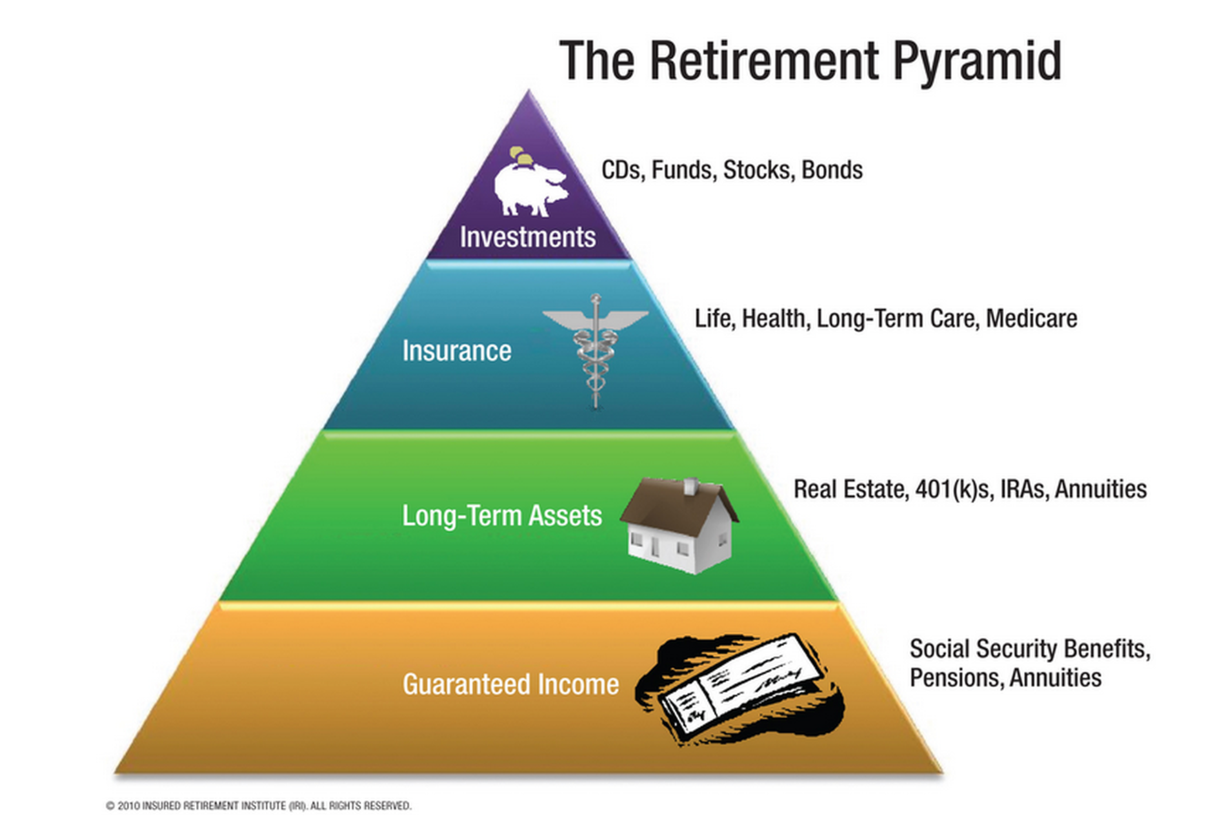
Meet with an objective, third-party with financial expertise.
Devise a plan that makes sense for you.
https://www.fool.com/investing/general/2014/08/17/the-pyramid-approach-to-retirement-planning.aspx

Slide 15
Independent of your starting point and plan…
Do not sell your retirement assets at the bottom of the market!

Slide 16
Financial Investments
(Don’t sell at the bottom)
Buy and hold, don’t buy and sell in a panic.
CASE STUDY: A teacher with $100,000 in retirement assets 1/1/2020.
If sold in panic on March 23, 2020, the teacher “preserves” $69,252 (Cut your losses! Scary time!)
But, hold until June 8, the portfolio value returns to $100,000 – hold until this week and you're at $108,000.
Advice: Keep a long-term perspective and help others do the same.

Slide 17
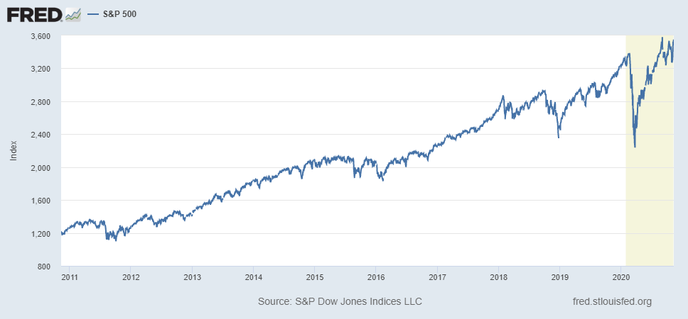
Stock market before and after the pandemic
Notes:
<a href='https://www.macrotrends.net/2526/sp-500-historical-annual-returns'>S&P 500 Historical Annual Returns</a>

Slide 18



Important disclosures
No one knows where financial markets will go in the future.
Even in this case, after June 8 there were again times when that teacher’s investment portfolio was worth less than $100,000. At other times, it was worth more.
But this much is certain: Panic selling during troubled times will lock in loss.

Slide 19
Take Inventory
Always have an inventory of your financial assets…
Financial assets include a wide variety of financial instruments including bank deposits, stocks, bonds and mutual funds.
Real estate and commodities are also often viewed as financial assets.
Cryptocurrencies are speculative assets with high volatility and risk.
Pensions, too.

Slide 20
Evaluate
Evaluate their expected returns and risks…
Leverage them against your debt and spending habits through a monthly budget and financial plan for life.
Identify where you are in the retirement process.
Individuals who are early may take on higher risks and expect higher returns.
Individuals who are close to retirement will want low risks and low and steady returns.

Slide 21
Case Study: Two Investors
Ana is a young teacher, 22 years old, and accepts her first job.
She is aware that investing involves an opportunity cost—giving up the next-best thing. It could be new clothes, car, vacation, or whatever she do alternatively with her invested money.
In her financial plan, Ana decided to save $2,000 a year, drive a used car financed with a loan, and rent a moderately nice apartment with a friend.
Ana was committed to save. She understand the power of compound interest and Rule of 70.
Ana invested $2,000 a year. After 12 years, decided to buy a Tesla without touching her investments. They were for retirement.
She planned on retiring at age 65.

Slide 22
Case Study: Two Investors, Cont’d
Shawn entered teaching at 34 years old.
He also graduated from college at 22, but traveled, worked to live, and bought a new car, lived in a luxurious apartment, and went around the world.
Like Ana, his choices included opportunity costs.
At age 34, Shawn married and decided to start saving and investing for his financial future.
He did his research and learned that what you have earned is not what matters most but what you save and invest is what determines your lifetime wealth.
Shawn estimated that he had 25 to 30 productive years in his career.
So, with this focus, Shawn saved $2,000 a year for the next 32 years until he retired at the end of his 65th year.

Slide 23
Wealth
Case Study: Two Investors, Cont’d
Ana
Shawn
Invests $2000 a year for 12 years from age 22 - 34.
Stops, and invests nothing for 31 years from age 34-65.
Retires at age 65.
Invests $0 a year for 12 years from age 22 - 34.
Invests $2000 a year for 31 years from age 34 - 65.
Retires at age 65.

Slide 24
Drag your dot to indicate who will retire with the most wealth at age 65.
Ana
Shawn
$2000 a year for 12 years (Ana at 22)
$2000 a year for 31 years (Shawn at 32)

Slide 25
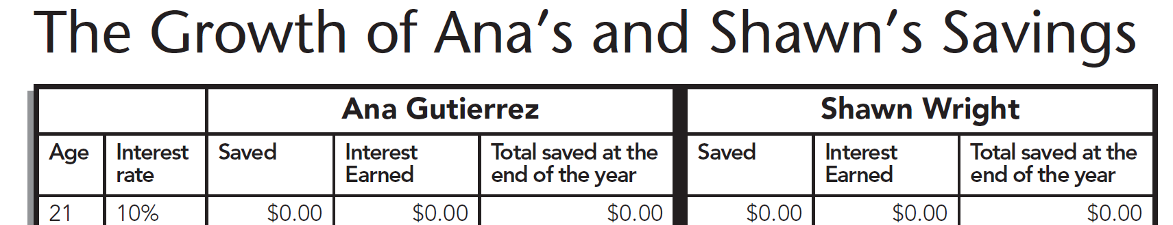
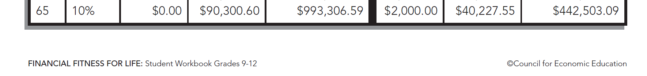
FFFL, 9-12: Lesson 20
Available for purchase at CEE store

Slide 26

Advise the following…
Background: Young public-school teacher with student debt, single, and renting
Retirement planning options:
  Pay off debt first; do not set private money aside for retirement; depend on defined-contributions pension
  Put a plan in place to pay off debt; contribute to Roth IRA (expected return is 6%), and participate in defined contributions pension
  Pay off no debt in hope of loan forgiveness and let the pension plan cover retirement

Slide 27


More information
Background: Young public-school teacher with student debt, single, and renting
Retirement planning options:
  Pay off debt first (4%); do not set private money aside for retirement; depend on defined-contributions pension
  Put a plan in place to pay off debt (4%); contribute to Roth IRA (expected return is 6%), and participate in defined contributions pension (easy choice)
  Pay off no debt in hope of loan forgiveness (uncertain) and let the pension plan cover retirement (risky)

Slide 28
References
EconEdLink.org
Financial Fitness for Life, Grades 9-12
Teachers Can Be Financially Fit, Too

Slide 29

CEE Affiliates
https://www.councilforeconed.org/resources/local-affiliates/

Slide 30




Thank You to Our Sponsors!

