Slide 1
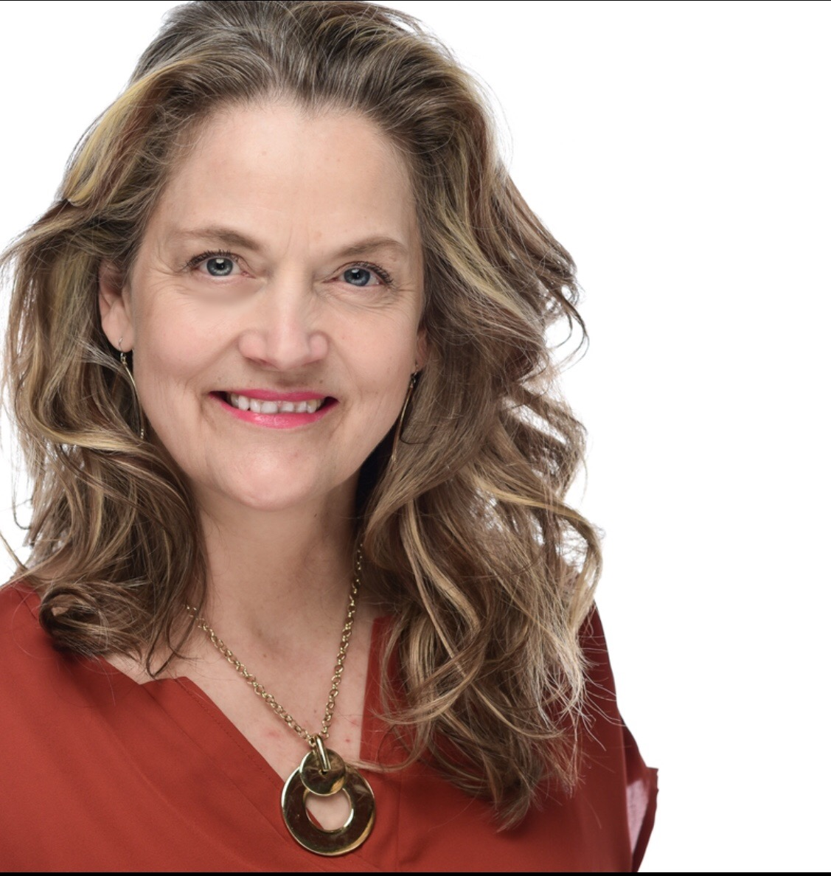
Your Personal Finance for Teachers: Making Informed Decisions Around Current Events Teachers Can Be Financially Fit, Too Tawni Hunt Ferrarini, PhD Lindenwood University tferrarini@lindenwood.edu Tawni.org

Slide 2
EconEdLink Membership
You can now access CEE’s professional development webinars directly on EconEdLink.org! To receive these new professional development benefits, become an EconEdLink member. As a member, you will now be able to:
Automatically receive a professional development certificate via e-mail within 24 hours after viewing any webinar for a minimum of 45 minutes
Register for upcoming webinars with a simple one-click process
Easily download presentations, lesson plan materials and activities for each webinar
Search and view all webinars at your convenience
Save webinars to your EconEdLink dashboard for easy access to the event
You may access our new Professional Development page here

Slide 3
Professional Development Certificate
Earn your professional development certificate for this webinar:
Watch a minimum of 45-minutes, and a professional development certificate will automatically be e-mailed to you within 24 hours.
Access resources:
Download presentations, lesson plan materials, and activities for each webinar at EconEdLink.org/professional-development/

Slide 4
Discussion Starter
Which current events interest you most?

Slide 5
A Little Background
Teachers Can Be Financially Fit: Economist’s Advice for Educators
Written by four teachers for teachers (Mark Schug, Bill Wood, Scott Niederjohn and Tawni Ferrarini)
This 14-chapter book customized personal finance for teachers and includes case studies and 911s.
The book can be ordered from Springer (the publisher, it offers bulk order discounts) or Amazon.
This site overs financial tools and curriculum links for teachers. www.financiallyfitteachers.com

Slide 6
Agenda
Welcome to “Your Personal Finance for Teachers: Making Informed Decisions Around Current Events”
Review key financial objectives
Link the investment decisions of today to future finances
Complete two case studies
Identify useful resources
Review – once over lightly

Slide 7
Objectives
Establish links to national and regional standards
Define finances for teachers
Link today’s spending and saving to future retirement
Explore strategies to live comfortably and securely given current events
Identify resources to leverage
Identify where you will learn about how to put financial literacy to good use as a teacher

Slide 8
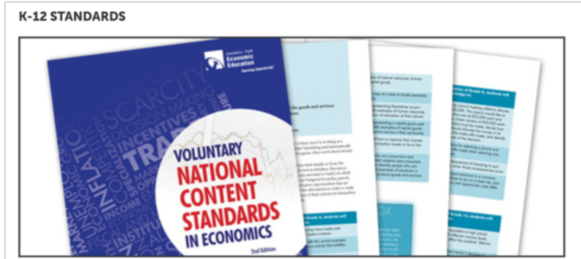
National Standards
3. Allocation & 12. Interest Rates
5. Financial Investing

Slide 9
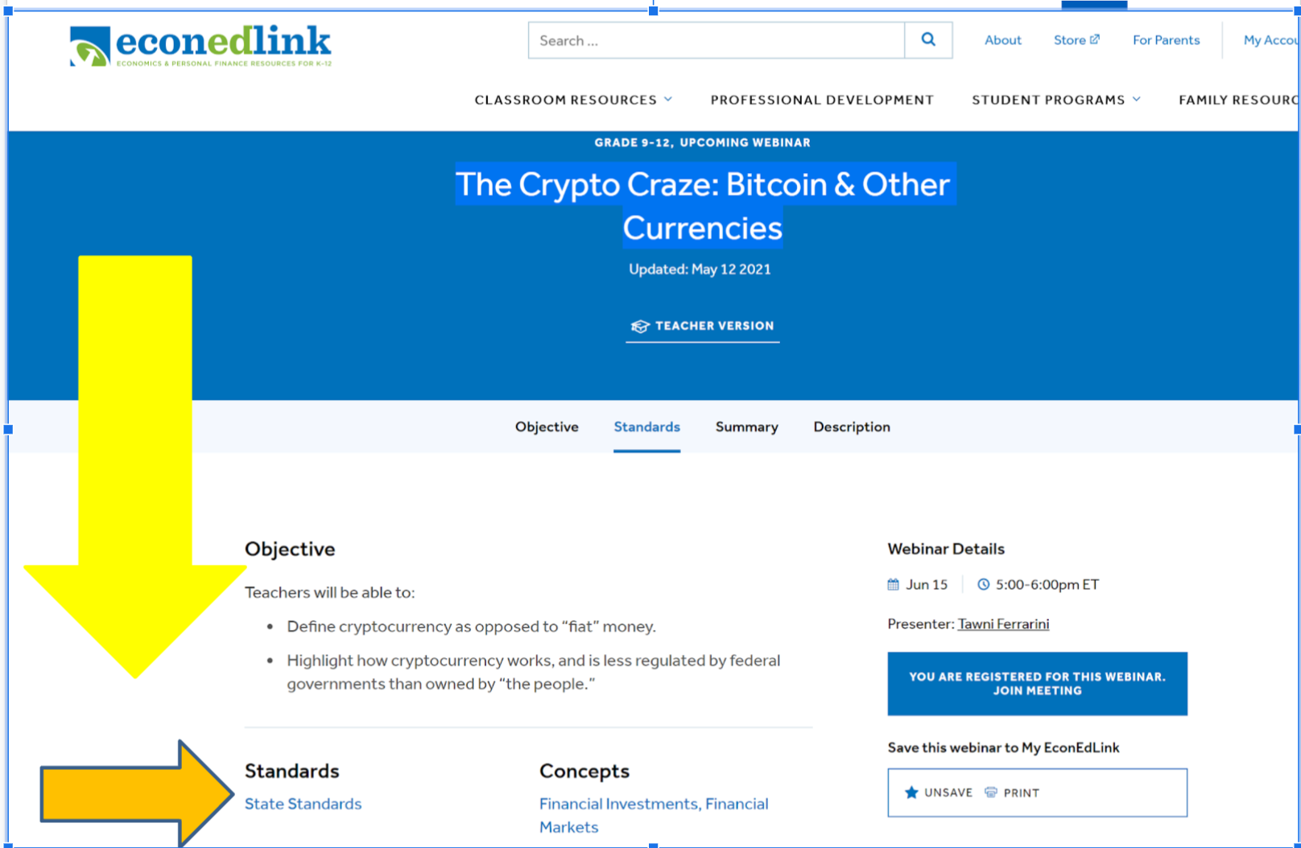
State Standards
Find your list of corresponding regional standards with your favorite browser.

Slide 10
Teacher’s Financial Challenges
Name two challenges unique to teachers.

Slide 11
Drag your dot to indicate whether you agree or disagree:
Agree
Disagree
RESPOND: I could “retire” comfortably at the end of this academic term if offered 50% of one year’s pay as severance or laid off.

Slide 12
Realities
Every living being retires
Every profession faces periods of unemployment

Slide 13
Problems
How do you want to navigate in light of current events?
What are your short and long-run alternatives and their associated benefits/costs/risks?

Slide 14
Framing the Task
Different people save and invest for different reasons, including large purchases (such as higher education, autos and homes), covering unexpected expenses, and retirement
People’s choices about how much to save and for what to save are based on their tastes, preferences and circumstances

Slide 15
Framing the Main Task
Choose comfortable and secure financial living as a key goal.
Use the present to build a future income stream based on research.
Current events come and go.

Slide 16
Financial Investing
Financial investment involves the purchase of financial assets. The intent is to increase income in the future or build wealth over time.
Investors choose among stocks, bonds, savings, and and various other financial instruments.
Each has different risks and expected rates of return.

Slide 17
Consult with an objective, third-party with financial expertise.
Devise a plan that makes sense for you.
What we teach
Life
https://www.fool.com/investing/general/2014/08/17/the-pyramid-approach-to-retirement-planning.aspx

Slide 18
Independent of where you are...
What do you do with your financial assets when the economy crashes?

Slide 19
Independent of your starting point and where you are…
Do not sell your retirement assets at the bottom of the market!

Slide 20
Financial Investments - Don’t sell at the bottom
Buy and hold, don’t buy and sell in a panic
CASE STUDY: A teacher with $100,000 in retirement assets 1/1/2020.
If sold in panic on March 23, 2020, the teacher “preserves” $69,252 (Cut your losses! Scary time!)
But, hold until June 8, the portfolio value returns to $100,000 – hold until this week and you're at $108,000.
Advice: Keep a long-term perspective and help others do the same

Slide 21
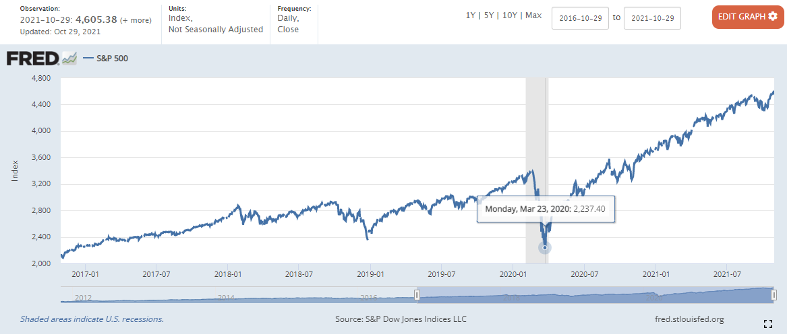
Stock market before and after the pandemic
Notes:
<a href='https://www.macrotrends.net/2526/sp-500-historical-annual-returns'>S&P 500 Historical Annual Returns</a>

Slide 22
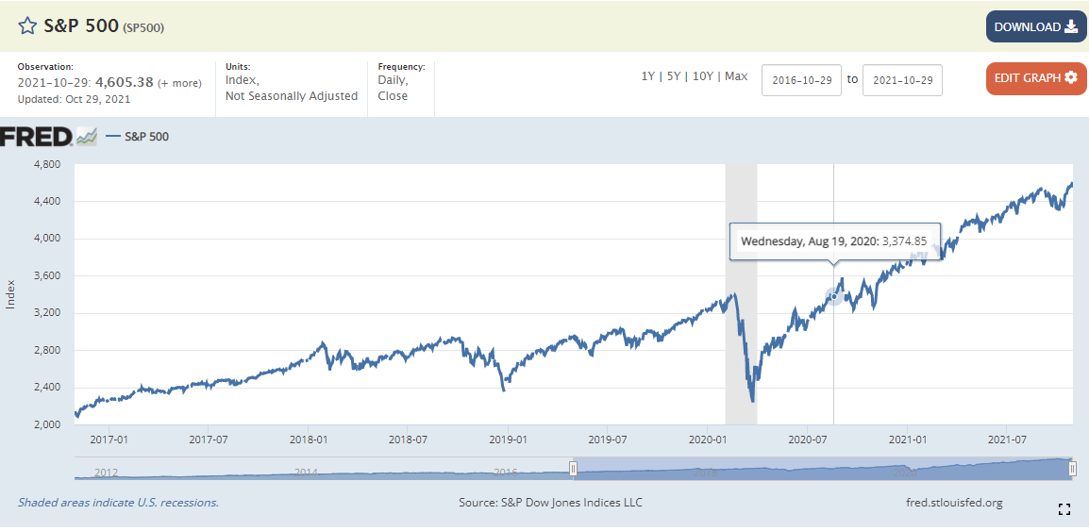
Stock market before and after the pandemic
Notes:
<a href='https://www.macrotrends.net/2526/sp-500-historical-annual-returns'>S&P 500 Historical Annual Returns</a>

Slide 23
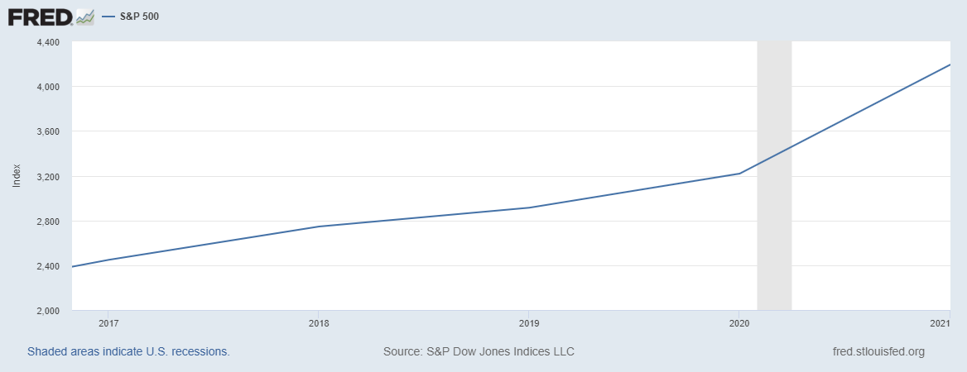
Stock market before and after the pandemic
Notes:
<a href='https://www.macrotrends.net/2526/sp-500-historical-annual-returns'>S&P 500 Historical Annual Returns</a>

Slide 24
Important disclosures
No one knows where financial markets will go in the future.
Even in this case, after June 8 there were again times when that teacher’s investment portfolio was worth less than $100,000. At other times, it was worth more.
But this much is certain: Panic selling during troubled times will lock in loss.

Slide 25
Take Inventory
Step back and take an inventory of your financial assets
Financial assets include a wide variety of financial instruments including bank deposits, stocks, bonds, and mutual funds
Identify all income streams - earned income, passive income, dividends, interest, and more
Real estate and commodities are also often viewed as financial assets
Cryptocurrencies, Game Stop Stocks and such are speculative assets with high volatility and risk
Pensions are, too

Slide 26
Evaluate
Evaluate their expected returns and risks.
Leverage them against your debt and spending habits through a monthly budget and financial plan for life.
Identify where you are in the retirement process.
Individuals who are early may take on higher risks and expect higher returns.
Individuals who are close to retirement will want low risks and low and steady returns.

Slide 27
Case Study: Two Investors
Ana is a young teacher, 22 years old, and accepts her first job.
She is aware that investing involves an opportunity cost—giving up the next-best thing. It could be new clothes, car, vacation, or whatever she do alternatively with her invested money.
In her financial plan, Ana decided to save $2,000 a year, drive a used car financed with a loan, and rent a moderately nice apartment with a friend.
Ana was committed to save. She understand the power of compound interest and Rule of 70.
Ana invested $2,000 a year. After 12 years, decided to buy a Tesla without touching her investments. They were for retirement.
She planned on retiring at age 65.

Slide 28
Case Study: Two Investors Cont’d 2
Shaun entered teaching at 34 years old.
He also graduated from college at 22, but traveled, worked to live, and bought a new car, lived in a luxurious apartment, and went around the world.
Like Ana, his choices included opportunity costs.
At age 34, Shaun married and decided to start saving and investing for his financial future.
He did his research and learned that what you have earned is not what matters most but what you save and invest is what determines your lifetime wealth.
Shaun estimated that he had 25 to 30 productive years in his career.
So, with this focus, Shaun saved $2,000 a year for the next 32 years until he retired at the end of his 65th year.

Slide 29
Wealth
Case Study: Two Investors Cont’d 3
Ana
Shaun
Invests $2000 a year for 12 years from age 22 - 34.
Stops, and invests nothing for 31 years from age 34-65.
Retires at age 65.
Invests $0 a year for 12 years from age 22 - 34.
Invests $2000 a year for 31 years from age 34 - 65.
Retires at age 65.
Let’s evaluate the two strategies.

Slide 30
Drag your dot to indicate who will retire with the most wealth at age 65.
Ana
Shaun
$2000 a year for 12 years or $24K over 12 years (Ana at 22)
$2000 a year for 31 years or $62K over 31 years (Shaun at 32)

Slide 31
FFFL, 9-12, Lesson 20

Slide 32
Wow! Just wow!
Apply the Rule of 70/72: Double your earn income through the power of compounding.
The number of years to double = 70/(rate of expected returns)
= 70/10% (hypothetical rate of return is 10%. Selected because math is easy
Putting your some of your income to work by letting others invest it

Slide 33
Advise the following teacher
Background: Young public-school teacher with student debt, single, and renting
Debt financing options:
Pay off no debt in hope of loan forgiveness and let the pension plan cover retirement
Pay off debt first; do not set private money aside for retirement; depend on defined-contributions pension
Put a plan in place to pay off debt; contribute to Roth IRA (expected return is 6%), and participate in defined contributions pension

Slide 34
More Information
Background: Young public-school teacher with student debt, single, and renting
Retirement planning options:
Pay off no debt in hope of loan forgiveness (uncertain), poor credit history (higher interest rates on future loans) and let the pension plan cover retirement (risky, possibly 0%)
Pay off debt first (4%); do not set private money aside for retirement (0%); depend on defined-contributions pension (2%)
Put a plan in place to pay off debt (4%); contribute to Roth IRA (expected return is 6%), and participate in defined contributions pension (6%)

Slide 35
References
EconEdLink.org
Financial Fitness for Life, Grades 9-12
Teachers Can Be Financially Fit, Too

Slide 36
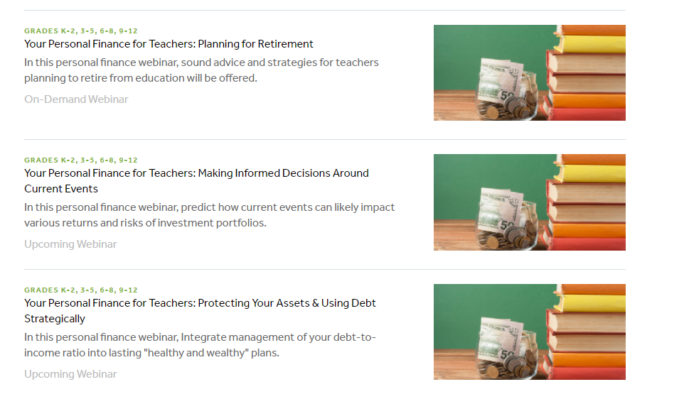
Nov 10

Slide 37
Once over, lightly
Established links to national and regional standards
Defined retirement for you, the teacher
Linked today’s spending and saving to future retirement
Explored strategies to meet retirement goals
Identified resources – we have two upcoming webinars
Committed to beginning today

Slide 38
Questions?

Slide 39
CEE Affiliates
https://www.councilforeconed.org/resources/local-affiliates/

Slide 40
Thank You to Our Sponsors!

