Slide 1
A.P. Macroeconomics:
Opportunity Cost
&
The Production Possibility Curve
Presented by
Kathleen Brennan
October 18, 2021 kbrennan@mountsaintmary.org

Slide 2
EconEdLink Membership
You can now access CEE’s professional development webinars directly on EconEdLink.org! To receive these new professional development benefits, become an EconEdLink member. As a member, you will now be able to:
Automatically receive a professional development certificate via e-mail within 24 hours after viewing any webinar for a minimum of 45 minutes
Register for upcoming webinars with a simple one-click process
Easily download presentations, lesson plan materials and activities for each webinar
Search and view all webinars at your convenience
Save webinars to your EconEdLink dashboard for easy access to the event
You may access our new Professional Development page here

Slide 3
Professional Development Certificate
To earn your professional development certificate for this webinar, you must:
Watch a minimum of 45-minutes and you will automatically receive a professional development certificate via e-mail within 24 hours.
Accessing resources:
You can now easily download presentations, lesson plan materials, and activities for each webinar from EconEdLink.org/professional-development/

Slide 4
AP Macro Topic 1.2
Opportunity Cost
Production Possibility Curve (PPC)

Slide 5
National Standards
Standard 2: Decision Making
  Effective decision making requires comparing the additional costs of alternatives with the additional benefits. Many choices involve doing a little more or a little less of something: few choices are “all or nothing” decisions.
Standard 3: Allocation
  Different methods can be used to allocate goods and services. People acting individually or collectively must choose which methods to use to allocate different kinds of goods and services.

Slide 6
AP Learning Objectives
Define (using graphs as appropriate) the PPC and related terms.
Explain (using graphs as appropriate) how the PPC illustrates opportunity costs, tradeoffs, inefficiency, efficiency, and economic growth or contraction under various conditions.
Calculate (using data from PPCs or tables as appropriate) opportunity cost.
Course Framework V.1 © 2019 College Board

Slide 7
AP Essential Knowledge
The PPC is a model used to show the tradeoffs associated with allocating resources.
The PPC can be used to illustrate the concepts of scarcity, opportunity cost, efficiency, underutilized resources, and economic growth or contraction.
The shape of the PPC depends on whether the opportunity costs are constant, increasing, or decreasing.
The PPC can shift because of changes in factors of production as well as changes in productive technology.
Economic growth results in an outward shift of the PPC.
Course Framework V.1 © 2019 College Board

Slide 8
Objectives
To define and discuss the concept of opportunity cost in individual choice and decision-making.
To calculate opportunity costs from data and/or graphs.
To become familiar with digital resources to reinforce learning and prepare for the AP Macroeconomics exam.
To share problem sets and activities that can be used to engage students.

Slide 9
What is Opportunity Cost?
One a resource or factor of production has been put to productive use an opportunity cost is incurred.
Opportunity cost is the next best alternative use for a resource.
No matter what we do with our time or resources, we always incur an opportunity cost.

Slide 10
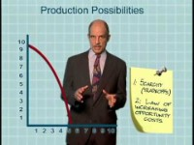
The Production Possibility Curve
Paul Solman

Slide 11
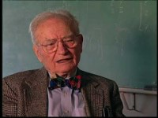
Opportunity Cost
Going to a Football Game
Paul Solman: Making Sense

Slide 12
TINSTAAFL!
There is no such thing as a free lunch!
Everything has a cost.

Slide 13
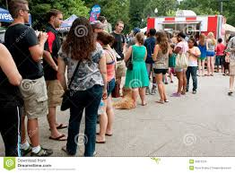
Question of the Day
How long should you be willing to stand in line for a “free” ice cream???

Slide 14

TANSTAAFL
(0:00- 0:45)
Marginal Revolution University

Slide 15
TINSTAAFL Illustrated:
The PPC
PPC- Production Possibilities Curve (or Frontier)
PPC is a graph showing all the possible combinations of output for an economy that is fully employing all of its resources in producing two goods.

Slide 16

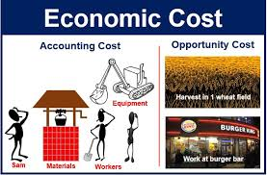
Quantifying Benefits and Costs
Benefits
Utility= the amount of satisfaction from an action or purchase
Costs
Explicit costs
Implicit costs

Slide 17
Costs
  Explicit Costs- monetary payment made to an outsider to acquire an item, service or activity
  Implicit Costs- the imputed costs of the next best alternative
  Total Costs = Explicit Costs + Implicit Costs
  Both explicit and implicit costs are considered opportunity costs.

Slide 18
Sunk Costs
A cost that has been incurred and cannot be reversed. A sunk costs exists regardless of whatever choice you make. Sunk costs ARE NOT opportunity costs.

Slide 19
The Opportunity Cost Principle
The true cost of something is the next best alternative you must give up to get it. Your decision should reflect all your opportunity costs, rather than just your out-of-pocket expenses.

Slide 20
Opportunity Cost
Discussion Question:
  What is one tradeoff you have made in the last 24 hours?
  What was the opportunity cost of an economic decision you made in the last week?

Slide 21
Opportunity Cost Examples
The opportunity cost of watching TV on a weeknight is the benefit you could have gotten from studying economics.
The opportunity cost of going to college is the income you could have earned getting a job out of high school.
The opportunity cost of starting your own business are the wages you give up by working at another company.
The opportunity cost of using forests to build houses is the enjoyment people get from having pristine forests.

Slide 22
The Opportunity Cost of Pursuing a College Education (per year)
If you go to College | If you decide to work full-time | Cost of College relative to working full-time
Tuition- $50,000 | You won’t pay tuition | $50,000 tuition
You don’t get a job | You earn $30,000 | $30,000 foregone income
Room and board- $20,000 | Rent and meals- $20,000 | No opportunity cost (You have to pay for housing and food regardless)
8 hours per day studying | 8 hours per day working | No opportunity cost
 |  | Total= $80,000 opportunity cost
You should only pursue a college education if the benefits exceed the total opportunity costs of $320,000 (4 years of college).

Slide 23
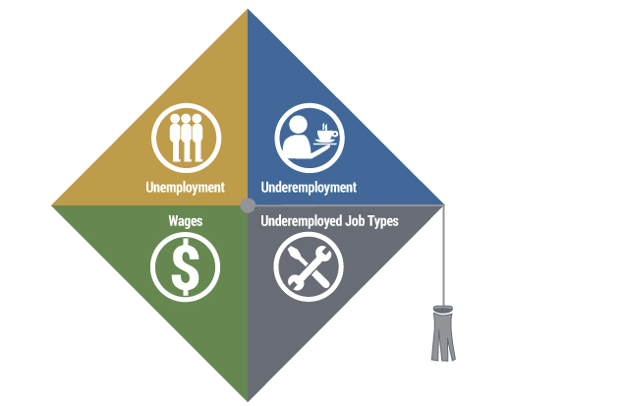
The Labor Market for Recent College Graduates

Slide 24
The Production Possibilities Curve
Illustrates the possible combinations of goods or services that can be produced by a single nation, firm or individual
Shows: scarcity, tradeoffs, opportunity cost, economic growth, efficiency, unemployment

Slide 25
Assumptions
Full-employment of its productive resources
Resources are fixed
Only two goods are produced
The economy is closed; does not trade with other countries
Technology is fixed

Slide 26
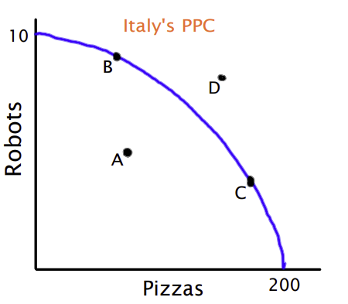
Production Possibility Curve

Slide 27
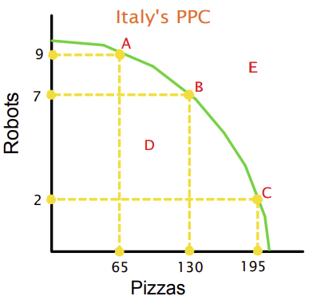
Production Possibility Curve
Which points are attainable? A, B, C, D
Which points are not desirable? D
Which points are unattainable? E
Why is the PPC concave? Increasing OC
Which point is likely to lead to growth? A
How does the PPC illustrate:
  Scarcity
  Tradeoffs
  Opportunity costs

Slide 28
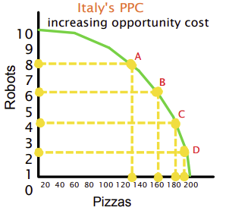
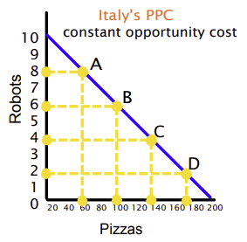
Constant vs.
Increasing Opportunity Costs
CONCAVE
LINEAR

Slide 29
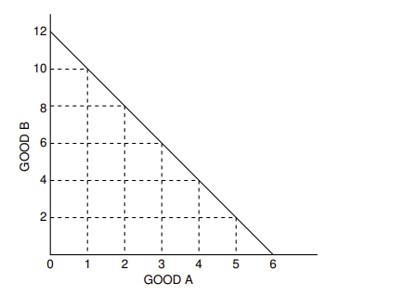
Constant Opportunity Cost
What is the opportunity cost of moving from:
a to b? 2 units of Good B
b to c? 2 units of Good B
c to d? 2 units of Good B
d to e? 2 units of Good B
e to f? 2 units of Good B
f to g? 2 units of Good B
a b c d e f g
Good B | 12 | 10 | 8 | 6 | 4 | 2 | 0
Good A | 0 | 1 | 2 | 3 | 4 | 5 | 6

Slide 30
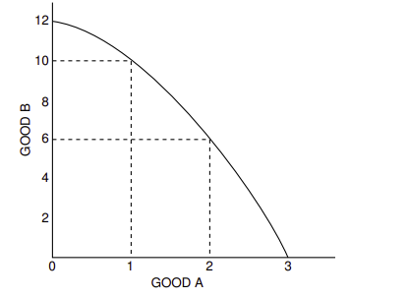
Increasing Opportunity Cost
What is the opportunity cost of moving from:
a to b? 2 units of Good B
b to c? 4 units of Good B
c to d? 6 units of Good B
a b c d
Good B | 12 | 10 | 6 | 0
Good A | 0 | 1 | 2 | 3

Slide 31
PPC Shifters
Change in quantity of resources
Changes in quality of resources
Change in technology
Change in trade

Slide 32
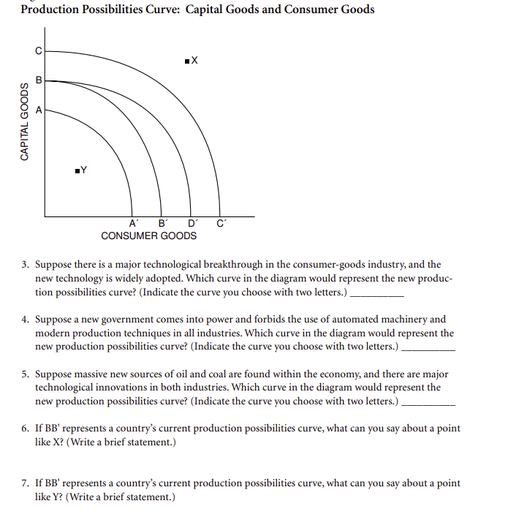
Morton: Advanced Placement Macroeconomics

Slide 33
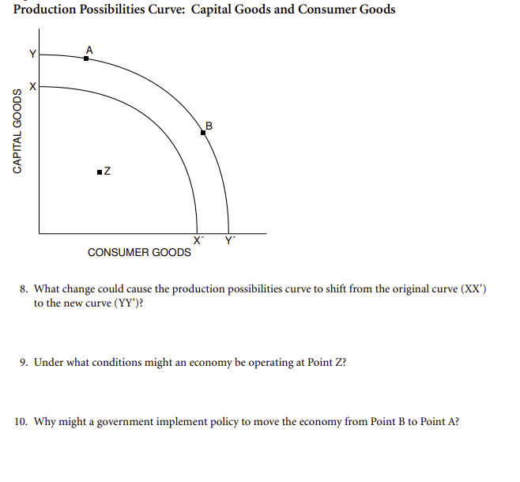
Morton: Advanced Placement Macroeconomics

Slide 34

Opportunity Cost Kahoot

Slide 35
Assessment Questions
CEE Opportunity Cost Resources
https://create.kahoot.it/share/opportunity-cost-kb/203869e2-27b0-49c2-9d42-693cf266b6f6

Slide 36

CEE Affiliates
https://www.councilforeconed.org/resources/local-affiliates/

Slide 37




Thank You to Our Sponsors!

