Slide 1
Marvelous World of Economics: Using the MCU to Teach Economics
John Kruggel
Associate Director for Program JMU Center for Economic Education 11/16/21 kruggejb@jmu.edu

Slide 2
EconEdLink Membership
You can now access CEE’s professional development webinars directly on EconEdLink.org! To receive these new professional development benefits, become an EconEdLink member. As a member, you will now be able to:
Automatically receive a professional development certificate via e-mail within 24 hours after viewing any webinar for a minimum of 45 minutes
Register for upcoming webinars with a simple one-click process
Easily download presentations, lesson plan materials and activities for each webinar
Search and view all webinars at your convenience
Save webinars to your EconEdLink dashboard for easy access to the event
You may access our new Professional Development page here

Slide 3
Professional Development Certificate
To earn your professional development certificate for this webinar, you must:
Watch a minimum of 45-minutes and you will automatically receive a professional development certificate via e-mail within 24 hours.
Accessing resources:
You can now easily download presentations, lesson plan materials, and activities for each webinar from EconEdLink.org/professional-development/

Slide 4
Agenda
15 mins: Imitation or Theft? Copyrights and Trademarks
10 mins: Decision making with the Hulk
10 mins: Thanos and Malthus
15 mins: Prisoner’s Dilemma with Loki
5 mins: Q&A

Slide 5
Origin Stories
Origin stories are crucial to the popularity of superheroes.
What would Spider-Man be without his guilt over his Uncle Ben’s death?
What would Magneto be without the persecution he faced under the Nazis?

Slide 6
Origin Stories
TV Tropes broke down most origin stories into basic categories here a few they listed:
Lucky Accident: Spider-Man, Daredevil, etc.
Lab accident or chemical spill that gives someone super powers.
The Chosen One: Dr. Strange, Ghost Rider, etc.
Powers given to someone by a powerful being, ancient alien race, etc.
Non-Human Hero: Thor, Rocket Raccoon
They’re superhuman because they’re NOT human.
My Own Creation: Iron Man, Hank Pym
Scientist, etc. makes cool stuff or invents something that gives them powers
Augmentation/evolution: Captain America, X-Men
Sometimes they’re just born with super powers, or they are experimented on.

Slide 7
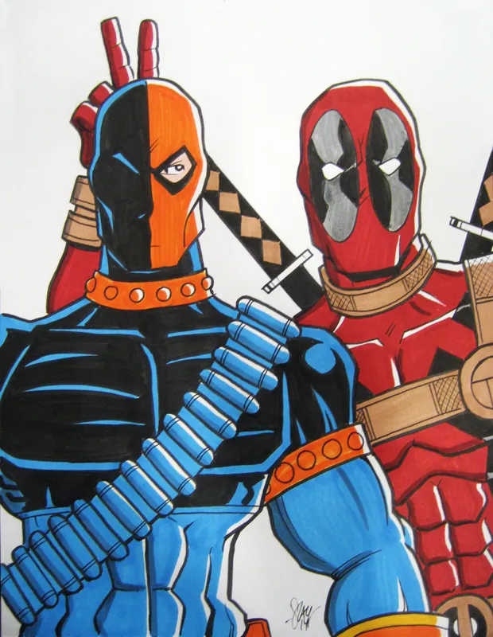
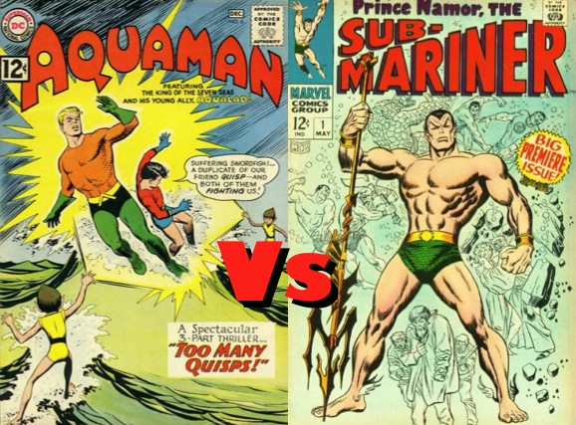
Imitation or Theft?
Creativity is hard! Origin stories are important, but even more so is the look of a superhero AND their powers.
What happens when writers and artists run out of ideas?

Slide 8
Oligopolies
So, why copy ideas? Why not compete by lowering prices?
It’s important to understand that comic book companies would most likely be considered an oligopoly.
Specifically, they might be a duopoly:
Duopolies exist when 2 companies (DC and Marvel) own all (or nearly all) of the market for a given service or product.
Duopolies are a form of an oligopoly.

Slide 9
Interdependence
Oligopolies try to avoid price competition because they are interdependent, meaning the actions of one firm rely on the reactions of the other firms. Instead, oligopolies rely on non-price competition.
Example: When Honda installed a vacuum in the Odyssey (2014), Chrysler followed suit by adding a (name-brand) vacuum in the Pacifica (2017).
What might happen If Chrysler had lowered their prices to outsell Honda?

Slide 10
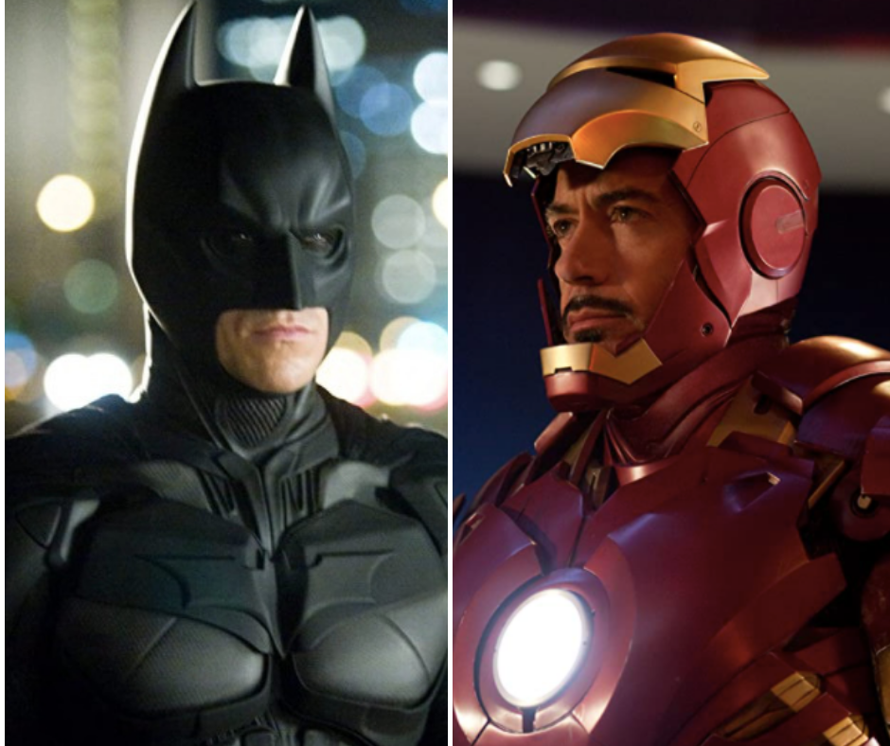
Batman or Iron Man?
Both Iron Man and Batman are considered genius playboy philanthropists who gain superpowers from their suits and gadgets.
Batman first appeared in May of 1939.
Iron Man’s first comic was in March of 1963.

Slide 11
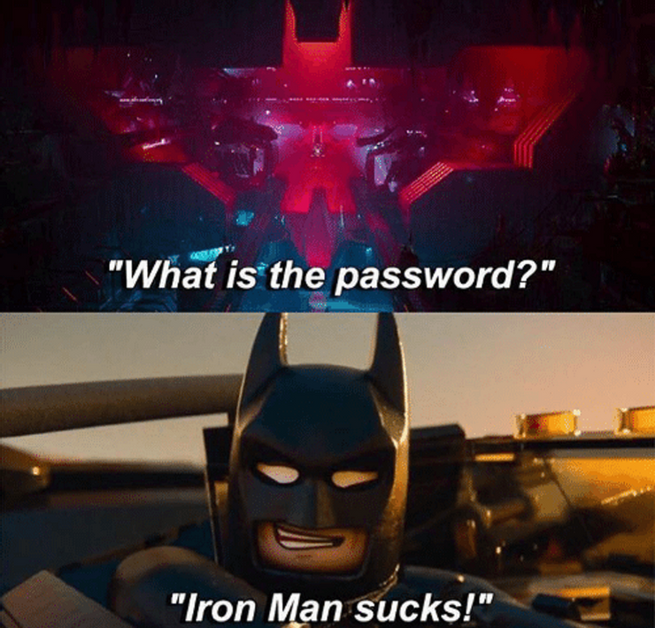

Slide 12
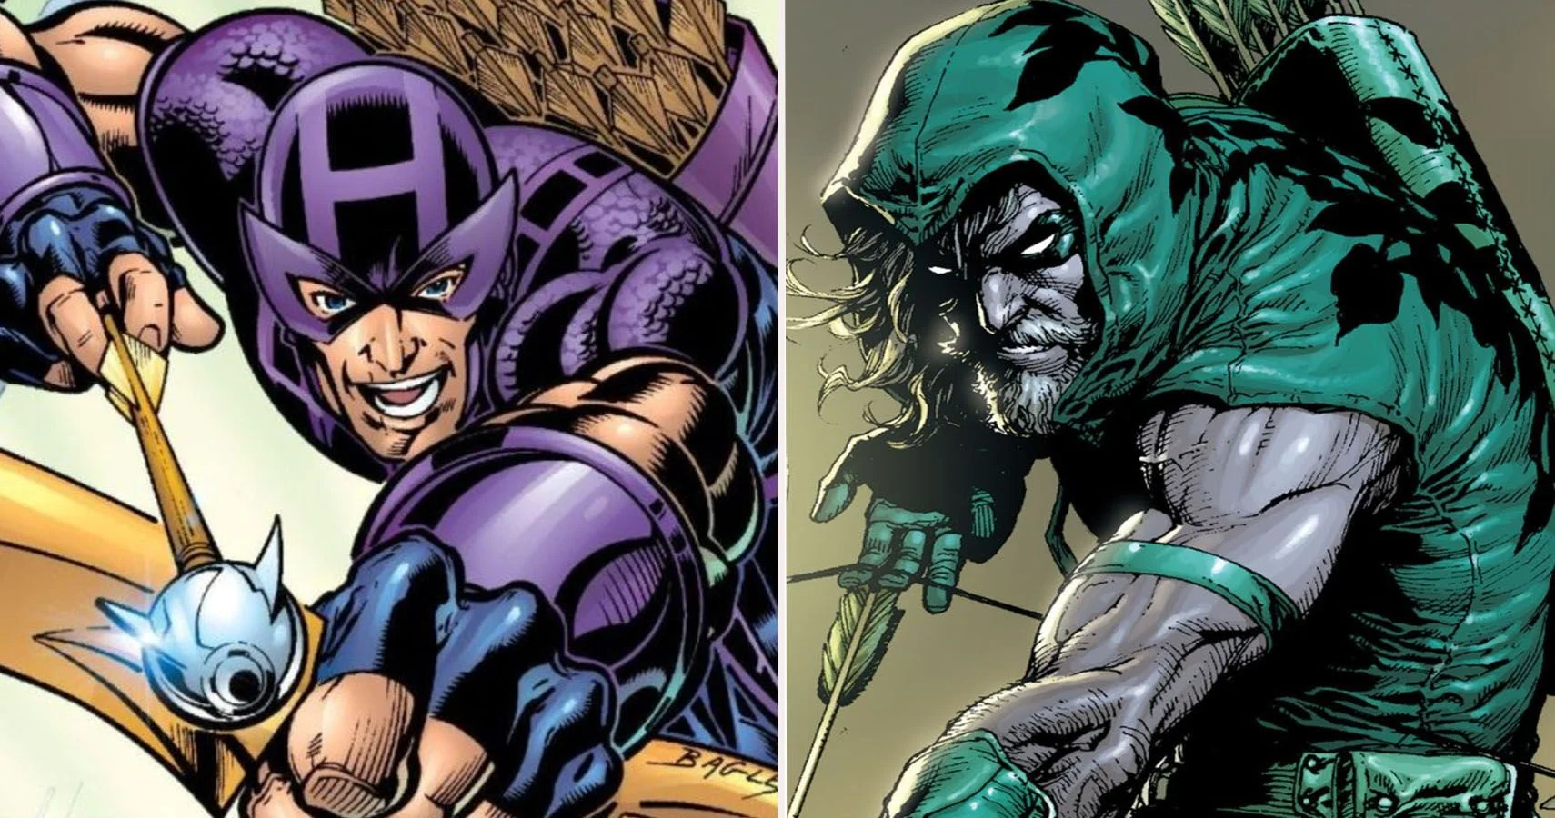
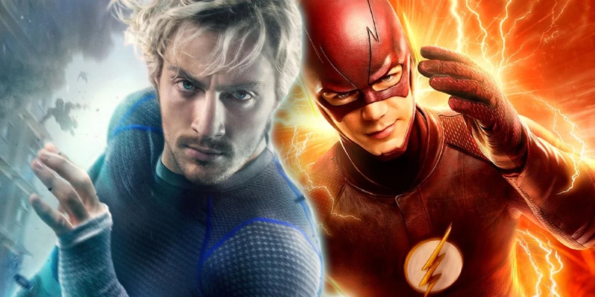
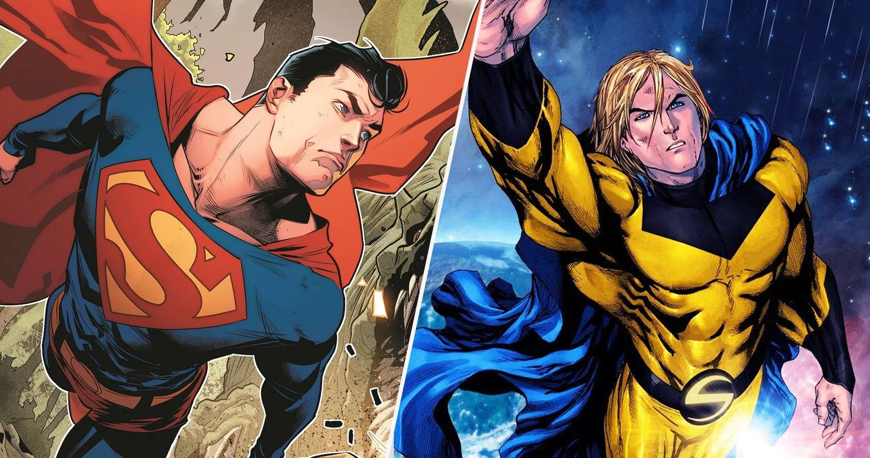
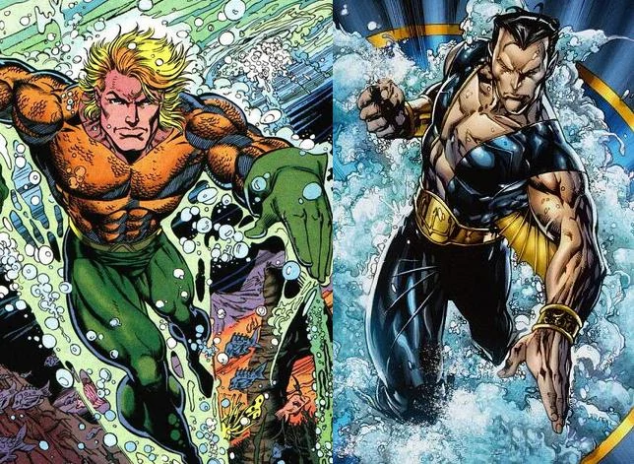
Honored Tradition?
Green Arrow (DC) 1941 vs. Hawkeye (Marvel) 1983
Quicksilver (Marvel) 1964 vs. Flash (DC) 1940
Superman (DC) 1938 vs.
Sentry (Marvel) 2000
Aquaman (DC) 1941 vs. Namor (Marvel) 1939

Slide 13
What About Copyrights?
According to the U.S. Copyright Office:
A drawing, picture, depiction, or written description of a character can be registered for copyright.
Protection does not, however, extend to the title or general theme for a cartoon, or comic strip, the general idea or name for characters depicted, or their intangible attributes.
So, does Marvel’s Sentry violate DC’s copyright for Superman?
Or does Iron Man violate the copyright for Batman?

Slide 14
Another Pop Culture Example
Famous scene from Coming to America

Slide 15
Trademarks & Captain Marvel
A trademark is “...any word, name, symbol, or design, or any combination thereof, used in commerce to identify and distinguish the goods of one manufacturer or seller from those of another...”
Captain Marvel is an interesting case study on copyrights and trademarks with comic books.
BOTH Marvel and DC have a character named Captain Marvel.

Slide 16
Quick Rundown
In the 1940s/late 1930s, Fawcett Publications created Captain Marvel. The character was more popular than Superman, with a VERY similar backstory... reporter by day with super strength, super speed, etc.
DC comics sued Fawcett and won. Fawcett went out of business in the 1950s.
In the 1960s, Marvel Comics was created and trademarked the name “Captain Marvel,” DC comics later brought back Captain Marvel from Fawcett, but legally couldn’t name the comic Captain Marvel so instead named it after the word the boy used to transform...
Shazam! So, even though Shazam! technically predates Captain Marvel, they can never be called Captain Marvel due to trademark laws.

Slide 17
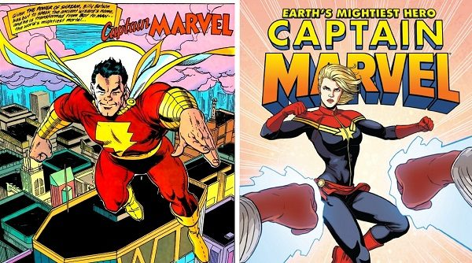

Slide 18
Complements & Substitutes
Complements are goods that are used together.
Hot dogs and hot dog buns are a good example, or hot dogs and mustard.
Substitutes are goods that can replace each other.
Coke and Pepsi are a good example, or butter and margarine.

Slide 19
Complements & Substitutes
Complements and substitutes do rely on consumer tastes and preferences in some cases.
Hot dogs and ketchup might be complementary goods for some, but will get you kicked out of some restaurants in Chicago

Slide 20
Check for Understanding Activity
Hand out cards with images of competing superheroes.
Have them identify which superhero is a complement to each and which is a substitute for each.

Slide 21
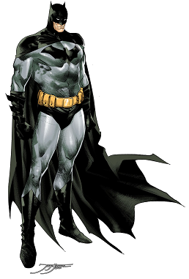
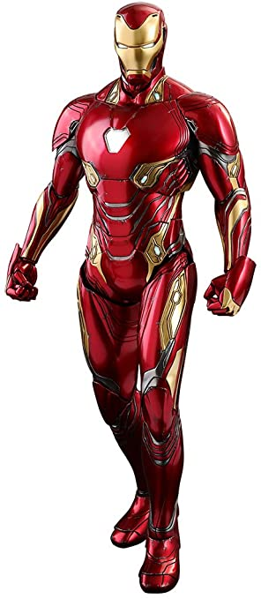
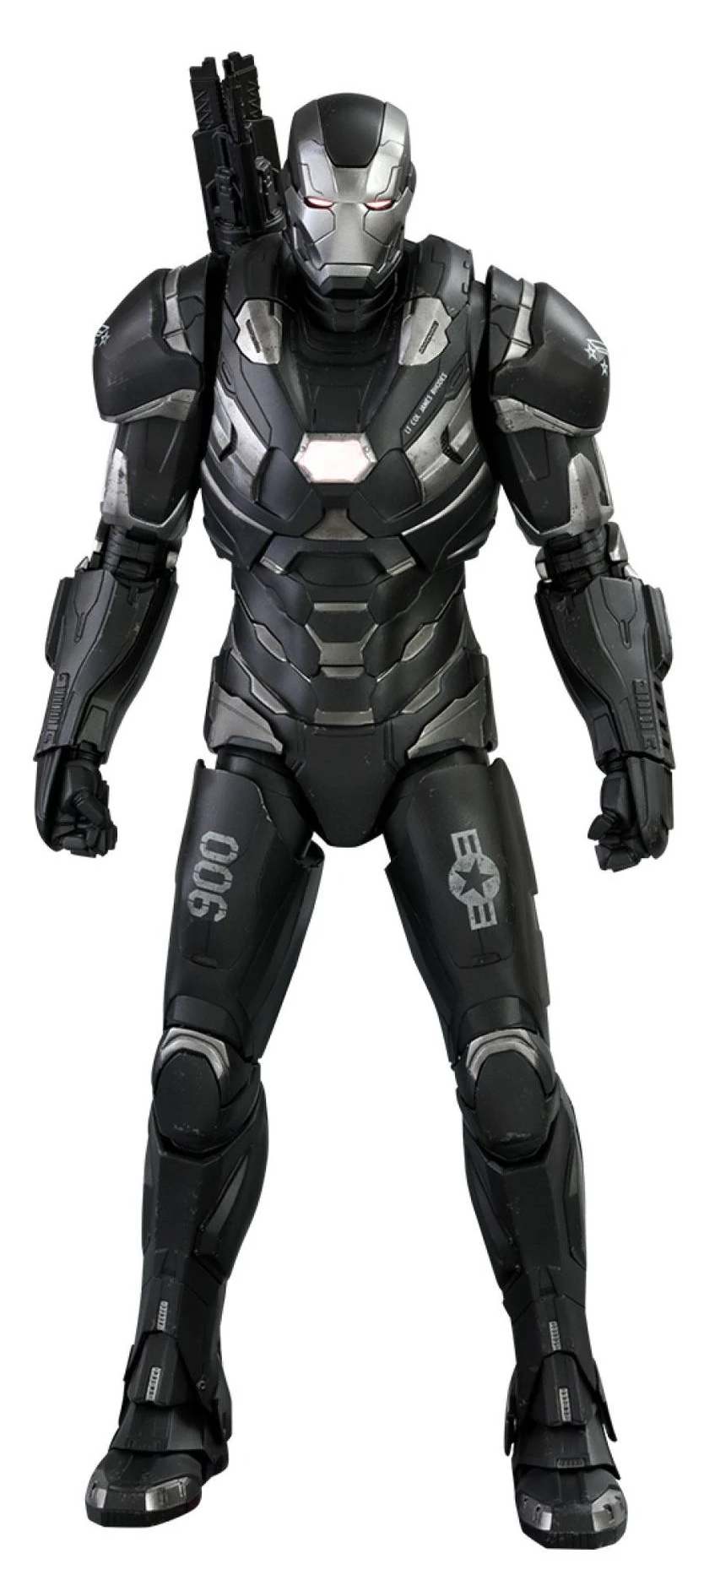
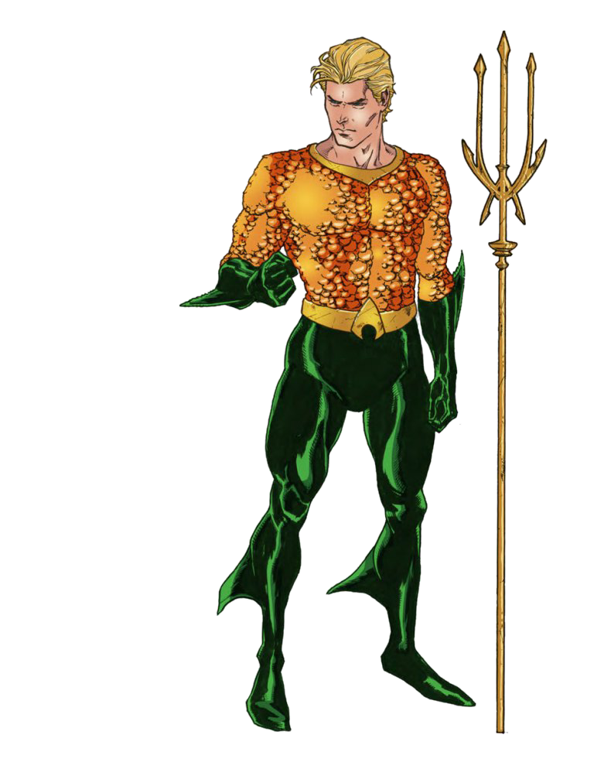
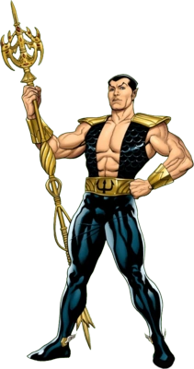
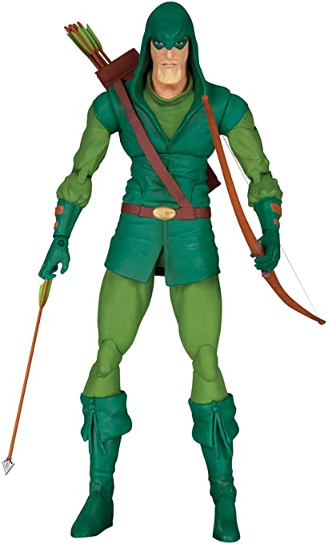

Slide 22
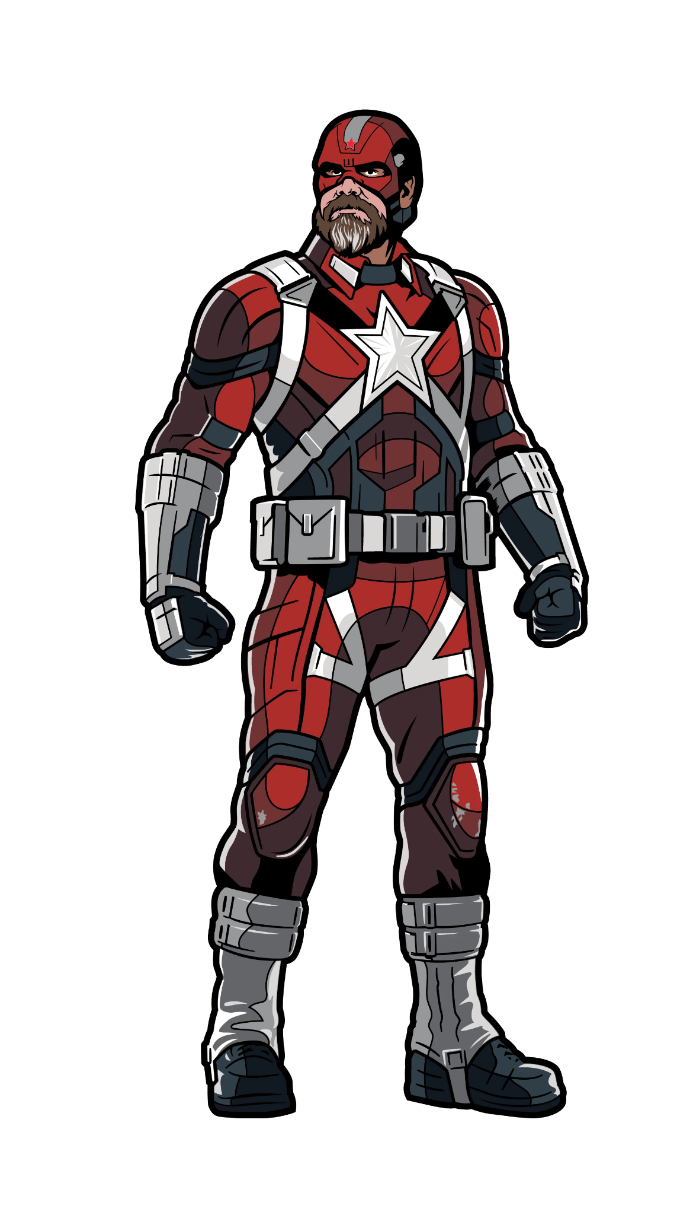
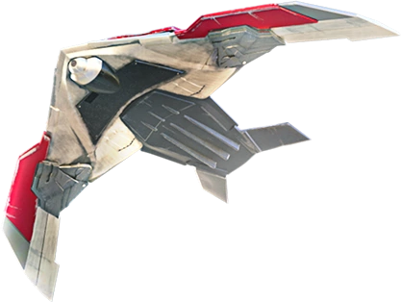
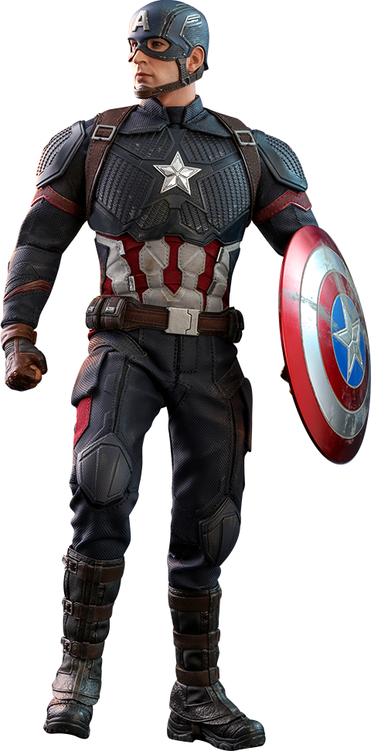
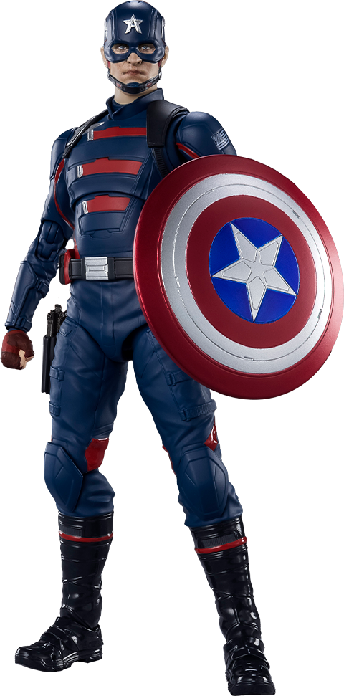
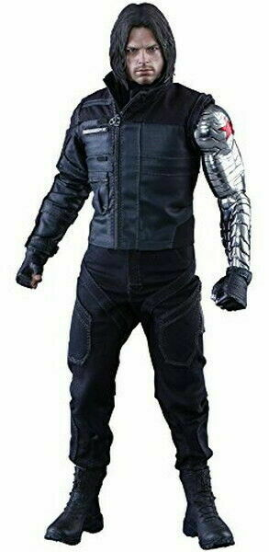
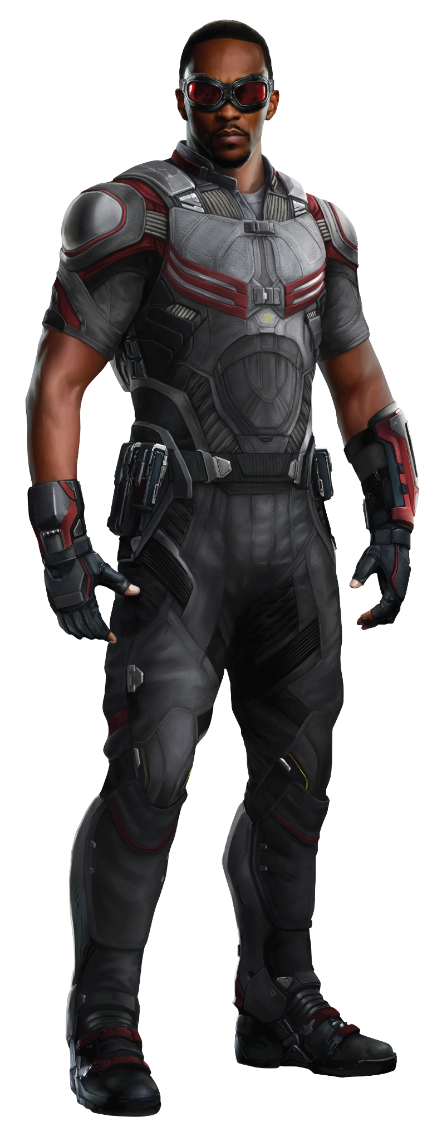

Slide 23
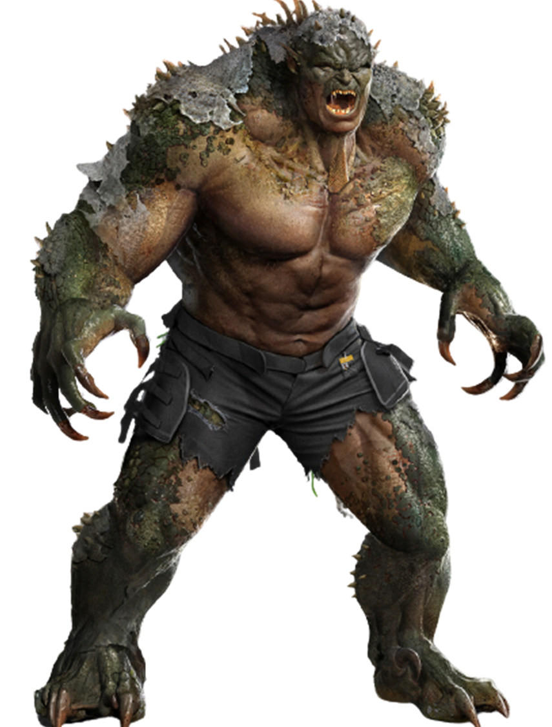
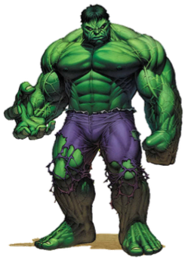
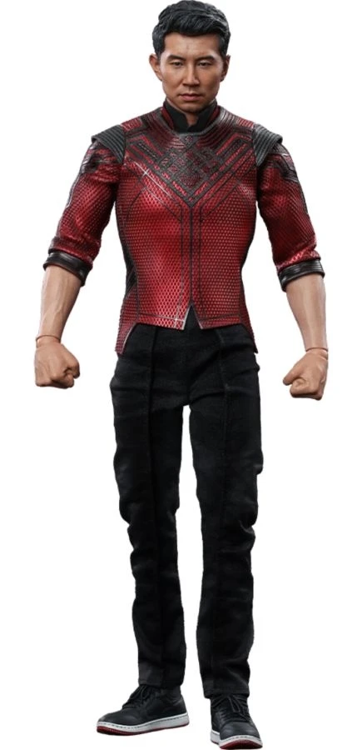
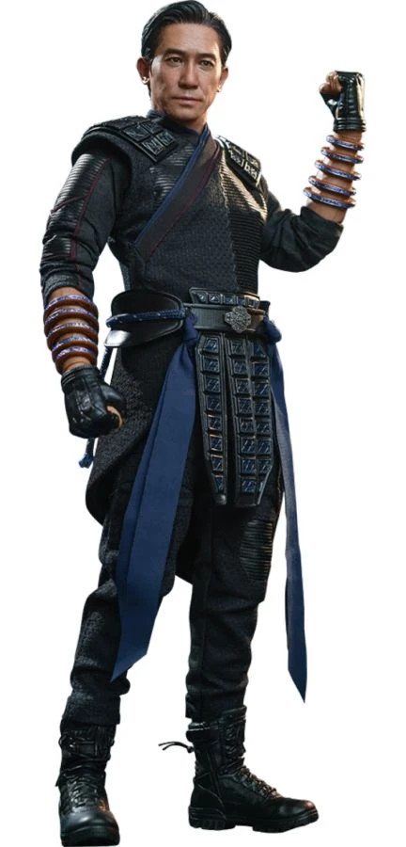
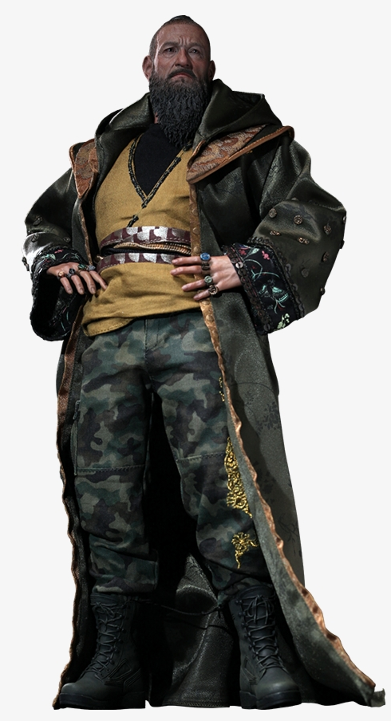

Slide 24
Other combos?
Which substitutes/complements would you include?
-Maybe focus on DC/Marvel copies?
-No X-Men!?!
-Defenders vs. Avengers?
Also, could you use these cards to discuss comparative advantage?
*Battle of New York is a GREAT opening for specialization based on comparative advantage.

Slide 25
Decision Making with Hulk

Slide 26
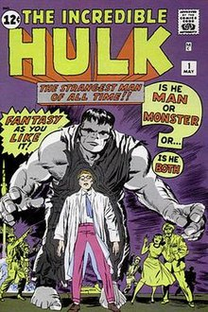
Bruce Banner Makes a Choice
Bruce Banner developed the first gamma bomb for the U.S. military. A teenager (Rick Jones) sneaks onto the bomb’s test site when it’s getting ready to detonate.
Banner rushes onto the test site and pushes the teen into a trench to protect him from the gamma bomb.
Banner is bombarded by gamma rays and the Hulk is born.

Slide 27
PACED Model
The PACED Model is a great tool for decision-making.
Identify a Problem
Brainstorm Alternatives to the problem
Use Criteria to judge the alternatives
Evaluate the solution
Decide

Slide 28
Banner’s Model
Problem: Should he risk his safety to help a teenager?
Alternatives:
Help, he probably couldn’t live with himself if he didn’t.
Don’t help, kid shouldn’t be snooping around, natural consequences.
Get someone else to help, it’s an army base surely someone else is closer/less valuable
Delay the gamma bomb test
Criteria: What should Dr. Banner consider with each alternative?
Evaluate:
Decide:

Slide 29
Extension Activity
Have students pick a superhero and create a problem they must face (or use one from a comic or movie).
Should Natasha Rominoff help her sister?
Should Wanda Maximoff destroy the Mind Stone?
Should Thanos destroy half of creation?
Should Gambit date Rogue?
Should Shang Chi fight his sister?
Have them create their own PACED Model based on that scenario.

Slide 30
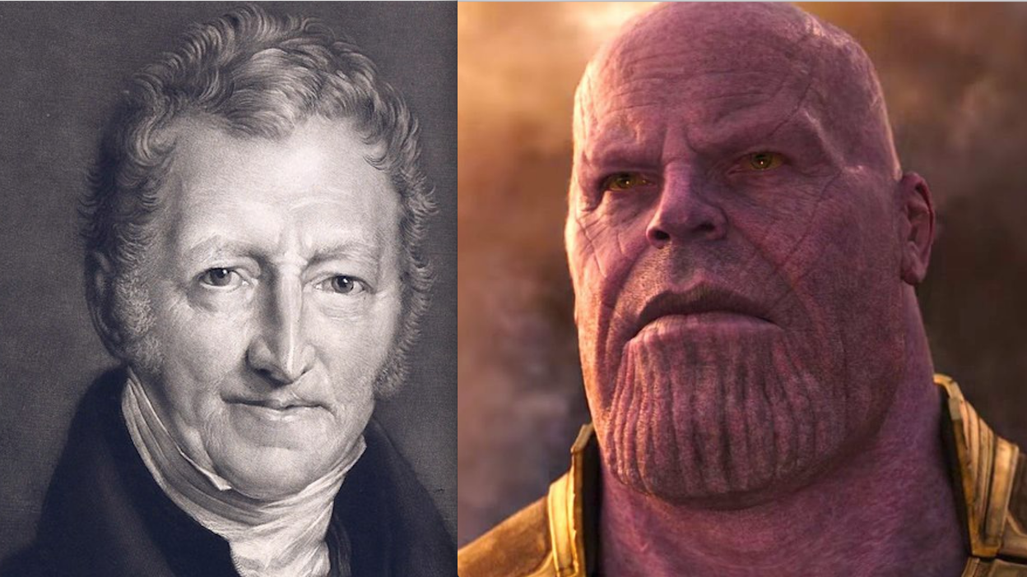
Thanos and Malthus

Slide 31
Thanos and Malthus
In the Infinity War saga, Thanos plans to destroy half the universe to preserve resources for the other half.
“The universe is finite, its resources finite, if life is left unchecked, life will cease to exist.”
This thought mirrors concerns first voiced by Thomas Malthus in the late 1700s. Malthus was concerned that population growth would outpace food production.
“The power of population is so superior to the power of the earth to produce subsistence for man, that premature death must in some shape or other visit the human race.”

Slide 32
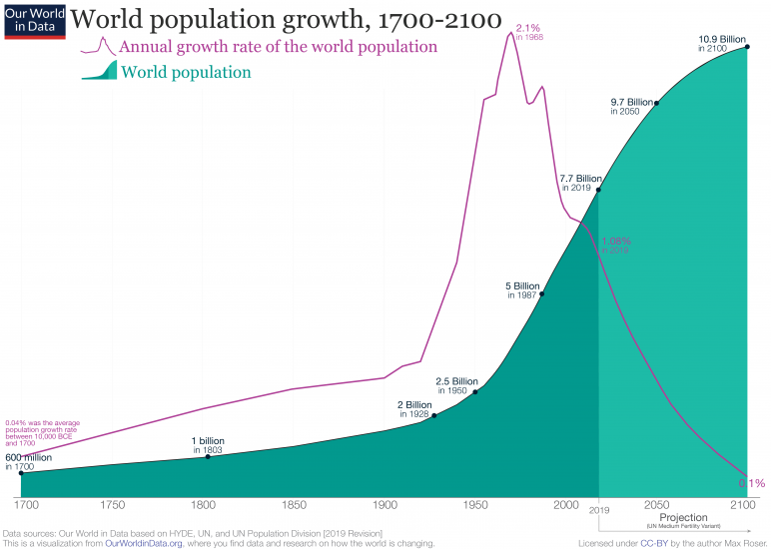
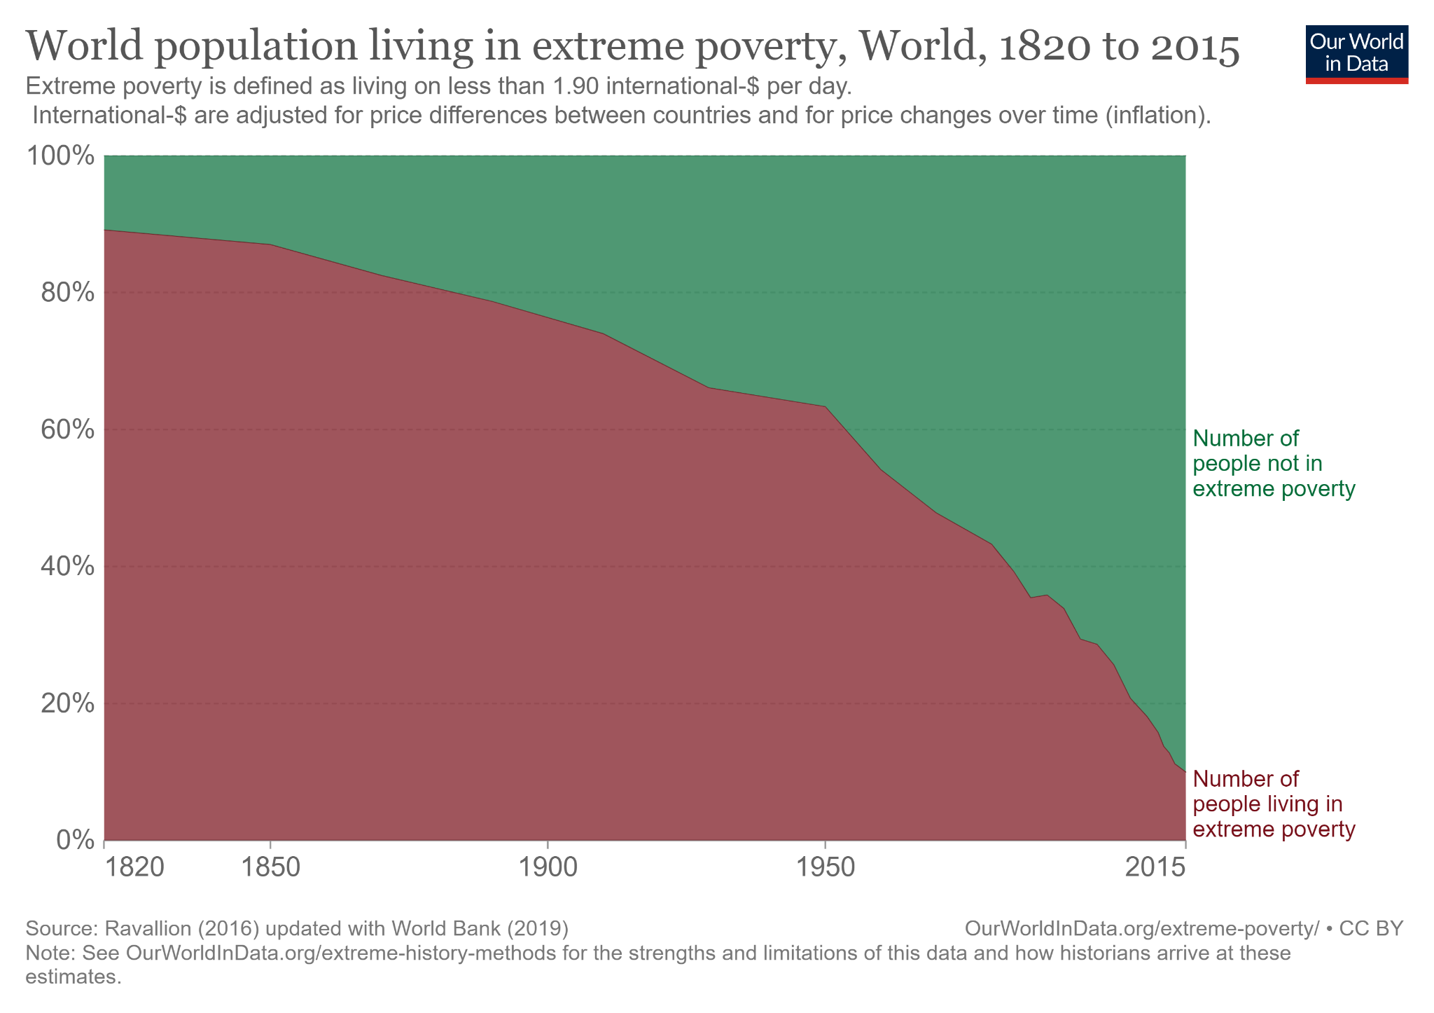
What Malthus, and Thanos, failed to take into account was innovation and technological advancements…
The Foundation for Economic Education posits an interesting idea, if Thanos had infinite power, why not just double the resources in the universe?

Slide 33
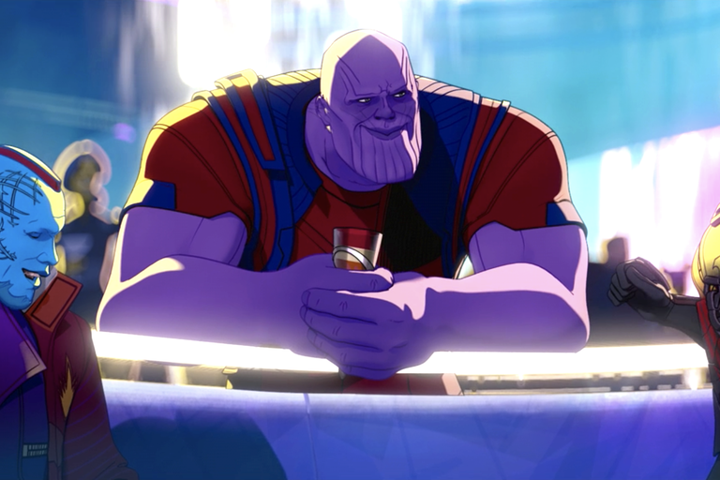
Thanos Reformed?
In Episode 2 of Marvel’s What If? A Thanos from a different timeline is revealed.
“I’m a big enough man to admit when I’m wrong...T’Challa here showed me there was more than one way to reallocate the universe’s resources.”

Slide 34
The Prisoner’s Dilemma and

Slide 35
Prisoner’s Dilemma with
Loki & Sylvie
In Episode 6 of season 1 of Loki, Loki and his variant Sylvie confront the “He Who Remains” variant of Kang the Conqueror.
Sylvie is determined to gain her freedom and take down the Time Variance Authority (TVA) and restore free will.
Loki’s motives are a little simpler. He wants to control the TVA (and the universe)

Slide 36
Options
Kang offers Loki and Sylvie a few options throughout the episode.
His servant, Miss Minutes, offers a new timeline for them where they would win the Battle of New York and defeat Thanos, thus ruling that universe.
Kang offers for them to take over for him and control the entire multiverse.
Kang says they can kill him and restore free will, but will start another war for control of the multiverse.

Slide 37
What Should They Do?
Ask students what they think Loki and Sylvie should do.
Should they take the timeline where they rule and live happily ever after?
Should they take over for Kang and rule the entire multiverse together?
Should they kill Kang and restore free will to the multiverse?

Slide 38
Strategies
Do either Loki or Sylvie (or Kang) have a dominant strategy?
In game theory, a dominant strategy exists if one player has a superior tactic regardless of how the other player(s) act.
Are there any extenuating circumstances that might impact either Loki or Sylvie’s decision?
Can Sylvie trust Loki (vice versa).
Should they believe/trust Kang?
Do either of them have the same goal?

Slide 39
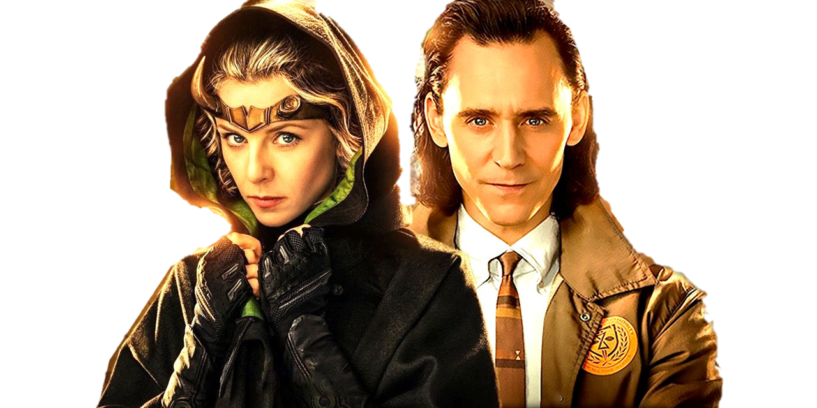
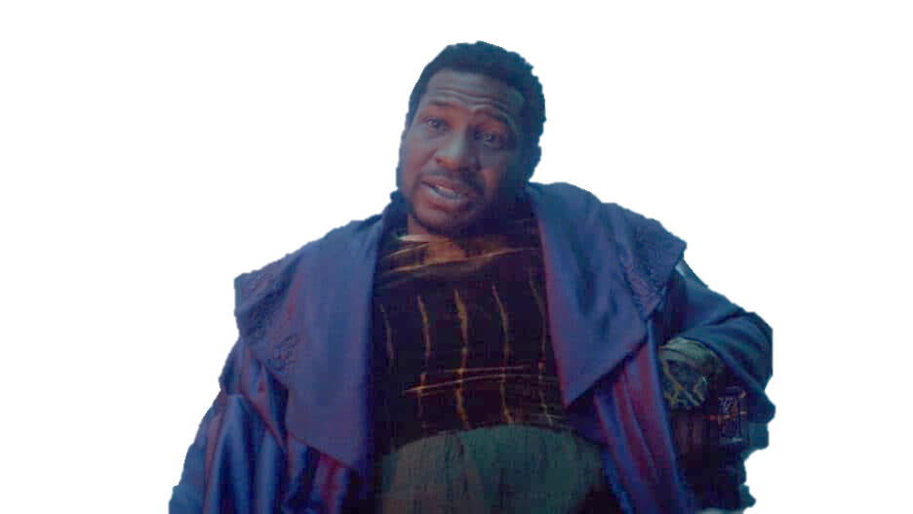
Let’s vote!
Option 1: Timeline offered by Miss Minutes where they live happily ever after ruling their universe.
Option 2: Take over the multiverse from Kang and rule together happily ever after.
Option 3: Kill Kang and restore free will to the multiverse while risking all out war.

Slide 40
More Game Theory with Superheroes
Games superheroes play: Teaching game theory with comic book favorites by Brian O’Roark and Bill Grant

Slide 41
Additional Resources
Super-Economics Man! Using Superheroes to Teach Economics by Brian O’Roark
Superheroes and Economics: The Shadowy World of Capes, Masks and Invisible Hands (Routledge Economics and Popular Culture Series) 1st Edition
Subsidies and the film industry: John Charles Bradbury, Kennesaw State University
Lessons from Black Panther, Bookings Institute

Slide 42
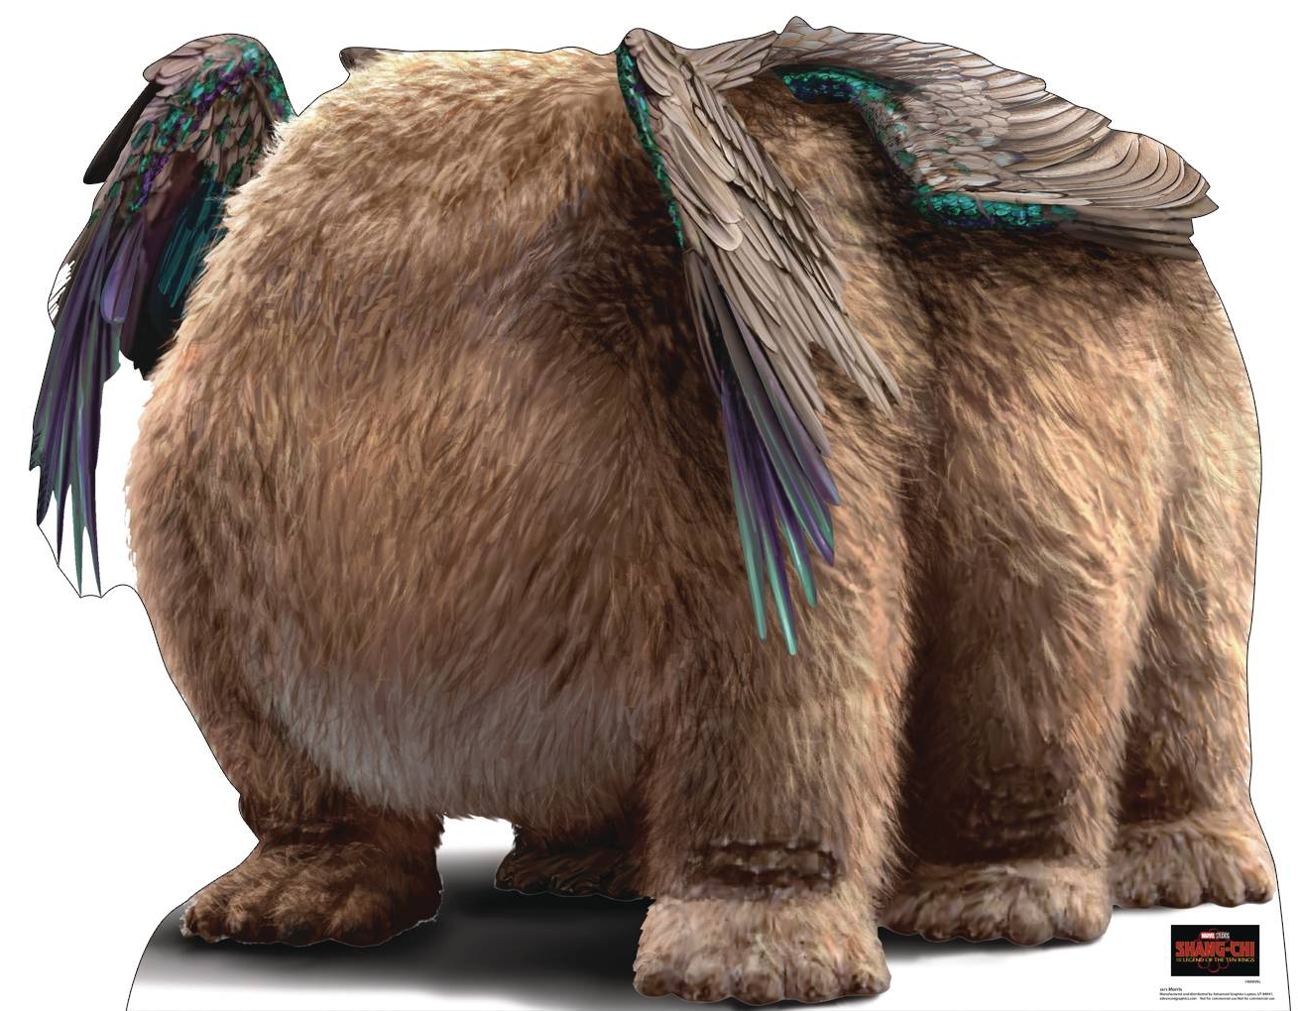
Questions?
Hopefully your MB of attending was ≥ your MC of attending

Slide 43
CEE Affiliates
https://www.councilforeconed.org/resources/local-affiliates/

Slide 44
Thank You to Our Sponsors!

