Slide 1
COVID 19 and the Economic Future of Cities: Deurbanization, Adaptation and Innovation Presented by Theodore Opderbeck 6/8/21 opderbeckt@waldwickschools.org

Slide 2
EconEdLink Membership
You can now access CEE’s professional development webinars directly on EconEdLink.org! To receive these new professional development benefits, become an EconEdLink member. As a member, you will now be able to:
Automatically receive a professional development certificate via e-mail within 24 hours after viewing any webinar for a minimum of 45 minutes
Register for upcoming webinars with a simple one-click process
Easily download presentations, lesson plan materials and activities for each webinar
Search and view all webinars at your convenience
Save webinars to your EconEdLink dashboard for easy access to the event
You may access our new Professional Development page here

Slide 3
Professional Development Certificate
To earn your professional development certificate for this webinar, you must:
Watch a minimum of 45-minutes and you will automatically receive a professional development certificate via e-mail within 24 hours.
Accessing resources:
You can now easily download presentations, lesson plan materials, and activities for each webinar from EconEdLink.org/professional-development/

Slide 4
Agenda
Discuss the economic impact of COVID 19 on American cities
Analyze future demographic and economic predictions pertaining to cities
Discuss innovative, entrepreneurial ideas as cities remake themselves in the wake of COVID 19
Examine creative lesson ideas for students to engage in the content
Explore digital formative assessment options

Slide 5
Objectives
To discuss the negative effects of COVID 19 on the economies of American cities
To examine short term and long term effects of the pandemic on population trends and economies of cities
To predict some future trends regarding innovation and entrepreneurship as cities remake themselves
To explore creative lesson plans and learning activities
To model formative assessment options to use in class

Slide 6
National Standards
Council for Econ Ed Standard 1: Scarcity
Council for Econ Ed Standard 2: Decision Making
Council for Econ Ed Standard 7: Markets and Prices
Council for Econ Ed Standard 15: Economic Growth
https://www.councilforeconed.org/wp-content/uploads/2012/03/voluntary-national-content-standards-2010.pdf

Slide 7
State Standards
12. E2 INDIVIDUALS AND BUSINESSES IN THE PRODUCT AND FACTOR MARKETS: Free enterprise is a pillar of the United States economy and is based on the principle that individuals and businesses are free to make their own economic choices as they participate in these markets. Individuals buy the goods and services that they desire from businesses in the product markets, and they contribute to producing these goods and services by supplying the resources that they own to businesses in the factor markets.
http://www.nysed.gov/common/nysed/files/programs/curriculum-instruction/ss-framework-9-12.pdf

Slide 8
Economics and Cross Curricular Applications
Science/ Technology
Public Policy
Entrepreneurship
Political Studies
Geography
Scarcity and Opportunity Cost
Supply and Demand
Resource Allocation Models
Fiscal Policy

Slide 9
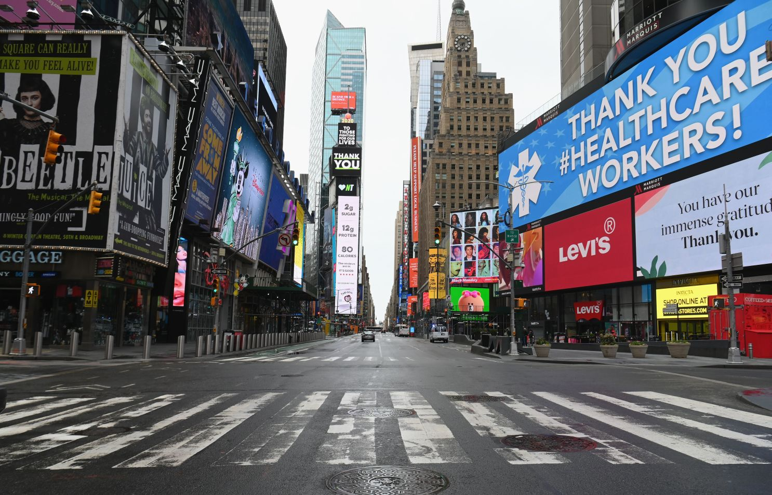
Vladimir Lenin: “There are decades where nothing happens; and there are weeks when decades happen”

Slide 10
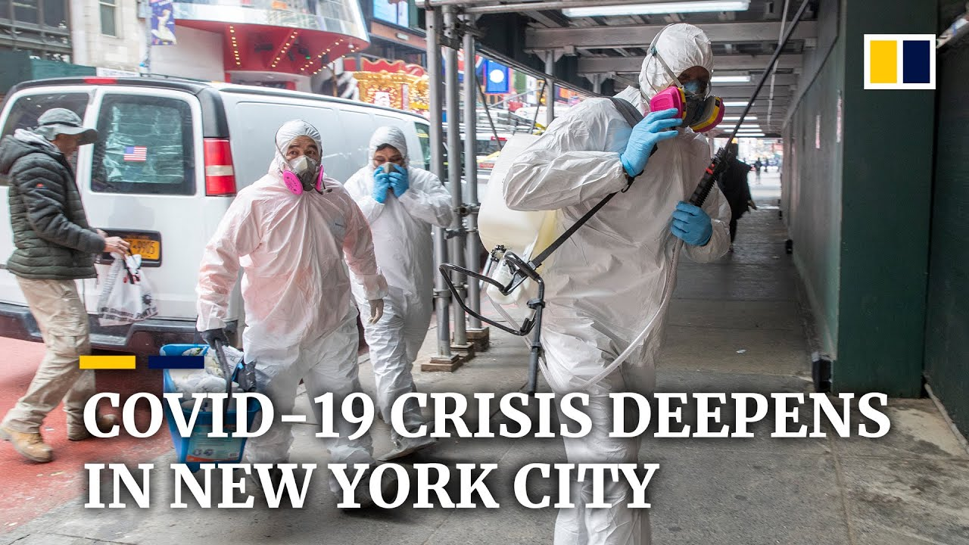
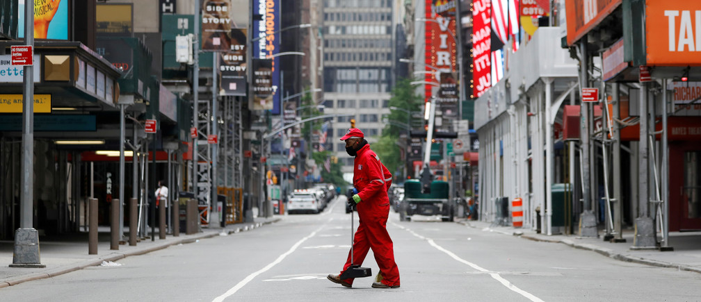
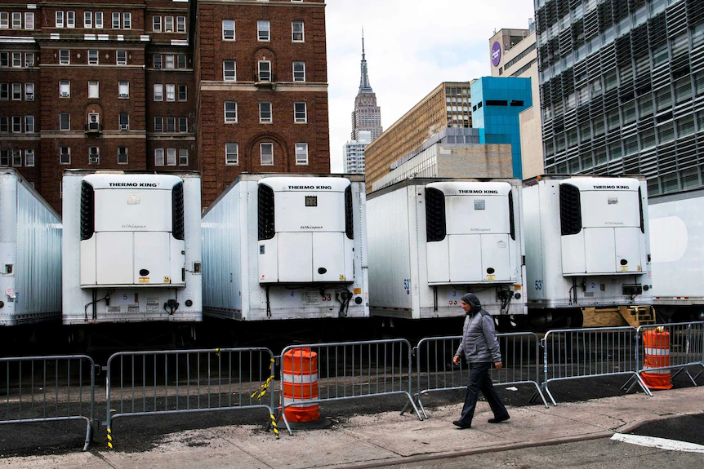
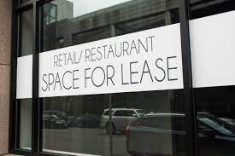
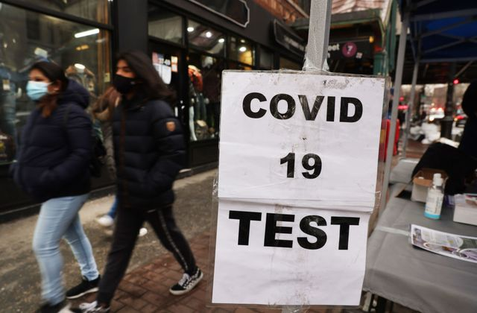

Slide 11
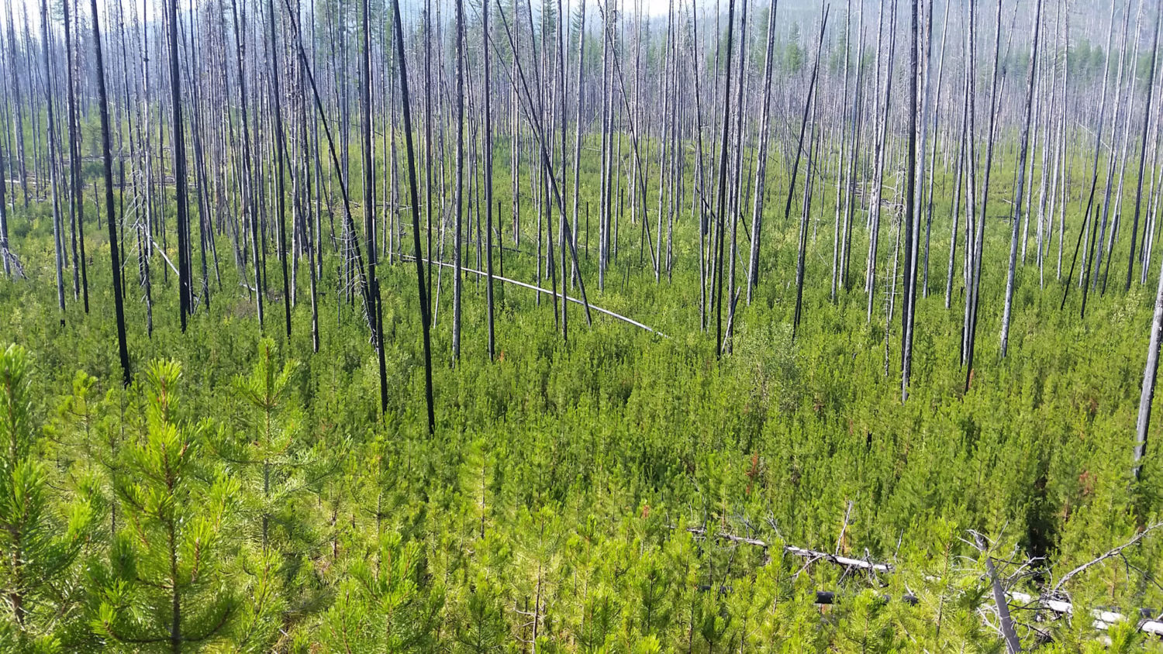
Derek Thompson, “The Atlantic”:
“The coming urban reset [can be compared] to the effects of a forest fire that rages through the underbrush leaving what looks to be death and ruin, but eventually as new light streams in, sets in motion a renewed cycle of growth.”

Slide 12
Some Generalizations ...
COVID exacerbated economic and social trends that were already in play. COVID - “The Great Accelerator”
Cities have been affected asymmetrically, specifically in regards to geography and size
There is much uncertainty as to the speed and extent of the economic recovery in cities (“V” shaped vs. “K” shaped; forces of supply and demand”; “pent up demand”)

Slide 13
Pre-Covid Urban Population Trends
Globally: large scale urbanization
U.S.: early 2010’s (post Great Recession) - increase in “large city” population; later 2010’s - flattening and decrease in large city population
Later 2010’s: rise of smaller southern and western urban centers.
Immigration to major cities slowed in late 2010’s

Slide 14
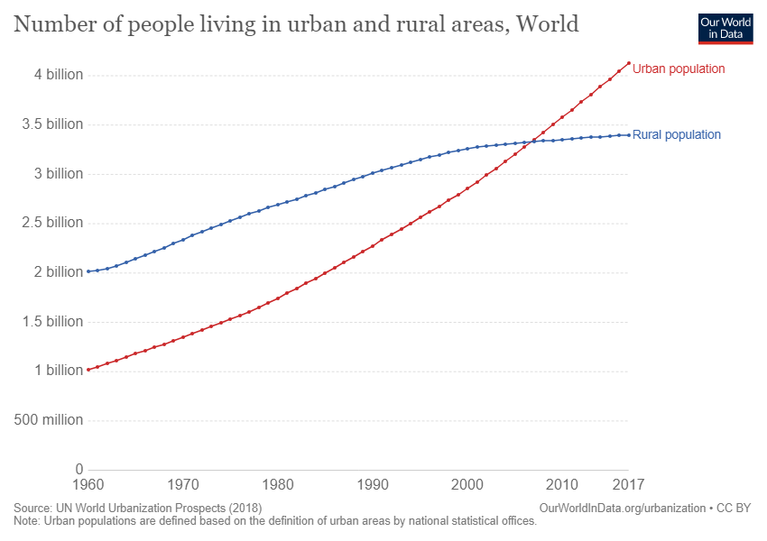
Global urban population growth is increasing rapidly …

Slide 15
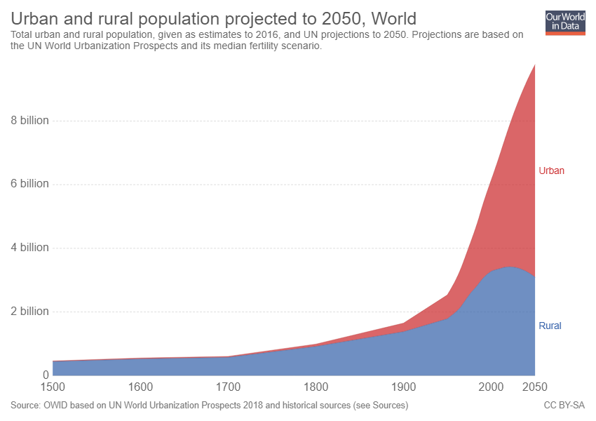

Slide 16
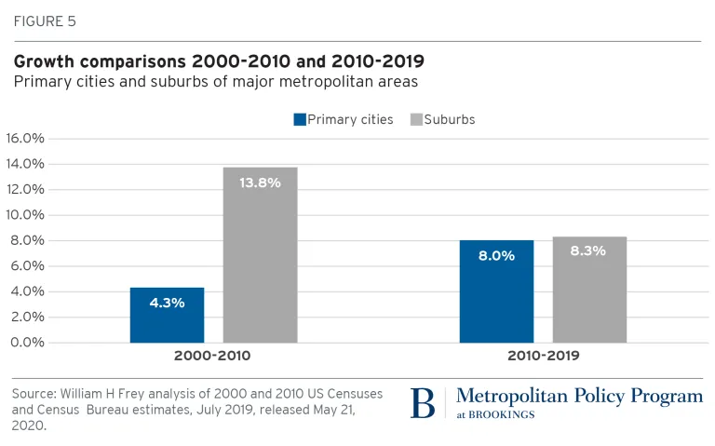
Population growth in major U.S. cities increased in the 2010’s …

Slide 17
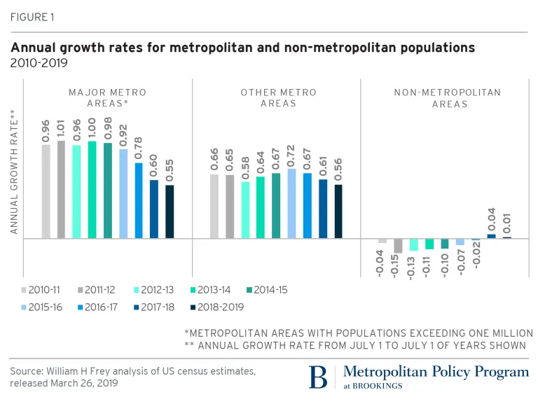
But slowed in the late 2010’s ...

Slide 18
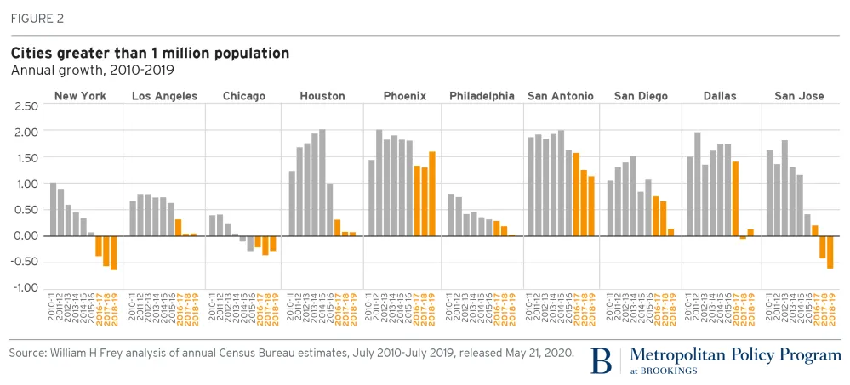
While growth in the biggest cities flattened or diminished, other cities grew in terms of population …

Slide 19
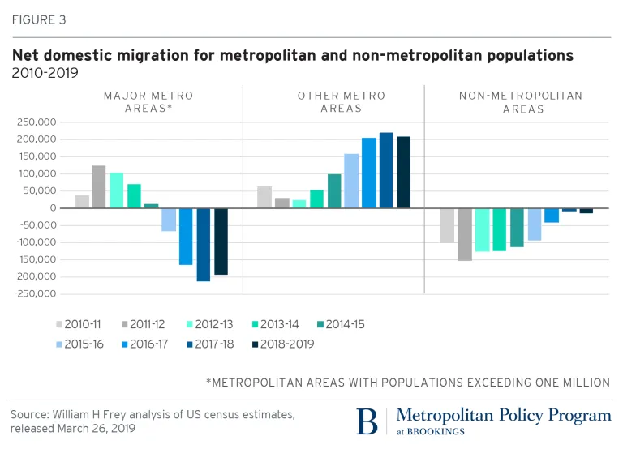

Slide 21
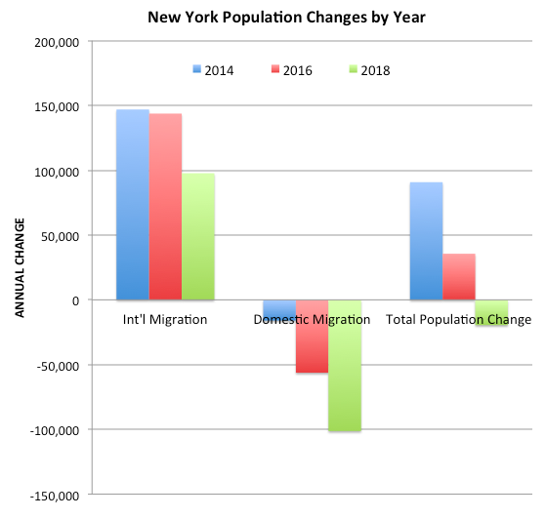

Slide 22
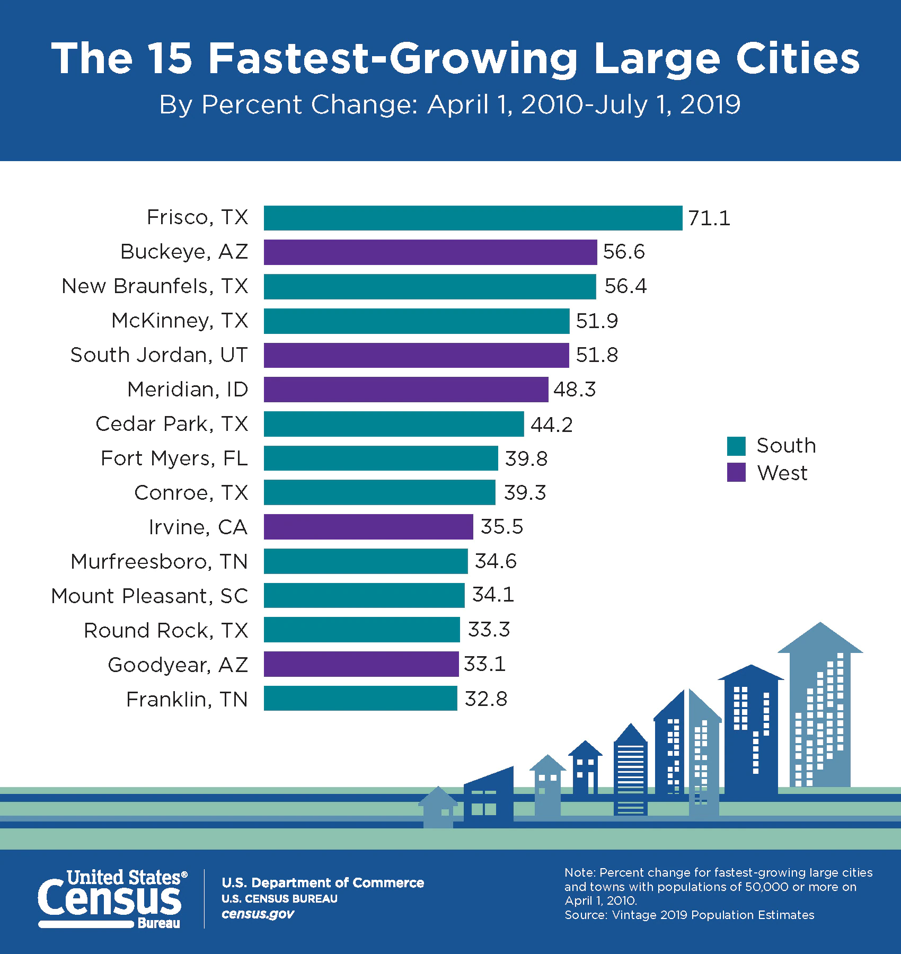

Slide 23
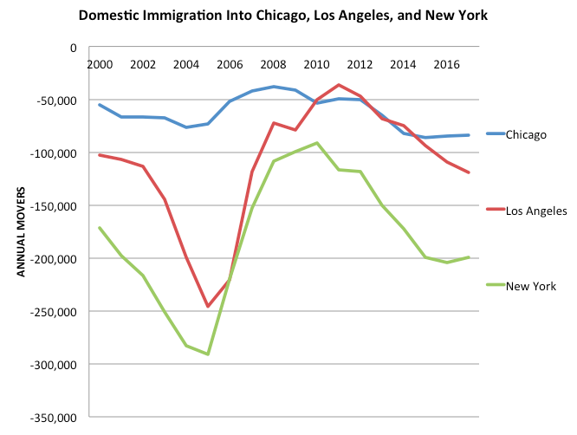
Domestic immigration into major cities declined …

Slide 24
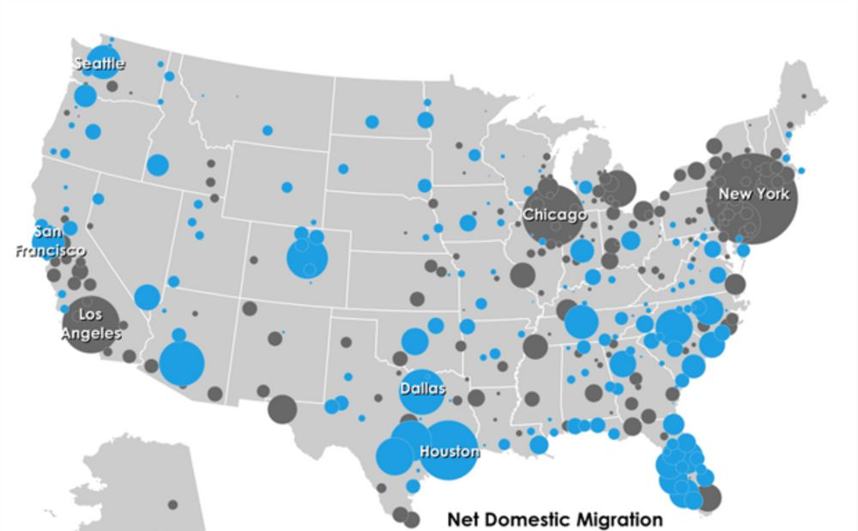

Slide 25
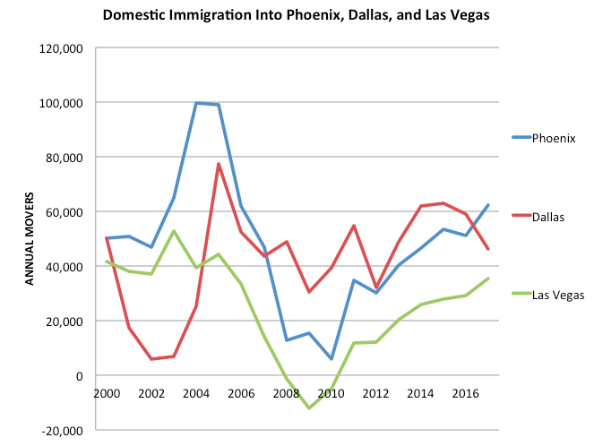
Some cities experienced increased domestic immigration

Slide 26
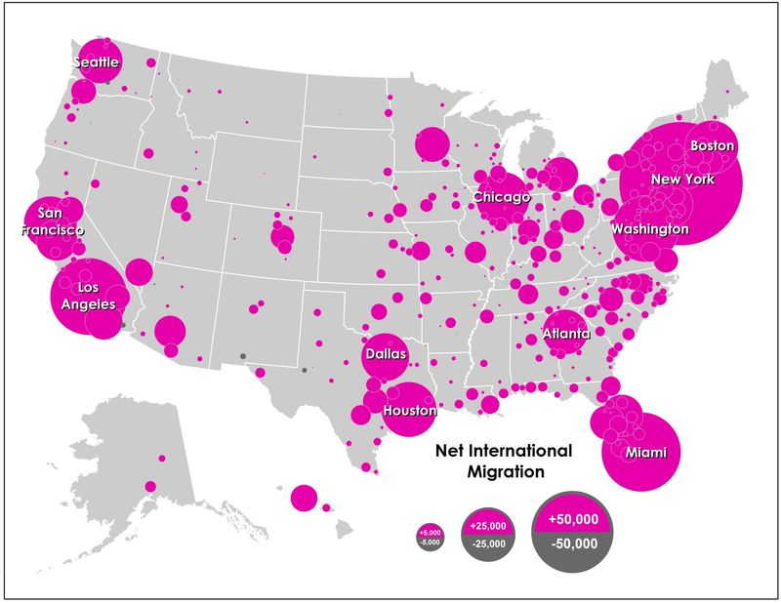
International Immigration to Major Cities Accelerated ...

Slide 27
Factors Affecting Pre-Covid Urbanization Trends
Rising demand for housing in early 2010’s caused rapid increase in urban real estate prices
Middle/lower income families were pushed out of overly expensive large cities
Demographics
Millennial families approaching their 30’s moving out of large cities in favor of smaller cities and suburbs
Baby boomers retiring to more affordable locations
More restrictive immigration policies post 2016
Decimation of retail due to technological changes

Slide 28
COVID 19 and Immediate Shocks to Cities
Epicenters of Covid cases - strain on resources, finances, human capital
Massive shutdowns - retail, offices, restaurants, entertainment, transit
Increased unemployment/ remote work
Some migration out of cities: commercial and residential
Commercial real estate vacancies

Slide 29
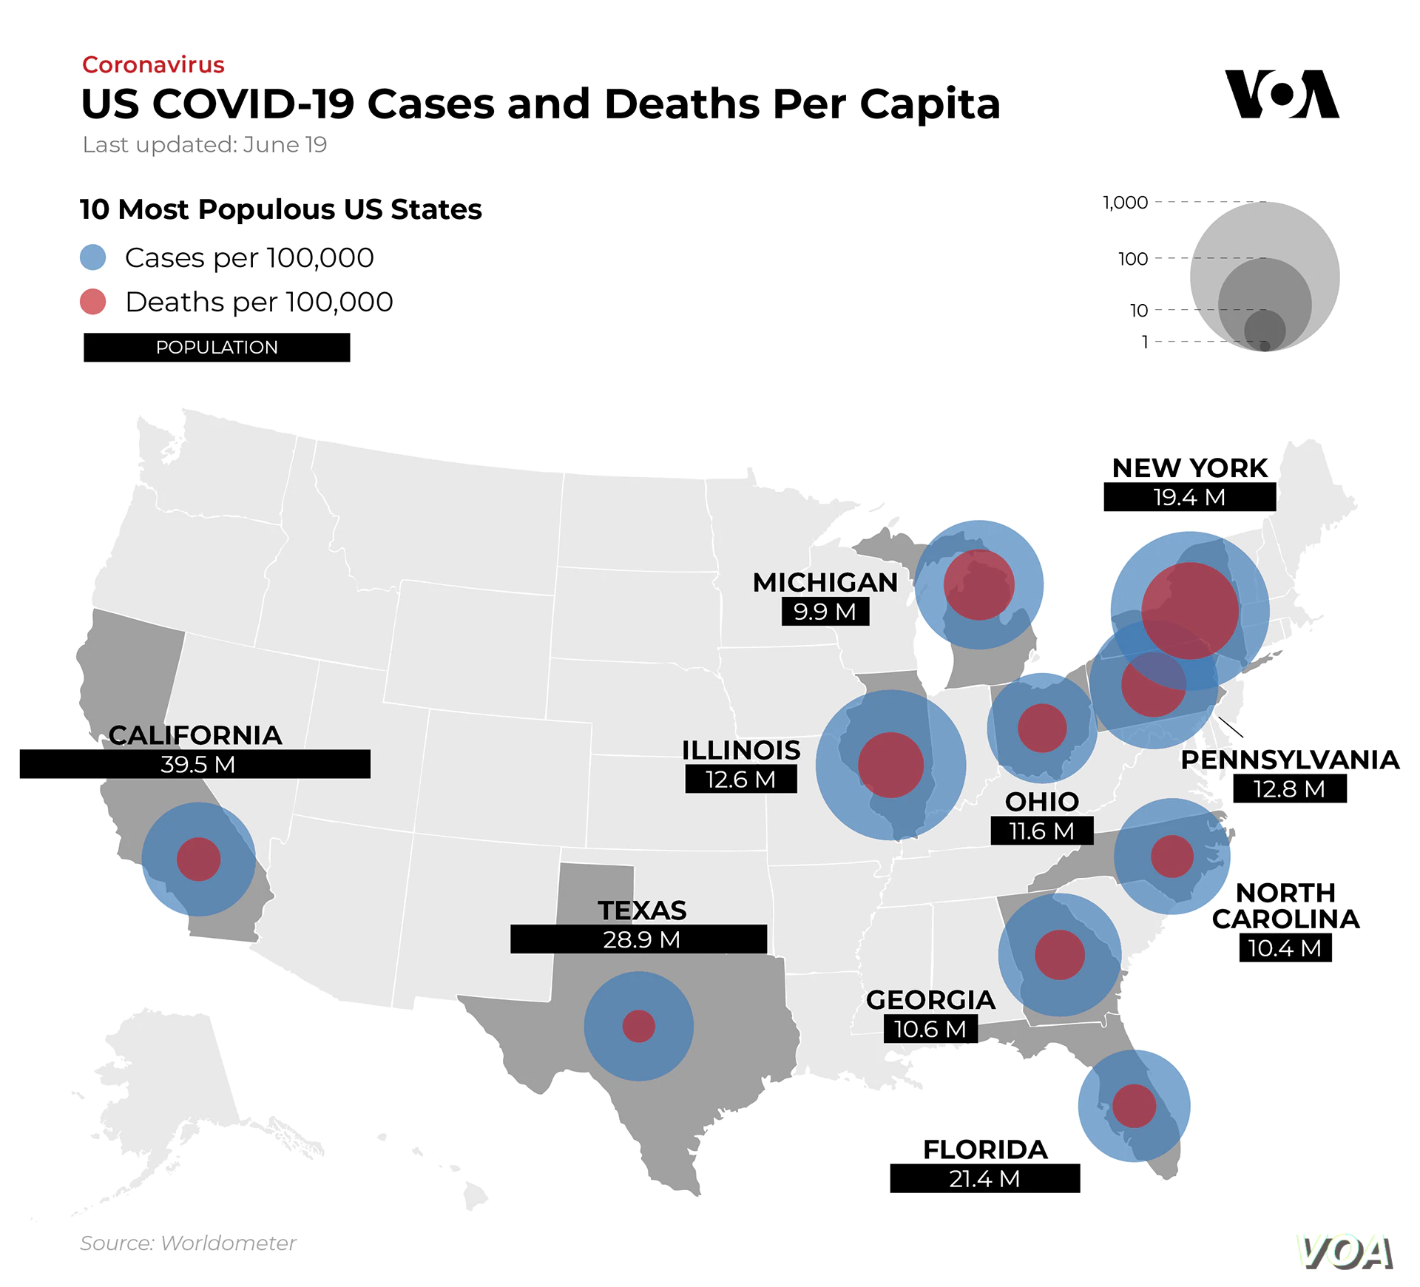

Slide 30
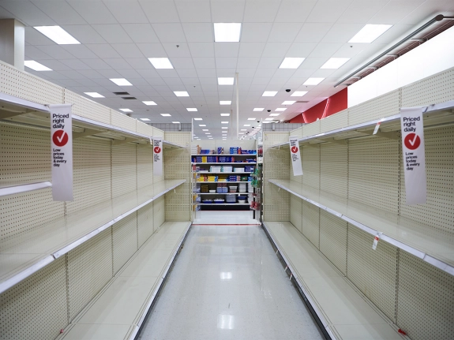
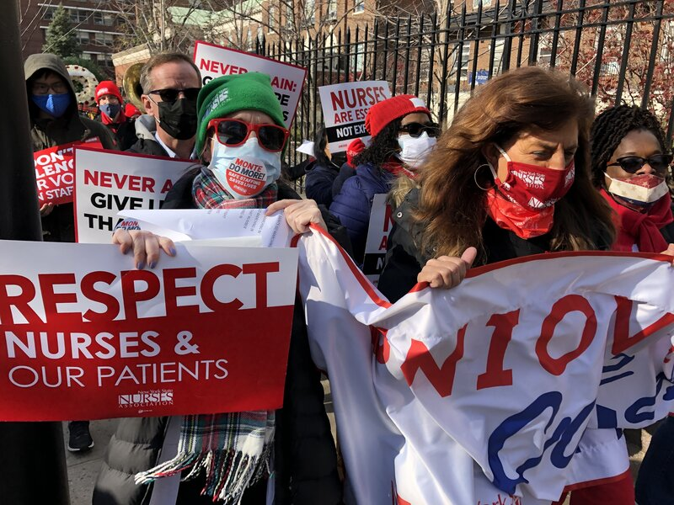
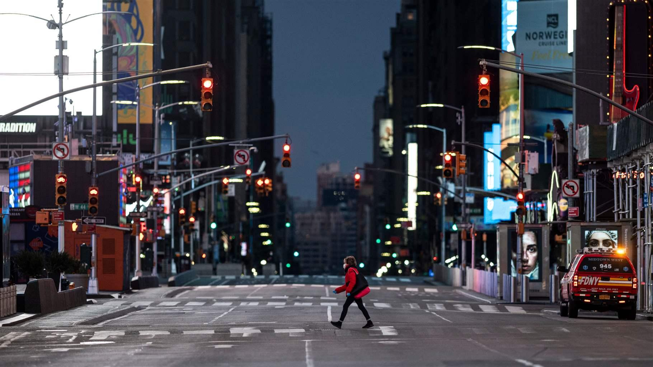
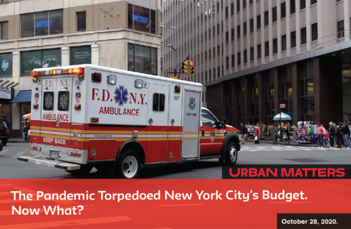
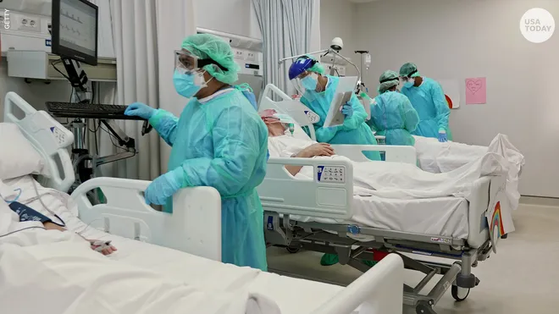

Slide 31
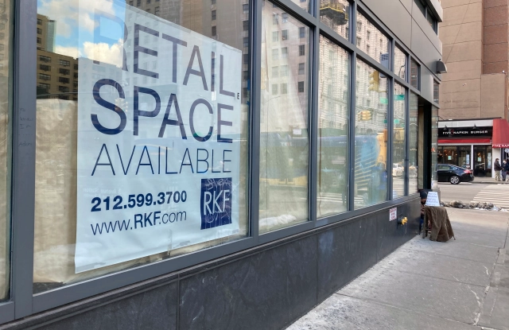
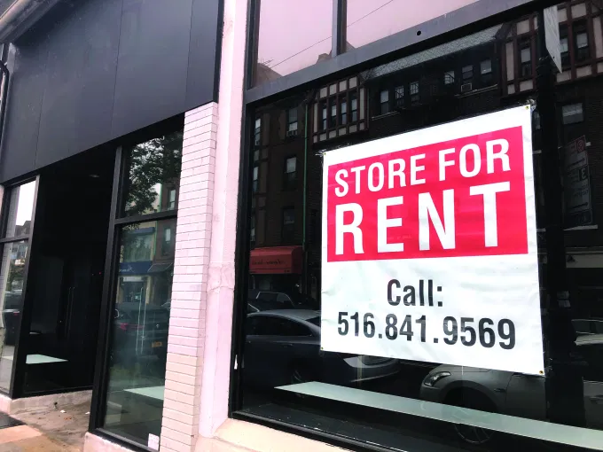
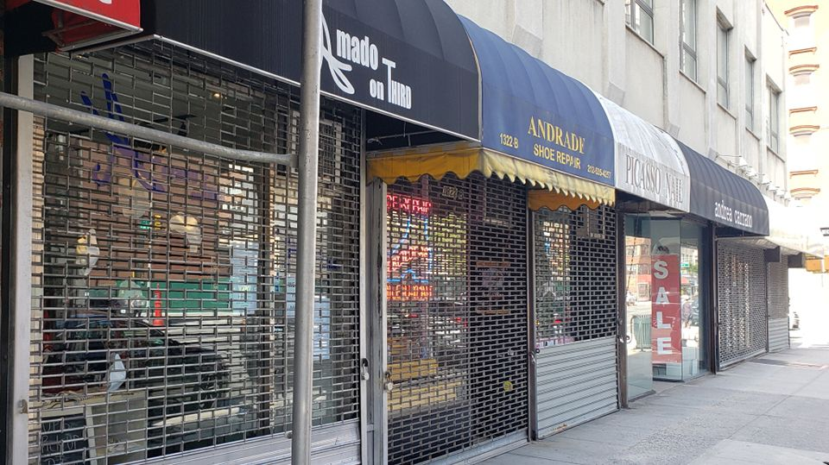
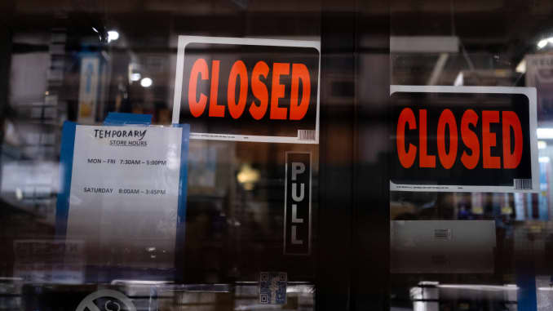

Slide 32
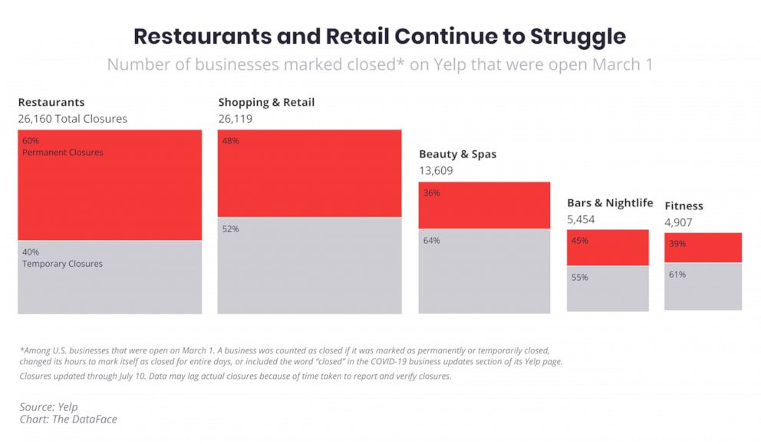

Slide 33
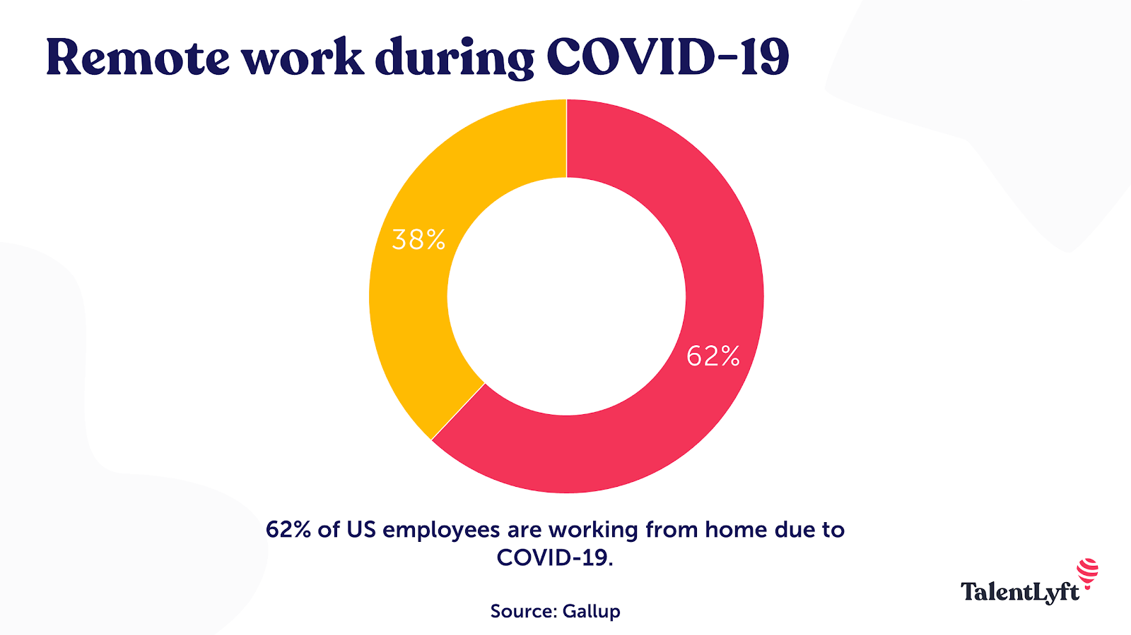

Slide 34
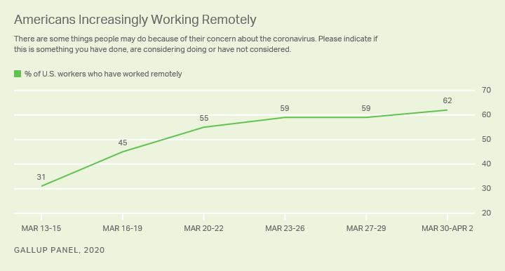

Slide 35
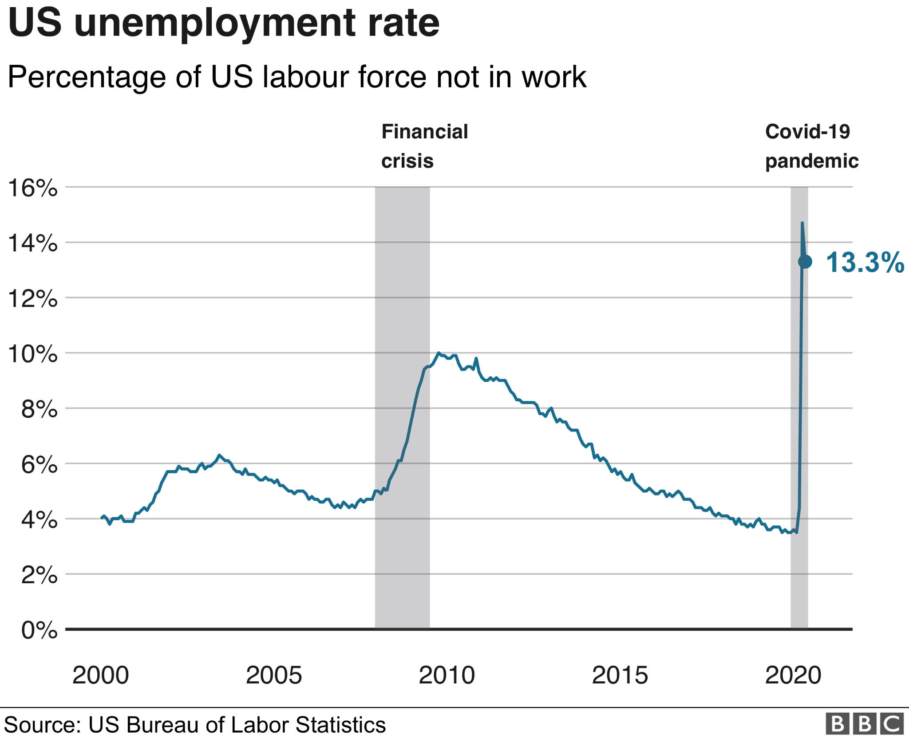

Slide 36
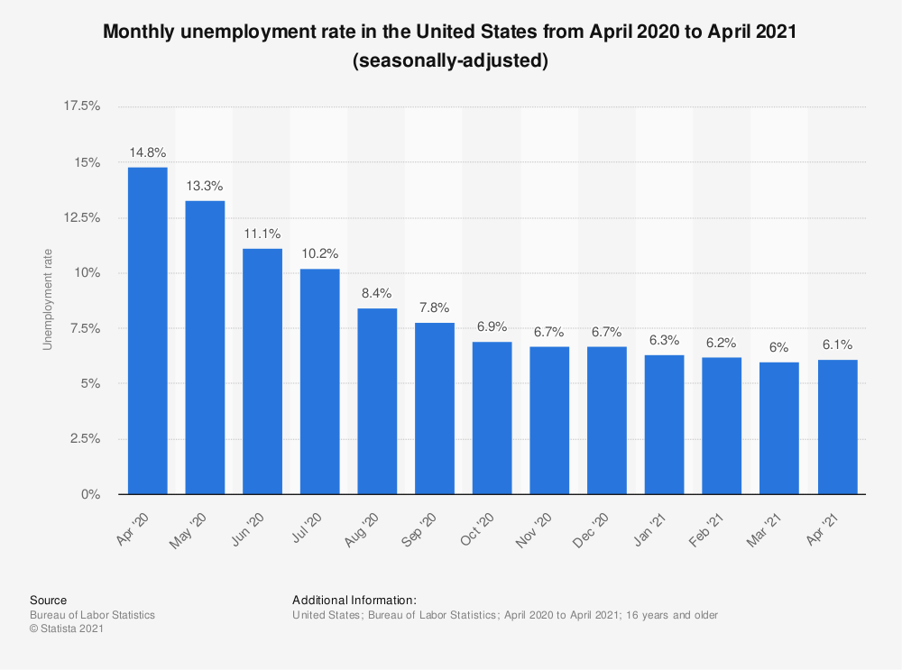

Slide 37
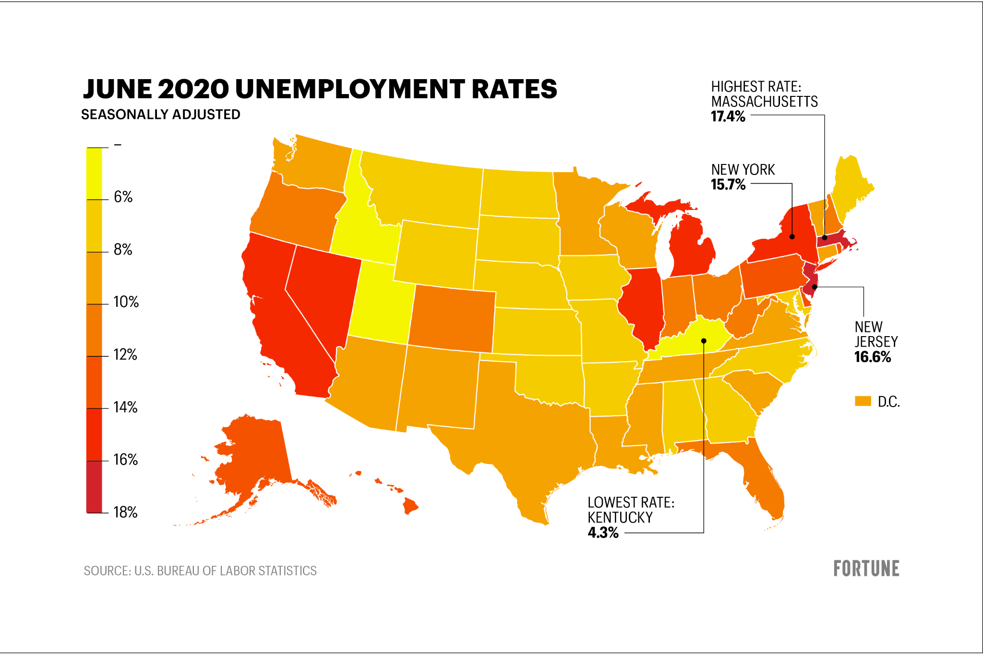

Slide 38
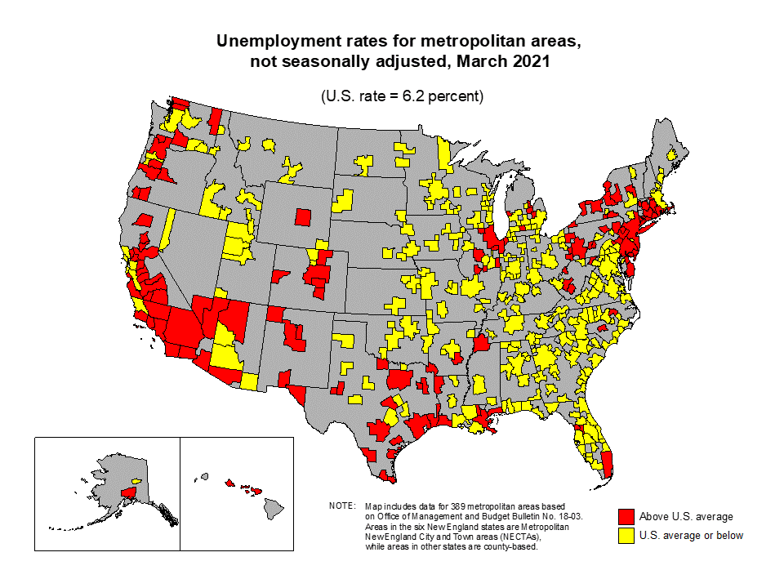

Slide 39
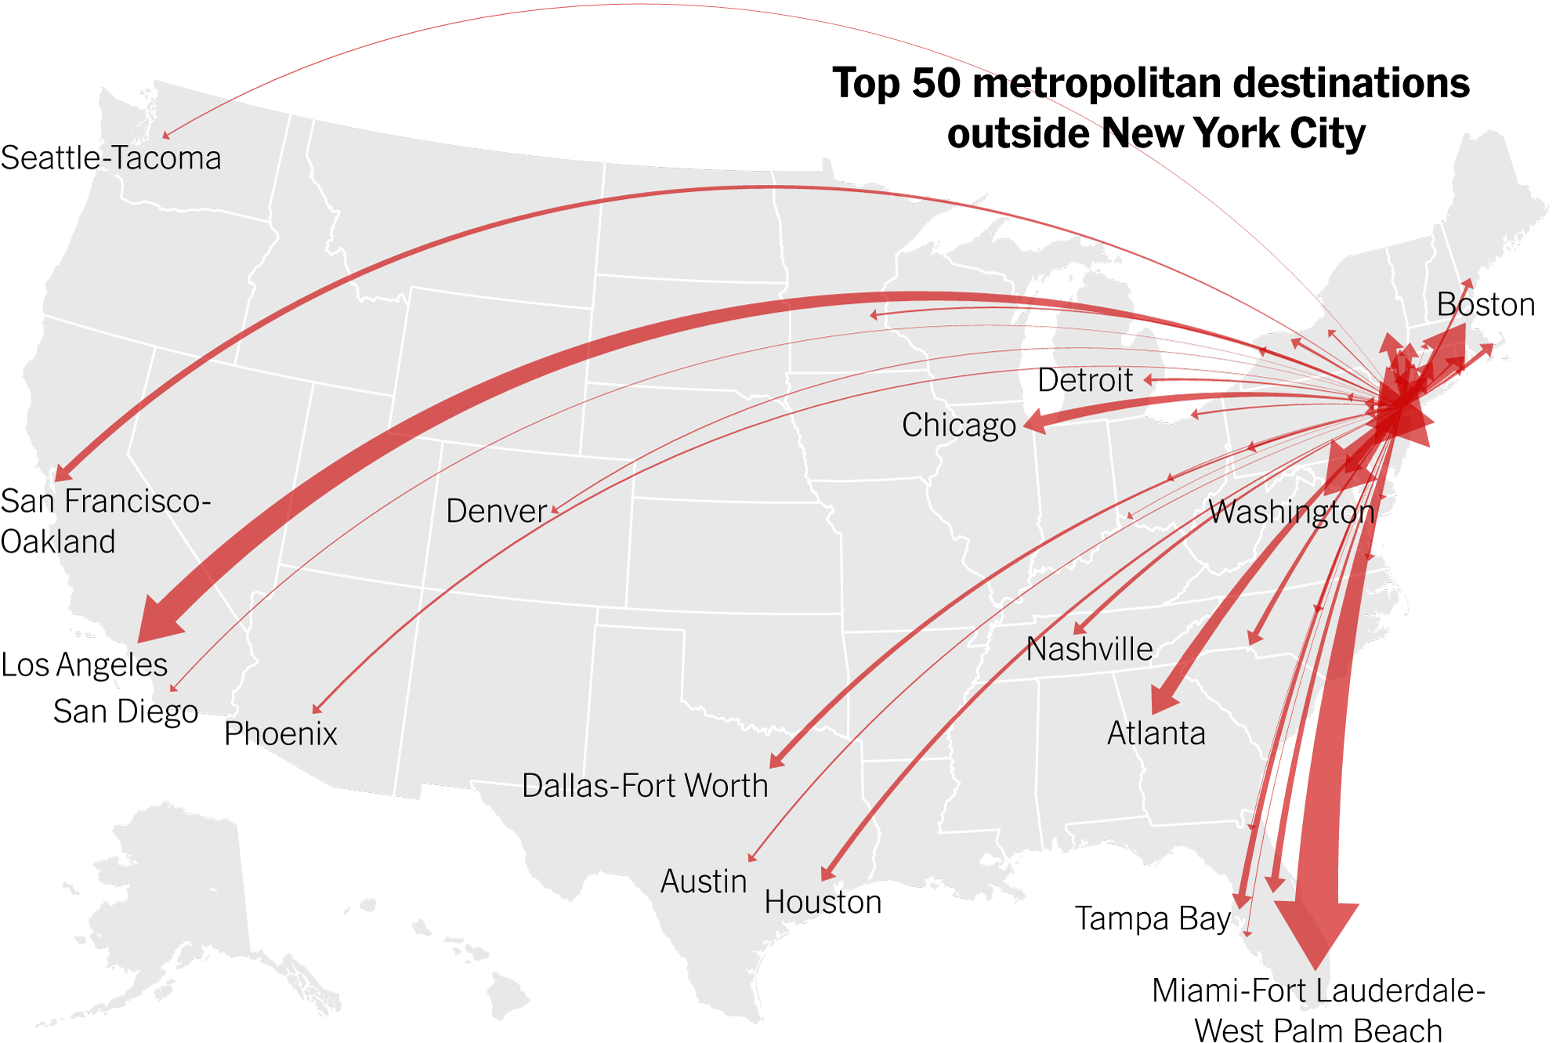

Slide 40
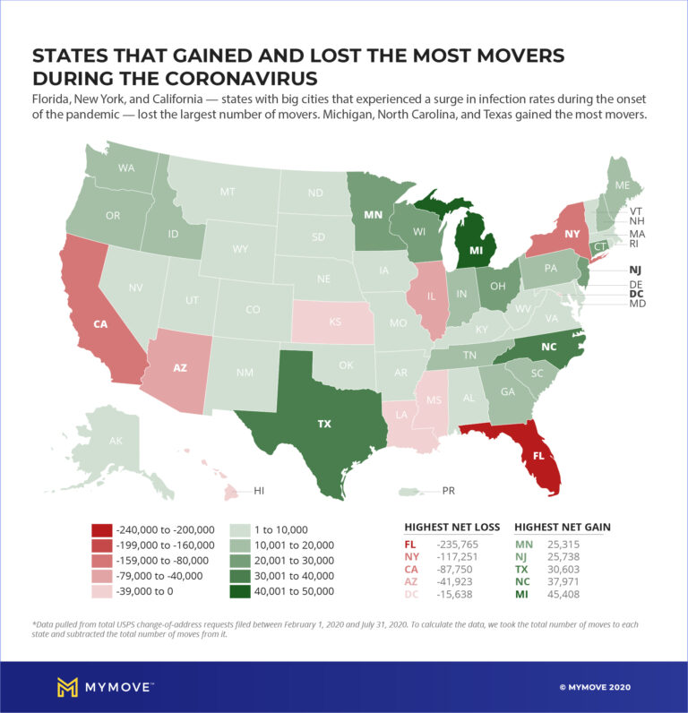

Slide 41
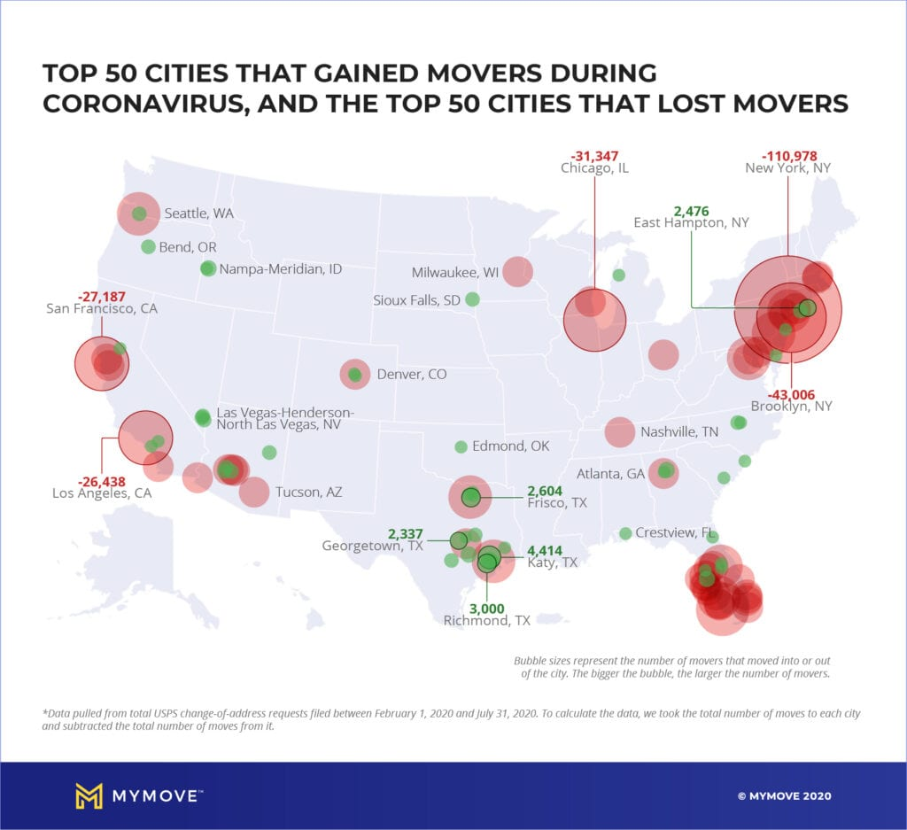

Slide 42
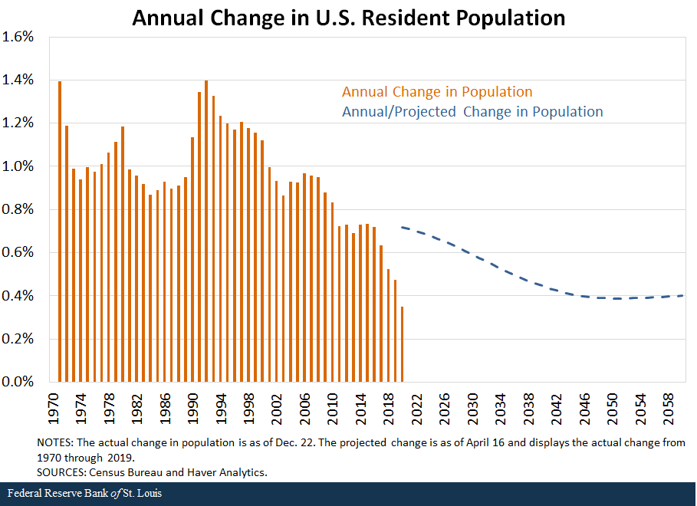

Slide 43
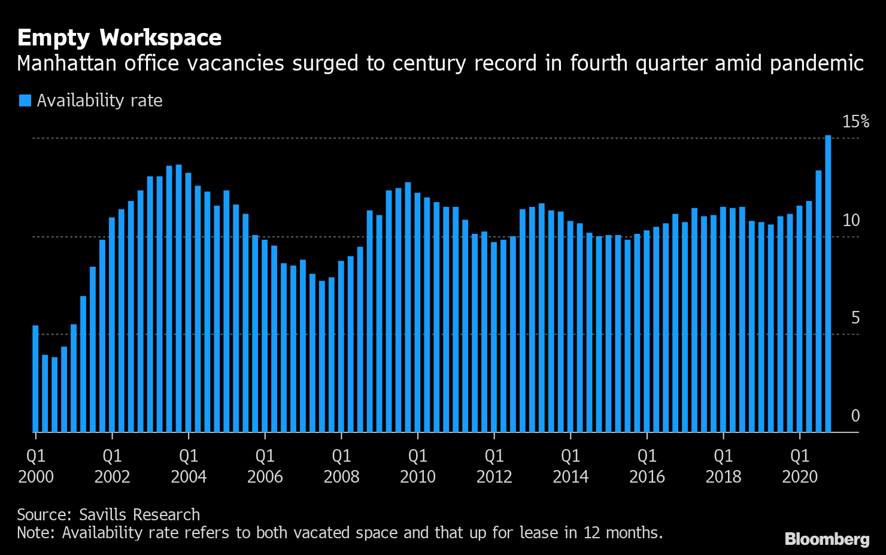

Slide 44
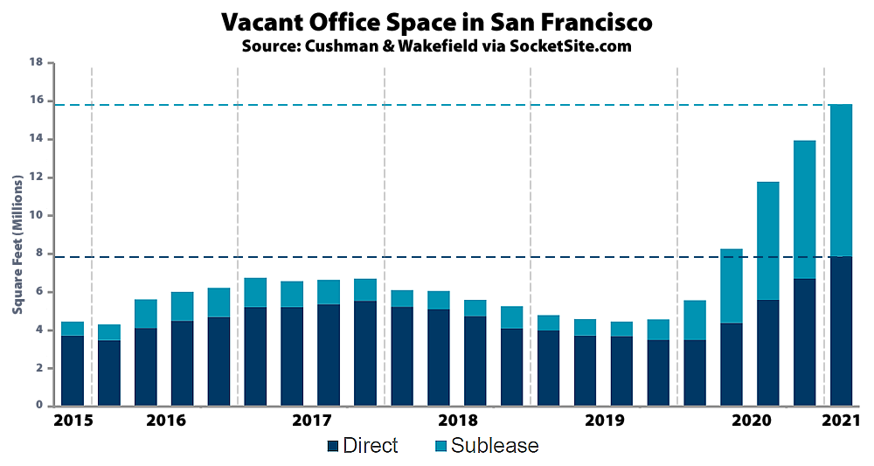

Slide 45
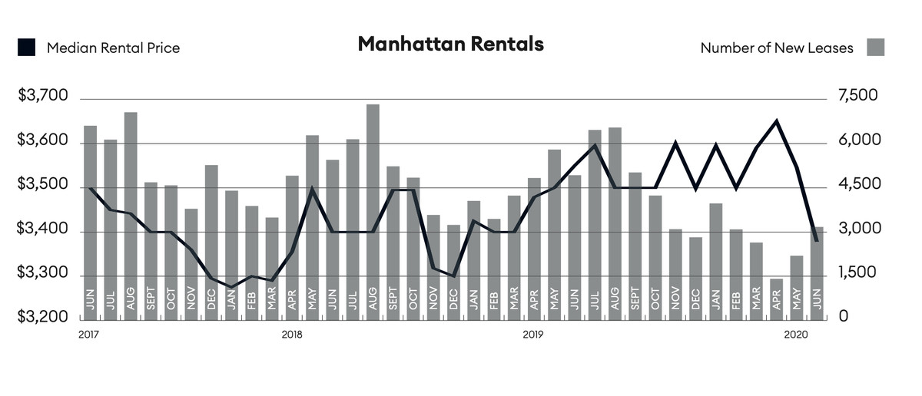

Slide 46
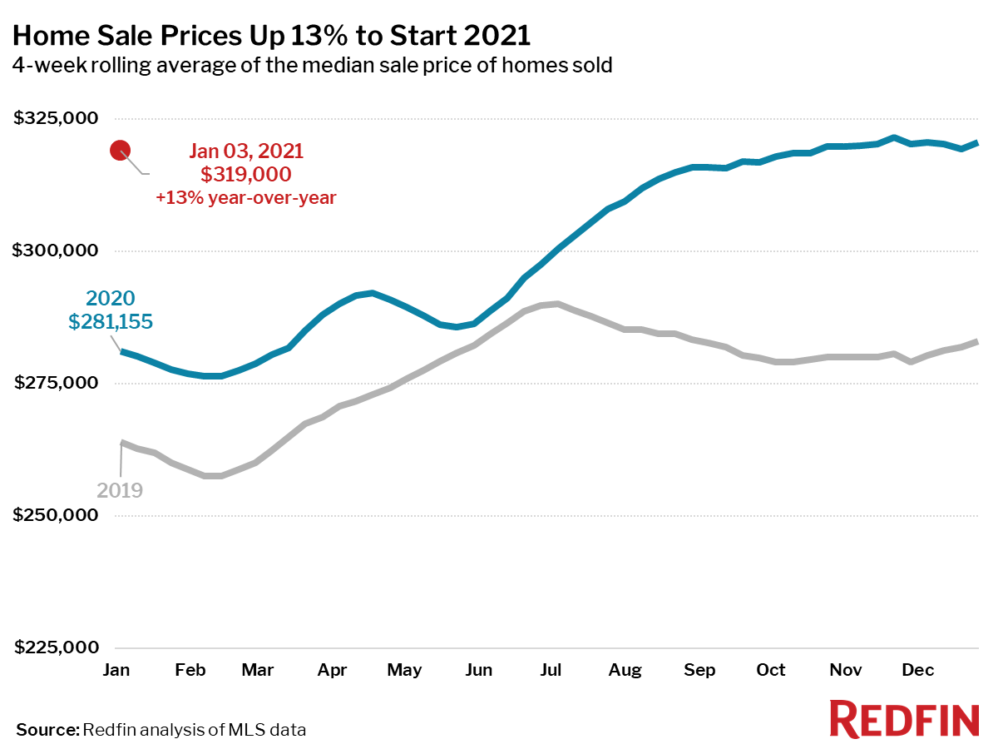

Slide 47
Moving Forward: Questions to Consider
With recent restrictions easing, how fast can economic activity recover?
To what extent will temporary remote work become a permanent reality?
Will decreasing residential and commercial real estate prices draw renters/buyers back to major cities?
Will smaller cities (esp in the South and West) continue to grow despite the COVID aftermath?

Slide 48
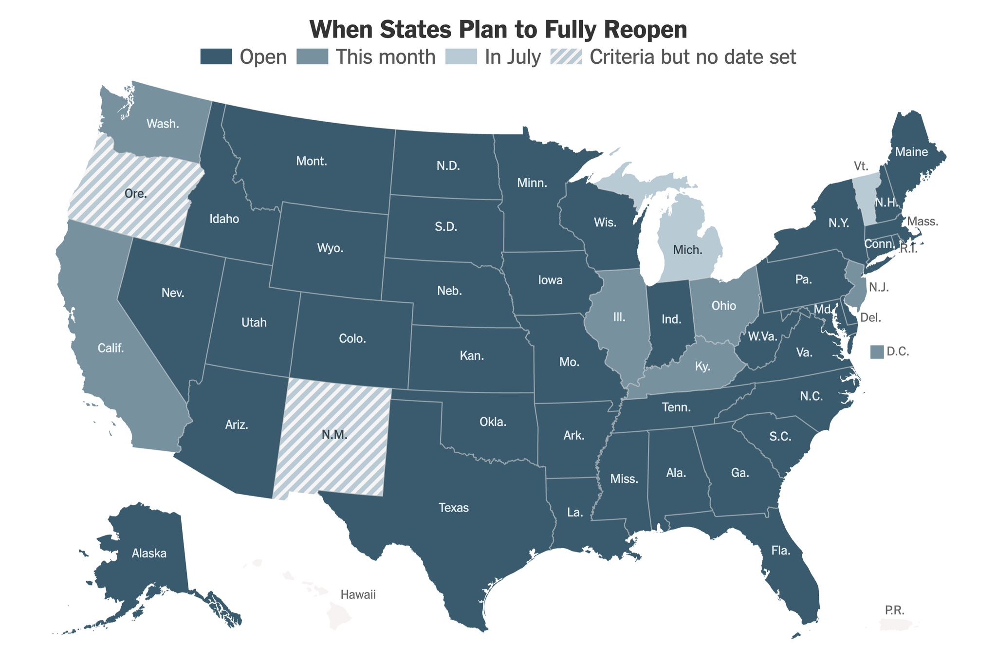
https://www.usatoday.com/storytelling/coronavirus-reopening-america-map/

Slide 49
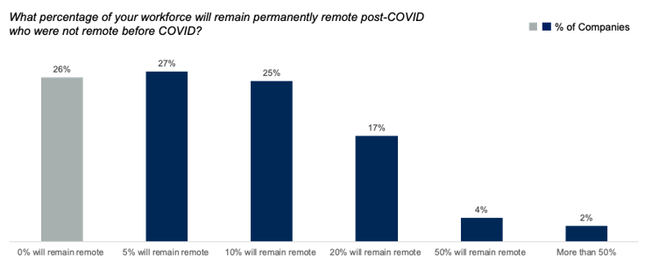

Slide 50
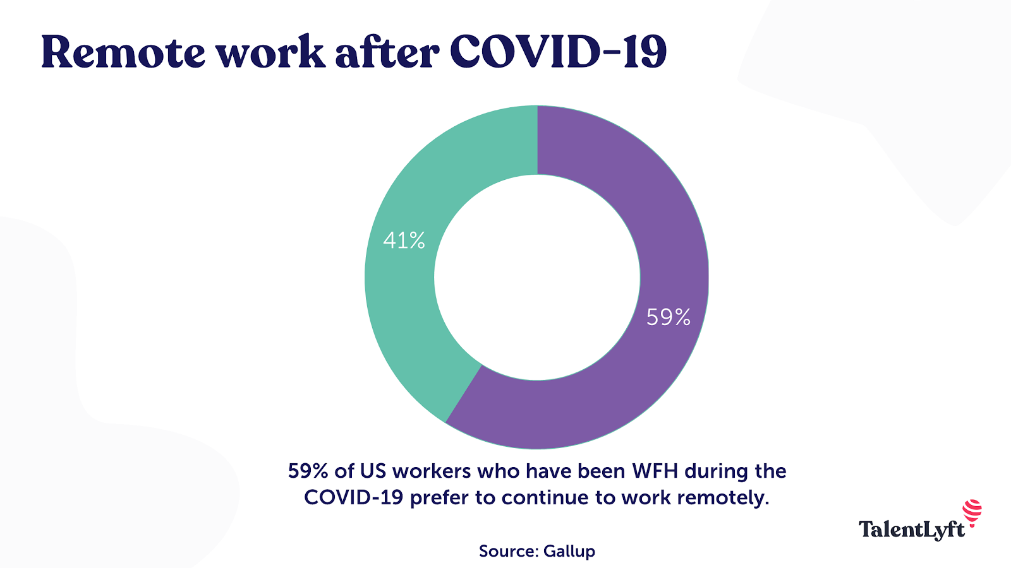

Slide 51
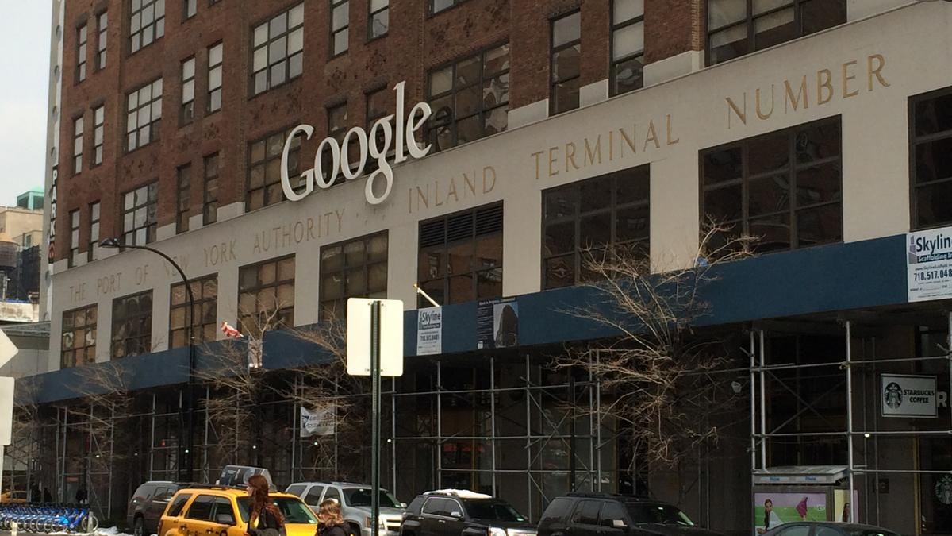
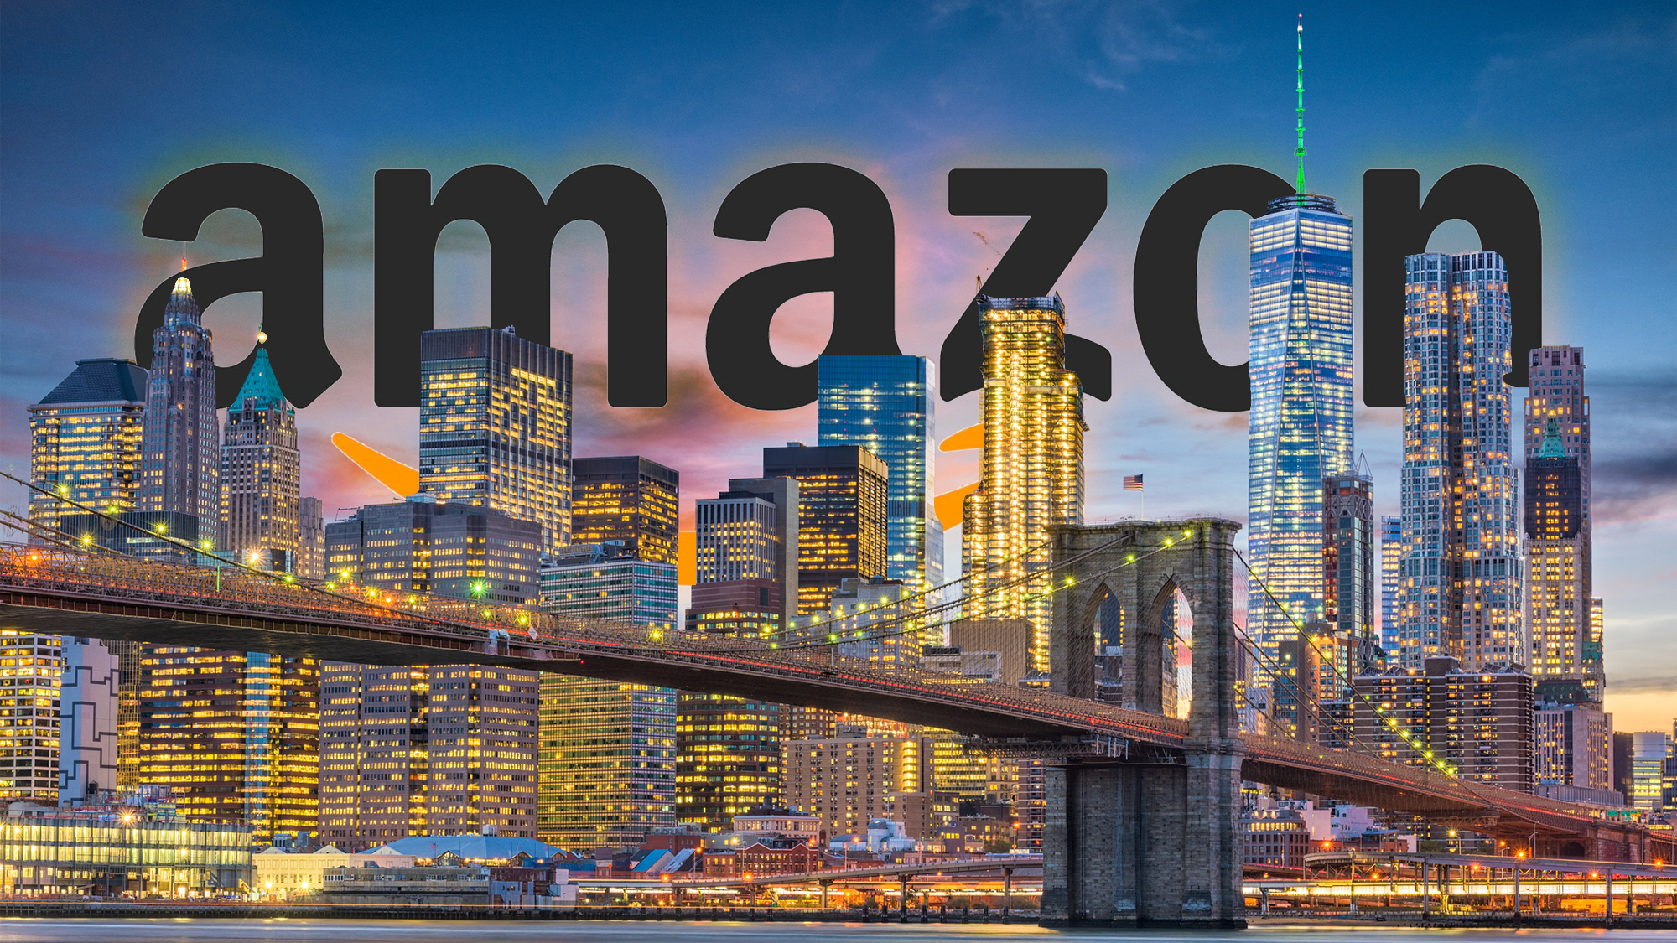
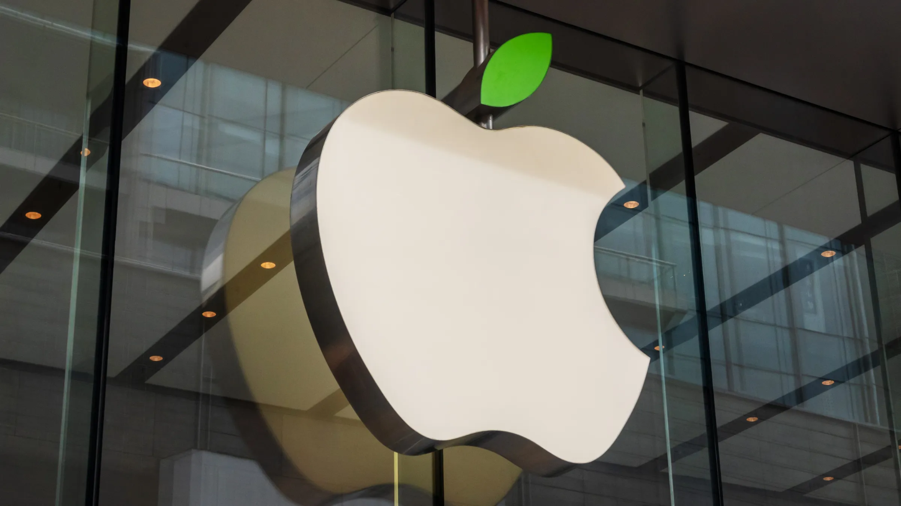
Commercial Real Estate
Big Tech Snatching Up Cheaper CRE:
https://www.jacobinmag.com/2021/04/nyc-real-estate-covid-pandemic-big-tech-retail-closures
https://www.forbes.com/sites/jackkelly/2020/10/16/amazon-apple-google-and-facebook-are-all-scooping-up-office-space-in-new-york-despite-predictions-of-the-citys-demise/?sh=3a106e572c0f

Slide 52
A Post Covid Path Forward for Cities

Slide 53
A Path Forward Post Covid: Key Areas of Concern and New Opportunities ...
Housing affordability and income inequality
Access to public space/ open areas
Entrepreneurial opportunities for small businesses/ new emerging industries
Declining population growth/ restrictive immigration/ demographics
Quality of life/recreation/ entertainment
Future of retail
Climate change and green infrastructure

Slide 54
Urban “Metrofitting”
“Transforming existing cities by combining available resources with human creativity, prompted by new thinking about new and old urban problems”
Remaking Cities, Tony Fry

Slide 55
Addressing Housing Affordability and Shortages
Promote policies that protect and expand affordable housing in “high opportunity neighborhoods.” Use of subsidies, grants, and public funding
Purchasing unused commercial real estate and convert to affordable housing:
Some cities are purchasing shopping malls and retail centers and creating symbiotic housing and retail
Historical example: NYC “Ten Year Plan” in the 1970’s offered subsidies for nonprofit and private developers to purchase abandoned lots and buildings and create over 200,000 affordable units.
Create “Community Land Trusts”
Neighborhood Stabilization Programs to protect against foreclosures and evictions

Slide 57
Empty Retail Space to Affordable housing: https://www.bloomberg.com/news/articles/2020-06-30/a-case-for-turning-empty-malls-into-housing?srnd=citylab

Slide 58
Expanding Public Open Space
More “pedestrian only blocks” in cities
Widening sidewalks and creating new bicycle lanes
Creating more public parks:
Currently 15% of urban areas are parkland
Convert abandoned areas to parks and open spaces
Ex: Highline in NYC
Utilizing “Privately Owned Public Spaces” (POPS)
More public access to open space in cities promotes economic growth and employment opportunities

Slide 61
Fostering a Climate of Entrepreneurship/ Small Business Prosperity/Attracting Young Workers
Financial incentives:
Some cities (ex: Topeka, Tulsa, Savannah) are offering up to $10,000 to relocate - small businesses and remote workers
“Youthification” - the movement of young workers, businesses owners to cities. Create a youth culture to attract young workers, entrepreneurs
Invest in emerging industries/ technologies
Property tax rebates
International Immigration Policy

Slide 63
Improving Quality of Life
Prioritize public health issues:
Previous pandemics led to great public health reforms and new emphasis on health and sanitation
Open subsidized testing sites, prevention screening, and programs to promote long term health
Encourage more walking, bike riding, public transit and discourage mass commuting via automobile
Reducing pollution, crowding, noise with smart traffic redirection
Using abandoned buildings to create art galleries, open public space
Emphasis on small scale, locally sourced art and culture

Slide 64
Revitalizing Urban Retail
Rethinking retail centers into more of a “destination”:
Mixing public art and open space with stores
Creating pedestrian greenways/gardens
Offering free public entertainment/music
Store vacancies present opportunities for reduced rents and a new brand of locally-focused retail
Open air markets, street fairs
“Pop Up” retail stores centered on events
“Fifteen minute neighborhoods”

Slide 65
Dealing with Climate Change and Investing in Green Infrastructure
Both a challenge and an opportunity:
Ex: “Green collar” jobs
Green Retrofit commercial buildings and skyscrapers:
Centers of renewable energy - solar, wind
Create vertical farms
Improve energy efficiency of existing buildings
Establishing “urban natural ecosystems”:
More trees, better soil conservation, less asphalt
Reinforcing or creating marshland, parks as buffers for storms

Slide 67
https://www.fastcompany.com/3044037/forget-desert-solar-farms-we-can-get-more-than-enough-solar-energy-from-cities

Slide 68
One last word about the future of the urban office workplace ...
Most workers and businesses agree that there will be a “hybrid” arrangement:
A few days in the office a week
Still a need for socializing, collaboration and face to face interaction
Office space will be redesigned:
Less “industrial,” more “human”
More space to work, collaborate, learn and create

Slide 70
Learning Activities for Students

Slide 71
City Council Mock Proposal for “City of the Future”
Students research a city that has been affected by COVID
Students create a presentation acting as consultants suggesting specific plans for the future in terms of the following:
Housing, public space, entrepreneurship, retail, “metrofitting,” green infrastructure, working space, public health, etc.
Have the rest of the class act as city council members voting on the specific plans

Slide 72
Students Create a Podcast: Cities and COVID - Challenges and Possibilities
Students research the economic and social impact of COVID on U.S. cities
Students also research ways to remake cities post COVID
Students create a 5-10 minute podcast modeled after an NPR type of broadcast. Music, transitions, effects are encouraged
Podcast apps for students: https://www.npr.org/2020/02/21/807372536/a-studio-at-your-fingertips-5-apps-teachers-are-using-to-make-student-podcasts

Slide 73
Students Create a Blueprint for a “City of the Future”
Moving forward from the aftermath of COVID, what do we want our cities to look and be like:
Students create a visual representation of their ideas for a city of the future that is sustainable, inclusive, progressive, and offers new, fresh ways of living/working
Possible Ideas to use:
Drawn blueprints
Minecraft
Google Sketchup: https://www.sketchup.com/plans-and-pricing/sketchup-free

Slide 74
https://www.weforum.org/agenda/2020/08/future-of-cities-covid-19/

Slide 75
Digital Formative Assessment/Game Options
Socrative: www.socrative.com
Google Forms/Polls: https://www.google.com/forms/about/
Poll Everywhere: https://www.polleverywhere.com/
Quizlet: https://quizlet.com/
Blooket: https://www.blooket.com/

Slide 76
Review/ Assessment Questions - Socrative
Socrative.com
Room Name: Opderbeck

Slide 77
References
https://www.worldbank.org/en/news/feature/2021/03/02/future-of-cities-will-shape-post-covid-19-world
https://www.theatlantic.com/international/archive/2020/06/coronavirus-pandemic-urban-suburbs-cities/612760/
https://www.wired.com/story/pandemic-opportunity-remake-cities/

Slide 78
References cont’d
https://www.theguardian.com/business/2020/aug/30/the-reversal-of-gentrification-how-covid-19-could-remake-australias-cities
https://www.bloomberg.com/news/features/2020-07-02/how-coronavirus-will-reshape-u-s-cities
https://www.brookings.edu/research/even-before-coronavirus-census-shows-u-s-cities-growth-was-stagnating/
https://www.weforum.org/agenda/2020/08/future-of-cities-covid-19/

Slide 79
References cont’d
https://www.bloomberg.com/news/articles/2020-06-30/a-case-for-turning-empty-malls-into-housing?srnd=citylab
https://www.housingwire.com/articles/47649-freddie-mac-housing-market-is-short-25-million-units/
https://www.brookings.edu/research/even-before-coronavirus-census-shows-u-s-cities-growth-was-stagnating/
https://cityobservatory.org/youthmovement/
https://www.bloomberg.com/news/articles/2015-02-05/is-your-neighborhood-changing-it-might-be-youthification-not-gentrification

Slide 80
References cont’d
https://www.brookings.edu/research/even-before-coronavirus-census-shows-u-s-cities-growth-was-stagnating/
https://cityobservatory.org/youthmovement/
https://www.bloomberg.com/news/articles/2015-02-05/is-your-neighborhood-changing-it-might-be-youthification-not-gentrification
https://www.vox.com/cities-and-urbanism/2020/4/13/21218759/coronavirus-cities-lockdown-covid-19-brent-toderian

Slide 81
References cont’d
https://www.vox.com/cities-and-urbanism/2020/4/13/21218759/coronavirus-cities-lockdown-covid-19-brent-toderian
https://content-static.upwork.com/blog/uploads/sites/6/2020/05/26131624/Upwork_EconomistReport_FWR_052020.pdf
https://www.bloomberg.com/news/articles/2020-06-23/cities-are-looking-to-lure-newly-remote-workers
https://www.brookings.edu/blog/the-avenue/2020/03/31/when-will-your-city-feel-the-fiscal-impact-of-covid-19/

Slide 82
References cont’d
Podcasts:
https://www.wbur.org/onpoint/2020/06/26/how-coronavirus-will-change-city-life
https://www.greentechmedia.com/articles/read/remaking-the-climate-resilient-city

Slide 83
Formative Assessment EdTech Tools
Nearpod: www.nearpod.com
Quizlet Live: www.quizlet.com
Kahoot: www.kahoot.com
Gimkit: www.gimkit.com
Blooket: www.blooket.com

Slide 84
CEE Affiliates
https://www.councilforeconed.org/resources/local-affiliates/

Slide 85
Thank You to Our Sponsors!

