Slide 1
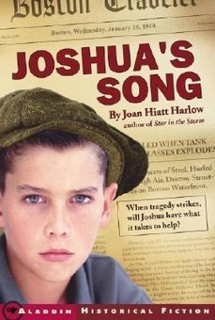
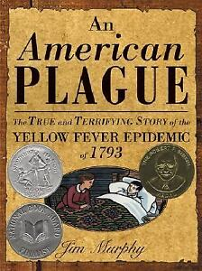
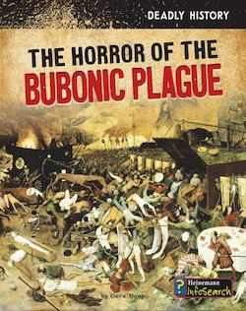
Pandemics Past, Present & Future:
Young Adult Literature featuring Scarcity, Decision-Making and Economic Systems
Lynne Farrell Stover February 23, 2021 stoverlf@jmu.edu

Slide 2
EconEdLink Membership
You can now access CEE’s professional development webinars directly on EconEdLink.org! To receive these new professional development benefits, become an EconEdLink member. As a member, you will now be able to:
Automatically receive a professional development certificate via e-mail within 24 hours after viewing any webinar for a minimum of 45 minutes
Register for upcoming webinars with a simple one-click process
Easily download presentations, lesson plan materials and activities for each webinar
Search and view all webinars at your convenience
Save webinars to your EconEdLink dashboard for easy access to the event
You may access our new Professional Development page here

Slide 3
Professional Development Certificate
To earn your professional development certificate for this webinar, you must:
Watch a minimum of 45-minutes and you will automatically receive a professional development certificate via e-mail within 24 hours.
Accessing resources:
You can now easily download presentations, lesson plan materials, and activities for each webinar from EconEdLink.org/professional-development/

Slide 4
Agenda
In this webinar, we review middle/high school books that feature past pandemics and how they relate to current events…
Economics concepts include:
Allocation of Limited Resources
Privilege vs. Poverty
Opportunity Cost
Demand & Supply
Economic Systems
Also provided:
Hands on lessons and activities
Websites providing support materials
Related standards
Annotated bibliography
Q & A opportunities

Slide 5
Objectives
Teachers will be able to:
Review the history of pandemics and how this information is related to current events.
Explore both historical fiction and informational texts and identify the economic concepts found in them.
Learn how to webinar content to teach age- appropriate lessons and activities based on the featured concepts.

Slide 6
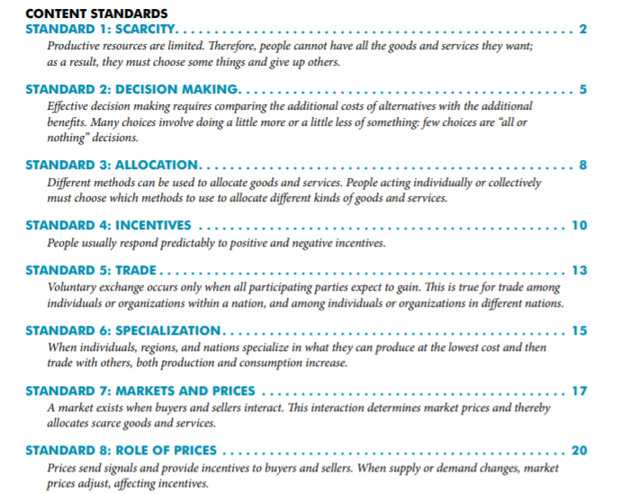
National Standards
https://www.councilforeconed.org/wp-content/uploads/2012/03/voluntary-national-content-standards-2010.pdf

Slide 7
State Standards
Virginia HISTORY & SOCIAL SCIENCE Standards of Learning
CE.11 The student will apply social science skills to understand how economic decisions are made in the marketplace by
a) explaining that because of scarcity, consumers, producers, and governments must make choices, understanding that everyone’s choice has an opportunity cost; and
comparing and contrasting how traditional, free market, command, and mixed economies decide how to allocate their limited resources.
EPF.1 The student will demonstrate knowledge of basic economic concepts and structures by
a) describing how consumers, businesses, and government decision makers face scarcity of resources and must make trade-offs and incur opportunity costs

Slide 8
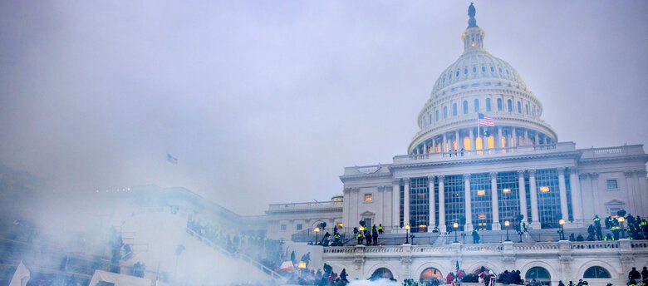
You don’t know it’s “history”
We are living through events that will one day be “history,” but we’re not fully aware of how
We don’t know how it will come out
The characters in these books didn’t either

Slide 10
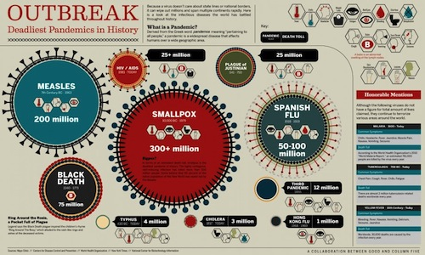

Slide 11
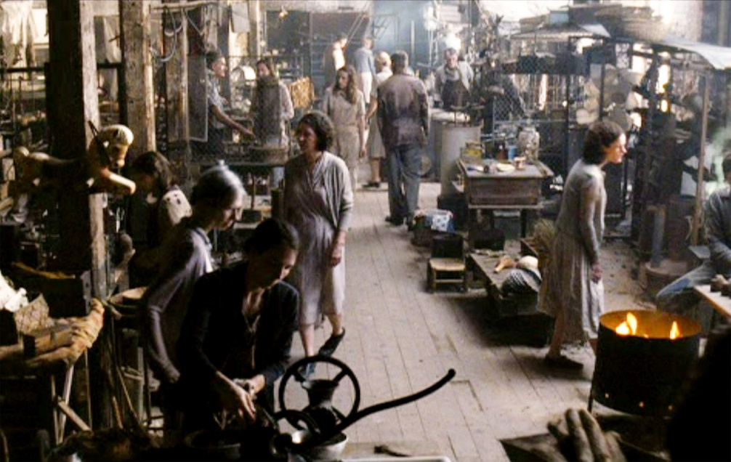
Economic Themes in These Books –
Allocation of Limited Resources
Privilege vs. Poverty
Decision Making
Privilege vs. Poverty
Demand & Supply
Economic Systems

Slide 12
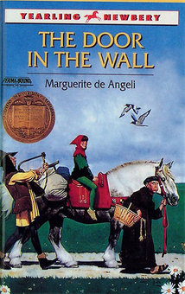
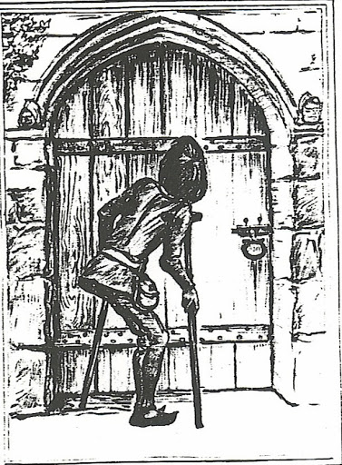
The Door in the Wall by Marguerite de Angeli
Publisher: Dell Yearling
Copyright Date: 1949
Edition Date: 1990
Reading Level: 6.2
Interest Level: 4-7

Slide 13
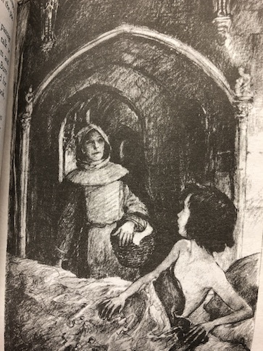
Story Synopsis: Robin’s story, set in fourteenth-century England, unfolds as the Black Death is ravaging Europe.
His parents have arranged from him to be sent away learn how to be a knight. However, his dreams are threatened when he loses the use of his legs. A doctor reassures 10-year-old Robin that the weakness in his legs is not caused by the plague. While parents are away, the servants abandon the house, fearing the plague.
Robin is saved by Brother Luke, who takes him to a monastery and cares for him. There Robin learns to read, swim, and carve wood. With the help of crutches, he learns independence and self confidence. Brother Luke tells Robin that, before overcoming a challenge, you must first find "the door in the wall."

Slide 14
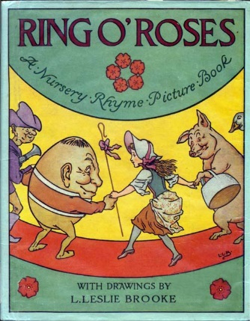
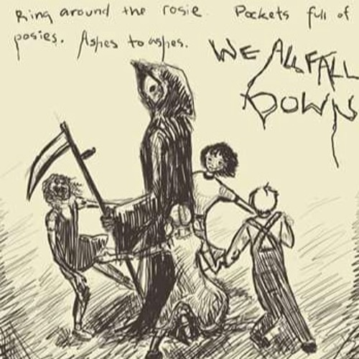
”Ring around the Rosie”
"Ring around the Rosie,
Pocket full of posey,
Ashes, Ashes, we all fall down"
This nursery rhyme began about 1347 and derives from the not-so-delightful Black Plague, which killed over twenty-five million people in the fourteenth century.
The “Ring around a Rosie” refers to the round, red rash that is the first symptom of the disease. The practice of carrying flowers and placing them around the infected person for protection is described in the phrase, “a pocket full of posies.”
“Ashes” is a corruption or imitation of the sneezing sounds made by the infected person. Finally, “we all fall down” describes the many dead resulting from the disease.

Slide 15
http://livinginmedievaleurope.weebly.com/the-black-death-simulation.html

Slide 16
The Horror of the Bubonic Plague
Publisher: Heinemann Library Copyright Date: 2018
Reading Level: 4.0
Interest Level: 3-6

Slide 17
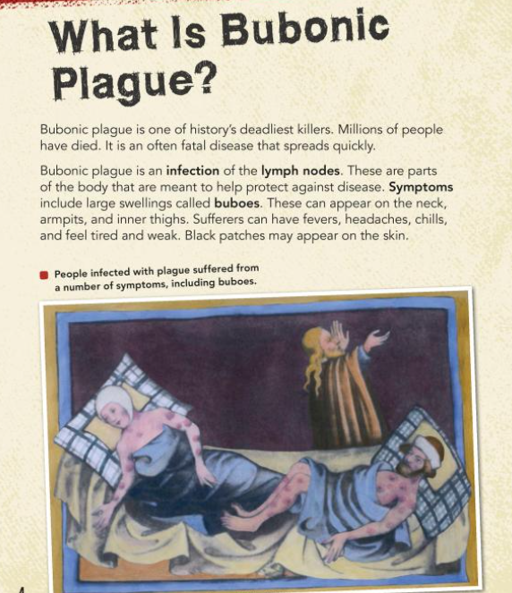
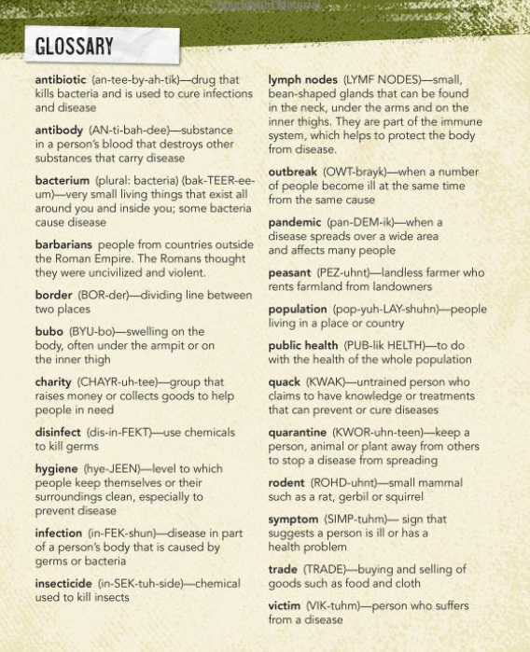
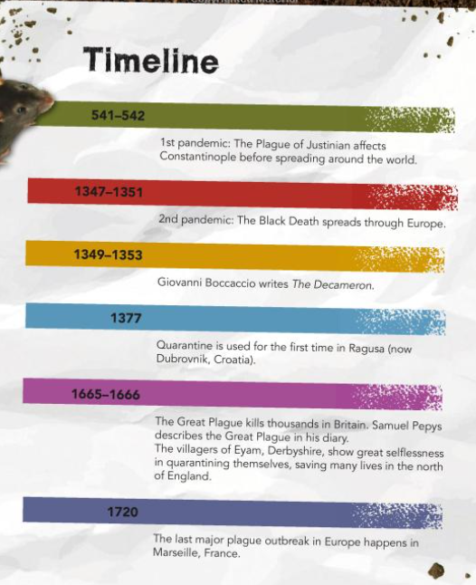
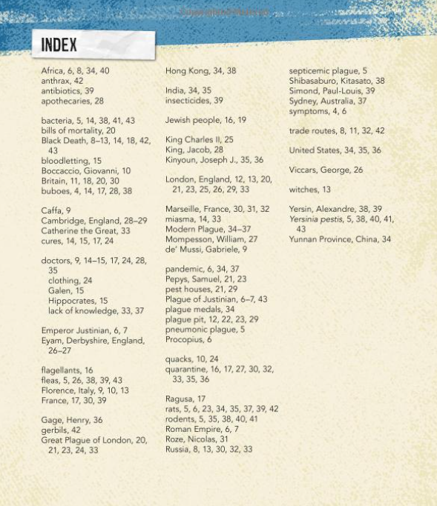
Informational text

Slide 18
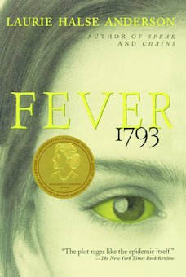
Fever 1793 by Laurie Halse Anderson
Publisher: Aladdin
Copyright Date: 2000
Reading Level: 4.4
Interest Level: 7-12

Slide 19
Story Synopsis: During the summer of 1793, fourteen-year-old Mattie Cook lives above the family coffee shop with her widowed mother and grandfather. Mattie spends her days avoiding chores and making plans to turn the family business into the finest Philadelphia has ever seen. But then the fever breaks out. Disease sweeps the streets, destroying everything in its path and turning Mattie's world upside down. At her feverish mother's insistence, she flees the city with her grandfather. But she soon discovers that the sickness is everywhere, and Mattie must learn quickly how to survive in a city turned frantic with an outbreak.

Slide 20
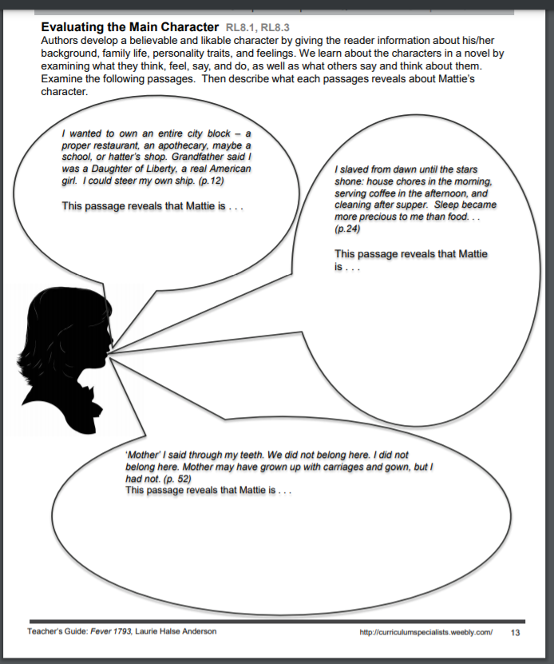
http://d28hgpri8am2if.cloudfront.net/tagged_assets/15282/fever%201793_cg.pdf
Possible Answers:
Entrepreneurial
An exhausted worker providing services
Uncomfortable with wealth

Slide 21
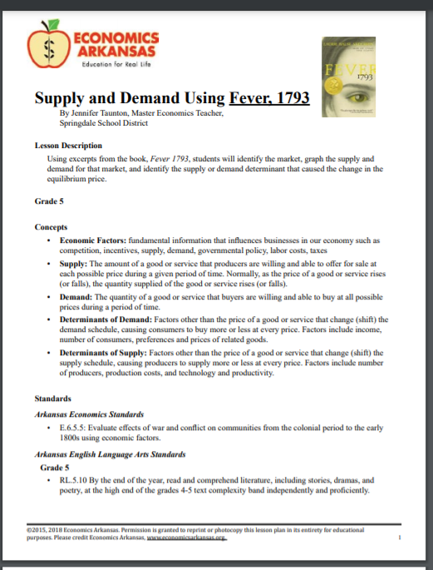
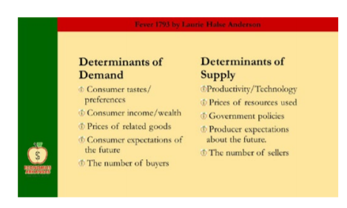
https://www.economicsarkansas.org/for_teachers/lesson-plans-4-5.html

Slide 22
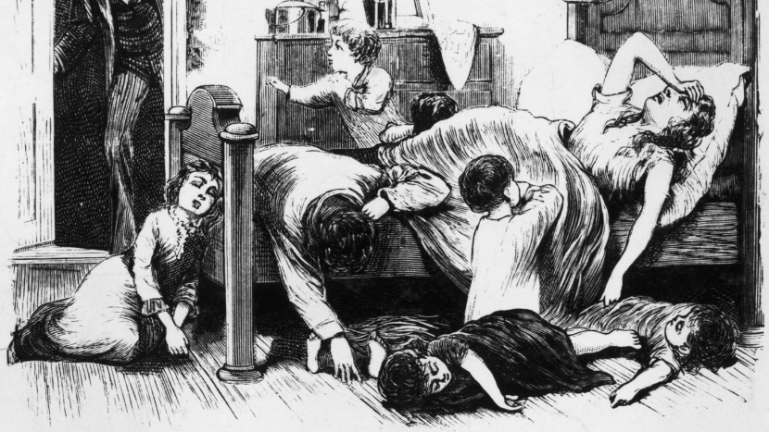
An American Plague:
The True and Terrifying Story of the Yellow Fever Epidemic of 1793 by Jim Murphy
Publisher: Houghton Mifflin Copyright Date: 2003
Reading Level: 9.0
Interest Level: 5-9

Slide 23
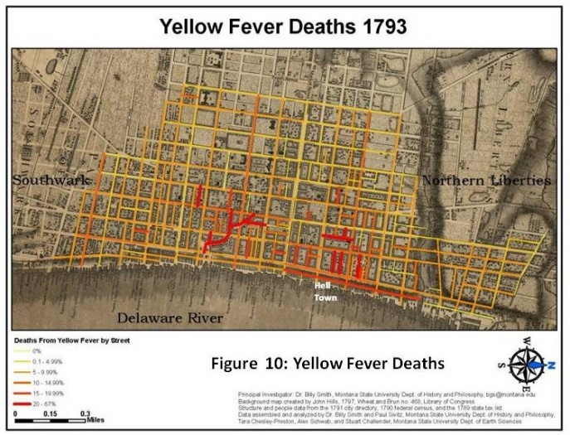
Book Synopsis: This award-winning informational text describes the illness known as yellow fever and the toll it took in Pennsylvania, relating the epidemic to the major social and political events of the day and to 18th-century medical beliefs and practices.

Slide 24
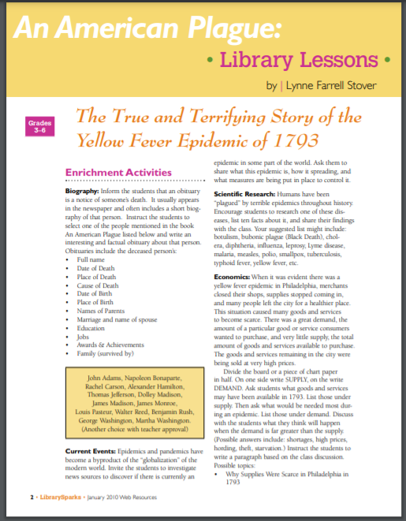
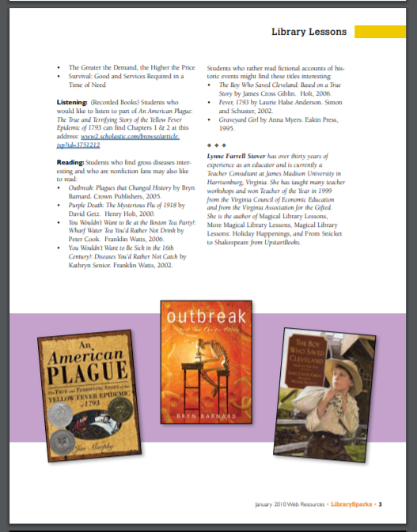
https://www.librarysparks.com/wp-content/uploads/2016/06/lsp_jan10_ll.pdf

Slide 25
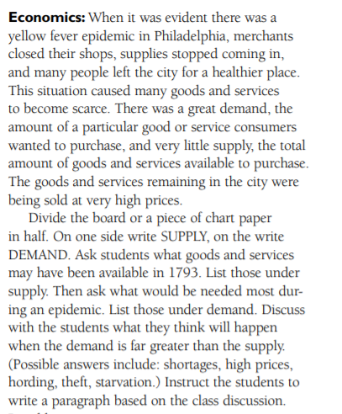
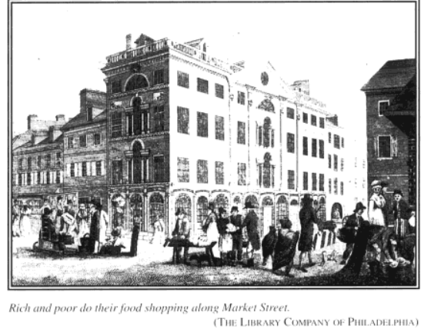

Slide 26
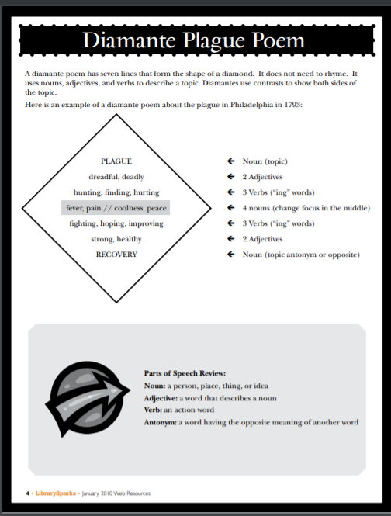
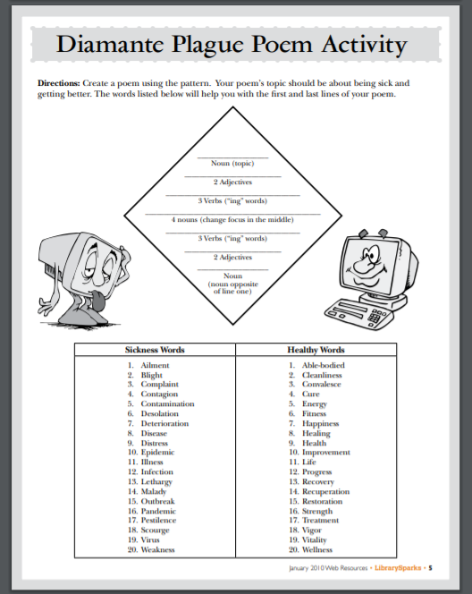

Slide 27
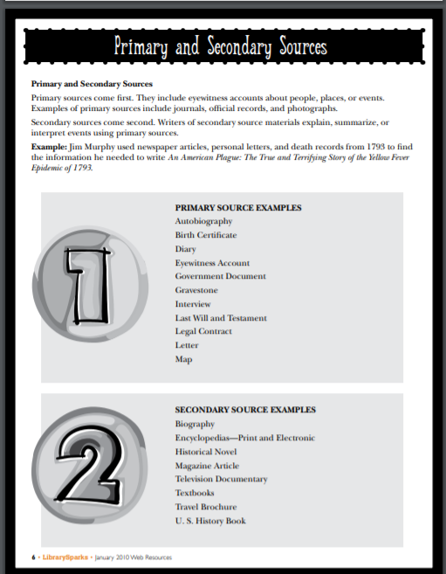
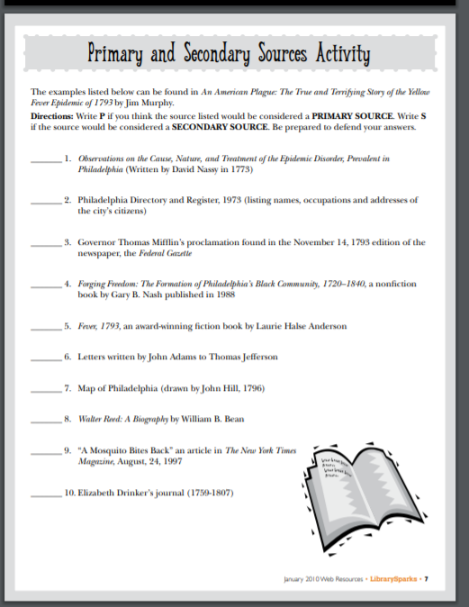

Slide 28
Joshua’s Song by Joan Hiatt Harlow
Publisher: Aladdin
Copyright Date: 2001
Reading Level: 4.0
Interest Level: 4-7

Slide 29
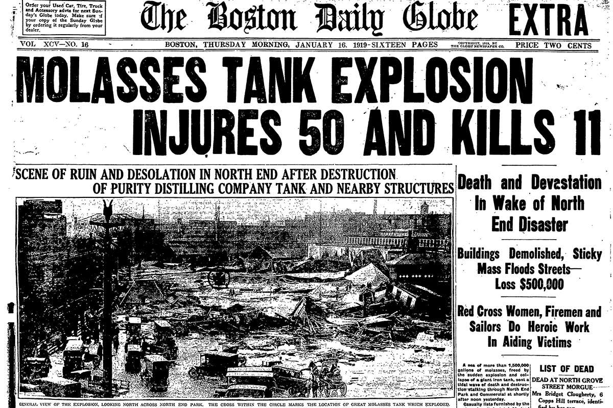
Story Synopsis: Needing to earn money after his father's death during the influenza epidemic of 1918, thirteen-year-old Joshua Harper works as a newspaper boy in Boston, one day finding himself in the vicinity of an explosion that sends tons of molasses coursing through the streets.

Slide 30
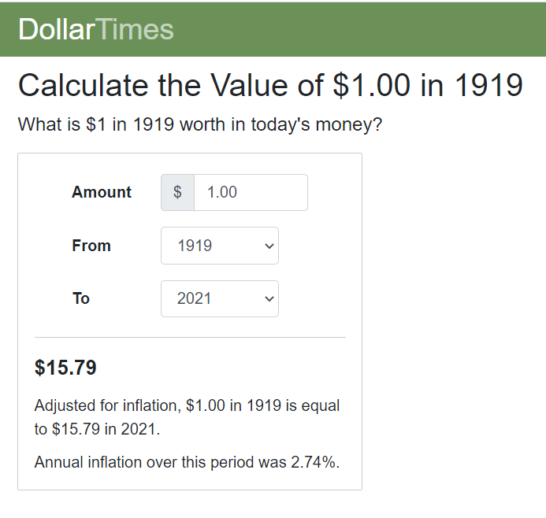
Activity
https://www.dollartimes.com/inflation/inflation.php?amount=1&year=1919
Challenge students to write their own math money problems using examples from Joshua’s life as they compare to today’s prices. Examples include: Price of newspapers, room rentals, food cost, salary of workers, and transportation fees.

Slide 31
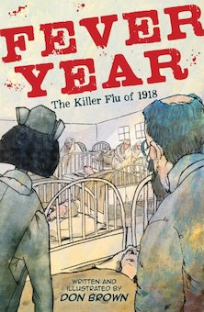
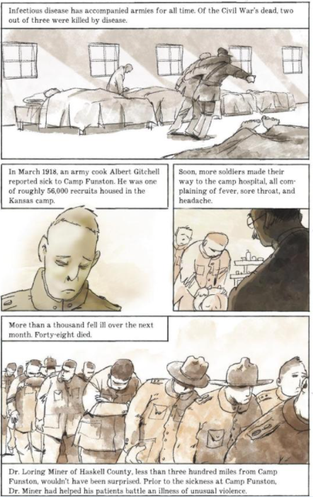
Fever Year: The Killer Flu of 1918 by Don Brown
Publisher: Houghton Mifflin
Copyright Date: 2019
Reading Level: 6.7
Interest Level: 4-7
Graphic Novel

Slide 32
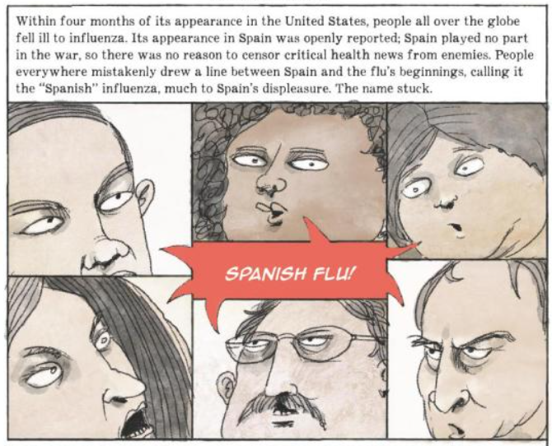
Book Synopsis: This nonfiction graphic novel explores the causes, effects and lessons learned from the Spanish Influenza epidemic of 1918.
New Year's Day, 1918. America has declared war on Germany and is gathering troops to fight, but there's something coming that is deadlier than any war. When people begin to fall ill, most Americans don't suspect influenza. The flu is known to be dangerous to the very old, young or frail, but the Spanish flu is exceptionally violent. Soon, thousands of people succumb. Then tens of thousands, hundreds of thousands and more. Graves can't be dug quickly enough. What made the influenza of 1918 so exceptionally deadly--and what can modern science help us understand about this tragic episode in history?

Slide 33
The Hunger Games trilogy is a post-apocalyptic tale that takes place in a barely recognizable North America. Told in the voice of sixteen-year-old Katniss Everdeen, a citizen of the desperately poor District 12, the reader learns of the government’s method of keeping the deprived population under control.
Every year the Capitol demands that each district select, through the means of an unfair lottery system, a boy and a girl to become tributes in the nationally televised “Hunger Games.” Here, with much fanfare, the twenty-four young participants must fight to the death until only one remains.

Slide 34
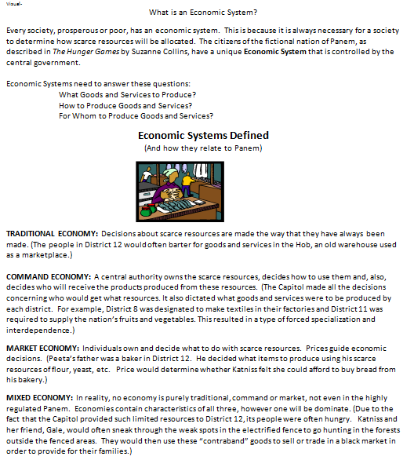
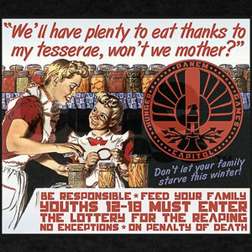
Economic Systems

Slide 36
The Ballad of Songbirds and Snakes by Suzanne Collins
Reading Level: 6.0
Interest Level: 7-12
Publisher: Scholastic Press
Copyright: 2020

Slide 37
Story synopsis: Capitol has emerged triumphant from a civil war. Now, with the rebellious Districts quelled, the once-powerful Snows live a precarious existence in a penthouse apartment, concealing their poverty from the rest of the city’s aristocracy. The Games are in their 10th year, and losing their audience; those in charge decide to bring in mentors from the city’s elite to increase engagement. The teenage Coriolanus is chosen to mentor Lucy Gray Baird, an eccentric vagabond singer who has been picked as a tribute from District 12. He must guide her to win, pleasing both the spectators and his teachers. Coriolanus sees his chance to gain glory back for his family name, his eyes firmly fixed on the cash prize and his future career.

Slide 38
“The Ballad of Songbirds and Snakes”
Possible Content Connections
History – Global Alliances and Ancient Civilizations
Economics – Taxes, Trade, Wages and Productive Resources
Languages - Latin and Greek
Music – Folk Songs & Protest Lyrics
Science – Cloning and Genetic Engineering

Slide 39
Yes… A movie is forthcoming

Slide 40
Assessment Questions
For class discussion:
What have you heard about COVID 19?
What can we learn by reading about past pandemics?
Do you think it’s possible to watch too much news concerning COVID 19?
What are your major concerns about pandemics?

Slide 41
Resources
Resource | Link
Bubonic Plague Simulation | http://livinginmedievaleurope.weebly.com/the-black-death-simulation.html
Fever 1793 (Yellow Fever) Teacher’s Guide | http://d28hgpri8am2if.cloudfront.net/tagged_assets/15282/fever%201793_cg.pdf
An American Plague (Yellow Fever) Lessons & Activities | https://www.librarysparks.com/wp-content/uploads/2016/06/lsp_jan10_ll.pdf
Supply & Demand Lesson Fever 1793 | https://www.economicsarkansas.org/for_teachers/lesson-plans-4-5.html
Currency Converter (1919 Spanish Flu) | https://www.dollartimes.com/inflation/inflation.php?amount=1&year=1919

Slide 42
CEE Affiliates
https://www.councilforeconed.org/resources/local-affiliates/

Slide 43
Thank You to Our Sponsors!

Slide 44
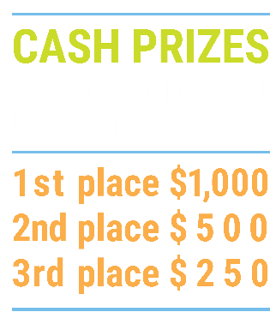
We’ve gone Virtual!
Teach Economics?
Your students may have what it takes to compete in the nation’s only high school economics competition!
Why Play?
• Fun team learning experience
• Great for college applications
• No other challenge like this
• Online participation makes access easy
• Chance for cash prizes
How it Works
Teams register
Teachers enroll team(s) of 3- 4 high school students from the same school. Multiple teams allowed.
Teams compete within their state
Compete to win your state competition for a chance to advance to the National Semi-Finals.
National Semi-Finals: May 3-20, 2021
Teams answer multiple-choice questions on macroeconomics, microeconomics, and international & current events.
National Finals: May 22-24, 2021
Teams analyze an economic issue and present their solution. Top teams engage in the Finals Quiz Bowl where they face-off answering questions to claim the National Title.
Two divisions based on experience level
David Ricardo for first-time competitors who have taken no more than one economics course.
Adam Smith for returning competitors, AP, International Baccalaureate, and honors students.
Register Today at NationalEconomicsChallenge.org

Slide 45
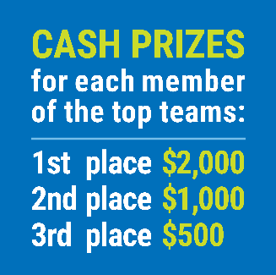
FIND YOUR LOCAL COMPETITION AND REGISTER TODAY!
The National Personal Finance Challenge is a competition that provides high school students with an exciting and motivating opportunity to build, apply, and demonstrate their knowledge of money management.
Through online exams and a personal finance simulation, teams showcase their expertise in earning income, buying goods and services, saving, using credit, investing, as well as protecting and insuring.
Teams of up to four students, with one teacher/coach, can qualify to represent their state at the National Personal Finance Challenge by winning their local competition.
NATIONALS
Semi-Finals: First round elimination via online multiple-choice questions.
Finals: Case study round virtually co-hosted by the Cleveland Fed on June 3.
personalfinancechallenge.org

Slide 46
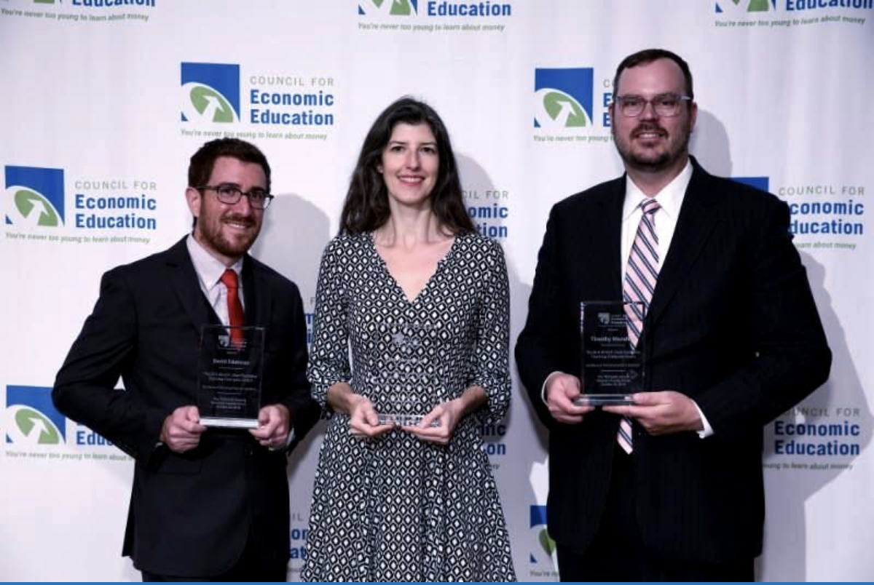
The 2021 Sloan Teaching Champion Award
Winners receive:
A cash award of $5,000
A cash award of $2,500 for their school to support economic education
Recognition at our annual Visionary Awards convening
This award promotes economic education by honoring three outstanding teachers who incorporate exemplary teaching techniques that improve their students’ economic understanding in and out of the classroom.
This award is open to New York metropolitan area high school teachers of all subjects, not just teachers of economics. Applicants must demonstrate how they integrate economics into their teaching.
Sound like you or someone you know?
Applicants must teach in one of the
Twelve New York state counties (New York, Kings, Bronx, Richmond, Queens, Nassau, Suffolk, Westchester, Putnam, Rockland, Orange and Duchess)
Eight New Jersey counties (Bergen, Passaic, Essex, Hudson, Middlesex, Union, Morris, Monmouth), or the
Two Connecticut counties (Fairfield and New Haven)
Application will be launched on Friday February 19th 2021
You can access the application here.
CONTACT
Please feel free to e-mail us at rrivera@councilforeconed.org
with any questions you have.

Slide 47
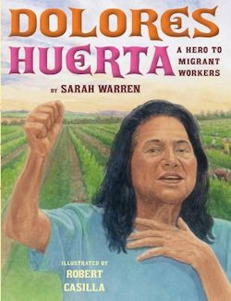
Enterprising Women:
Using Children’s Literature to Teach Economics
Presented by Lynne Farrell Stover
Date March 16, 2021
stoverlf@jmu.edu

