Slide 1
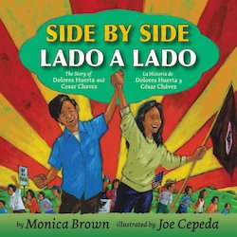

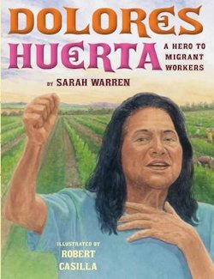
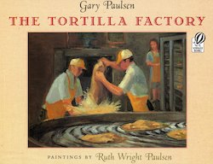
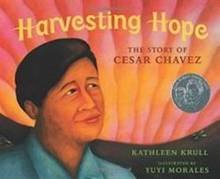

Hispanic Heritage Month:
Using Picture Books to Teach Economics, Ethics and Civil Rights
Lynne Farrell Stover
October 5, 2021 stoverlf@jmu.edu

Slide 2
EconEdLink Membership
You can now access CEE’s professional development webinars directly on EconEdLink.org! To receive these new professional development benefits, become an EconEdLink member. As a member, you will now be able to:
Automatically receive a professional development certificate via e-mail within 24 hours after viewing any webinar for a minimum of 45 minutes
Register for upcoming webinars with a simple one-click process
Easily download presentations, lesson plan materials and activities for each webinar
Search and view all webinars at your convenience
Save webinars to your EconEdLink dashboard for easy access to the event
You may access our new Professional Development page here

Slide 3
Professional Development Certificate
To earn your professional development certificate for this webinar, you must:
Watch a minimum of 45-minutes and you will automatically receive a professional development certificate via e-mail within 24 hours.
Accessing resources:
You can now easily download presentations, lesson plan materials, and activities for each webinar from EconEdLink.org/professional-development/

Slide 4
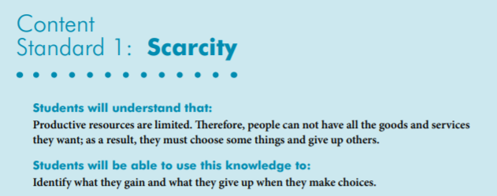

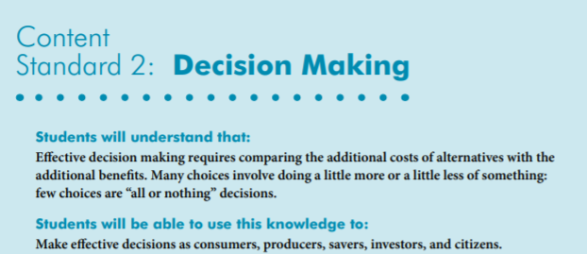
National Standards
https://www.councilforeconed.org/wp-content/uploads/2012/03/voluntary-national-content-standards-2010.pdf

Slide 5

State Standards
Virginia HISTORY & SOCIAL SCIENCE Standards of Learning
K.9 The student will
a) recognize that people make choices because they cannot have everything they want; and
explain that people work to earn money to buy the things they want.
1.8 The student will explain that people make choices because they cannot have everything they want.
2.4 The student will describe how the contributions of selected individuals changed the lives of Americans, with emphasis on
i) Cesar Chavez
2.8 The student will describe natural resources (water, soil, wood, and coal), human resources (people at work), and capital resources (machines, tools, and buildings).
2.10 The student will explain that scarcity (limited resources) requires people to make choices about producing and consuming goods and services.
3.10 The student will identify examples of making an economic choice and will explain the idea of
opportunity cost (what is given up when making a choice).

Slide 6
Objectives
Teachers will be able to:
Review basic economic concepts.
Explore a set of new picture books (copyrights 2017-2020) and learn how to identify the economic concepts found in them.
Learn how to use book content to teach age appropriate lessons and activities based on the featured concepts.

Slide 7
Agenda
In this webinar we will discover a set of new picture books that engage young students as they learn about:
Opportunity Cost
Entrepreneurship
Productive Resources
Money
Choices
Human Capital
Also provided:
Hands on lessons and activities
Websites providing support materials
Related standards
Annotated bibliography
Q & A opportunities

Slide 8
Using Children’s Literature to Teach Economics
It is to be noted that by using children’s picture books to teach in the content areas we are providing students with engaging background information that encourages them to relate to concepts, improve vocabulary, and promote reading and writing skills.
Children’s literature offers many interdisciplinary possibilities including those of economics and personal finance.

Slide 9
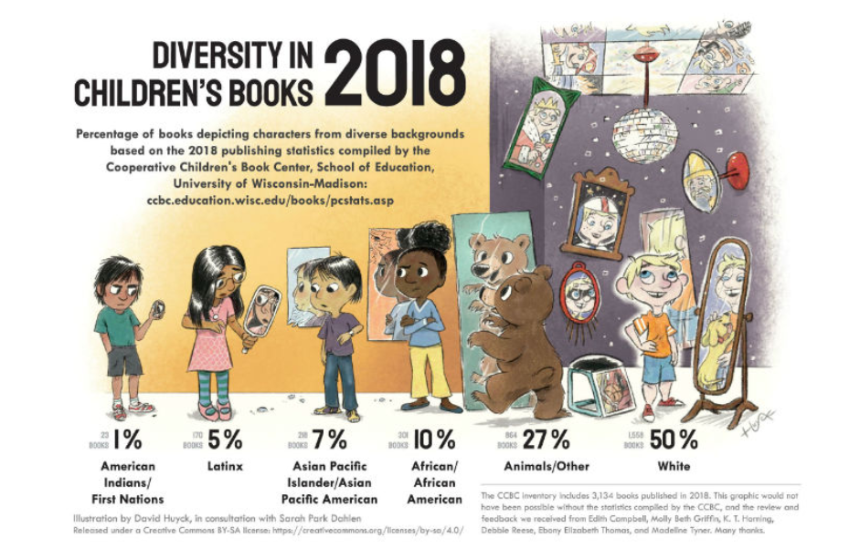

Slide 10

Tia Isa Wants a Car
Publisher: Candlewick
Copyright: 2011
Reading Level: 3.0
Interest Level: P-2
Spanish
Edition
https://www.youtube.com/watch?v=8K-MtzB62IU
Ten Minutes

Slide 11

Tía Isa Wants a Car
Story Synopsis: One hot summer day Tía Isa makes a bold statement; she wants a car. Her niece, the story’s narrator, thinks this is a grand idea. Saving the money to buy a car is not going to be easy. Most of the money Tía Isa earns at the bakery is sent to help family members who are living on a faraway island. (This island could be Cuba. The author is Cuban-American.)
The young girl wants to help her aunt. Resourcefully, she finds jobs in the neighborhood and puts all of her earnings in a saving sock that grows into a “giant money sausage.” When enough is saved and the car is purchased, the first thing Tía Isa does is tape a picture of the family on the dashboard.

Slide 12
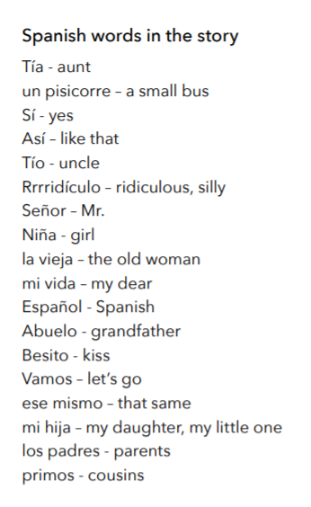
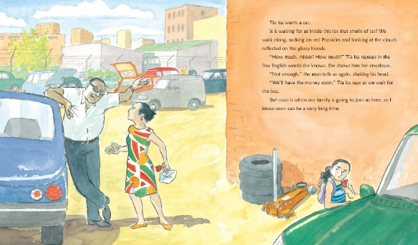
Lending a delightful Latin flavor are the Spanish words embedded throughout the text. This is not confusing and a glossary is not needed. Claudio Munoz's animated illustrations in watercolor and ink, add detail and humor.

Slide 13
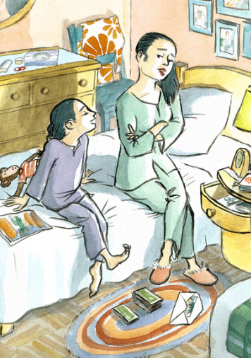
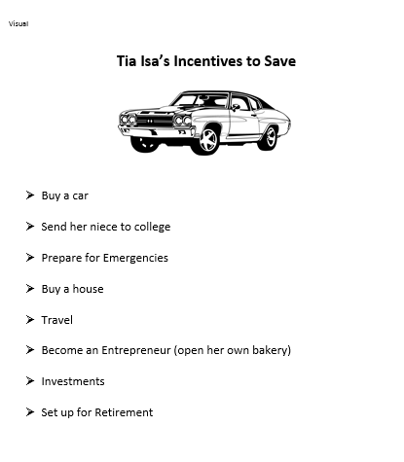

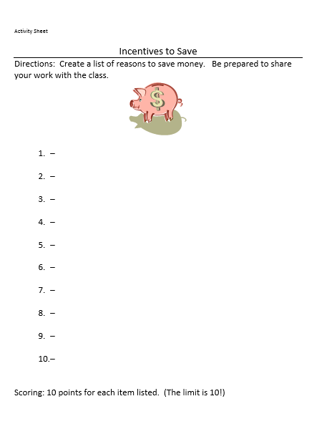
Incentives to Save

Slide 14
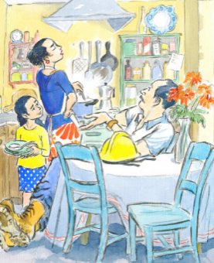
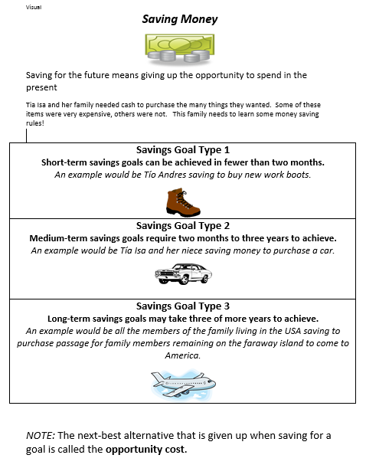
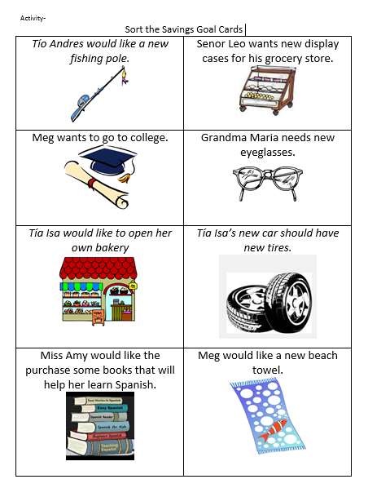
Savings Goals

Slide 15
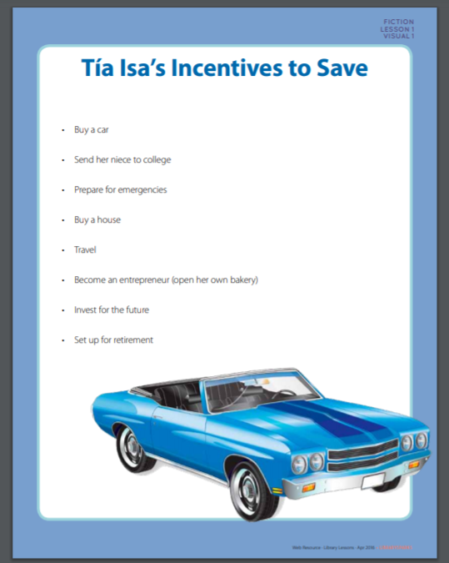
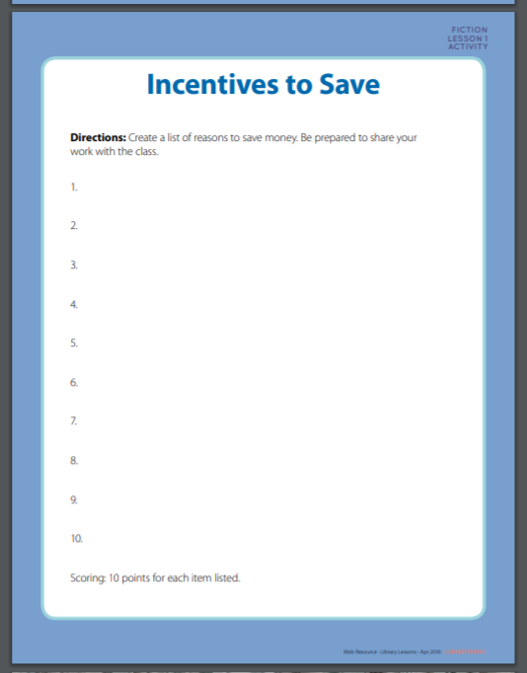
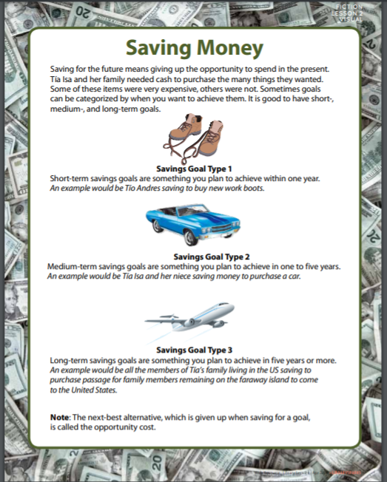
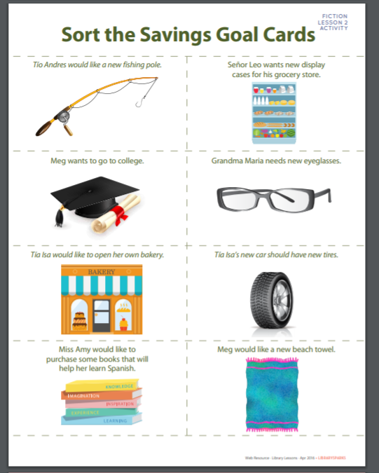
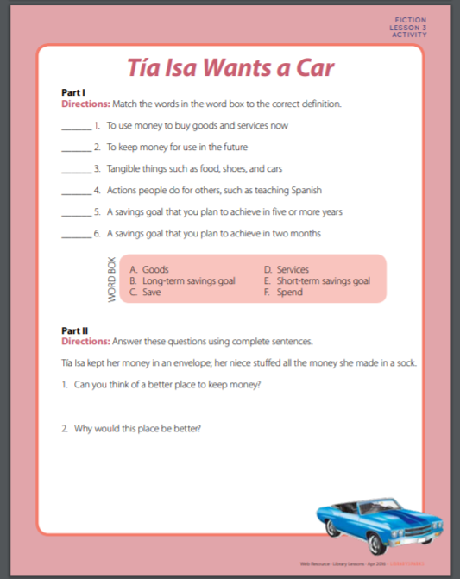
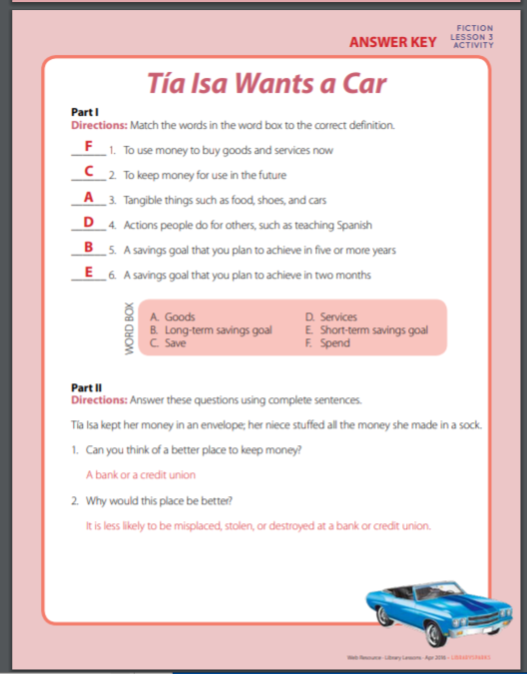
https://www.librarysparks.com/wp-content/uploads/2016/06/lsp_ll_fiction_apr16.pdf

Slide 16
The Tortilla Factory
Publisher: Houghton Mifflin
Copyright Date: 1995
Reading Level: 2.7
Interest Level: 2-5
Synopsis The text traces the journey of corn from harvest and grinding to the tortilla factory. By concentrating on hands rather than on the individual faces of the workers, the oil-on-linen paintings demonstrate respect for the ethic of hard work and hold broad, universal appeal. Readers will embrace the book for its clear emphasis on the simple beauty found in the cycles of life for plants and human beings. Also available in Spanish.
https://www.youtube.com/watch?v=wqYvpOT_Mhc

Slide 17

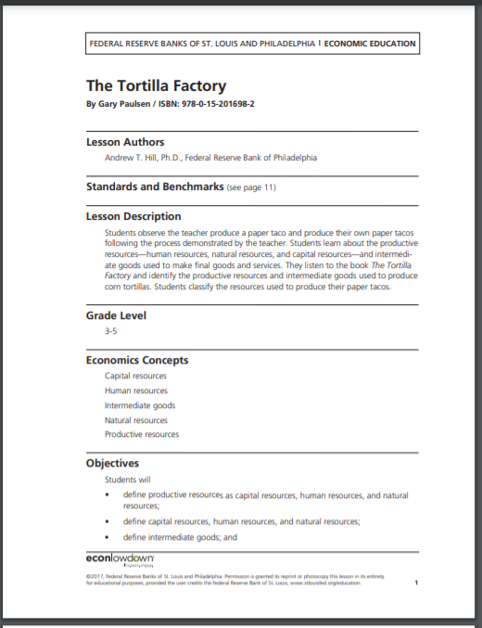
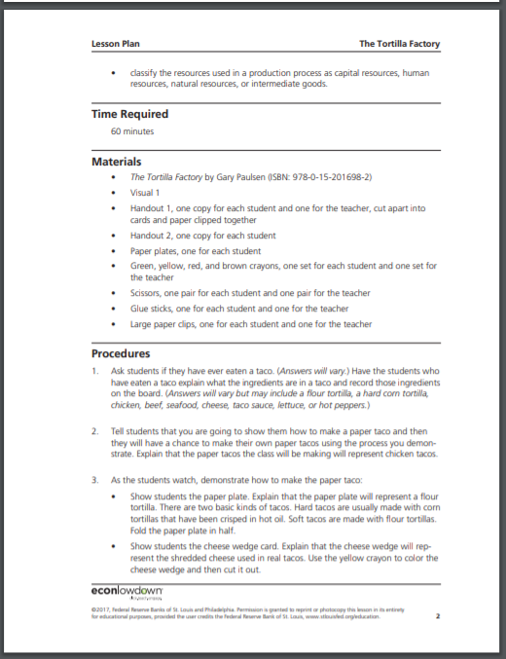
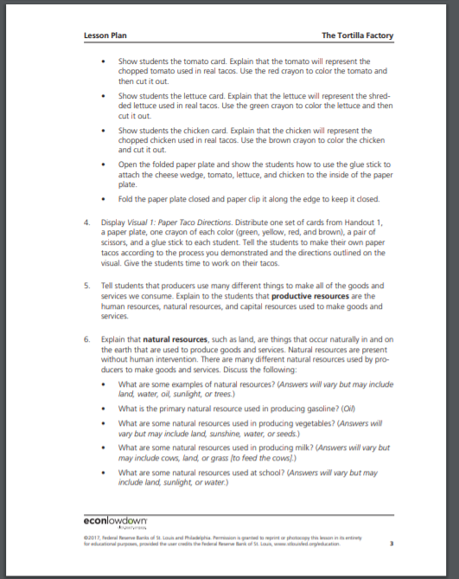
https://www.stlouisfed.org/-/media/project/frbstl/stlouisfed/education/lessons/pdf/the-tortilla-factory.pdf

Slide 18
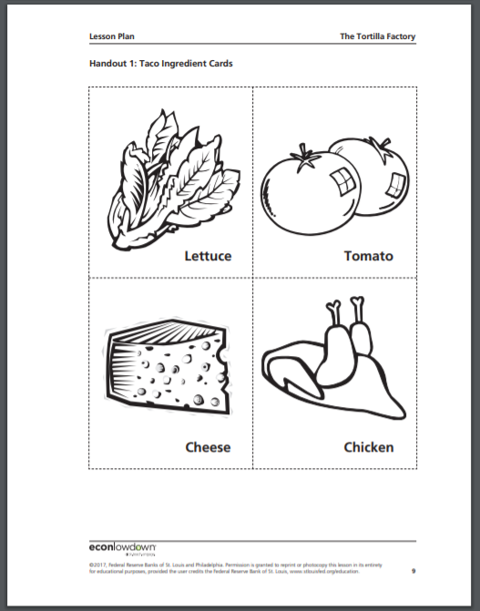
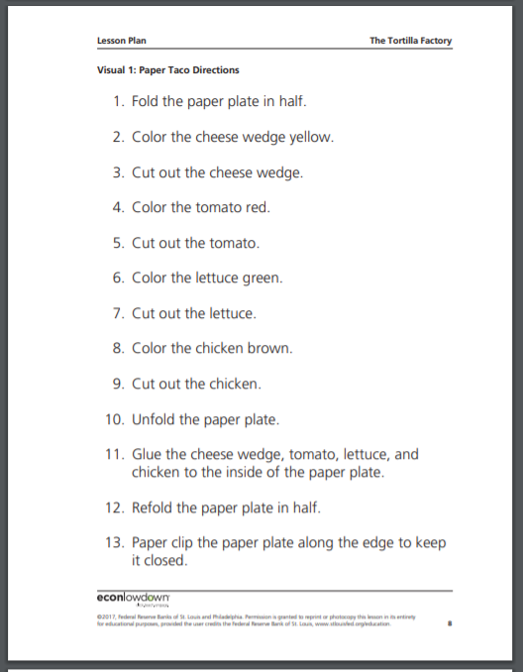

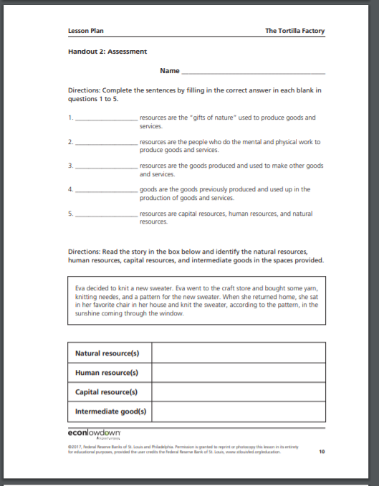

Slide 19
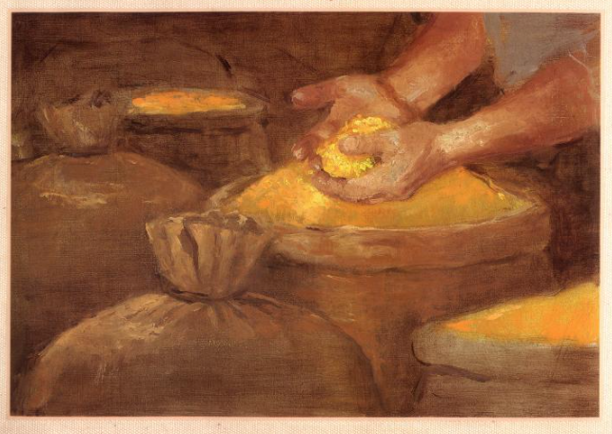
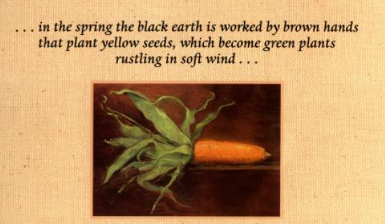
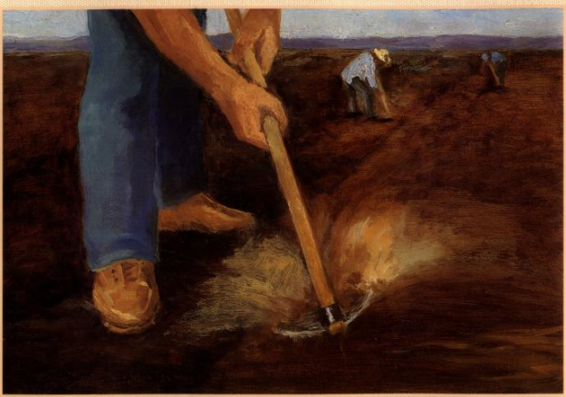
Food for Thought
Cookbook
Poem
Hispanic Culture
Art
Agriculture

Slide 20

A Bike Like Sergio’s
Publisher: Candlewick
Copyright Date: 2016
Reading Level: 3.1
Interest Level: K-3

Slide 21
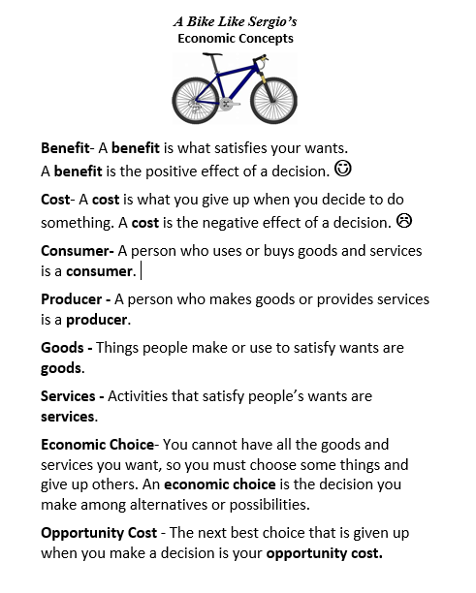

Slide 22
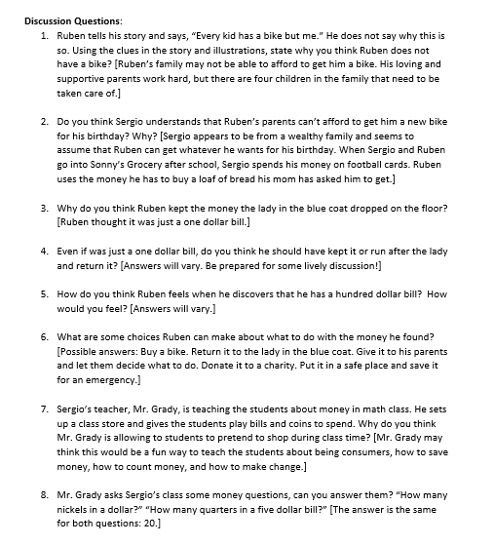
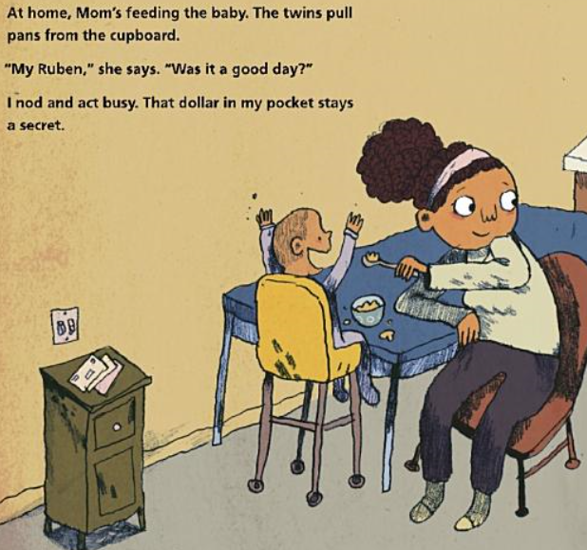
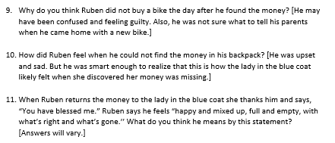
http://vcee.org/elementary-school/reading-makes-cents/2018-19-featured-books/

Slide 23
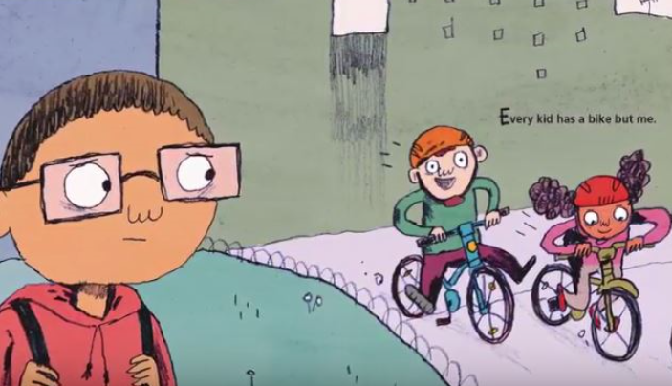
Ruben feels like he is the only kid without a bike. His friend Sergio reminds him that his birthday is coming, but Ruben knows that the kinds of birthday gifts he and Sergio receive are not the same.

Slide 24
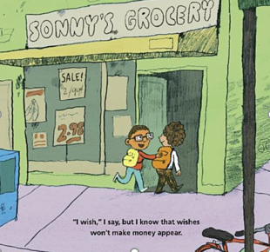
Ruben’s mom often sends him to Sonny’s Corner Store for groceries. Sometimes she doesn’t have enough money for everything on the list and has to cross off items, but when Sergio spends money at the store, it is for candy and football cards.

Slide 25
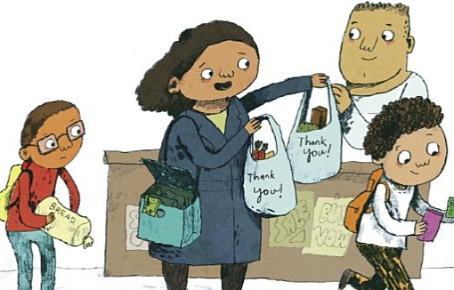
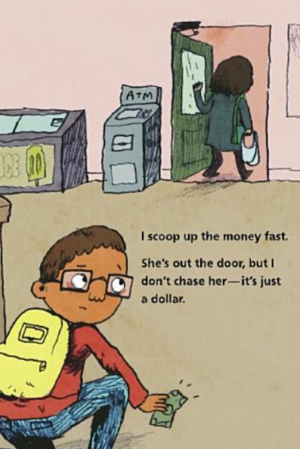
While at the store, Ruben sees a dollar bill fall out of the lady with a blue coat’s purse. He picks it up and puts it in his pocket.

Slide 26
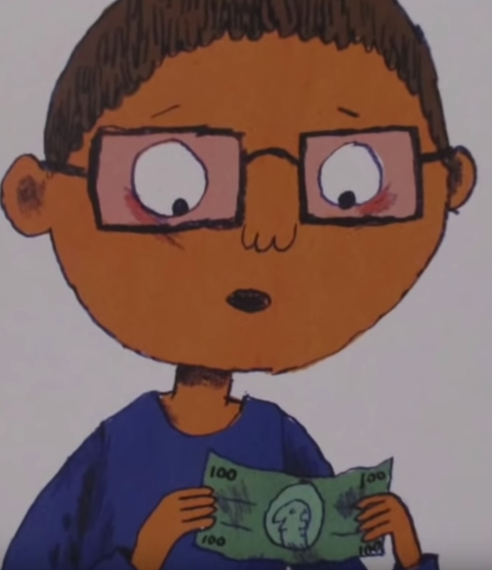
But when Ruben gets home, he discovers it’s not one dollar or even five or ten—it’s a hundred-dollar bill, more than enough for a new bike just like Sergio’s! But what about the groceries his mom has crossed off her list? And what about the woman who lost her money?

Slide 27
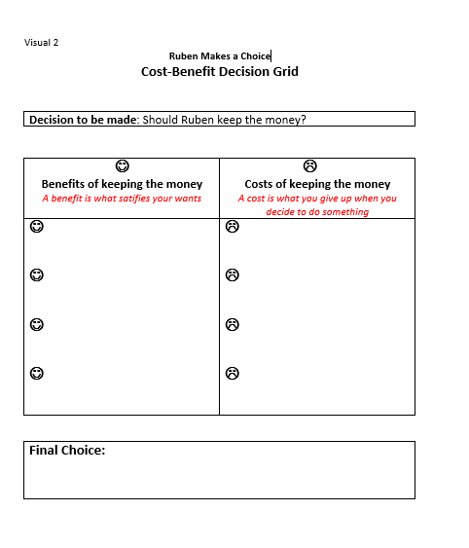


Slide 28
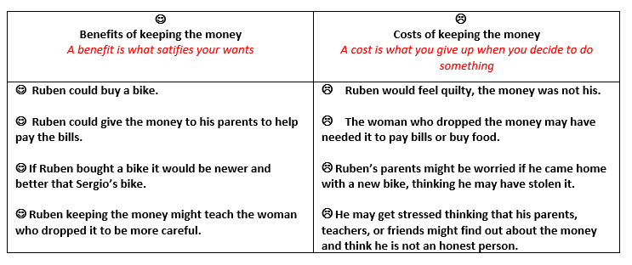
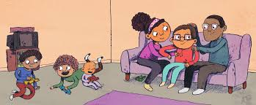
Possible Responses

Slide 29
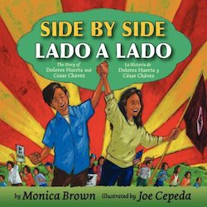
Publisher: Harper Collins
Copyright Date: 2010
Reading Level: 4.2
Interest Level: K-3
Note: A Spanish translation runs beneath and alongside the English-language text. Back materials are also presented in both languages.
https://www.youtube.com/watch?v=T-5dkaakpXM

Slide 30
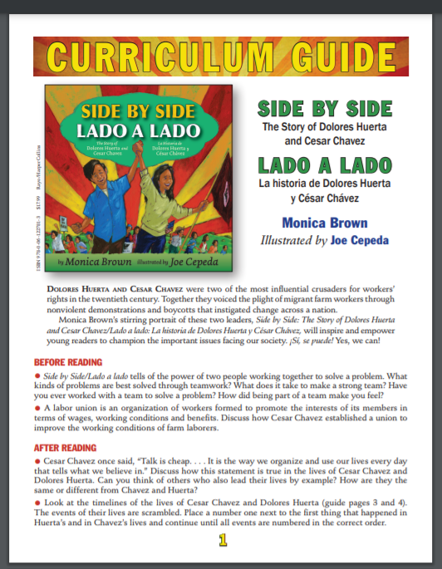
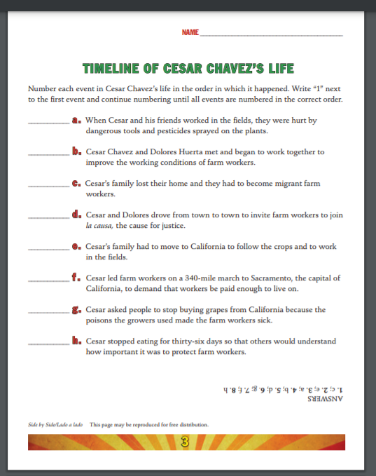
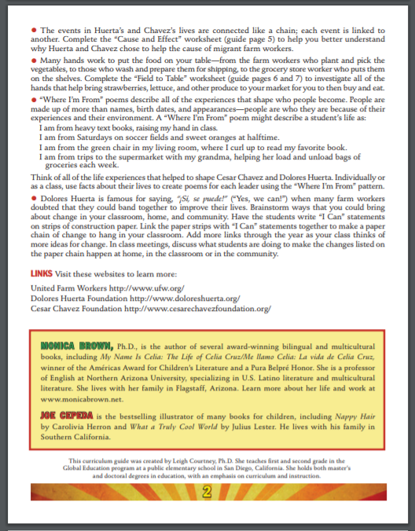
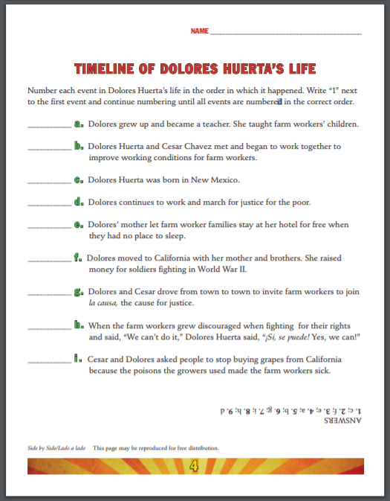
http://www.monicabrown.net/teachers/Side_by_Side_Curriculum_Guide.pdf

Slide 31
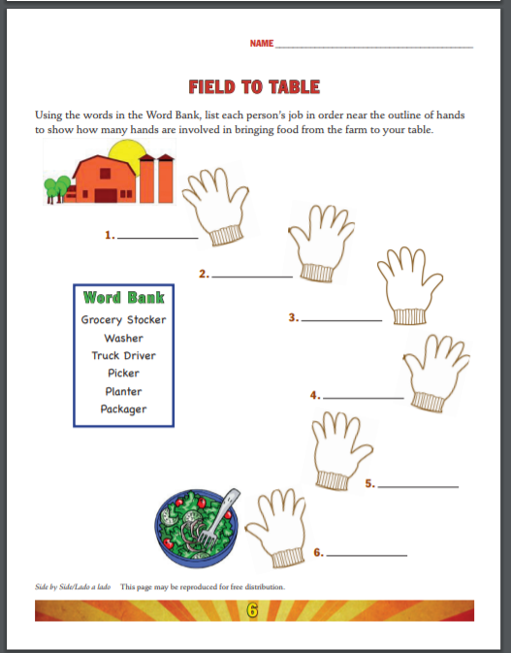
Building on a Good Activity
Concepts
Jobs
Natural Resources
Capital Resources
Human Resources
Specialization
Extensions
Continue list until food is on table
Essential Workers
List for other products [dairy, honey, poultry

Slide 32
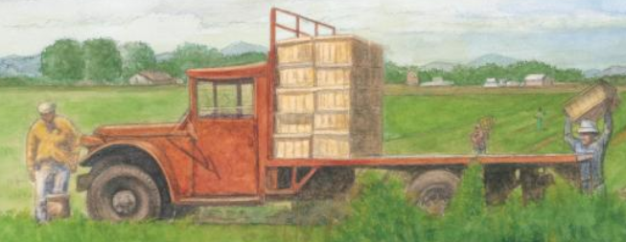
Delores Huerta: A Hero to Migrant Workers by Sarah Warren
Publisher: Marshall Cavendish
Copyright Date: 2012
Reading Level: 3.0
Interest Level: 2-5
Birthdate: April 10, 1930

Slide 33
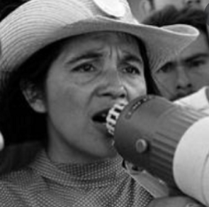


Dolores is a teacher, a mother, and a friend. She is a warrior, an organizer, and a peacemaker. When she finds out that the farm workers in her community are poorly paid and working under dangerous conditions, she stands up for their rights ensuring fair and safe work places for migrant workers.

Slide 34


Timeline

Slide 35


What Do You Think?
Migrant farm workers had to use the short-handled hoe for thinning and weeding crops. Because it required them to stoop during long hours in the fields, the hoe became a symbol of the exploitive working conditions. Campaigns by the United Farm Workers and others helped outlaw use of the hoe in 1975.
What was the reasoning behind the
mandatory use of the short-handled hoe…?

Slide 36

Harvesting Hope
Publisher: Harcourt
Copyright Date: 2003
Reading Level: 5.6
Interest Level: 2-5
A biography of Cesar Chavez, from age ten when he and his family lived happily on their Arizona ranch, to age thirty-eight when he led a peaceful protest against California migrant workers' miserable working conditions

Slide 37





Slide 38






http://librarysparks.com/wp-content/uploads/2016/06/lsp_aug09_lib_lessons.pdf

Slide 39






Bonus Theme: Immigration

Slide 40

Dreamers
by Yuyi Morales
Publisher: Holiday House
Copyright Date: 2018
Reading Level: 2.2
Interest Level: K-3
A picture book autobiography

Slide 41


Dreamers
Soñadores
Synopsis: Yuyi Morales brought her hopes, passions, strengths and stories with her, when she came to the United States in 1994 with her infant son. She left behind nearly everything she owned, but she didn't come empty-handed -- she brought her skills, determination and work ethic with her.

Slide 42


https://holidayhouse.com/wp-content/uploads/2019/01/Dreamers.pdf

Slide 43




LESSON:
Yuyi Makes a Choice
Cost-Benefit Analysis

Slide 44


Slide 45



Vote With Your Feet

Slide 46


Side Note
Wonderful Libraries: For Yuyi Morales and her son, the local public library was transformative. Her visits to San Francisco Public Library and its wealth of books offered her an opportunity to learn about this different country. Here she learns about new customs, learns to speak English and also finds a new career. She and her son now call America their home.

Slide 47

When Carmela wakes up on her birthday, her wish has already come true--she's finally old enough to join her big brother as he does the family errands! Together, they travel through their neighborhood, until they arrive at the laundromat, where Carmela finds a lone dandelion growing in the pavement. Before she can blow its white fluff away, her brother tells her that she has to make a wish. If only she can think of just the right wish to make . . .
Publisher: Penguin
Copyright Date: 2018
Reading Level: 4.0
Interest Level: P-2
https://www.youtube.com/watch?v=C_HwgJT54fE

Slide 48

38 Page Study Guide
http://images.randomhouse.com/teachers_guides/9780399257742.pdf

Slide 49



Concepts:
Choices
Goods & Services
Markets
Money
Productive Resources

Slide 50
Assessment Questions
What are the benefits of using children’s literature to teach economics and personal finance?
Is the availability to online readings of the featured books helpful? If so, in what way?
Is using a children’s book more difficult with online instruction?
How can picture books be used with older students?
Do you know of any new titles that can be added to the bibliography?

Slide 51


Slide 52

CEE Affiliates
https://www.councilforeconed.org/resources/local-affiliates/

Slide 53




Thank You to Our Sponsors!

