Slide 1
It’s All Elementary!
Part I:
Personal Finance for the Elementary Classroom
Presented by Teresa Mungai
October 21, 2021
Teresam@azecon.org

Slide 2
EconEdLink Membership
You can now access CEE’s professional development webinars directly on EconEdLink.org! To receive these new professional development benefits, become an EconEdLink member. As a member, you will now be able to:
Automatically receive a professional development certificate via e-mail within 24 hours after viewing any webinar for a minimum of 45 minutes
Register for upcoming webinars with a simple one-click process
Easily download presentations, lesson plan materials and activities for each webinar
Search and view all webinars at your convenience
Save webinars to your EconEdLink dashboard for easy access to the event
You may access our new Professional Development page here

Slide 3
Professional Development Certificate
To earn your professional development certificate for this webinar, you must:
Watch a minimum of 45-minutes and you will automatically receive a professional development certificate via e-mail within 24 hours.
Accessing resources:
You can now easily download presentations, lesson plan materials, and activities for each webinar from EconEdLink.org/professional-development/

Slide 4
Agenda
Review Personal Finance Standards
Learn about Interactive Lessons & Activities
Answer Any Questions about Today’s Materials

Slide 5
Objectives
Participants will review the Personal Finance standards for K-5th grade.
Participants will take part in interactive lesson activities that can be used in a K-5 classroom.
Participants will receive free resources that can be used to implement the new standards.

Slide 6
National Standards
Economics Standards
Standard 1: Scarcity
Standard 2: Decision Making
Standard 4: Incentives
Standard 5: Trade
Financial Literacy Standards
Standard 1: Earning Income
Standard 2: Buying Goods and Services
Standard 3: Saving

Slide 7
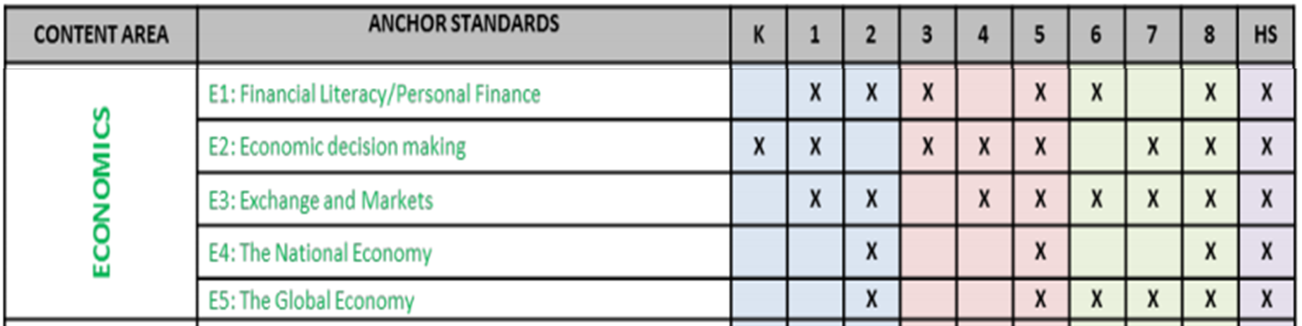
State Standards
Arizona History and Social Science Standards

Slide 8
Lesson Activities

Slide 9
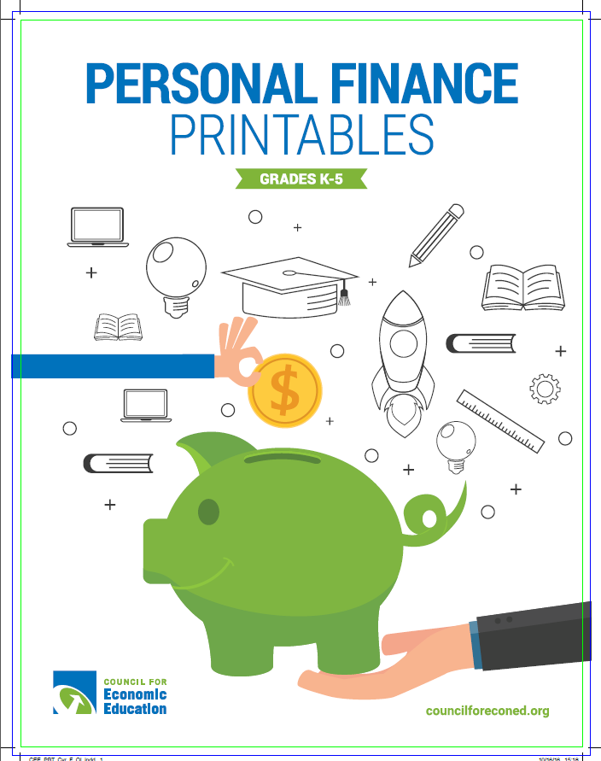
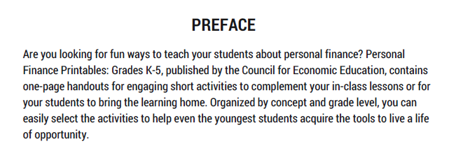
Notes:
https://www.econedlink.org/resources/personal-finance-printables/
Jamboard: https://jamboard.google.com/d/1vKy86SLDDhjvK3WlRjtD721VzdH9F40CJadWdUdCjSE/copy

Slide 10
“A Season of Goods”
Math and Economics: Connections for Life

Slide 11
Lesson Objectives
Identify Goods, Services, Consumers, and Producers
Make Choices about Purchasing Goods/Services Given a Budget
Add & Subtract 3 and 4 Digit Numbers
Make Economic Decisions
Use the 8 Mathematical Practices
Identify the characteristics of a season

Slide 12

Seasons
What are some characteristics of the seasons?

Slide 13
What are Goods?
Do we use the same goods and services all year long?
Why or why not?

Slide 14

What are Services?
What services have you used recently?
What services happen during certain seasons?

Slide 15
What is a Consumer?

Slide 16

What is a Producer?

Slide 17
Group Work/Activity
You will have a seasonal scenario (pgs. 11-14).
Decide what goods and services you will buy.
Explain your choices.
Compute your cost.
Compute how much you have left.
What will you do with your leftover money?
Notes:
https://padlet.com/teresa_mungai/jfm8b1rtdolirga0

Slide 18
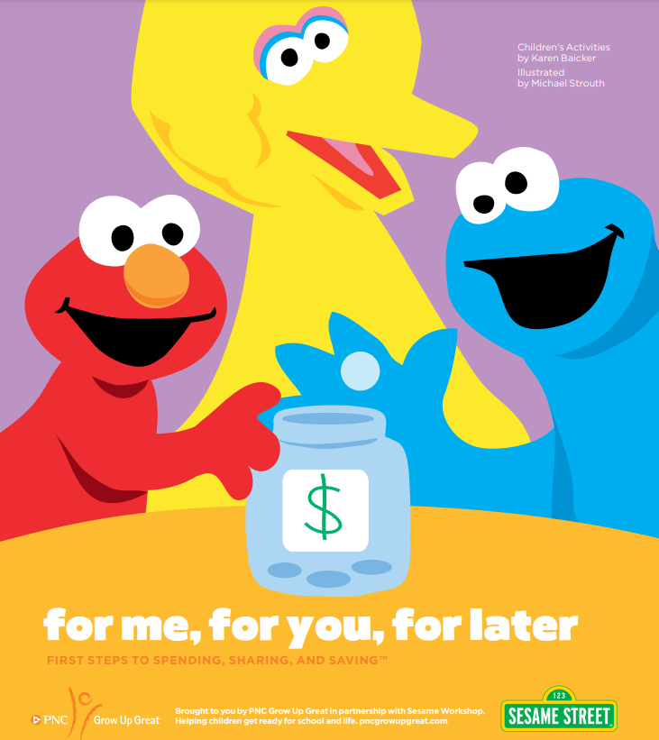
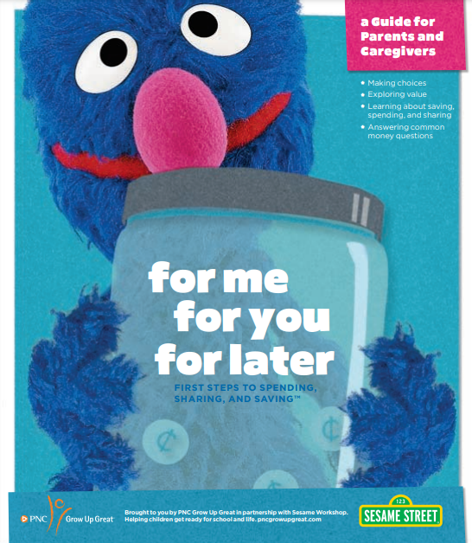
Sesame Street & Financial Literacy
Notes:
https://www.pnc.com/en/about-pnc/corporate-responsibility/grow-up-great/sesame-street-learning-resources.html?lnksrc=topnav

Slide 19
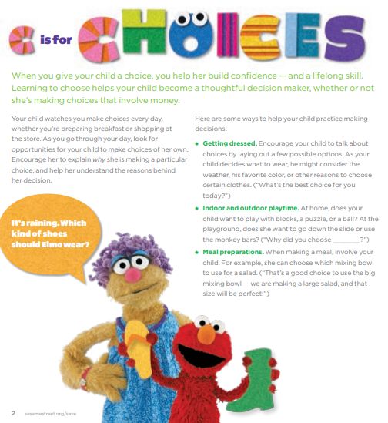
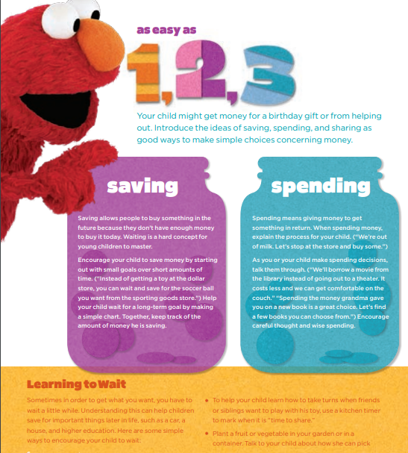

Slide 20

Multimedia Clip

Slide 21
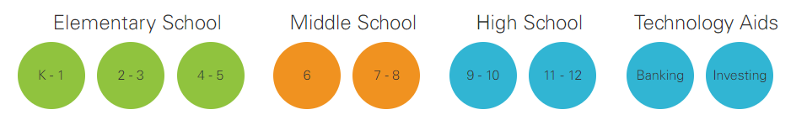
My Classroom Economy
Notes:
www.myclassroomeconomy.org

Slide 22
Questions?
Notes:
www.myclassroomeconomy.org

Slide 23
References
Personal Finance Printables:
  https://www.econedlink.org/resources/personal-finance-printables/
"A Season of Goods":
  Lesson: CLICK HERE
  Padlet: https://padlet.com/teresa_mungai/jfm8b1rtdolirga0
Sesame Street & Financial Literacy:
  https://www.pnc.com/en/about-pnc/corporate-responsibility/grow-up-great/sesame-street-learning-resources.html?lnksrc=topnav
My Classroom Economy:
  www.myclassroomeconomy.org

Slide 24

CEE Affiliates
https://www.councilforeconed.org/resources/local-affiliates/

Slide 25




Thank You to Our Sponsors!

