Slide 1
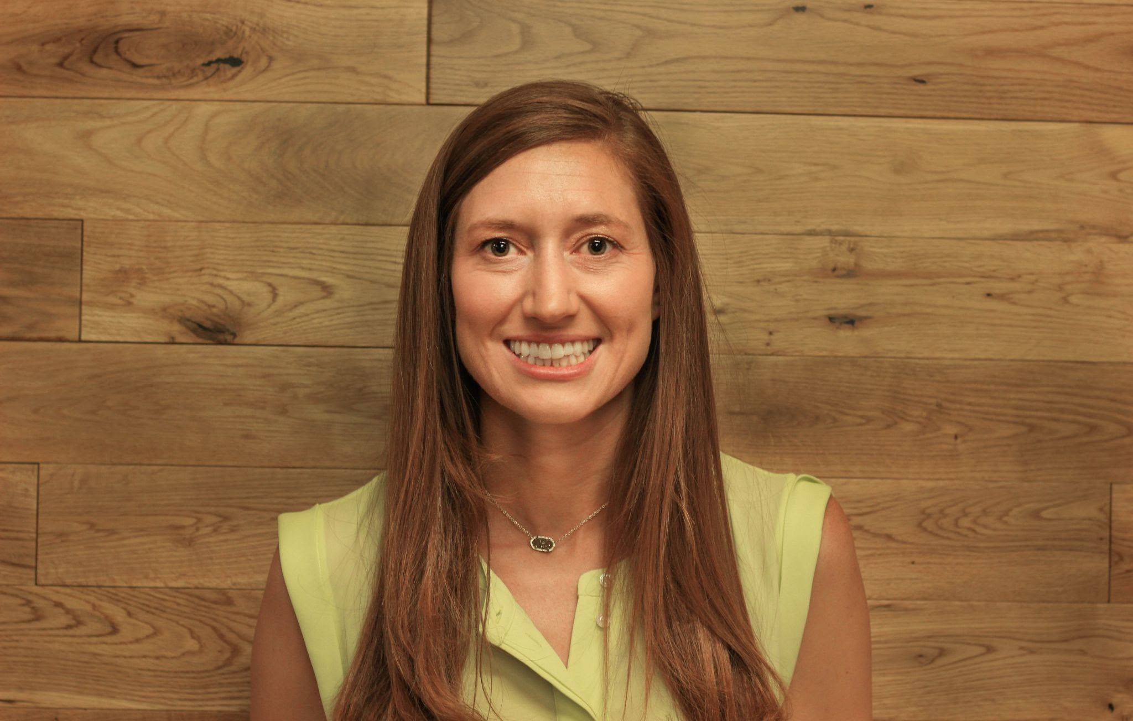
College and Career Readiness
The Economics of College
Presented by Susanna McConnell
October 19, 2021
Susanna.Pierce.McConnell@gmail.com

Slide 2
EconEdLink Membership
You can now access CEE’s professional development webinars directly on EconEdLink.org! To receive these new professional development benefits, become an EconEdLink member. As a member, you will now be able to:
Automatically receive a professional development certificate via e-mail within 24 hours after viewing any webinar for a minimum of 45 minutes
Register for upcoming webinars with a simple one-click process
Easily download presentations, lesson plan materials and activities for each webinar
Search and view all webinars at your convenience
Save webinars to your EconEdLink dashboard for easy access to the event
You may access our new Professional Development page here

Slide 3
Professional Development Certificate
To earn your professional development certificate for this webinar, you must:
Watch a minimum of 45-minutes and you will automatically receive a professional development certificate via e-mail within 24 hours.
Accessing resources:
You can now easily download presentations, lesson plan materials, and activities for each webinar from EconEdLink.org/professional-development/

Slide 4

Agenda
Who are you? College Roundup 🎓
College Activities
  Warm Ups
  Student Research
  Digital Discussions
  Alumni Panel
Reflection

Slide 5
National Standards
Standard 2:
  Effective decision making requires comparing the additional costs of alternatives with the additional benefits. Many choices involve doing a little more or a little less of something: few choices are “all or nothing” decisions.

Slide 6
AP Standards
Big Idea 2:
  There are trade-offs associated with any decision. Making optimal decisions requires evaluating the additional costs and benefits of possible actions.

Slide 7
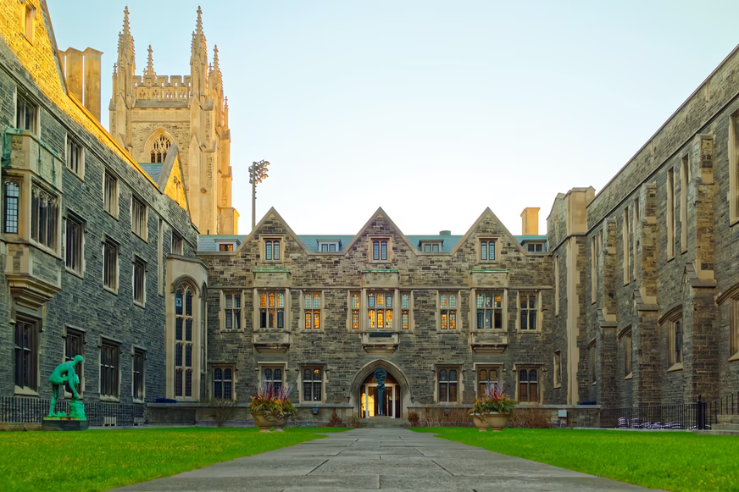

Let’s connect!
What college(s) did you attend?
Add your response in the Chat box!

Slide 8
Objectives
Participants will:
  discover economic terminology associated with college decision-making.
  learn strategies to facilitate student thinking and discussions about college decisions.
  connect with relevant media associated with college.
  reflect on the implementation into their own classroom.

Slide 9
Part 1: Warm Ups
How can you engage students when introducing college decision-making?
Content Connections and Pre-Thinking Activities

Slide 10
Background Content
Economics
Scarcity
Trade-offs
Opportunity Costs
Marginal Analysis
Incentives
Quizlet

Slide 11
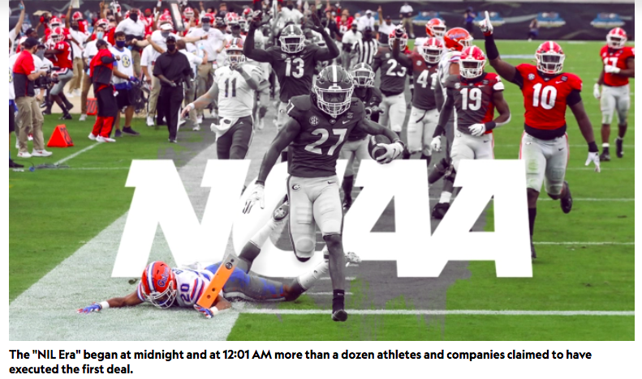
What current event connects to college decision-making?
Name, Image, and Likeness
College athletes can now acquire endorsements and sponsorships while playing athletics.

Slide 12
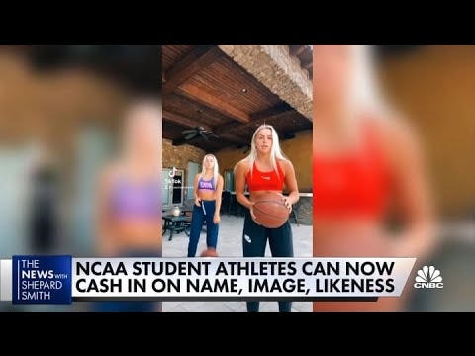
Warm Up #1: NIL Video
What, So What, Now What
What interesting facts did you hear in the video?
So what do you think about college athletes getting paid?
Now what do you think might be the short and long term impacts of this decision?

Slide 13
Warm Up #2 Poll: College athletes should be able to get paid.
1- Strongly Agree, 2- Agree, 3- Disagree, 4- Strongly Disagree

Slide 14
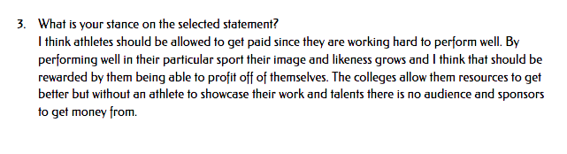
Sample Student Responses

Slide 15
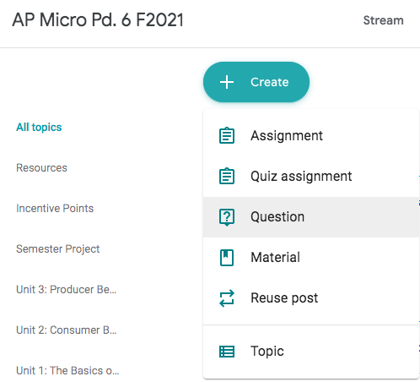
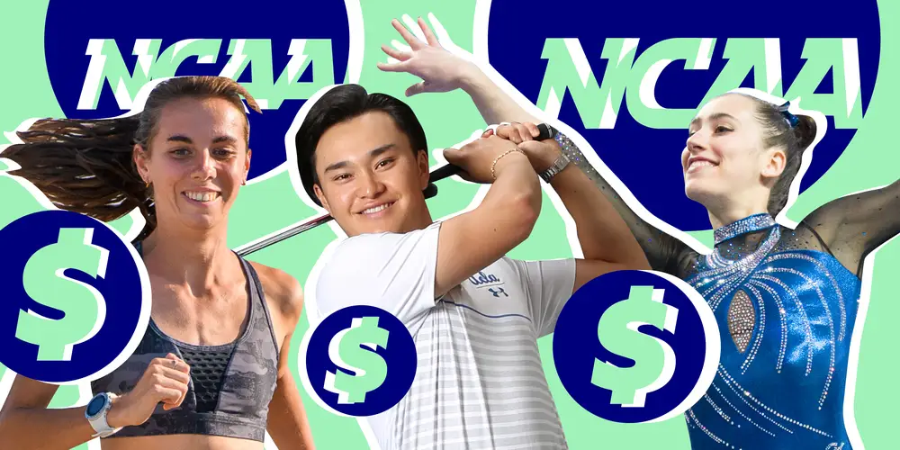
Warm Up #3: How might NIL deals change high school student actions today?
Google Classroom Question
Name, Image, and Likeness

Slide 16
Part 2: Student College Research
How can you teach marginal analysis with college decision-making?
Class Research or Homework Extensions

Slide 17
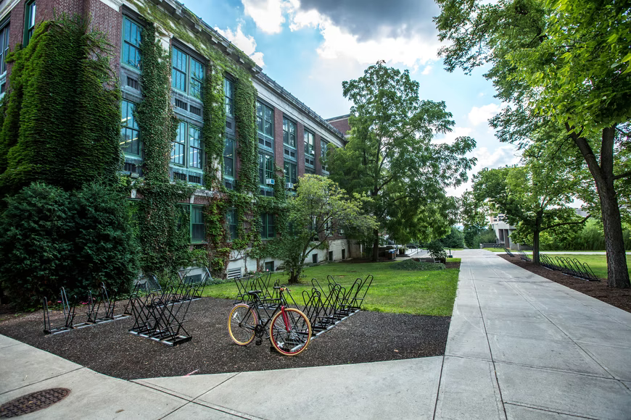
Background Information
Students select their top 3 colleges, and analyze the potential benefits and costs of each option.
College Insight Cappex Chegg

Slide 18
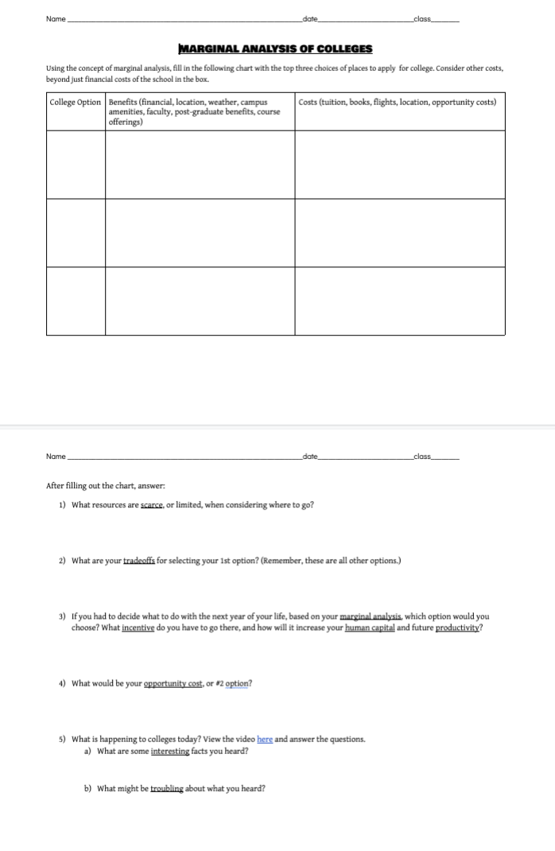
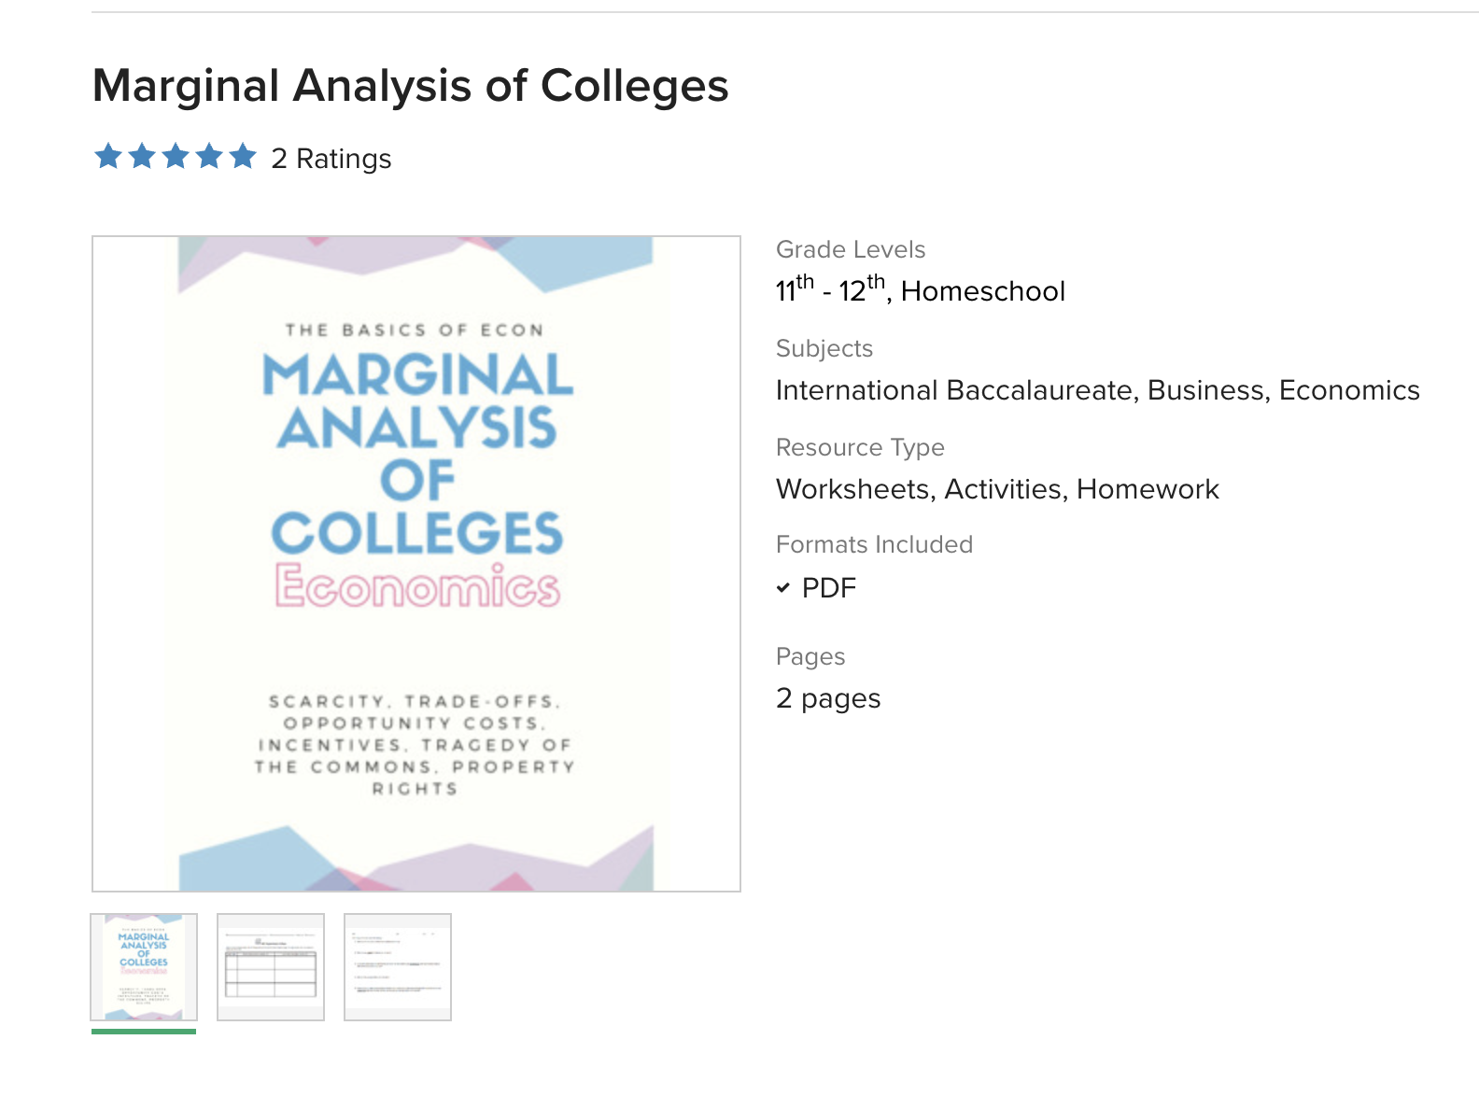
Marginal Analysis of Colleges Assignment

Slide 19
Activity Explained
Select 3 colleges.
Compile the benefits of each.
  financial, location, weather, faculty, post-career options
Compile the costs of each.
  tuition, books, flights
  opportunity costs
Decide which option yields the largest net benefit.

Slide 20
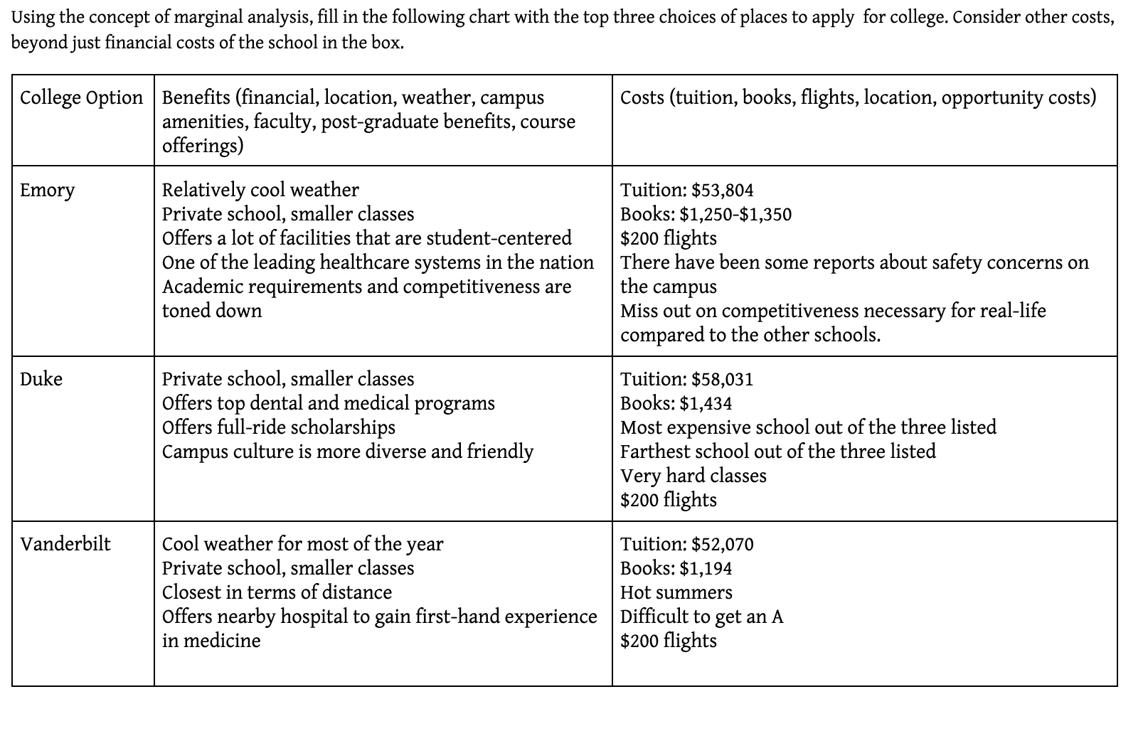
Student Example

Slide 21
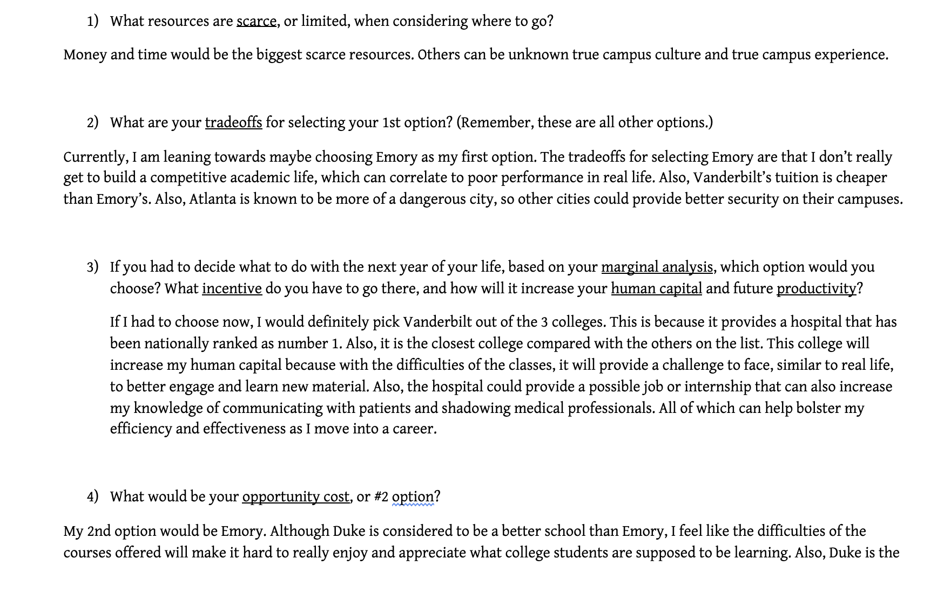
Student Example

Slide 22

Participant Zoom Chat:
Where has a student you taught gone to college, and why did he/she go there (Benefit/Costs)?
Collect Data

Slide 23
Part 3: Digital Share
How do you share student thoughts about college decisions?
Padlet
Digital Assessments

Slide 24
Activity Overview
Create a “shelf” Padlet with questions. Have students add their initials and respond to each question. Model answers.
Questions:
What are your top 3 college choices, and why?
What major are you hoping to pursue, and why?
If you had to decide today, which college would you choose, and why?
What career do you hope to pursue?

Slide 25
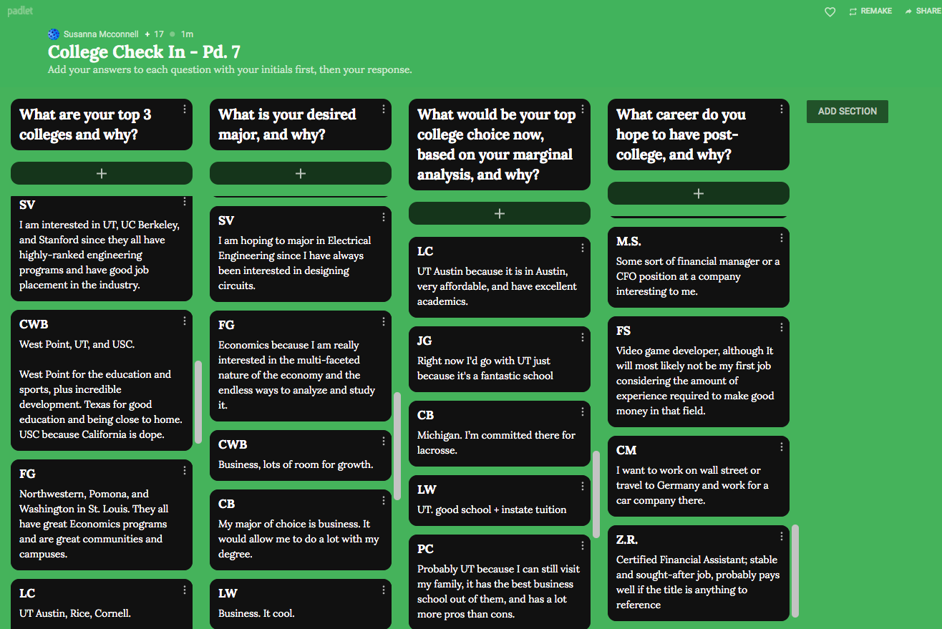
Padlet Example

Slide 26
Padlet Analysis + Discussion Prompts
Think, Pair, Share
What trends do you see in our class?
What questions do you now have for a peer?

Slide 27
Part 4: Alumni Insights
How can you answer student questions about college?
Alumni College Panel

Slide 28
College Panel Overview
Compile a panel of 4-5 alumni to speak in your classes about their college experience.
Share an editable Google sheets of class times for alumni to sign up.
Select a student moderator.
Setup the panel, with strict guidelines.
Compile questions for the moderator to ask the alumni.

Slide 29
College Panel Sample Questions
What advice do you have for students for finding the right fit for college?
How do you study in college and how does this compare to high school?
What has been your biggest challenge to adjusting to college life and increased independence?
What is something you would encourage students to appreciate as they are in their last year of high school that they might miss in the future?

Slide 30
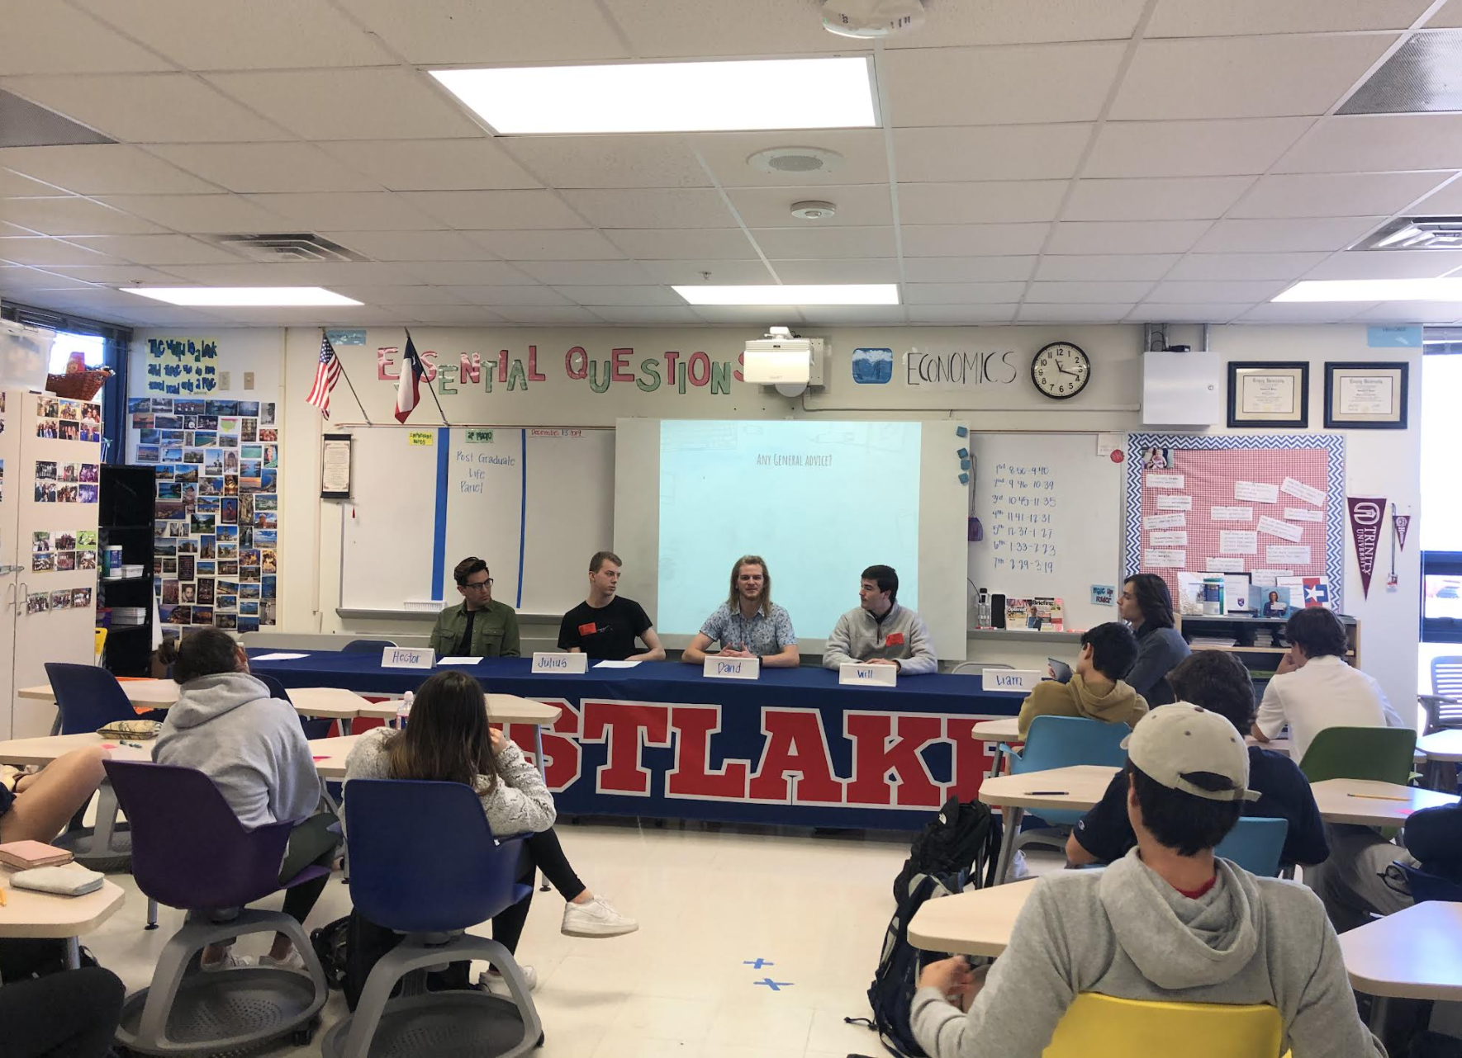
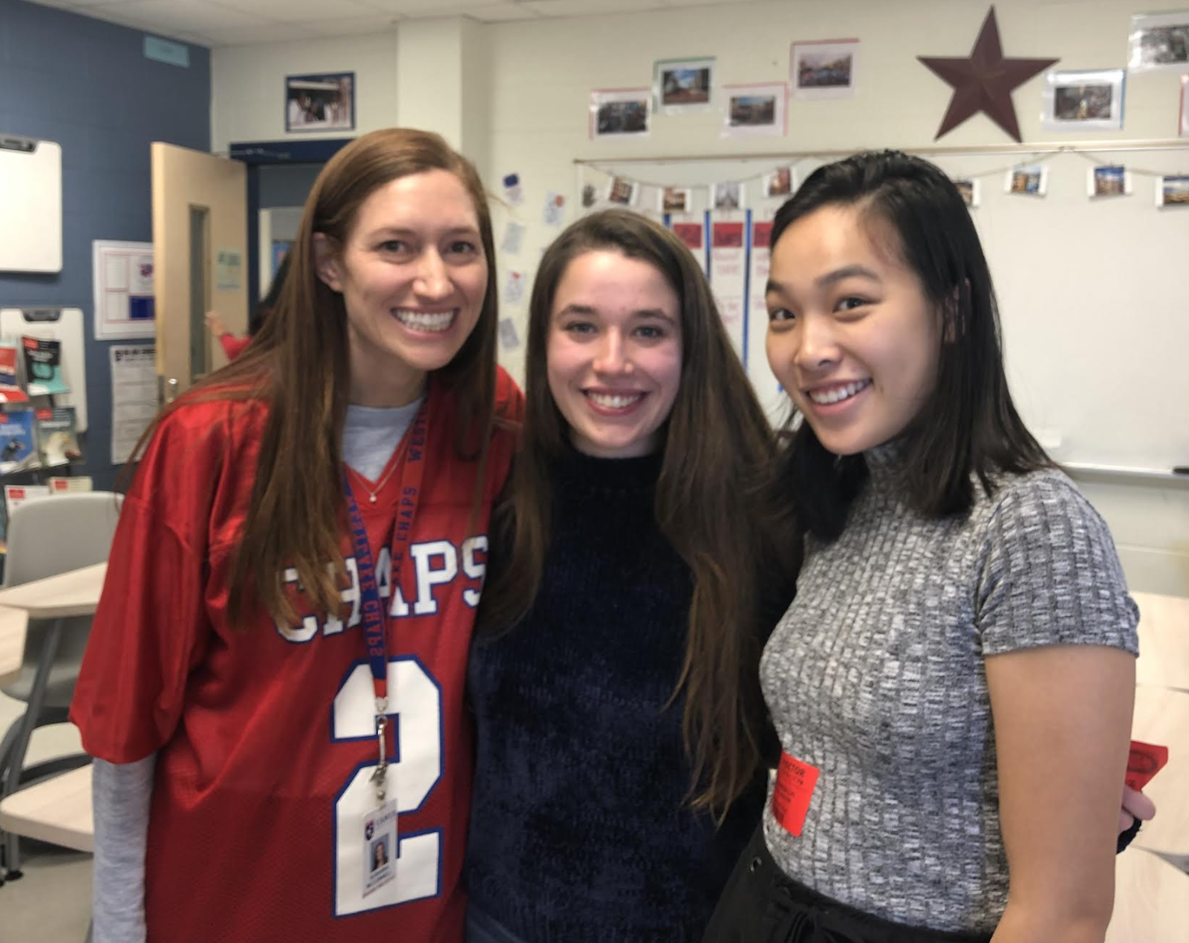
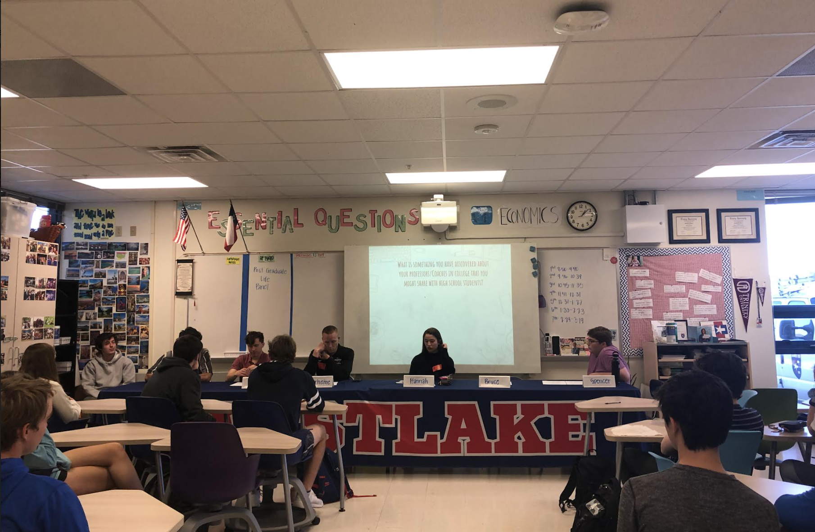
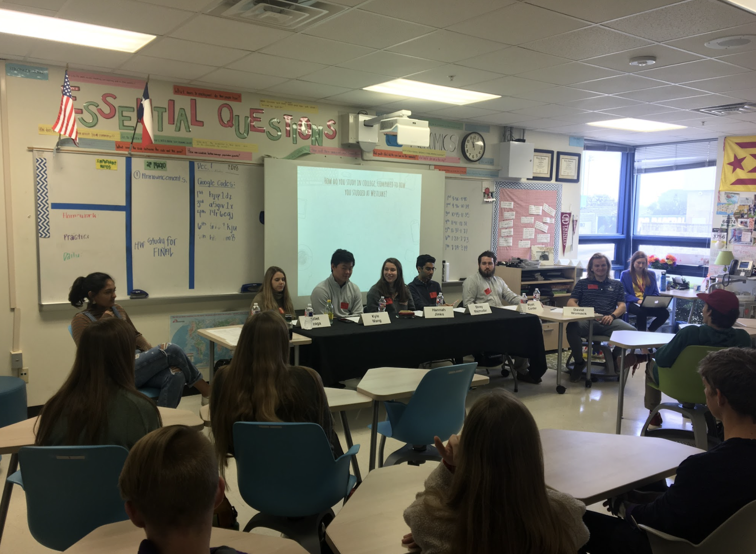
College Panel In Action

Slide 31
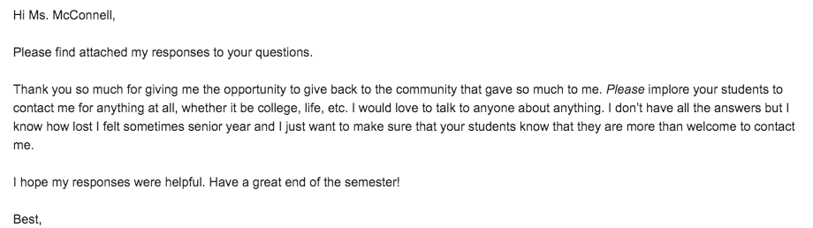
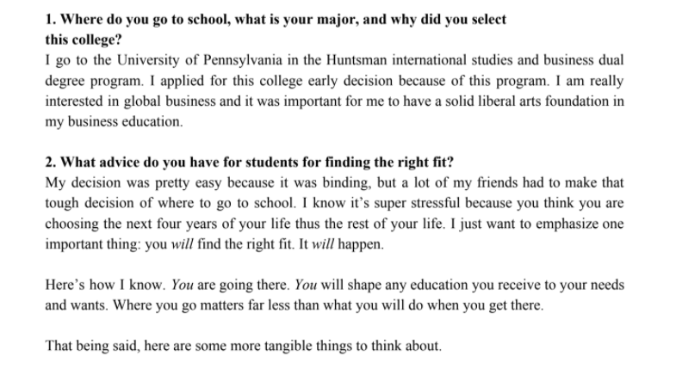
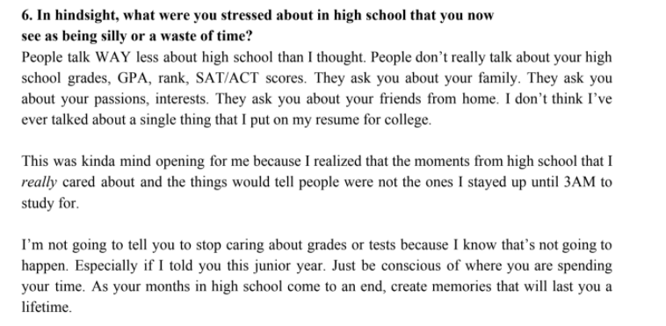
Alumni Perspectives
Alumni can email responses to the questions for students to read!

Slide 32
Review
Strategies for Integrating The Economics of College into Classrooms
Warm Ups
  Paying College Athletes
    What, So What, Now What (Video)
    Poll - College athletes
    Google Question (Article)
College Research + Decision-Making
  Marginal Analysis of Colleges
Digital Collaborative Assessment
  Padlet
  Small Table Discussion
Alumni Insights
  College Panel
  Email Insights

Slide 33

Reflect
How can you use these ideas in your classroom?
Zoom Chat

Slide 34
References
Unsplash Photos
CNBC: Student Athletes Can Be Paid
Business Insider: Name, Image, and Likeness
Prep Scholar: Best College Search Websites
Padlet
Susanna Pierce McConnell: TPT Store - Marginal Analysis of Colleges

Slide 35

CEE Affiliates
https://www.councilforeconed.org/resources/local-affiliates/

Slide 36




Thank You to Our Sponsors!

